Slide 1
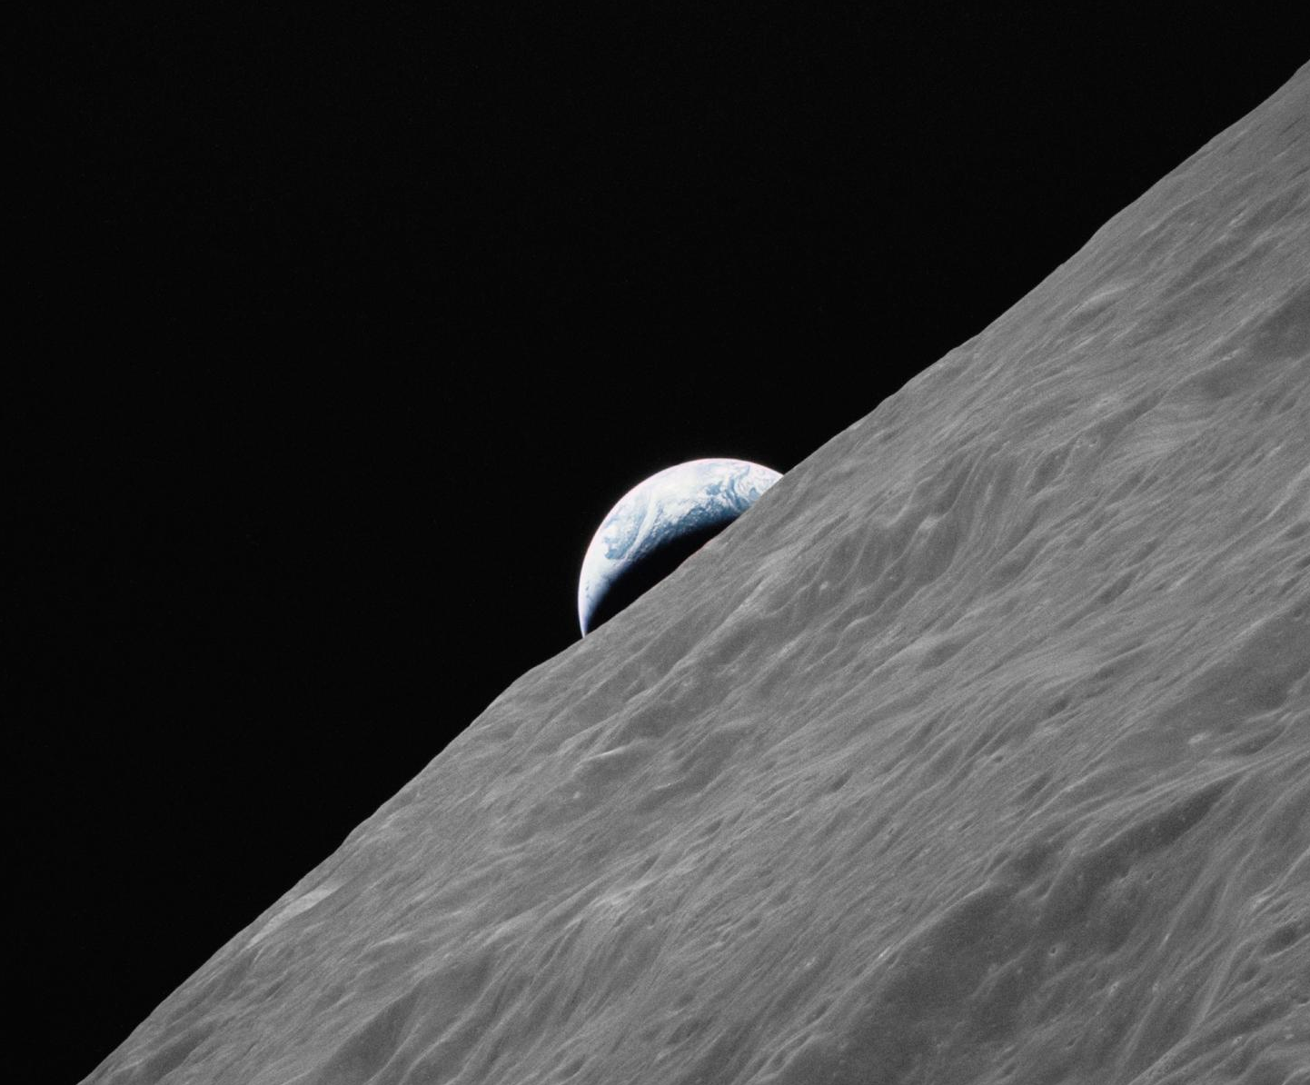
construction & materialisation

Slide 2
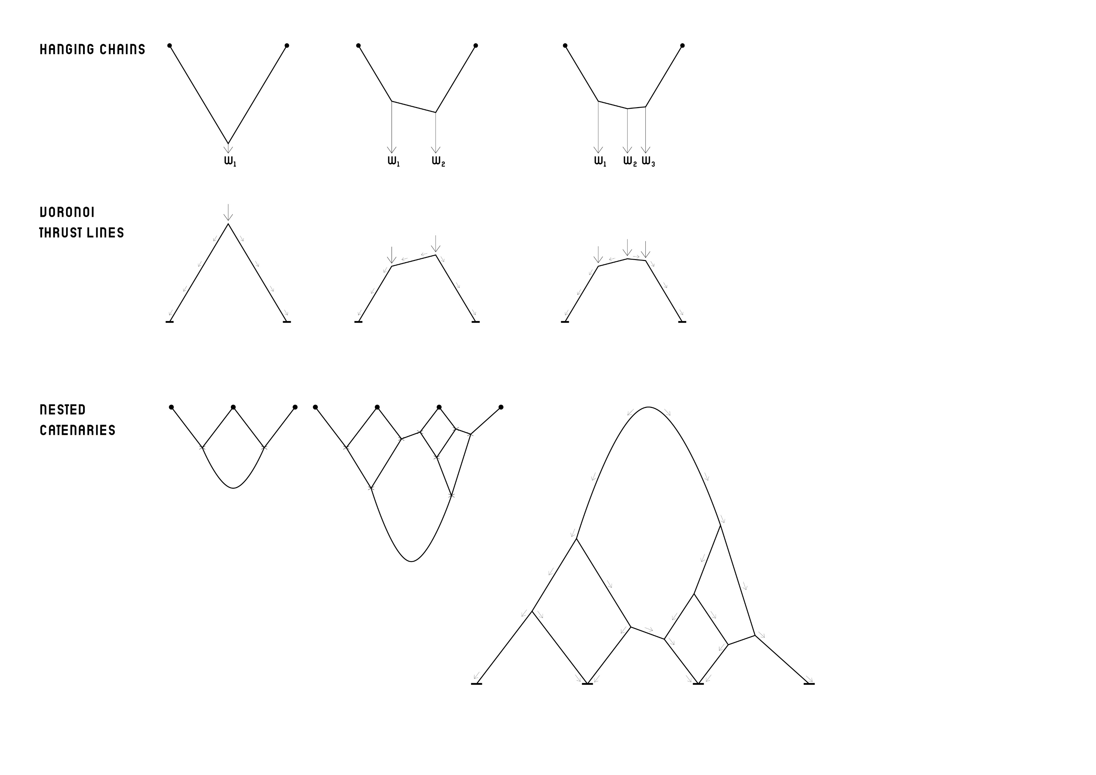
Structure
(inverted) catenary structure relationship
Hanging Chains (catenaries)
Inverted Catenaries = Voronoi Thrust Lines
Nested Catenaries
Inverted Nested Catenaries

Slide 3
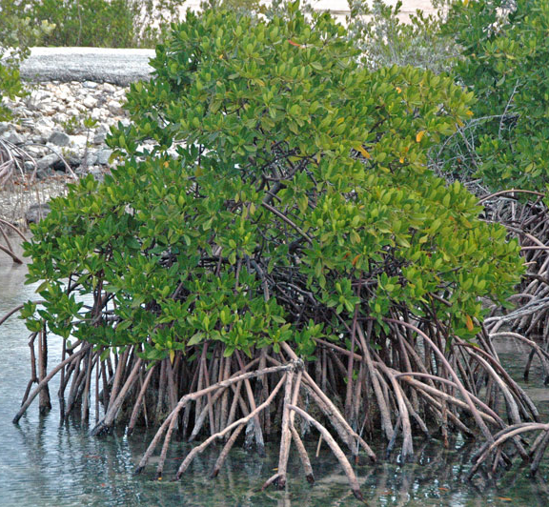
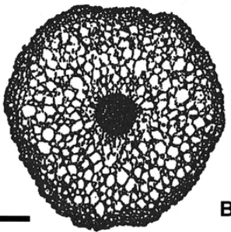
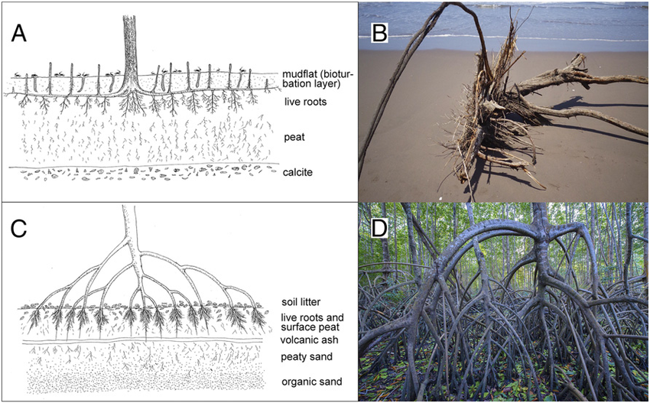
Structure
inverted nested catenaries in nature
Micro-structure that resembles Voronoi
Mangrove Tree roots
Stilt-Root = Structure that grows and expands over time
SOURCE: Journal of Plant Research (2004), Plantsnap
SOURCE: Proceedings of the National Academy of Sciences (2016)

Slide 4
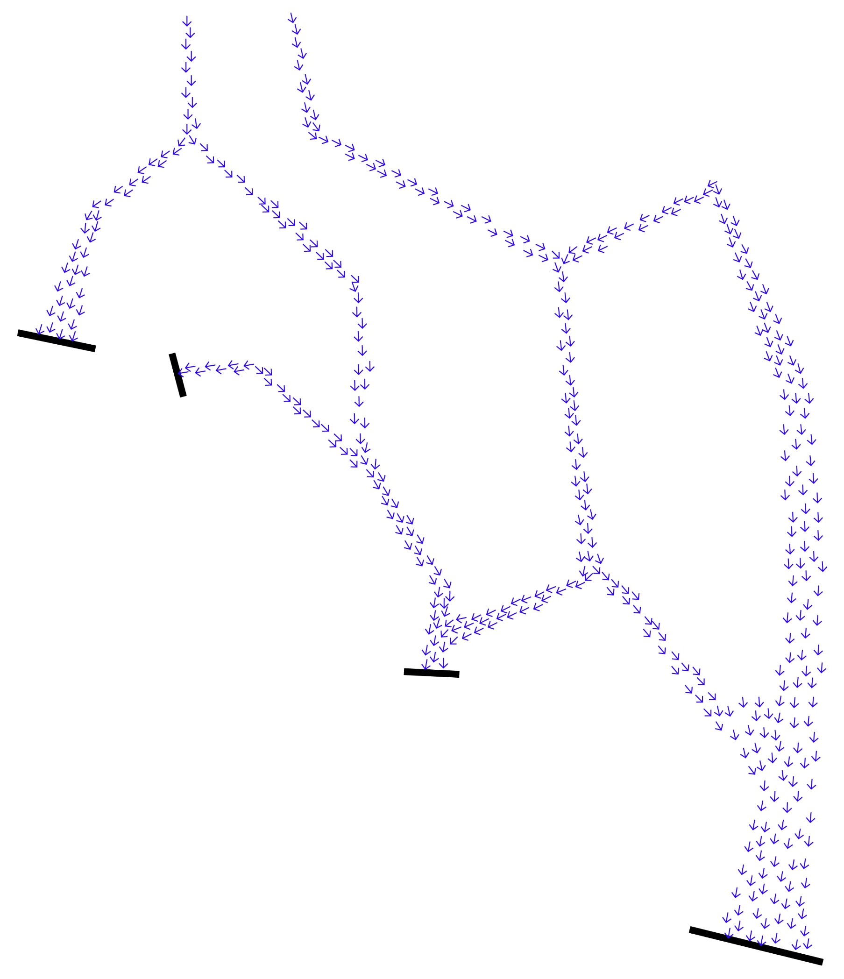
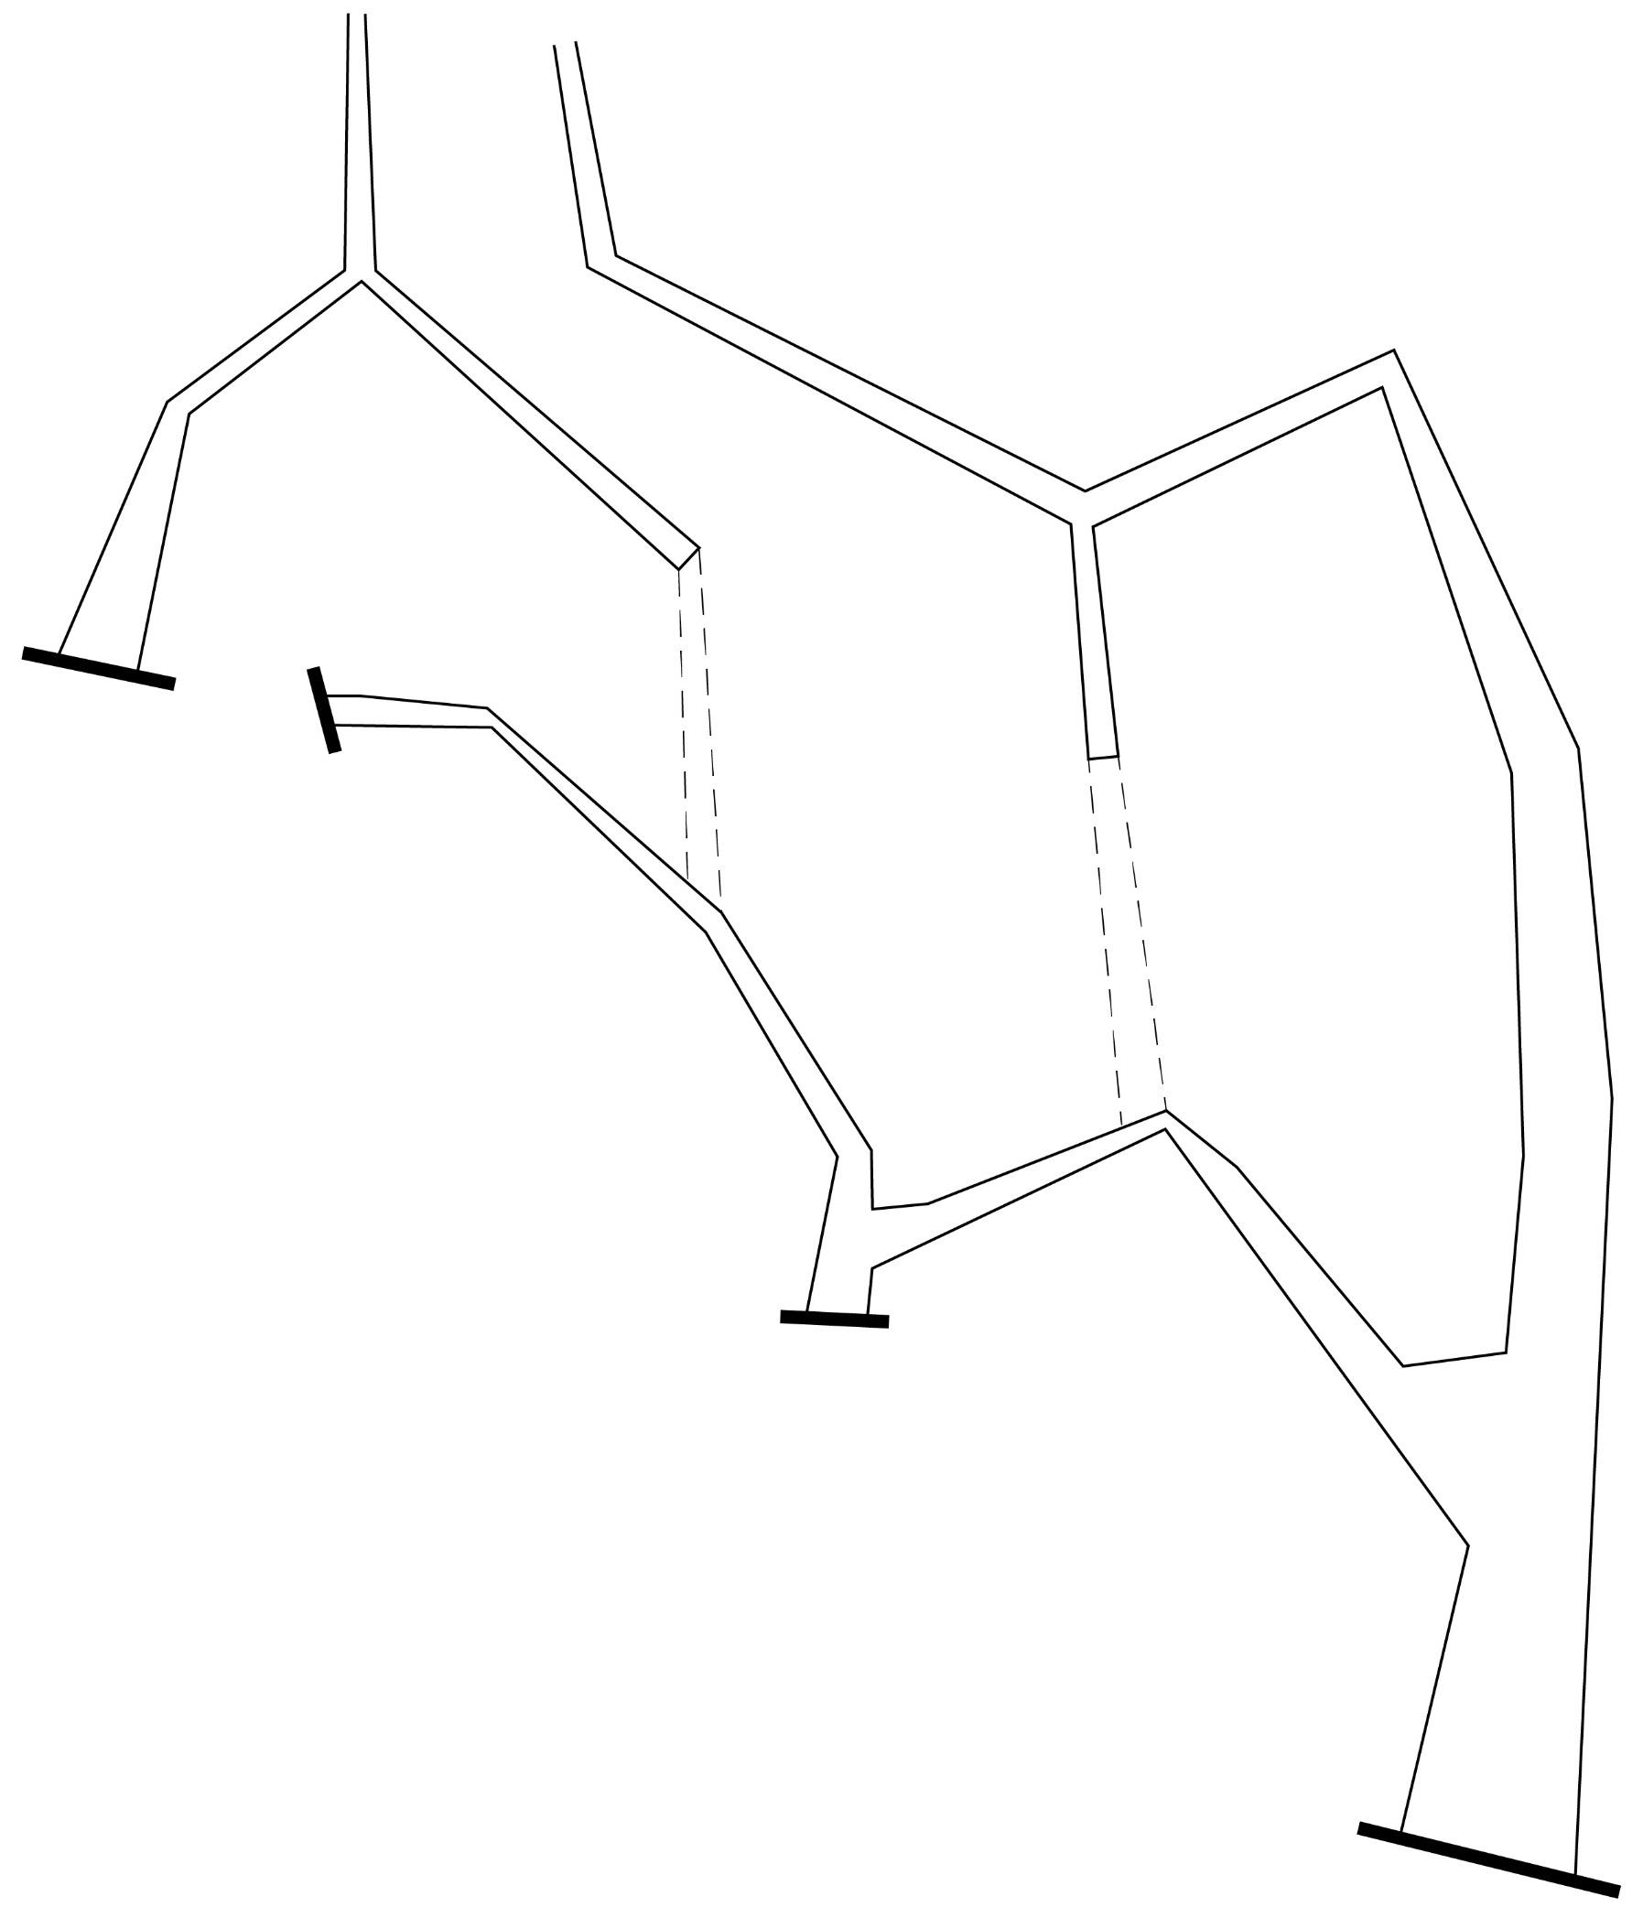
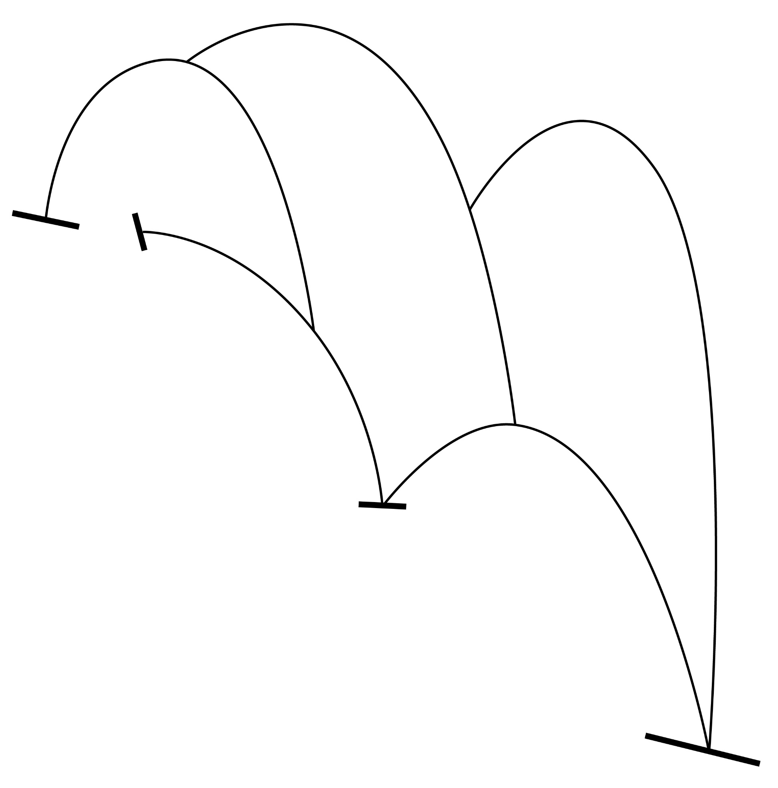
Structure
overall structural logic
Inverted Nested Catenaries Translation
Load Transfer Direction

Slide 5
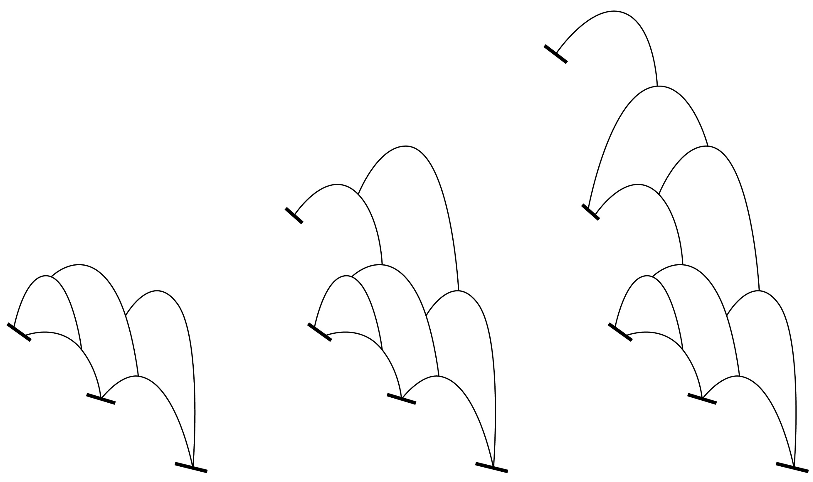
Structure
habitat expansion overtime
Current Stage
Future Stage
Nested catenaries structure is expandable overtime

Slide 6
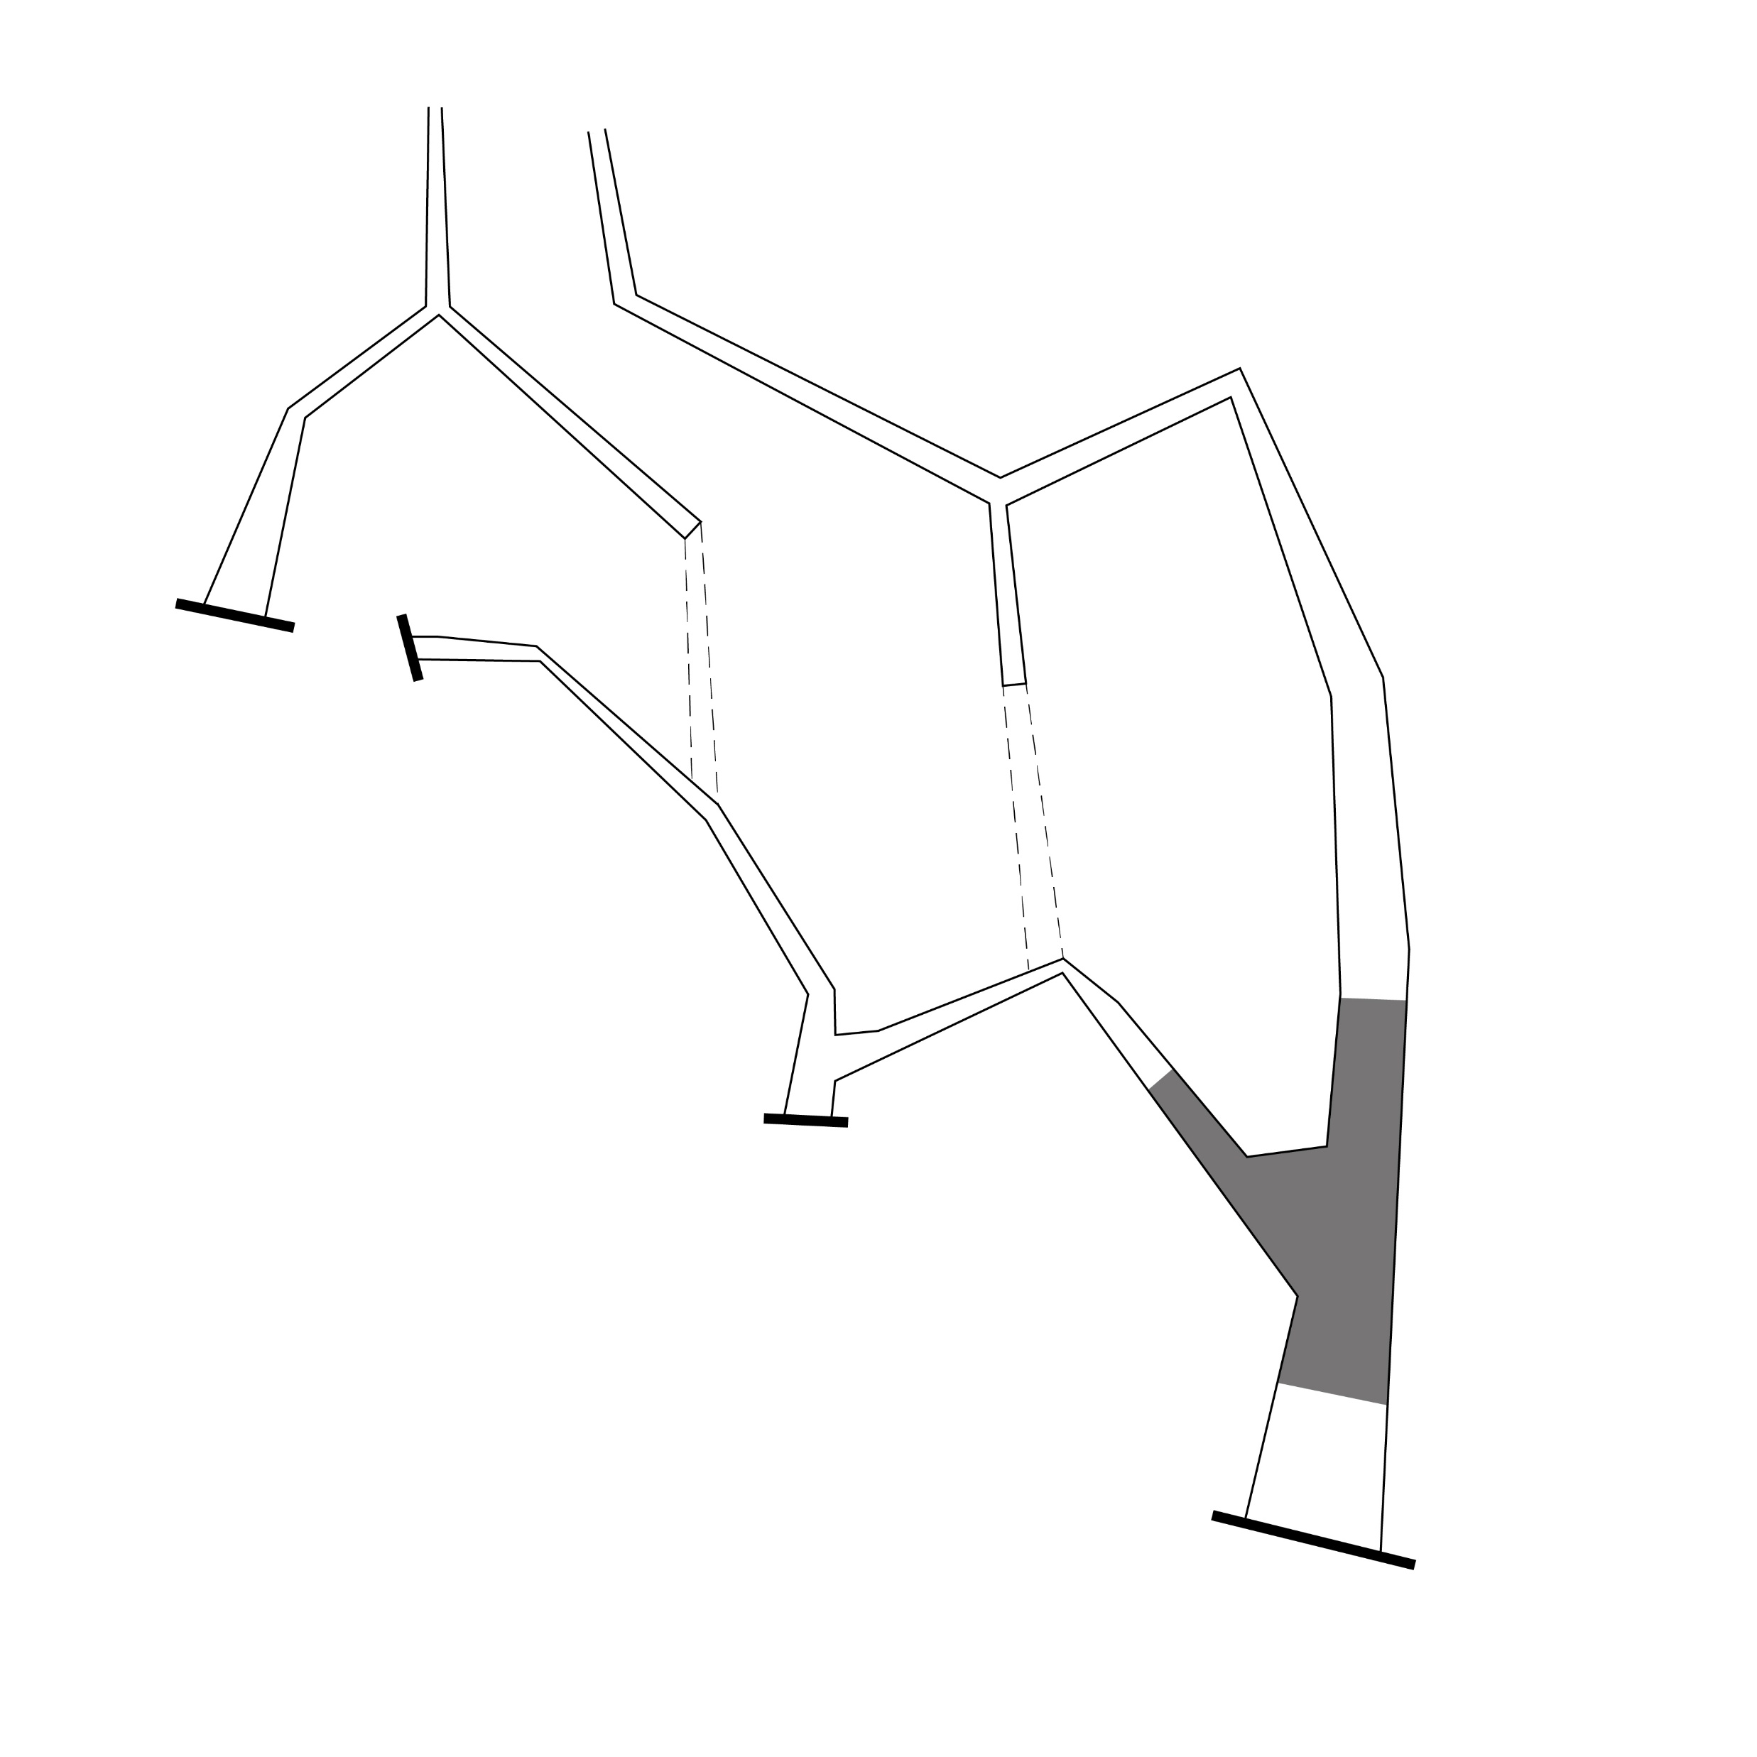
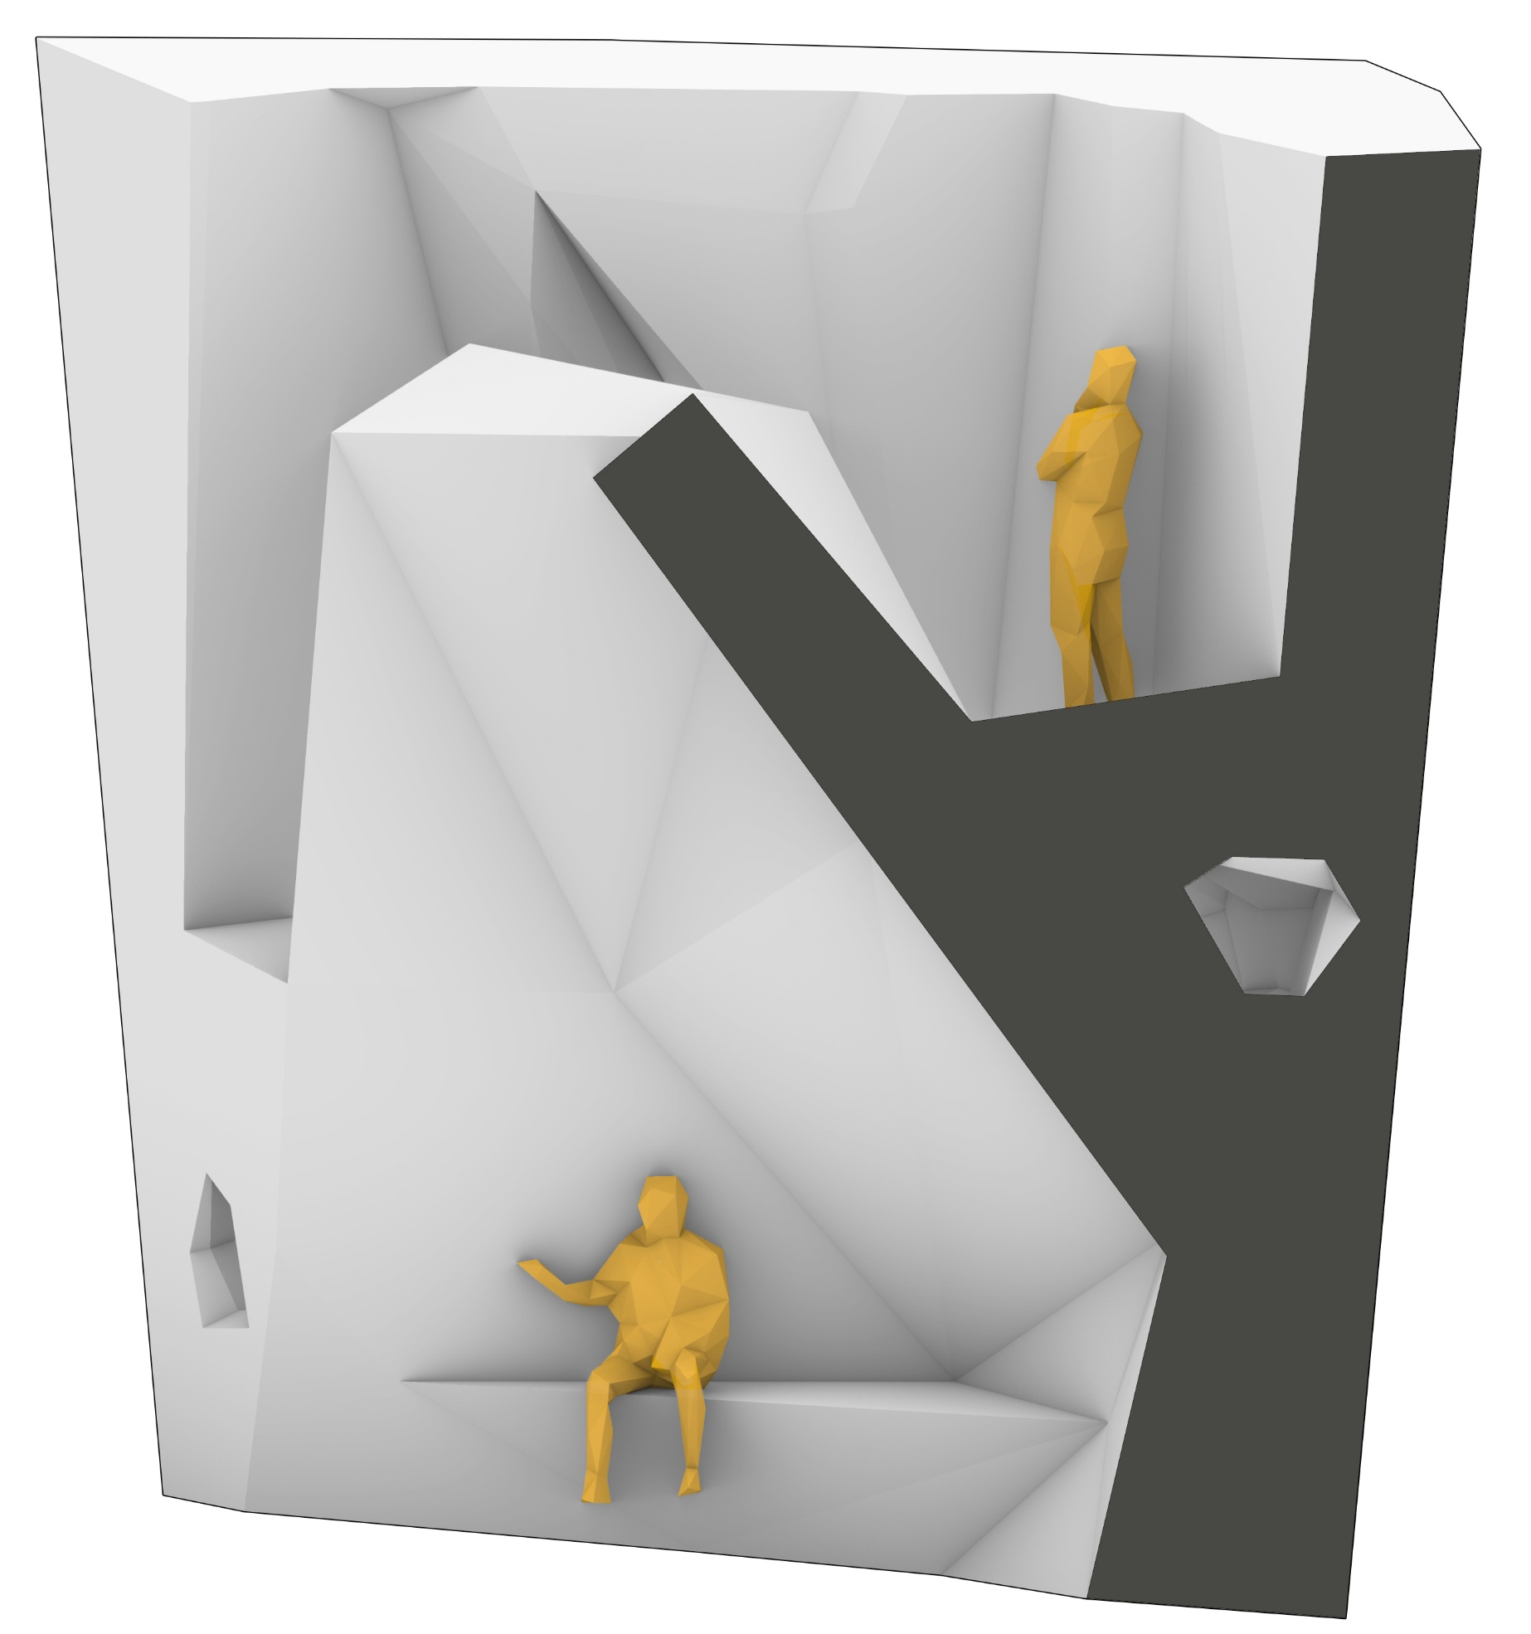
Construction | Building Fragment
wall fragment for assembly
(zoom in to 1:20)
Selected wall fragment

Slide 7
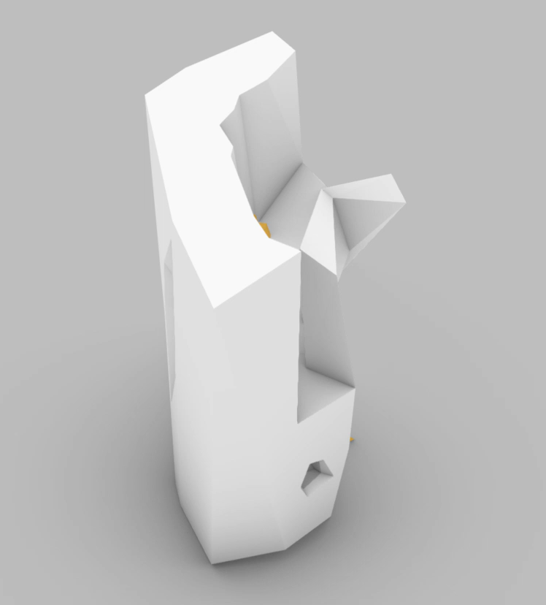
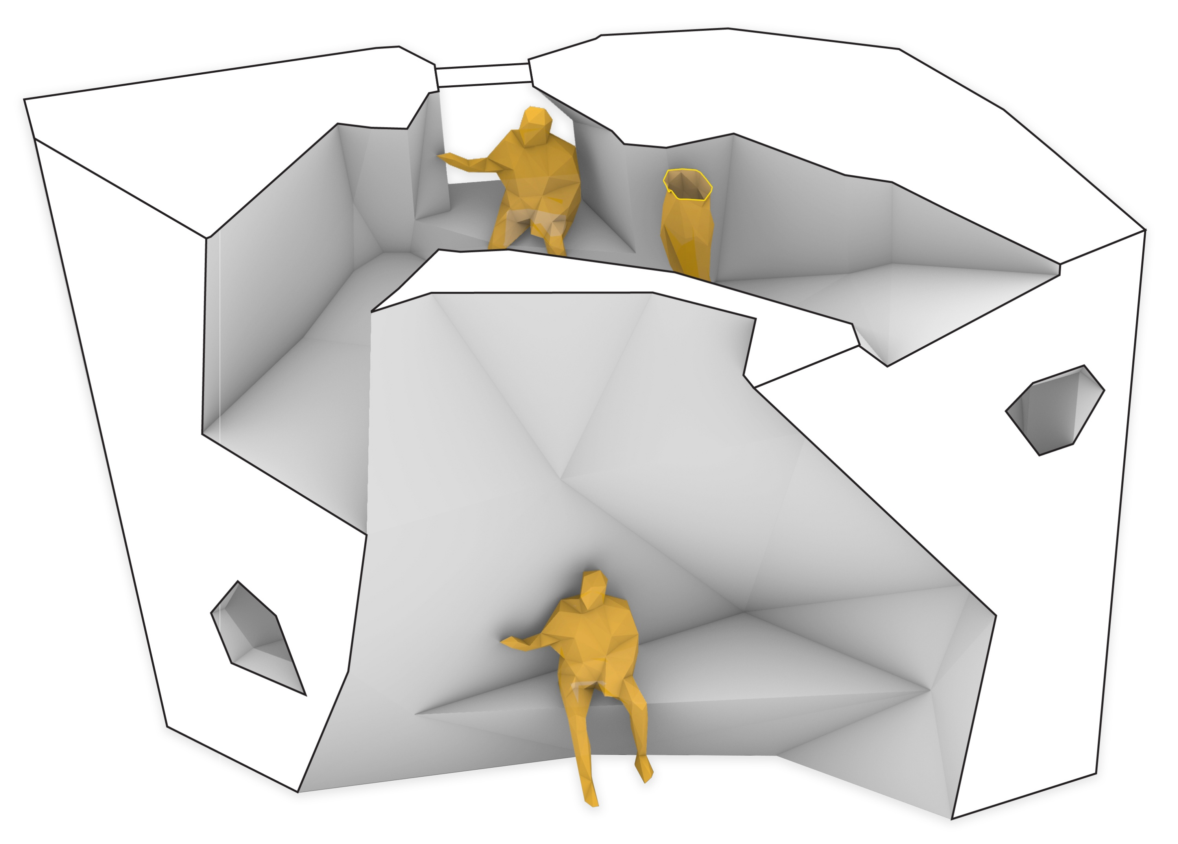
Construction | Building Fragment
wall fragment for assembly
Visual opening
To exterior
Internal Ramp
Maintenance/ service Channel for robots
Integrated seats
Wall Fragment Overview
Integrated Functions

Slide 8
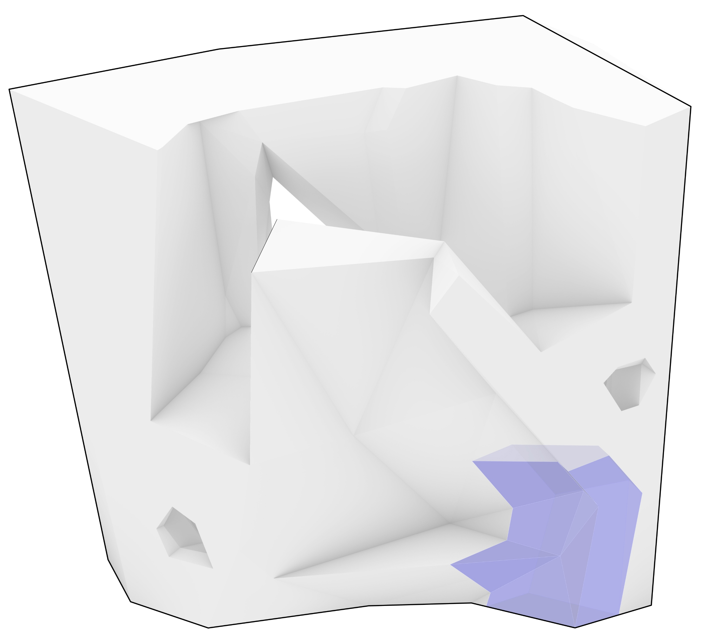
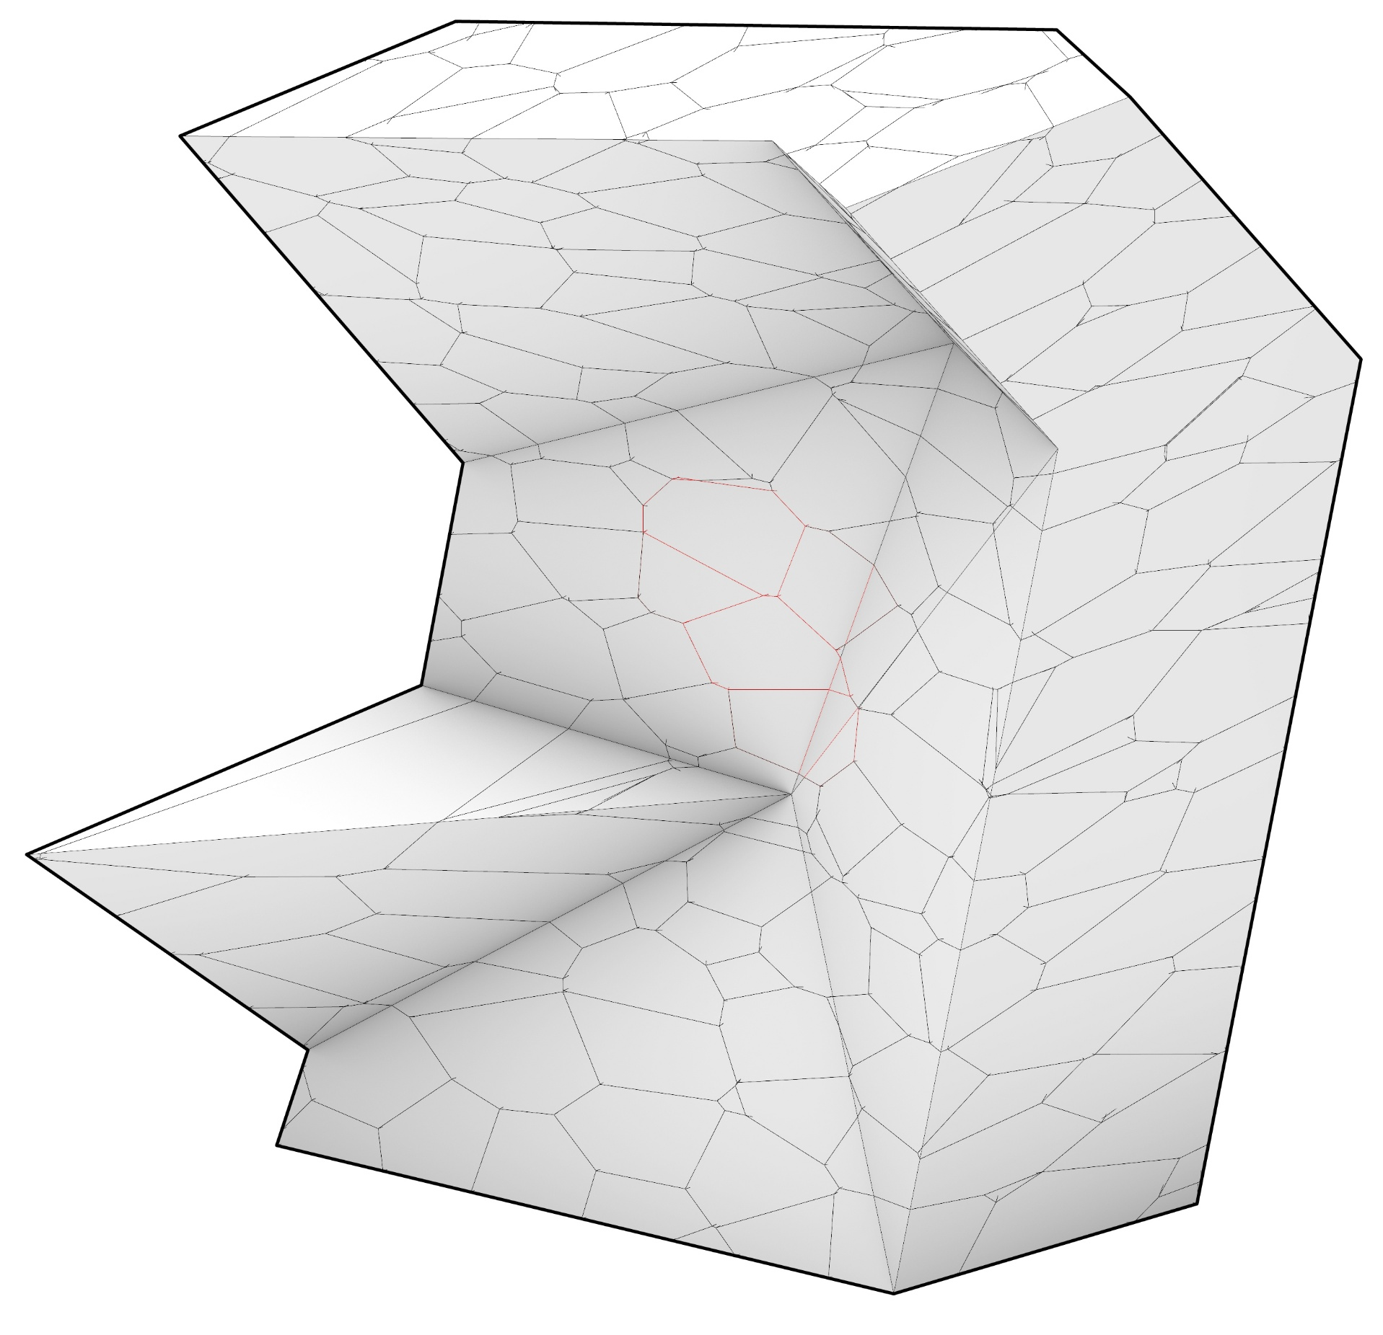
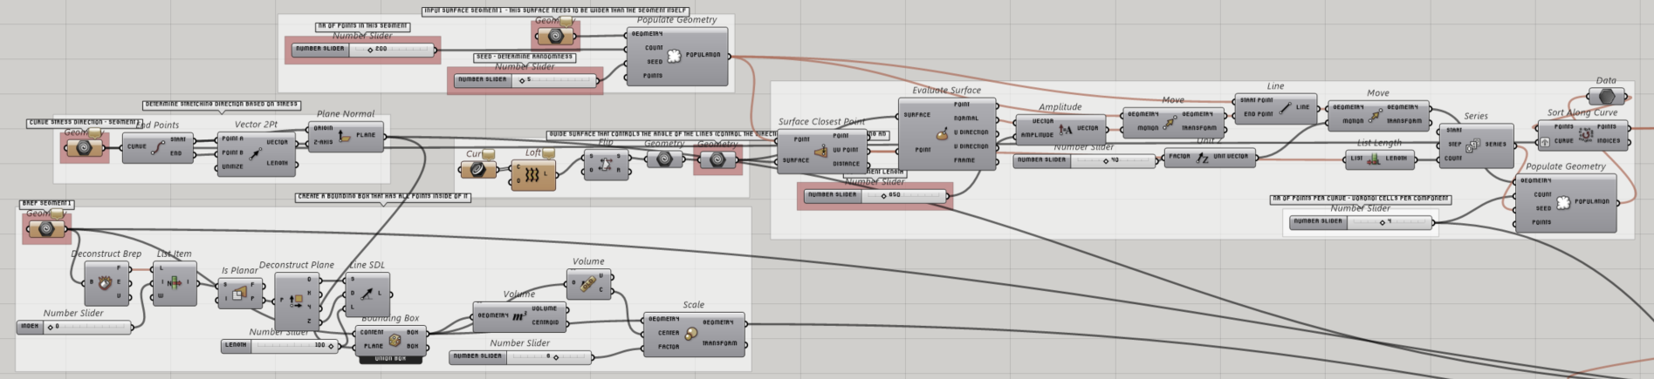
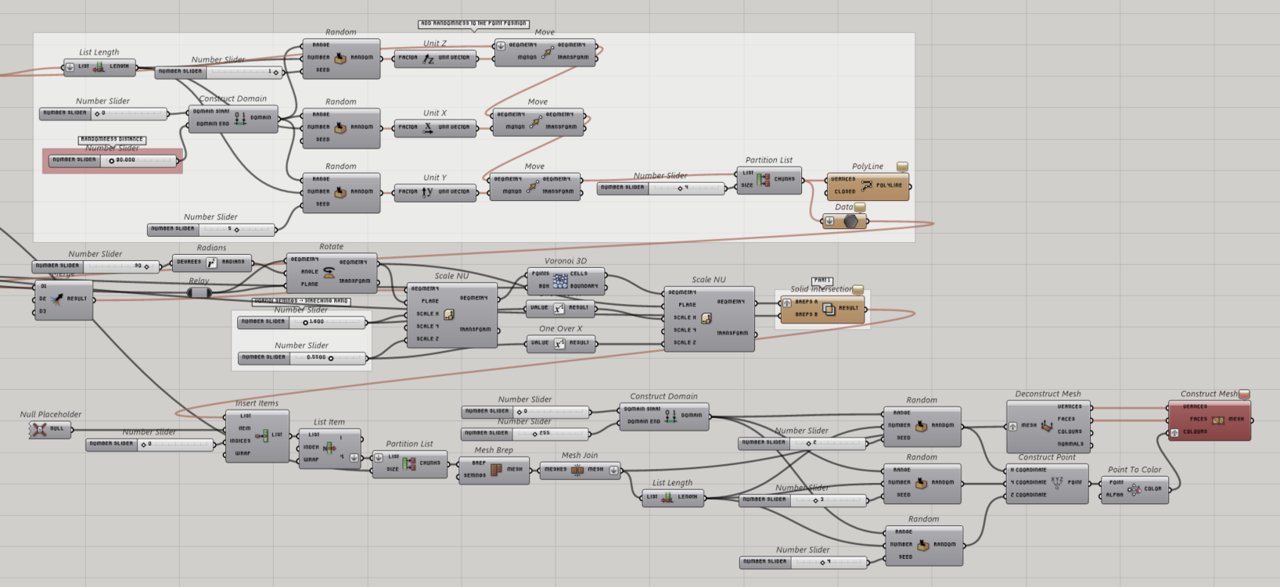
Construction | Building Fragment
components design generation
(zoom in to 1:5)
Sub-Fragment Selection
Computational script to generate components
Components Results

Slide 9
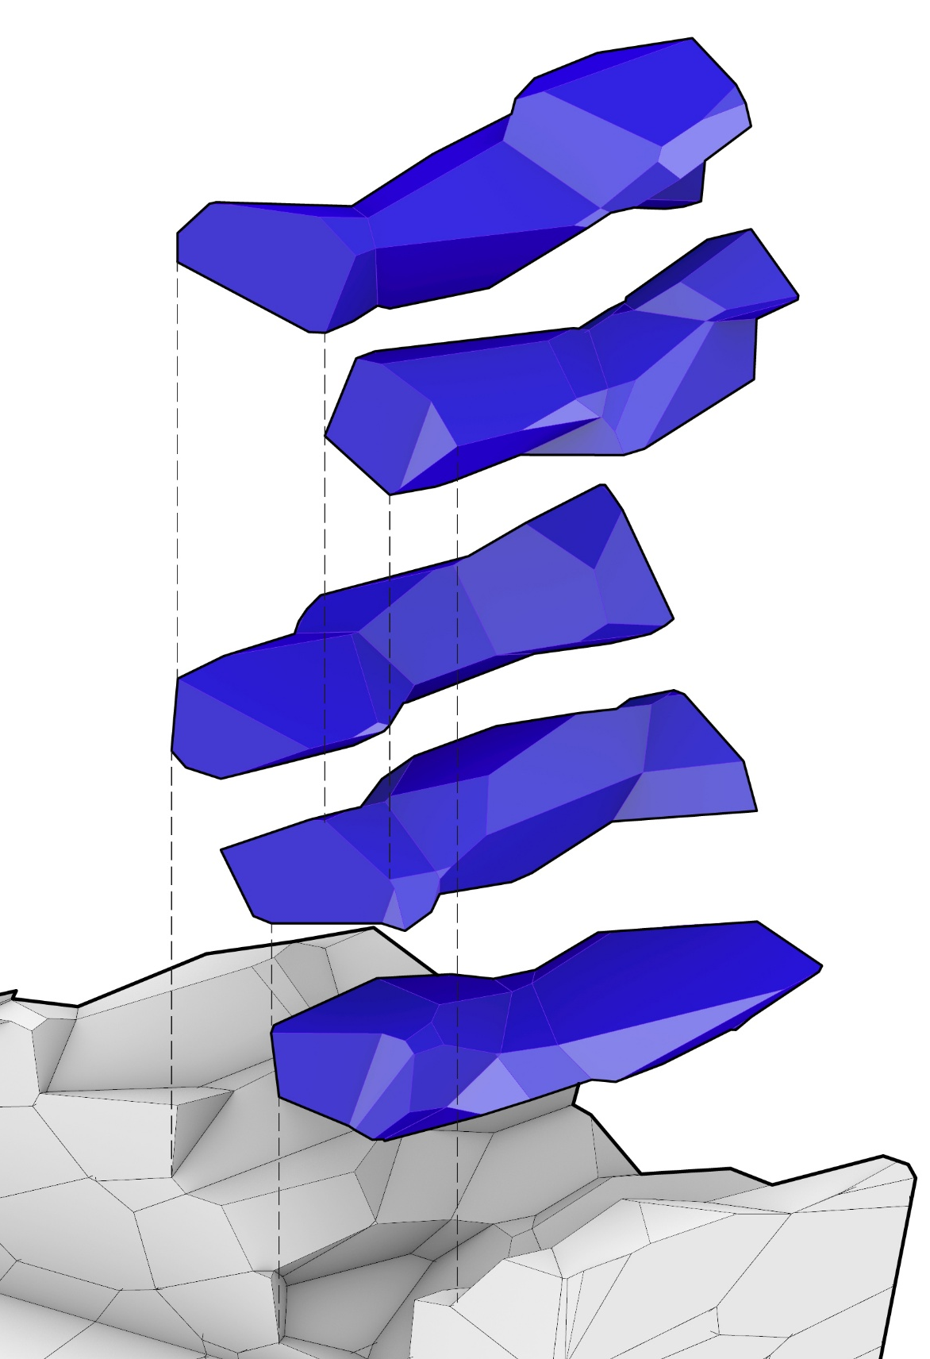
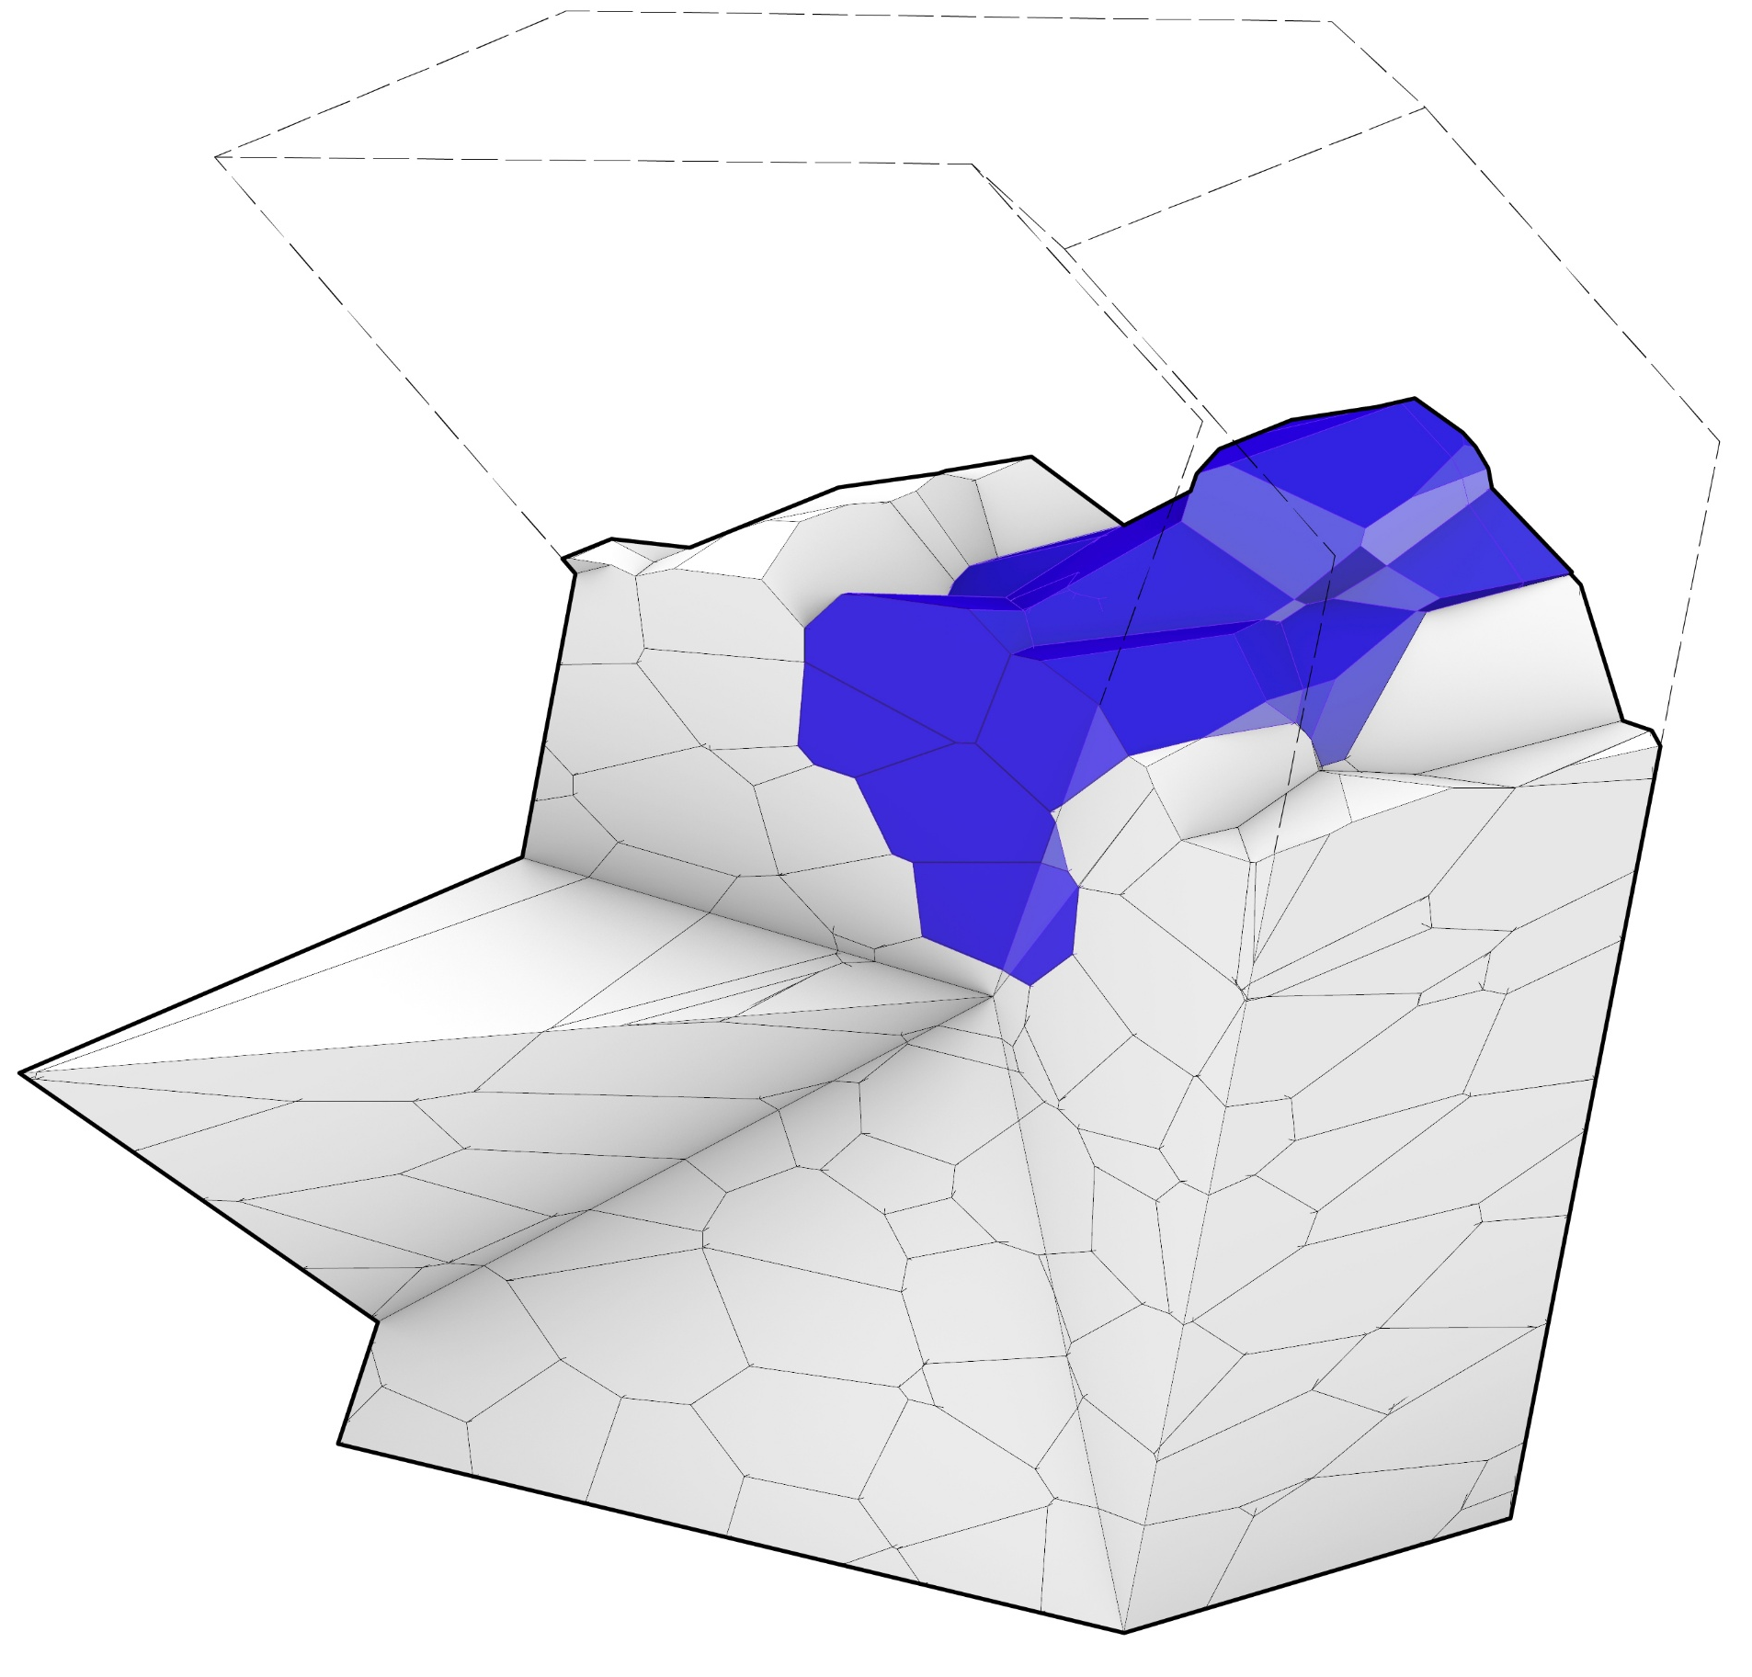
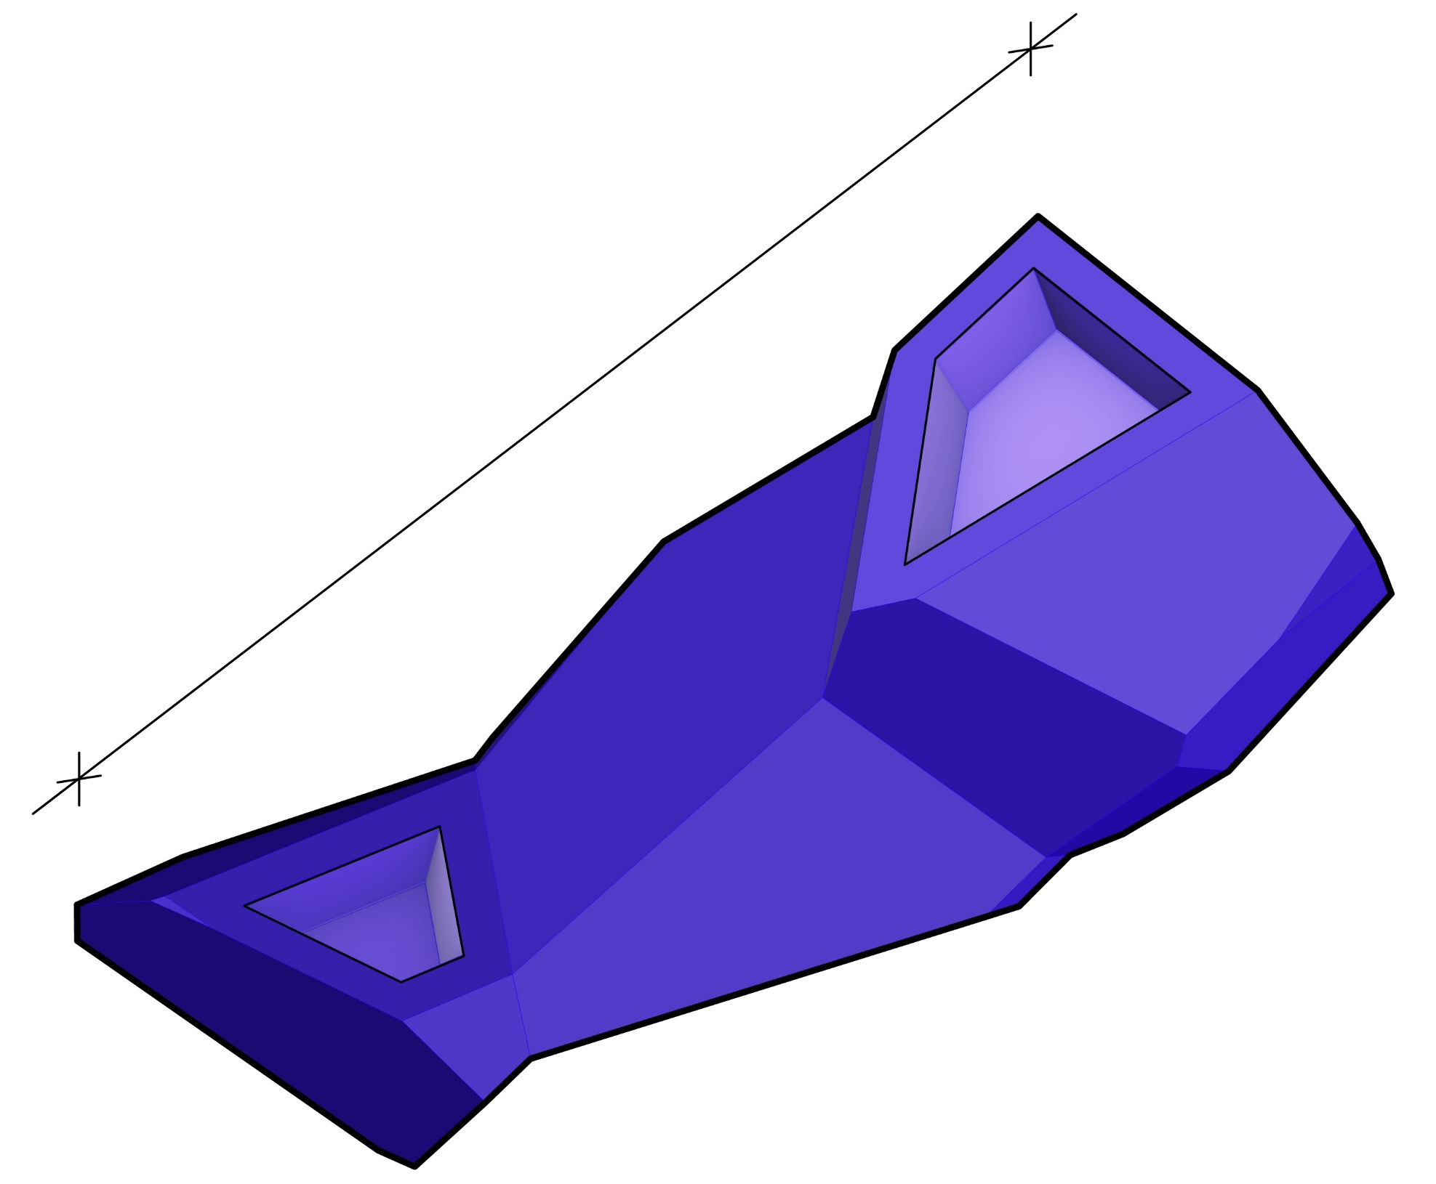
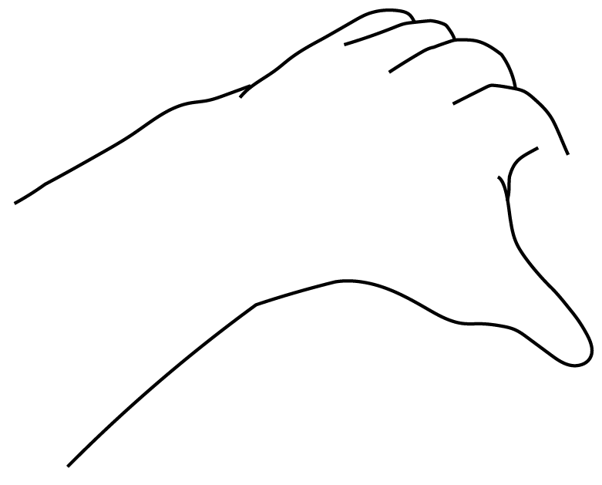
Construction | Building Fragment
component integration details
One Component Zoomed in
~650mm
Components are Stacked & 3D interlocked geometrically
Hole for grabbing the components
SOURCE: Fang Che Cheng et al.(2016)

Slide 10
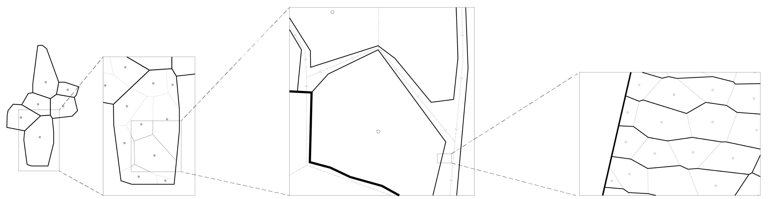
Construction
Voronoi as the overarching design system
Design Language consistency On rapid computation in the overall design scales
Architectural Design
Structural design
Material Design
- Scalable/ re-sizeable system with adjacencies
- Flexible integration with various elements (i.e. furniture)
- Resemblance to nature
- Adequate structural integrity on generated forms (resemblance to catenary actions)
- Effective material use (with toolpath design in case of 3d Printing)
- Interlocking properties suitable for stacking

Slide 11
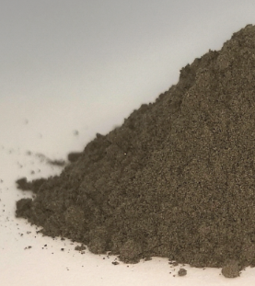
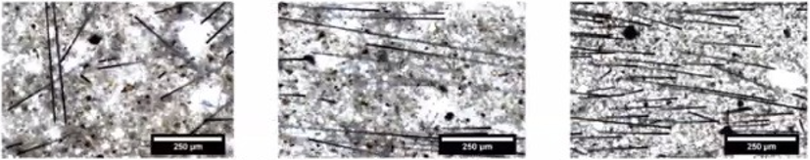
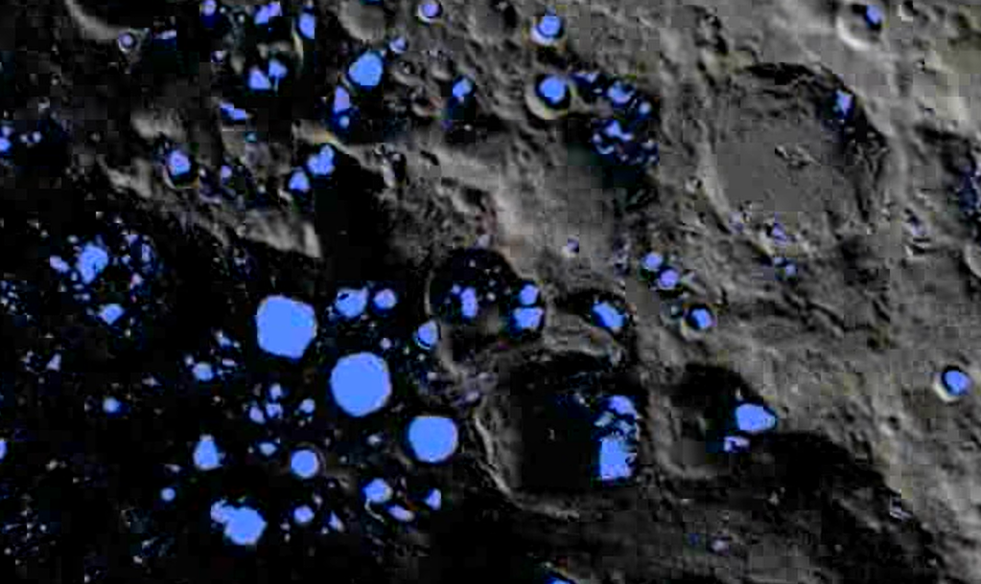
Materialisation
In Situ Resource Utilisation (ISRU)
Regolith =
Structural Blocks (High compression strength), 3D printed with
Carbon fibers AS Structural reinforcement material
(Tensile strength improvement)
Extracted from regolith =
40-45% oxygen for combustion & life support
42-48% Silicon products: glass fibre,
aerogels for seal materials, for insulation layer (NASA)
Metal Alloys (aluminium) for Frame
Source: Dirk Volkmer (2016), Rutzen et al. (2021)
(Left) Regolith // (Right) Carbon Fibers reinforcement
Ice =
Life support Materials (water, oxygen, Hydrogen)
Source: ESA, NASA
ICE
SOURCE: ESA, Matthias Rutzen (U Augsburg)

Slide 12
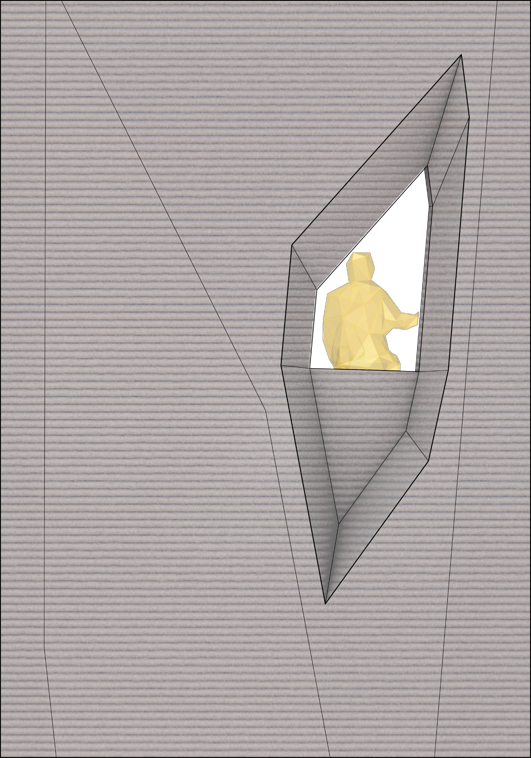
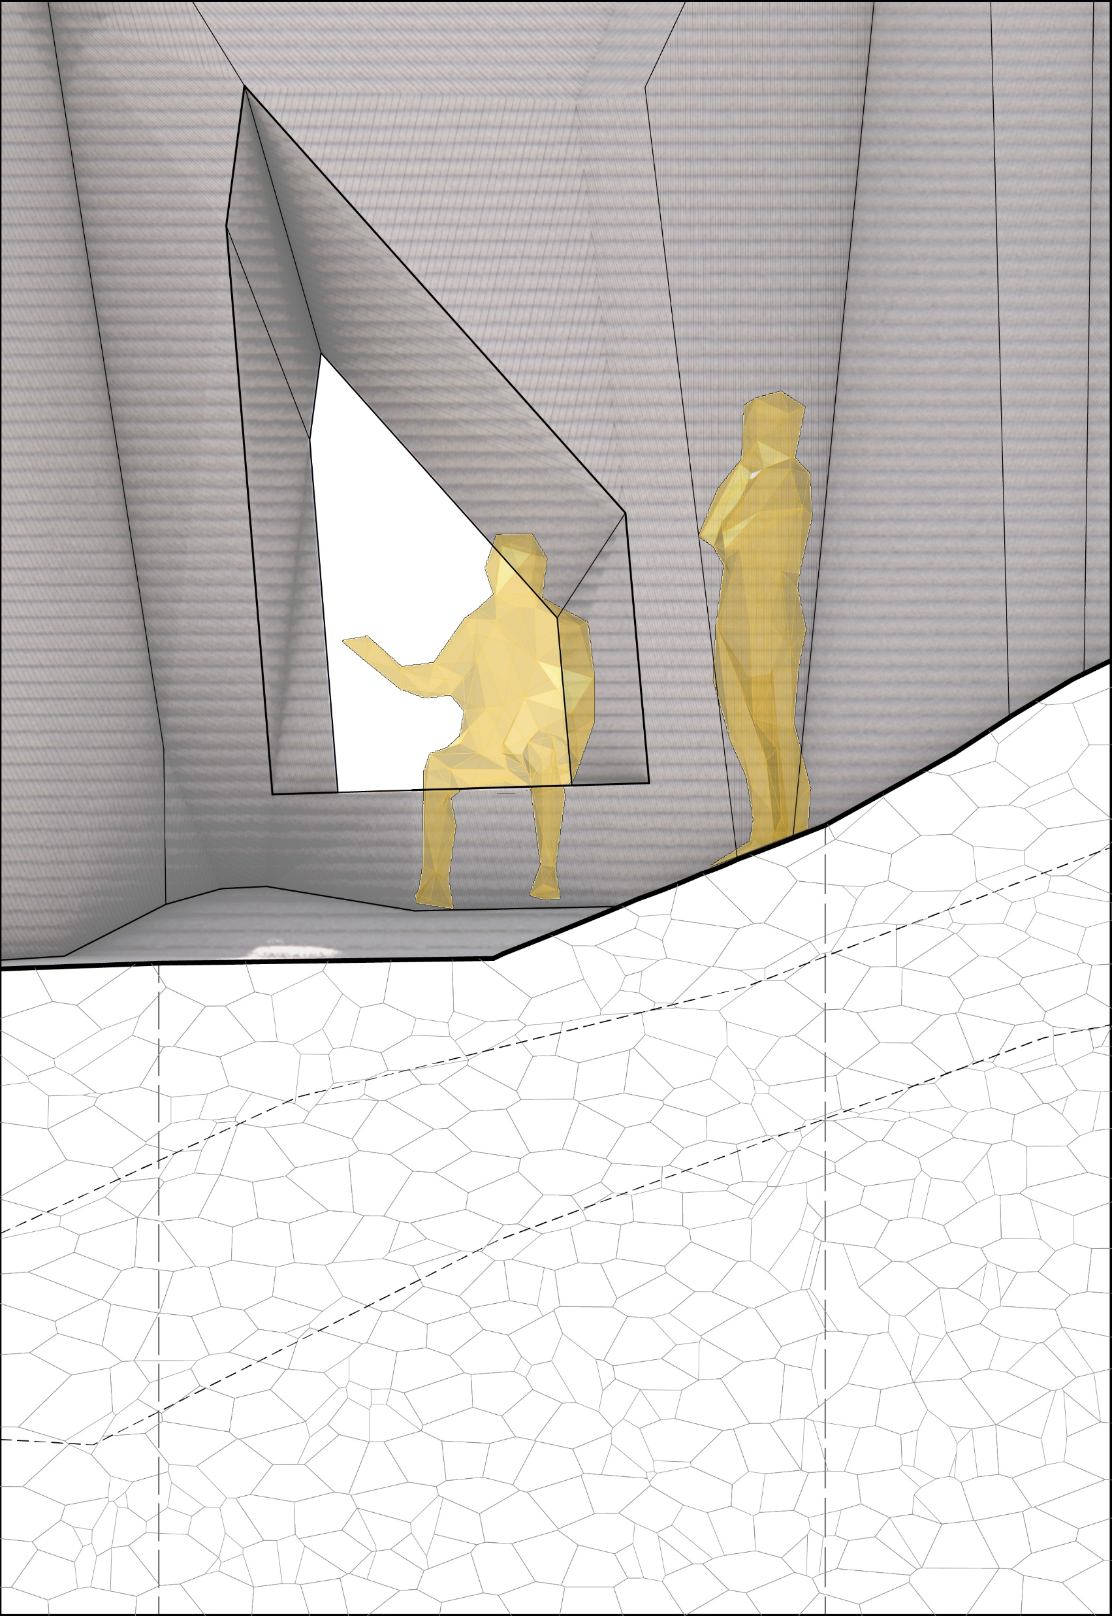
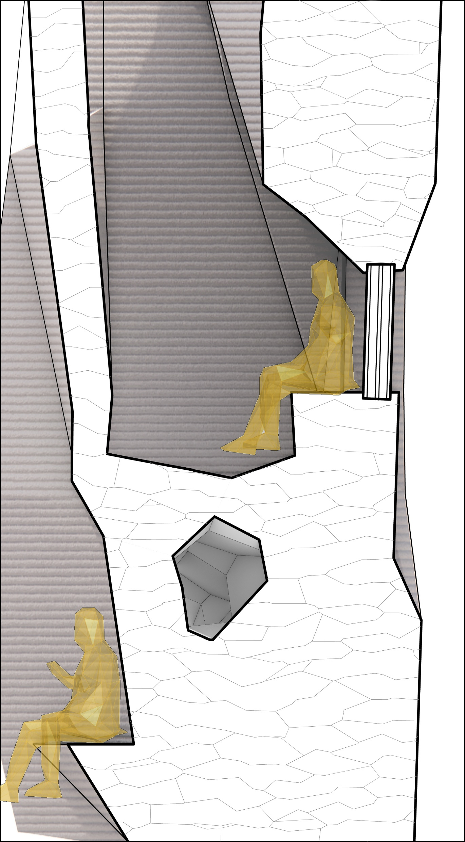
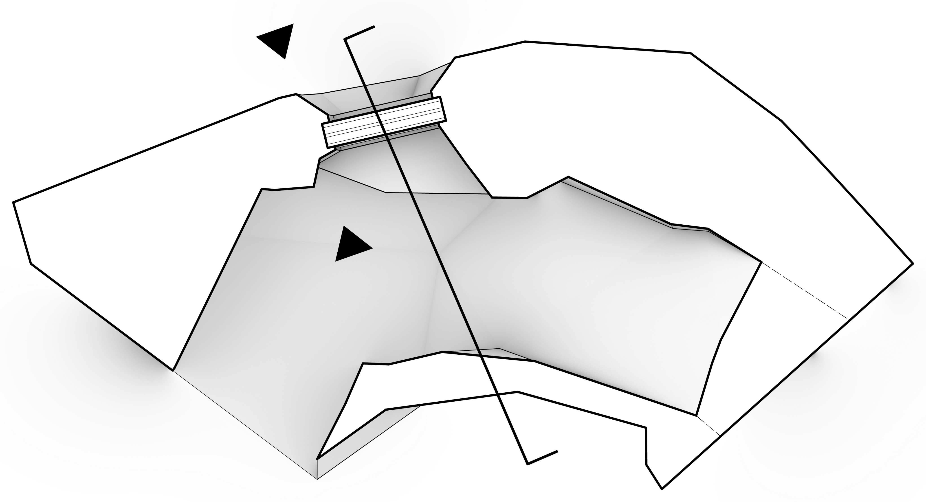
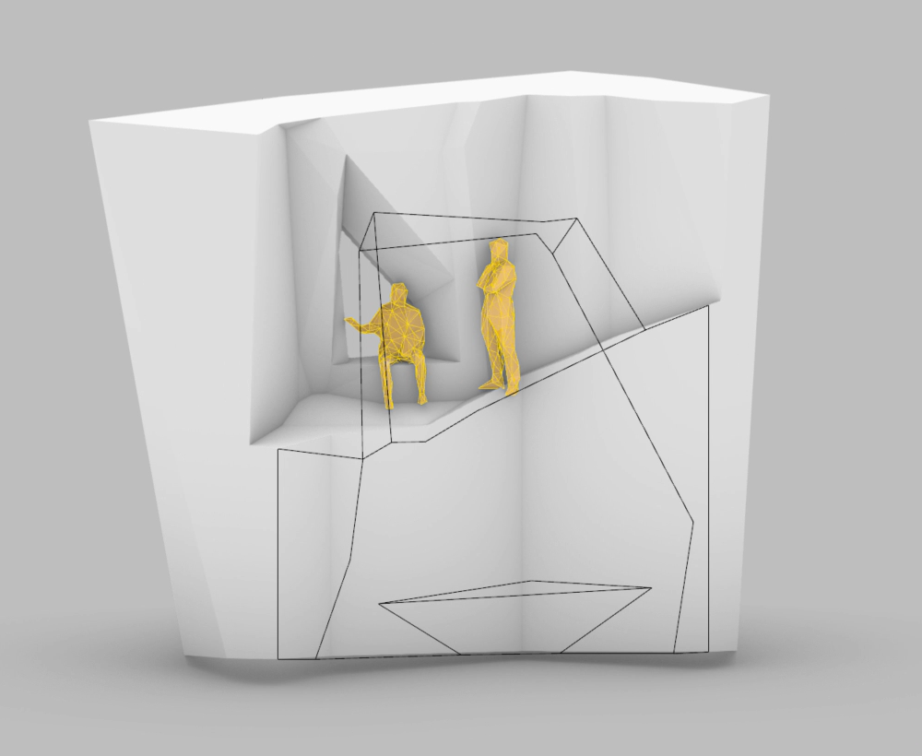
Materialisation
wall fragment
900mm
1200-1300mm
1
A’
1600mm
2
A
Maintenance/ service
Channel
1. Exterior Facade
2. Interior Facade
Section A-A’

Slide 13
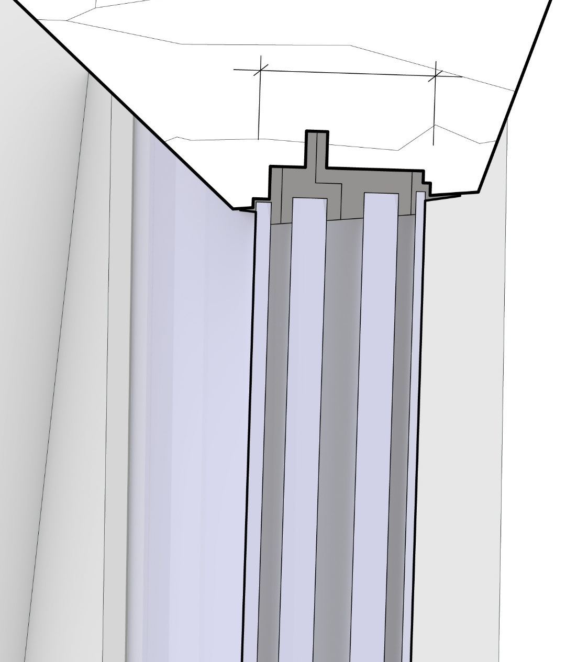
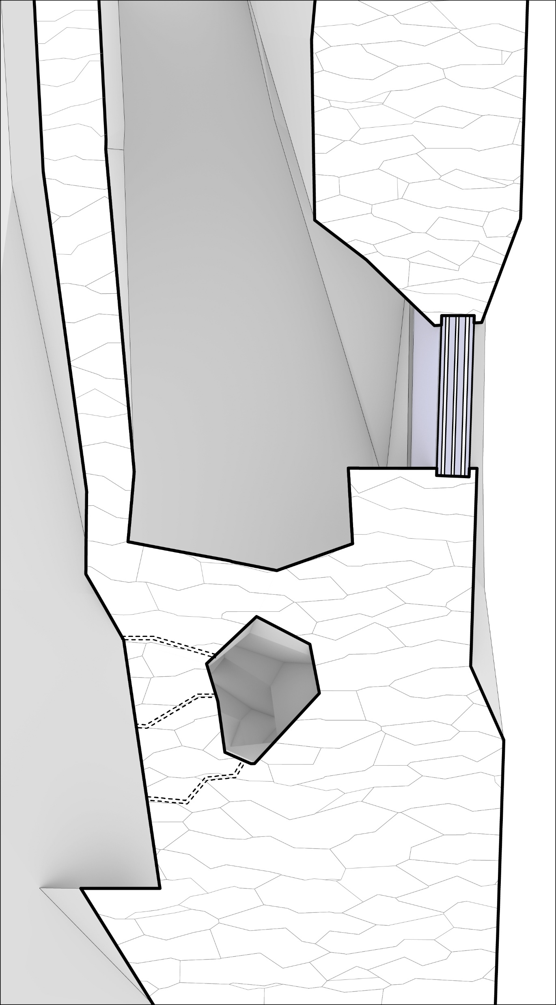
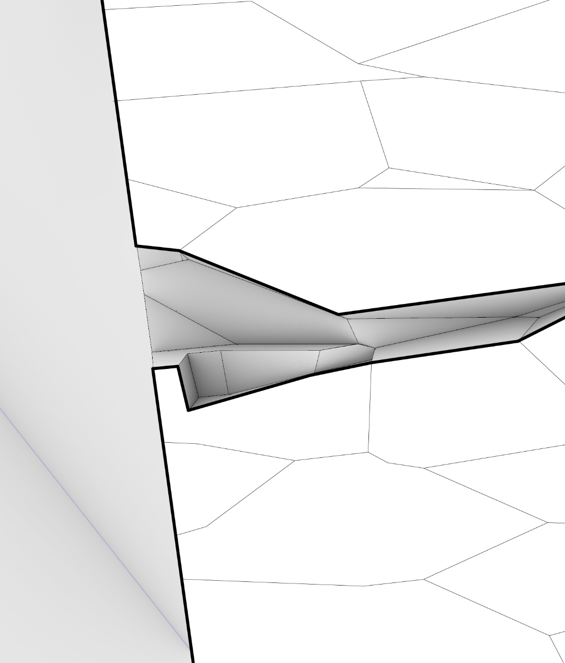

Materialisation
1
200mm
fragment details
Components:
Lunar Regolith 3D Printed blocks
Interior
exterior
Aerogel layer
For insulation and air-tight seal
3D Printed glass panel from silica
(with air-tight & Radiation Shield Performance)
1
2
2
Components:
Lunar Regolith 3D Printed blocks
Main channel For maintenance
by small robot
Integrated Channel for cables & pipings
Sub-Channels
For electricity and water
Integrated Kink
for climbing/ assembly grabbing
Kink for Seating
1m
10cm

Slide 14
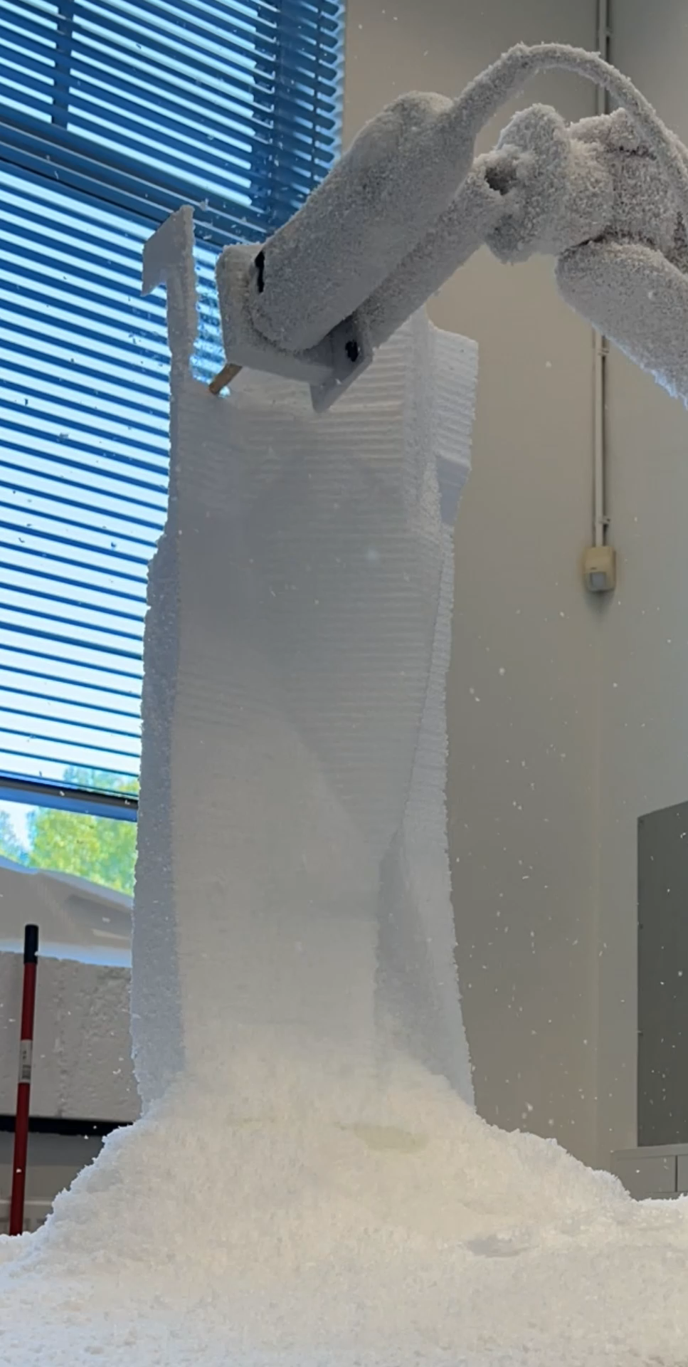
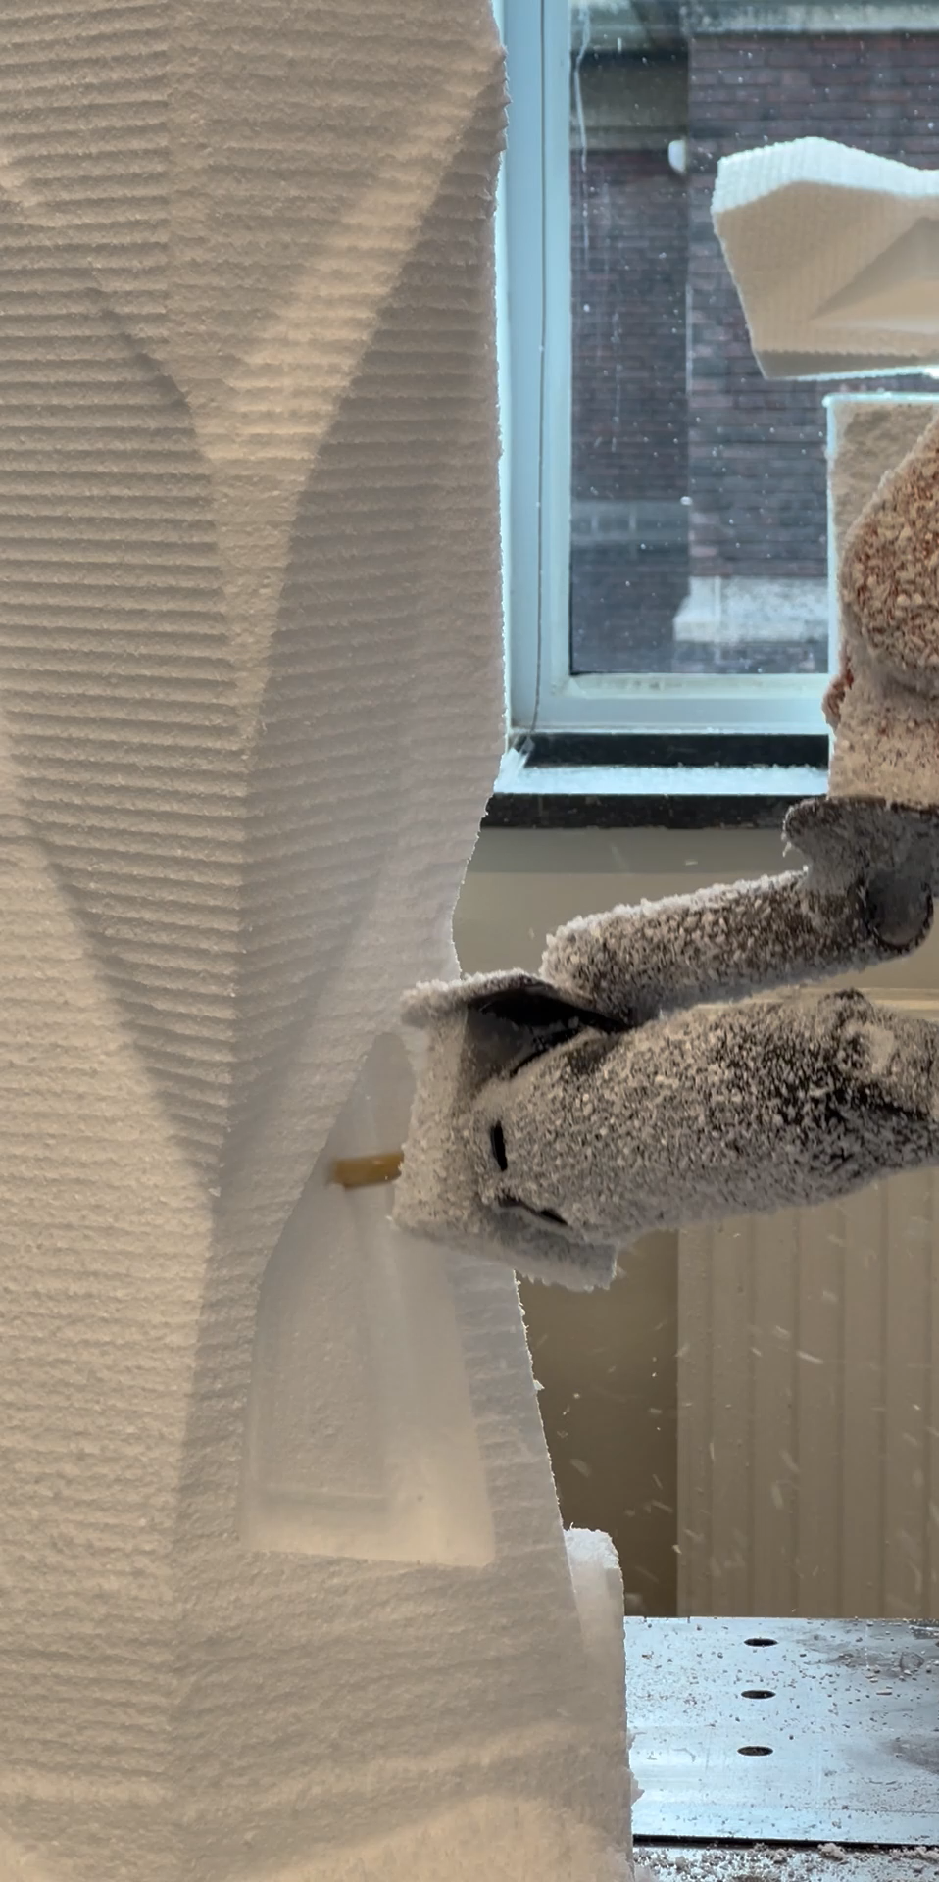
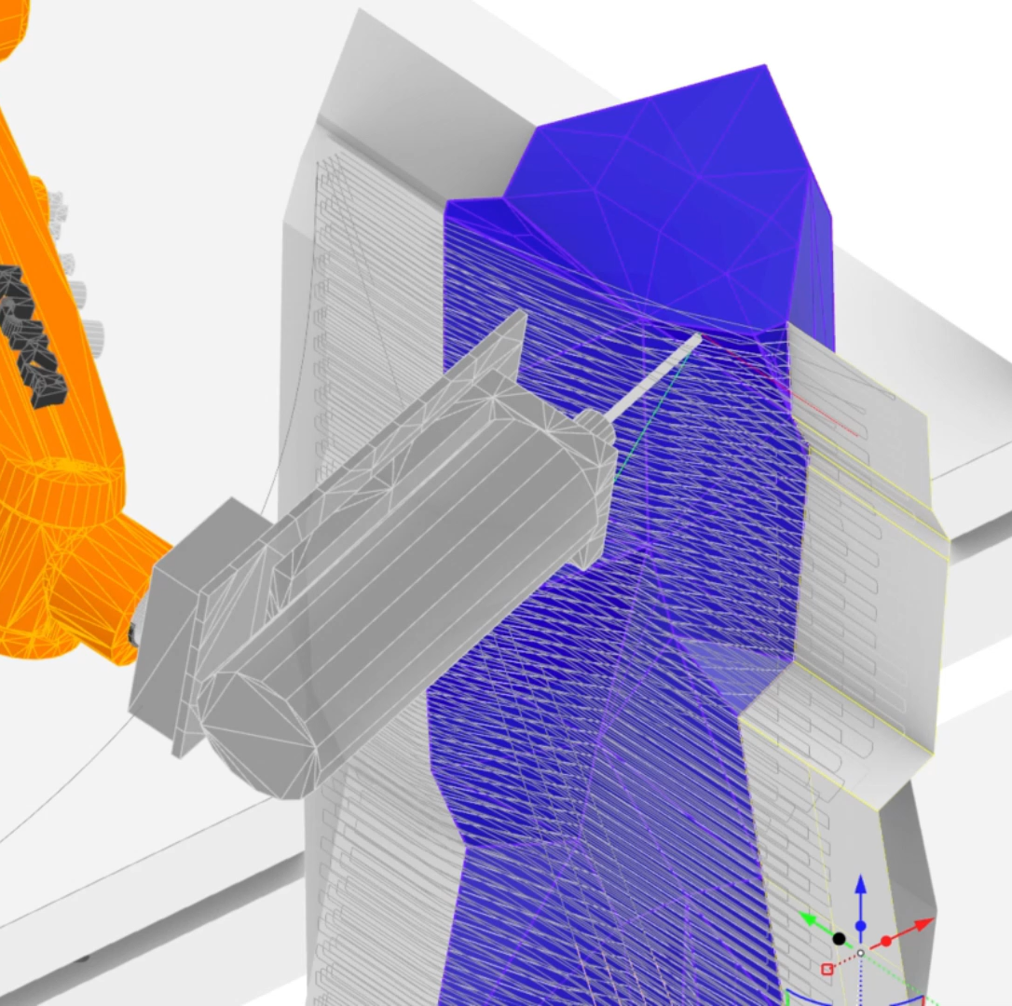
Materialisation
fabrication: mock-up
(zoom in to 1:1)
1:1 Fabrication Mock-Up (EPS foam)
Subtractive process
(milling out material)

Slide 15
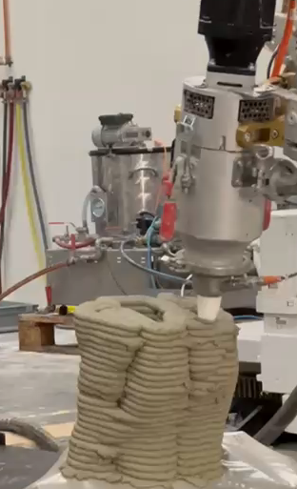
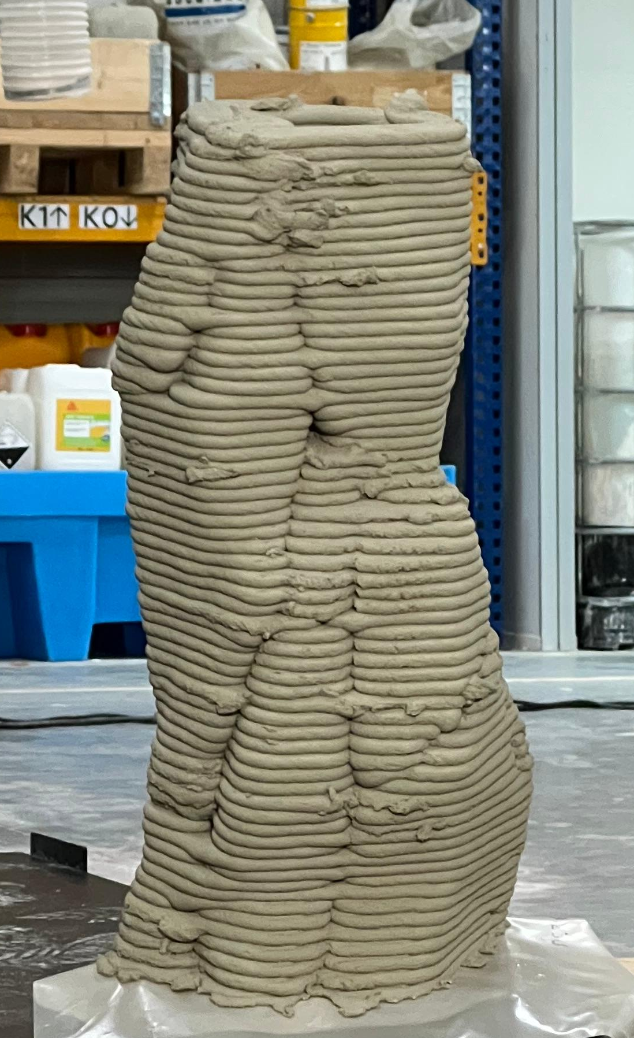
Materialisation
fabrication: 3D printing technology
Additive process and result
(concrete 3D printing at vertico, Eindhoven)
Comparative Lesson from Workshop: toolpath design process on the computational tool

Slide 16
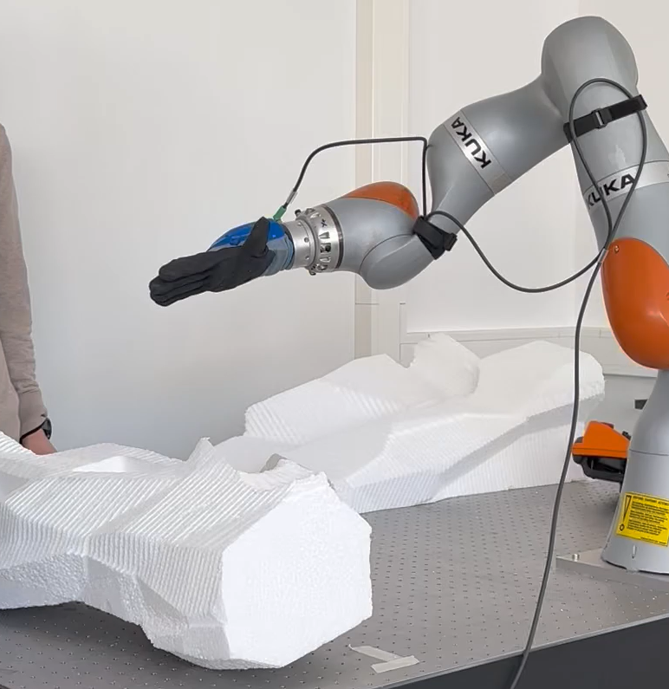
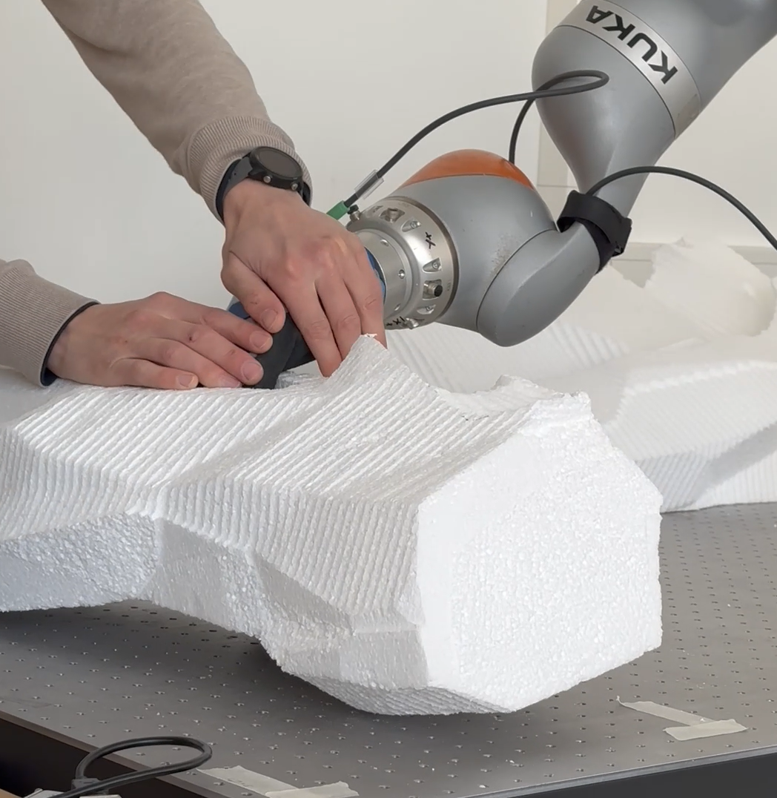
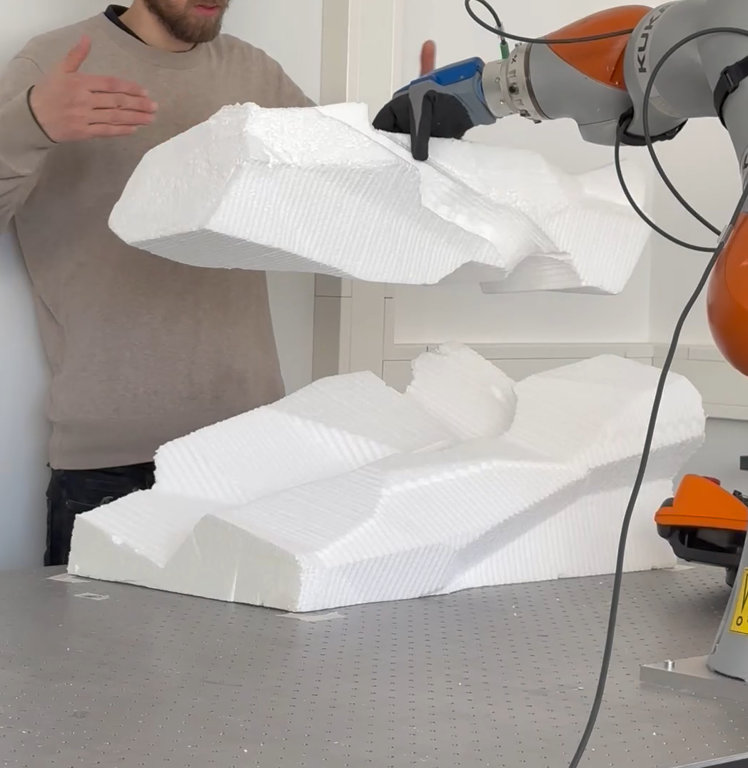
Construction | Assembly
assembly mock-up: Human-Robot Interaction (HRI)
Robotic process Supported by computer vision (CV)
1. Approaching component
1. Approaching component
1. Approaching component
2. Picking component (assisted)
3. Transporting component to designated point
2. Grabbing component (assisted)
3. Transporting component to designated point
4. Adjusting Component
5. Placing component (Assisted)

Slide 17
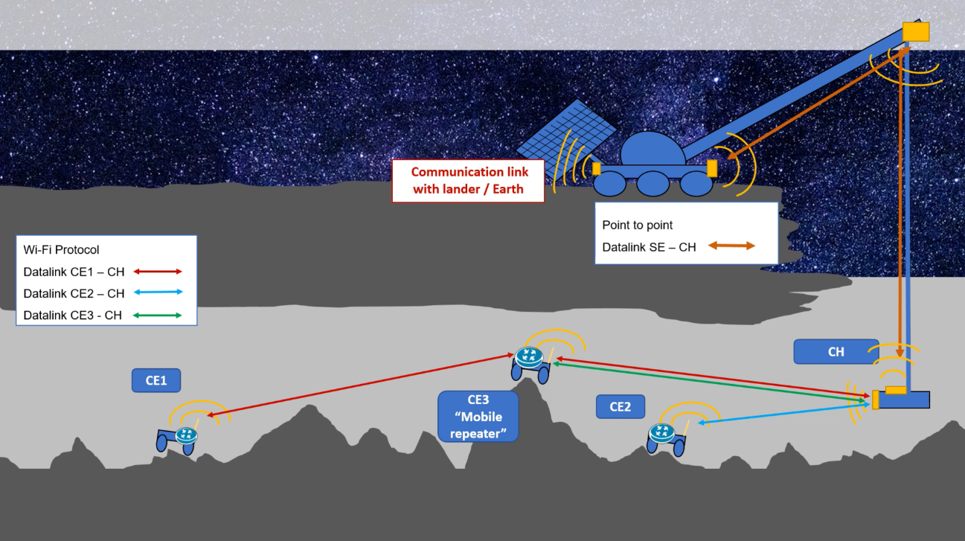
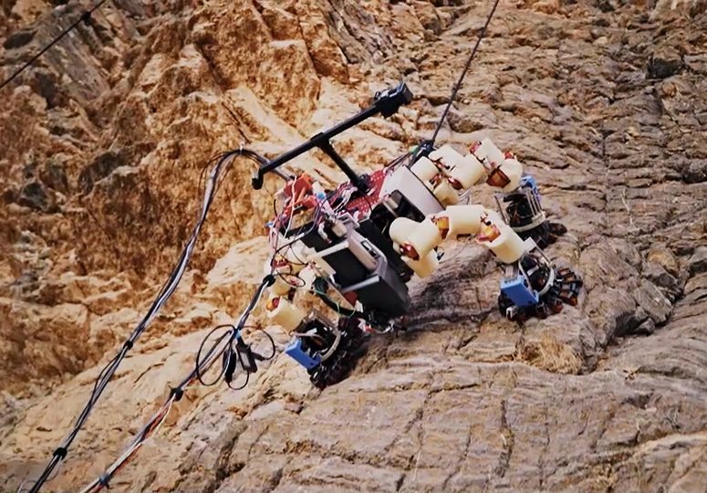
Construction | Assembly
robotic crane and climbing robots
Crane System to deploy smaller units and transmit energy
developed by Esa with Oviedo University
LEMUR By Nasa
tested in Death Valley, California
Source: ESA.INT
Source: Nasa.gov
Proposed Systems for exploring lunar underground pits

Slide 18
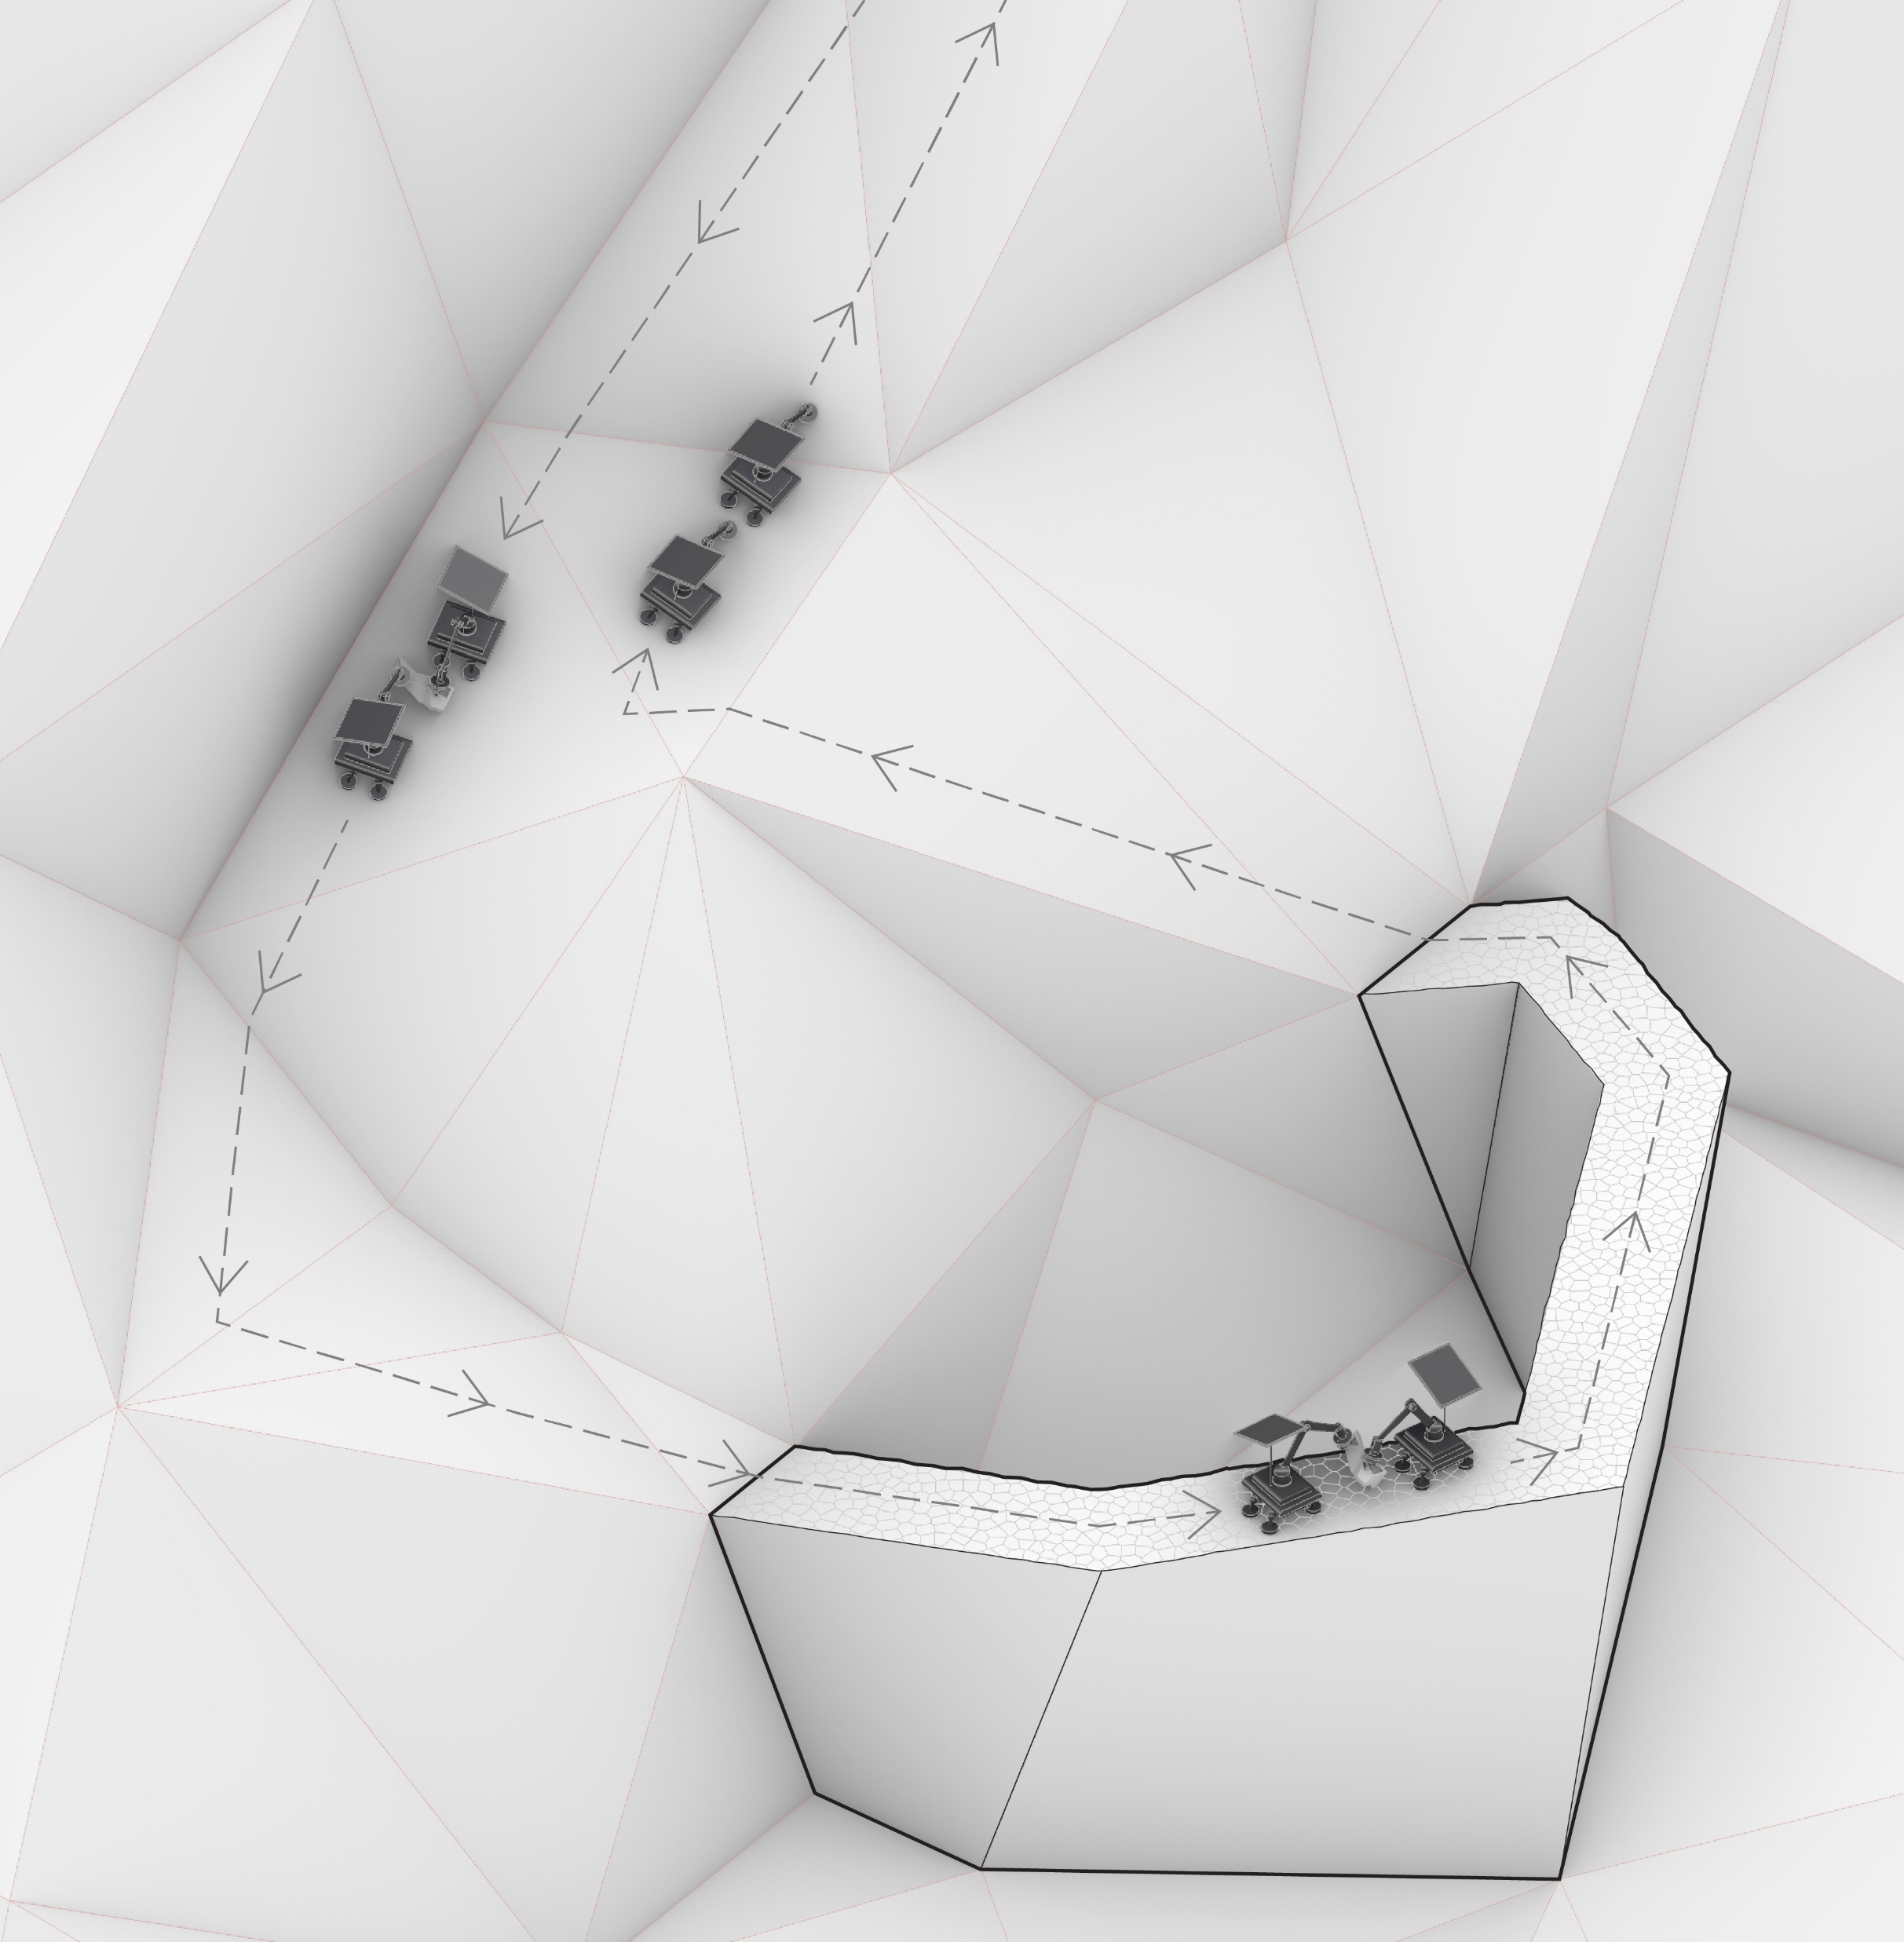
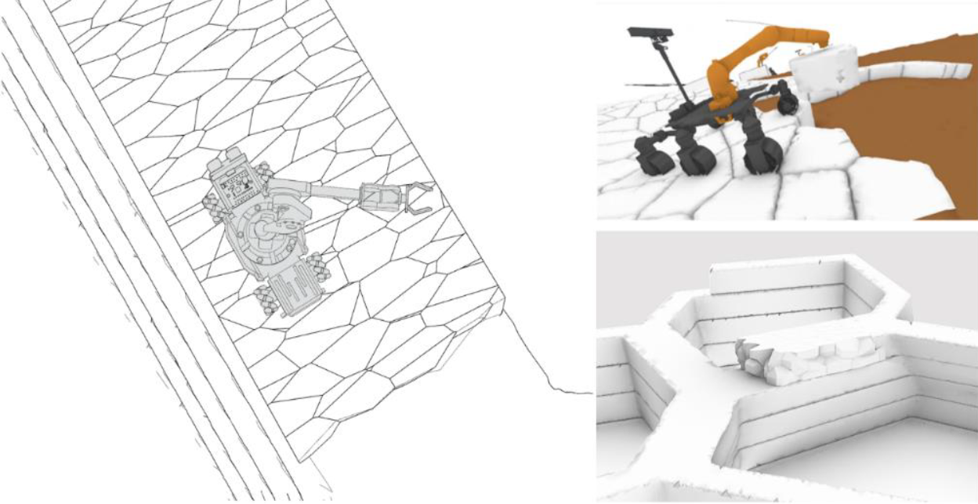
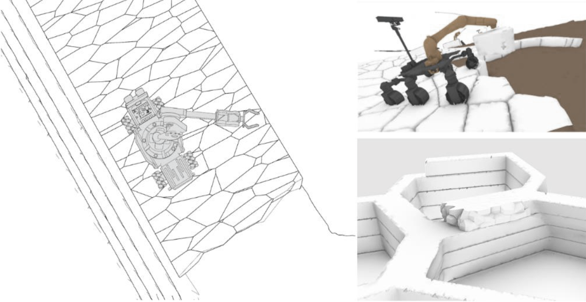
Construction | Assembly
assembly during construction
1
4
2
3
Stacked components create walkable path for the robots
SOURCE: Fang Che Cheng et al.(2016)
1. Defining Path & creating minor site adjustments
2. Two robots Transporting one component down
3. Placing components at designated place
4. Returning up & picking next component, repeat

Slide 19
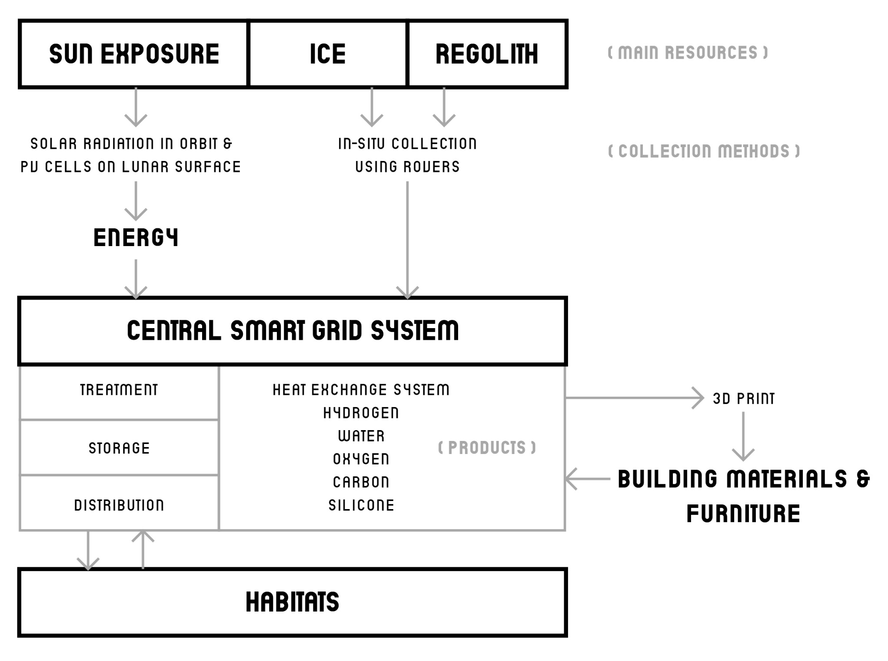
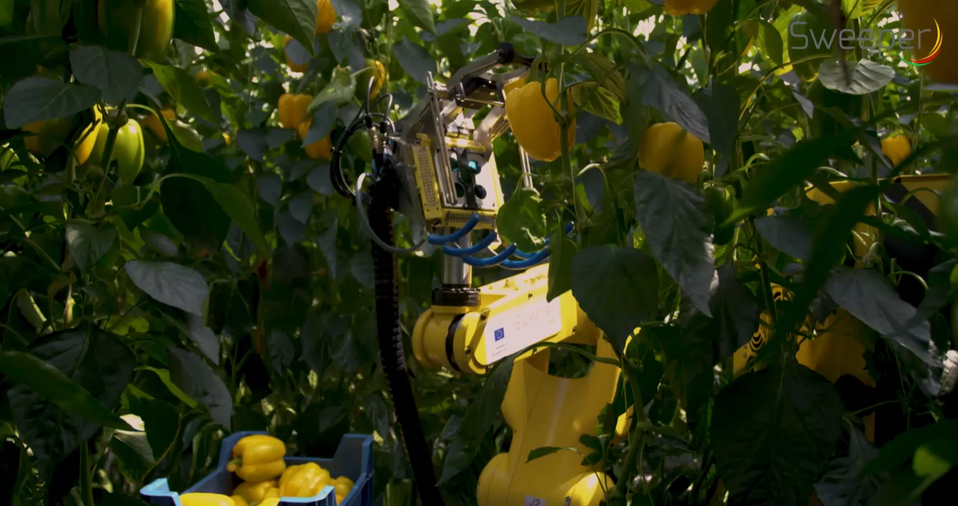
Energy Distribution
energy & resources collection/ distribution
Sweeper Robot
developed in Wageningen university & Research
Source: youtube.com/watch?v=DUgjFaYyecE

Slide 20
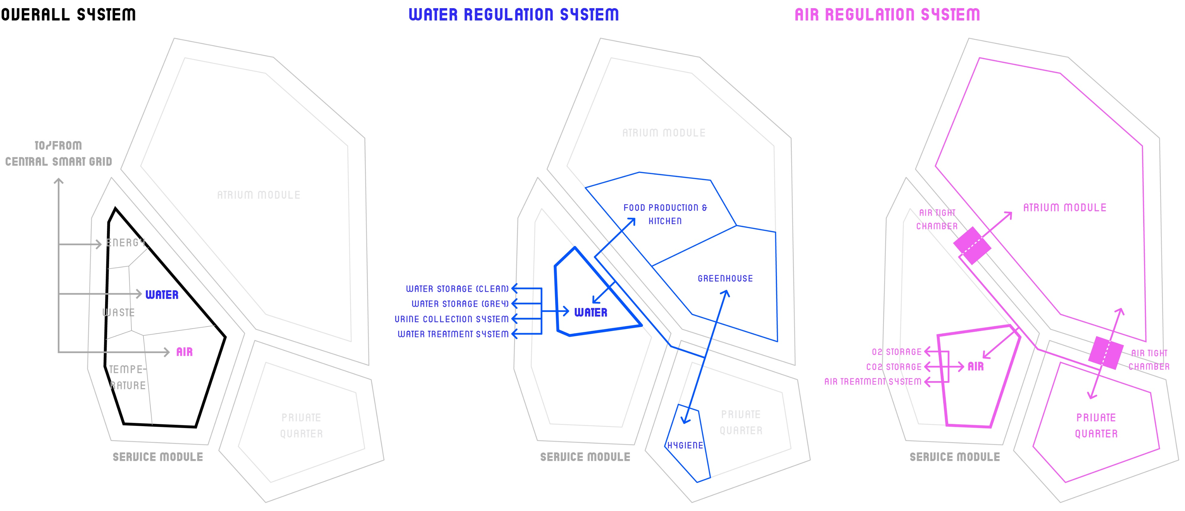
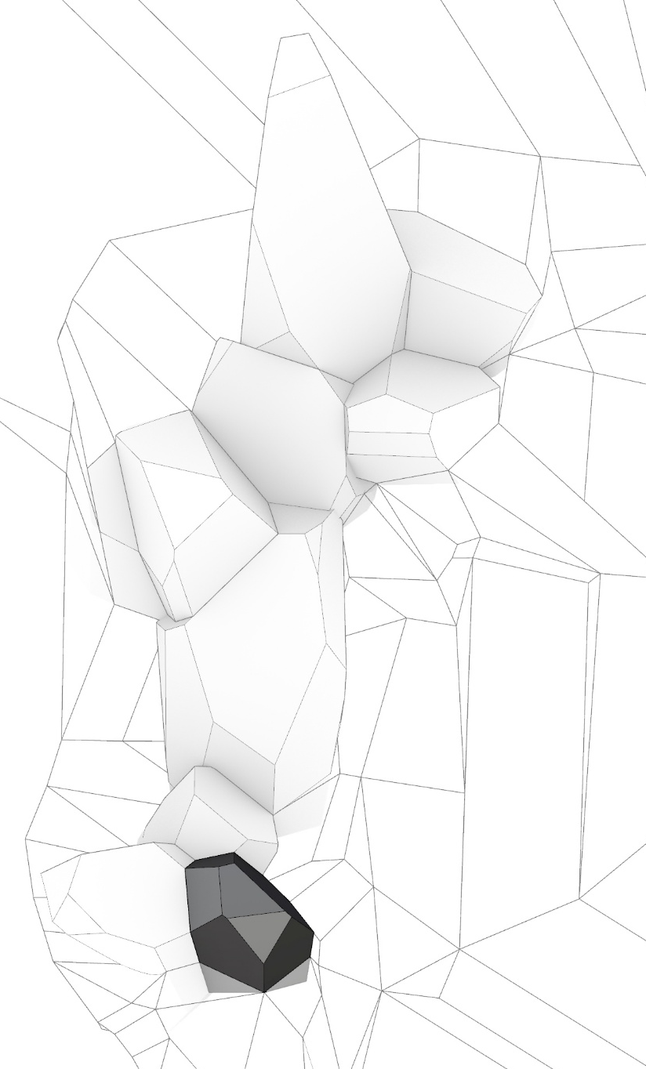
Energy Distribution
building service/ life support systems
Lower
Service Module

Slide 21


Energy Distribution
climate control strategy
Upper Service Module

Slide 22

Energy Distribution
closed-loop life support system
The Micro-Ecological Life Support System Alternative (MELiSSA)

Slide 23







Conclusion
summary & takeaways
Body & Muscles Integration
In Spatial Design
In-situ resource Utilisation (ISRU) &
Closed-loop life cycle
Robotic &
Clean construction

Slide 24

Conclusion
societal relevance
Ergonomics & human bodies:
- Rethinking sitting position to raise awareness on bodies
- Movement/posture-based architecture instead of function-based architecture
Body & Muscles Integration
Knowledge transfer loop to
on/off-earth architecture
Circular design and lifestyle:
- Exemplary towards often theoretical circular design on earth
- In-situ resource utilisation & Automated Construction
- Closed loop life cycle learnt from melissa
ISRU
Robotic construction

Slide 25
Q & A

