Slide 1
[Utopian vs Realistic]

Slide 2
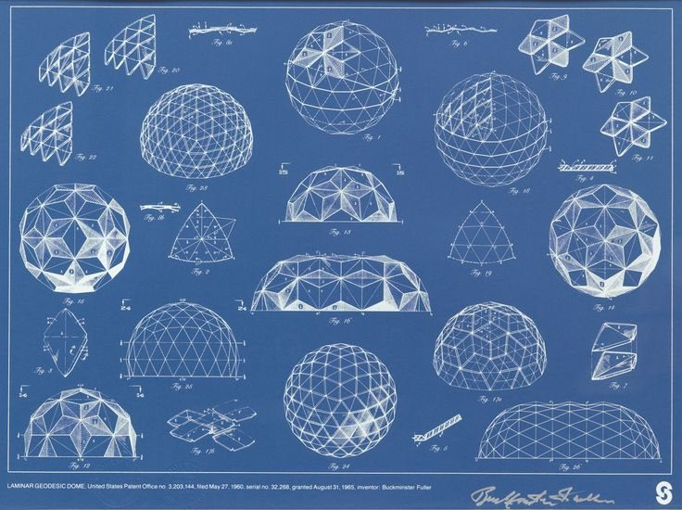
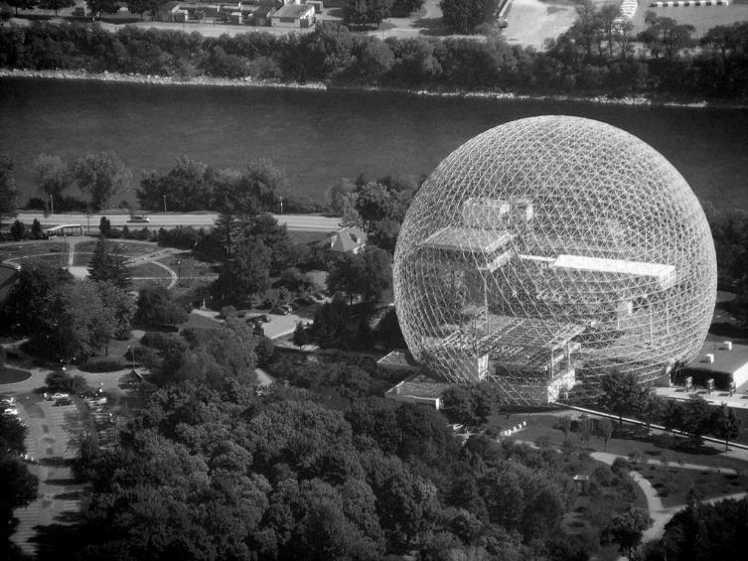
Buckminster Fuller
Geodesic domes
Post-war houses
Utilization of resources
Maximum volume covered in minimal surface
Geodesic domes, Buckminster Fuller
Montreal Biosphere, Buckminster Fuller

Slide 3
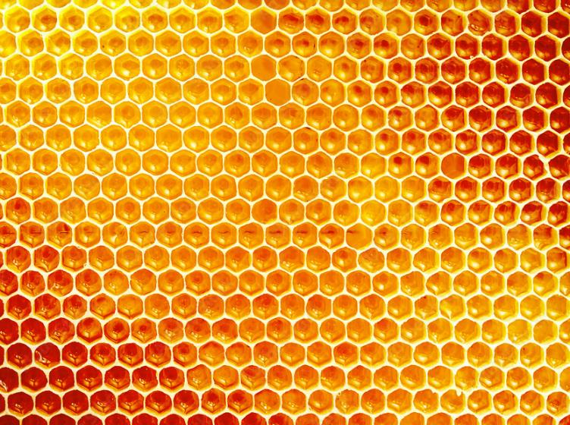
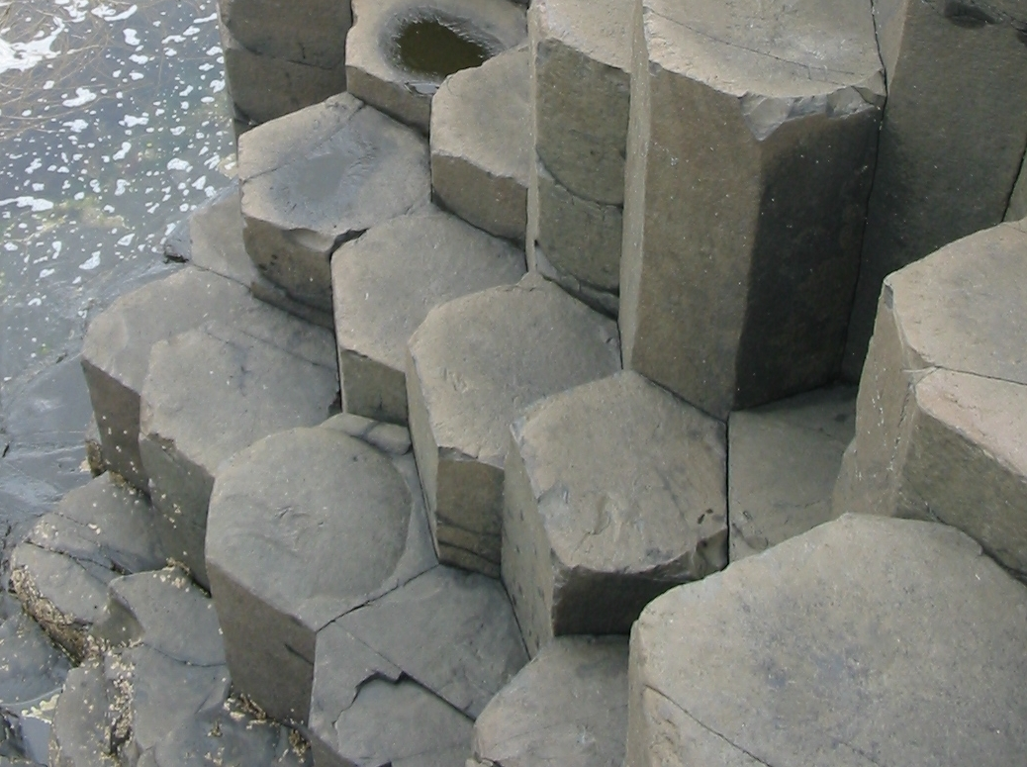
Honeycomb
Hexagonal prisms
Natural habitat
Utilization of resources in communal living
Maximum volume covered in minimal surface WHILE leaving no gaps
Honeycomb
Why Hexagonal Basalt Columns? Physical Review Letters 2015
Columnar jointing, Giant’s Causeway

Slide 4
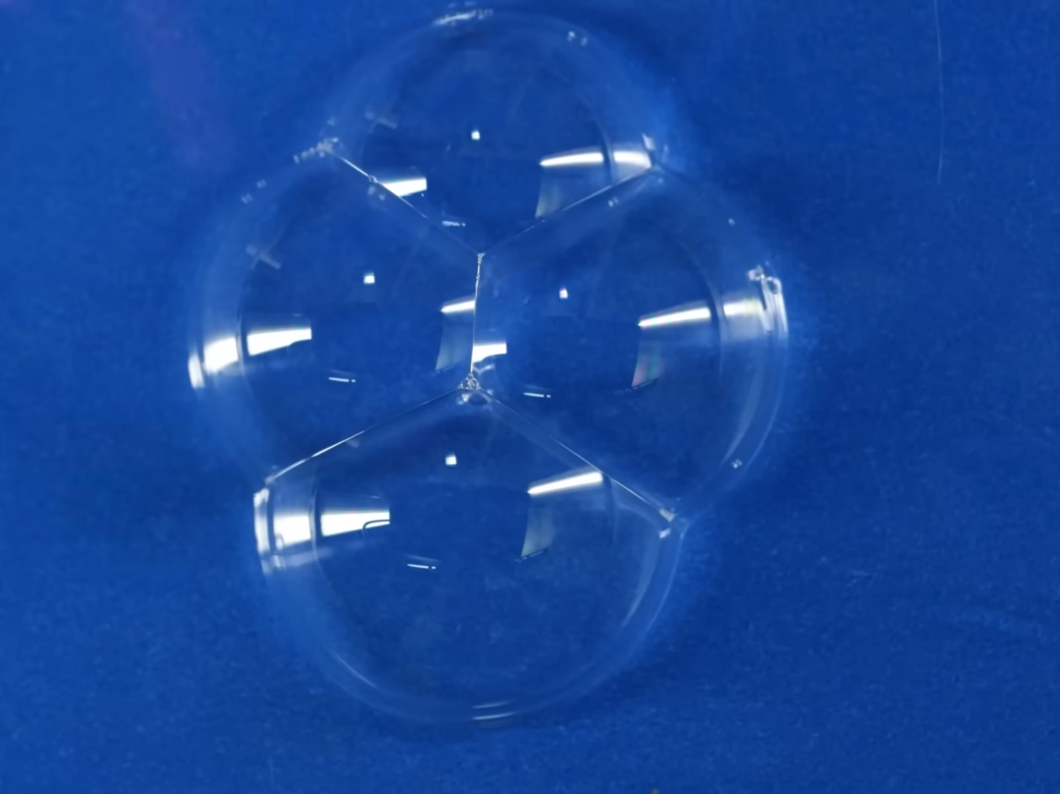
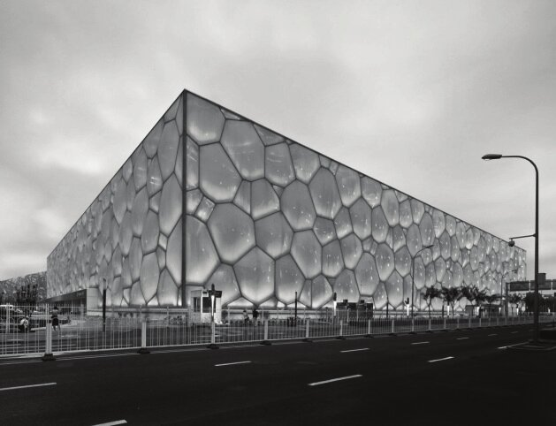
Stacking of Bubbles
Bubbles squeezing to find equilibrium
Physics phenomenon
Utilization of resources in 3-dimensional space
Maximum volume covered in minimal surface WHILE leaving no gaps
Translated into architecture
Inspiration for Water Cube, Beijing
https://youtu.be/Pypd_yKGYpA?si=J-e7QVRiLDzwKXYL
Water Cube, Beijing

Slide 5
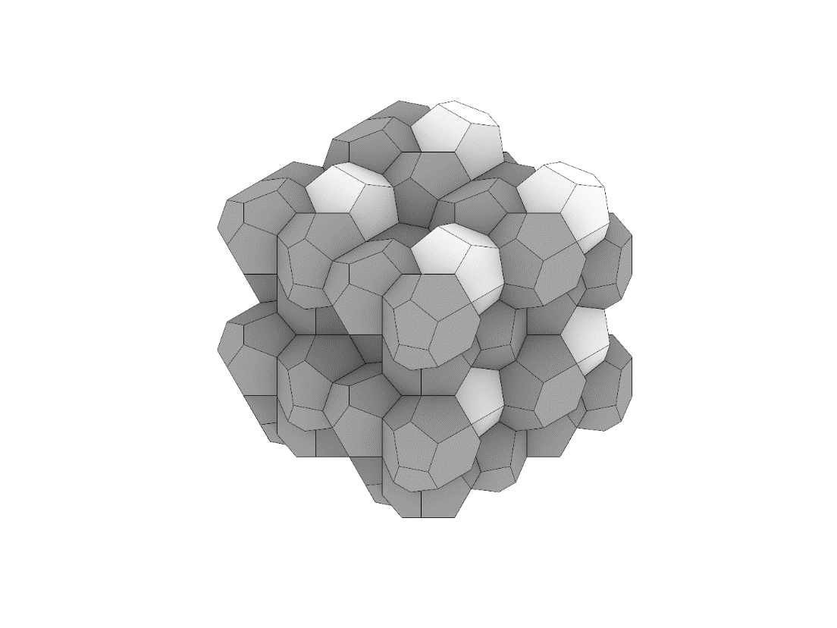
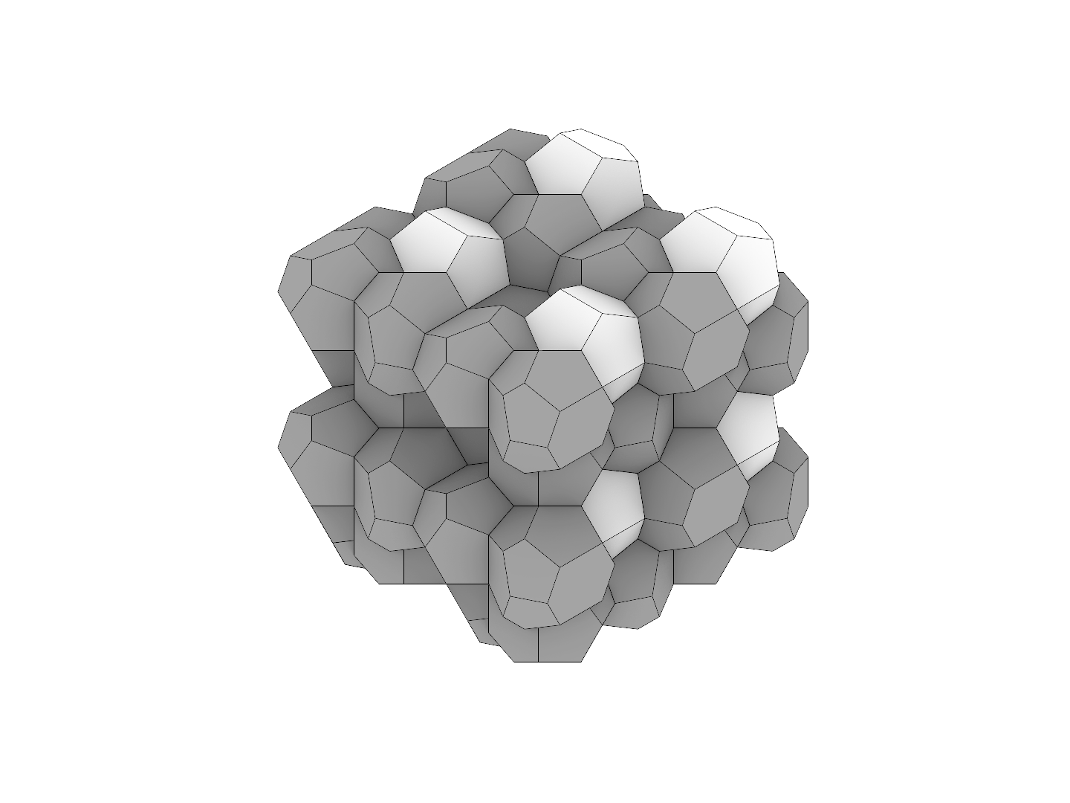
Utopian Future of Lunar Habitat
Weaire-Phelan structure
Mathematical model
Utilization of resources in 3-dimensional space
Maximum volume covered in minimal surface WHILE leaving no gaps
Weaire-Phelan structure, modelled by Walter Chung

Slide 6
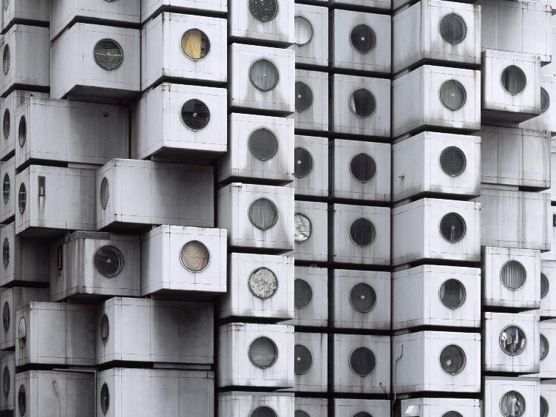
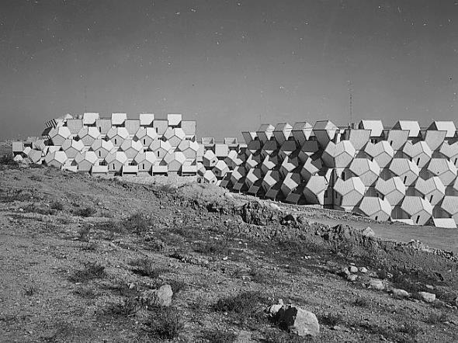
Modular Housing
High density housing habitats on the moon
Efficient space-packing
Ramot Polin Housing
Impractical on Earth
Unusable walls
Slanted windows
Opportunities on the moon
Nakagin Capsule Tower, Tokyo
Ramot Polin Housing, Israel

Slide 7
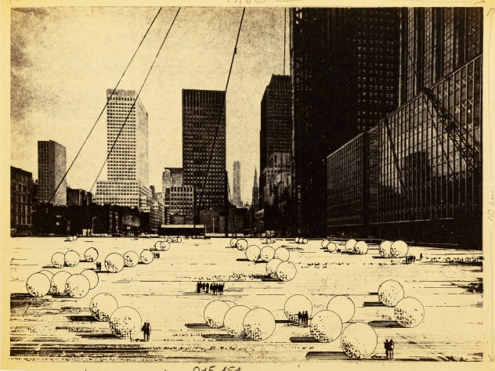
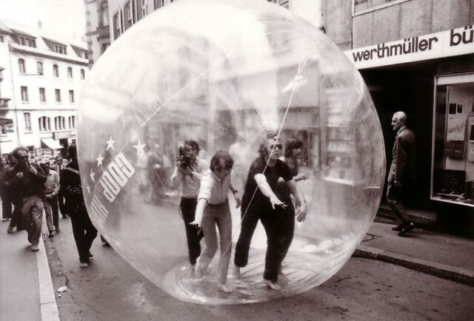
Nomadic Architecture
A provocation to challenge our degrees of liberty in the urban environment
Inhabiting the city means being at home everywhere
Man-egg-spheres, Ugo La Pietra
Restless Sphere, Coop Himmelb

Slide 8
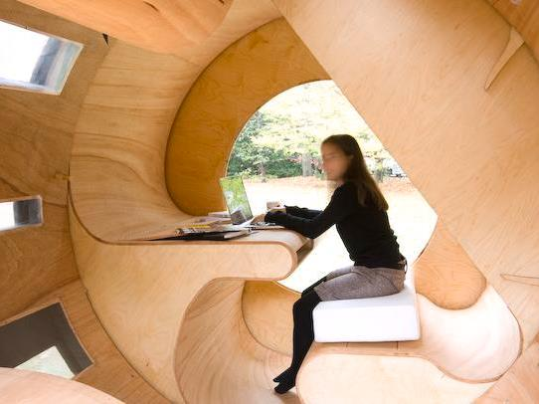
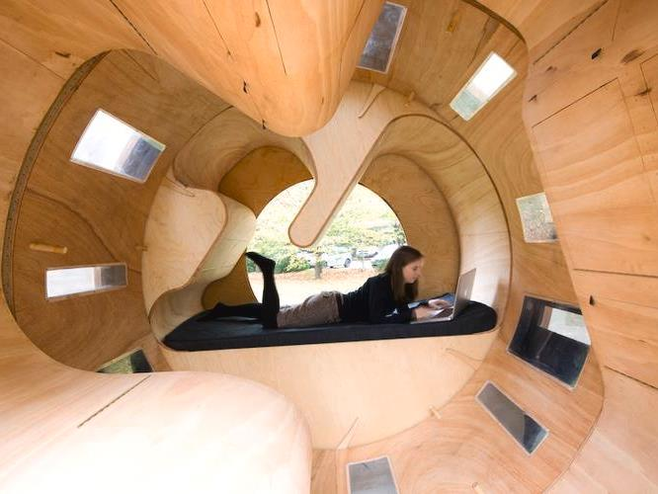
Rolling Architecture
Roll It experimental housing
Flexible space within a minimum housing unit
What if the housing module can roll
While the orientation of people inside can adapt freely
Roll It experimental housing, University of Karlsruhe
Ramot Polin Housing, Israel

Slide 9
[Human Activities in Micro-gravity]

Slide 10
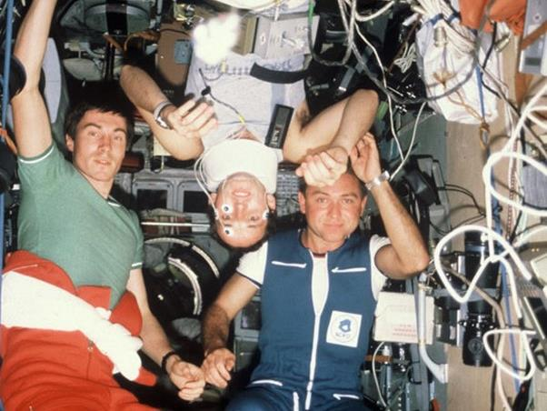
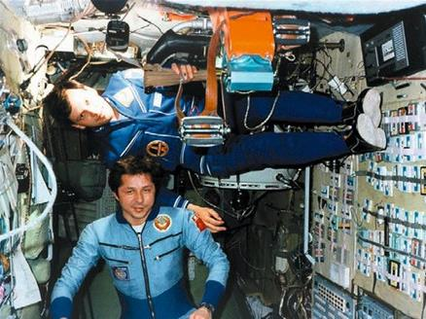
Orientation
Orientation in microgravity
Lost of the sense of up and down
“Enjoy being in in a module, that is really 3D, where there is no ceiling or floor.” Clervoy, (2009) comment on Mir space station
Stowage and object management
Insufficient stowage available
All modules of Mir were used to store equipment that was not used anymore and only a small corridor was left free
Finding and losing objects
They don’t fall down like they would on Earth
Lost of orientation in microgravity, Architecture for Astronauts

Slide 11
Assistance to moving
Floor covered with Velcro to aid moving around
Apollo, Salyut
Triangular grid on wall and ceilings/floors to ease moving around
Skylab
Multiple restraint straps
Apollo, Shuttle, Mir, ISS
Design leisure activities that integrate restraints
Velcro on shoes, NASA
Velcro on gloves, NASA

