Slide 1
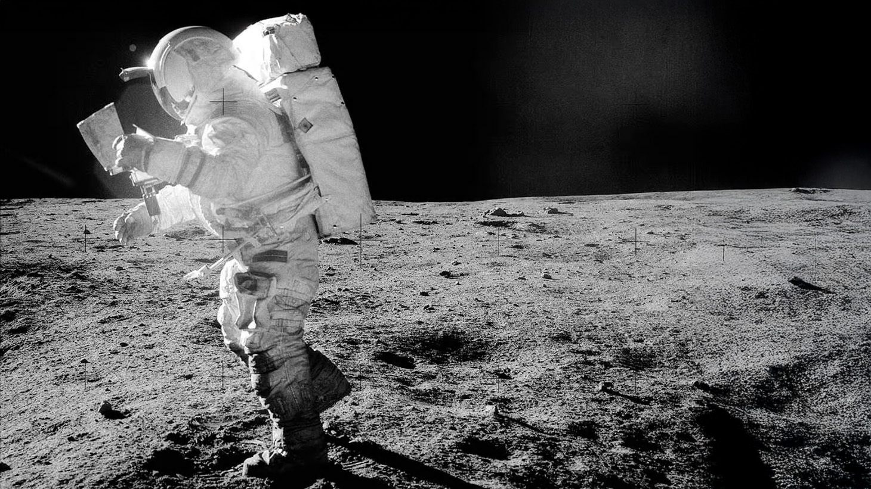
P5 Presentation
Terraforming Moon
Humanizing Lunar Living through Human-centric Design
Regina Tania Tan
Lunar Architecture and Infrastructure Graduation Studio 2024/25 | TU Delft Faculty of Architecture
Tutors: H. Bier, F. Adema, A. Hidding
Notes:
https://www.lpi.usra.edu/resources/lunarorbiter/frame/?5065
LUniversal
Terraforming Moon
Humanizing Lunar Living through Inclusive Habitat Design
Designing an Inclusive Lunar Habitat for Various Social Interaction
Humanizing Lunar Habitat through Human-centric Design

Slide 2
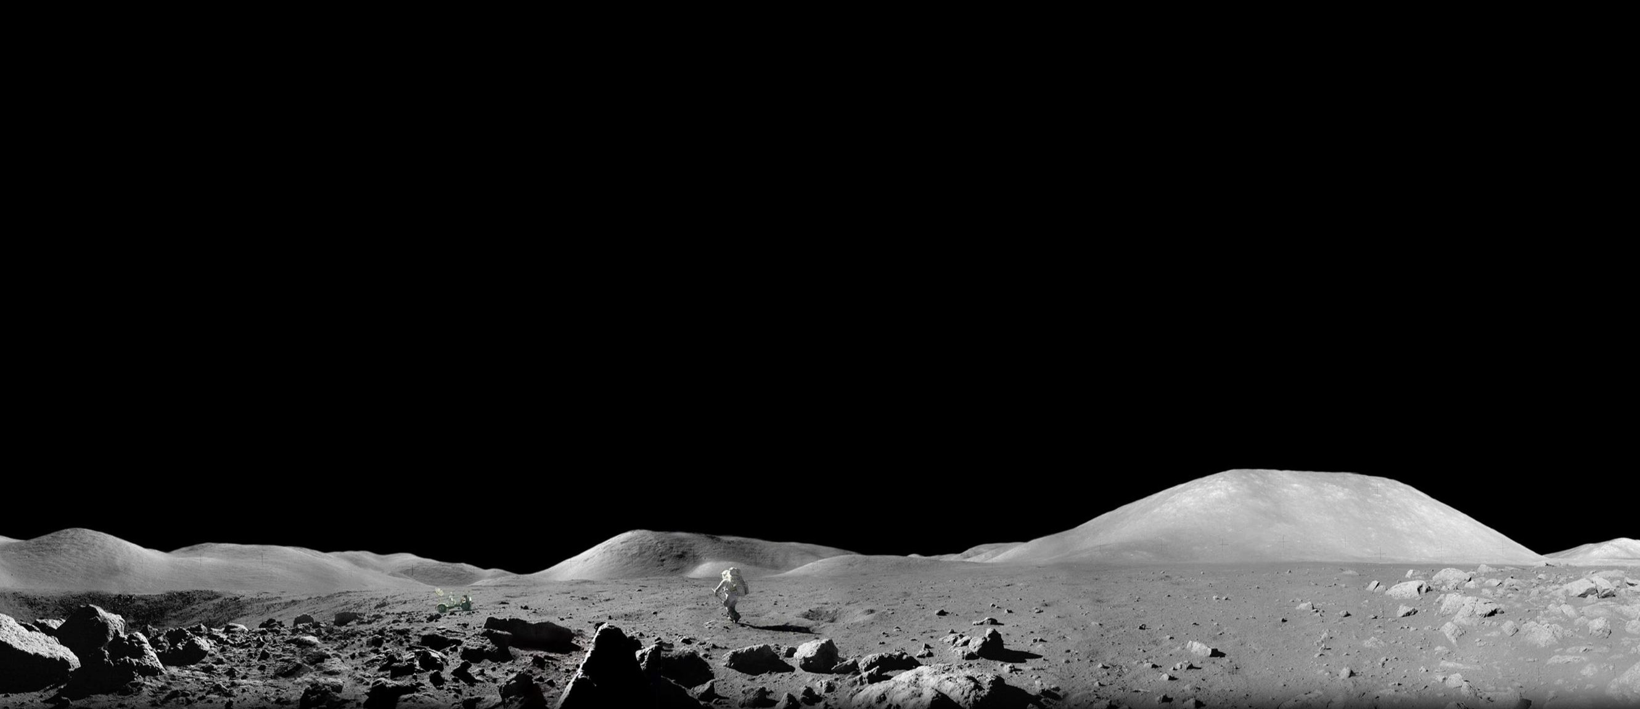
Background | Requirements
Settling in the unknown…
Astronaut Harrison Schmitt exploring lunar surface, Apollo 17 (1972), NASA.
Notes:
astronaut Harrison Schmitt exploring the lunar surface during the Apollo 17 mission in 1972
https://www.facebook.com/photo.php?fbid=1123171029169351&set=a.808655730620884&type=3

Slide 3
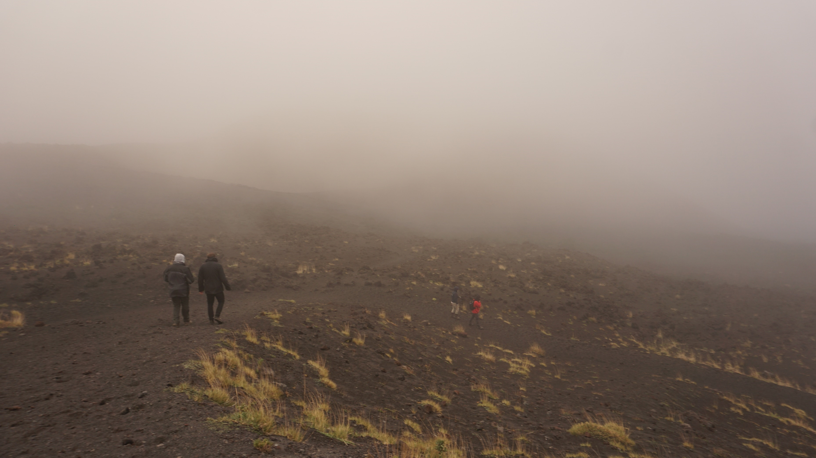
Background | Requirements
Settling in the unknown…
Mount Etna, Sicily, TU Delft Lava Tube Mission (2024)

Slide 4
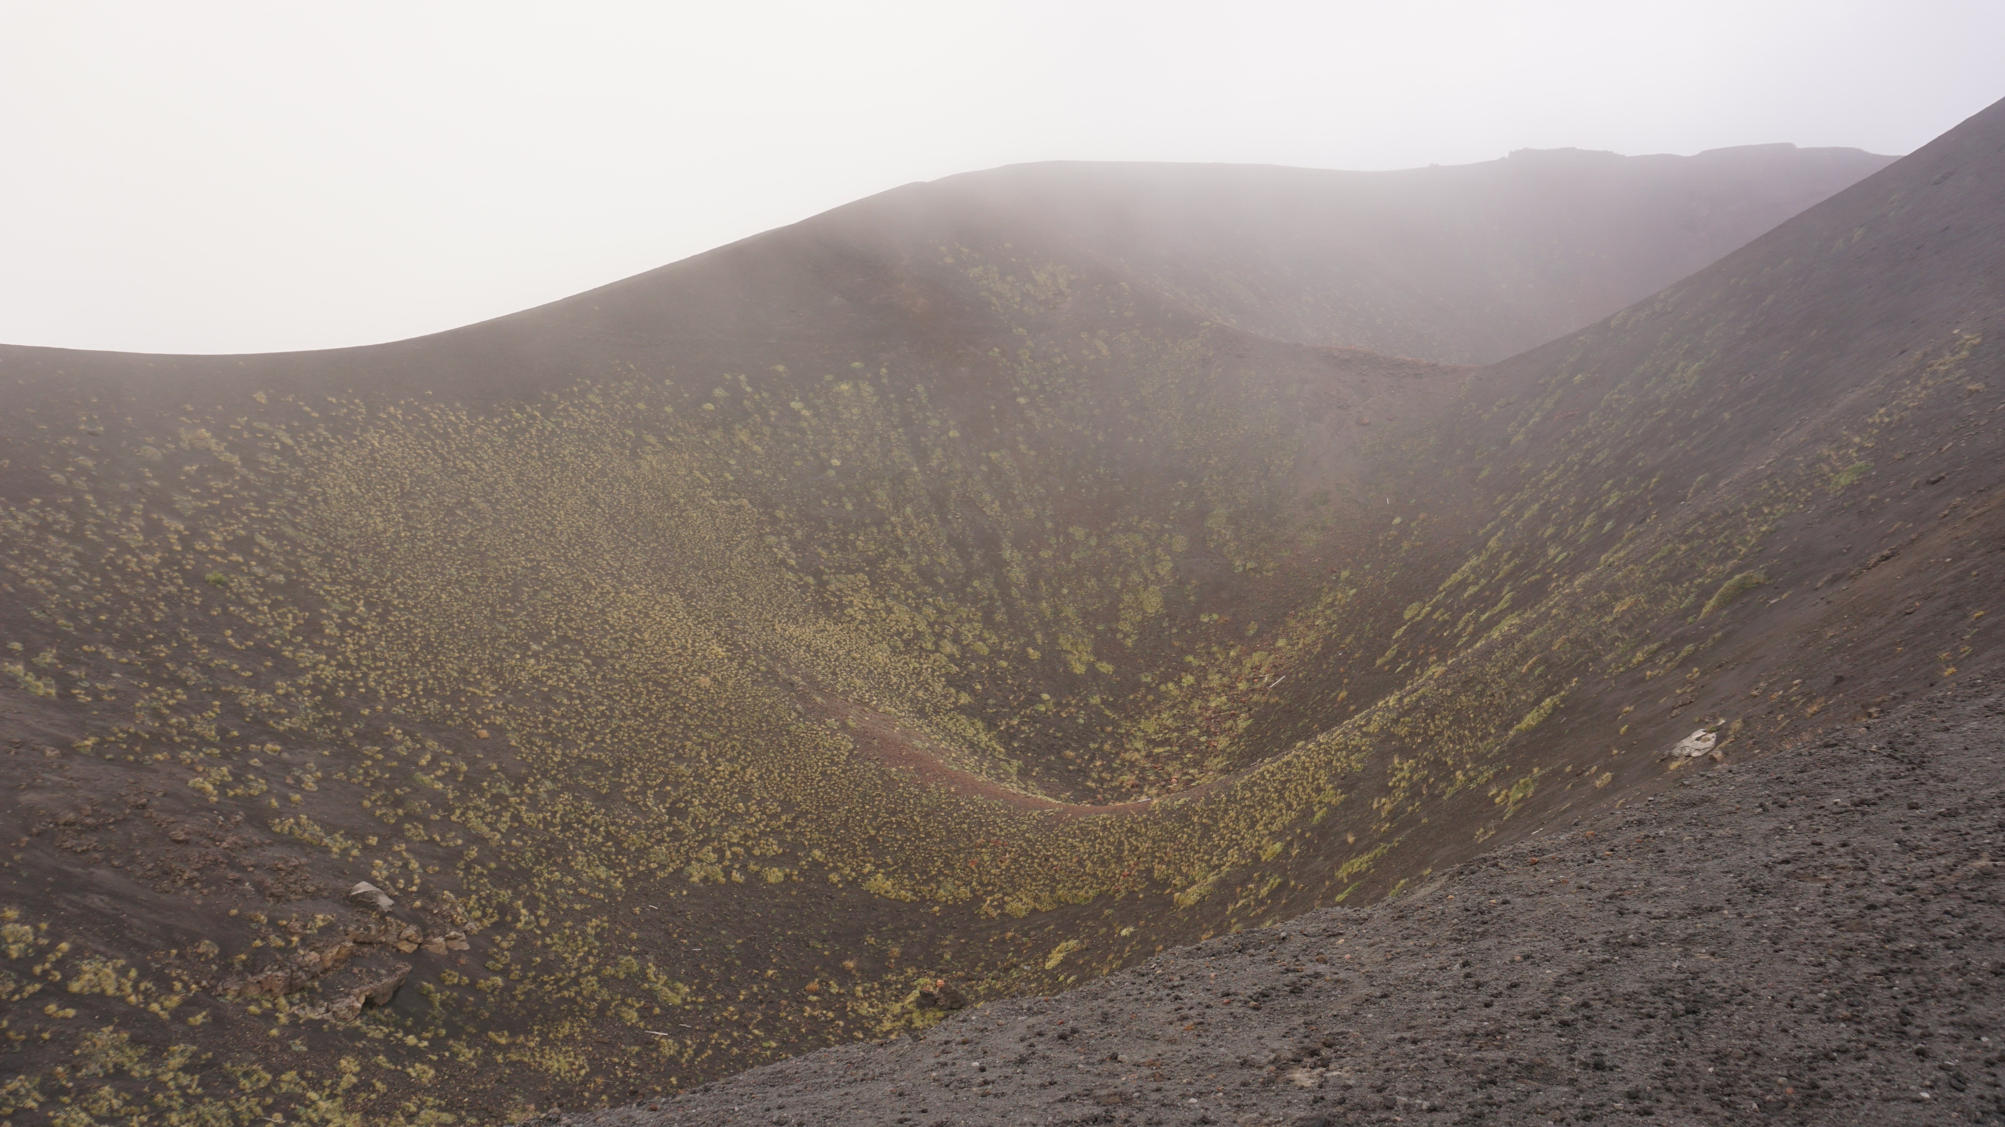
Background | Requirements
Settling in the unknown, on Earth
Expansive landscape…no human touch
Mount Etna, Sicily, TU Delft Lava Tube Mission (2024)
Notes:
Site – personal experience, analogue mission

Slide 5
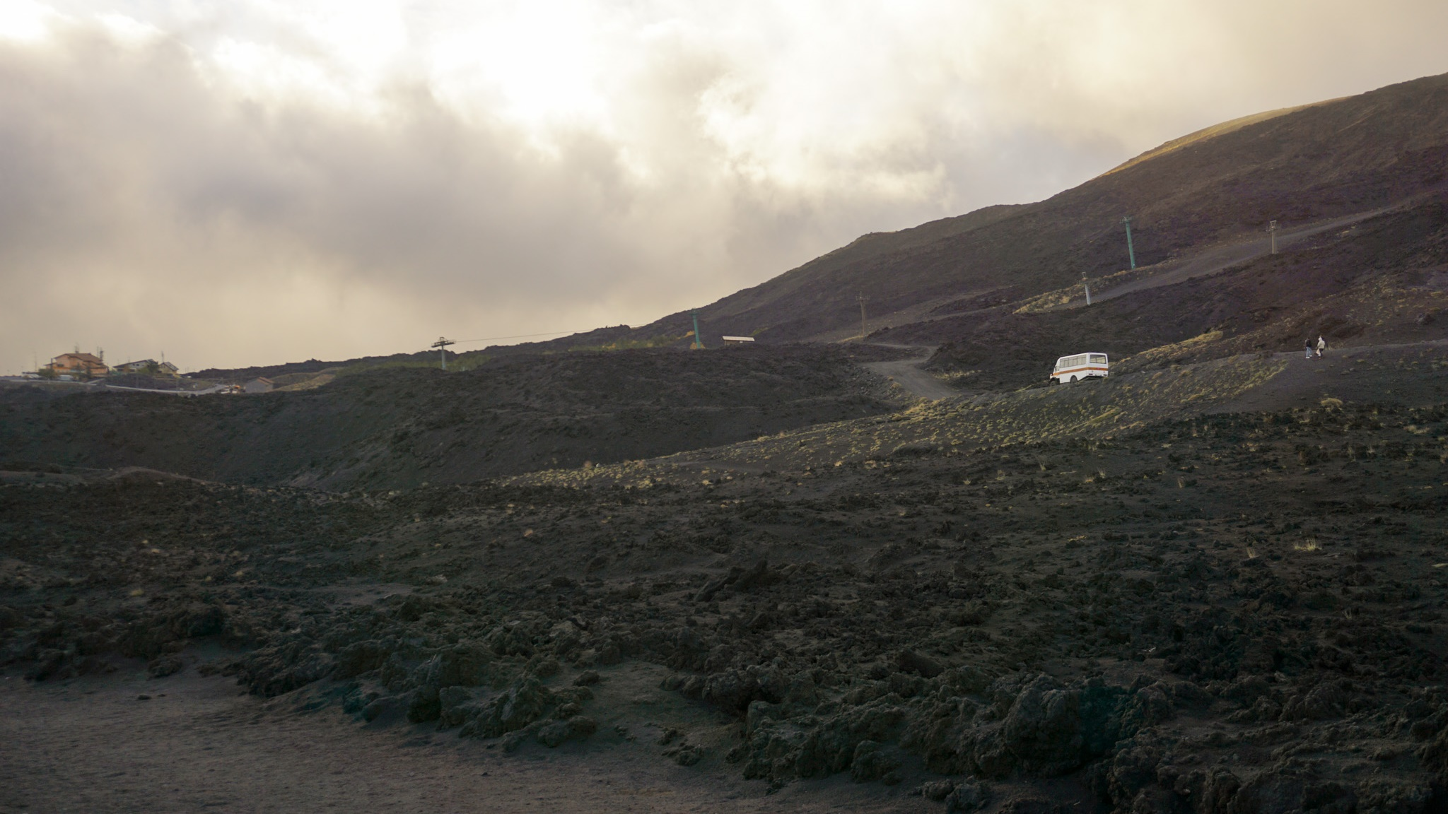
Background | Requirements
Need of something familiar…
human infrastructure as marker
Mount Etna, Sicily, TU Delft Lava Tube Mission (2024)
Notes:
Marker of scale, life,

Slide 6
Background | Requirements
Source: Architecture for Astronauts, last column added by author
Condition | Earth | Moon | Design Implications
Gravity | 1 g | 1/6 g | Consider low gravity effects
Atmosphere | 1 bar (O2, N2, CO2) | ~0 bar (almost vacuum) | Pressurized vessel
Length of day | 24 hours | 28 Earth days (14 days light / 14 days dark) | Site selection
Temperature | Mean 15°C Range: -89°C – 60°C | Mean -20°C Range: -233°C – 123°C | Thermal enclosure
Radiation | Protection by Earth’s atmosphere | Exposure to space radiation, secondary radiation from surface | Radiation enclosure
Water | 70.8% surface | In deep permanently shadowed craters & binded in regolith | Limited water
Dust | Generaly not harmful | Pervasive & potentially toxic, electromagnetic cling, lofts above surface | Physical enclosure
Others | - | Micrometeoroids, bright light & glare | Physical enclosure
Lunar environment:
physically hostile
Habitat = protection
Astronaut Harrison Schmitt exploring lunar surface, Apollo 17 (1972), NASA.
Notes:
What this means also is you would always stay inside the habitat
astronaut Harrison Schmitt exploring the lunar surface during the Apollo 17 mission in 1972
https://www.facebook.com/photo.php?fbid=1123171029169351&set=a.808655730620884&type=3

Slide 7
Background | Requirements
Lunar environment:
mentally hostile
“The most frightening aspect (of partaking the analogue testing) was not the lethal cold outside, but the isolation inside,”
Habitat = protection + habitability
Habitability: the suitability and value of a built habitat (lunar habitation) for its inhabitants (researchers) in a specific environment (lunar surface) and over a certain period of time (long-term >1 year)
Adapted from Sandra Hauplik-Meusburger, Architecture for Astronauts
Beth Healey, comment on her 14-month stay in Concordia Station analogue mission.
Astronaut Harrison Schmitt exploring lunar surface, Apollo 17 (1972), NASA.
Notes:
When we think about long-term, mental factors becomes important

Slide 8
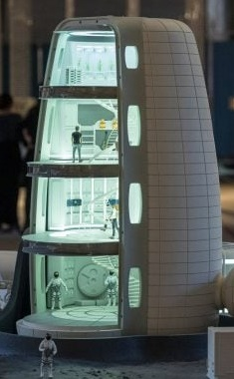
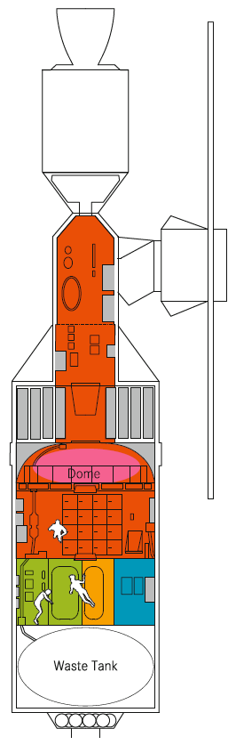
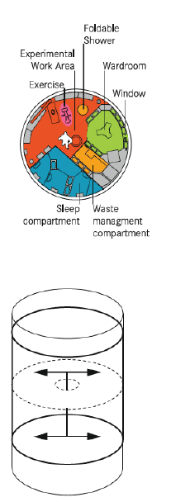
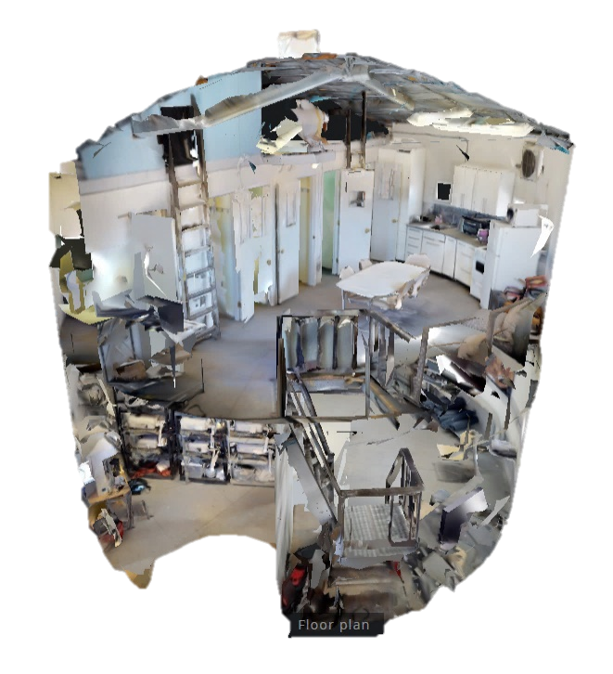
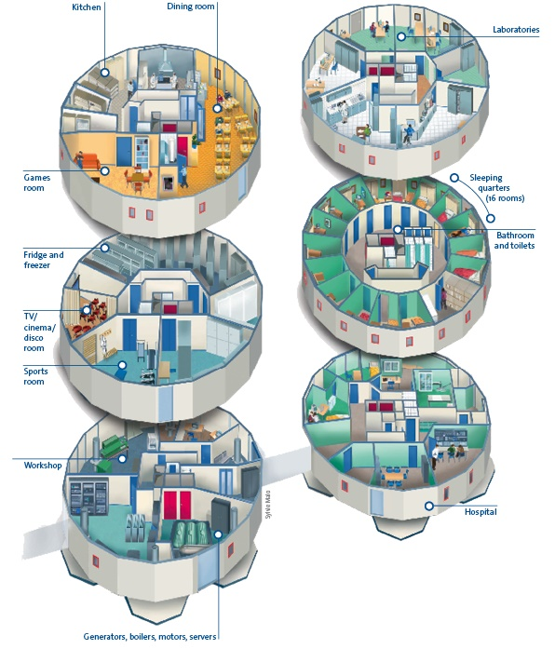
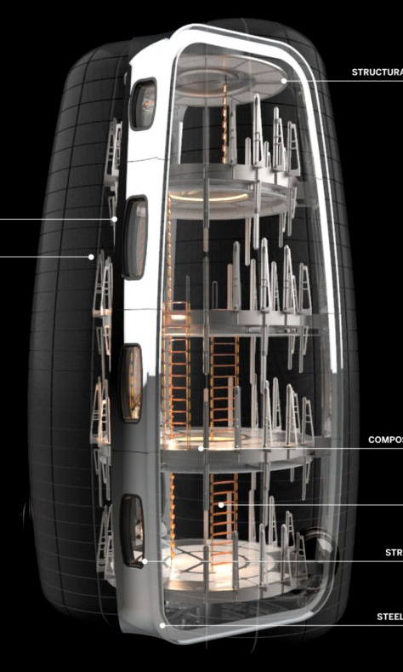
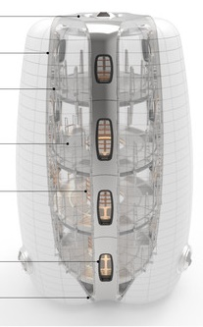
Engineered for non-human subjects, limited to feasibility
Background | Problem
Efficient form for transportability and environment protection (non-human actor)
Human de-centered design
Current schemes developed from functional aspect (not focusing on human behavior)
Spatial similarity of ISS TransHab and The Panopticon
Efficient form
Unit size
“We were stuffed in the capsule [Salyut] like sardines in a can.”
Jerry Linenger, 2000
[not to include– unit size]
US prison standard minimum 6.5 sqm
Europe prison standard minimum 6 sqm
UK cell sharing minimum 4.5 sqm/person
ISS sleeping quarter 2.5 sqm/person (2.5x1x1)
Recommended minimum NHV 25 sqm/person
Mars Desert Research Station, Utah, USA
Concordia Research Station, Antarctica
Skylab Space Station
Notes:
Current schemes developed from functional aspect (not focusing on human behavior)
However when we looked at current developments of space architecture, most schemes are developed from functional aspect, which de-center humans from the design
Engineered for non-human subjects, designed for efficiency / uniform spaces
While efficient, it creates monotonous spaces / lack of private space
Spatial arrangement /
Understandable for current timeline, but how about designing in the future where ISRU is already possible?
If only meet the demand for protection and efficiency, it decenters the human from the design
Not humane in long term
Panopticon = allocate same size of cells & rooms 19m2
This creates functional lunar habitait
Understandable when going to hostile environment
The Panopticon (Jeremy Bentham)
Space habitat built precedents are space stations, geared towards functionality for short-term living, which should not be the baseline for long term lunar surface habitats.
ISS TransHab: form given through structural properties of inflatable and centralized functional distribution for efficiency
The Panopticon: highly centralized, enabling surveillance of every inmate’s cell from a vantage point [form follows function]

Slide 9
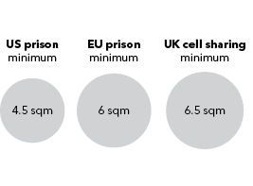

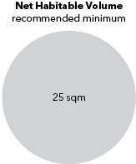
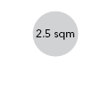
Background | Problem
Human de-centered design
Limited private area
[not to include– unit size]
US prison standard minimum 6.5 sqm
Europe prison standard minimum 6 sqm
UK cell sharing minimum 4.5 sqm/person
ISS sleeping quarter 2.5 sqm/person (2.5x1x1)
Recommended minimum NHV 25 sqm/person
“We were stuffed in the capsule [Salyut] like sardines in a can.”
Jerry Linenger, 2000
2.5 m³
25 m³
NHV for long-term mission
130 m3
NHV private-only areas?
Notes:
A very real example of human de-centered design is the very small private area allocation.
In the International Space Station, the sleeping quarter is even smaller than the minimum size of a prison cell.

Slide 10
No mutual consent on specific number for habitation size
Marc M. Cohen, book, p.28
Research Argument
How have existing developments meet the demands for long-term lunar settlement?
Short-term missions
Long-term habitation
Designing with human instinct in mind
Functional design
Human-centric design
“surviving”
“living”
Kyknya flow agak kepecah disini. Coba bbrp example aja
Mitigation AND enhancement
Technical requirements is not enough. Habitats need to consider psychological requirements.
Notes:
Function is undoubtedly important, but looking towards long-term, we have to move to human-centric design

Slide 11
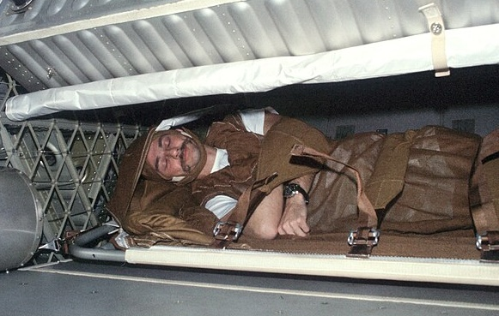
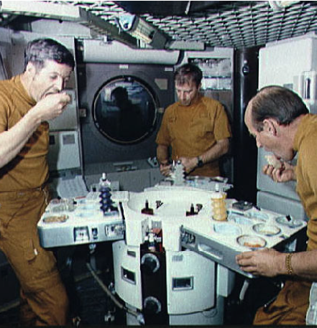
No mutual consent on specific number for habitation size
Marc M. Cohen, book, p.28
Research Argument
Human-centric design
in an Isolated, Confined, and Extreme (ICE) habitat
How have existing developments meet the demands for long-term lunar settlement?
Personalization
“(On sleeping) It’s got to be a place that can be modified in the way any individual desires.”
Gerald Carr, Skylab 4, NASA. 1974
Designing with human instinct in mind
Variety Social Interaction
Kyknya flow agak kepecah disini. Coba bbrp example aja
“…availability of an open, communal area is very important for crew morale and productivity during long duration isolation and confinement in space.”
Excerpts from NASA Human Integration Design Handbook, on Skylab and Shuttle-Mir experience.
Owen Garriott, Skylab 3
Dedicated dining table, Skylab Station.
Mitigation AND enhancement
Technical requirements is not enough. Habitats need to consider psychological requirements.
Notes:
Crucial to human-centric design is personalization, catering to each individuals’ needs, and providing variety of social interaction which has positive impact on crew morale and productivity
Success in design for human behavior in ICE environment
When we look into astronaut excerpts, human aspects notably personalization and variety of social interaction is important and even boost the crew productivity
https://commons.wikimedia.org/wiki/File:Owen_Garriott_sleeping_during_SKylab_3.jpg

Slide 12
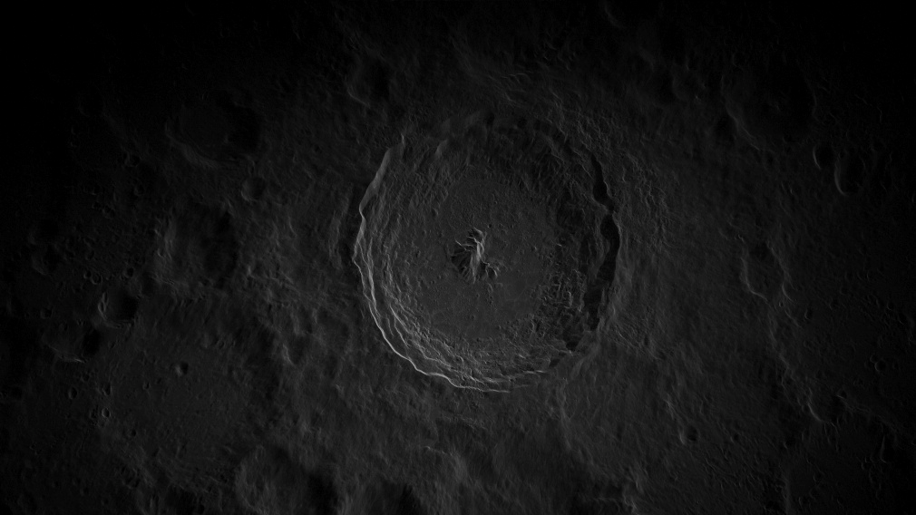
Research Argument
Problem Statement
Lack of space architecture precedents that prioritizes human behaviour in the design.
The social and psychological effects of long-term isolated nature of lunar habitation requires more human-centric design approaches.
Research Question
How to incorporate user-defined spaces based on human-centric design principles in designing long-term lunar habitation that balances social interaction and private boundaries, for the psychosocial well-being of the inhabitants?
Design Direction
A lunar habitat with heterogeneous spatial configurations to facilitate graduated access, ranging from communal engagement to secluded privacy.
Notes:
How to incorporate personal preferences in designing for long-term lunar habitation?
How can human experiences be incorporated in designing for a long-term lunar habitation for a more humanized lunar habitation?
How to incorporate human-centric design principles in the transitional spaces of long-term lunar habitation to create a more humanized space architecture?
Lack of space architecture precedents that prioritizes human behaviour in the design. Transitional spaces which has potential to enhance the spatial and social experience of lunar habitation are typically generalized to corridors.
Lack of space architecture precedents that prioritizes human behaviour in the design. Long-term habitation requires functionality, efficient use of resource, and habitability. This research will focus on habitability,
Spaces which has potential to enhance the spatial and social experience of lunar habitation are typically reduced to functionality

Slide 13
Research Argument
Limitations & Assumptions
Timeline
Earth-based technologies
HIGH-TECH
Swarm robots
2070
Nuclear facility
Water and regolith processing facility
2060
Terraforming Moon
Regolith accretion
2080
First families settle
2099
First lunar human birth
3D printing
2033
Permanent lunar base
PIONEER
Moon civilization
SETTLERS
2027
Artemis III Lunar Landing
Full In-situ Resource Utilization
Civilization size
PRIMITIVE
Notes:
Due to the high-level assumptions regarding feasibility (such as provision of metal extraction facilities – gausah disebut, ini di paper aja), the project will take place on the later stage of space habilitation

