Slide 1
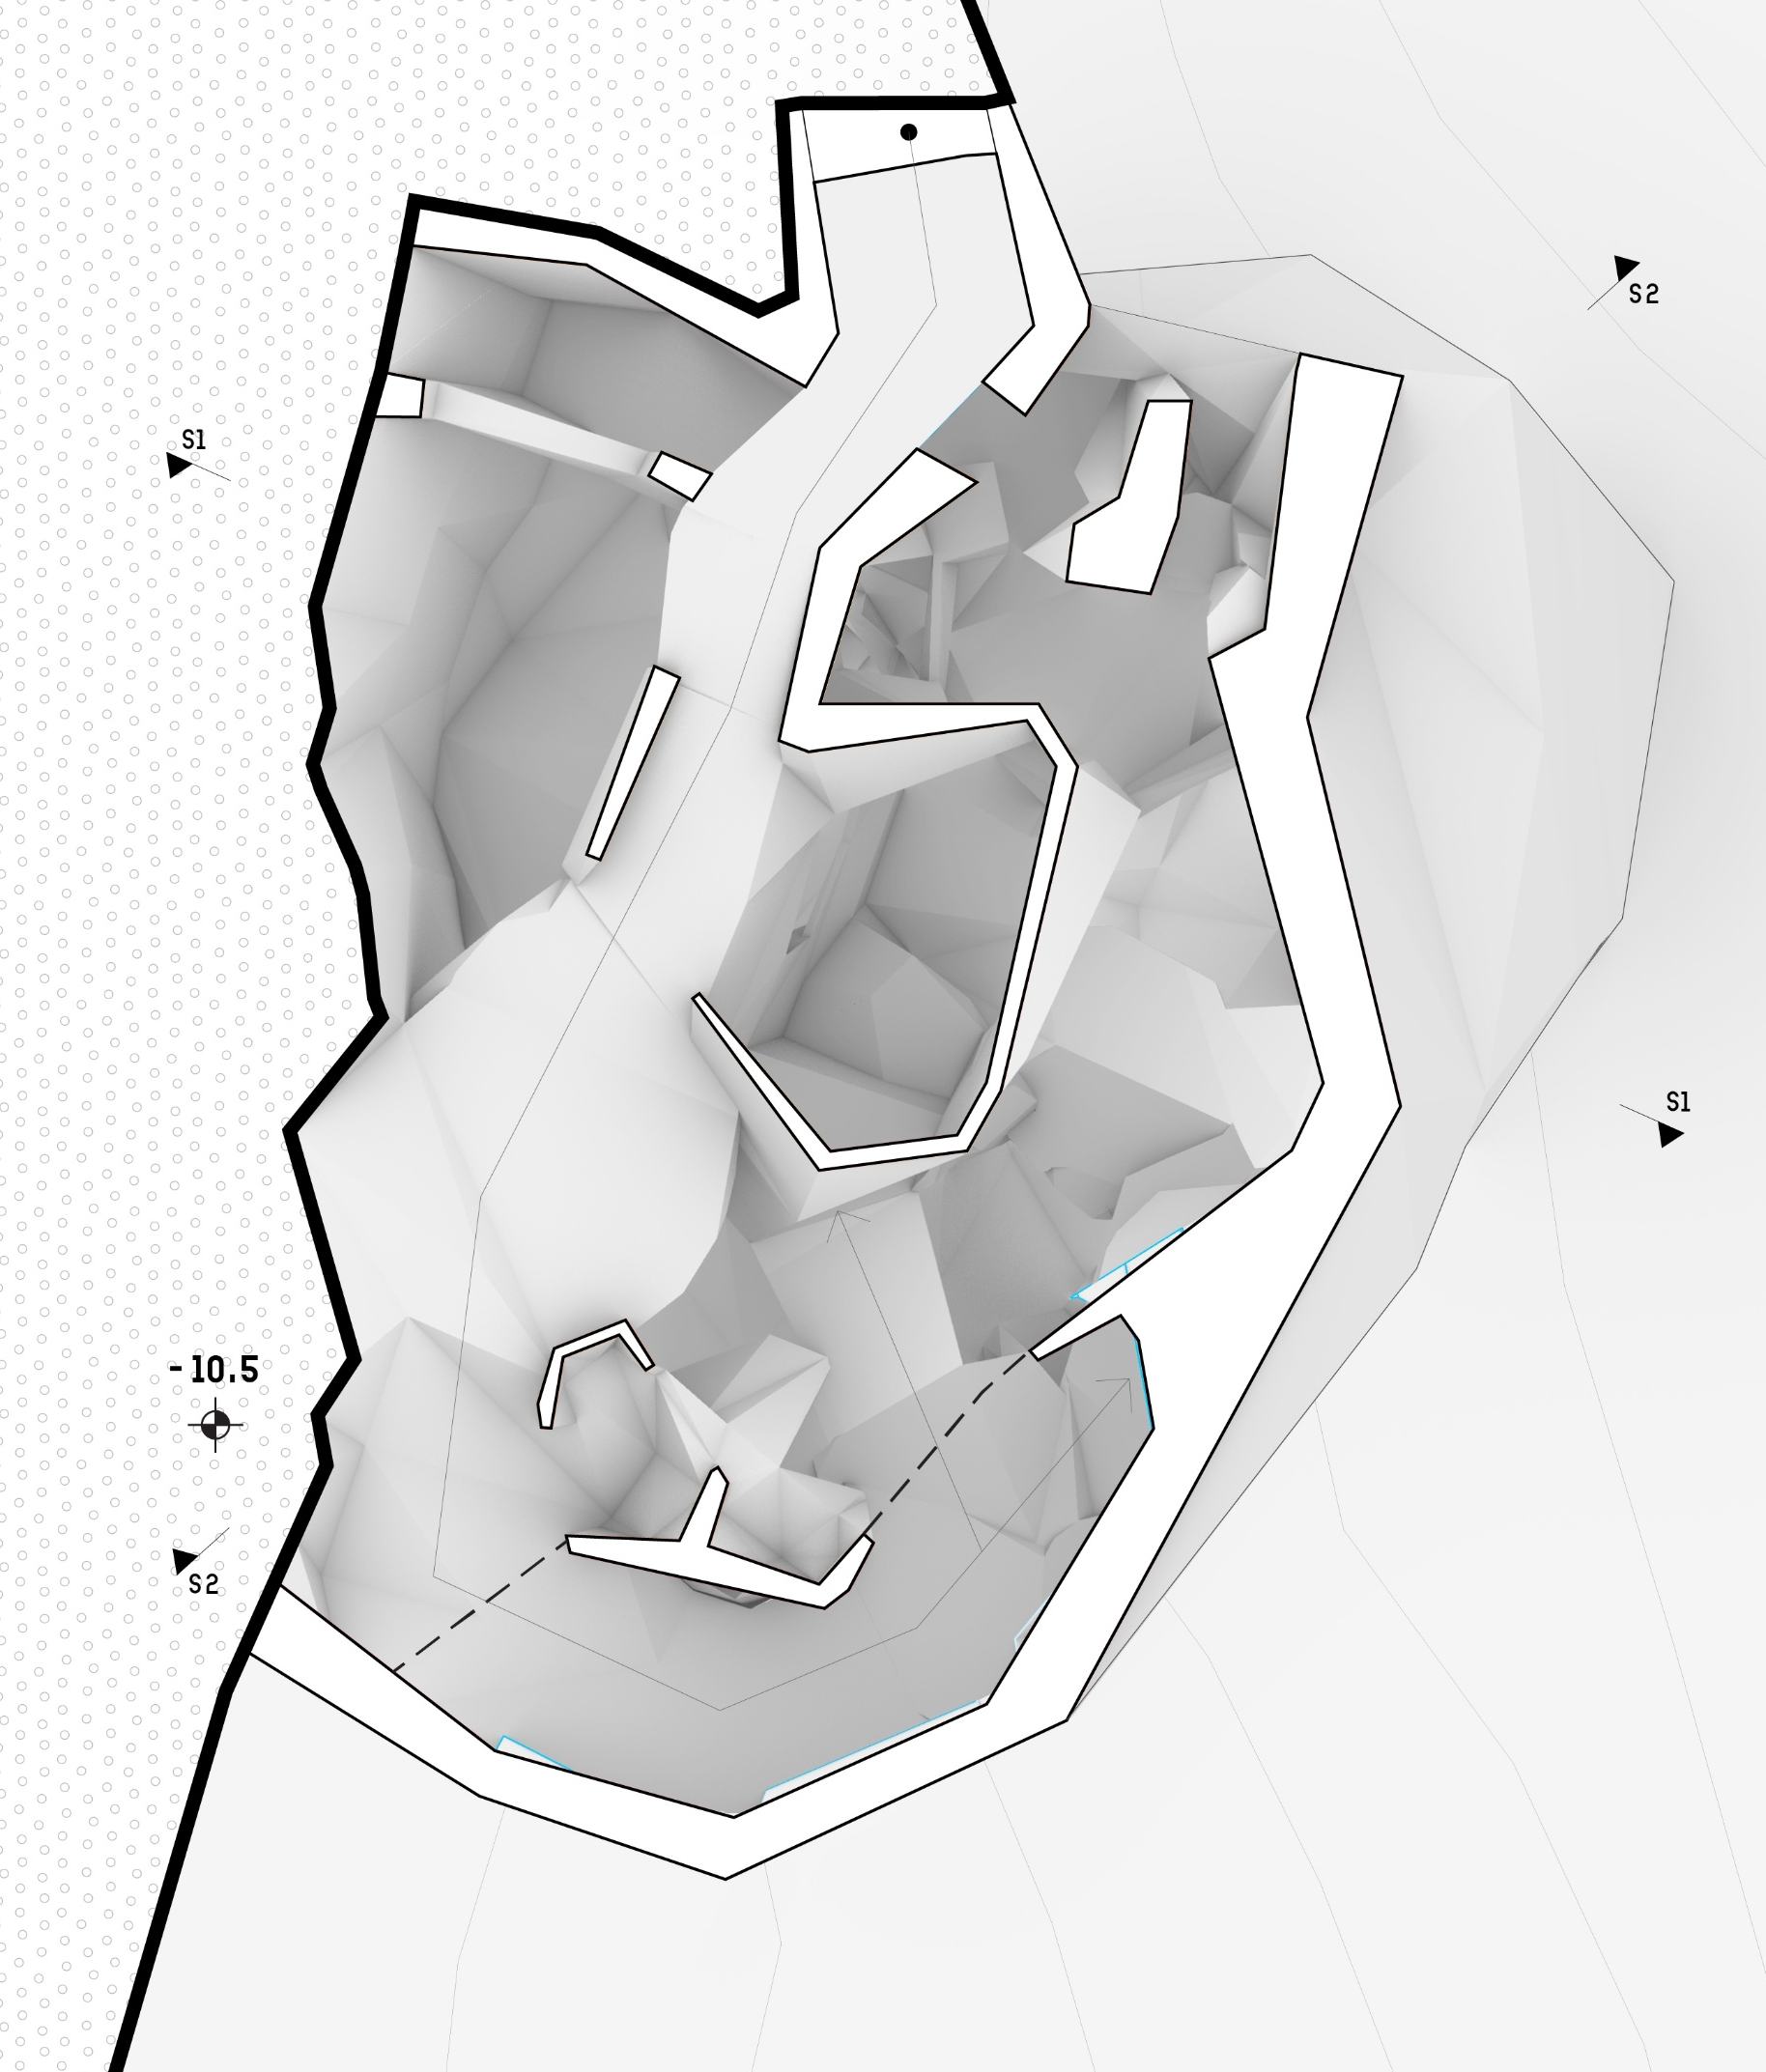
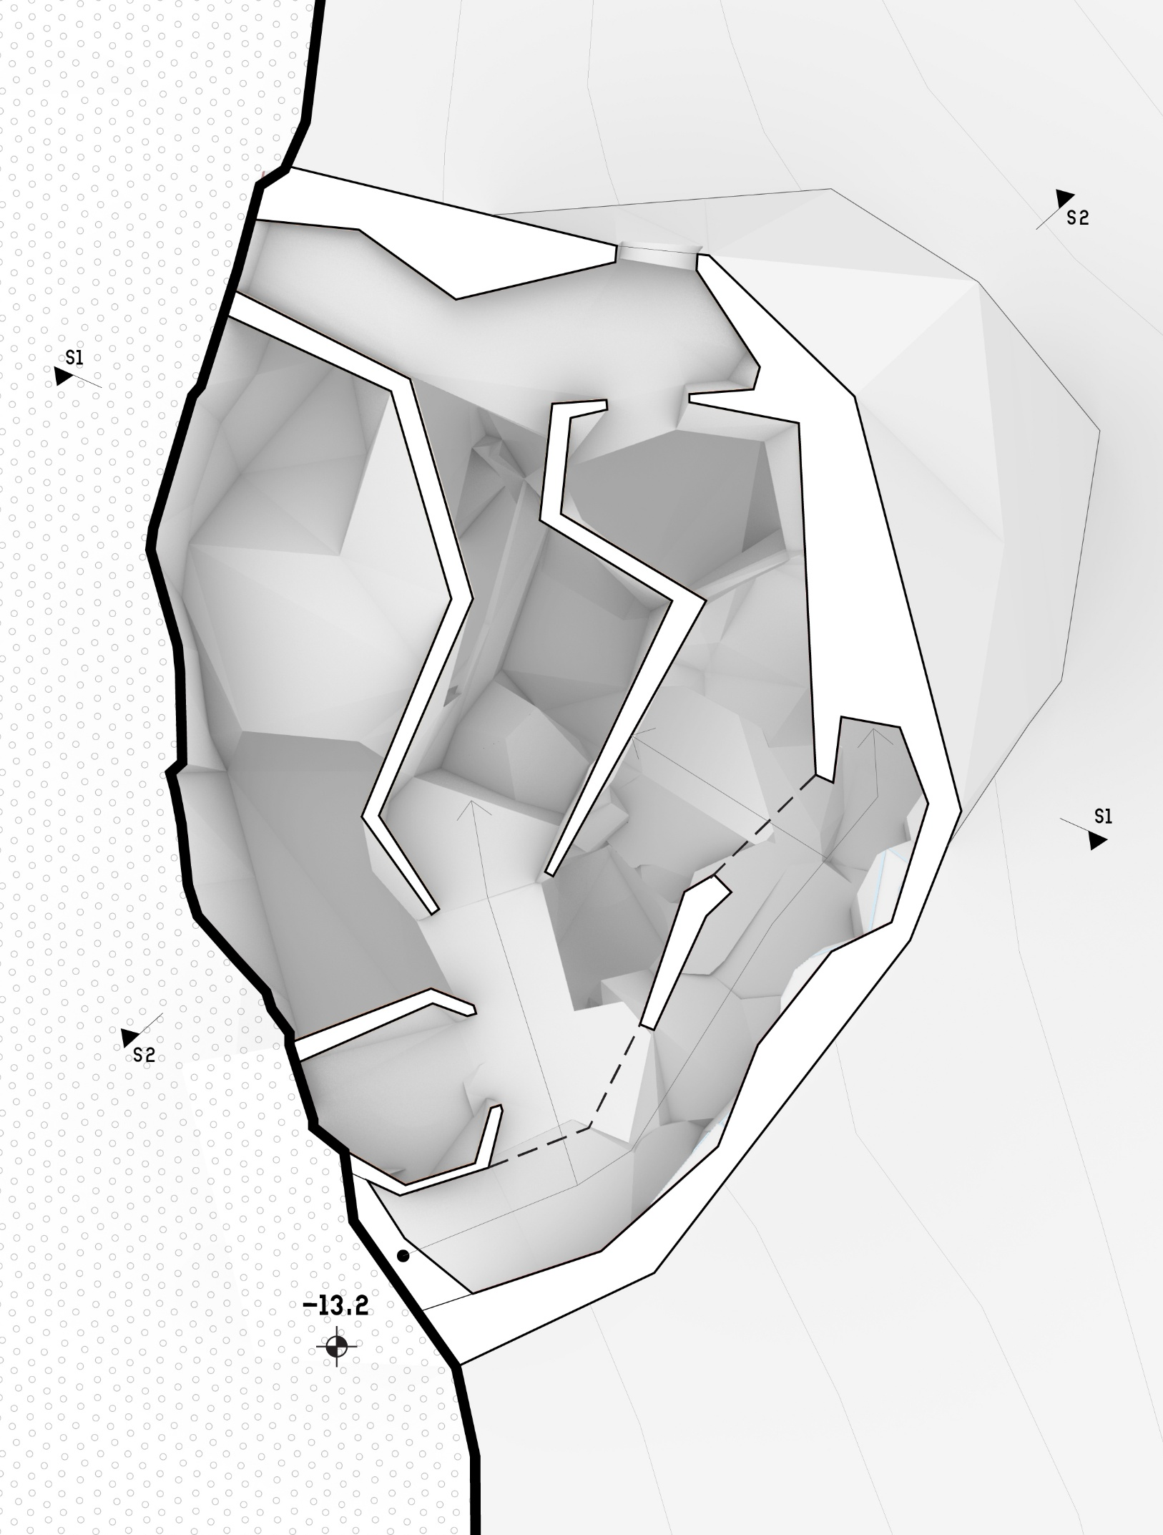
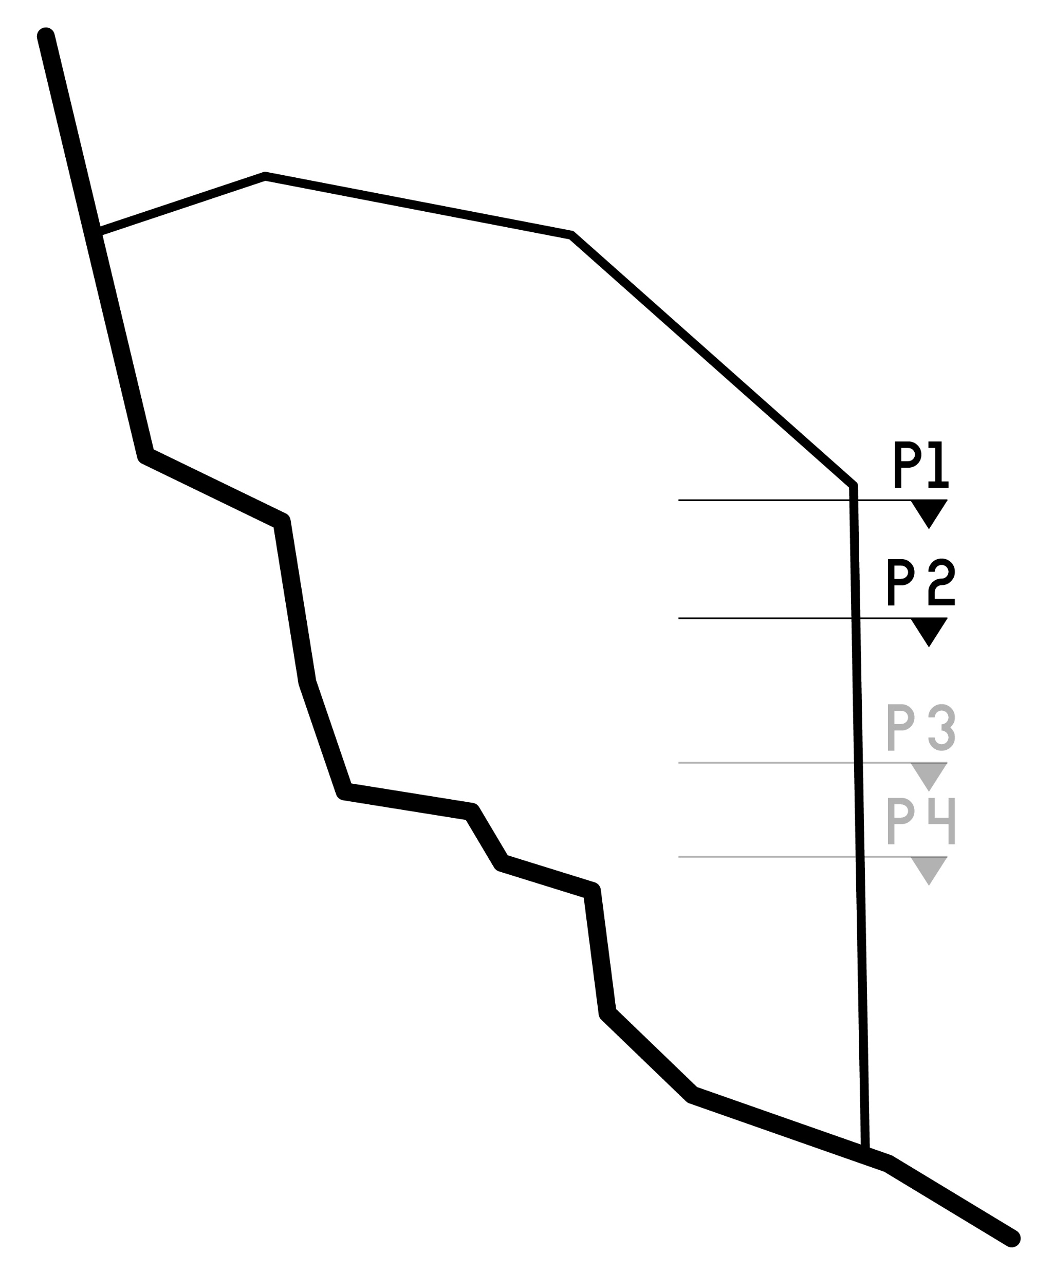
Design
plans
(zoom in to 1:100)
Architectural Elements –
Views, Body engagement
1
1
1
2
1
Work zone
2
Eat zone
3
3
Internal Rampway
3
5m
Plan 1 (- 10.5m)
Plan 2 (- 13.2m)

Slide 2
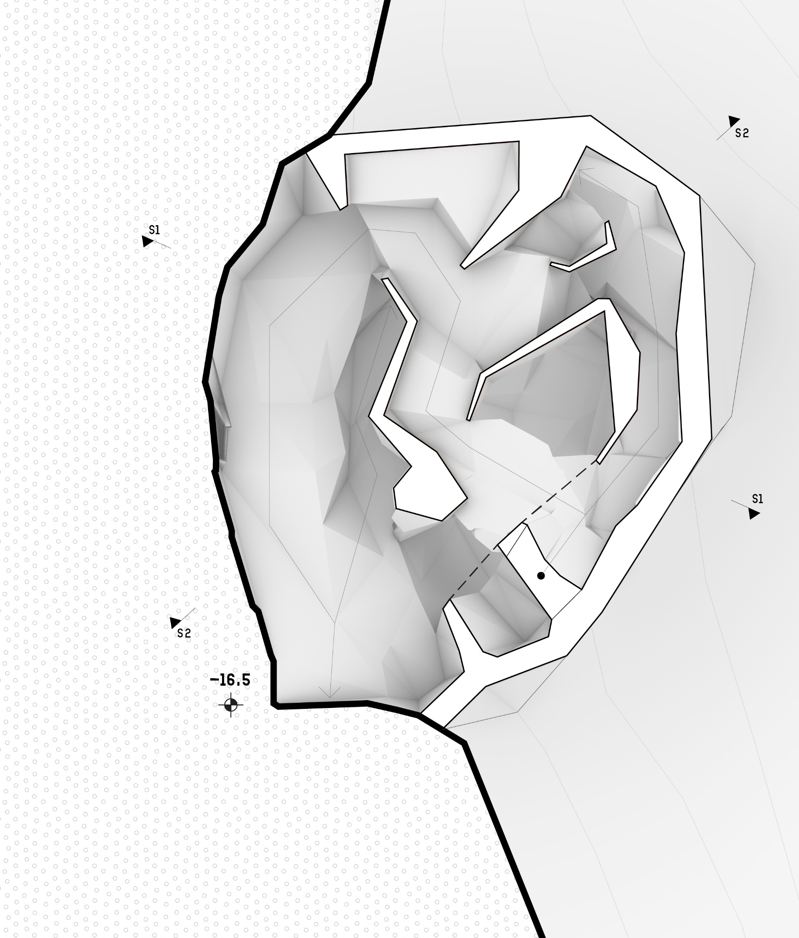
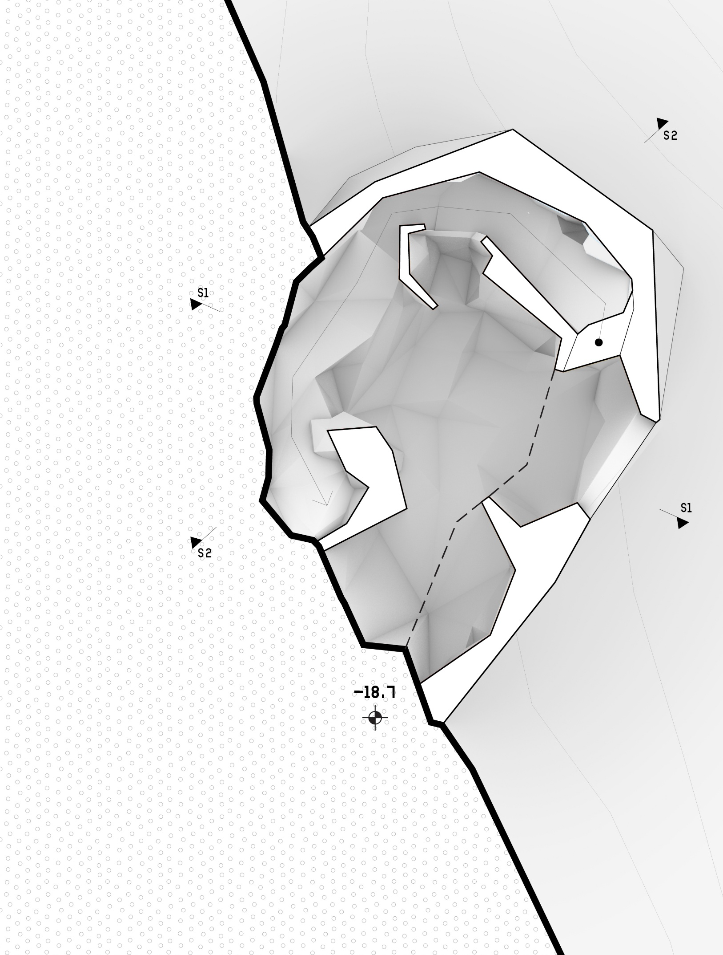
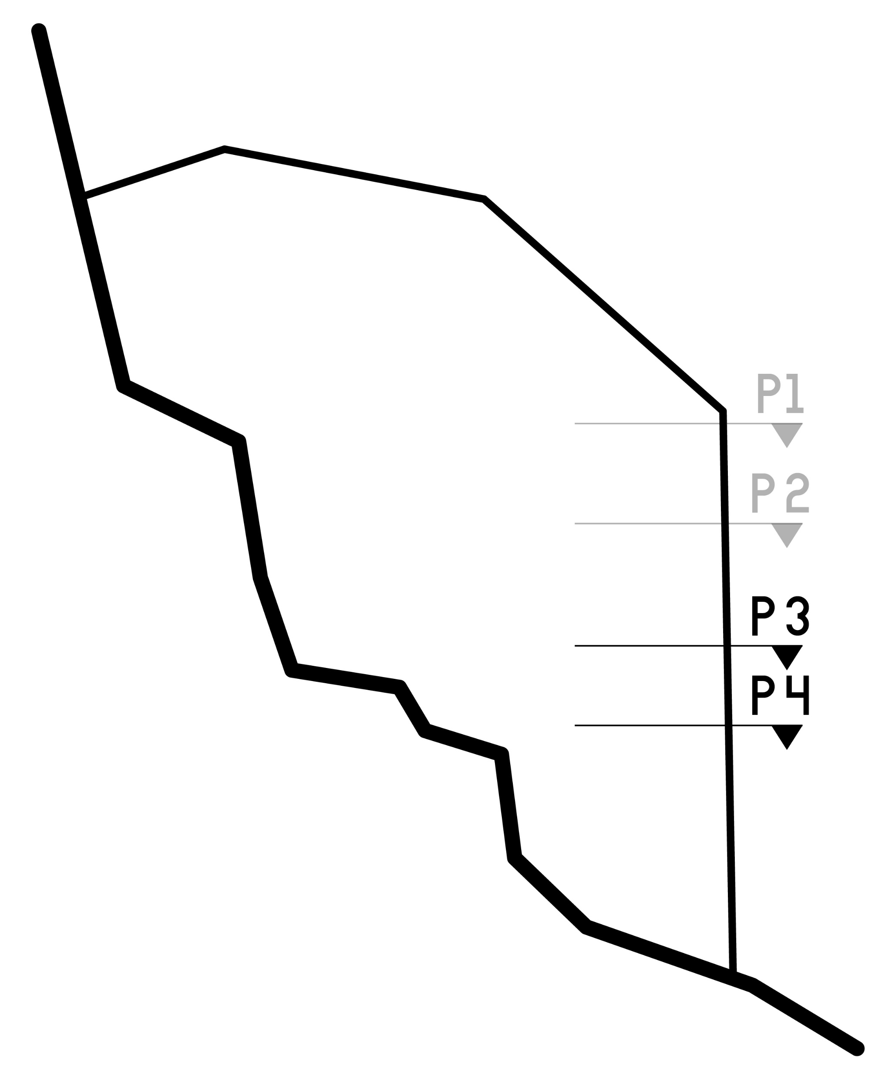
Design
plans
Architectural Elements –
Views, Body engagement
3
1
3
1
2
1
Eat zone
2
Socialise zone
3
Internal Rampway
5m
Plan 3 (- 16.5m)
Plan 4 (- 18.7m)

Slide 3
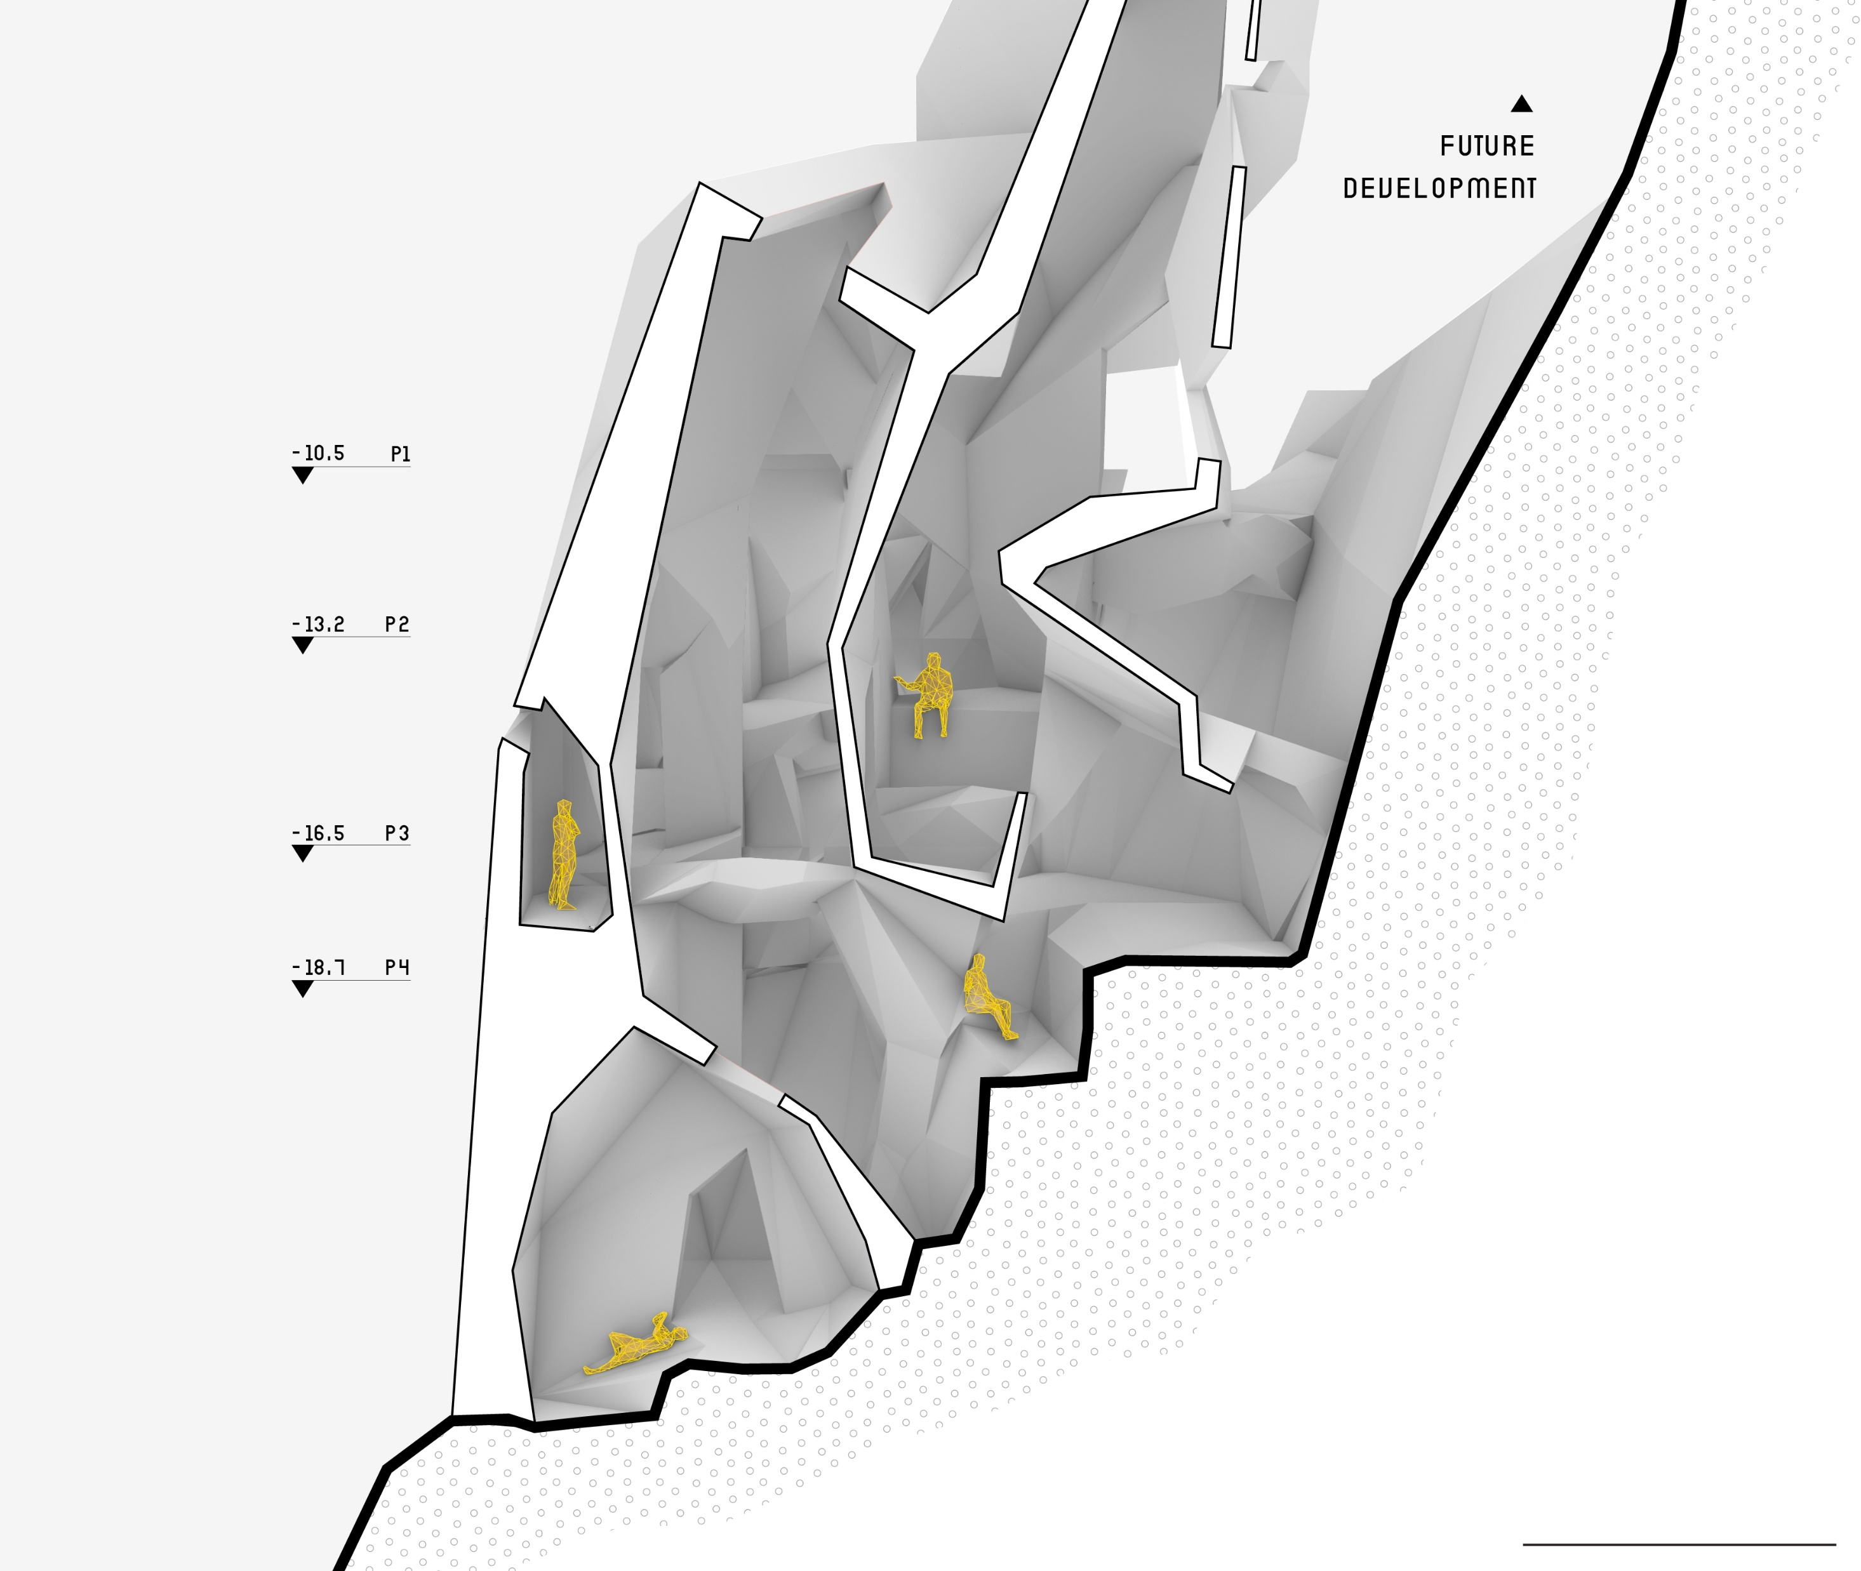
Design
sections
Architectural Elements –
Views, Body engagement
1
2
4
3
1
Work zone
2
Eat zone
3
Socialise zone
Section 1
4
Internal Rampway
5m

Slide 4
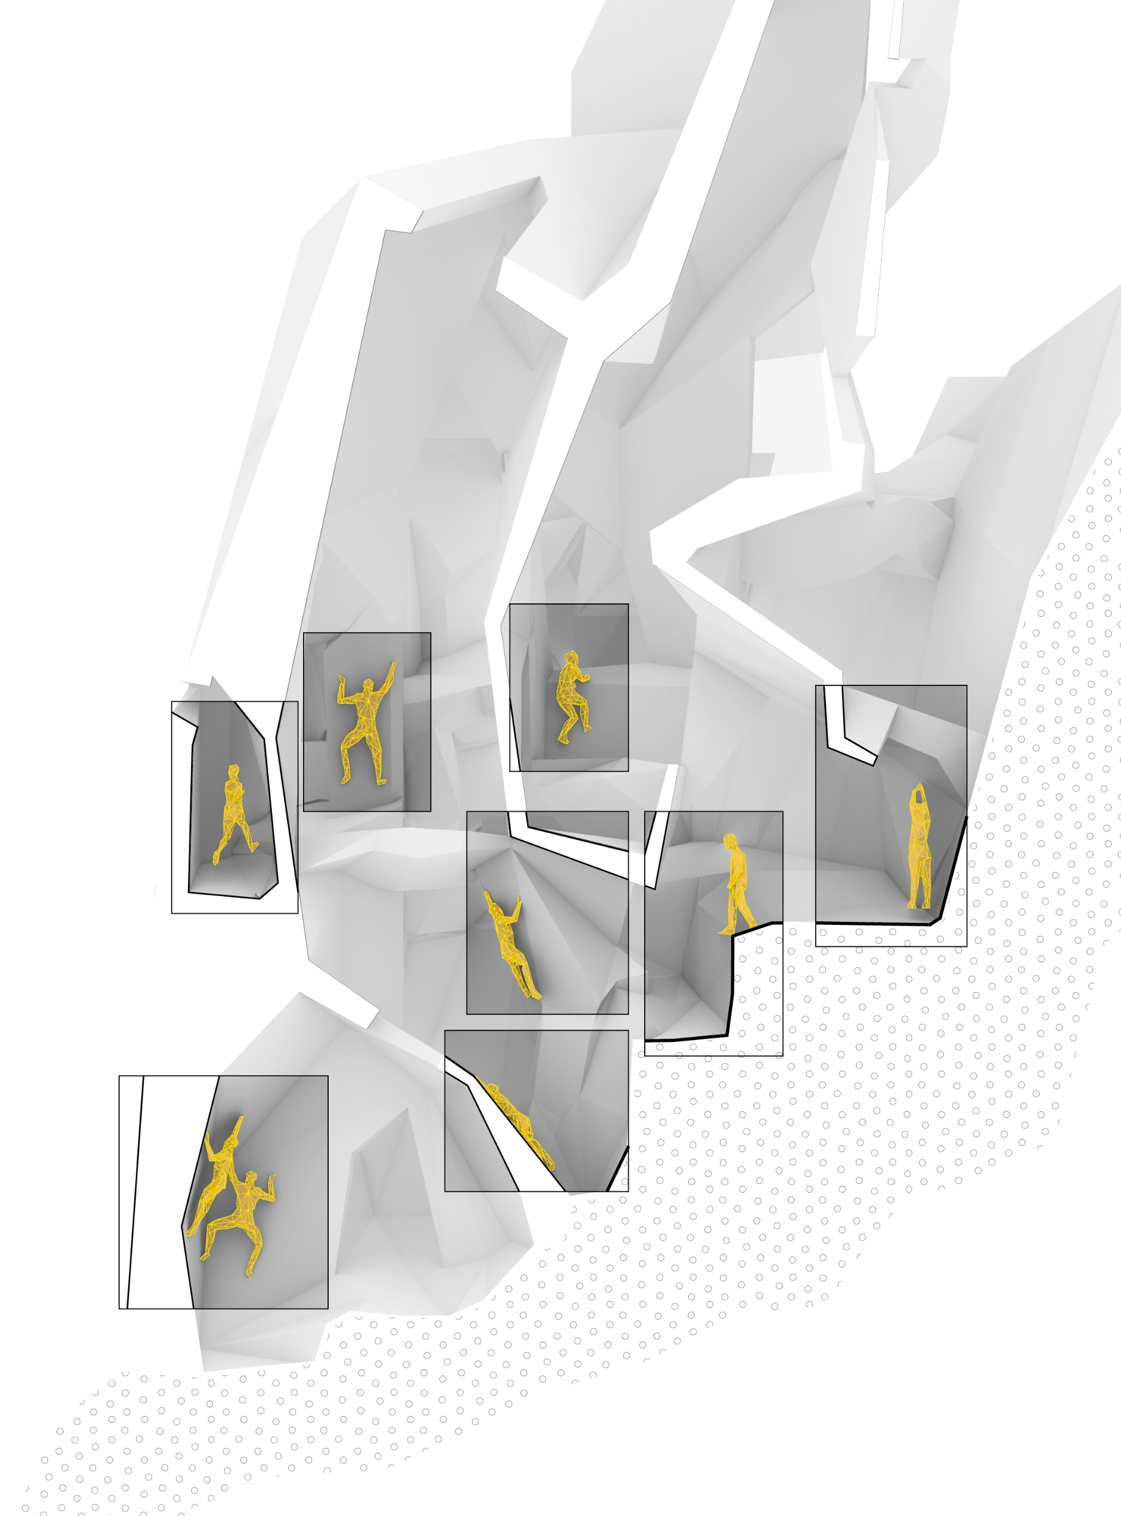
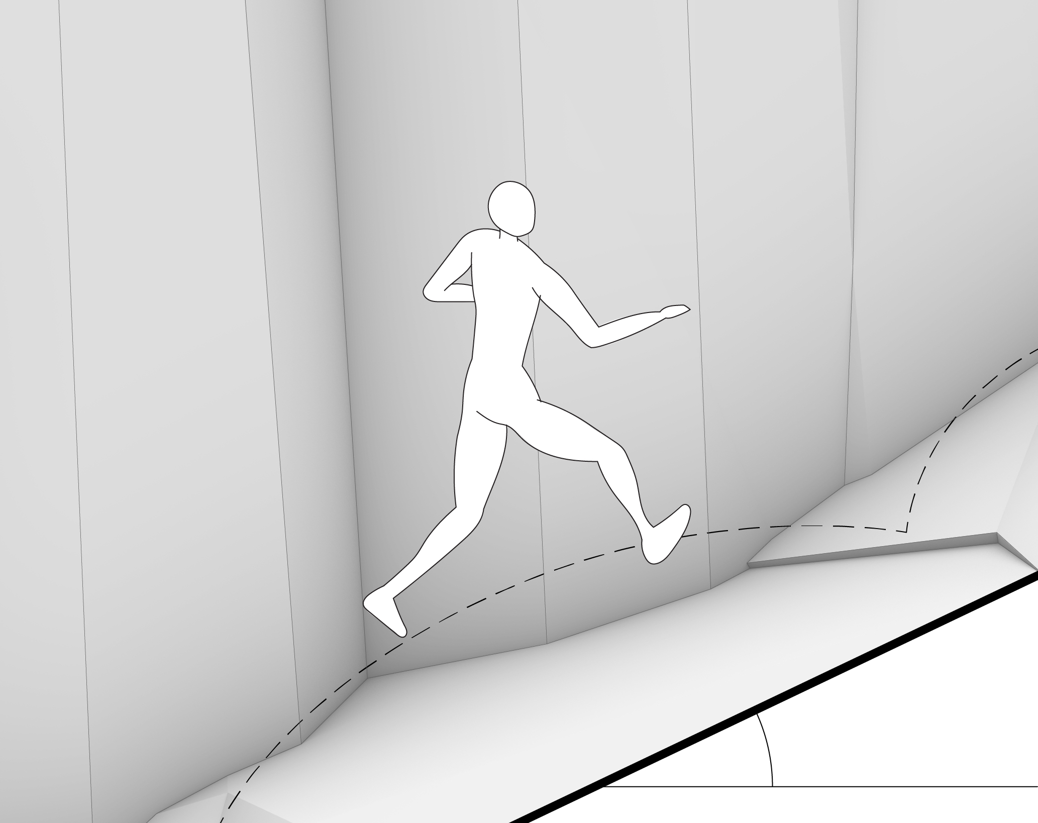
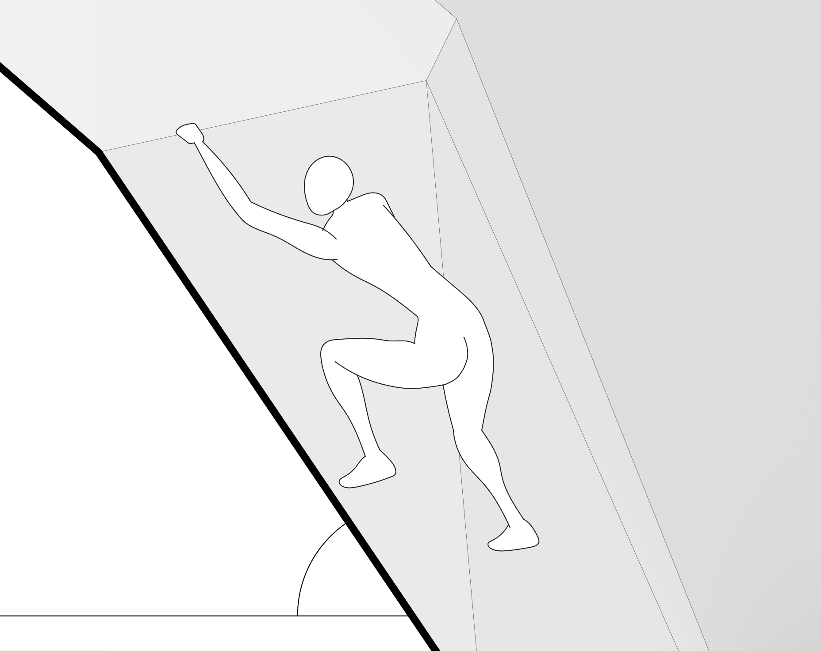
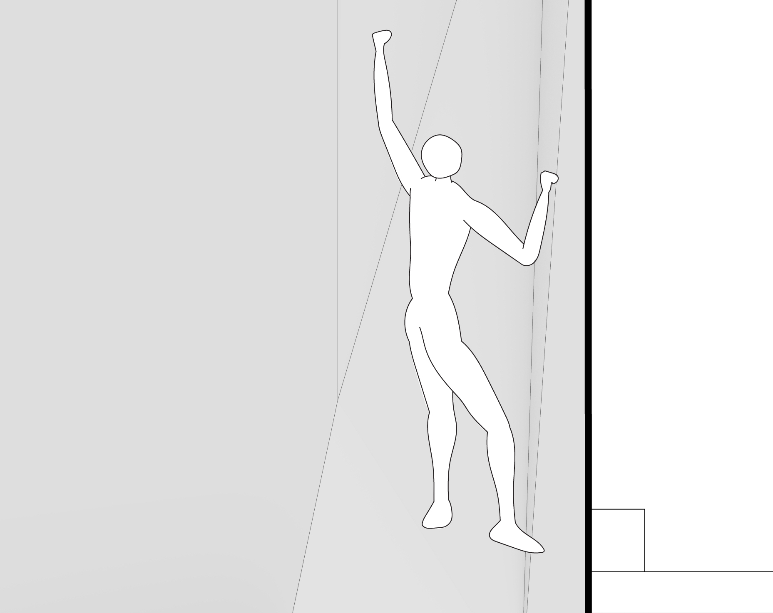
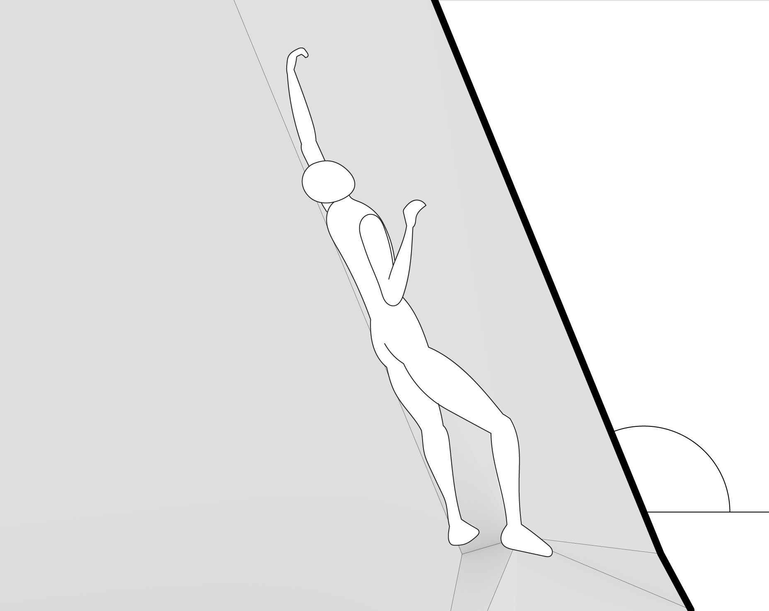
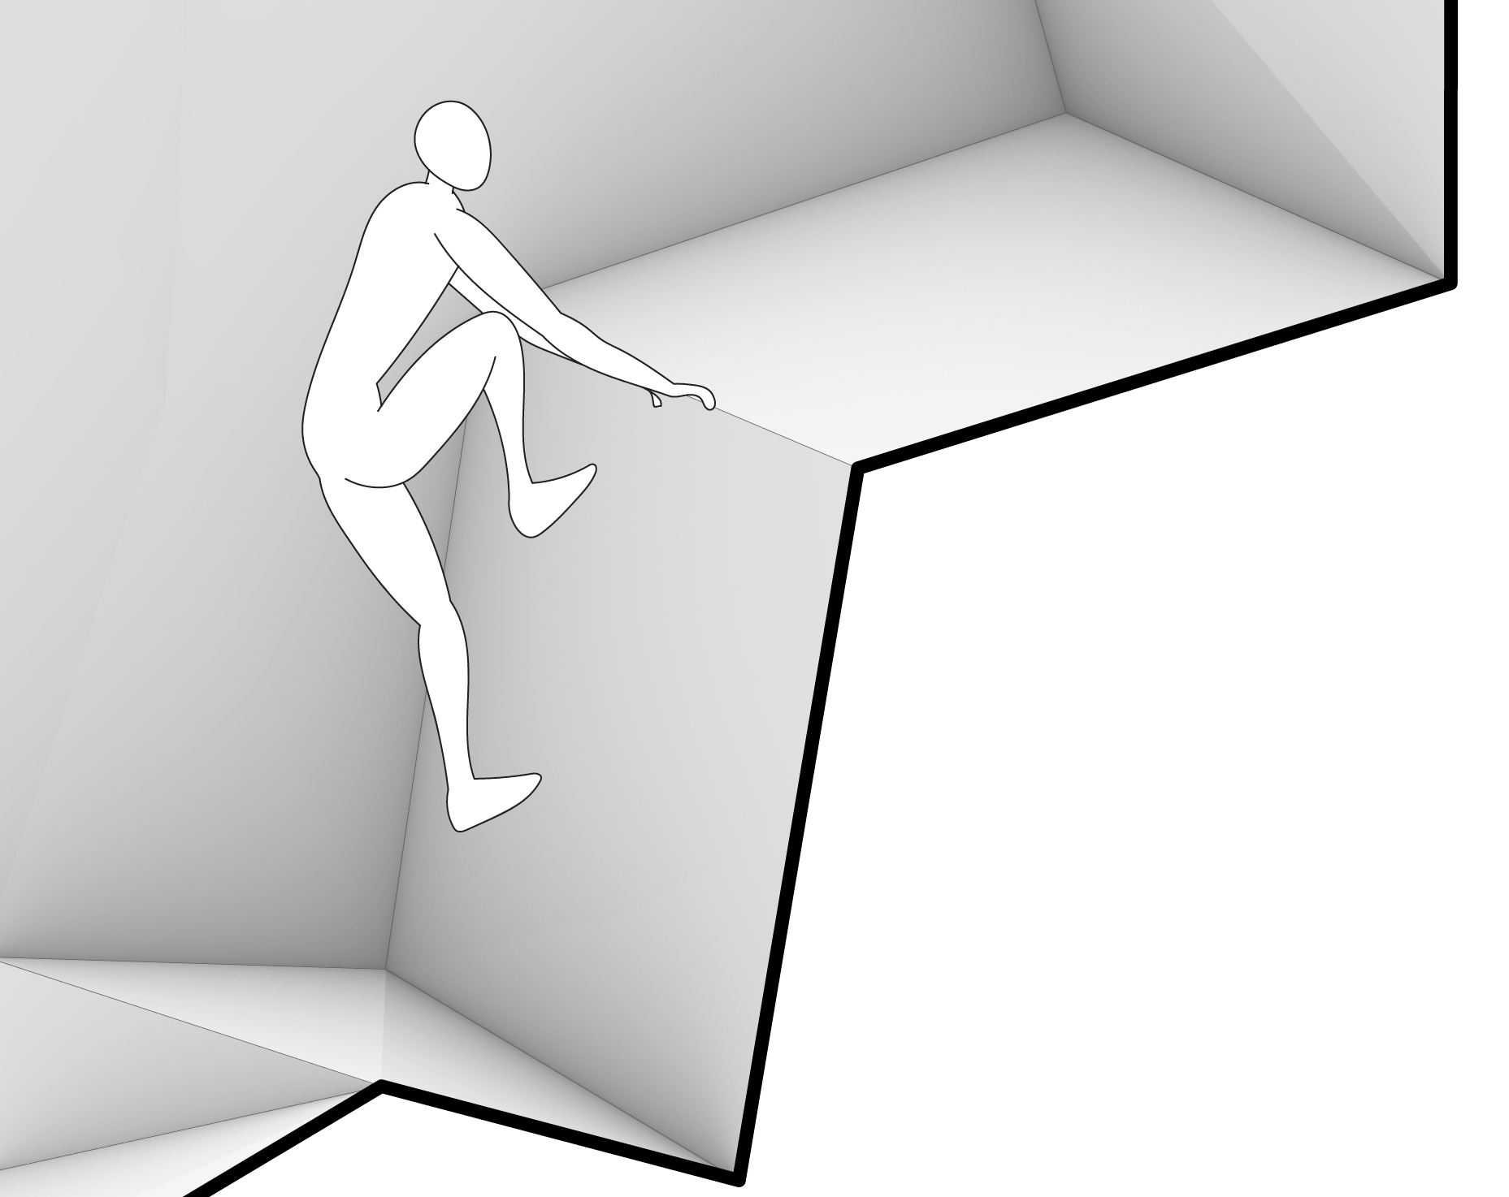
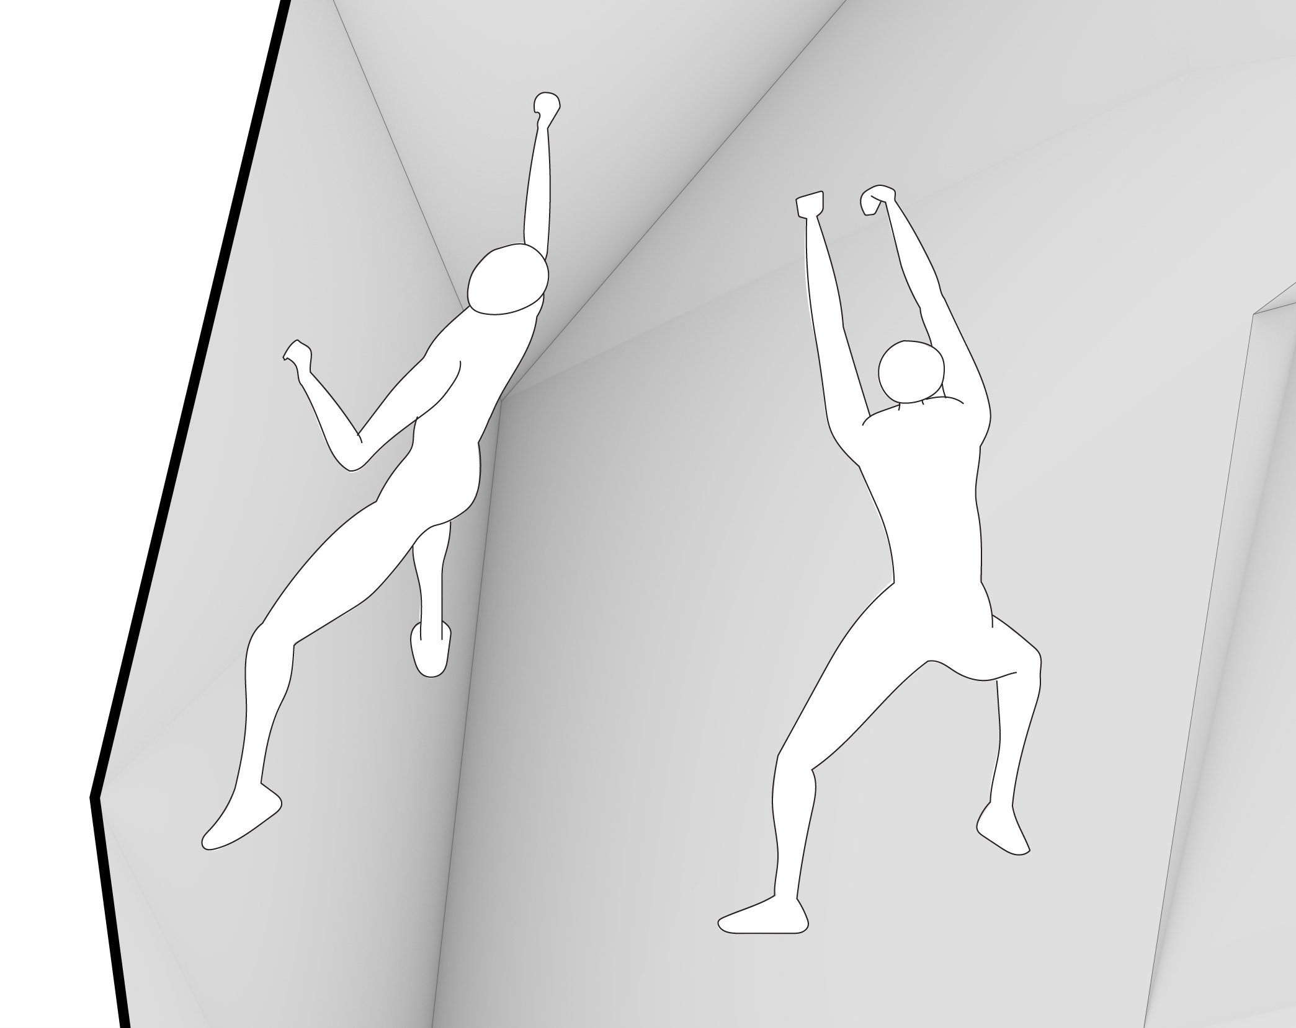
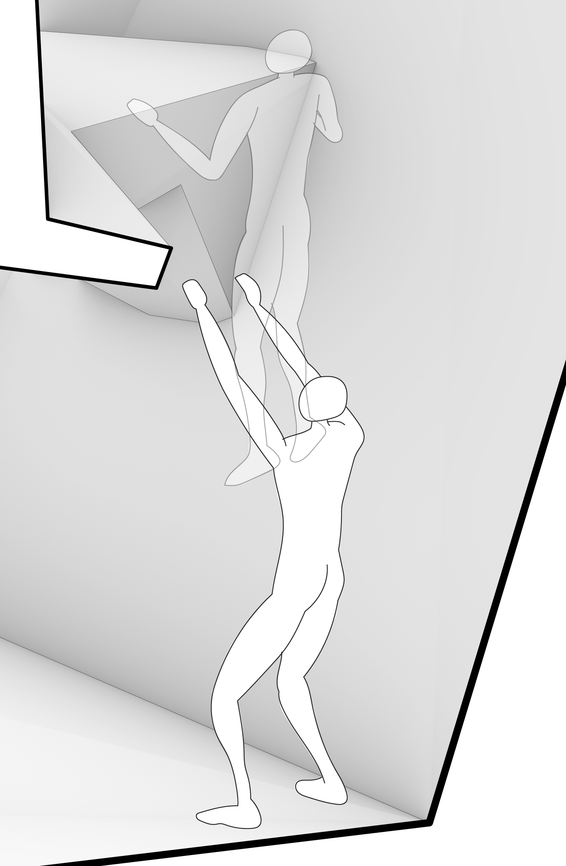
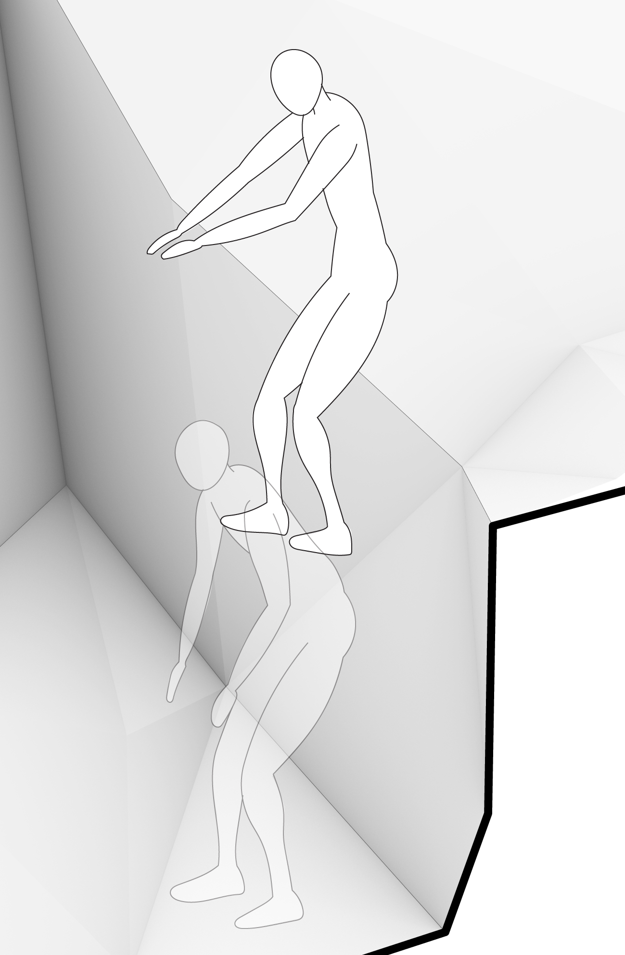
Design
motion and
movements
1
Body engagement through the architectural elements
0
5-25
5-25 Deg. Neutral Walk
2
3
4
5
3
1
7
0
110
4
7
0
0
60
90
60 Deg. Climb
90 Deg. Climb
110 Deg. Climb
5
6
7
2
6
Short Climb
Multiple Crew Climb
Jump up & Down

Slide 5
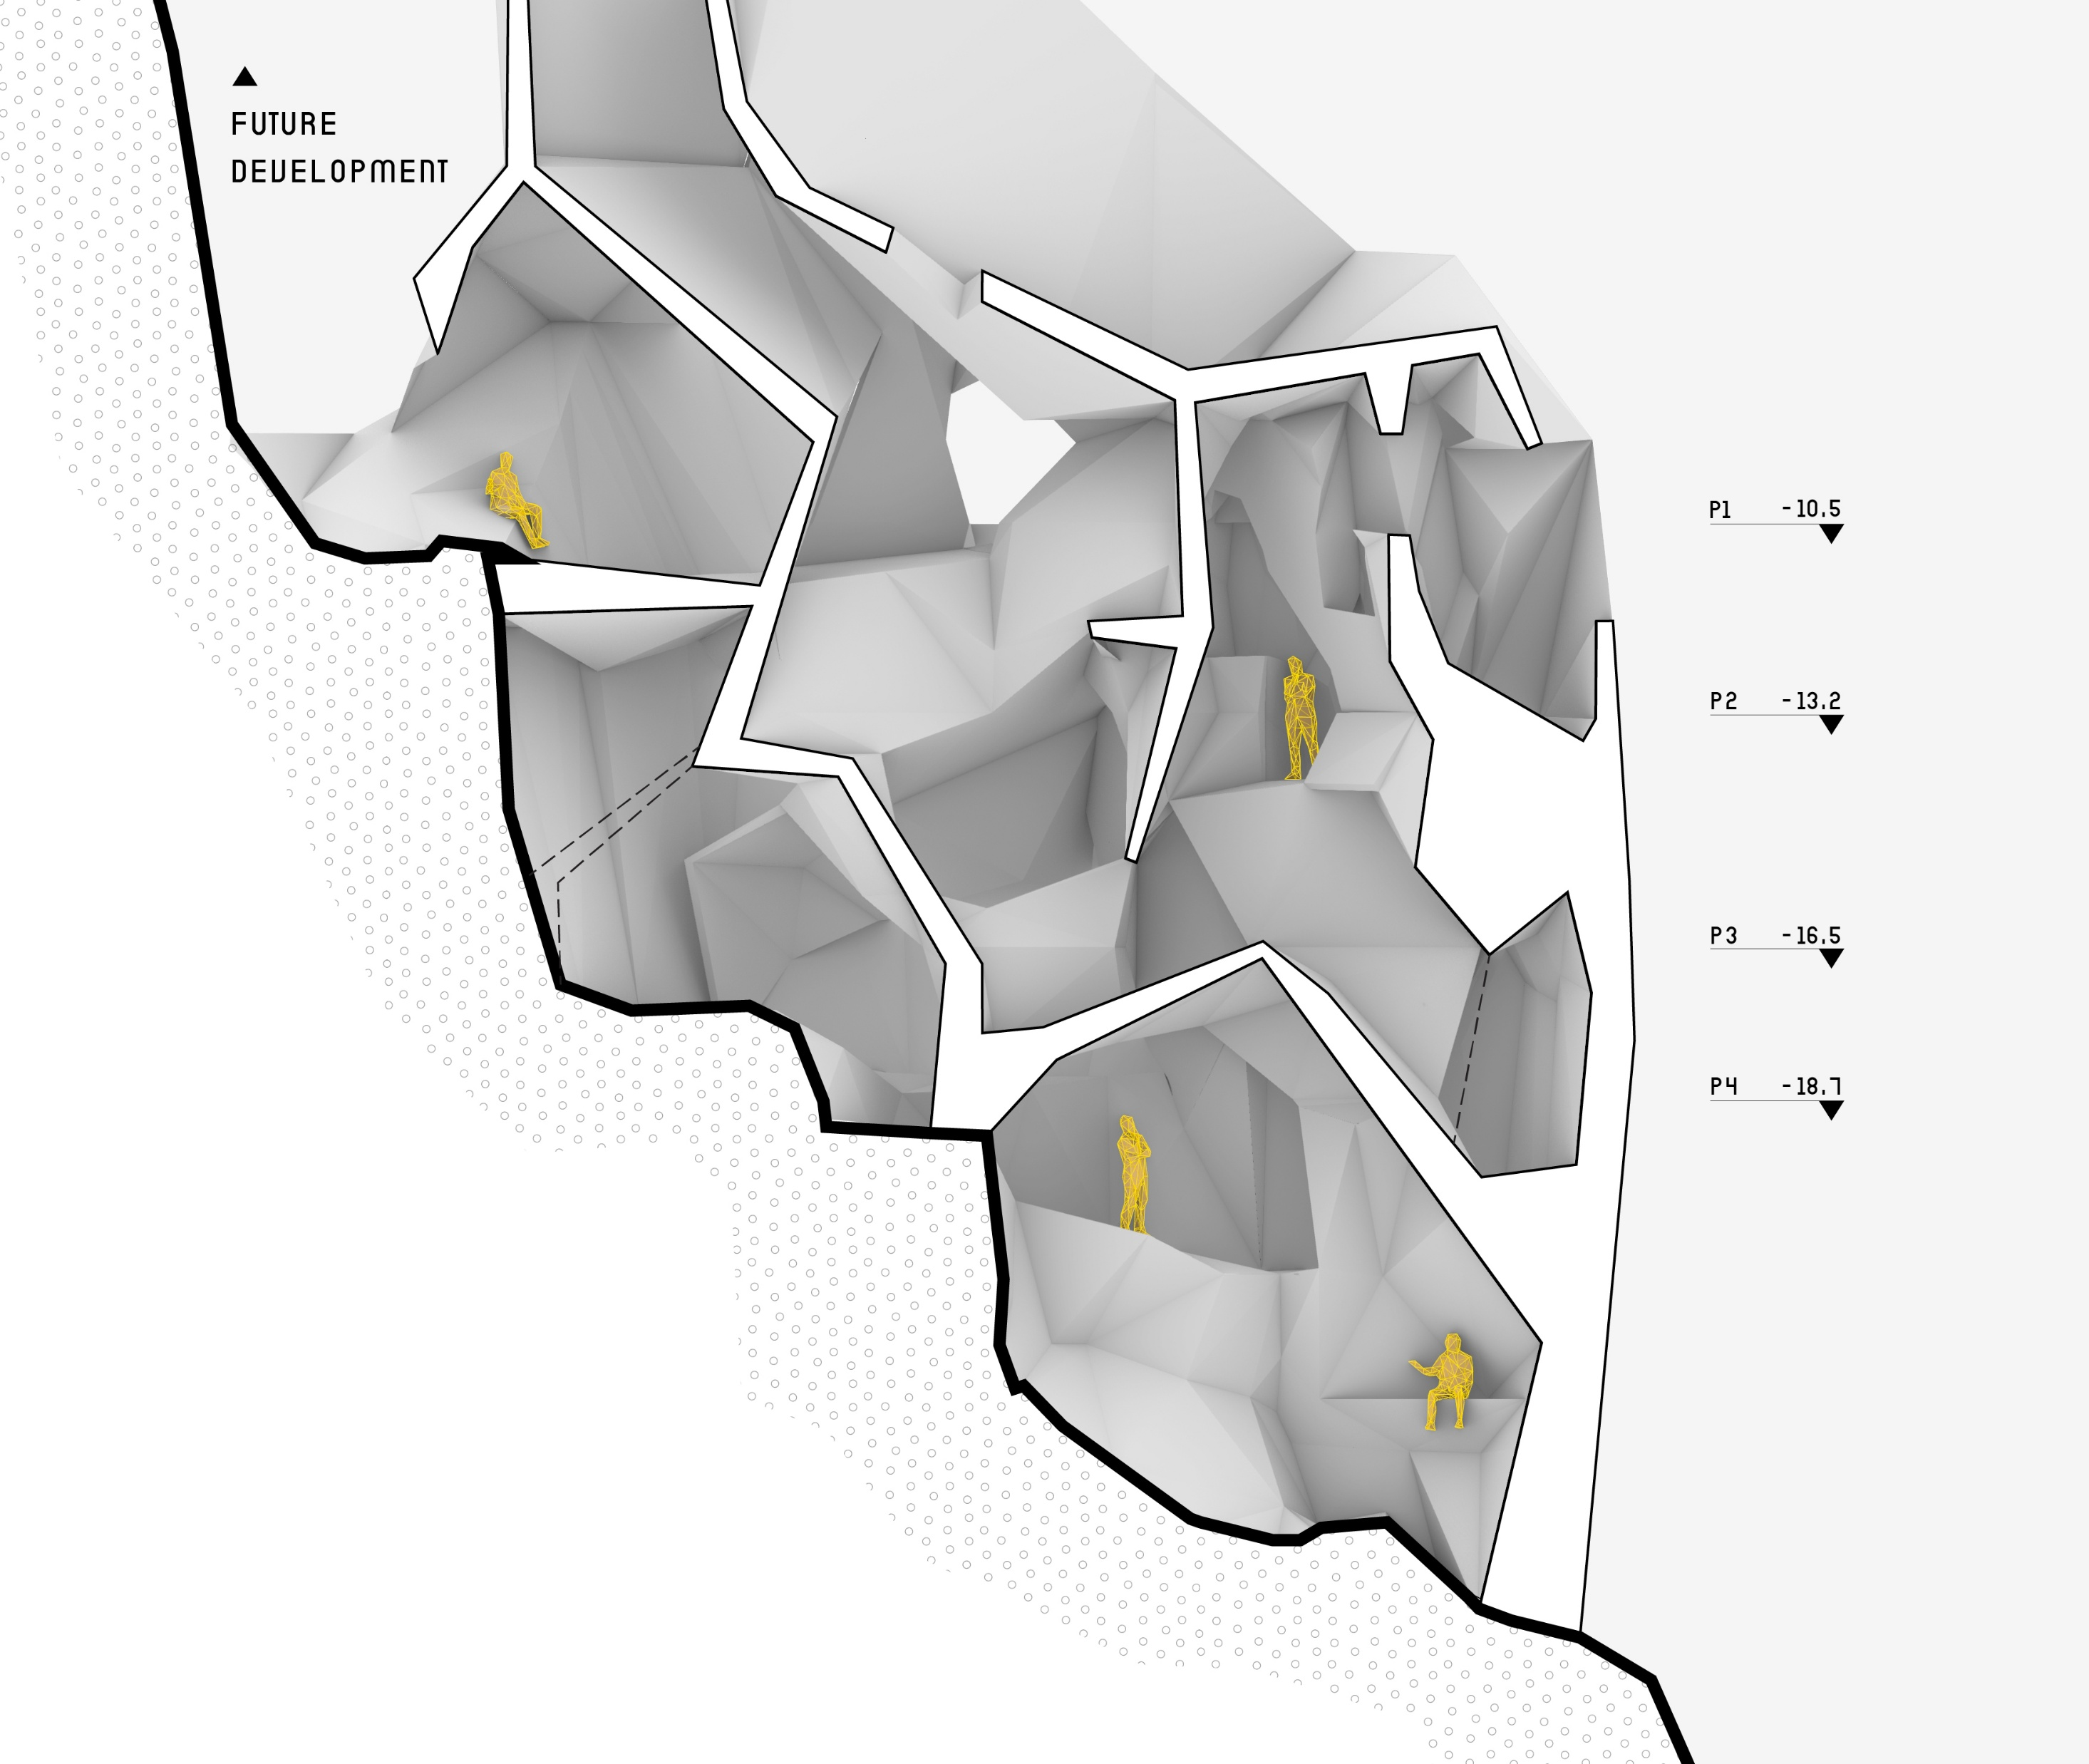
Design
sections
Architectural Elements –
Views, Body engagement
1
1
2
4
3
1
Work zone
2
Eat zone
3
Socialise zone
Section 2
4
Internal Rampway
5m

Slide 6
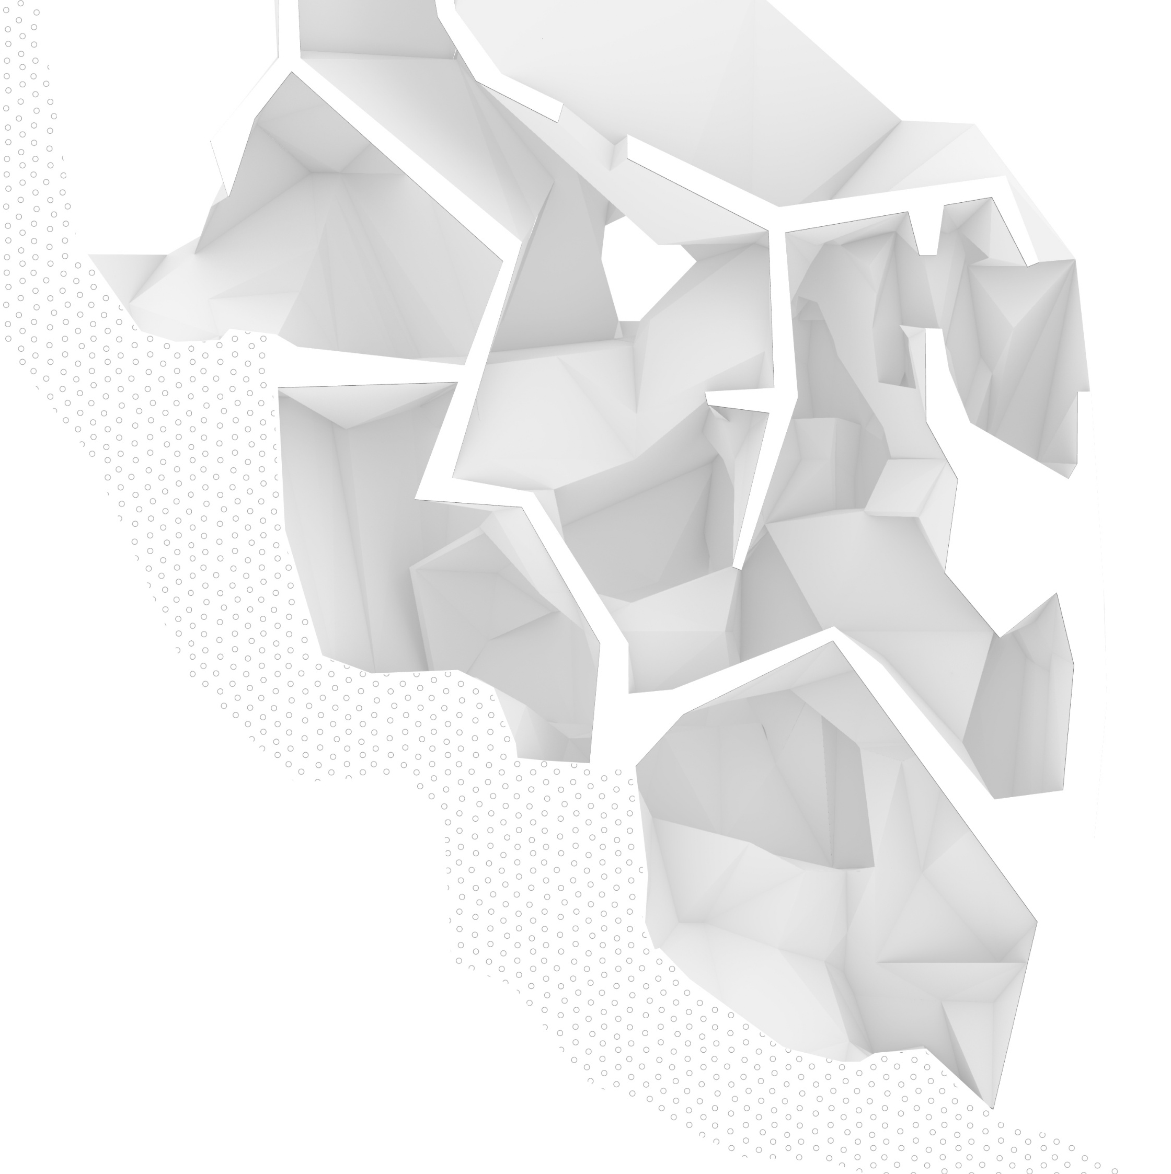
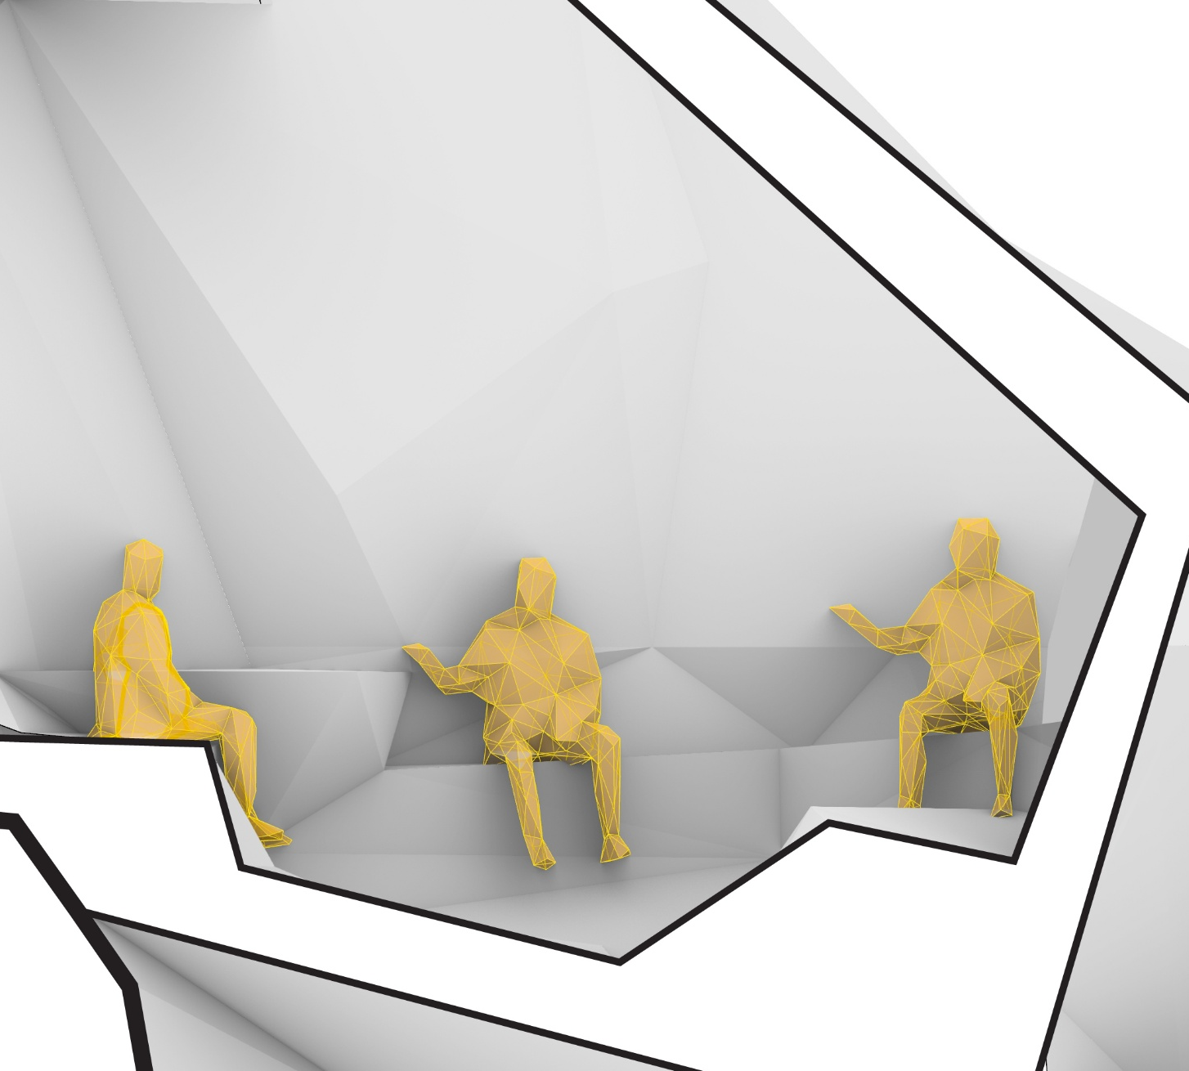
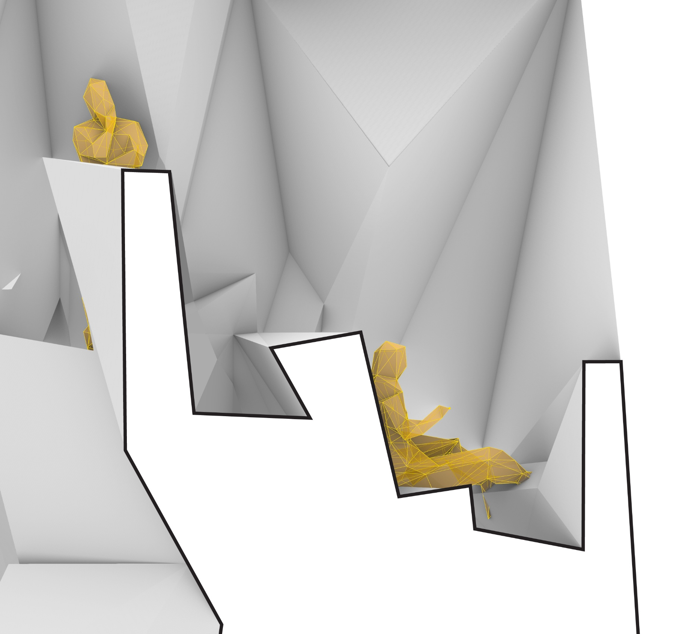
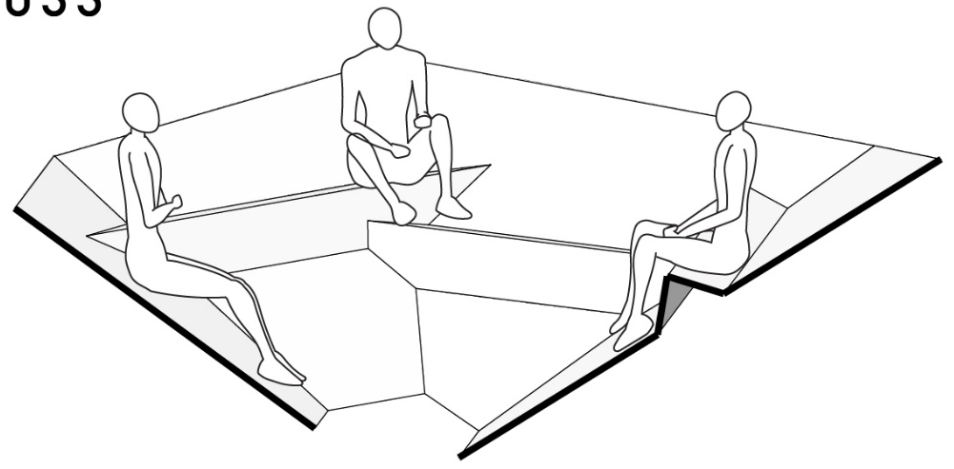
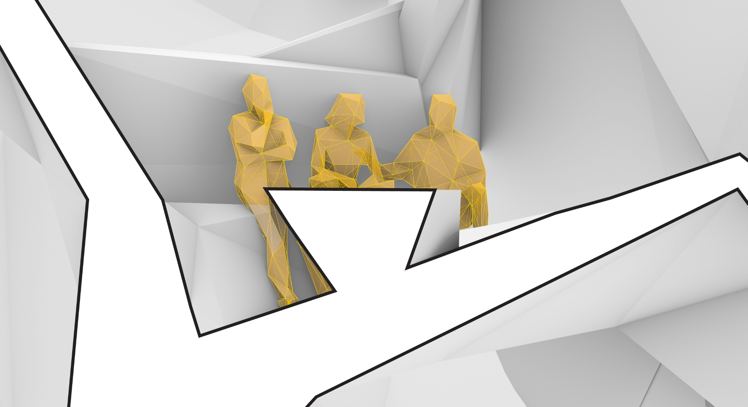

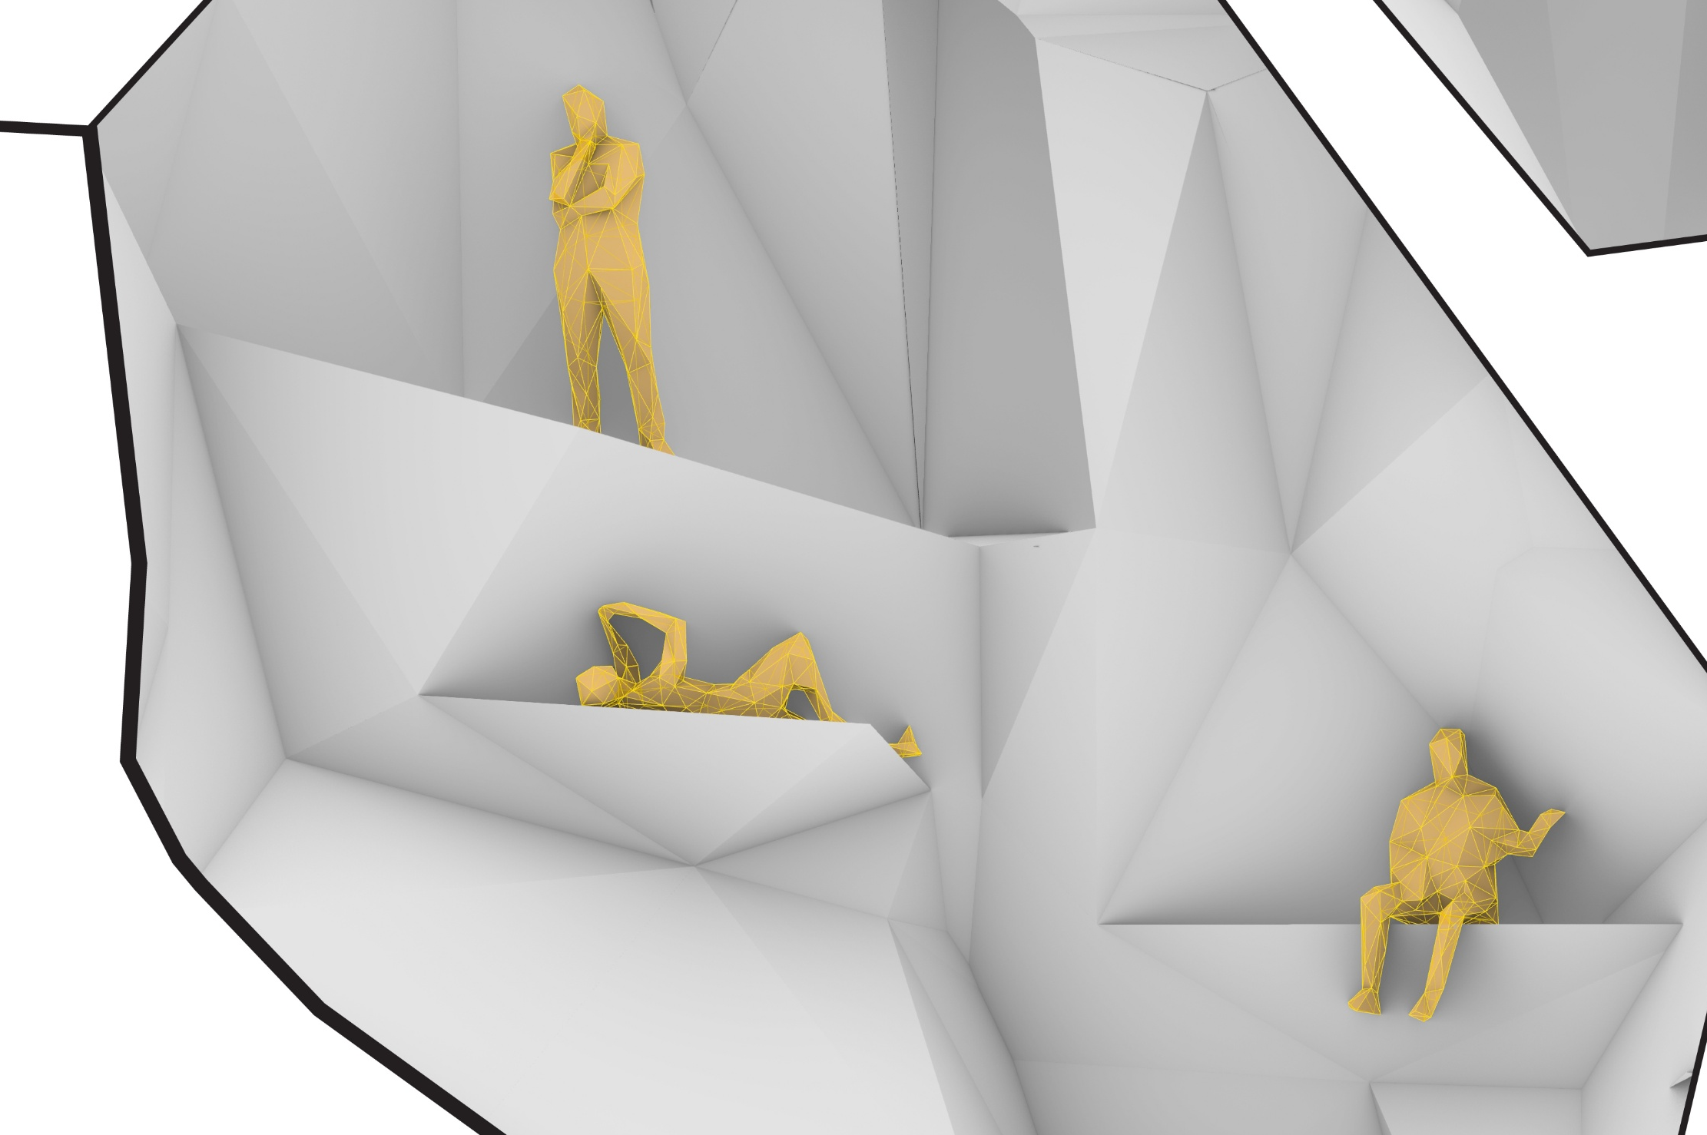

Design
activities to
furniture
integration
1
(zoom in to 1:50)
1
Human Basic Activities At the main atrium
1
Work
2
2
Eat
3
3
Socialise

Slide 7
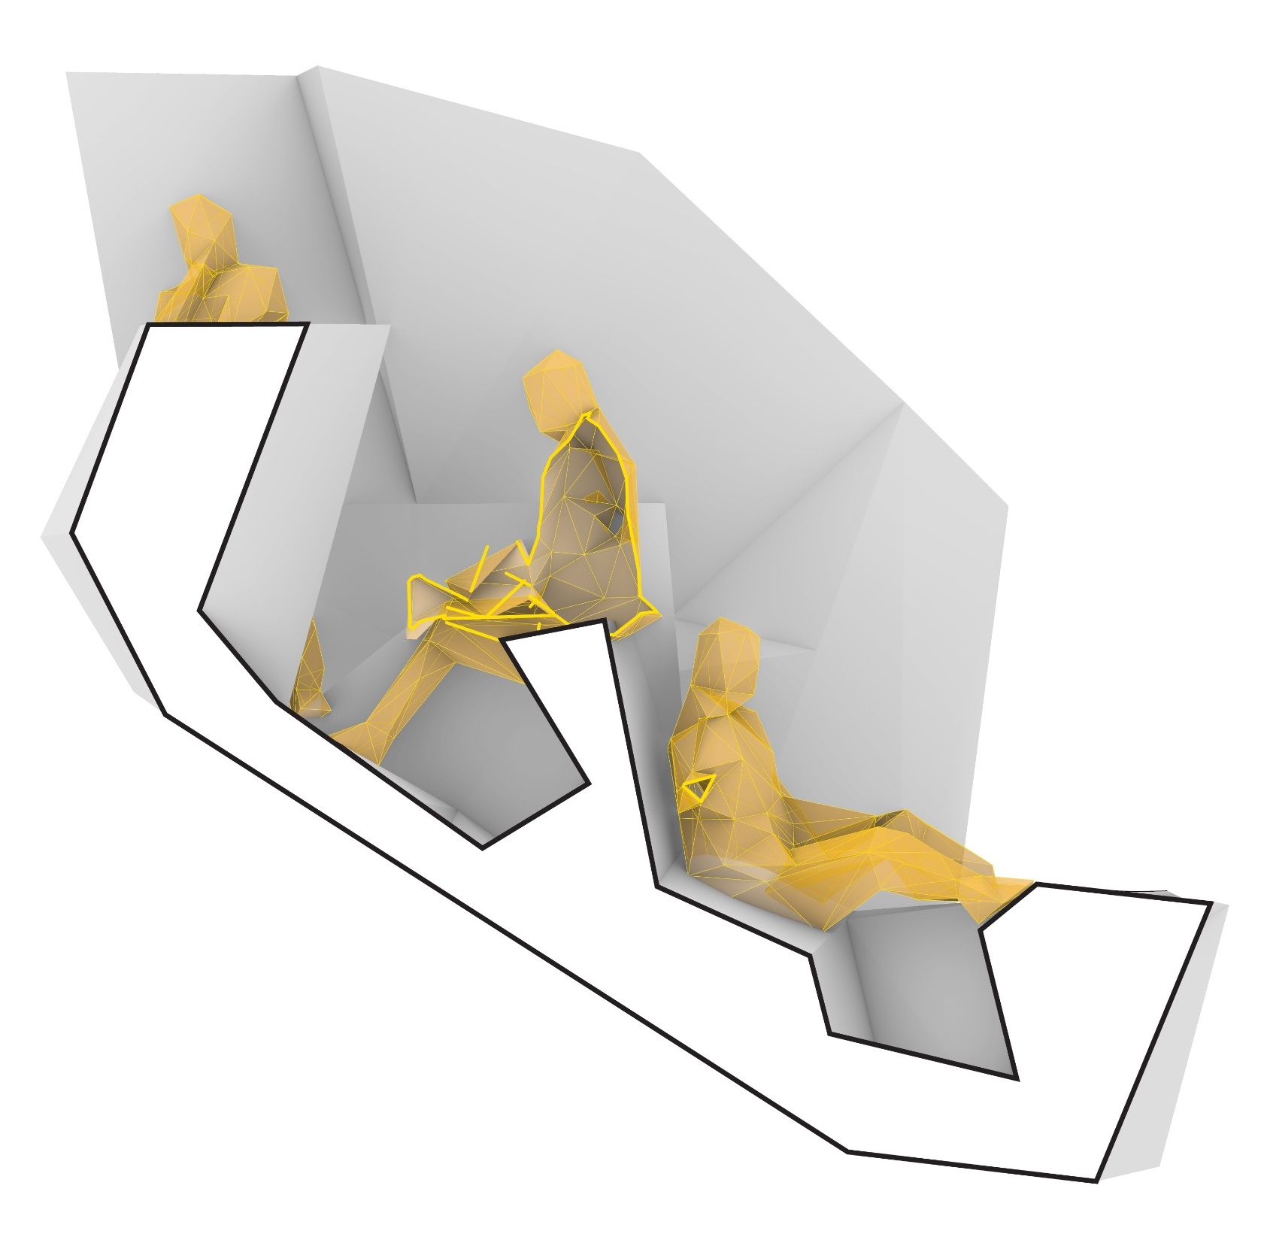
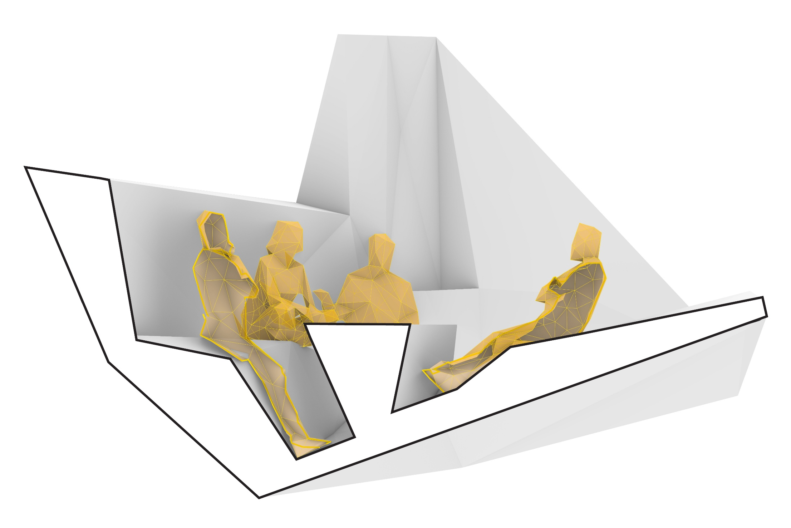
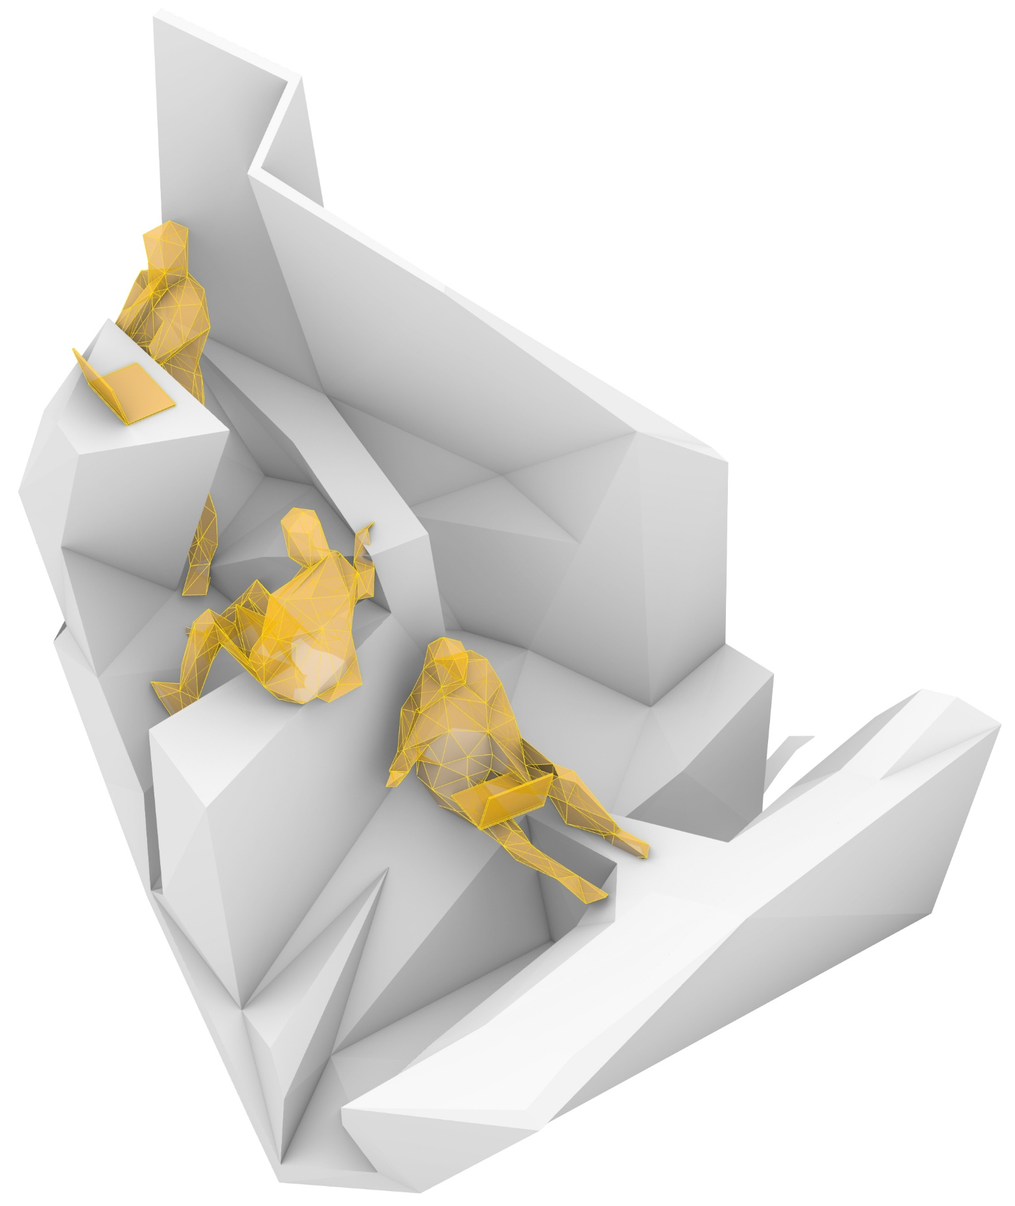
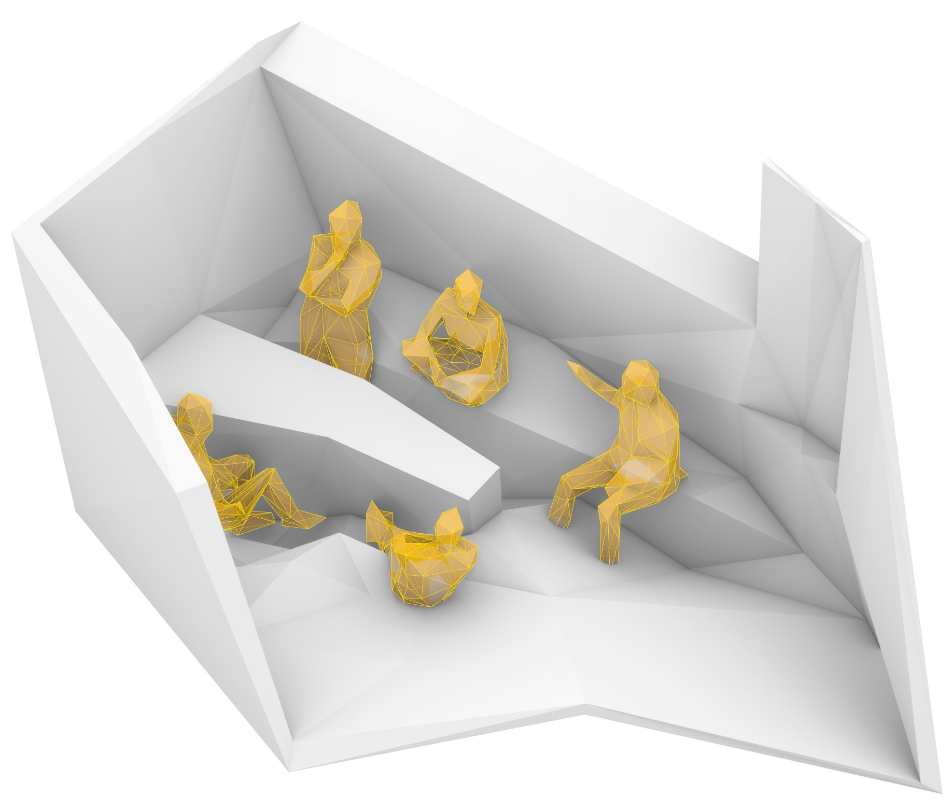
Design
Work (Desktop)
EAT
furniture integration
design:
levels and zoning
Resolution/ Specificity of Surfaces
Stable surfaces i.e. for food/ laptop
Spatial Zoning
Privacy levels
Specific predetermined function vs
flexibility for further development
Space <-> Body
Size, level difference,
degree of openness

Slide 8
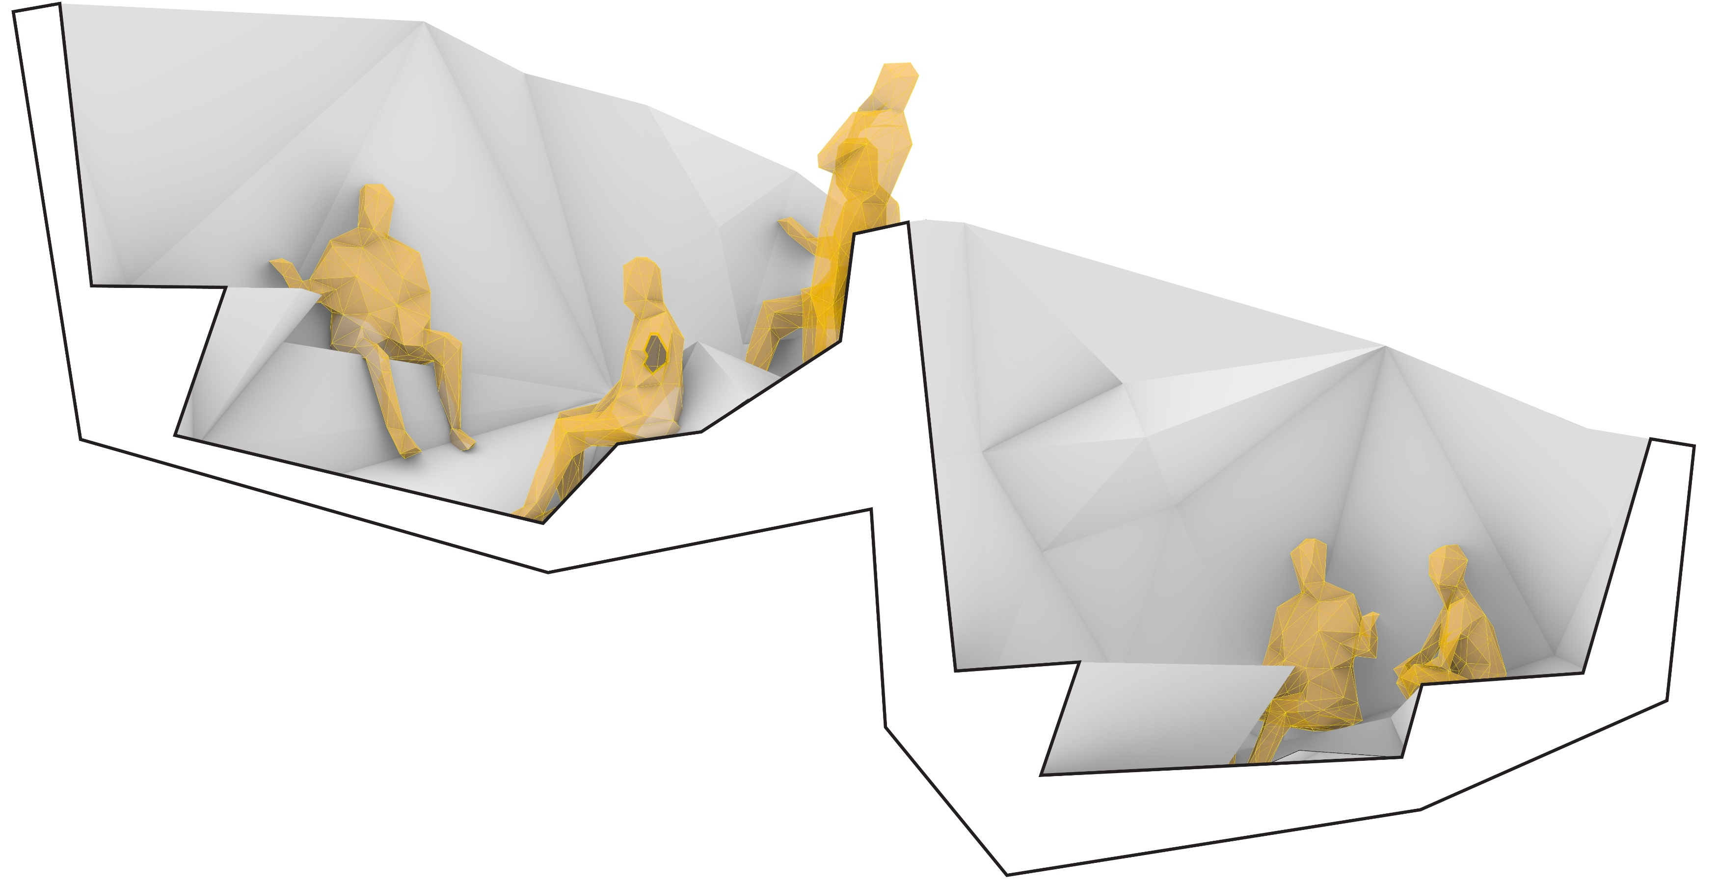
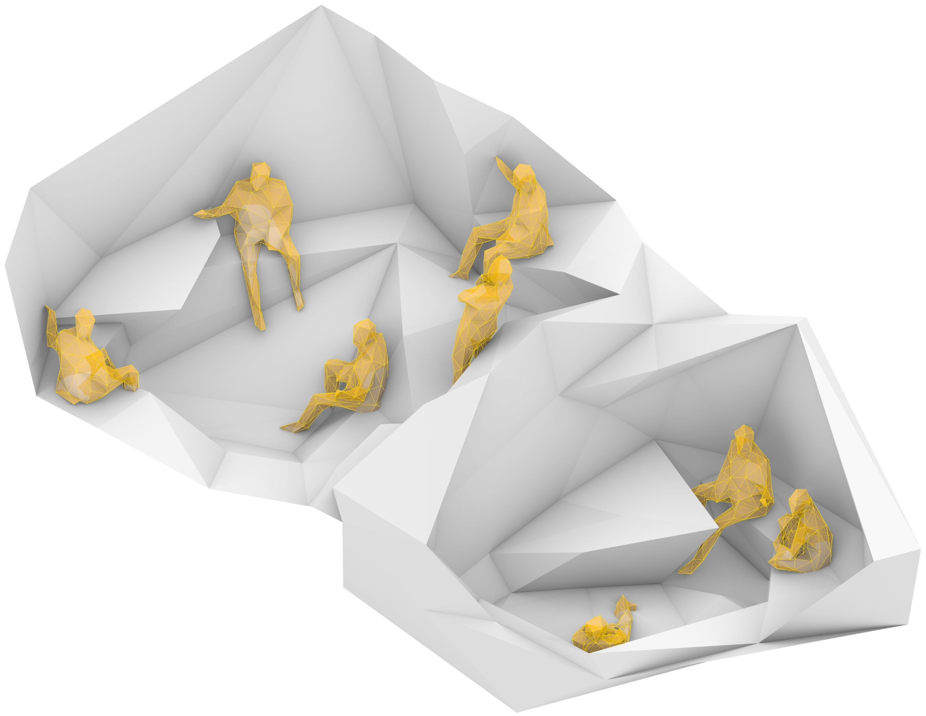
Design
furniture integration
design:
levels and zoning
Work (discussion)
Resolution/ Specificity of Surfaces
Stable surfaces i.e. for food/ laptop
Spatial Zoning
Privacy levels
Specific predetermined function vs
flexibility for further development
Space <-> Body
Size, level difference,
degree of openness

Slide 9
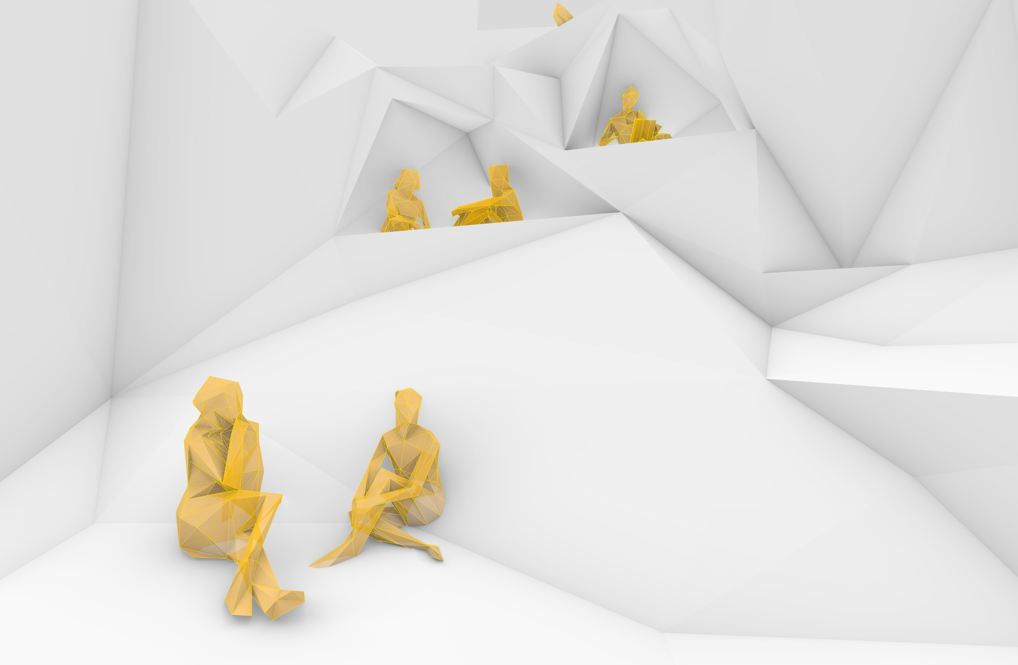
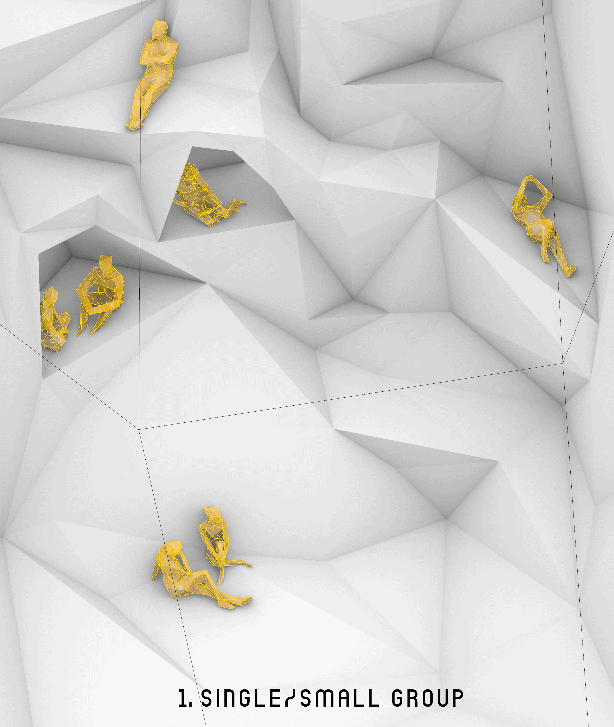
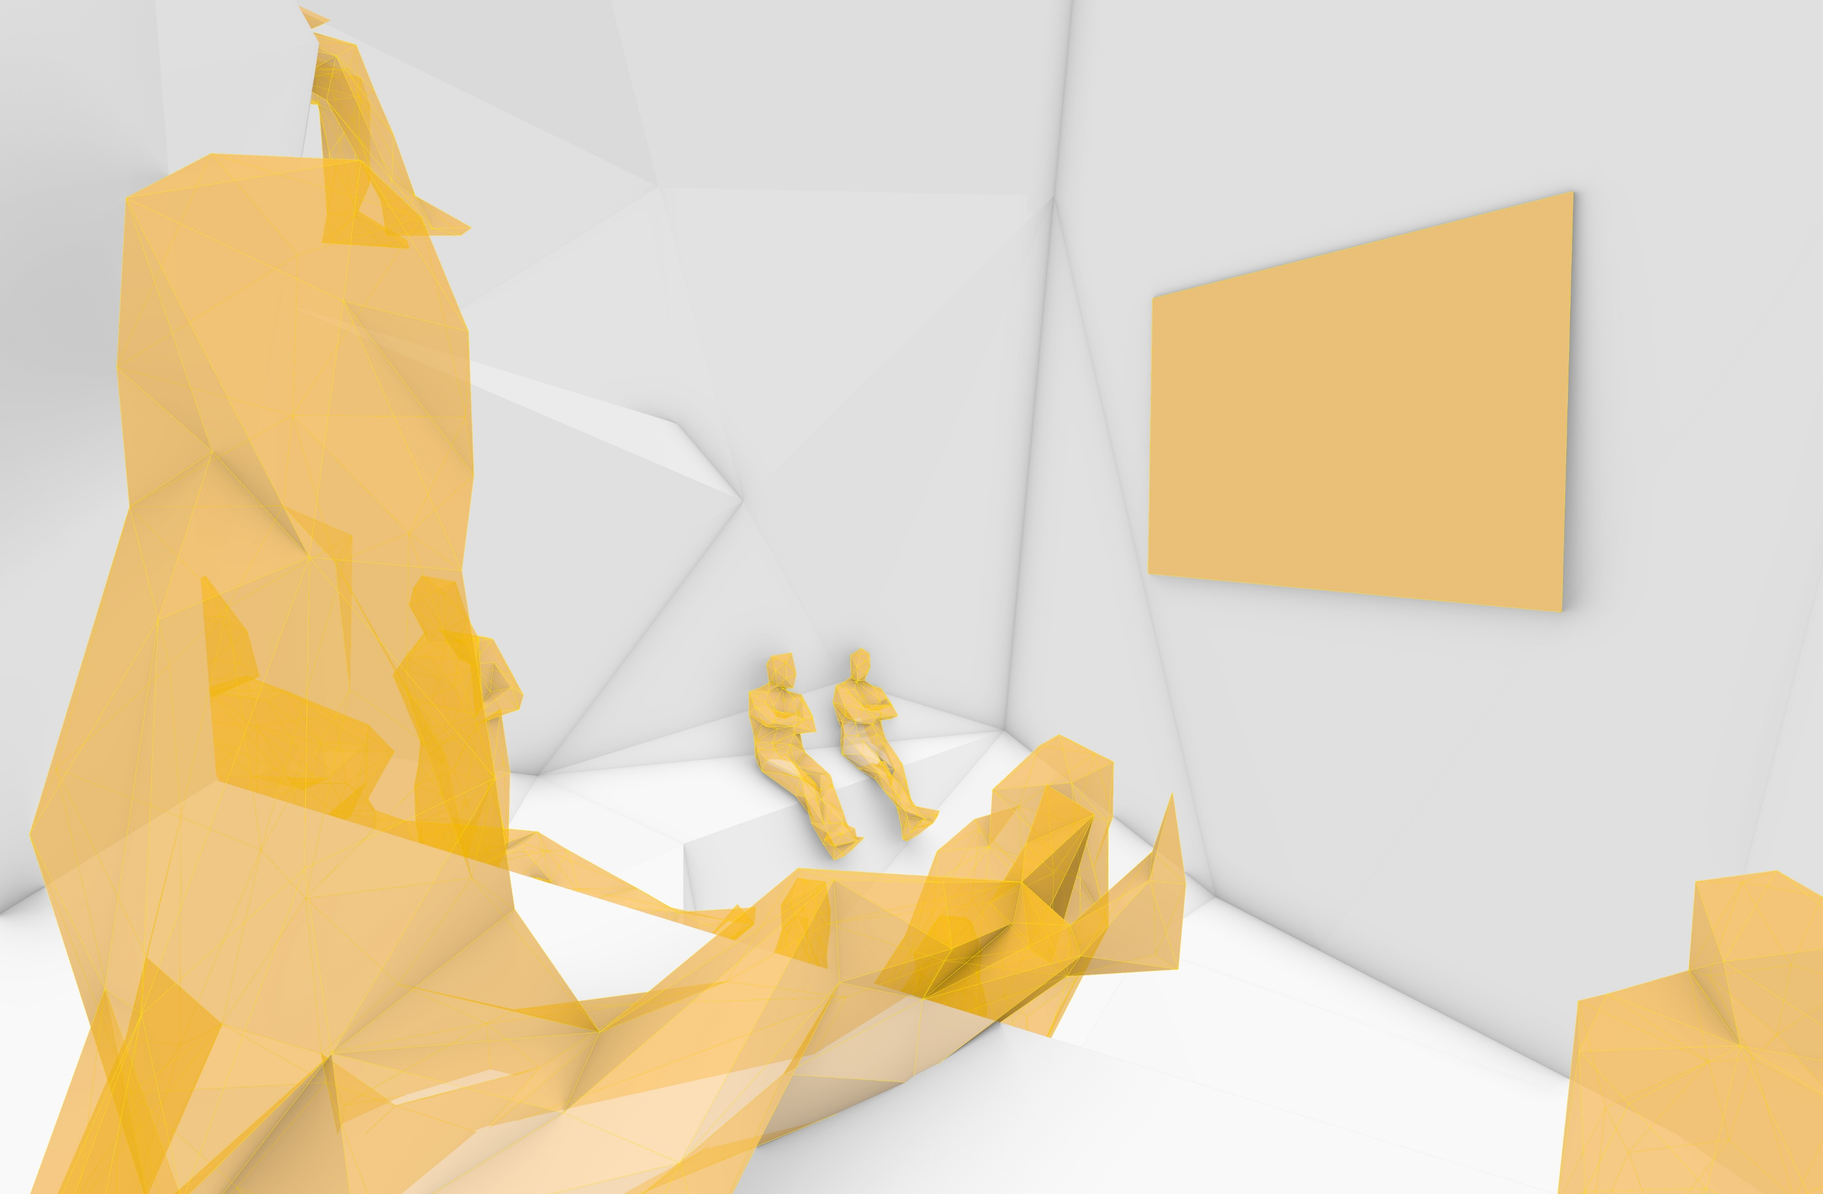
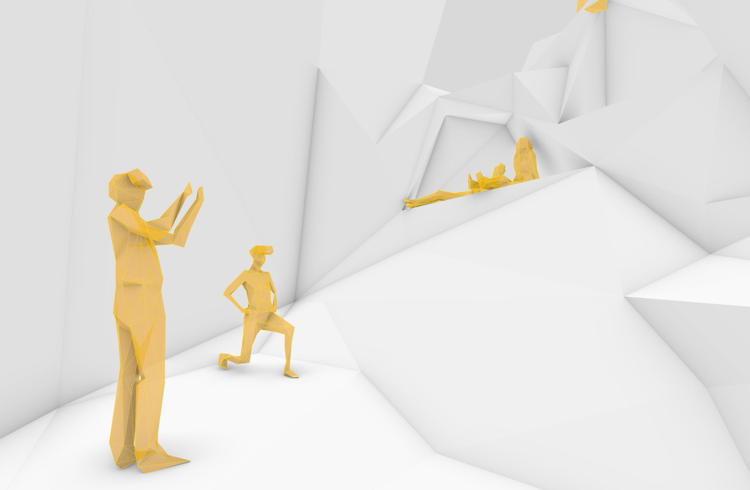
Design
furniture design:
various configurations
Small Group
Movie
Resolution/ Specificity of Surfaces
Spatial Zoning
Space <-> Body
VARIOUS SURFACES LEAD TO PERSONAL INTERPRETATIONS & PREFERENCES OF STATIONARY POSTURES
Arena/ VR Games

Slide 10
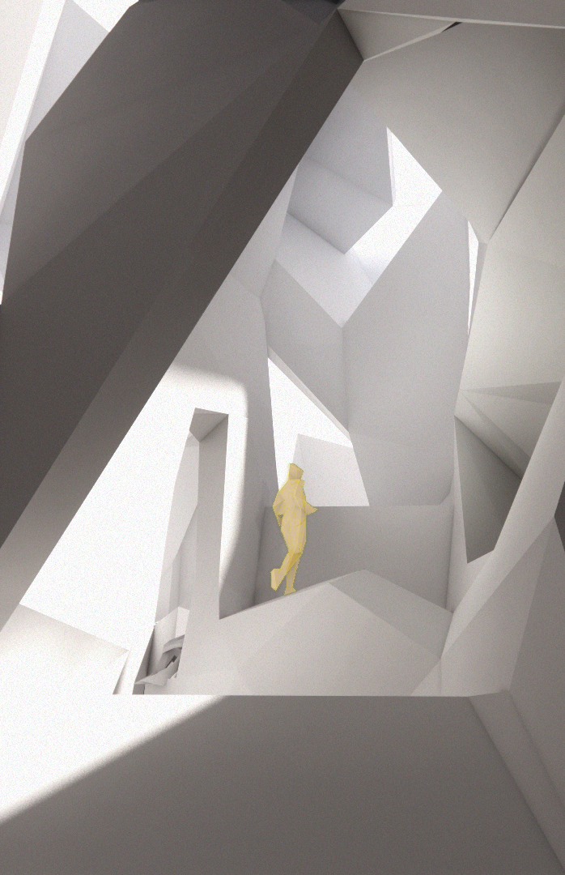
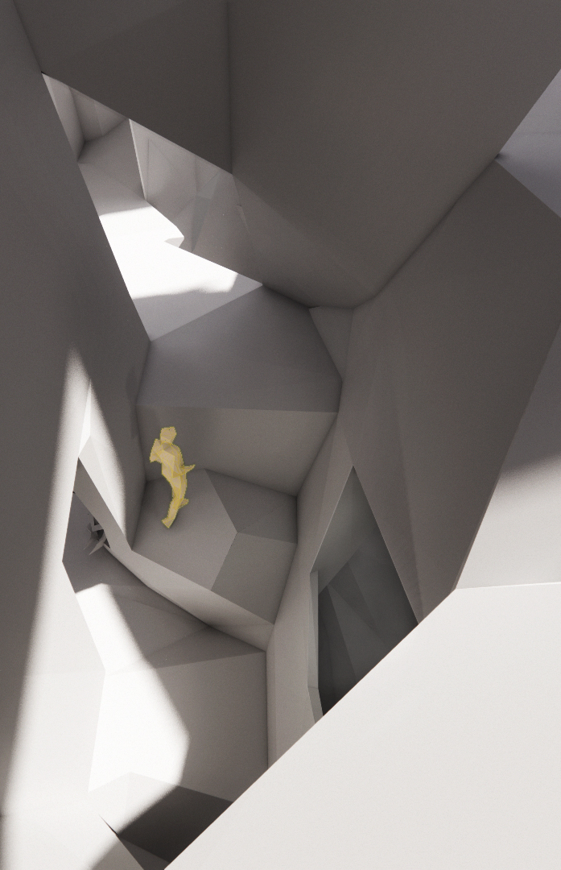
Design
impressions
Vertical Continuity

Slide 11
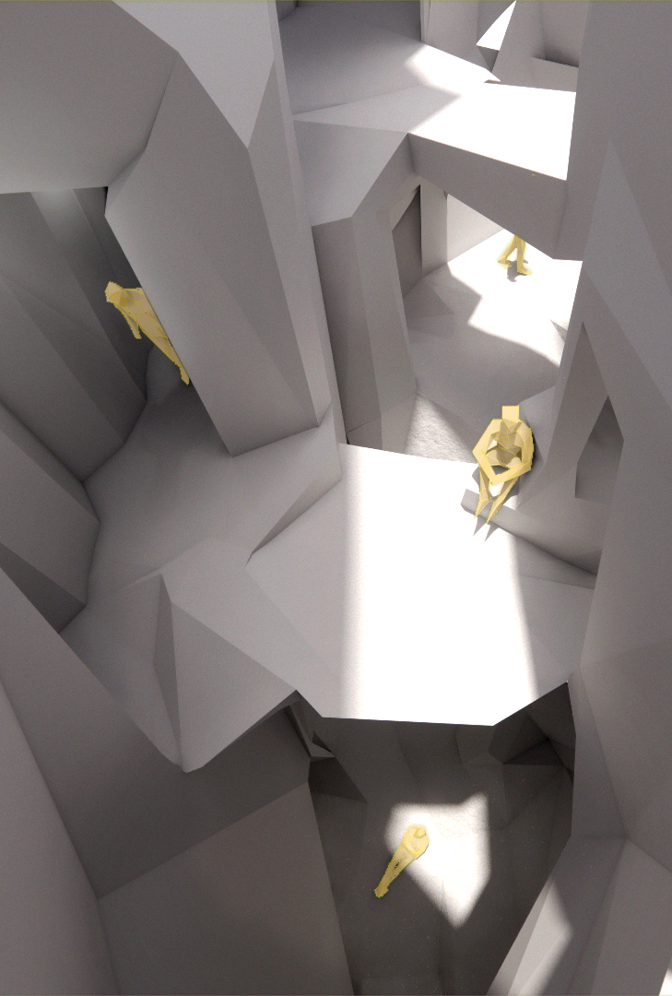
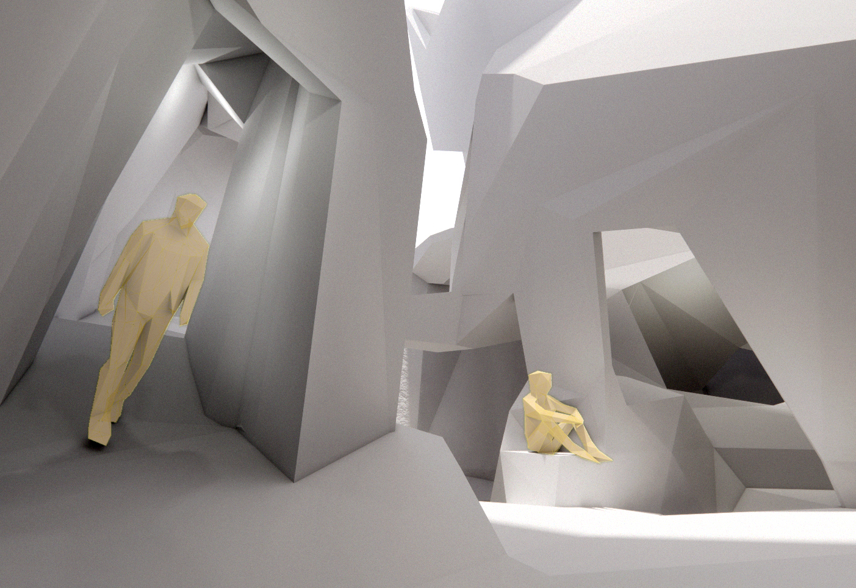
Design
impressions
Thick Wall Circulation

Slide 12
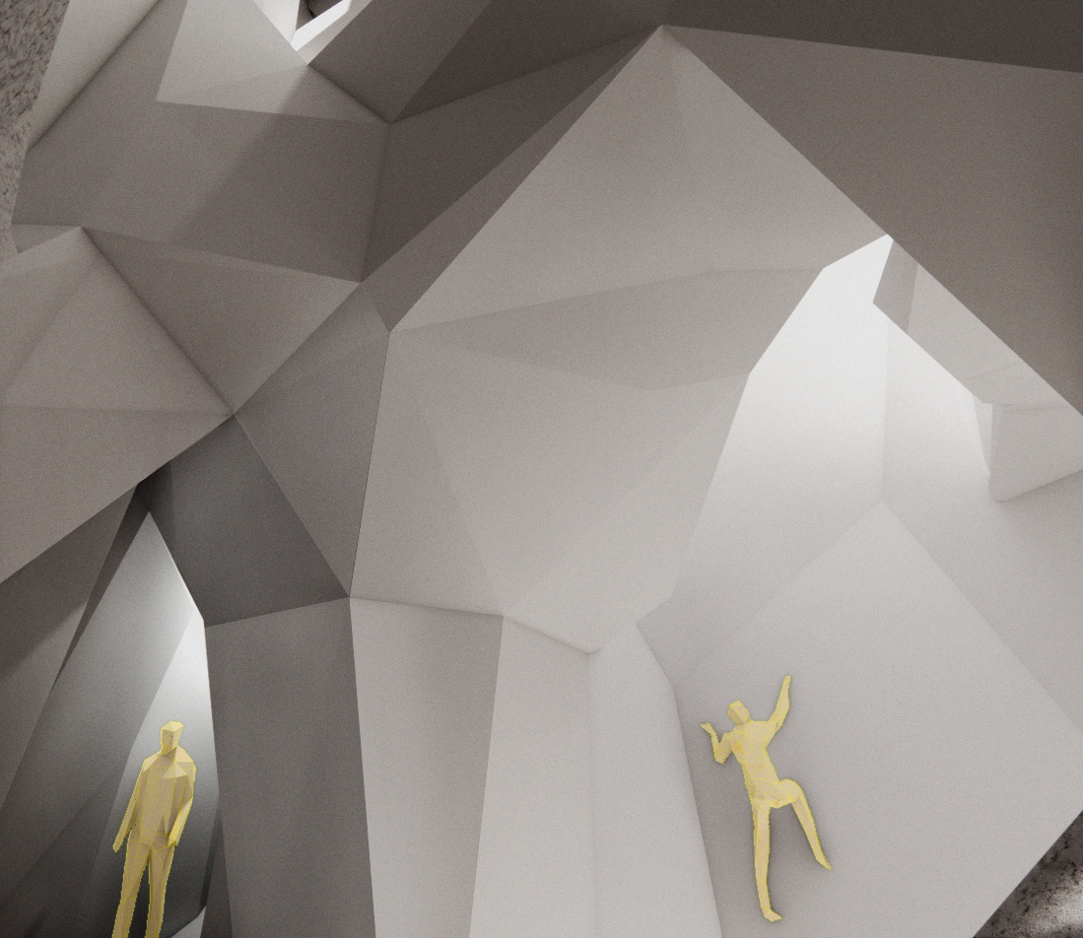
Design
impressions
Light from vertical shaft

Slide 13
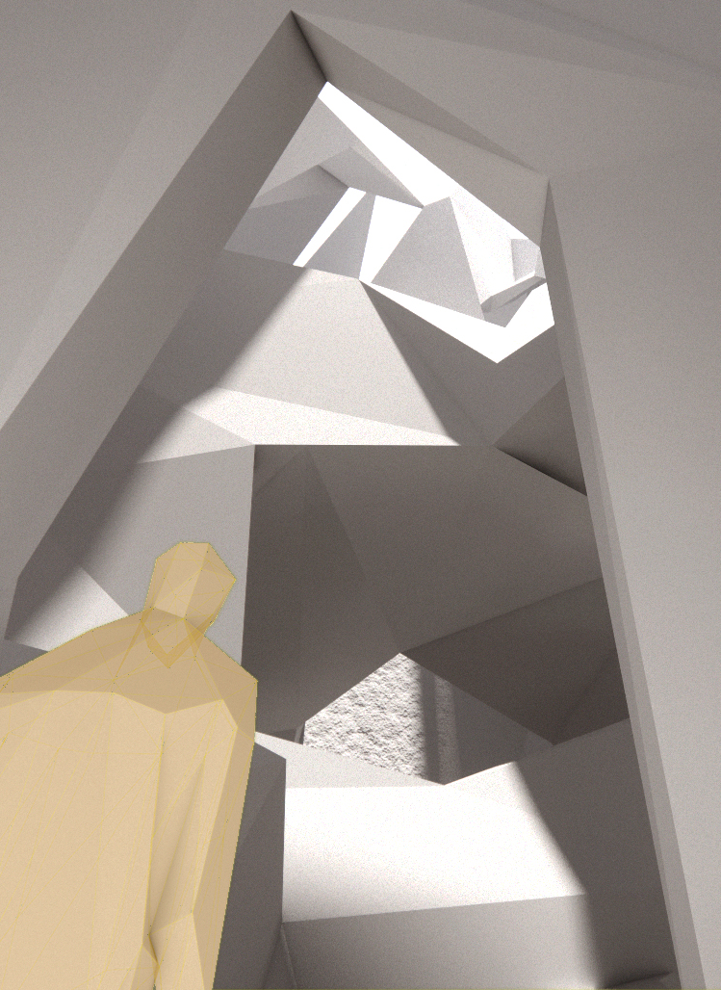
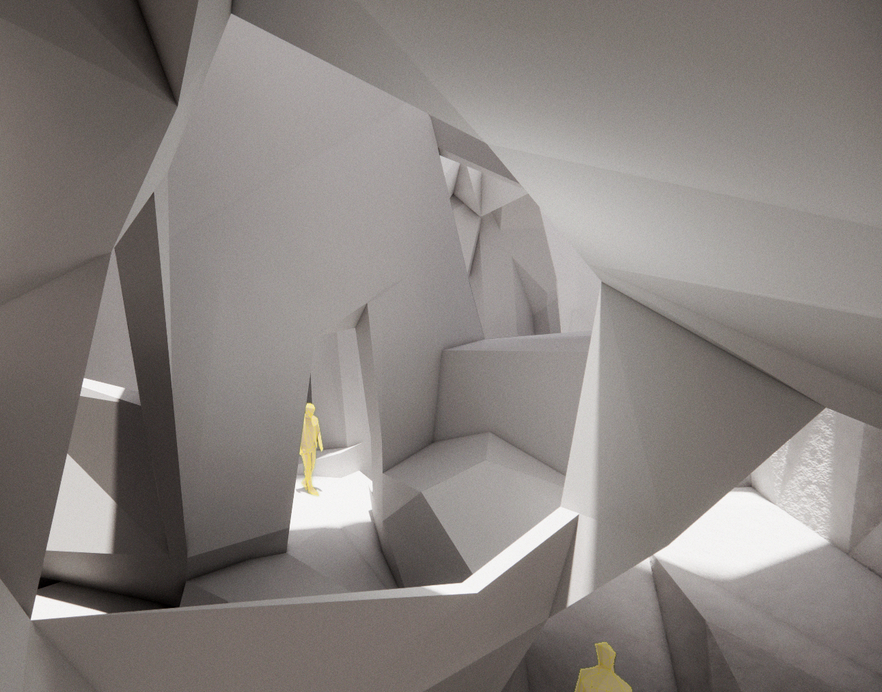
Design
impressions
Frames and Openings

Slide 14
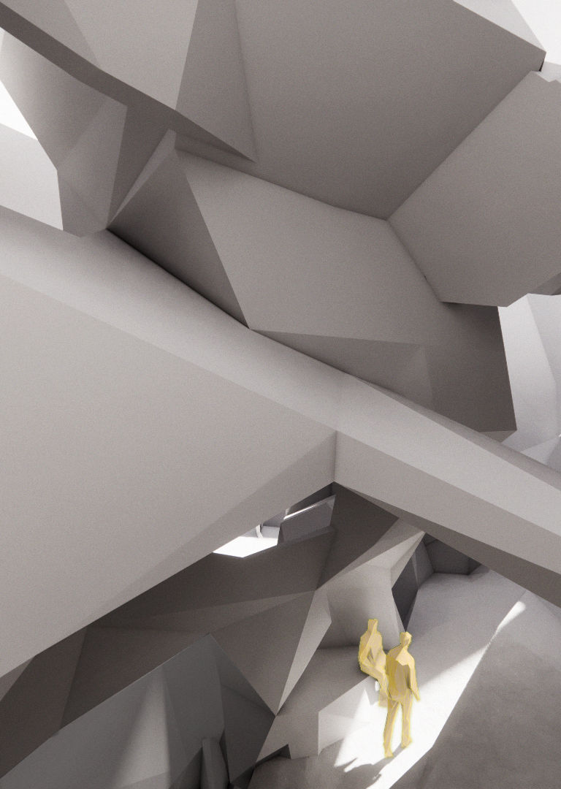
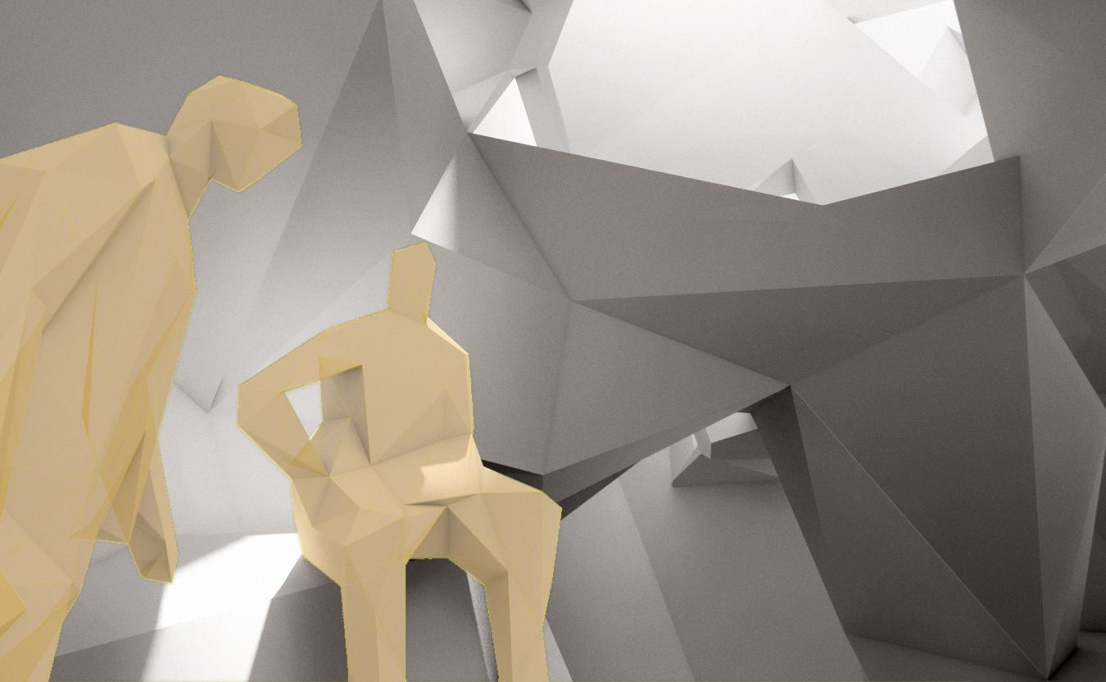
Design
impressions
Meeting and socialising

