Slide 1
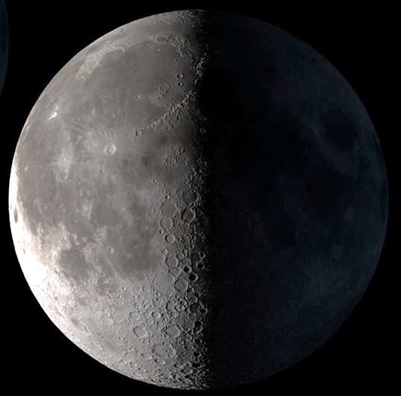
Designing Lunar Architecture

Slide 2

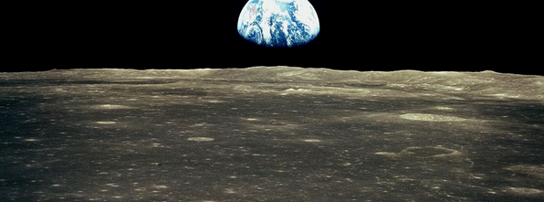
Near side of the Moon Lunar Equator
Location: Earth view
Earth directly overhead
Desirable for earth view from above
Lunar Poles
Earth visible at the horizon
Sometimes drops below horizon – not visible
2
Sophia Benfield | MoonSane | Lunar Architecture | Tutors: H. Bier & A. Hidding & F. Adema | 2024/25 | TU Delft

Slide 3
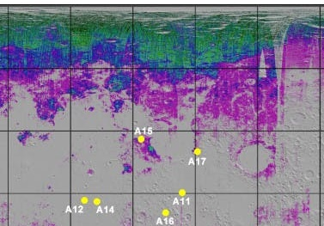
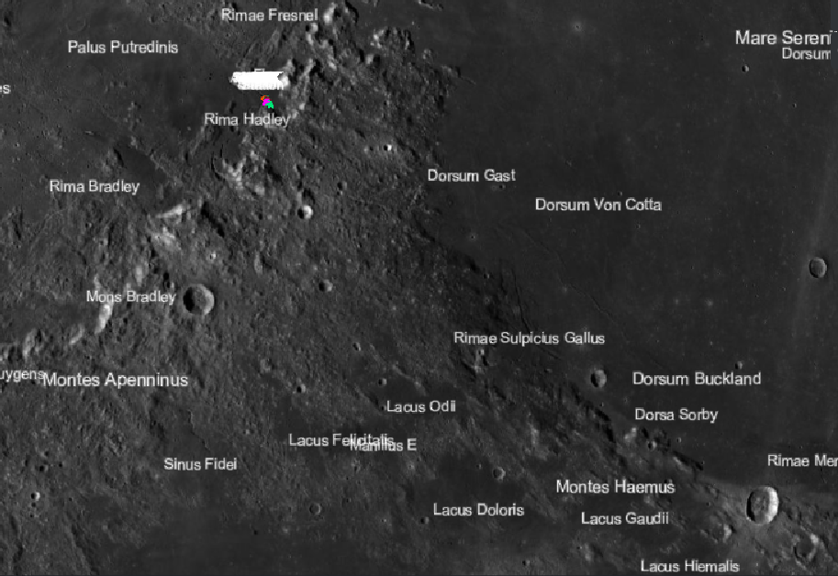

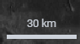
Location: Mare Serenitatis
330 ° 0 ° 30 ° 60 ° 90 °
90 °
60 °
30 °
0 °
Apollo 15
Source: Brown University
Edge of Mare Serenitatis
Presumed water/ice
Near Apollo 15 landing site
Source: Lunar/LROC Quickmap
3
Sophia Benfield | MoonSane | Lunar Architecture | Tutors: H. Bier & A. Hidding & F. Adema | 2024/25 | TU Delft

Slide 4
Program: main rooms
Main rooms
Private quarters
Sleeping area
Living quarters
Social area, eating area, kitchen
Research facility
Command and control
Workspace
Gym
Bathroom (&toilet)
Medical facility
Antechamber for EVA’s
(regolith cleaning and suit doffing)
Stowage
Additional rooms
Garden
Meditation space
earth viewing
“Minimum volume of 80m3 per person” (ESA)
4
Sophia Benfield | MoonSane | Lunar Architecture | Tutors: H. Bier & A. Hidding & F. Adema | 2024/25 | TU Delft

Slide 5
Program: minimum size
Room | m3 (1 person) | % | Same time use | Multiply factor | m3 (6 persons) | %
Private crew quarters | 2,5 | 3% | Yes - but separate | x 6 | 15 | 3,5%
Living quarters | 13,5 | 15% | Yes | x 6 | 81 | 19,5%
Kitchen | 2,5 | 3 % | Not all | x 2 | 5 | 1%
Research facility | 11 | 13% | Yes | x 6 | 66 | 16%
Garden Gym | 13,5 8 | 15% 9% | Yes Not all | x 6 x 3 | 81 24 | 19,5% 5,5%
Bathroom | 5 | 6% | Not all | x 2 | 10 | 2,5%
Medical facility | 8 | 9% | Not all | x 2 | 16 | 4%
EVA antechamber | 8 | 9% | Not all | x 3 | 24 | 5,5%
Storage general | 8 | 9% | Yes | x 6 | 48 | 11,5%
Subtotal: | 80 | 91% |  |  | 370 | 88,5%
Meditation space | 8 | 9% | Yes | x 6 | 48 | 11,5%
Total: | 88 | 100% |  |  | 418 | 100%
5
Sophia Benfield | MoonSane | Lunar Architecture | Tutors: H. Bier & A. Hidding & F. Adema | 2024/25 | TU Delft

Slide 6
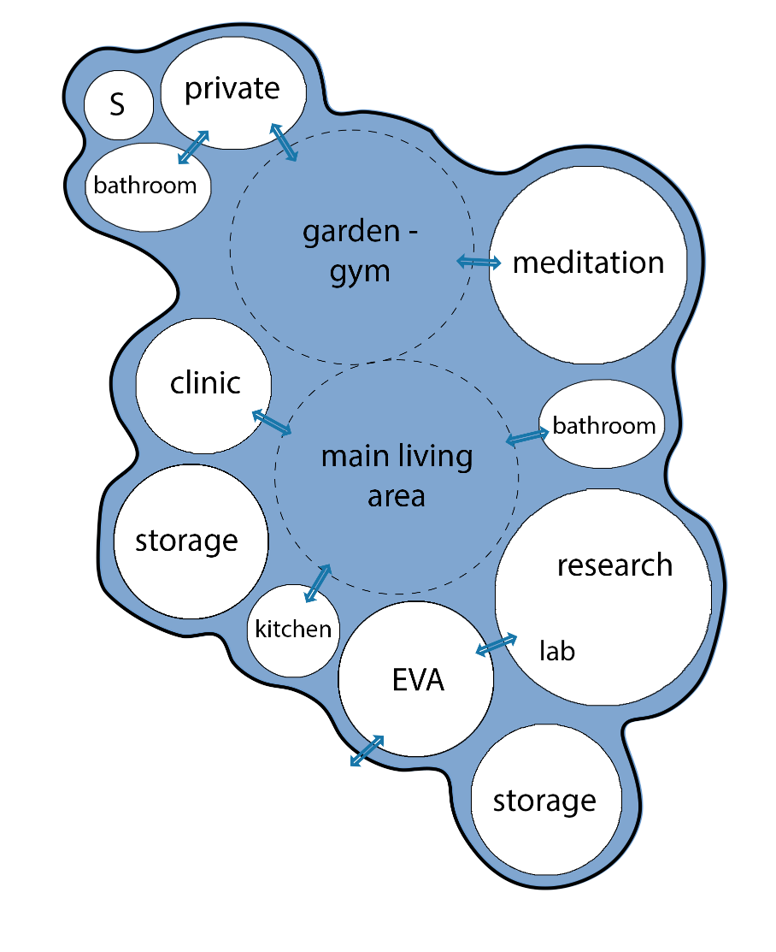
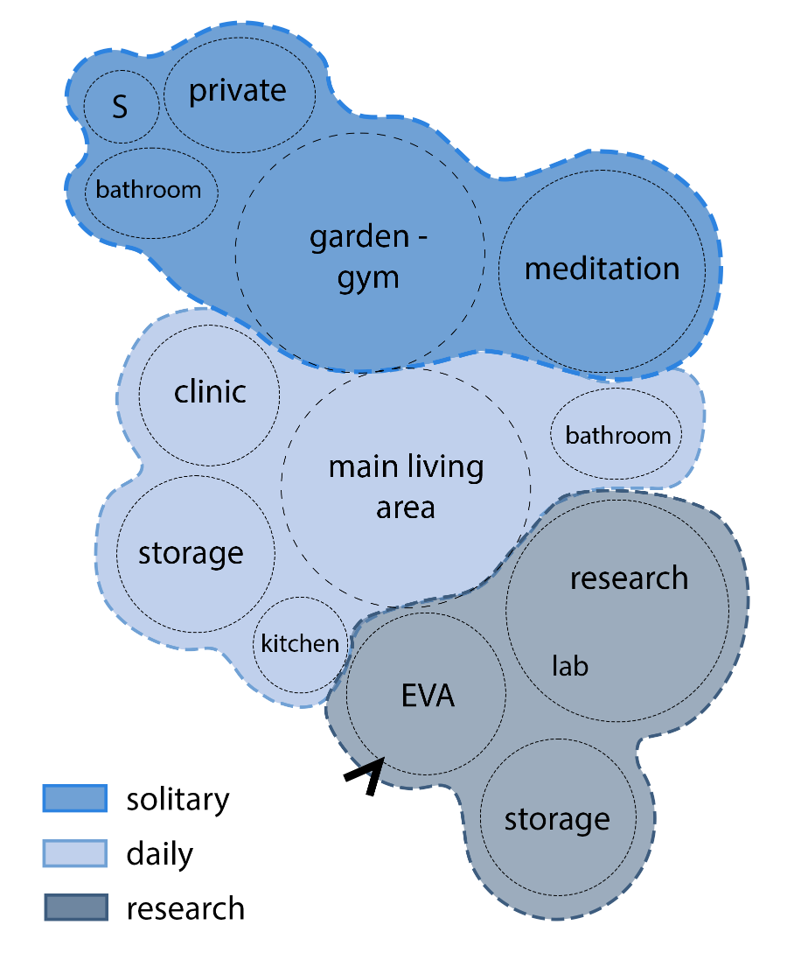
Connecting functions 2D
6
Sophia Benfield | MoonSane | Lunar Architecture | Tutors: H. Bier & A. Hidding & F. Adema | 2024/25 | TU Delft

Slide 7
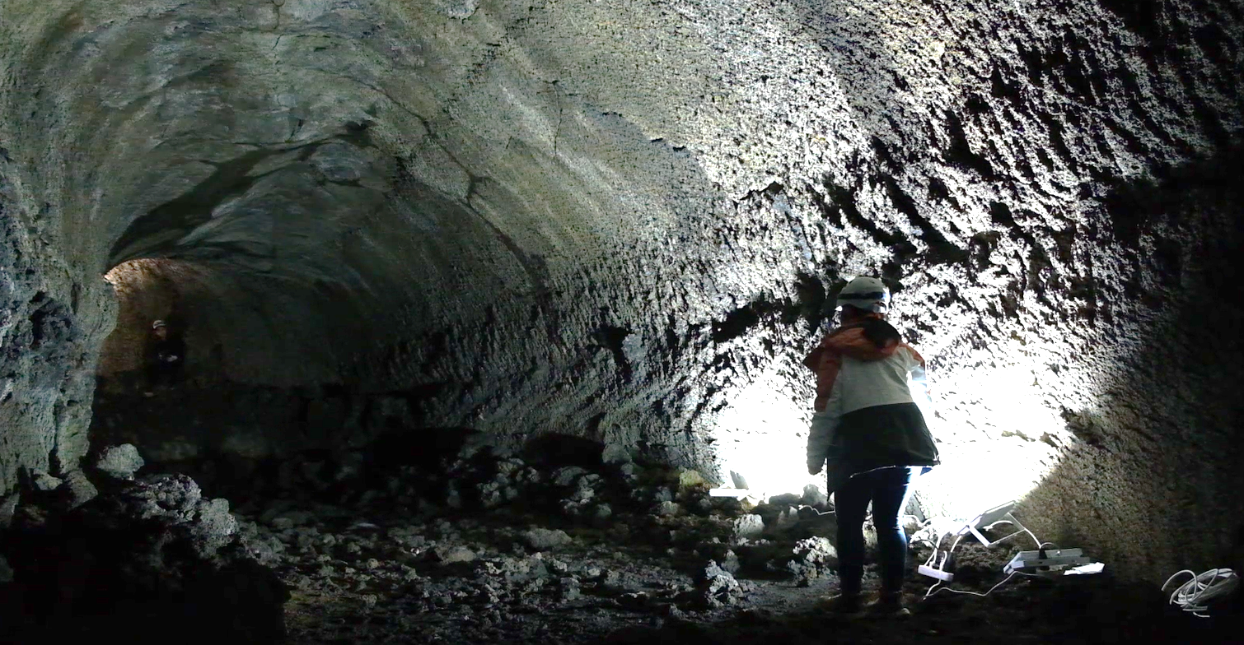
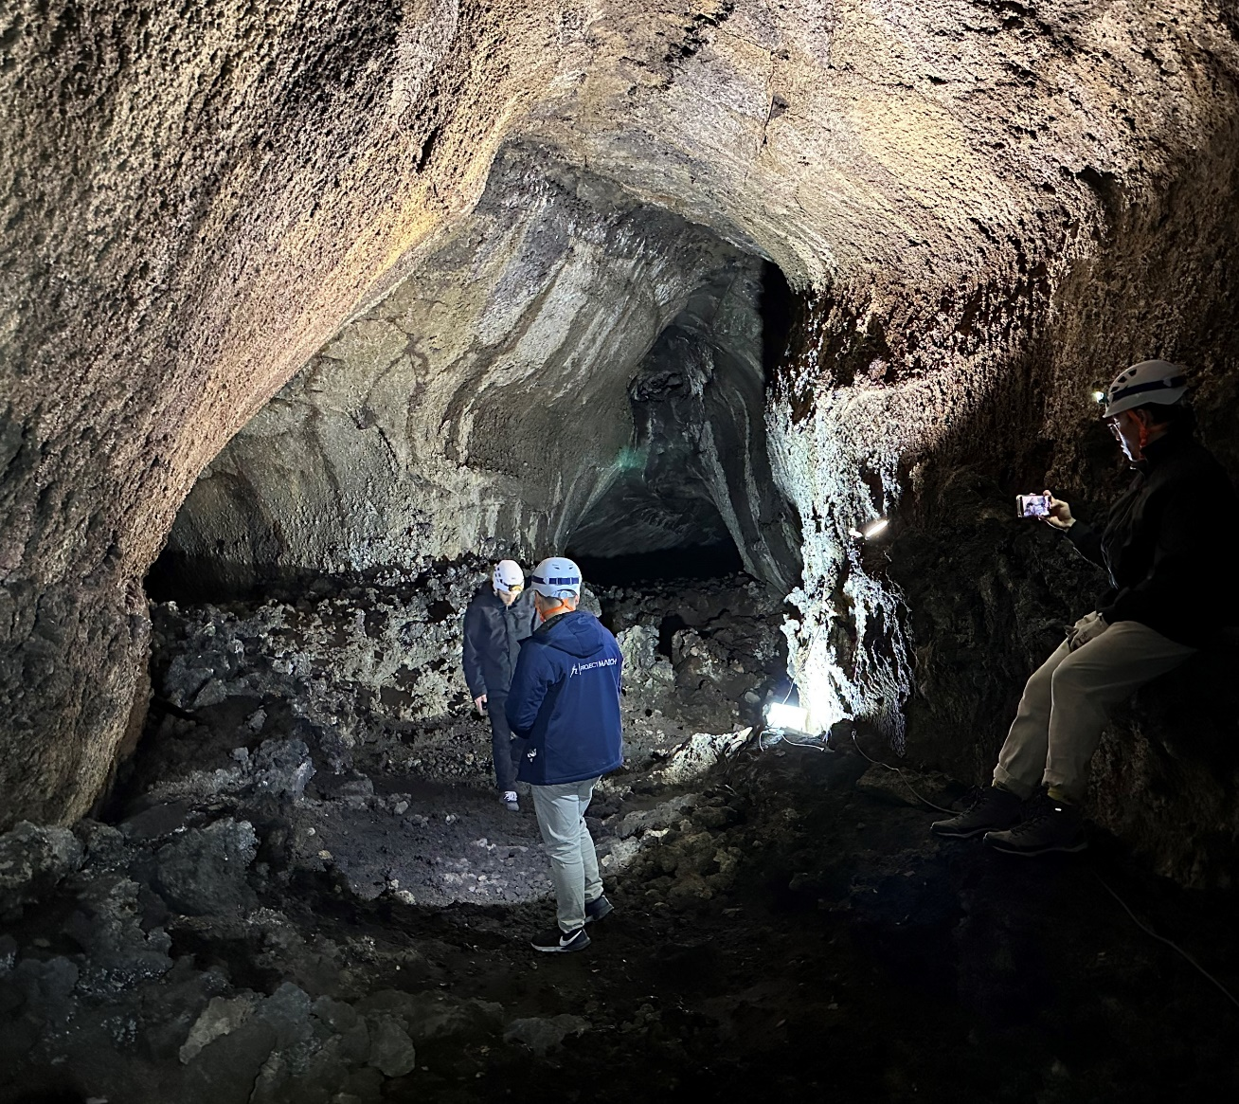
Lava tube mission
Corridors branching out
7
Sophia Benfield | MoonSane | Lunar Architecture | Tutors: H. Bier & A. Hidding & F. Adema | 2024/25 | TU Delft

Slide 8
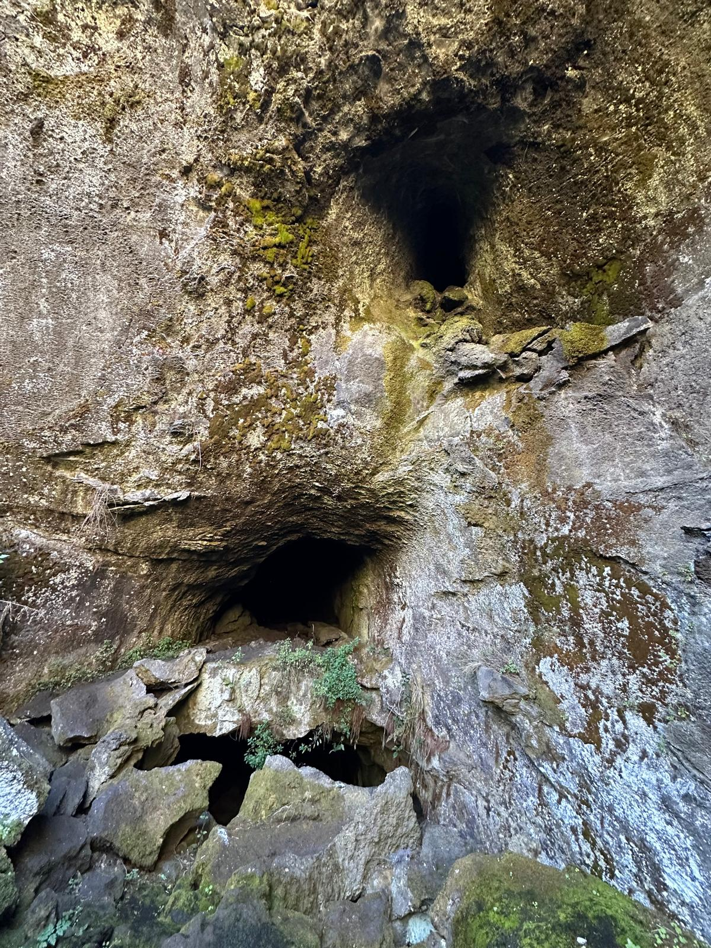
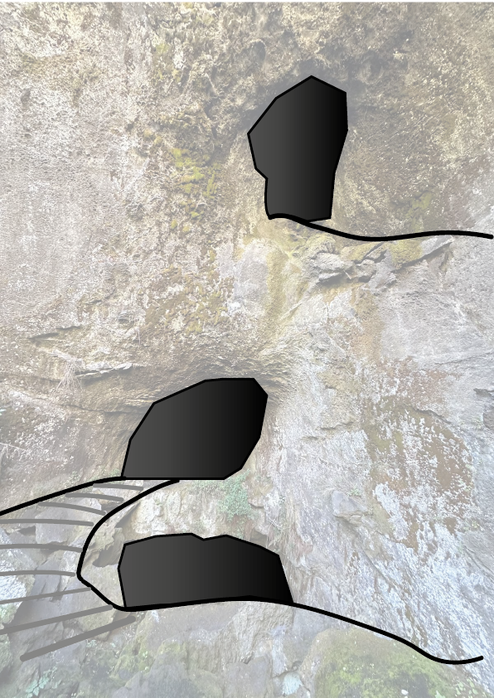
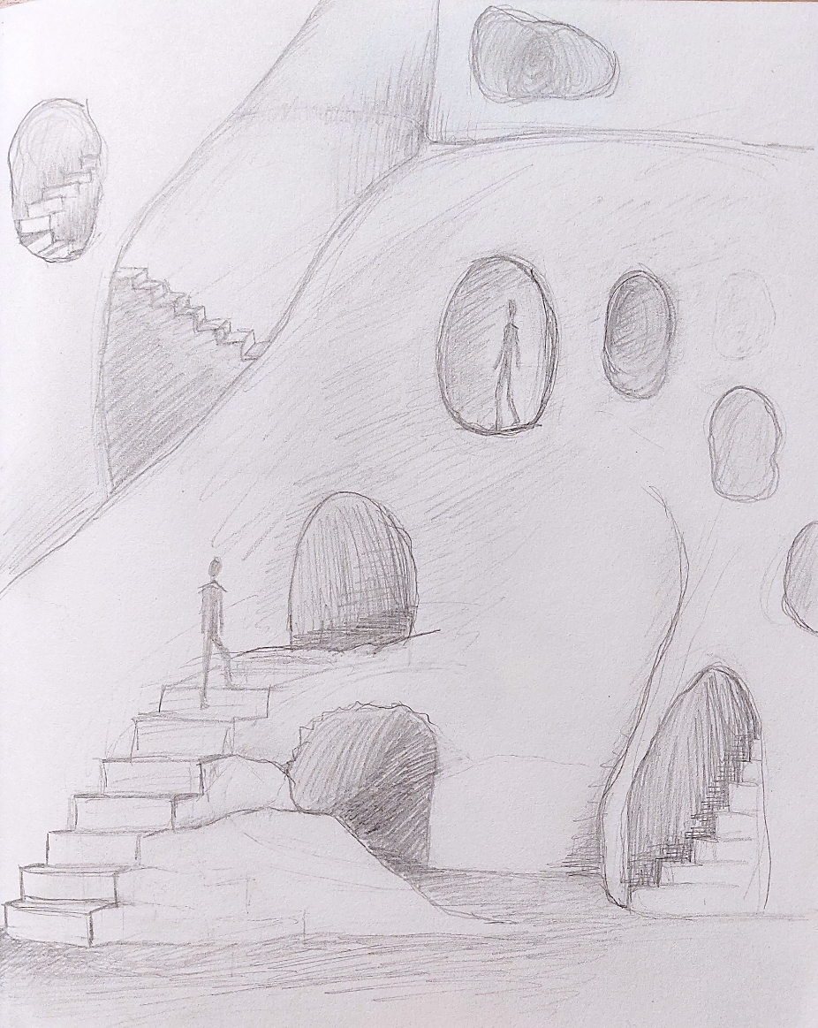
Lava tube mission: sketching
8
Sophia Benfield | MoonSane | Lunar Architecture | Tutor: H. Bier & A. Hidding | 2024/25 | TU Delft

Slide 9
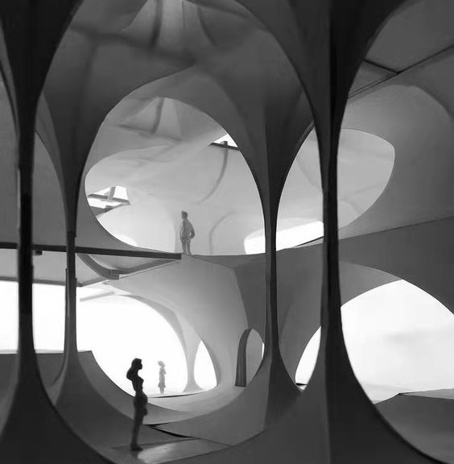
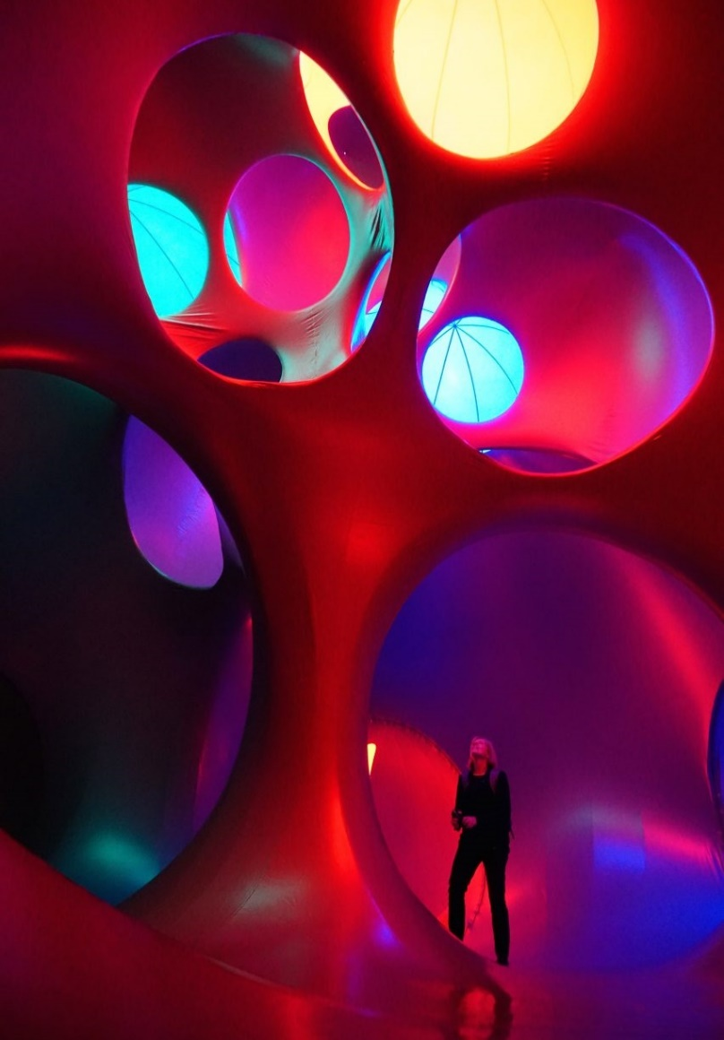
Spatial connection: 3D
Visually connecting spaces– decreasing confinement
Dynamic views
Big atrium that branches out
9
Sophia Benfield | MoonSane | Lunar Architecture | Tutors: H. Bier & A. Hidding & F. Adema | 2024/25 | TU Delft

Slide 10
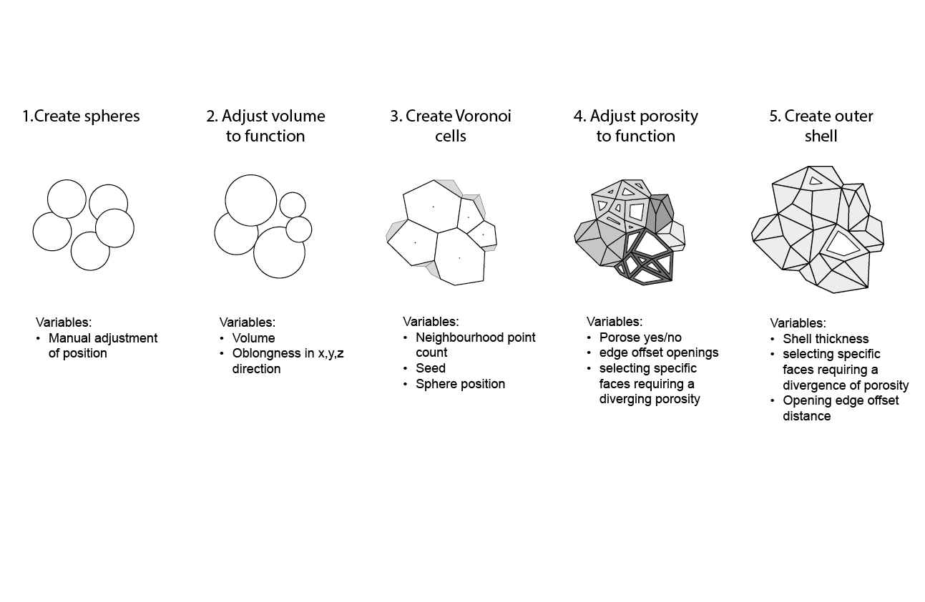
Permeability: computational script
10
Sophia Benfield | MoonSane | Lunar Architecture | Tutors: H. Bier & A. Hidding & F. Adema | 2024/25 | TU Delft

Slide 11
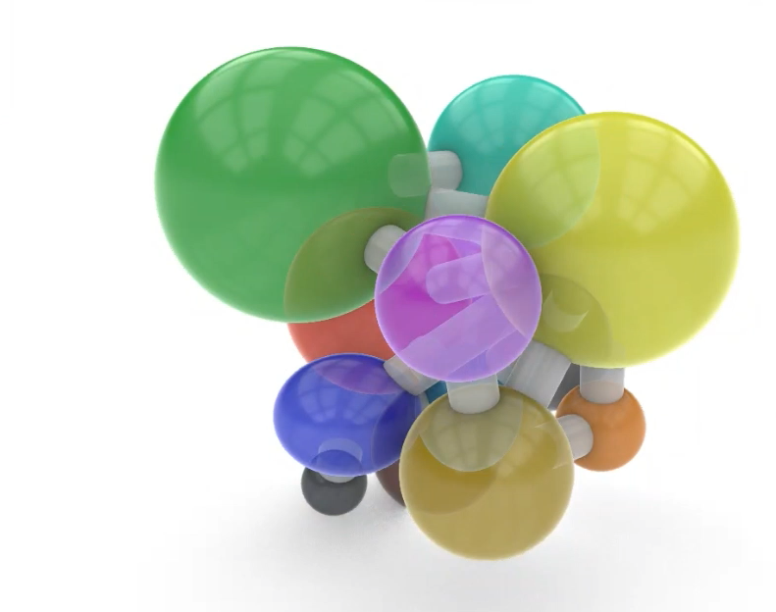
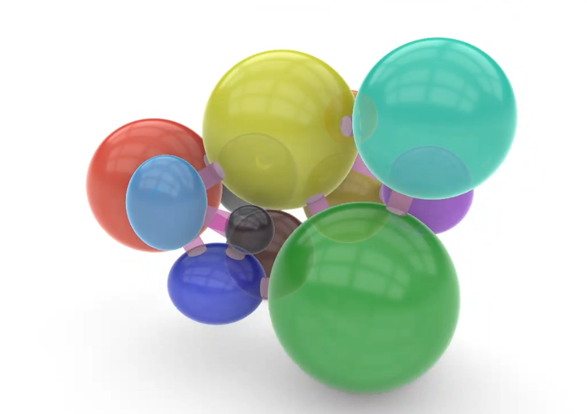
Connecting 3D: double atrium
 | Function
 | Living
 | Kitchen
 | Storage main
 | Meditation
 | Garden-gym
 | Medical
 | Private quarters
 | Bathroom
 | Storage private
 | Research
 | EVA chamber
 | Storage research
11
Sophia Benfield | MoonSane | Lunar Architecture | Tutors: H. Bier & A. Hidding & F. Adema | 2024/25 | TU Delft

Slide 12
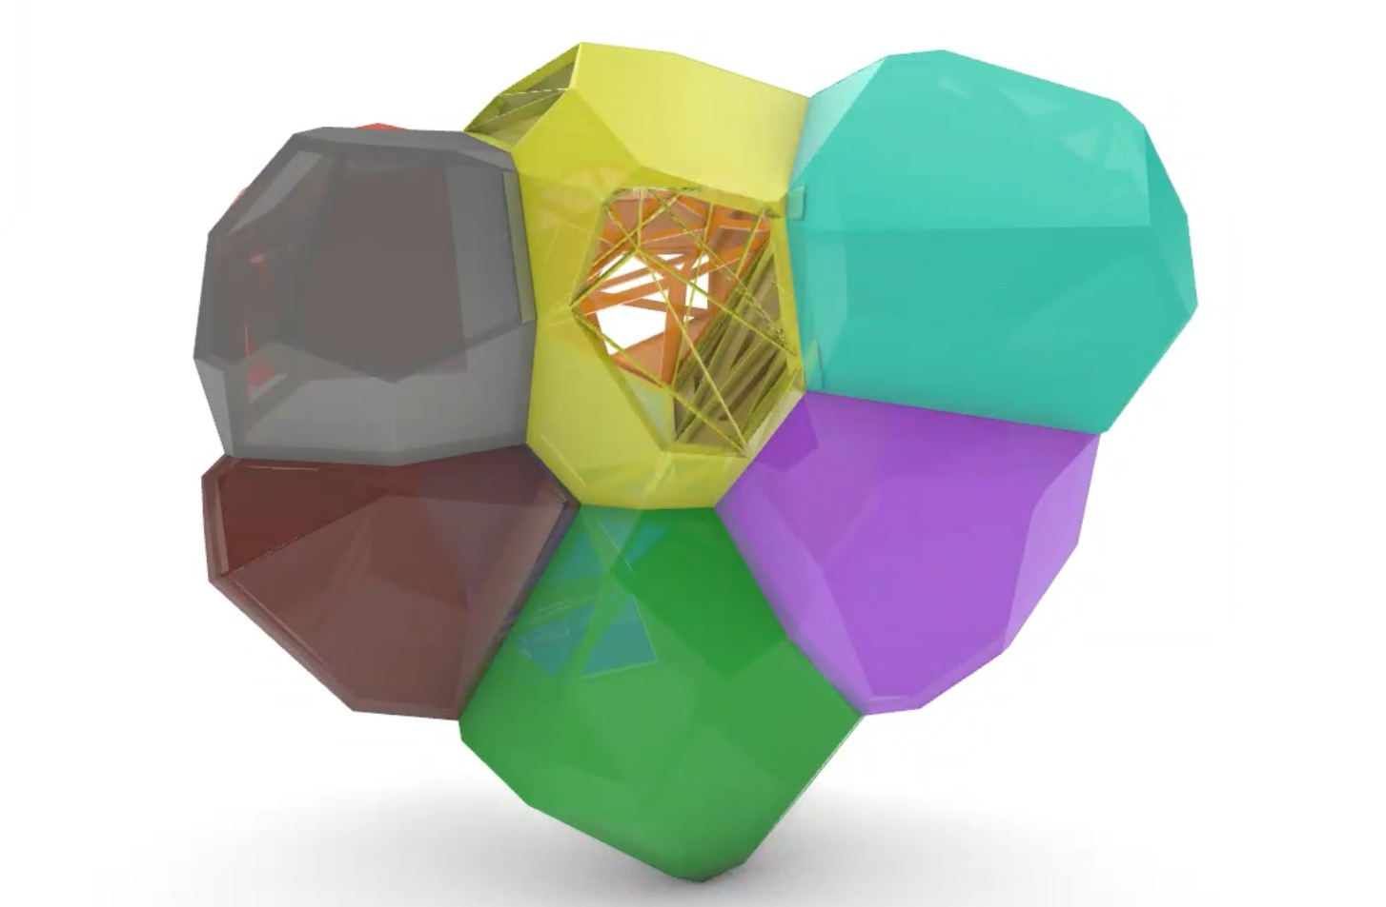
Permeability: Voronoi
 | Function | Permeability
 | Living | 80%
 | Kitchen | 62%
 | Storage main | 16%
 | Meditation | 10%
 | Garden-gym | 50%
 | Medical | 10%
 | Private quarters | 3%
 | Bathroom | 0%
 | Storage private | 0%
 | Research | 8%
 | EVA chamber | 5%
 | Storage research | 0%
12
Sophia Benfield | MoonSane | Lunar Architecture | Tutors: H. Bier & A. Hidding & F. Adema | 2024/25 | TU Delft

Slide 13
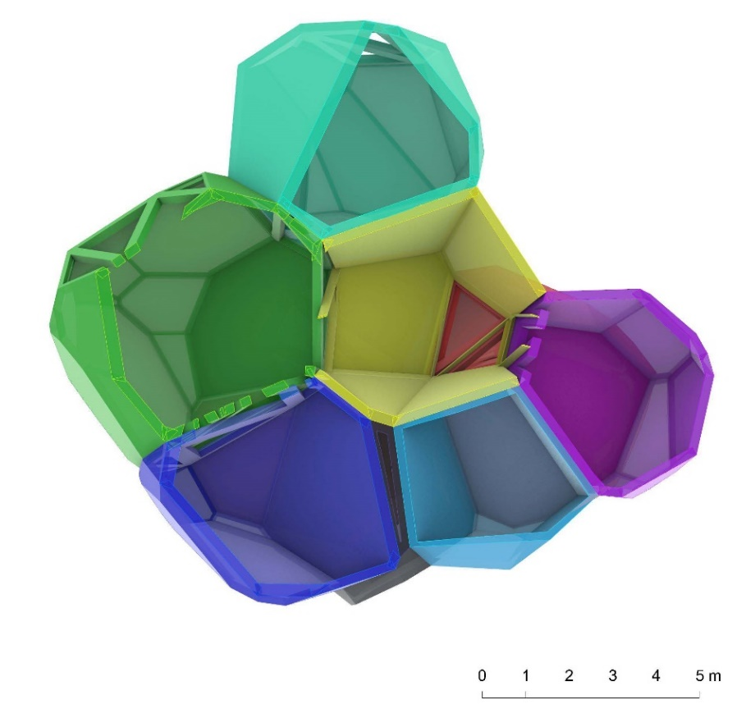
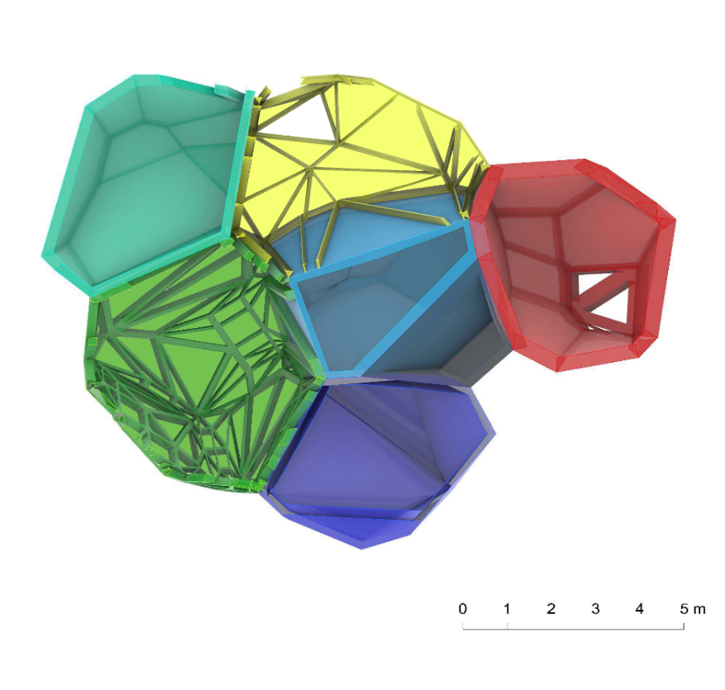
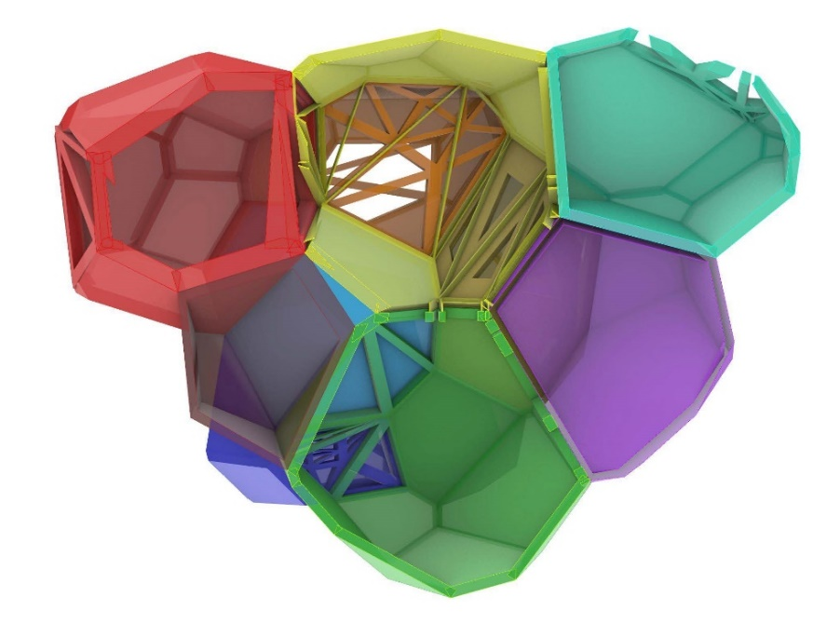
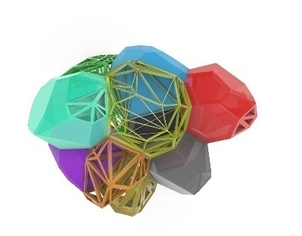
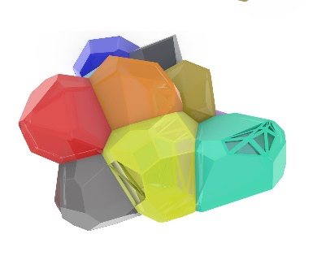
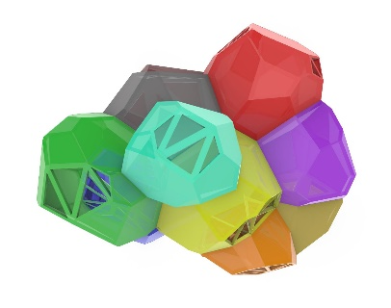

Permeability: iterations
13
Sophia Benfield | MoonSane | Lunar Architecture | Tutors: H. Bier & A. Hidding & F. Adema | 2024/25 | TU Delft

Slide 14
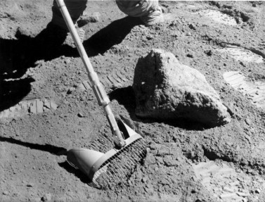
Exterior: Lunar Regolith
Main material:
Lunar Regolith
Strong compressive properties
Weak tensile properties
Radiation protection: will require thick walls (1,5+ m)
14
Sophia Benfield | MoonSane | Lunar Architecture | Tutors: H. Bier & A. Hidding & F. Adema | 2024/25 | TU Delft

Slide 15
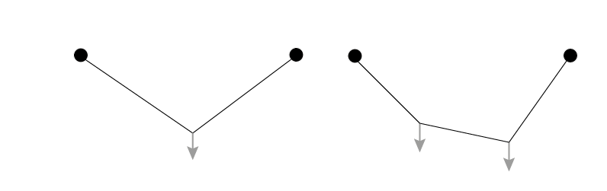
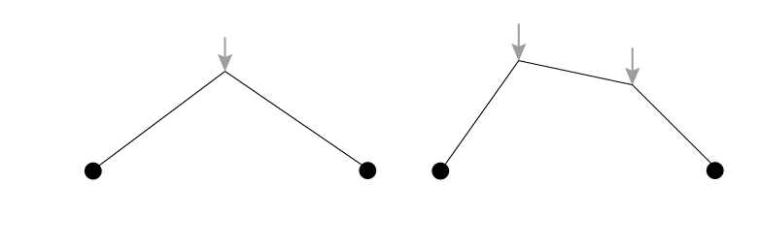
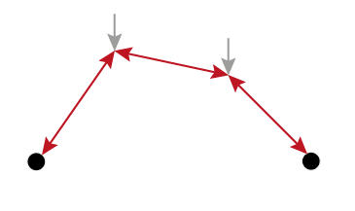
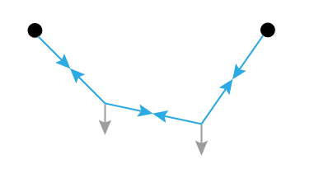
Catenary action
1 weight
2 weights
Mapping tensile forces by hanging weights on a cord
Inverted tension shows compression forces
15
Sophia Benfield | MoonSane | Lunar Architecture | Tutors: H. Bier & A. Hidding & F. Adema | 2024/25 | TU Delft

Slide 16
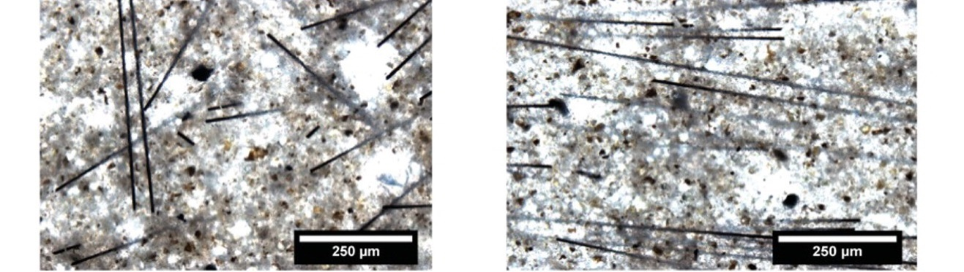
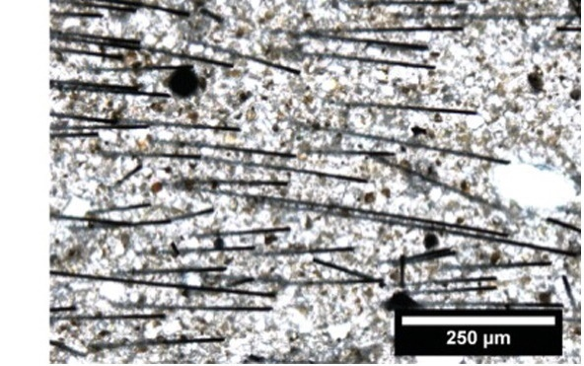
Carbon fibre
Reinforcing Lunar Regolith
Extract carbon to produce small fibres
Already applied in concrete
Add to Regolith mixture
improves tensile strength for static and dynamic loading
Hambach, M., Möller, H., Neumann, T., & Volkmer, D. (2016). Portland cement paste with aligned carbon fibers exhibiting exceptionally high flexural strength (> 100 MPa). Cement and Concrete Research, 89, 80-86.
16
Sophia Benfield | MoonSane | Lunar Architecture | Tutors: H. Bier & A. Hidding & F. Adema | 2024/25 | TU Delft

Slide 17
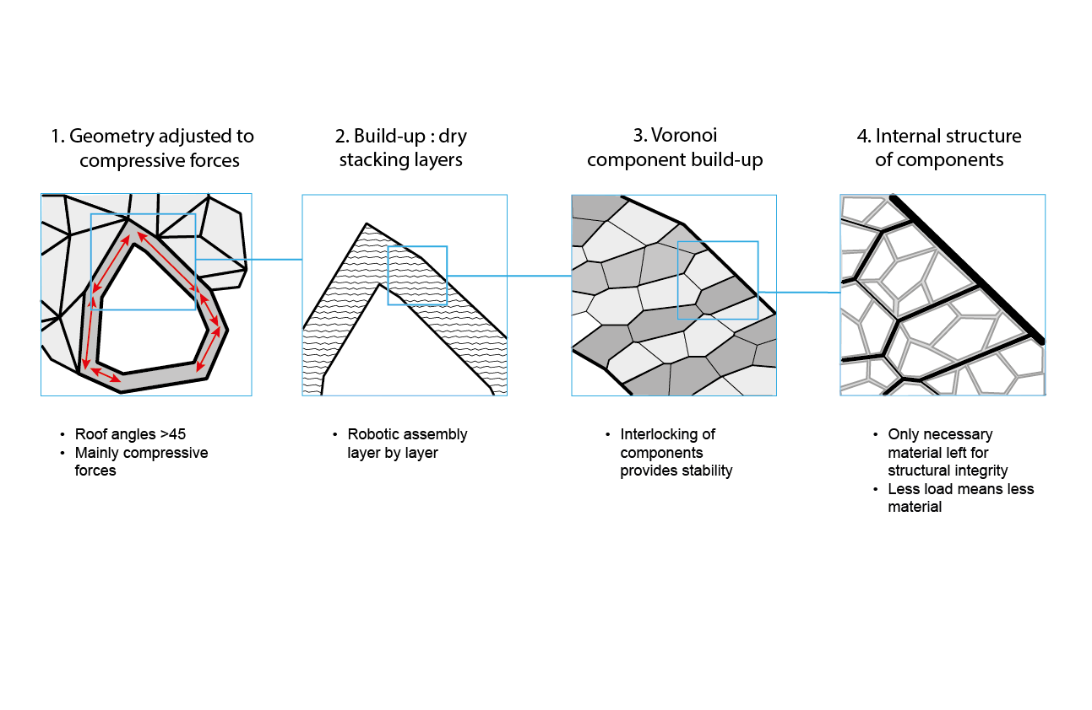
Catenary action: building
17
Sophia Benfield | MoonSane | Lunar Architecture | Tutors: H. Bier & A. Hidding & F. Adema | 2024/25 | TU Delft

Slide 18
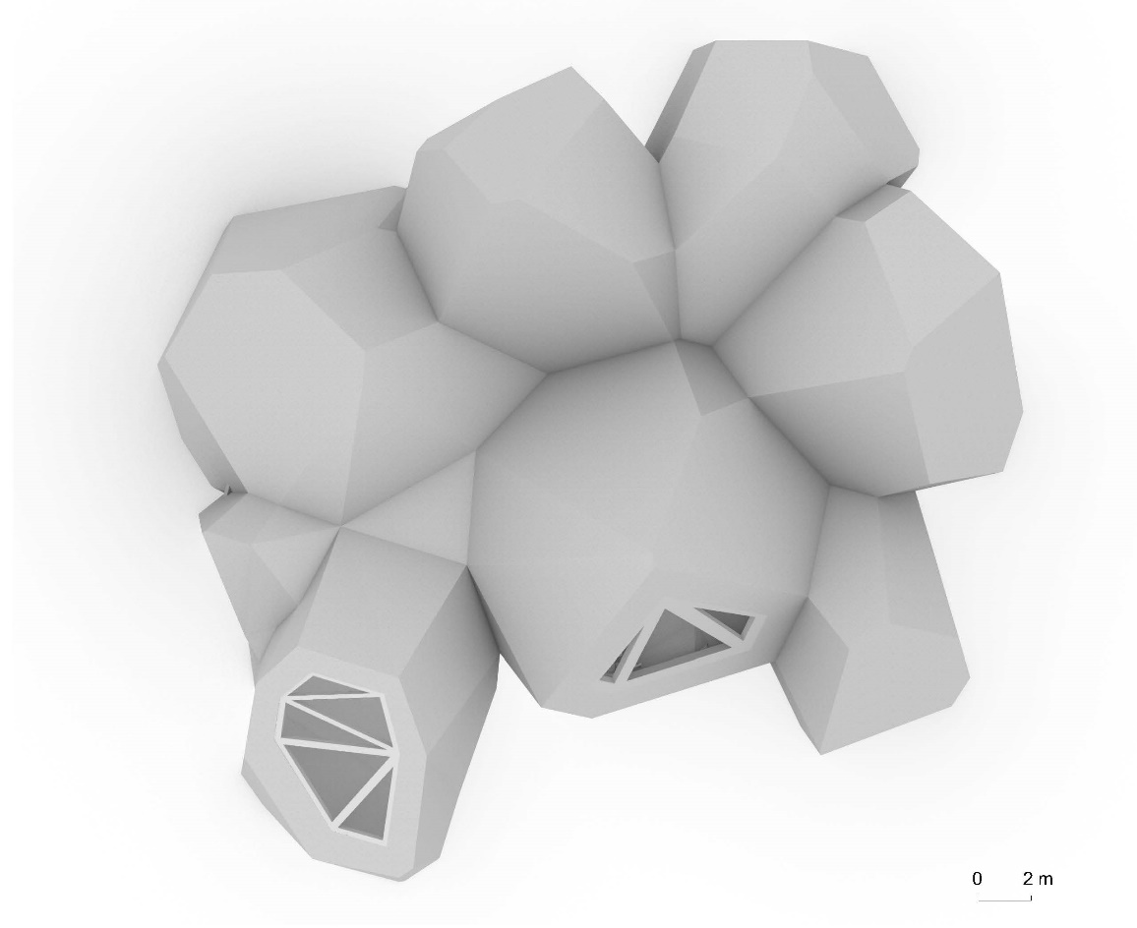

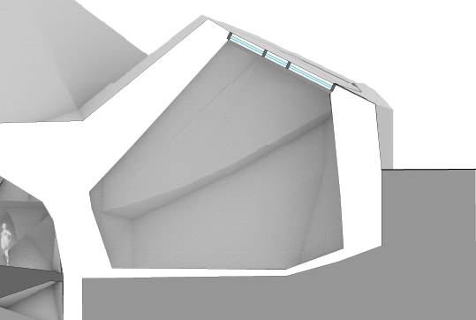

Creating views
Meditation space:
Map Earth view
N
Sky position
Latitude: 20
Zenith
20°
Orientation Longitude: 10
10°
18
Sophia Benfield | MoonSane | Lunar Architecture | Tutors: H. Bier & A. Hidding & F. Adema | 2024/25 | TU Delft

Slide 19
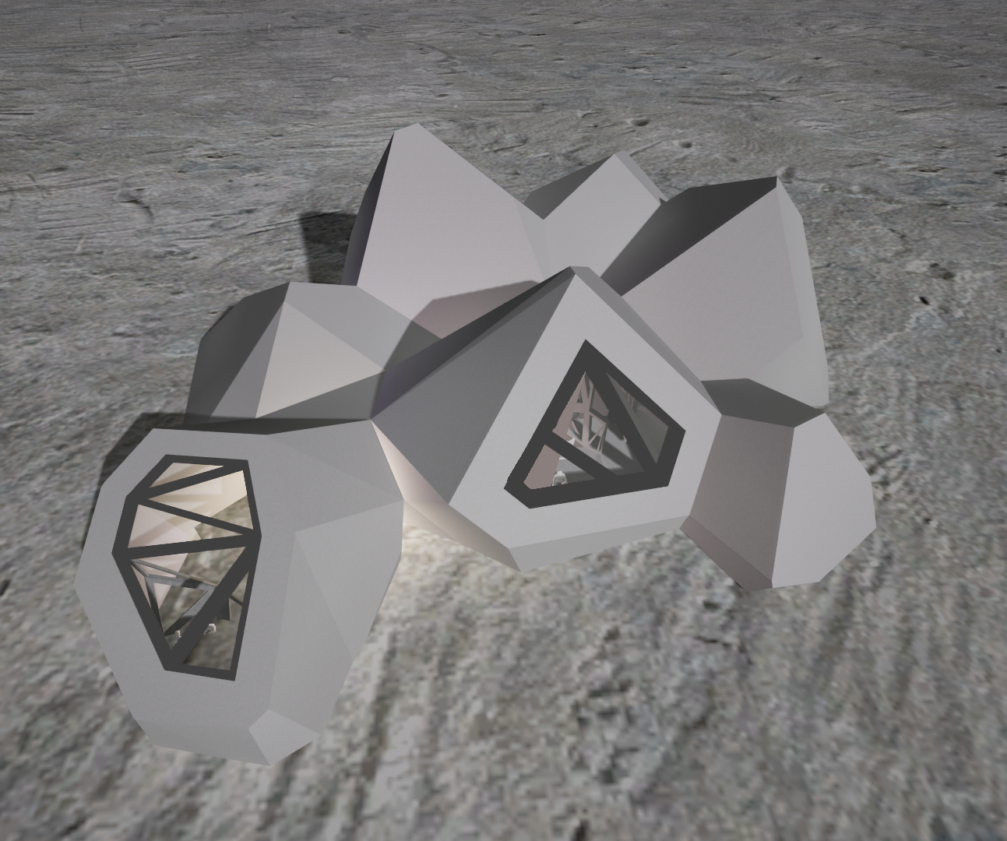
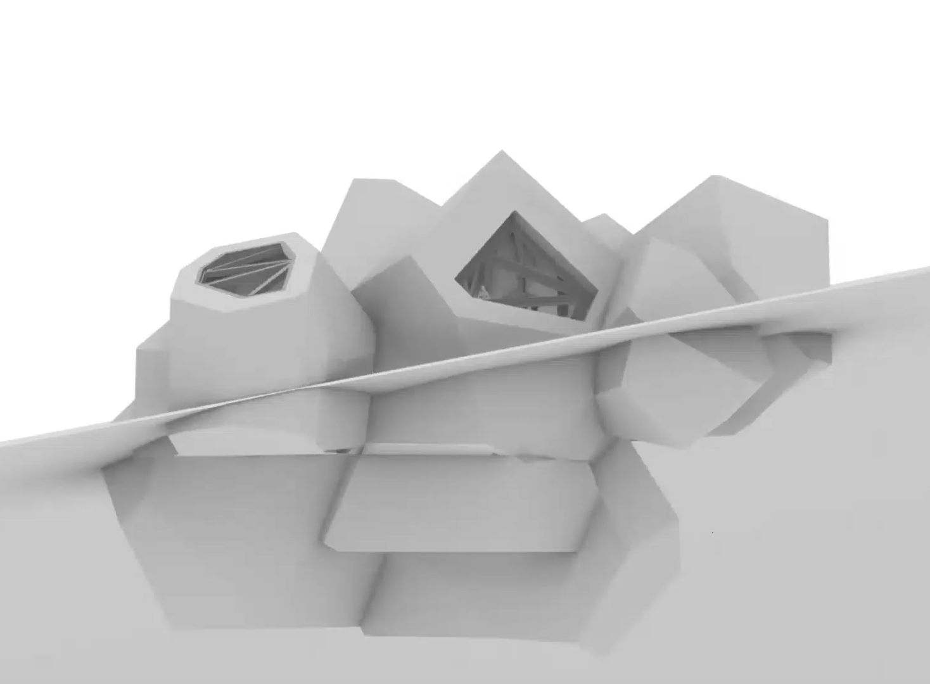
Building in location
Surface view
Dynamic section
19
Sophia Benfield | MoonSane | Lunar Architecture | Tutors: H. Bier & A. Hidding & F. Adema | 2024/25 | TU Delft

Slide 20
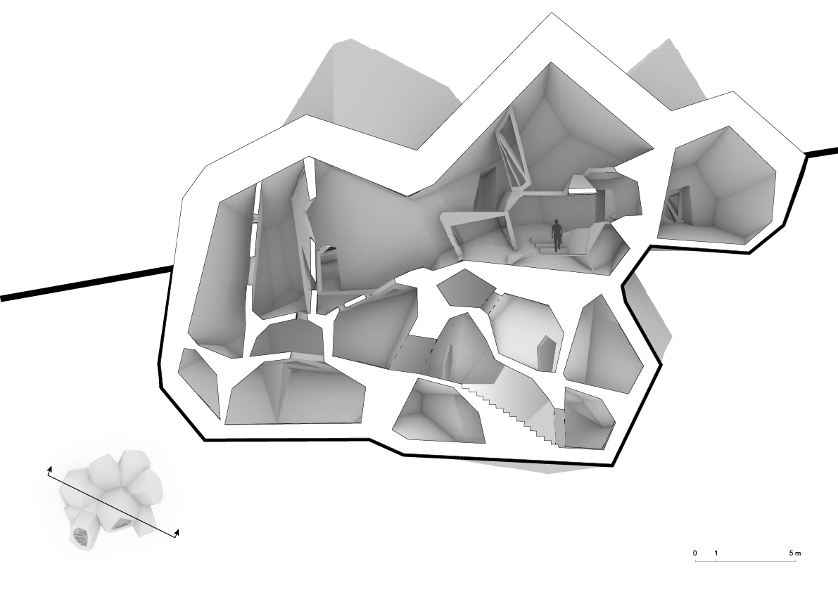
Plans
Section A
Section B
1 : 100
20
Sophia Benfield | MoonSane | Lunar Architecture | Tutors: H. Bier & A. Hidding & F. Adema | 2024/25 | TU Delft

Slide 21
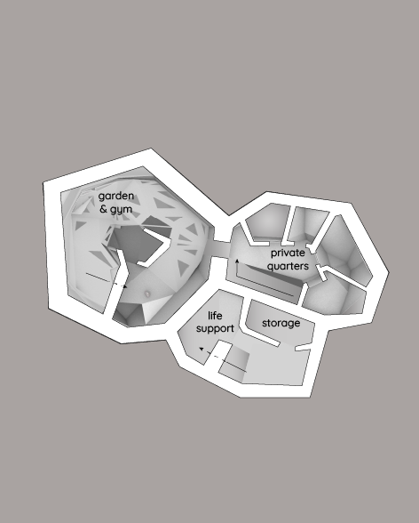
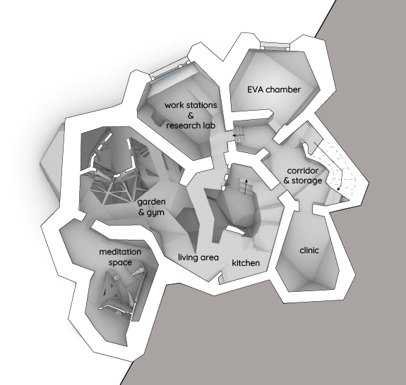
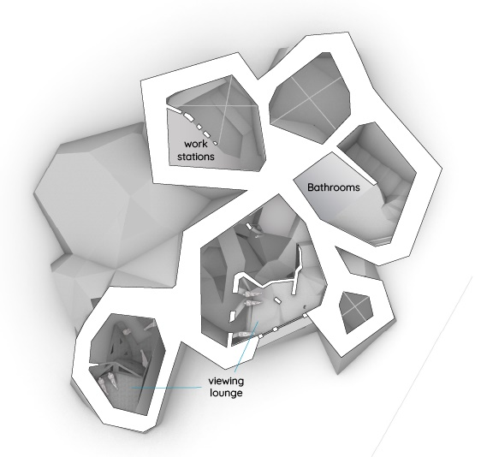


Plans
Plan -1
-6.6 m
Plan 0
0 m
Plan +1
+3.6 m
21
Sophia Benfield | MoonSane | Lunar Architecture | Tutors: H. Bier & A. Hidding & F. Adema | 2024/25 | TU Delft

Slide 22

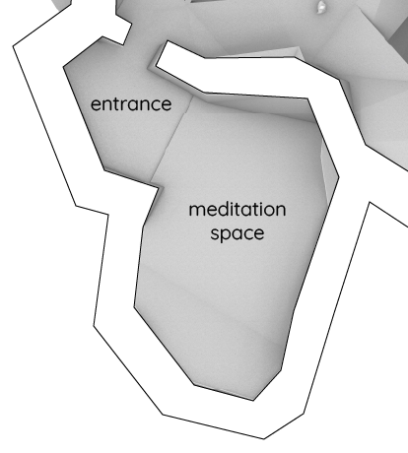

Meditation space
22
Sophia Benfield | MoonSane | Lunar Architecture | Tutors: H. Bier & A. Hidding & F. Adema | 2024/25 | TU Delft

Slide 23
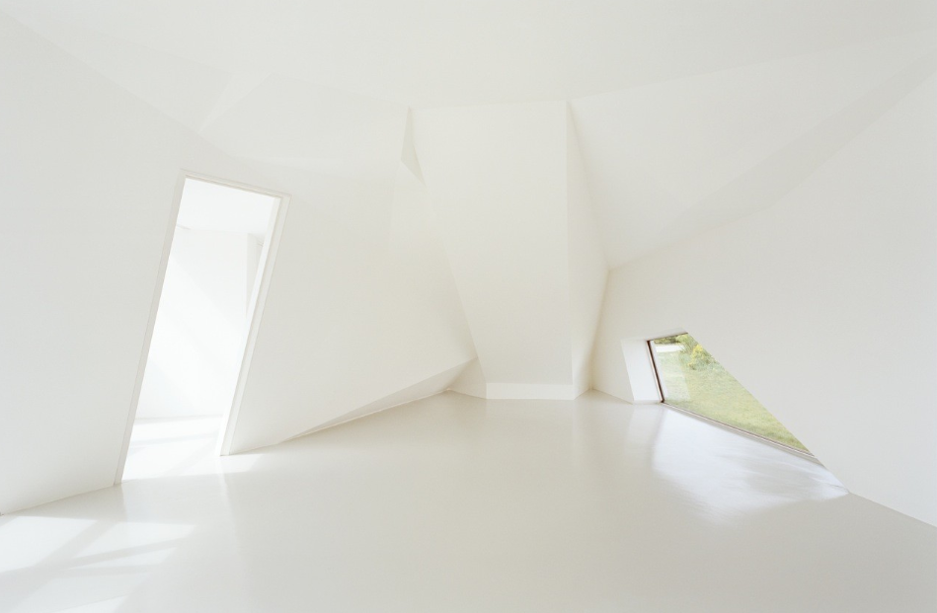
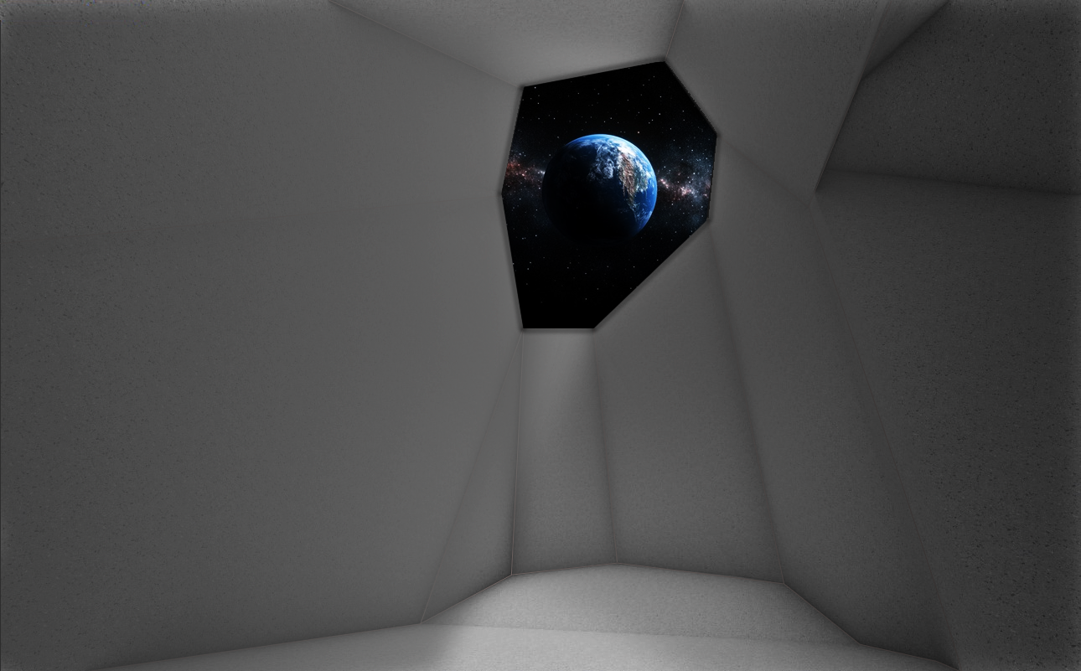
Asymmetric geometry
St. Joseph House - Wolfgang Tschapeller ZT GmbH
Interior meditation space
Source: St. Joseph House / Wolfgang Tschapeller ZT GmbH | ArchDaily
23
Sophia Benfield | MoonSane | Lunar Architecture | Tutors: H. Bier & A. Hidding & F. Adema | 2024/25 | TU Delft

Slide 24
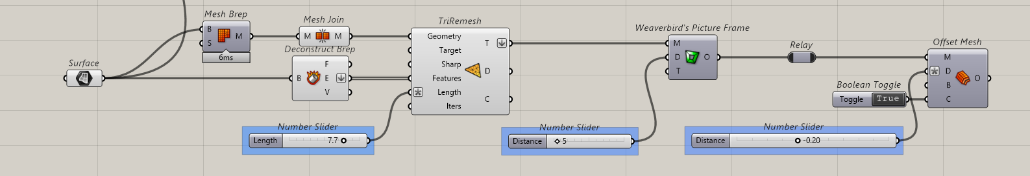
Methodology: computational design
Permeability study: furniture scale
1. triangulation
2. opening size
3. thickness
24
Sophia Benfield | MoonSane | Lunar Architecture | Tutors: H. Bier & A. Hidding & F. Adema | 2024/25 | TU Delft

Slide 25

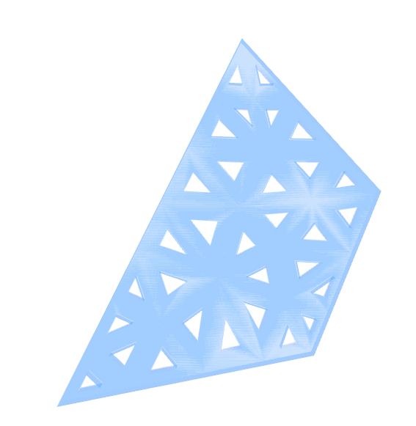



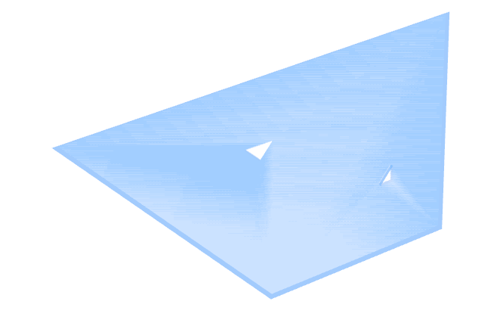
Permeability script
high
low
triangulation
opening size
25
Sophia Benfield | MoonSane | Lunar Architecture | Tutors: H. Bier & A. Hidding & F. Adema | 2024/25 | TU Delft

Slide 26
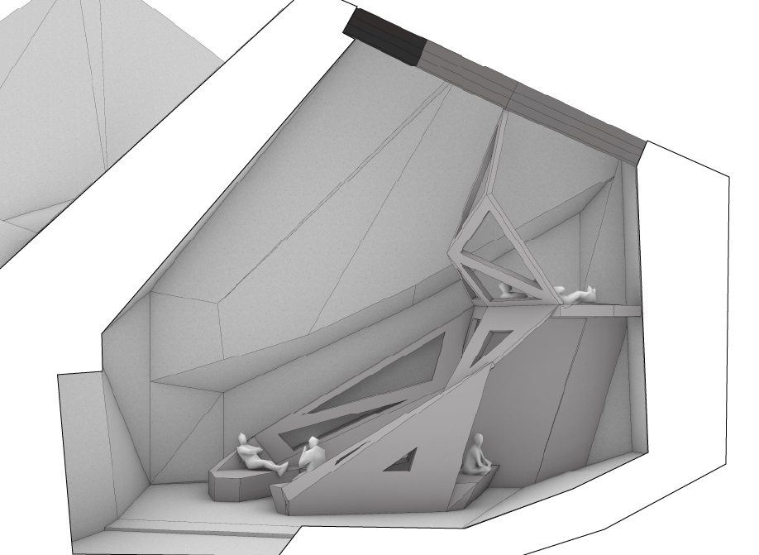
Interior division
Earth viewing
Relaxing
Reflecting
26
Sophia Benfield | MoonSane | Lunar Architecture | Tutors: H. Bier & A. Hidding & F. Adema | 2024/25 | TU Delft

Slide 27
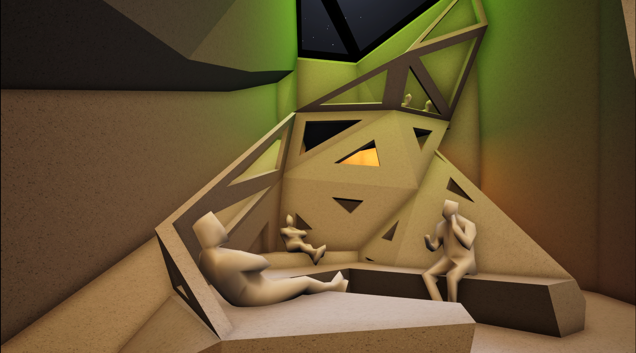
Relaxing
27

Slide 28
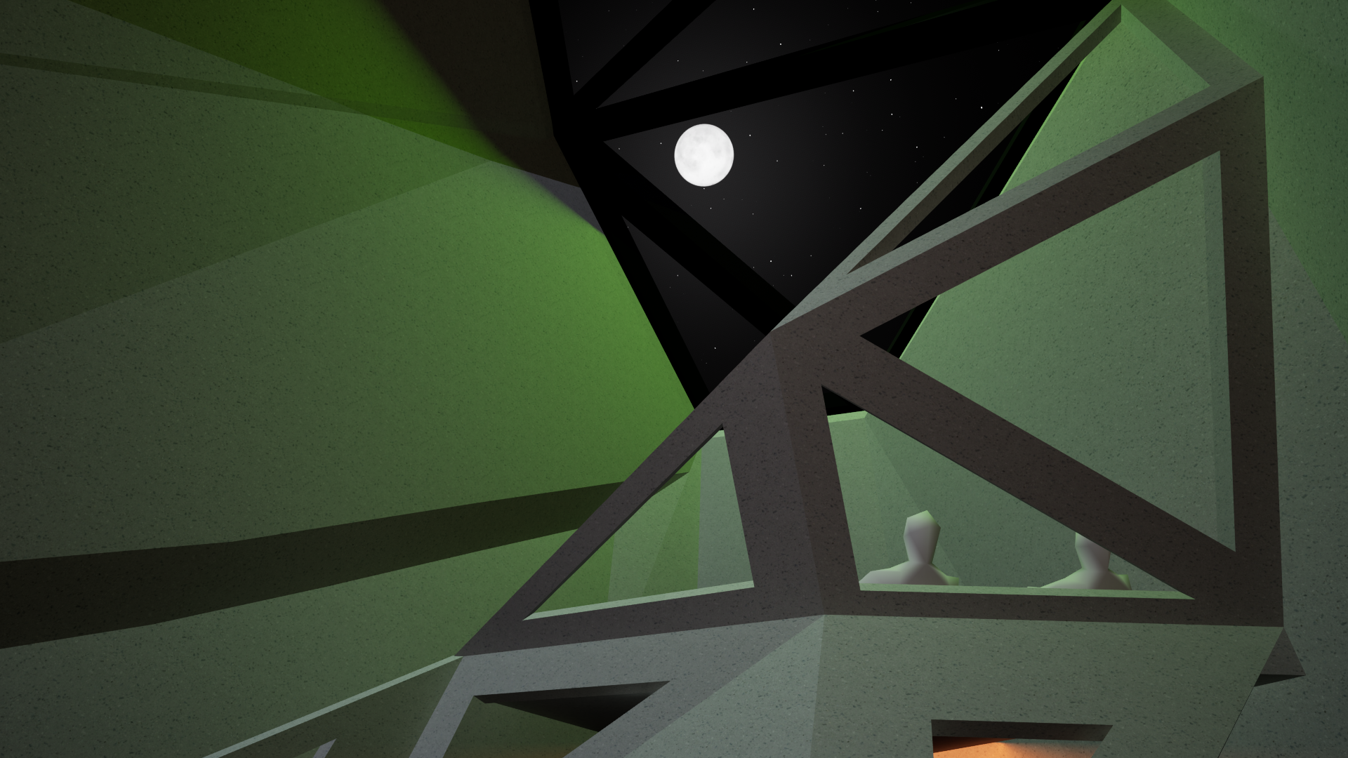
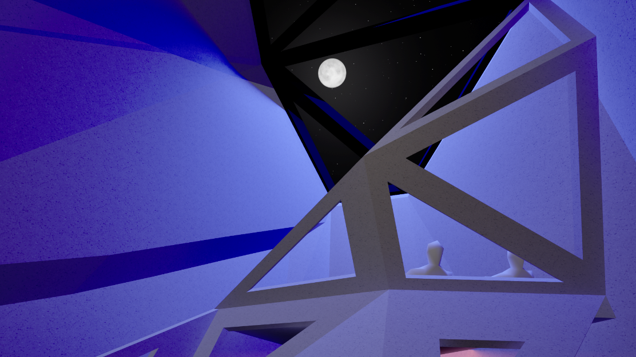


Earth viewing
28

Slide 29

Interior solitude space
Flexible OLED screens
Possible in irregular polygons
Lightweight & energy saving
Easy front-side maintenance and replacement
Adjustable colour and pattern
Monitoring physical state:
Heart rate
Temperature
Indicators of stress can inform visuals
Calming or uplifting effects
29
Sophia Benfield | MoonSane | Lunar Architecture | Tutors: H. Bier & A. Hidding & F. Adema | 2024/25 | TU Delft

Slide 30

Reflecting
30
Sophia Benfield | MoonSane | Lunar Architecture | Tutors: H. Bier & A. Hidding & F. Adema | 2024/25 | TU Delft

Slide 31




Impression daylight simulation
Sunrise
Midday
Sunset
31
Sophia Benfield | MoonSane | Lunar Architecture | Tutors: H. Bier & A. Hidding & F. Adema | 2024/25 | TU Delft

