Slide 1
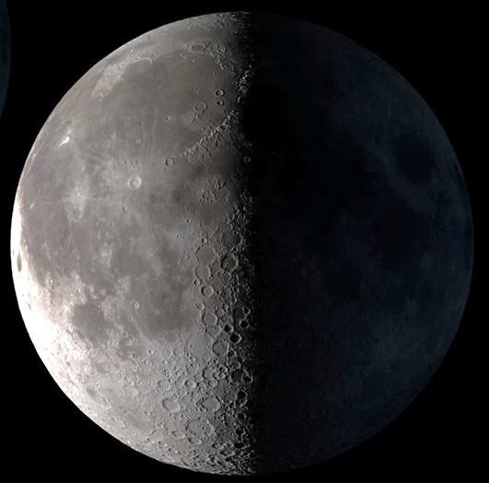
Constructing Lunar Architecture
Notes:
Now its time for construction

Slide 2
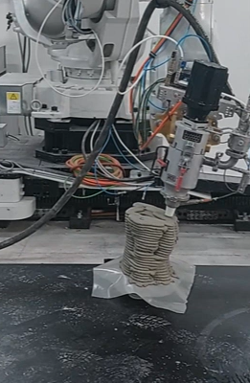
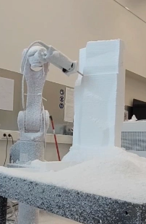
Workshop: component fabrication
Provides flexibility for Voronoi based geometry
Component adapted to form
Tested additive and subtractive method
2/67
Sophia Benfield | MoonSane | Lunar Architecture | Tutors: H. Bier & A. Hidding & F. Adema | 2024/25 | TU Delft
Notes:
The construction principle is based on PHD research from our faculty. Voronoi based components are stacked to create the thick wall that will protect against the harsh environment.
We did a workshop on the fabrication of these components, left shows the additive method and right shows the subtractive method. The additive method is what will be done with Lunar Regolith.

Slide 3
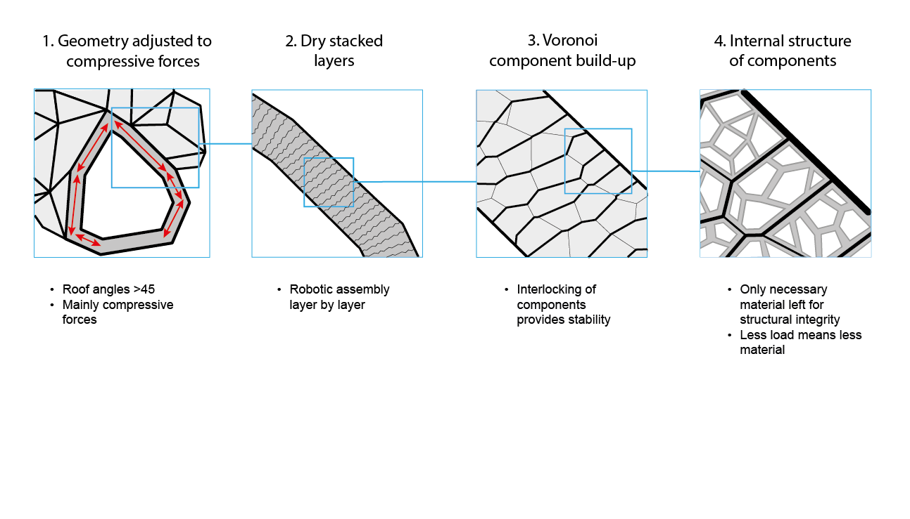
Wall construction
3/67
Sophia Benfield | MoonSane | Lunar Architecture | Tutors: H. Bier & A. Hidding & F. Adema | 2024/25 | TU Delft
Notes:
The geometry of the building has been adjusted to facilitate the compressive forces, with help of the Voronoi geometry I started with. When

Slide 4
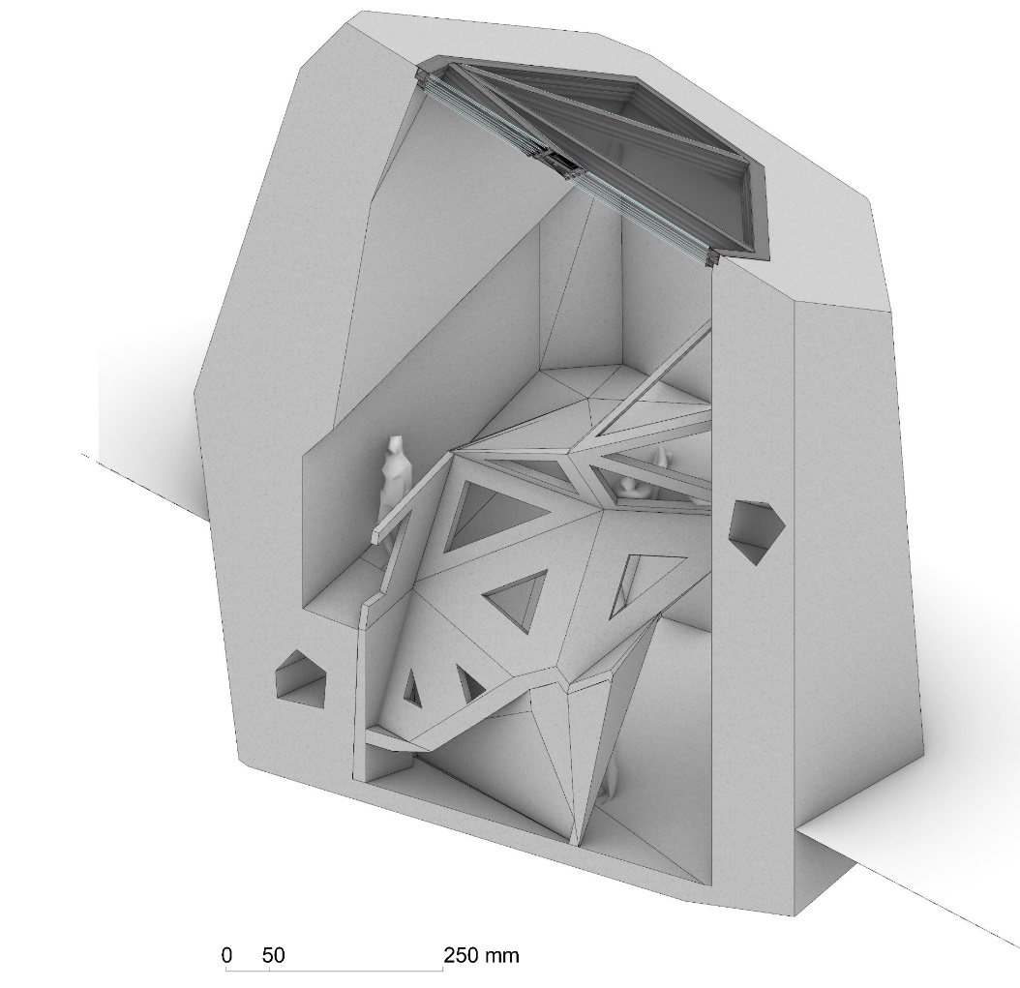
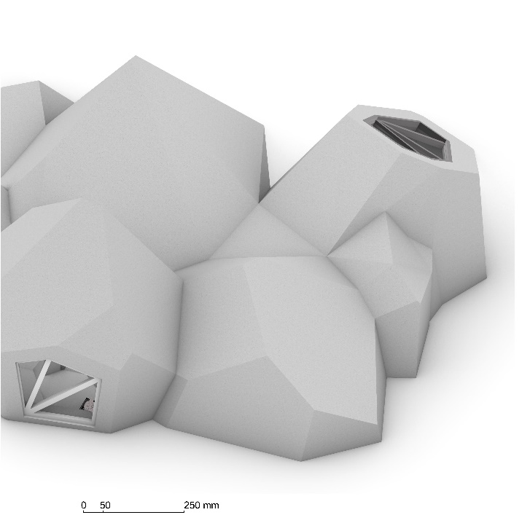
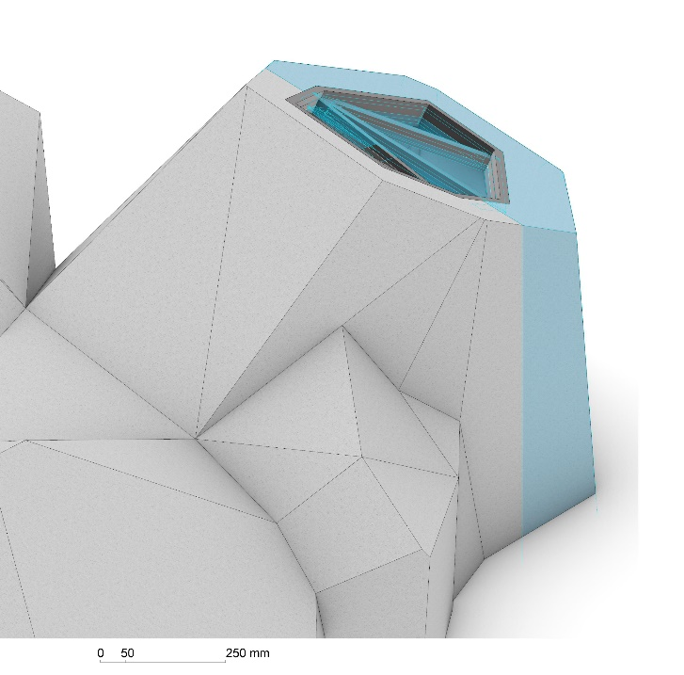
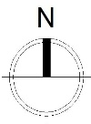
Fragment
North-west perspective
Section
Integrated walking ramp
Wall cavity for cables and pipes
Lunar surface
4/67
Sophia Benfield | MoonSane | Lunar Architecture | Tutors: H. Bier & A. Hidding & F. Adema | 2024/25 | TU Delft
Notes:
Like I have in my meditation space.
This is the fragment I chose, which is part of the meditation space, as it is most representative of my work and concept.

Slide 5
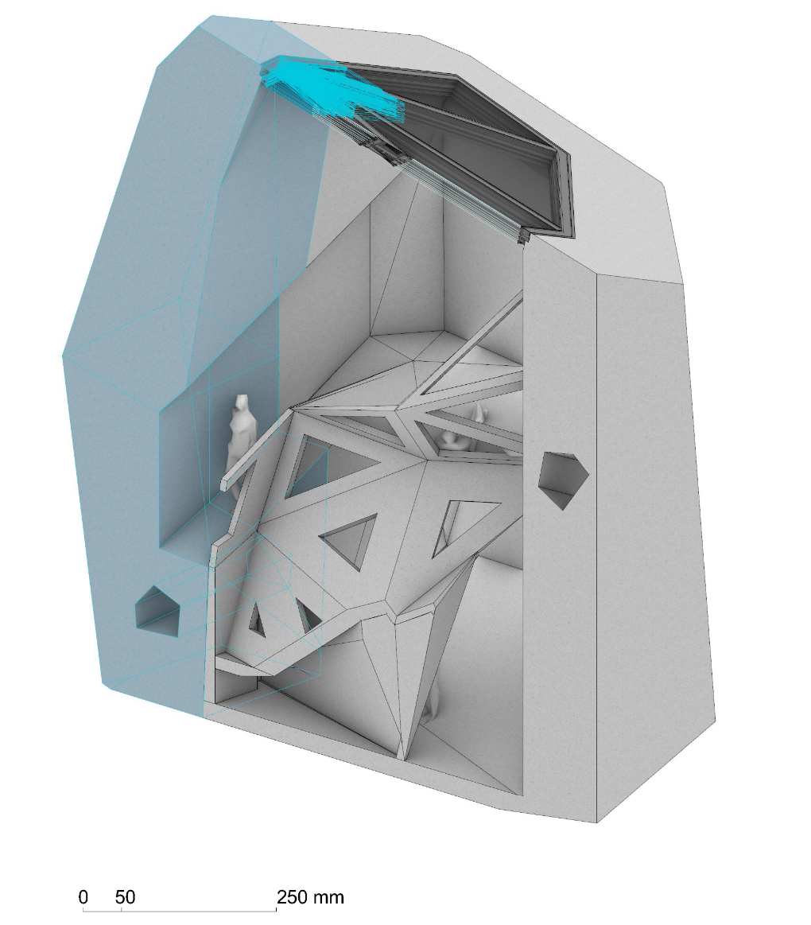
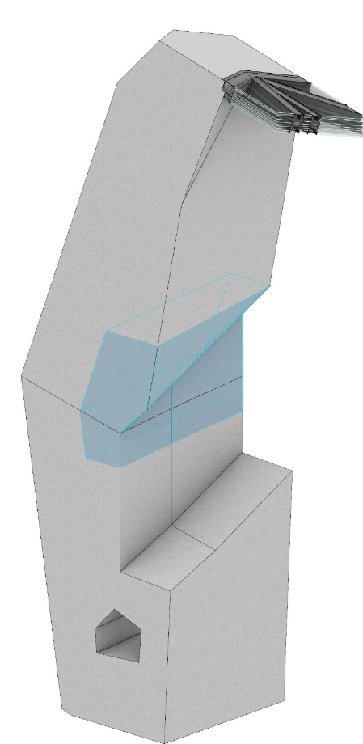
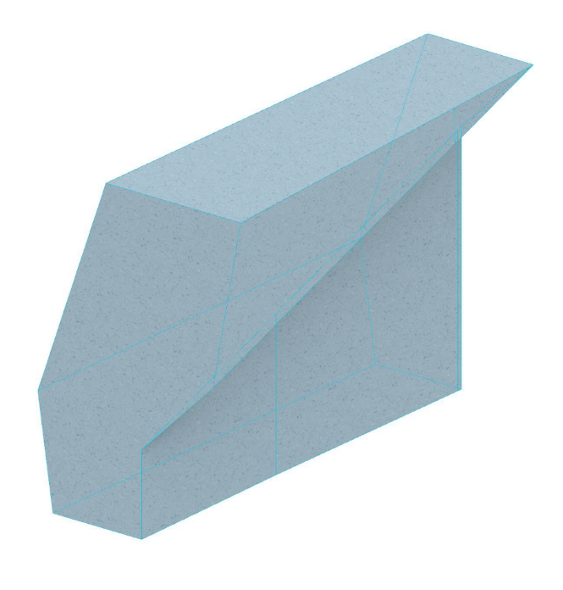
Fragment
Detail
0,55 m
1,2 m
1,6 m
6,9 m
5,6 m
5/67
Sophia Benfield | MoonSane | Lunar Architecture | Tutors: H. Bier & A. Hidding & F. Adema | 2024/25 | TU Delft
Notes:
The components are designed using a computational script. I have applied it to a fragment of a fragment, to get the right size components.

Slide 6
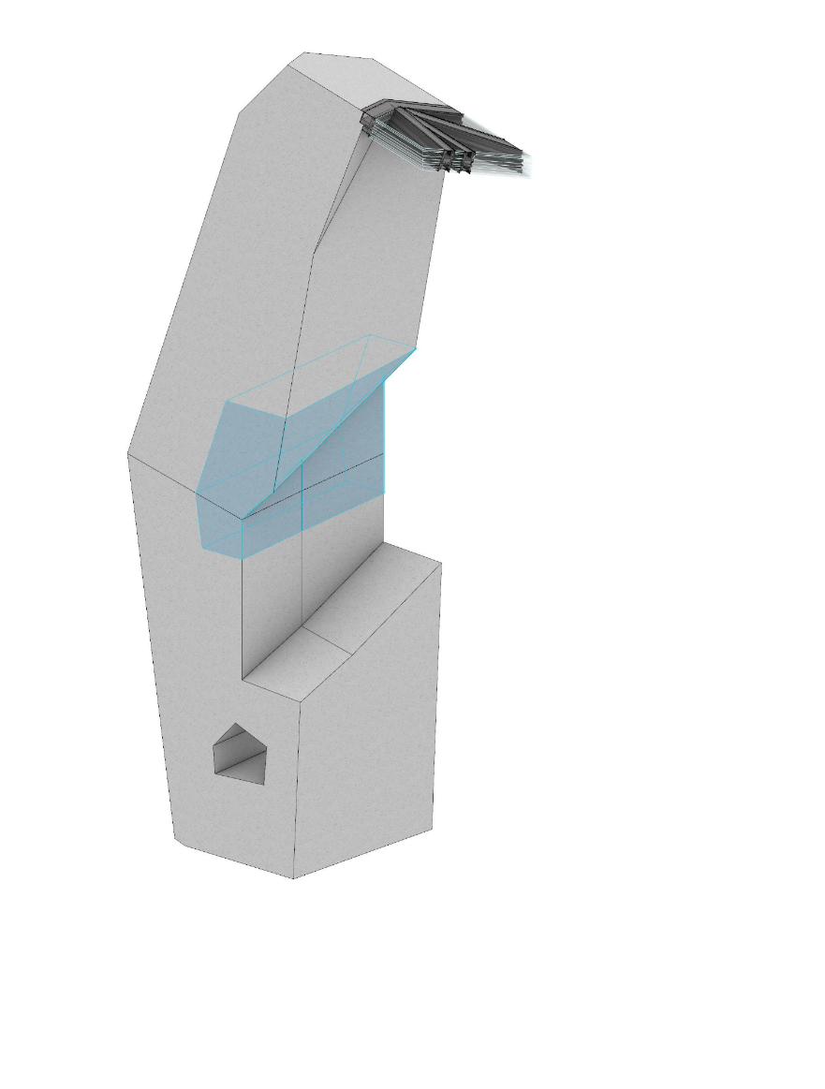
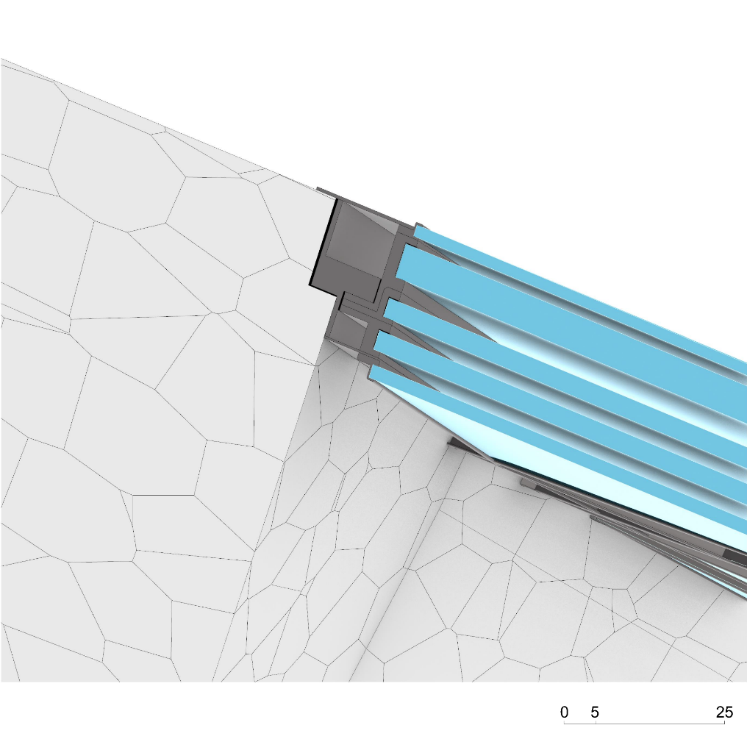
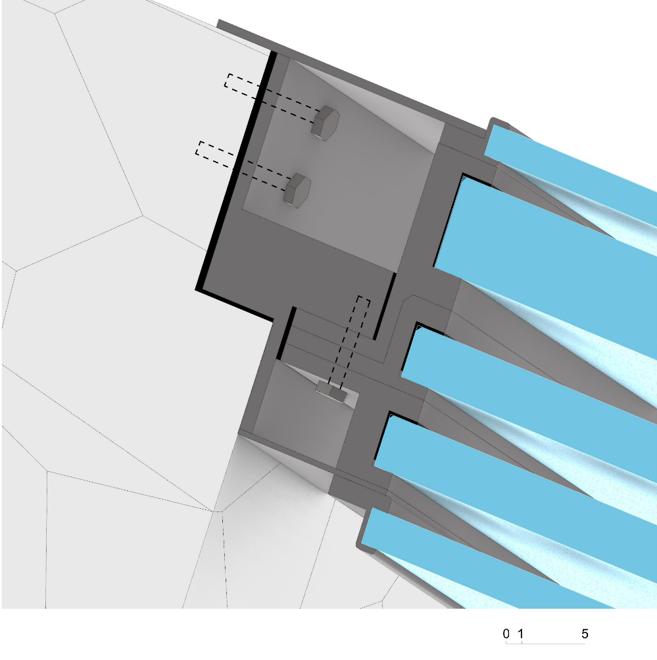
Detail: Window to structure
Regolith components
Forged aluminium
Sealing (aerogel)
Silica glass
6/67
Sophia Benfield | MoonSane | Lunar Architecture | Tutors: H. Bier & A. Hidding & F. Adema | 2024/25 | TU Delft
Notes:
An important part of my design is of course the window in the meditation space, that provides the Earth view. This detail shows how this window is connected to the wall made of the components. The window has several layers to withstand the pressure difference of outside and inside and was based on the ISS windows.

Slide 7
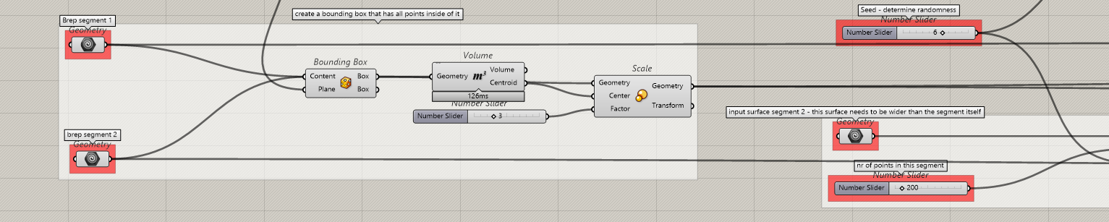
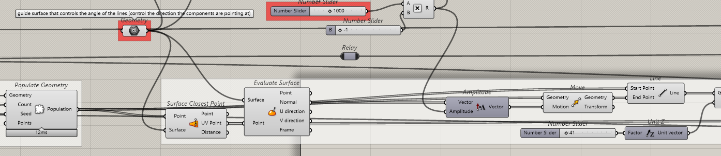
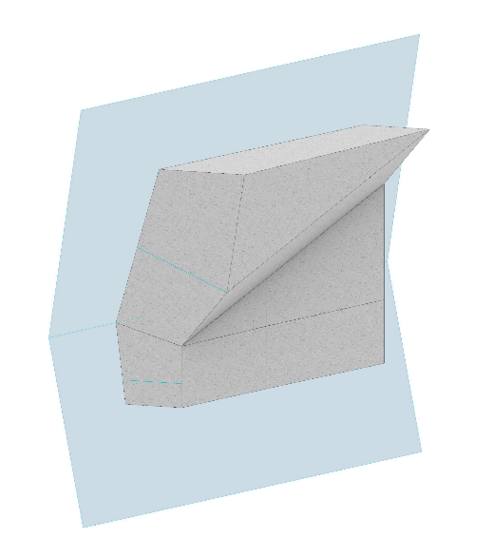
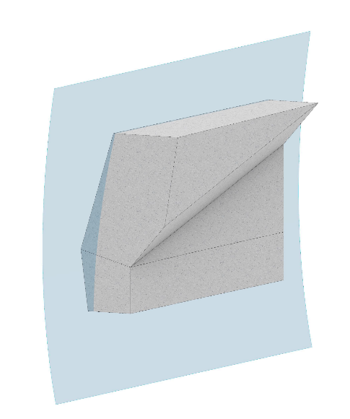
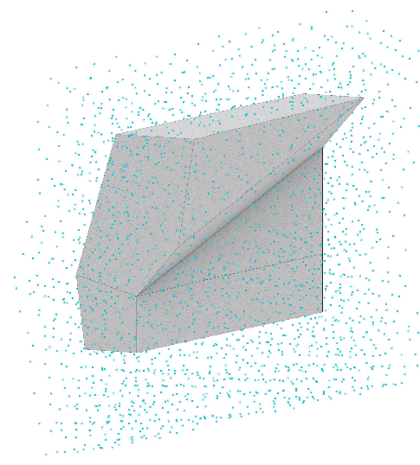
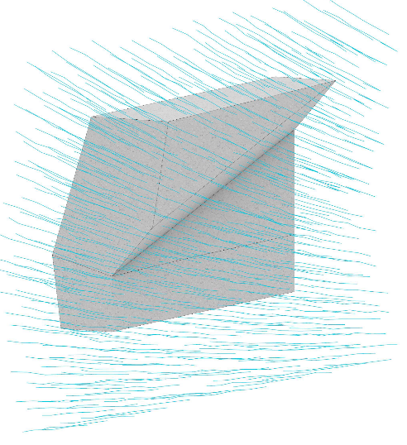
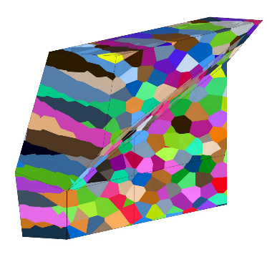
Component script
Component direction
Smoothing surface
Populate with points
Component lines
Voronoi components along lines
7/67
Sophia Benfield | MoonSane | Lunar Architecture | Tutors: H. Bier & A. Hidding & F. Adema | 2024/25 | TU Delft
Notes:
It is important to choose a fragment with a change in inclination, as this turning point is where most errors occur. The script is extensive, going through many steps.

Slide 8
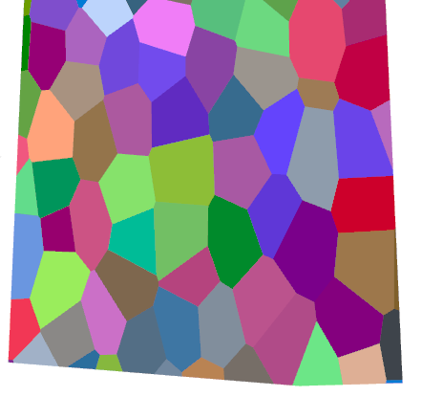








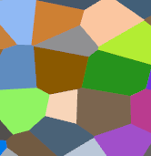
Evaluating components
Stretch direction
Diameter
± 200 mm
± 300 mm
± 400 mm
± 500 mm
± 600 mm
8/67
Sophia Benfield | MoonSane | Lunar Architecture | Tutors: H. Bier & A. Hidding & F. Adema | 2024/25 | TU Delft
Notes:
Several iterations are necessary, evaluating the shape of the components. It’s best to have flatter components for stacking, think like bricks would be, with a diameter of about 200 mm, this creates components the printing and transport robots can work with.

Slide 9
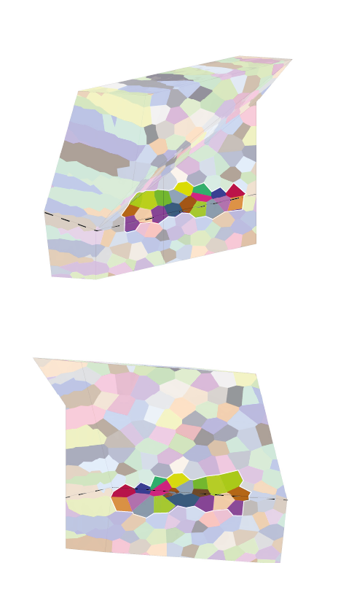
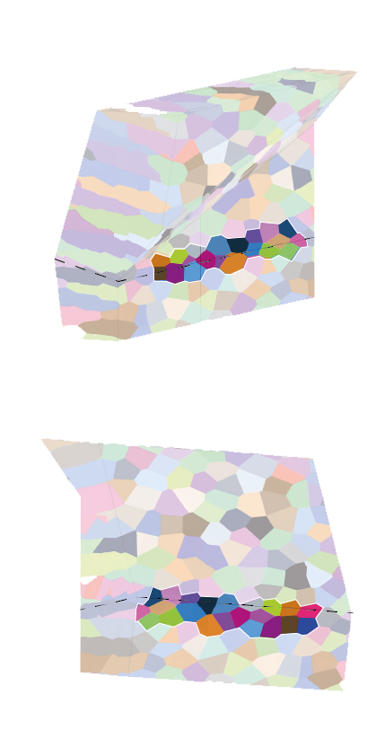
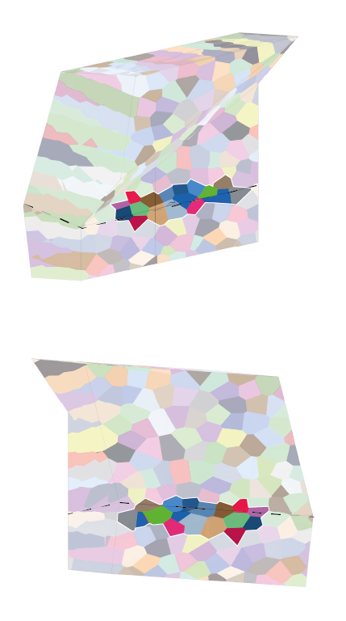
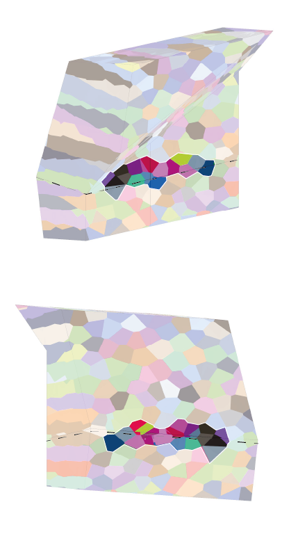
Evaluating components
Seed 1
Seed 2
Seed 5
Seed 6
9/67
Sophia Benfield | MoonSane | Lunar Architecture | Tutors: H. Bier & A. Hidding & F. Adema | 2024/25 | TU Delft
Notes:
Next, it’s important to evaluate the components at the changing inclination. For mine it was iteration 6 that had the most even components along that line.

Slide 10
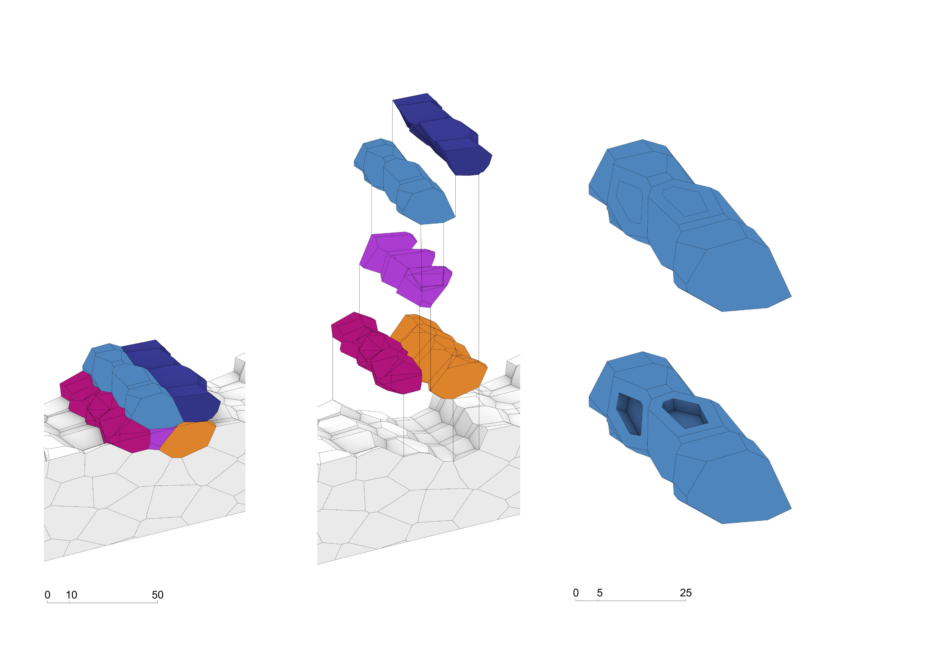
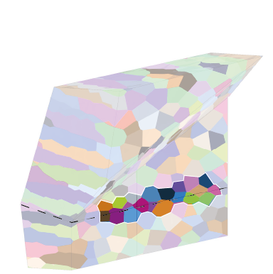
Evaluating components
Seed 6
Add gripping holes for the robot
595 mm
10/67
Sophia Benfield | MoonSane | Lunar Architecture | Tutors: H. Bier & A. Hidding & F. Adema | 2024/25 | TU Delft
Notes:
This shows some of those components and how they would be stacked together. It is also necessary to add grip holes for robots to carry them.

Slide 11
Construction: swarm robotics
Based on swarms in nature
Many small robots doing the same task
By dividing ground they cover it quickly
Inter-robot communication
Cooperation, organisation
11/67
Sophia Benfield | MoonSane | Lunar Architecture | Tutors: H. Bier & A. Hidding & F. Adema | 2024/25 | TU Delft
Notes:
The construction will be done by a swarm of small robots. They will help with excavation and collecting the Regolith for 3D printing the components. Robots will then take the components and place them in their proper location. This will probably be done using human-robot interaction.

Slide 12
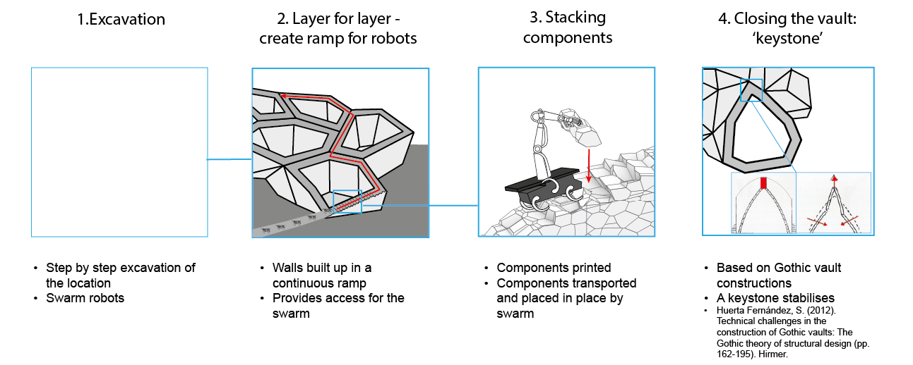
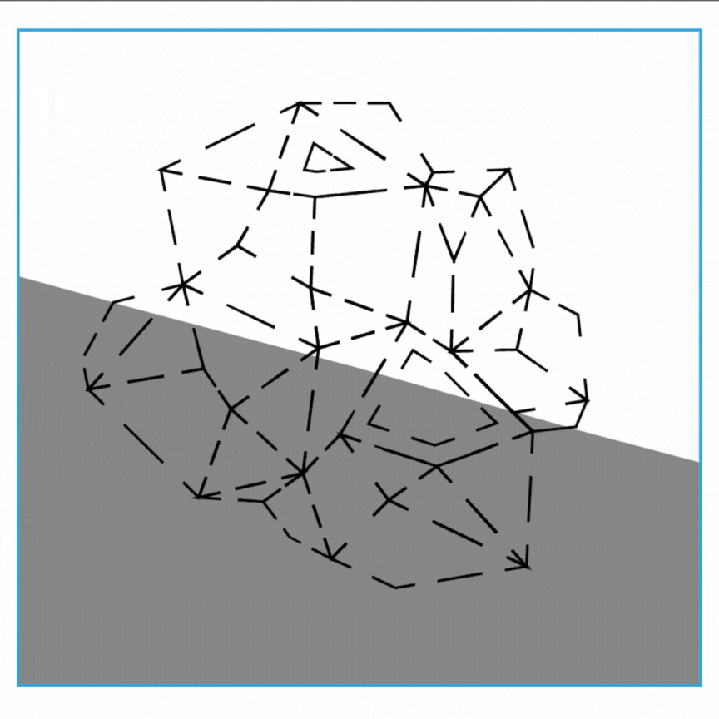
Construction: steps
12/67
Sophia Benfield | MoonSane | Lunar Architecture | Tutors: H. Bier & A. Hidding & F. Adema | 2024/25 | TU Delft
Notes:
The construction will be done by a swarm of small robots. They will help with excavation and collecting the Regolith for 3D printing the components. Robots will then take the components and place them in their proper location. This will probably be done using human-robot interaction.

Slide 13
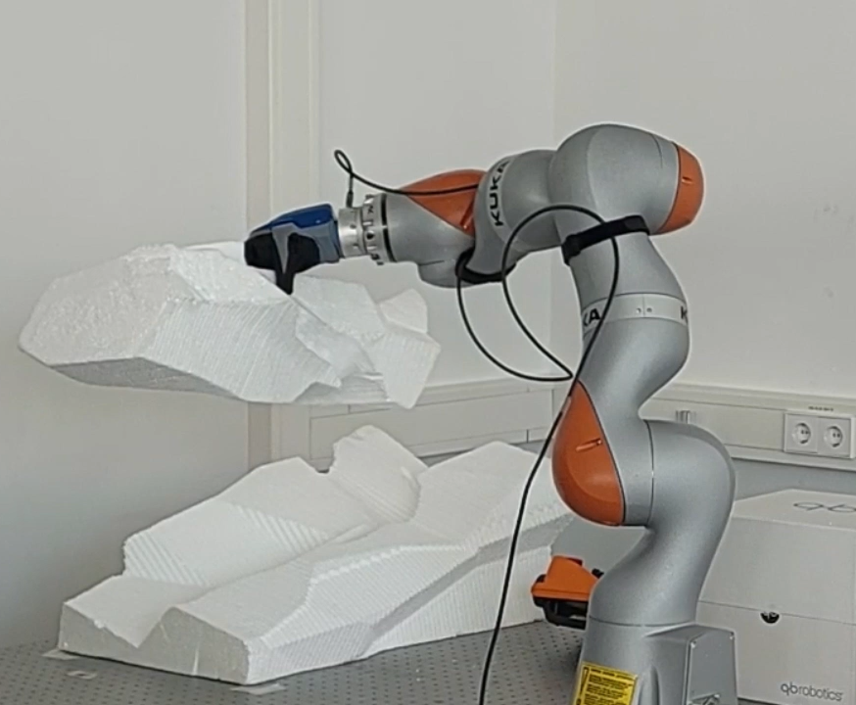
Construction: human-robot interaction
Combine strengths:
Robot: heavy lifting
Human: delicate motor skills
Robot learns
End goal is to become autonomous
13/67
Sophia Benfield | MoonSane | Lunar Architecture | Tutors: H. Bier & A. Hidding & F. Adema | 2024/25 | TU Delft
Notes:
At this moment in time, robots are not developed enough to do the placing of components by themselves. This is where HRI – or Human robot interaction will be implemented. This is about making the most of each others strengths. The robot can lift, while the human guides, as the robots motor skills are not developed yet.
The end goal is that the robot learns and will be able to do it by himself .

Slide 14
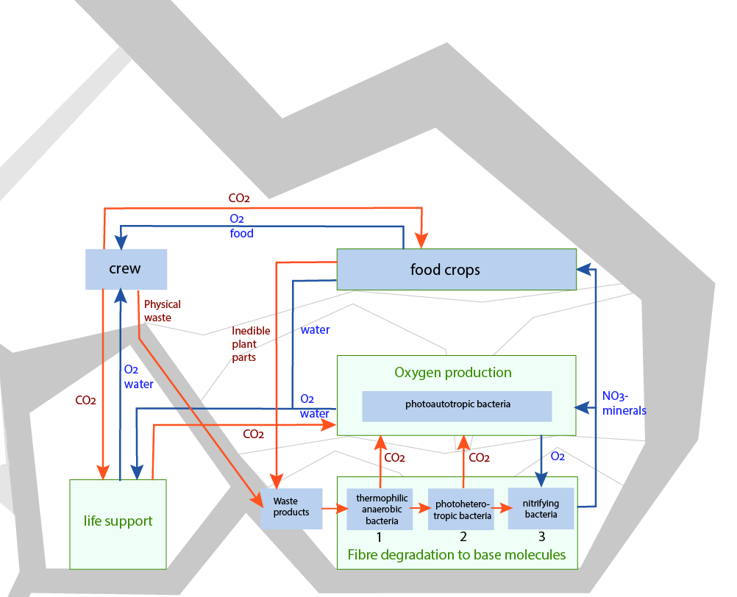
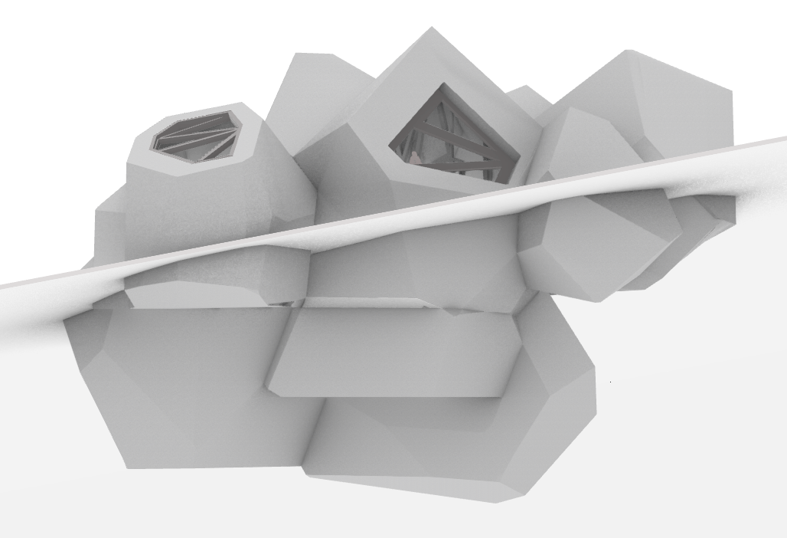
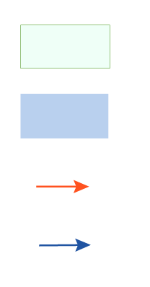
Life support: waste
MELiSSA research program
Closing the waste loop using bacteria and algae
Closed compartment
Component
Waste product
Usable product
14/67
Sophia Benfield | MoonSane | Lunar Architecture | Tutors: H. Bier & A. Hidding & F. Adema | 2024/25 | TU Delft

Slide 15
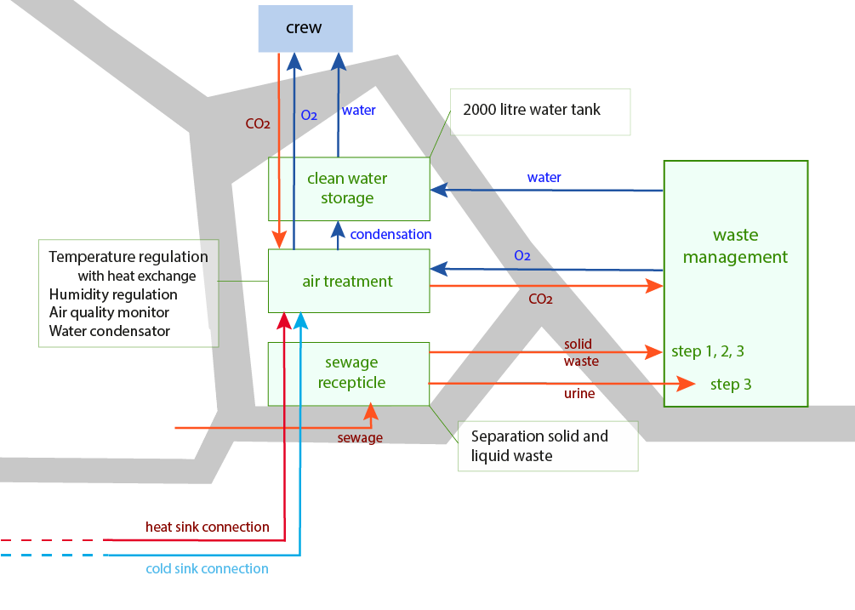
Life support: mechanical systems
Closed compartment
Component
Waste product
Usable product
15/67
Sophia Benfield | MoonSane | Lunar Architecture | Tutors: H. Bier & A. Hidding & F. Adema | 2024/25 | TU Delft

Slide 16
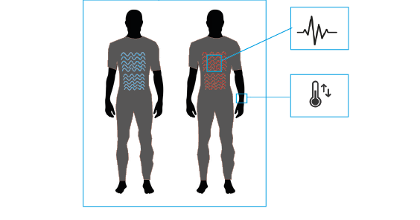
Personal climate
Heating
Cooling
Health monitoring and adapting schedule accordingly
Stress – take a break or meditate etc.
Adapting lighting
Personal settings at workstation, private and meditation room
Why personalisation?
Feeling of control in an otherwise uncontrollable setting
Smart textiles
16/67
Sophia Benfield | MoonSane | Lunar Architecture | Tutors: H. Bier & A. Hidding & F. Adema | 2024/25 | TU Delft

Slide 17
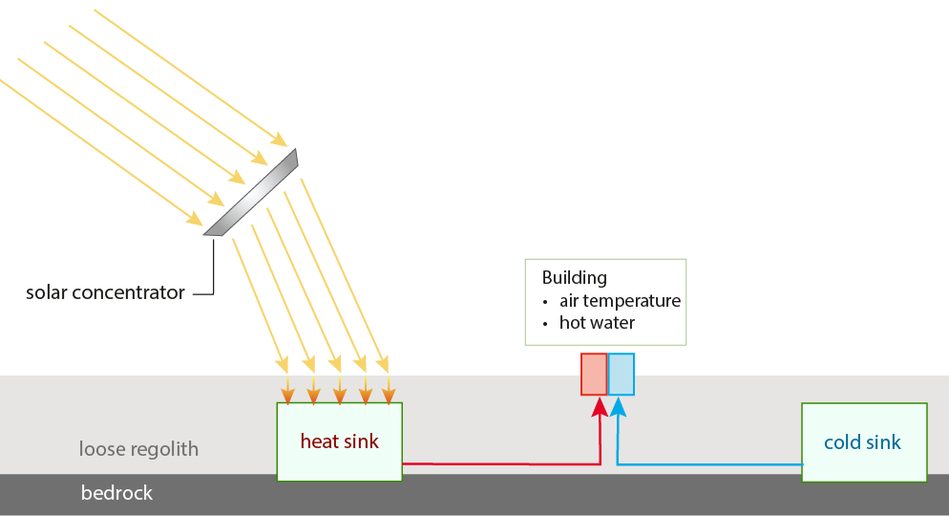
Life support: heating/cooling
Heat and cold production
Based on ESA research
17/67
Sophia Benfield | MoonSane | Lunar Architecture | Tutors: H. Bier & A. Hidding & F. Adema | 2024/25 | TU Delft

Slide 18
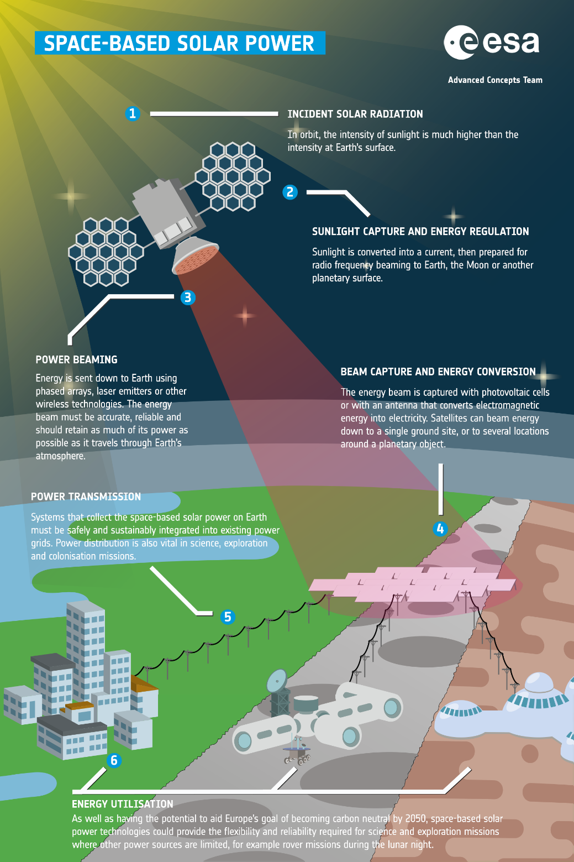
Energy supply
Space-based Solar Power
Satellites with solar panels
Collect energy in space and beamed down to converters on the surface
Distributed to habitats and equipment
18/67
Sophia Benfield | MoonSane | Lunar Architecture | Tutors: H. Bier & A. Hidding & F. Adema | 2024/25 | TU Delft

Slide 19
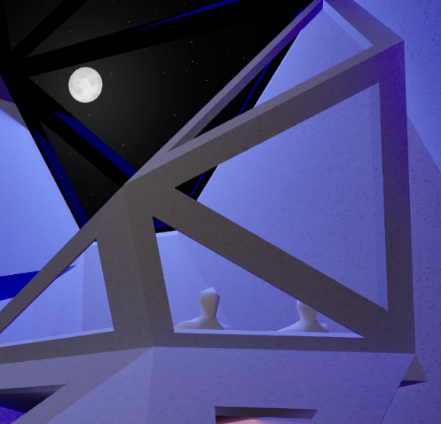
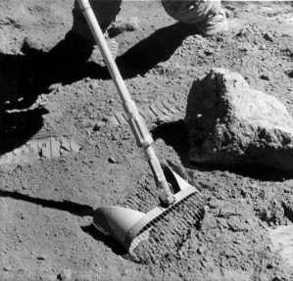

Concept
Summary & relevance
Mental health improvement by spatial design
In-situ resource utilisation
3D-printing & robotic assembly
19/67
Sophia Benfield | MoonSane | Lunar Architecture | Tutors: H. Bier & A. Hidding & F. Adema | 2024/25 | TU Delft
Notes:
To summarise, I propose to design a Lunar habitat that improves mental wellness by combining a dynamic lighting system with spatial geometry and views, both real and artificial. I also propose to add a meditation space combining the overview effect with mood lighting, where crew members can find peace of mind.

Slide 20
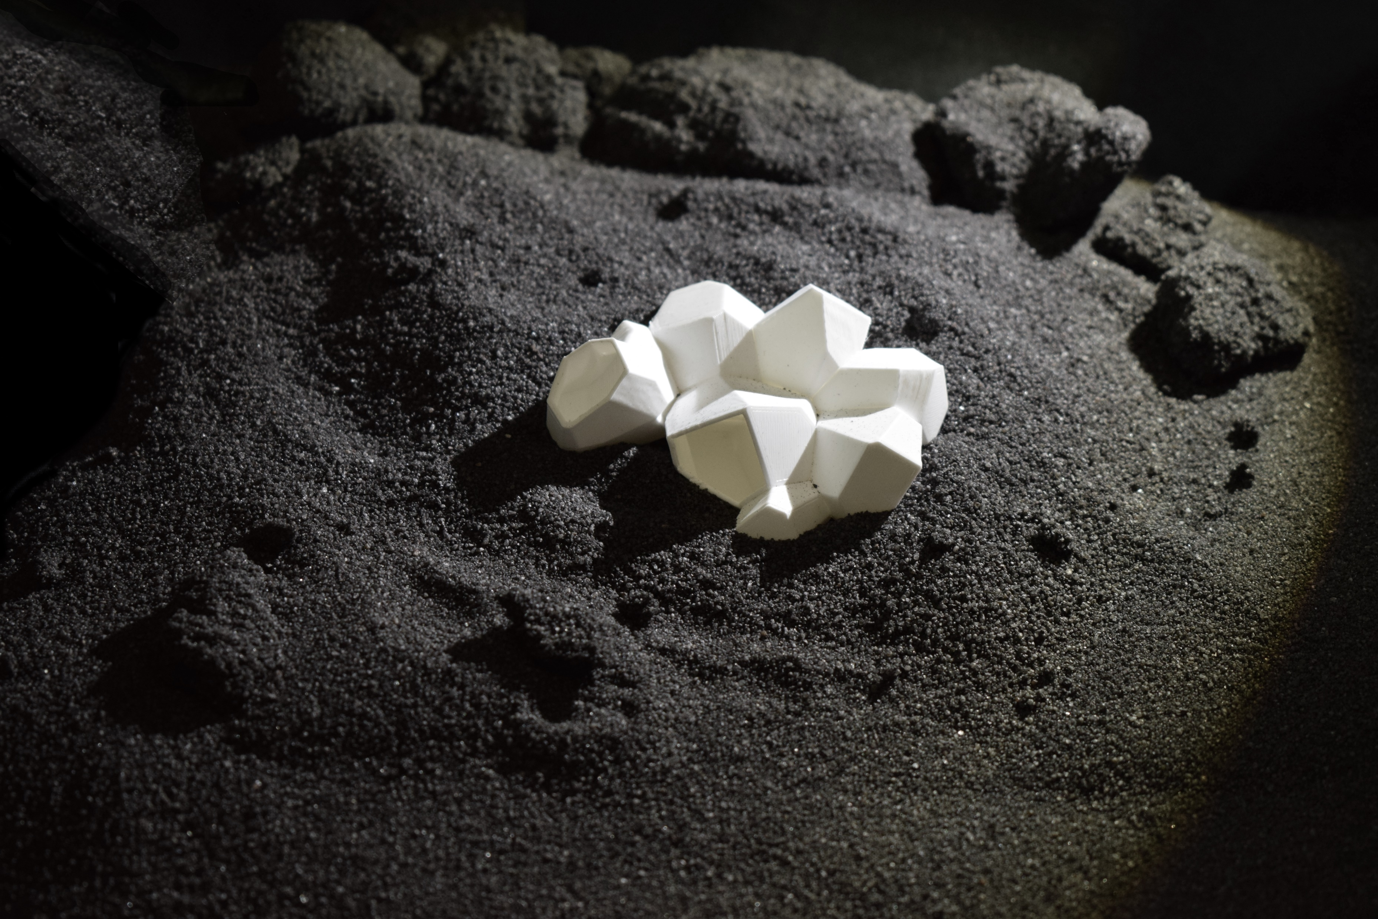
Q & A

