Slide 1
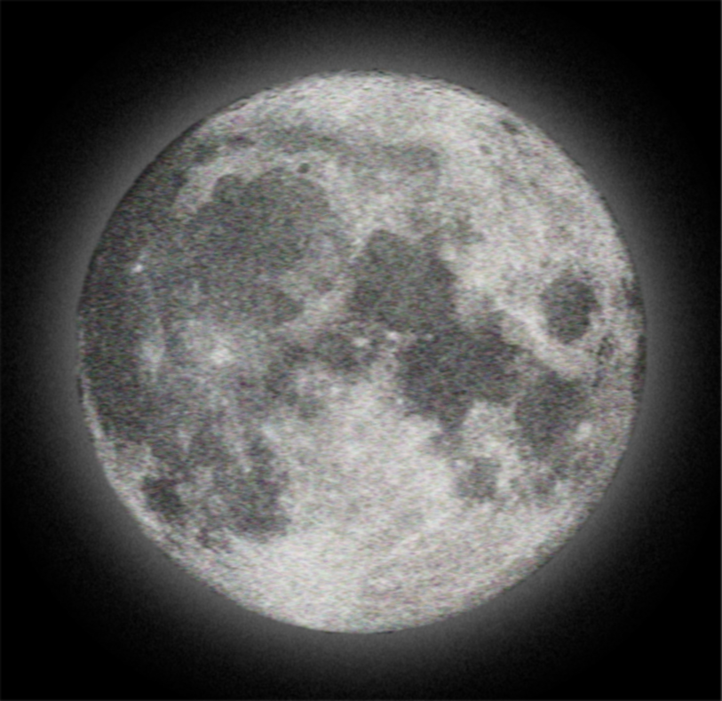
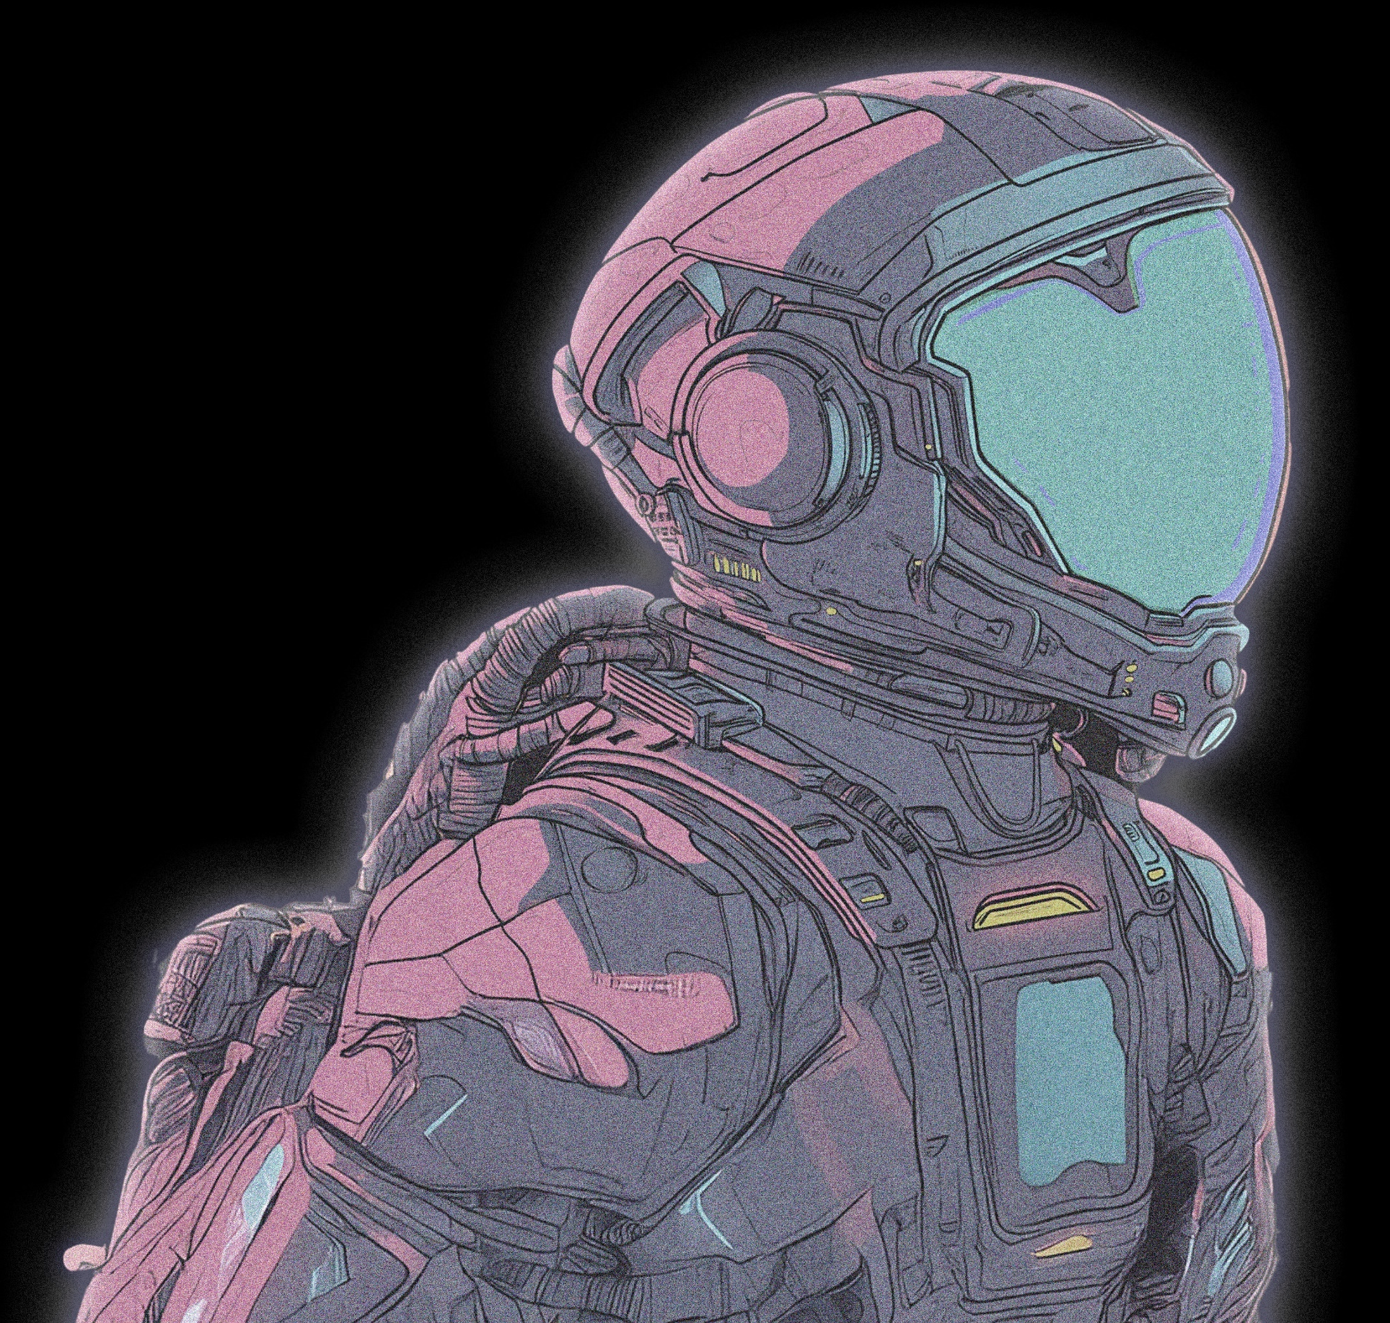
living on the moon?
Lunar Playscape:
Designing a Climbing-based Habitat
for Dynamic Human Body and Space Interaction
To work?
To play?
To commune?
LUNAR ARCHITECTURE & INFRASTRUCTURE
Jonathan Jonathan | P5 Presentation
Graduation Project 2024-2025 TU Delft BK
Tutors: Henriette Bier, Ferry adema, Arwin Hidding

Slide 2
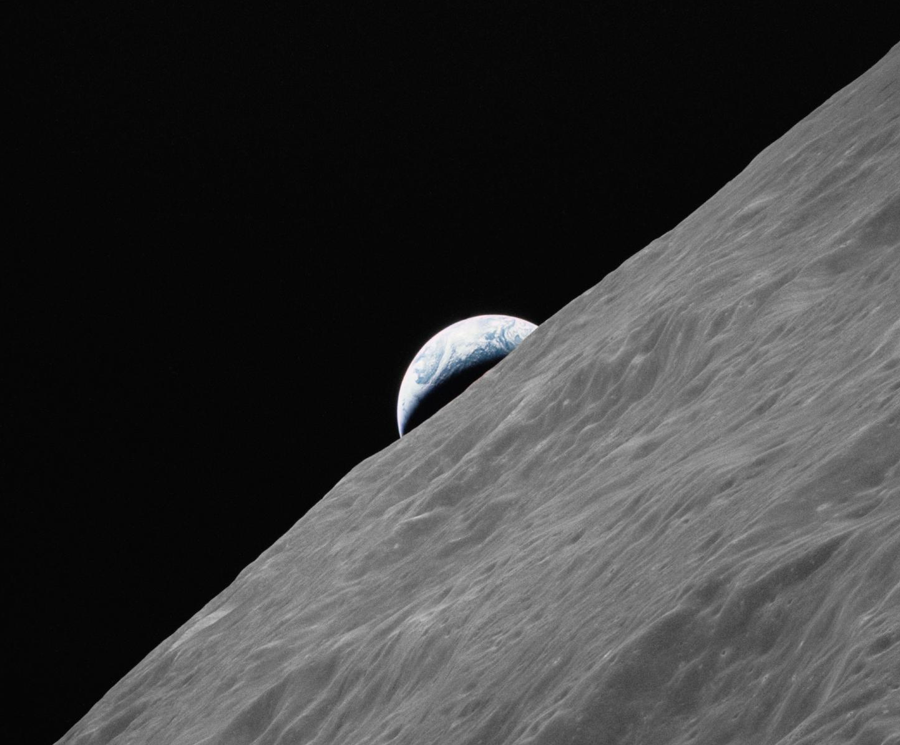
moon exploration
In the past

Slide 3
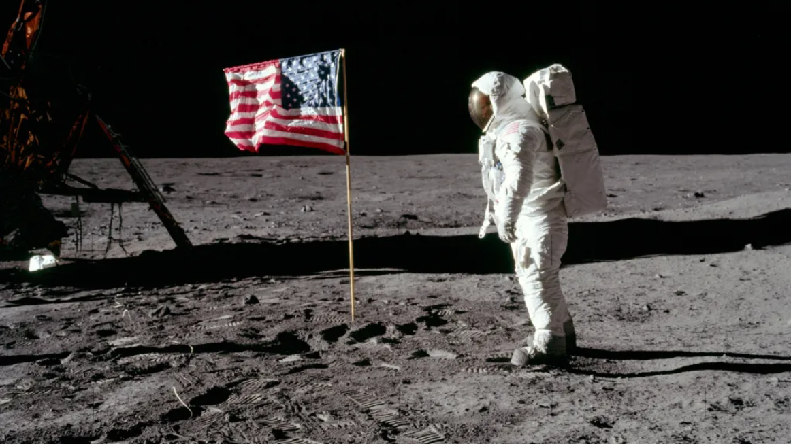
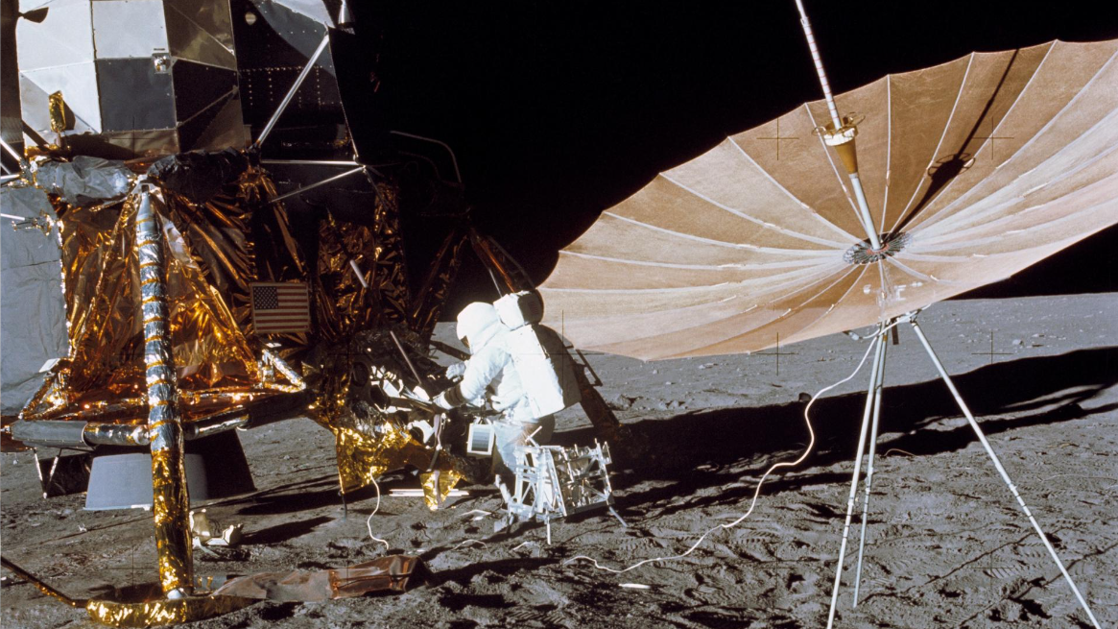

Research background
| Apollo missions
tasks intensive missions
11
Performed lunar landing And Return to earth
(National goal by President kennedy)
Apollo 11
12
Lunar exploration tasks by the lunar module,
Deployment of the apollo lunar surface experiments package,
Apollo 12
17
Geological surveying and sampling of materials, deploying and activating surface experiments, conducting in-flight experiments and photographic tasks during lunar orbit and trans-earth coast,
Source: Nasa.gov
Apollo 17

Slide 4
Research background
| Apollo missions
Numerous secondary tasks
Deployment of a television camera to transmit signals to earth, Deployment of a solar wind, seismic experiment package and a laser ranging retroreflector, gather samples of lunar-surface materials, photograph the lunar terrain, deployed scientific equipment, Lunar module spacecraft
Apollo 11
Selenological inspection, Surveys and samplings in landing areas, Development fot precision-landing capabilities, Further evaluations of working for long period, deployment and retrieval of other scientific experiments, photography of candidate exploration sites for future missions
Apollo 12
Deployed experiments such as Apollo Lunar Surface Experiments Package, with a heat flow experiment, lunar seismic profiling, lunar surface gravimeter, lunar atmospheric composition experiment, lunar ejecta and meteorites, lunar sampling and lunar orbital experiments
Source: Nasa.gov
Apollo 17

Slide 5
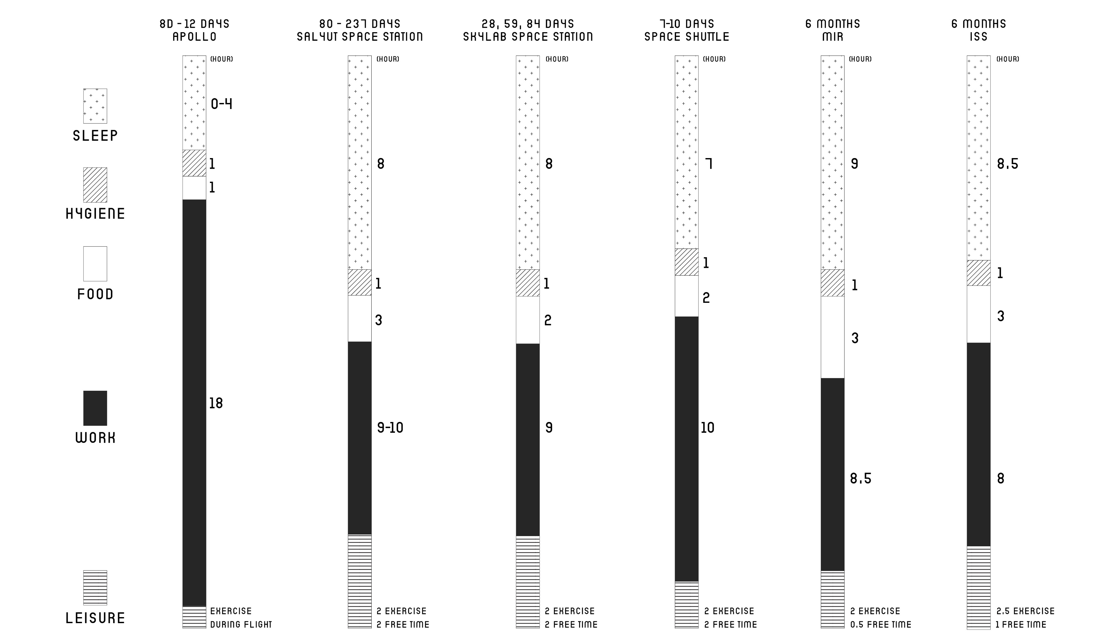
Research background
| activities distribution
Source: architecture for astronauts (book)

Slide 6
Research background
| activities distribution
short term missions
vs
long term habitation

Slide 7
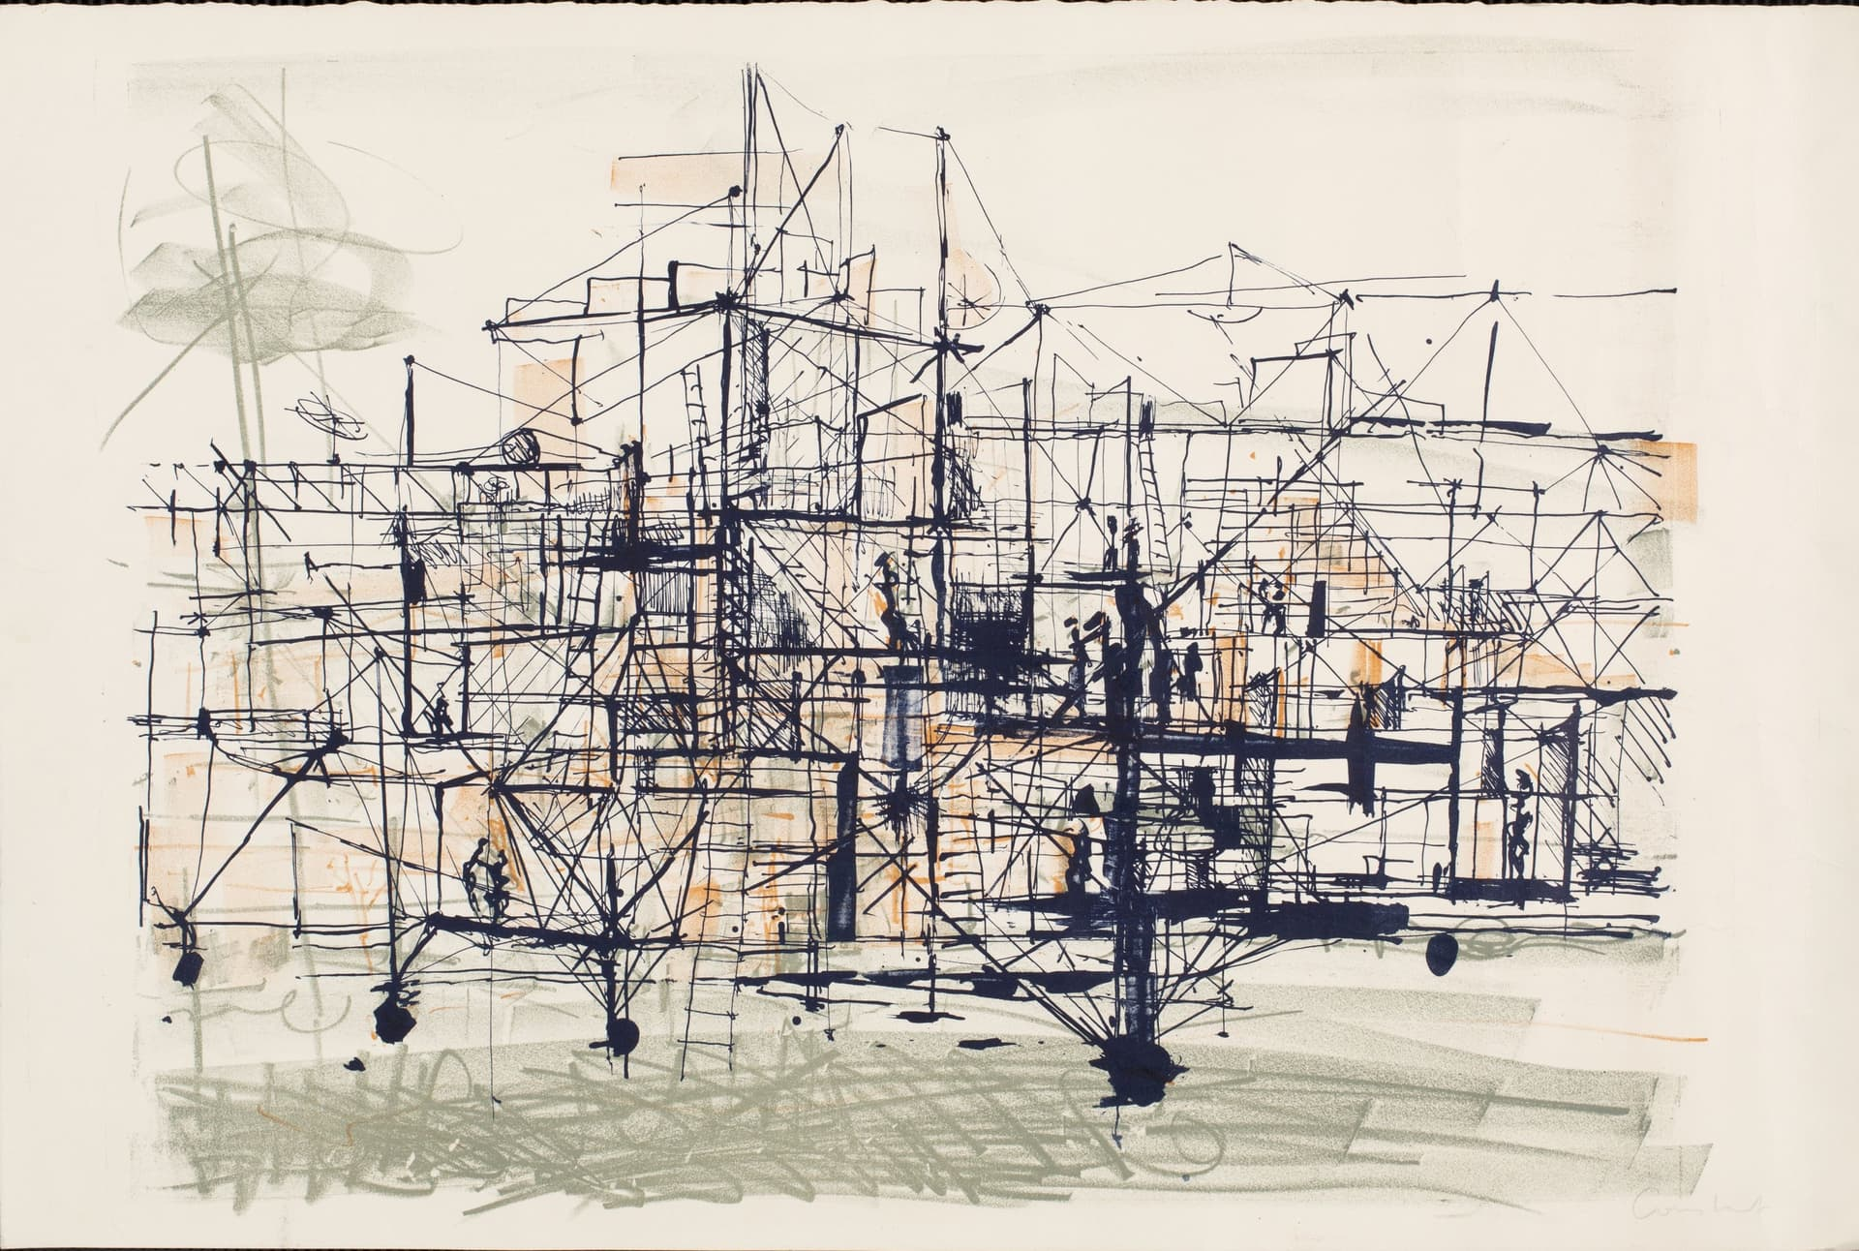
Research background
| work & play
human’s playing nature
Charles Duke from Apollo 16 said:
“Towards the end of our stay,
we got excited and we were going to do the high jump,
and I jumped and fell over backwards.
That was a scary time,
because if the backpack got broken,
I would have had it.”
Building Habitats on the moon p.248
Source: Nieuwe instituut
New Babylon by Constant

Slide 8
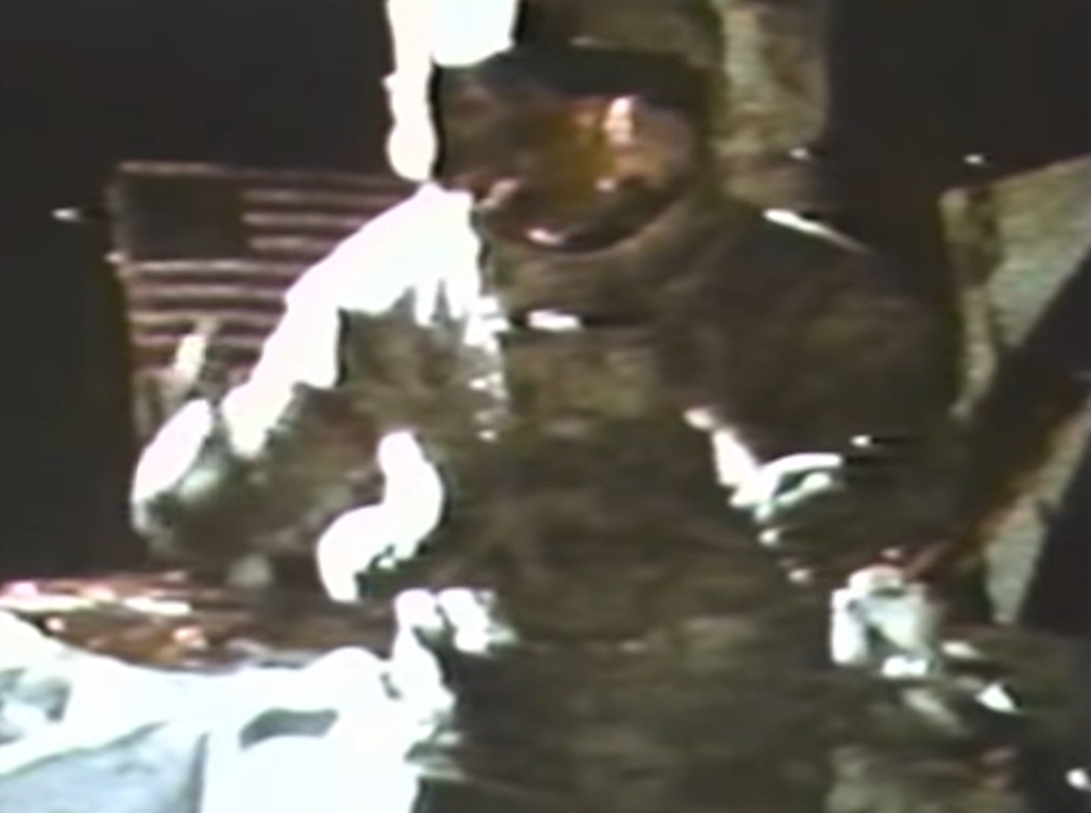
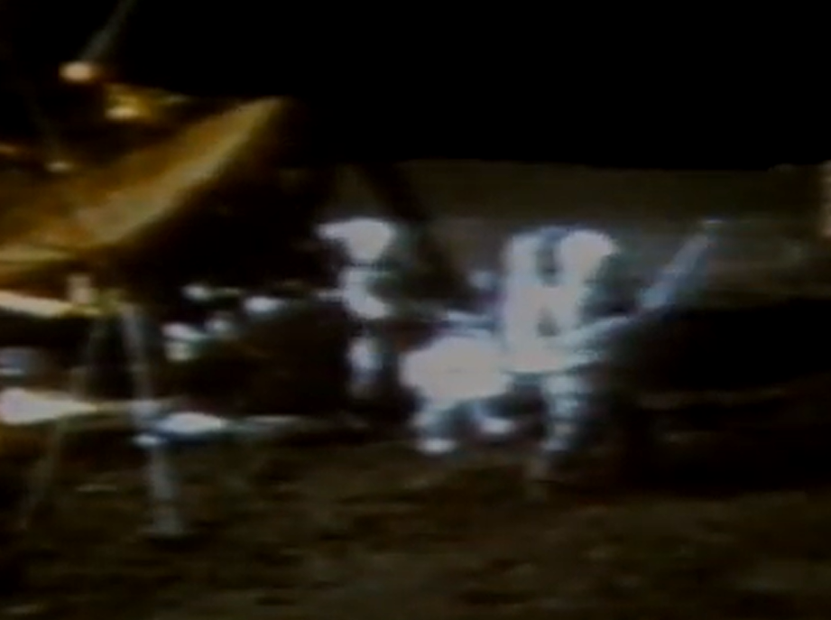
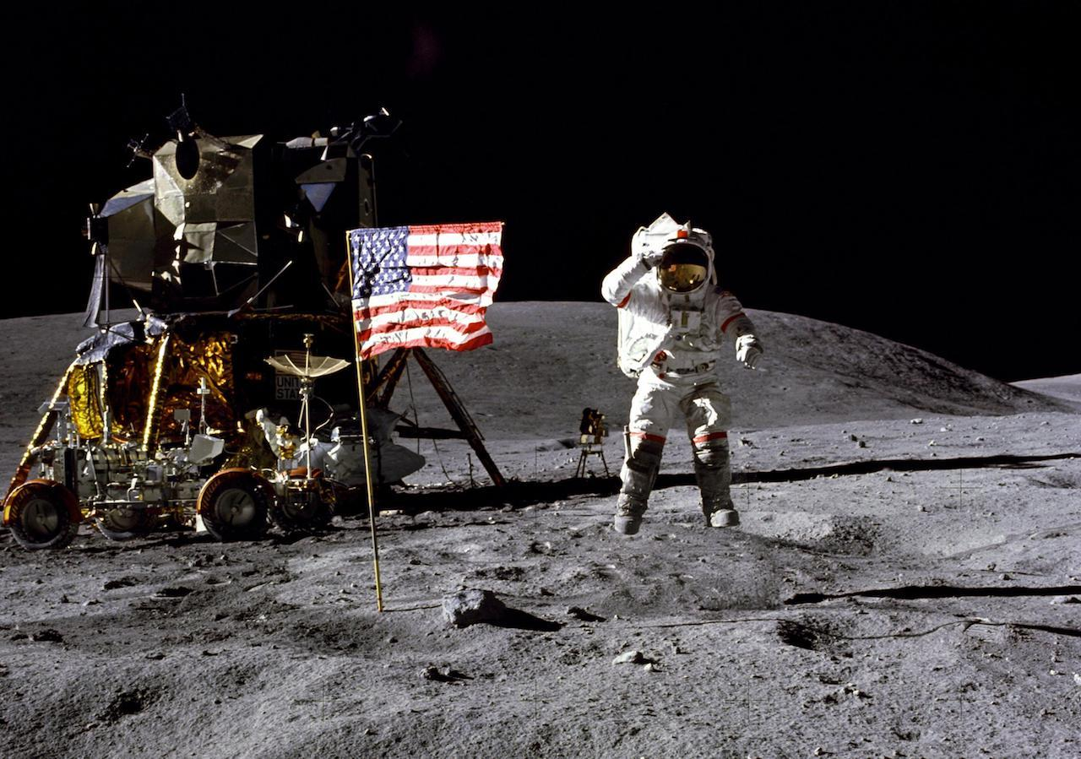
Research background
| work & play
human’s playing nature
Source: nasa.gov
Alan shepard (ap14)
Golf on the moon
David scott (ap15)
Hammer and feather
John Young (ap16)
Mid-air salute photo

Slide 9
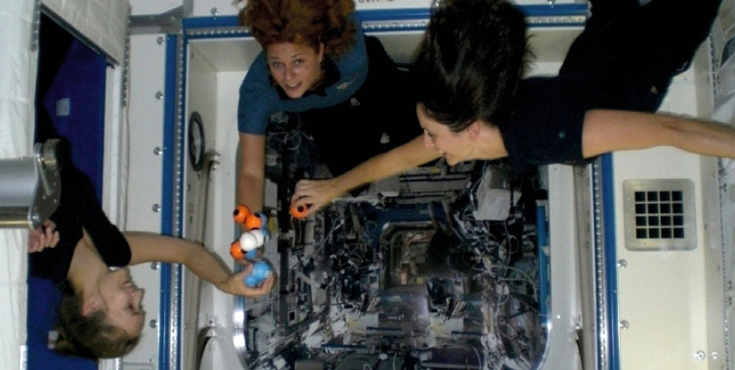
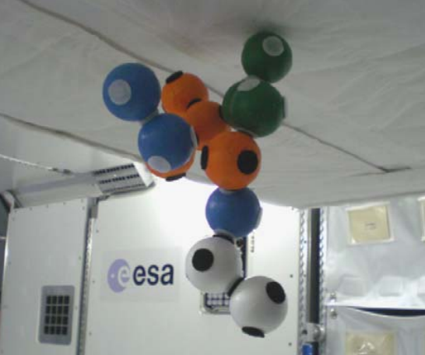
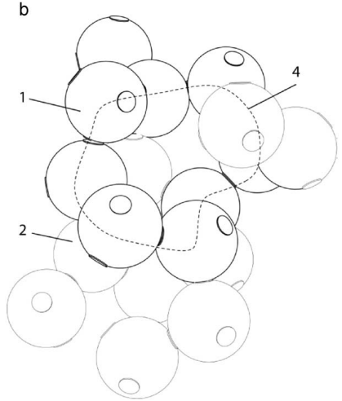
Research background
| work & play
current leisure situation
“subjected to high workloads under a tight schedule within a confined environment, astronauts have drawn on
leisure activities imported mostly from earth. Popular leisure activities documented to-date have concentrated on passive perusal of media
like records, audio cassettes, newspaper, letters, books, magazines, television, and movies”
Architecture for astronauts p.281
Game for space Prototype tested at iss
Source: S. Hauplik-Meusburger, et al., A game for space, Acta Astronautica (2009),
doi: ¨ 10.1016/j.actaastro.2009.07.017

Slide 10
Research background
| work & play
Lunar Playscape
Reimagines the lifestyle / activities
physical requirement
and
social requirement

Slide 11
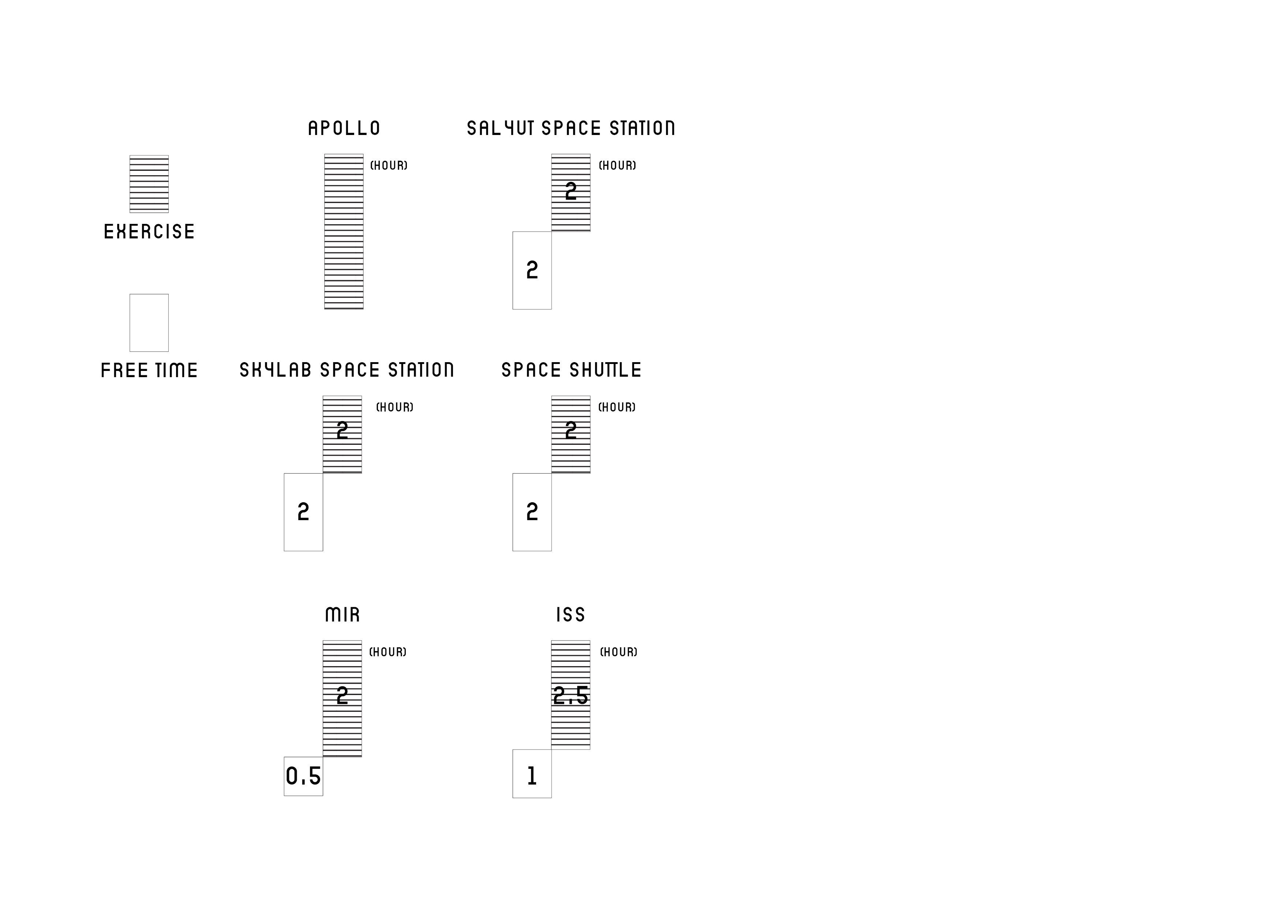
RESEARCH QUESTION
| physical requirement
1. physical
Long-term habitation
In
Low lunar gravity
affects
previous missions: Ave. 2-HR Daily work out
Source: architecture for astronauts (book)
Body structure
Muscle & bone density
New way of exercising -> Distributing Work out
Having breakfast
Going to meeting
Sitting in lunch lecture
Having social evening
Going to gym
Heading home

Slide 12
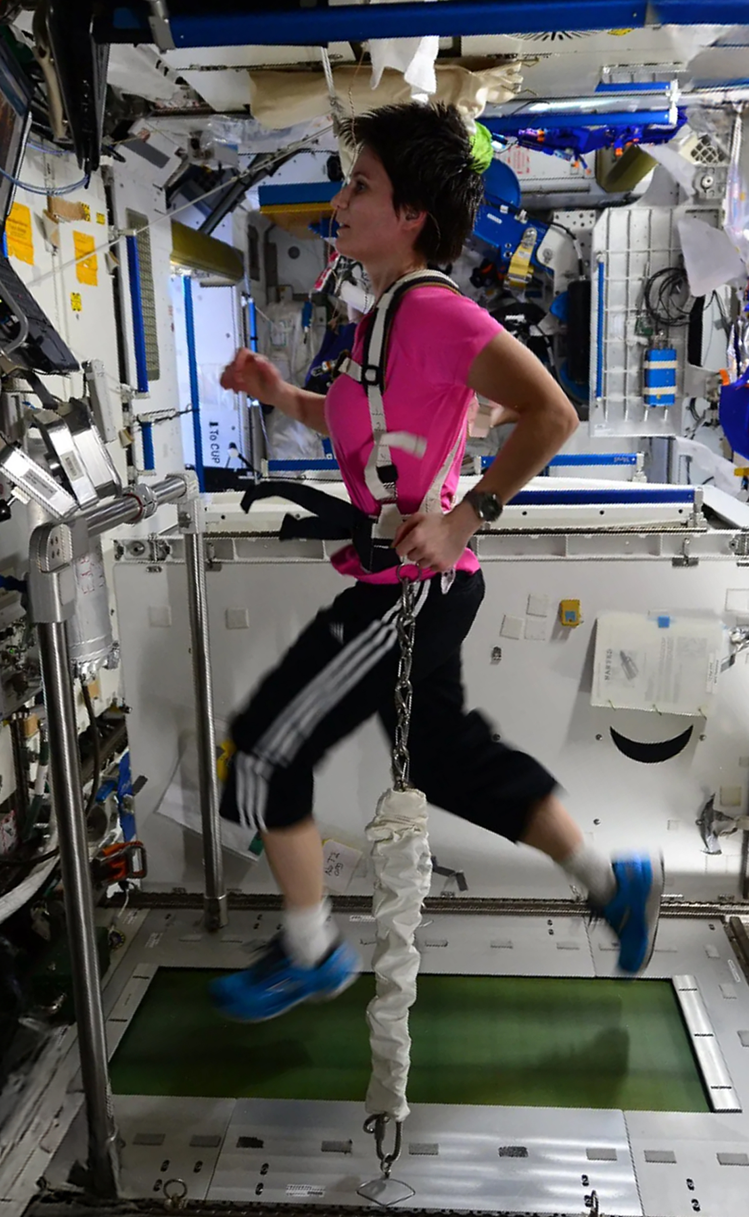
RESEARCH QUESTION
| physical requirement
“…I do get a sense of satisfaction from working out … exercise is not only a critical physical component … it has an important psychological component too.”
-peggy whitson, ISS-
“I could really run [in place] at different speeds and for long durations, and that’s the way I did all my exercise.”
-gene Cernan, apollo 17-
“I hate our exercises …
boring and monotonous, and heavy work …”
-Valery Ryumin, salyut-
“Sometimes it is very hard to force yourself to do. We like the treadmill the most, because we can do such a variety of exercises on it. In fact, we’ve even made up some new exercises of our own.”
-Lebedev, salyut-
Architecture for astronauts (book)
Treadmilling in the MIR space station
(Samantha Cristoforetti, ESA)

Slide 13
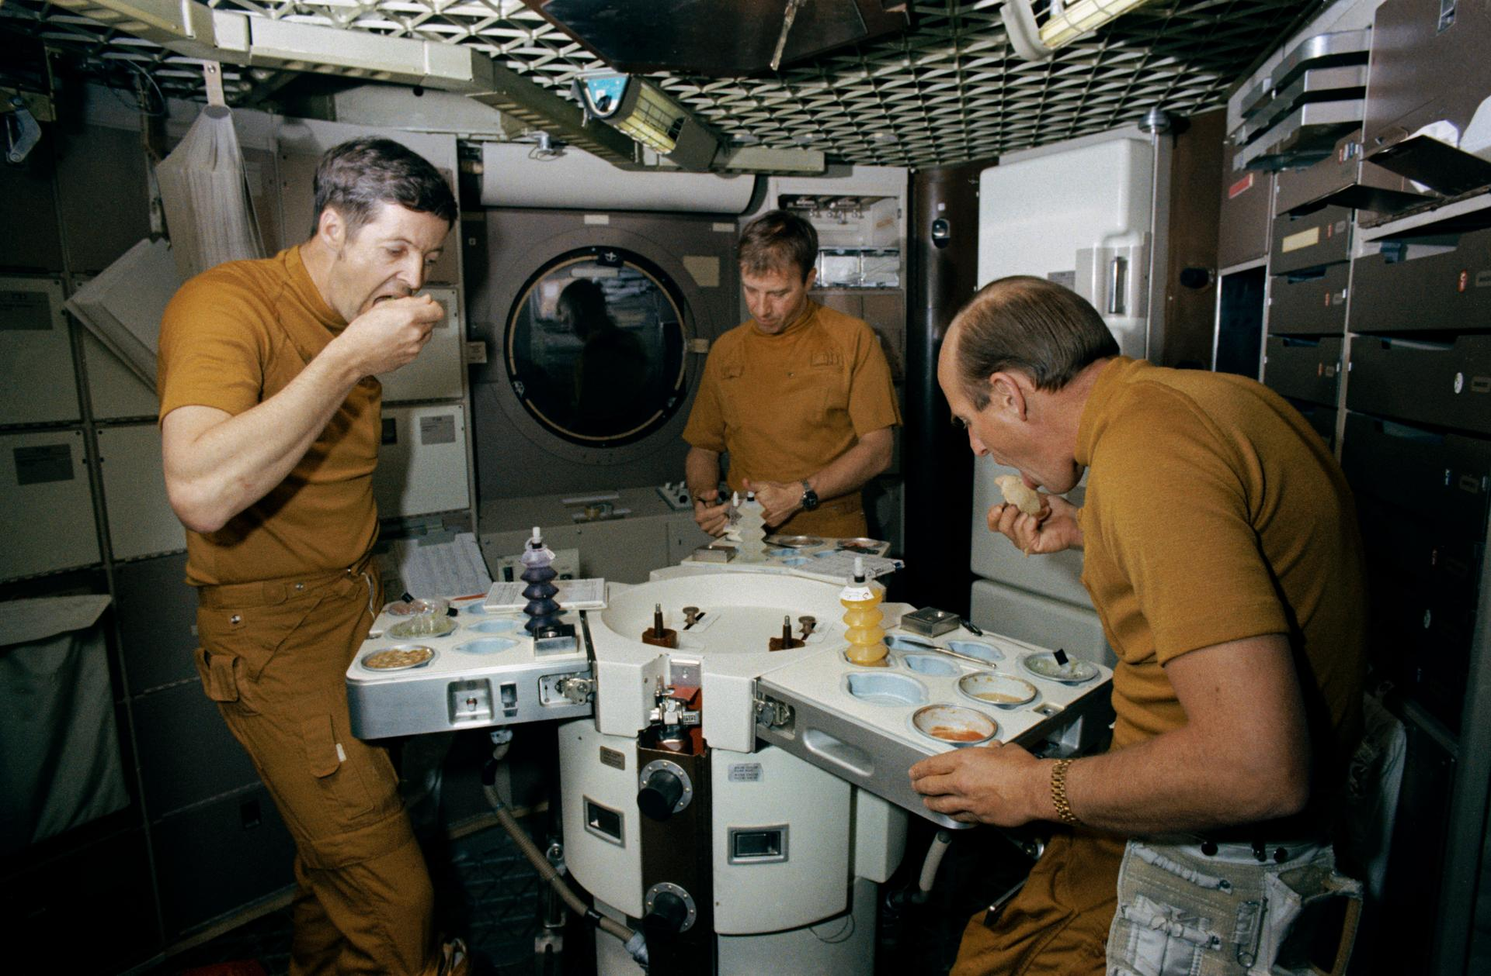
RESEARCH QUESTION
| social requirement
2. social
Increasing mooners population
Leads to
A query in
community creation
Space Station Wardroom Table for Skylab, America’s first experimental space station
Source: NASA

Slide 14
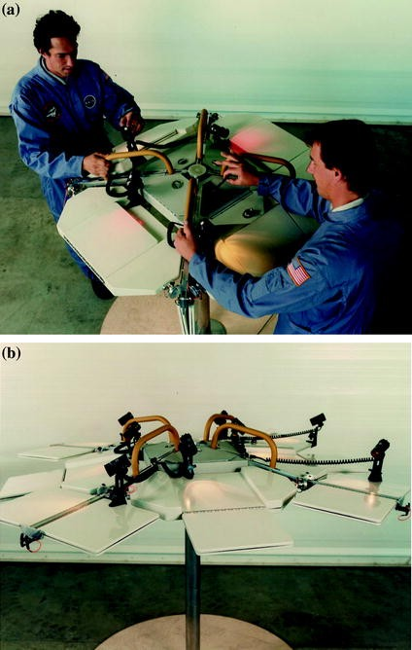
RESEARCH QUESTION
| social requirement
social life in previous spaceship
Very Low in priority
“Having dinner is a social activity shared by many cultures and is one of the habitual social customs that people carry into space … On skylab missions, crews refused to float over the table … they had for the first time a large dedicated area for food preparation and dining and were eating together on a specially designed table, eating with knives, forks and spoons
Space architecture education for architects and engineers p.131
More ways of SocialiSing?
Space Station Wardroom Table for Skylab, America’s first experimental space station
SOURCE: Space architecture education for architects and engineers p.77

Slide 15
RESEARCH QUESTION
| physical requirement
Physical & social well-being
playscape = incorporating muscle work & various postures
with architecture

Slide 16
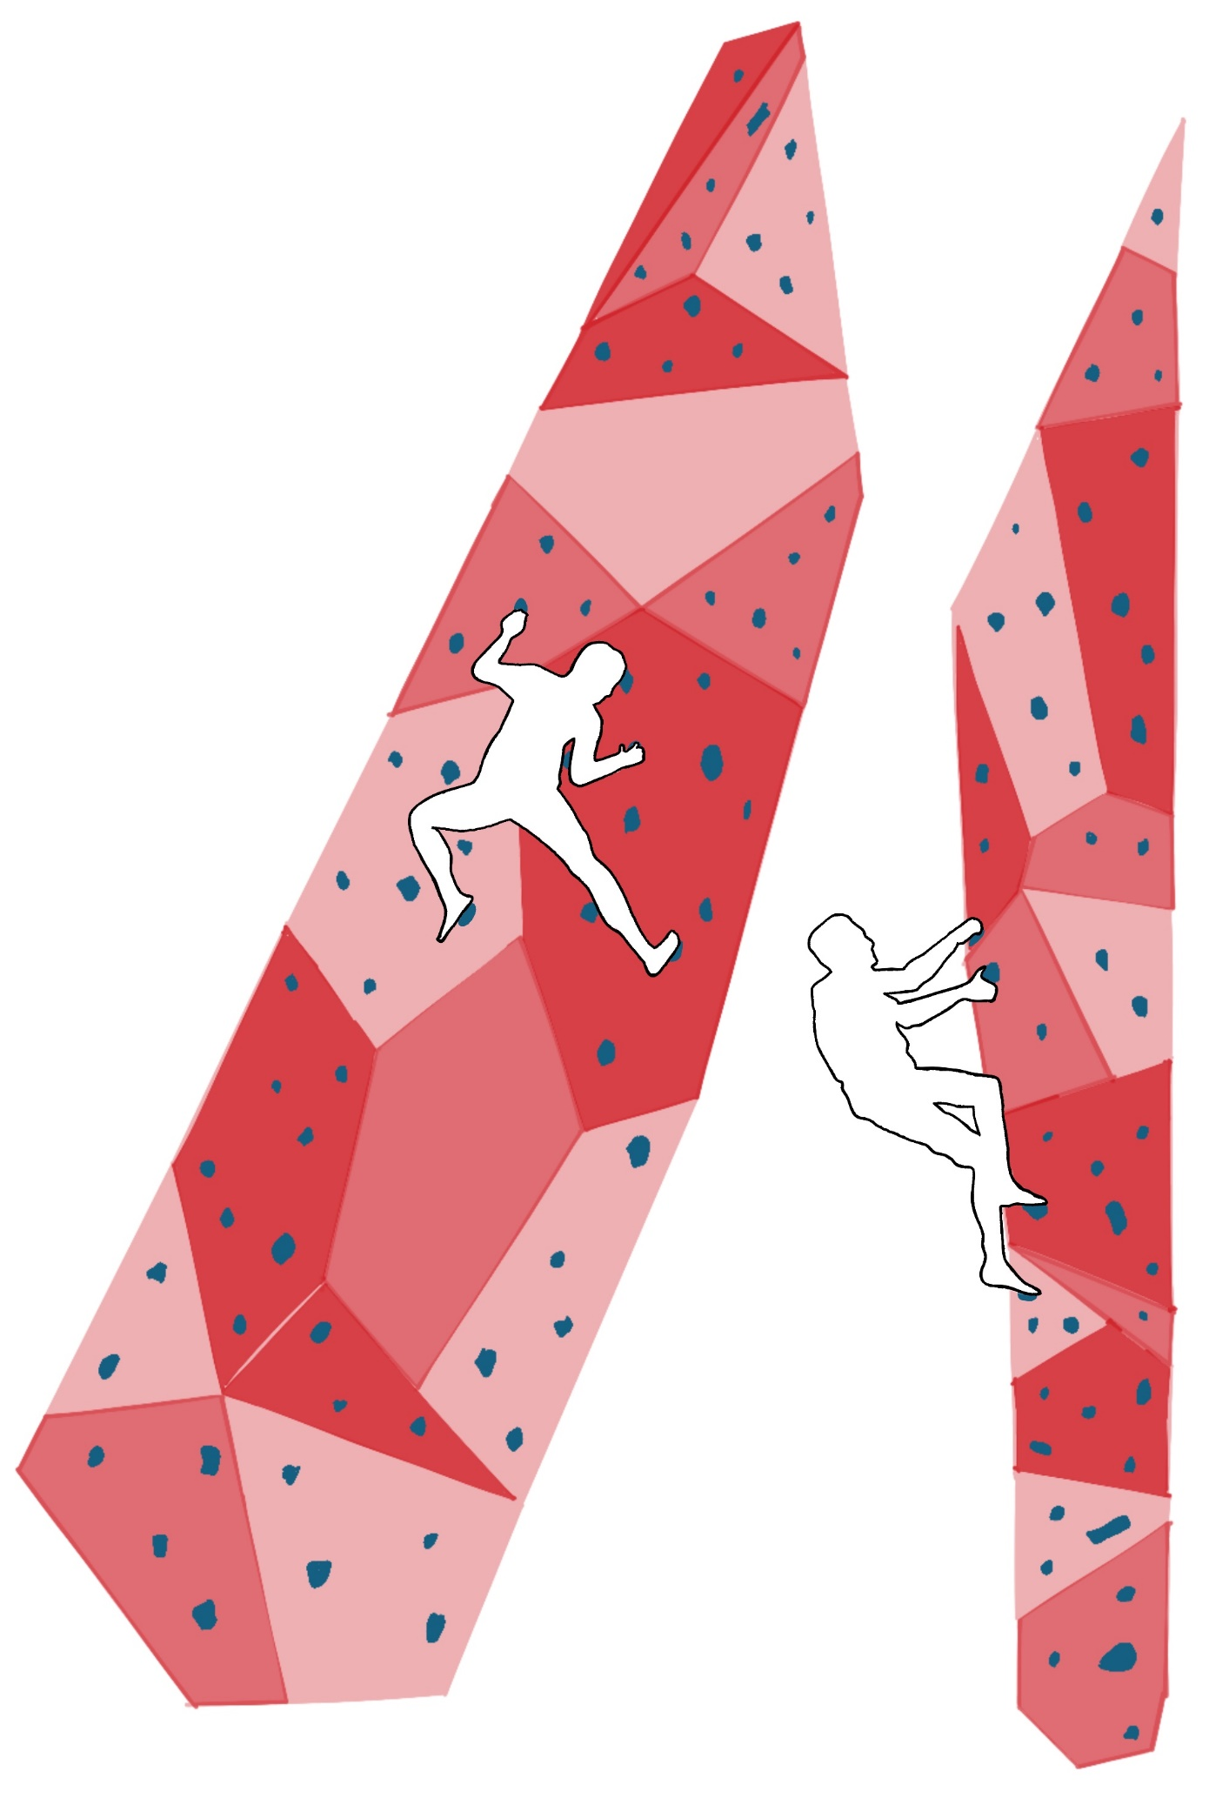
RESEARCH QUESTION
| climbing as a new normal
climbing as an act of new normal
To move by climbing -> Immersive diffusion into lunar conditions
1/6 weight of earth ->
lighter body weight, higher impact-less fall
Full body muscle use
Rich activity
development options
Trigger of another
body movements
(gripping, jumping, falling)

Slide 17
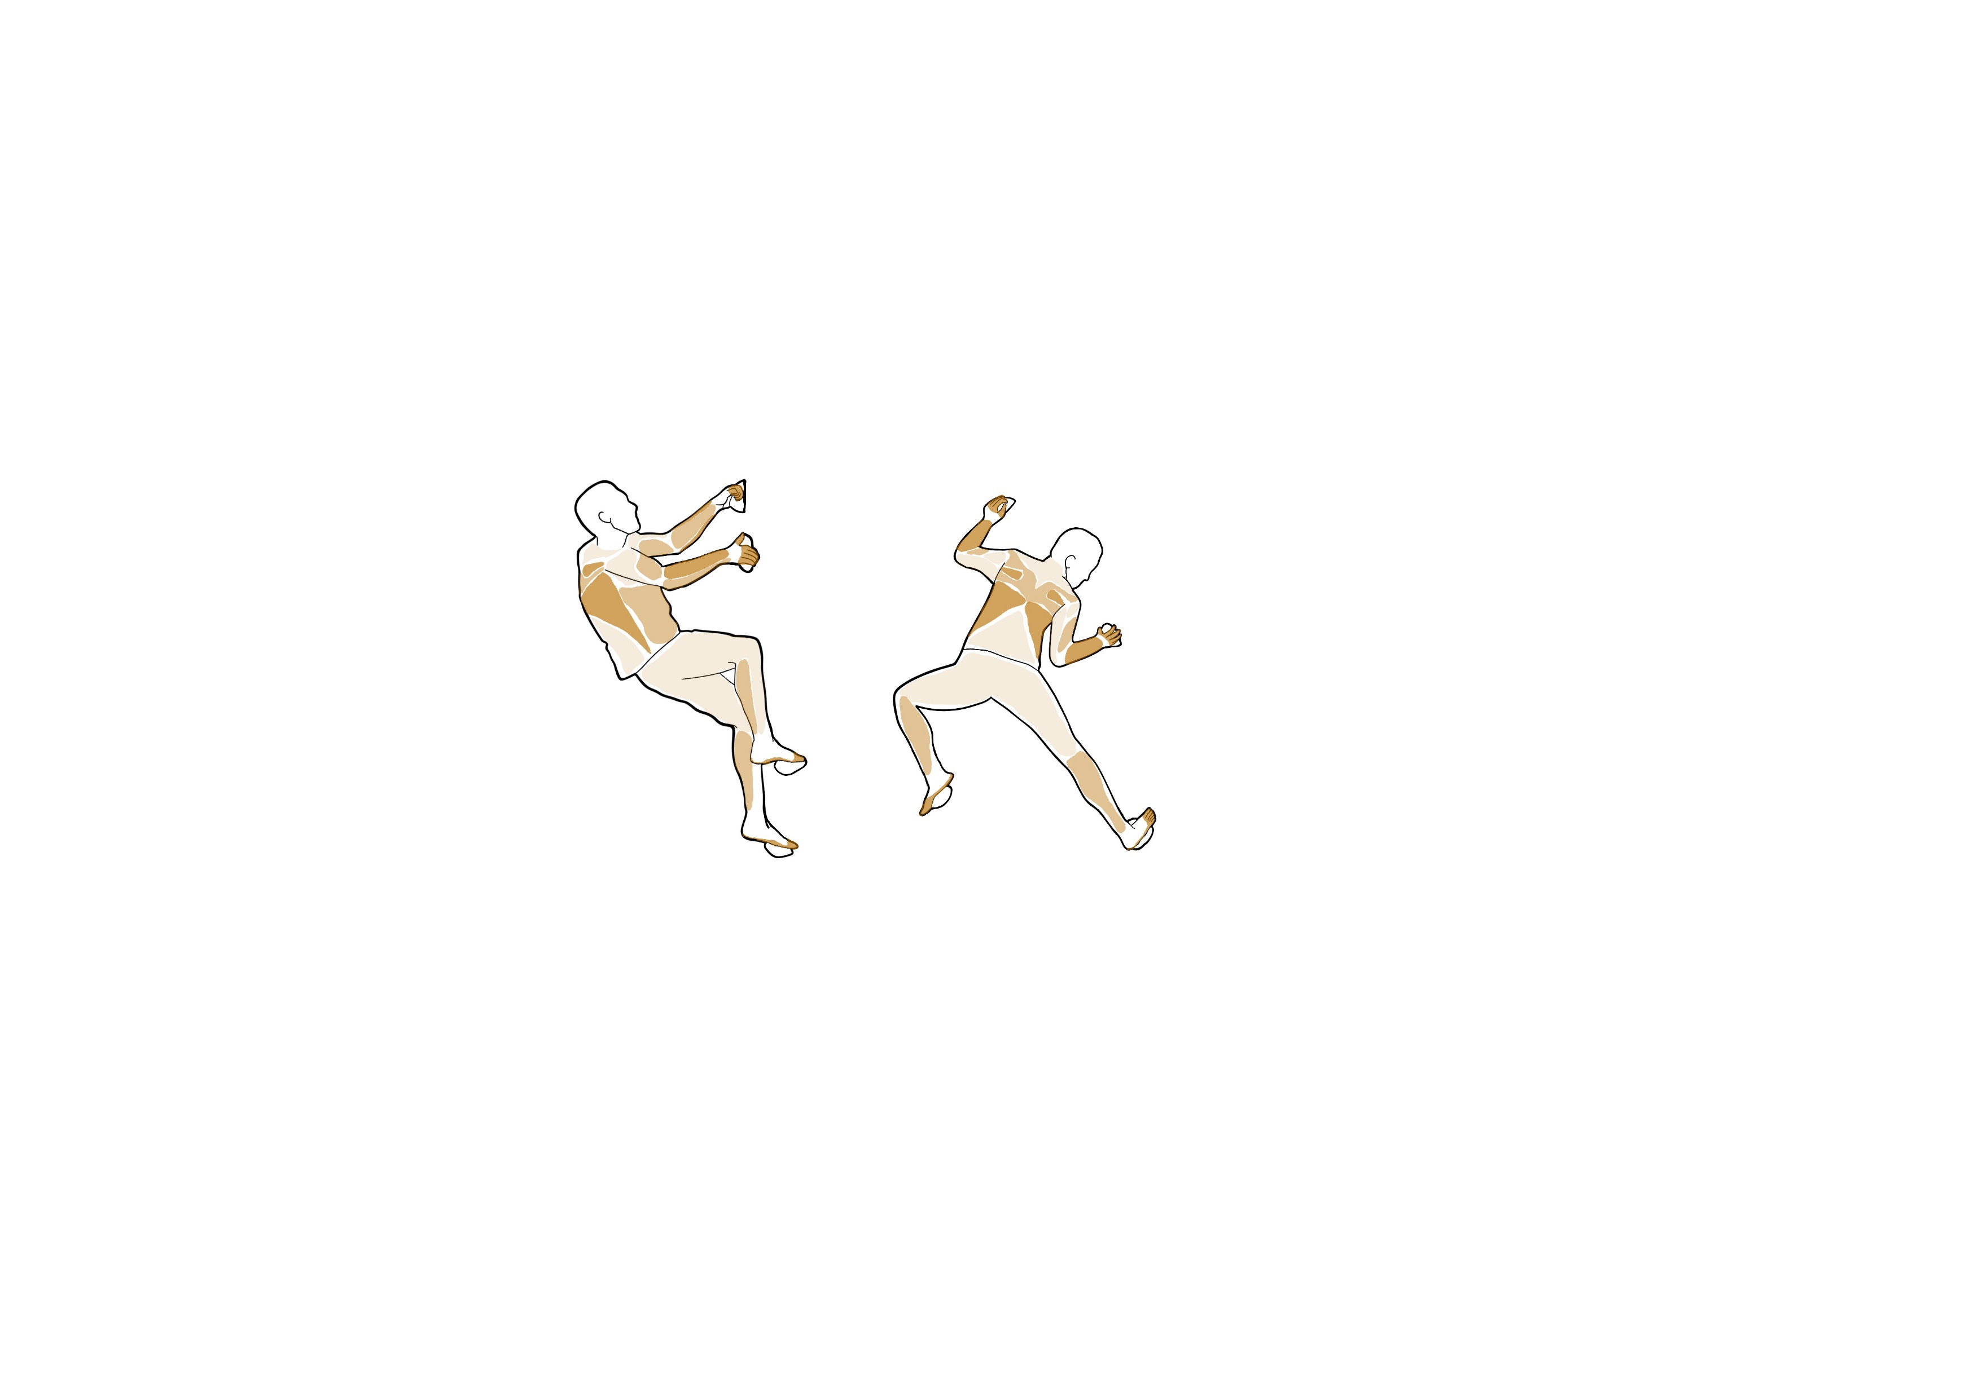
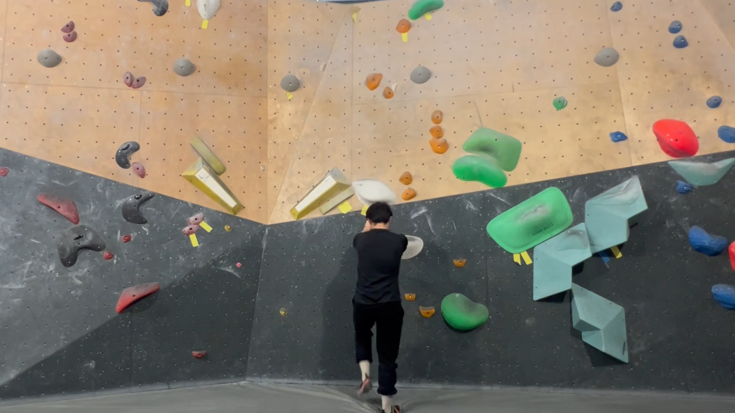
RESEARCH QUESTION
| climbing as a new normal
muscle activation
Arms
Back
Core
Legs
Experiencing Climbing
90-100% Stressed
Source: The wandering climber
50-90% Stressed
Less than 50% Stressed

Slide 18
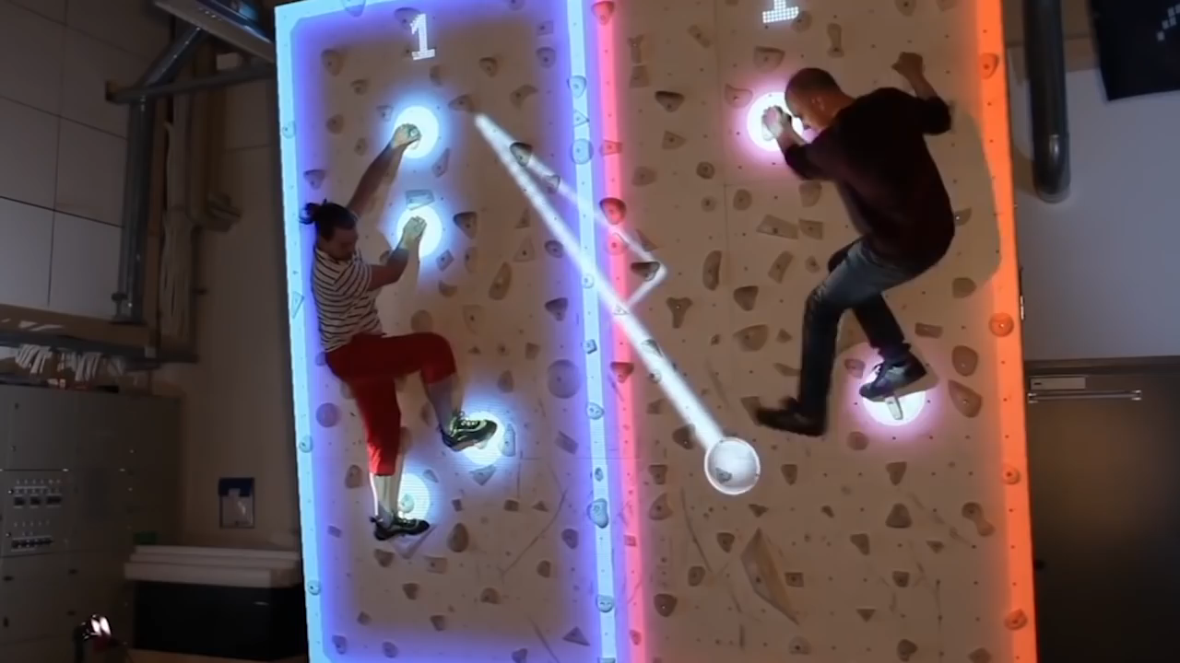
RESEARCH QUESTION
| climbing as a new normal
an effective social bonding tool
youtube.com/watch?v=kwticv9ai_Q&t=43s&ab_channel=TheMapleMedia

Slide 19
RESEARCH QUESTION
Research question
how is playscape designed under benefits of lunar environment
to foster work productivity and social interaction
during long-term lunar habitation?
Design direction
climbing habitat ->
to create interactive and engaging
environment, space and furniture

Slide 20
RESEARCH QUESTION
New Ritual
being on the moon is the perfect time to re-feel our body by engaging with new gravity & new architecture around us

Slide 21
project timeline
Design Context
| New ritual
PAST
MISSIONS
NOW
Anticipated future implementation
Distant Future
Apollo,
past space stations
Phase 1
Phase 2
Phase 3
- Deploying equipment
-Shelter to house important equipment For future long-term exploration
- Simple structure built entirely on earth and then deployed by robots or humans
- If humans’ presence is needed, it will be a short (a few days) mission
- Preparation of lunar permanent base
- Structure to host medium length (several months) mission for less than 10 inhabitants
- Inflatables and modular to be connected to phase 3, with all basic needs: shielding & oxygen
- Start of ISRU regolith utilisation with human-robot interaction
- Permanent habitation with better radiation shield to house more people
- Construction in well analysed site, i.e. lava tube
- Construction with developed ISRU technology from the previous phases
Space stations
(iss, Tiangong)
climbing habitat
constructed within stages
Source: Lunar Settlements (Book) by Haym Benaroya (2010)

Slide 22
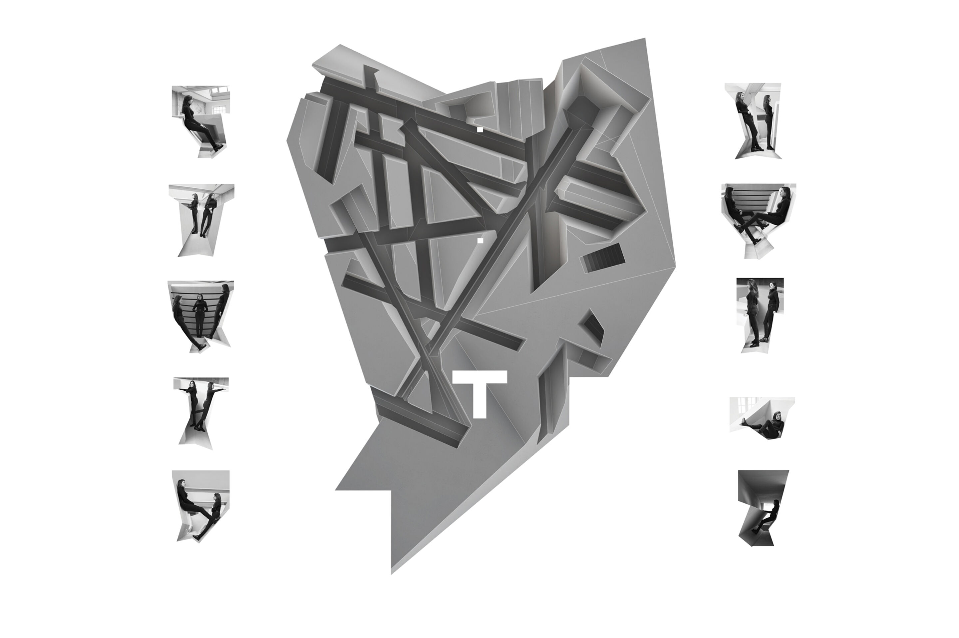
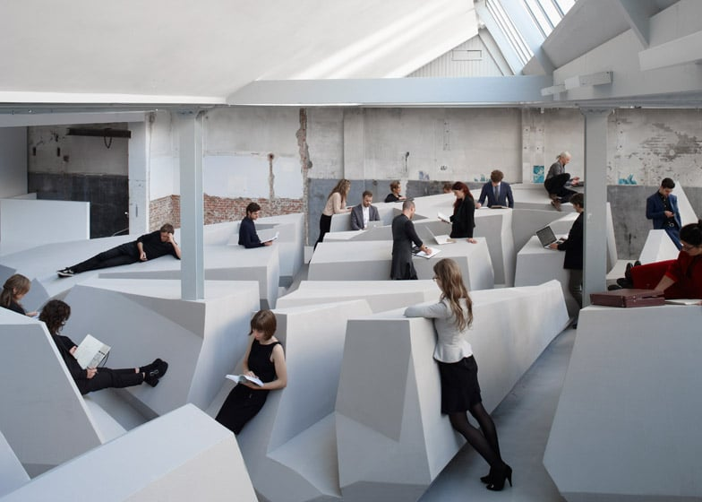
Design Context
| New ritual
human body postures & interactions in between
Unconventional Vertical Surfaces as a Counteract of Sedentary Workstyle
The end of sitting by raaaf
Source: raaaf.nl

Slide 23
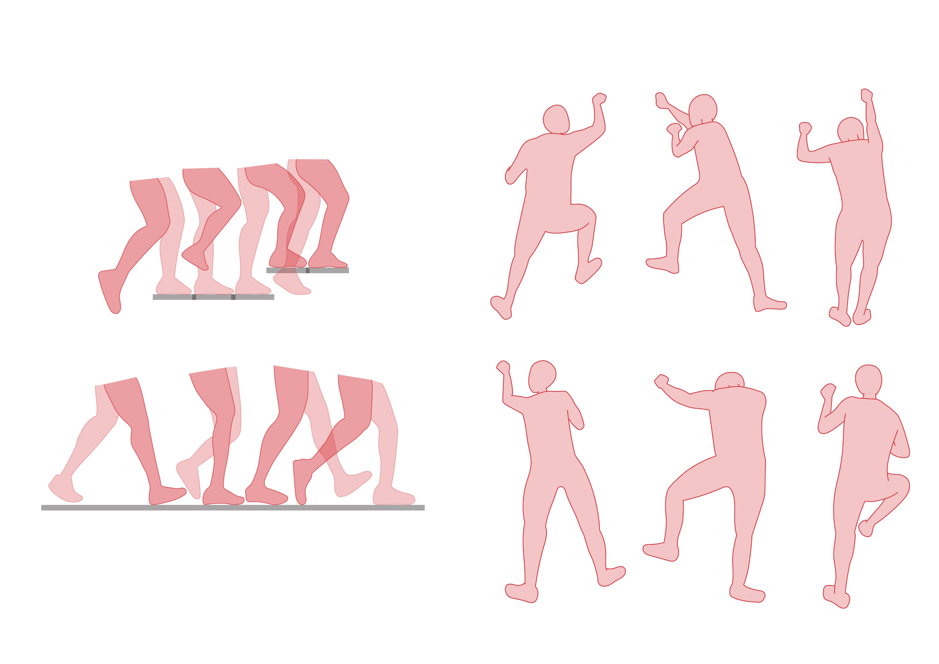
Design Context
| New ritual
human body postures & interactions in between
Climbing as a counteract of repetitive and static movements on earth
a
1
B
2
3
4
C
D
Walking = linear motion adapted to
flat & stable terrain
VS
2
3
4
1
a
B
C
D
Uniform dimensions of stair runs and rises
result in constant motion
Climbing Motions

Slide 24
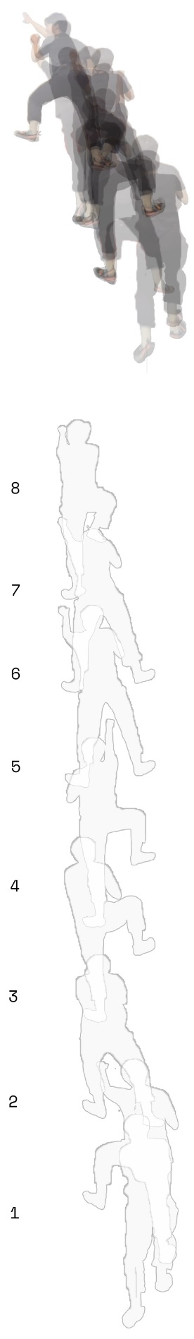
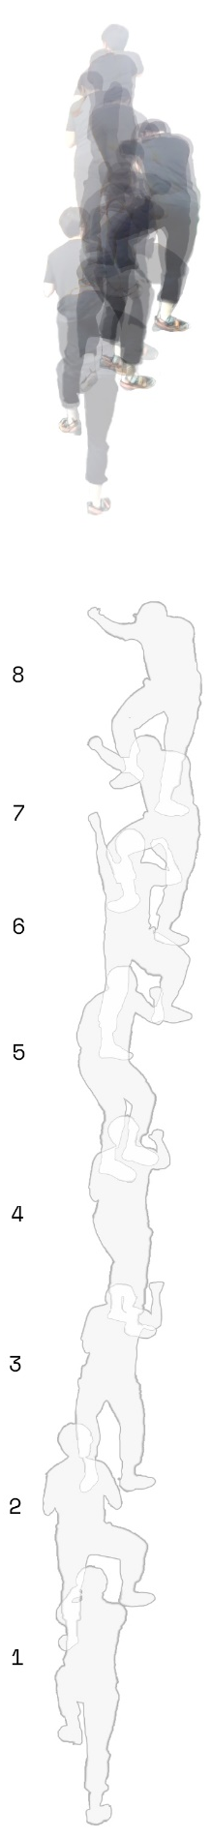
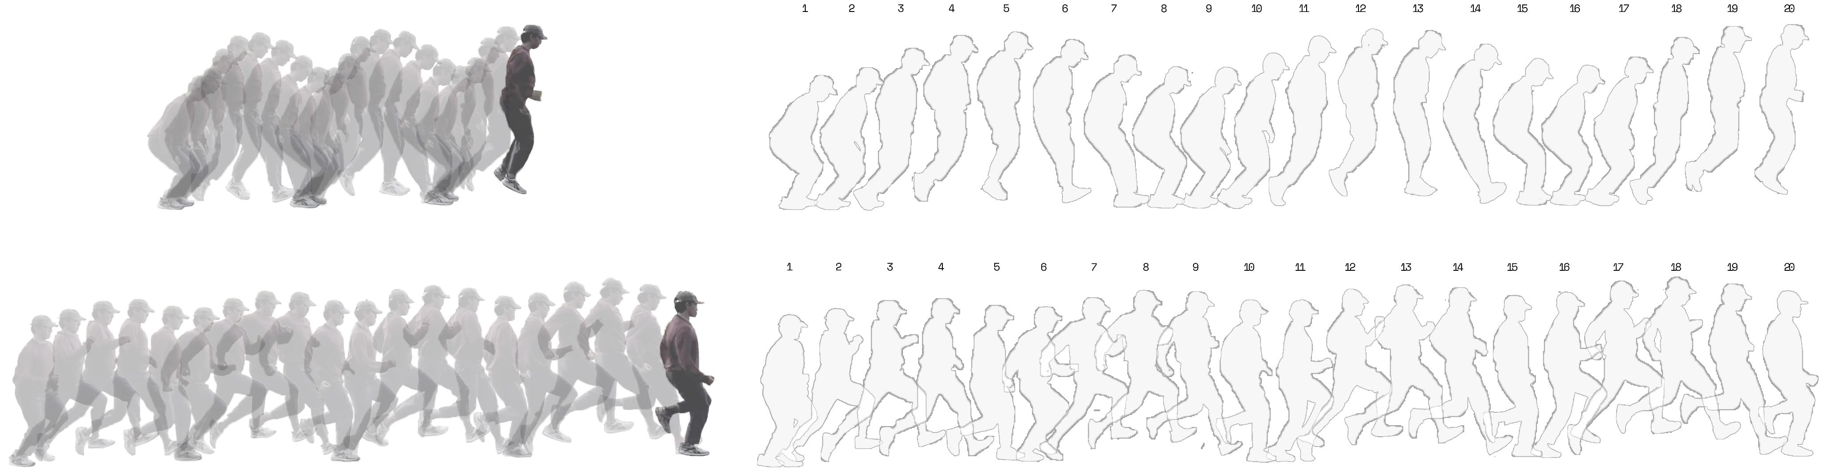
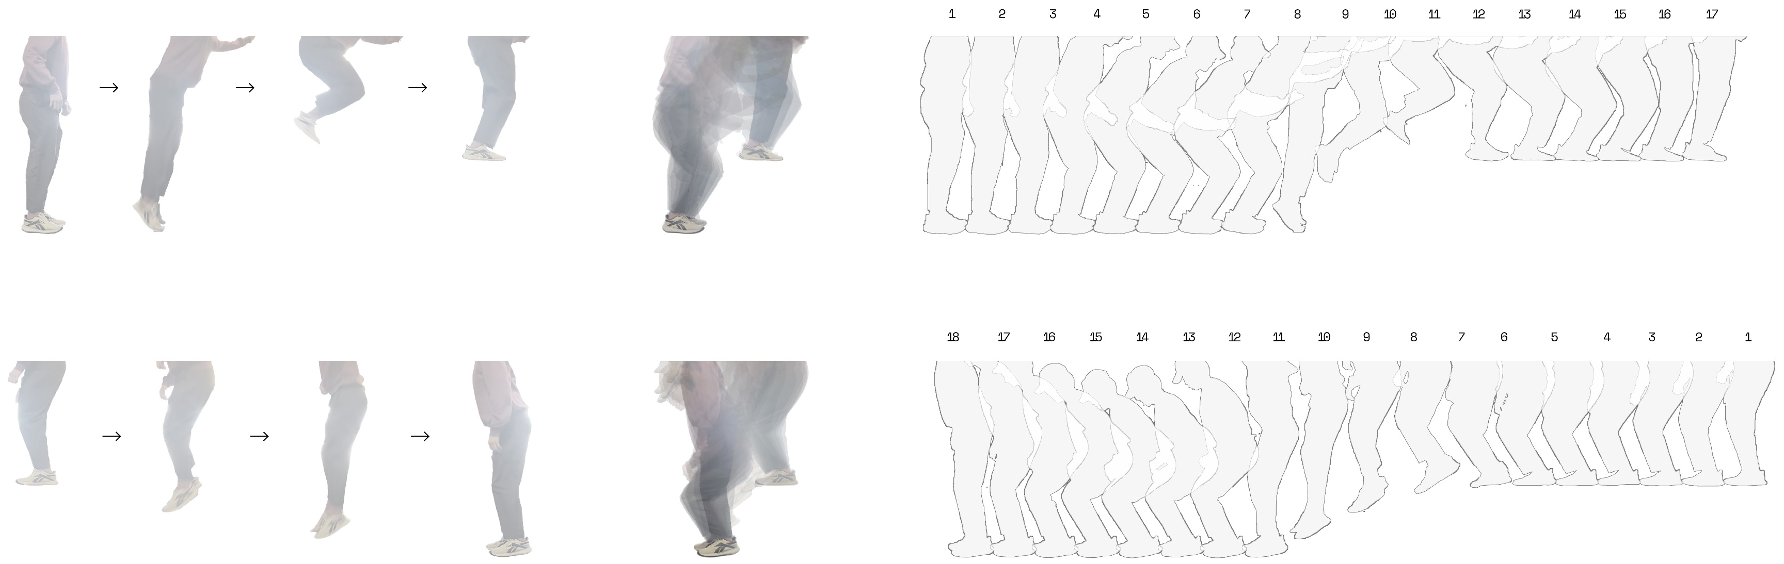
Design Context
| New ritual
human body movements mapping
Hopping & Galloping
High Jump (Up & Down 500mm)
Climbing

Slide 25
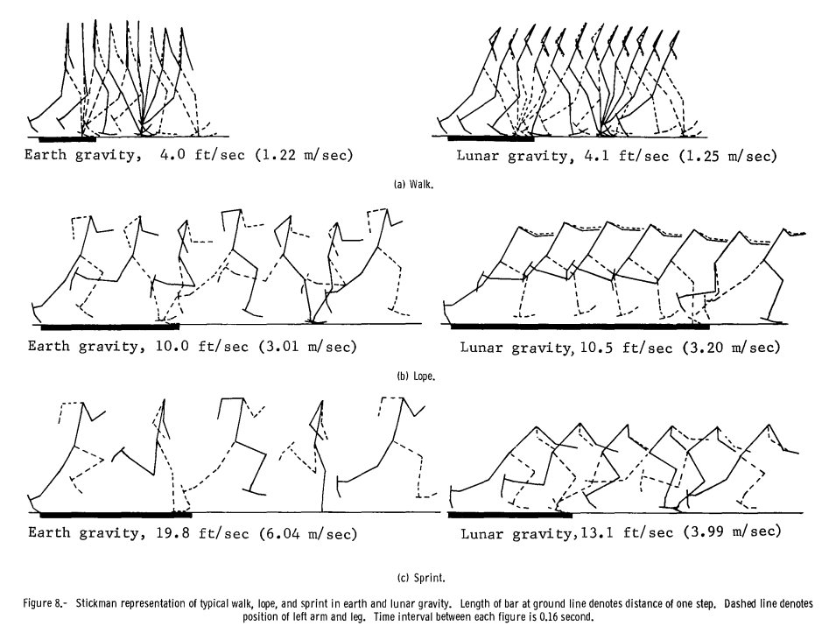
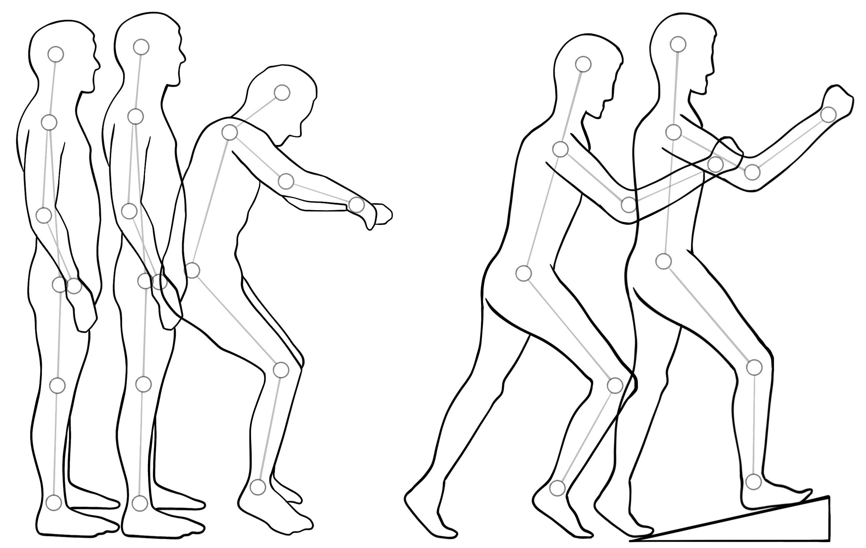
Design Context
| New ritual
body movement against gravity
Elongated Spine
1 G
1/6 G
1/6 G
0 G
Source: Nasa
Absence of Friction
to push back
Comparative measurements of walking and running gaits (1966)
Neutral Position & start of walking

Slide 26
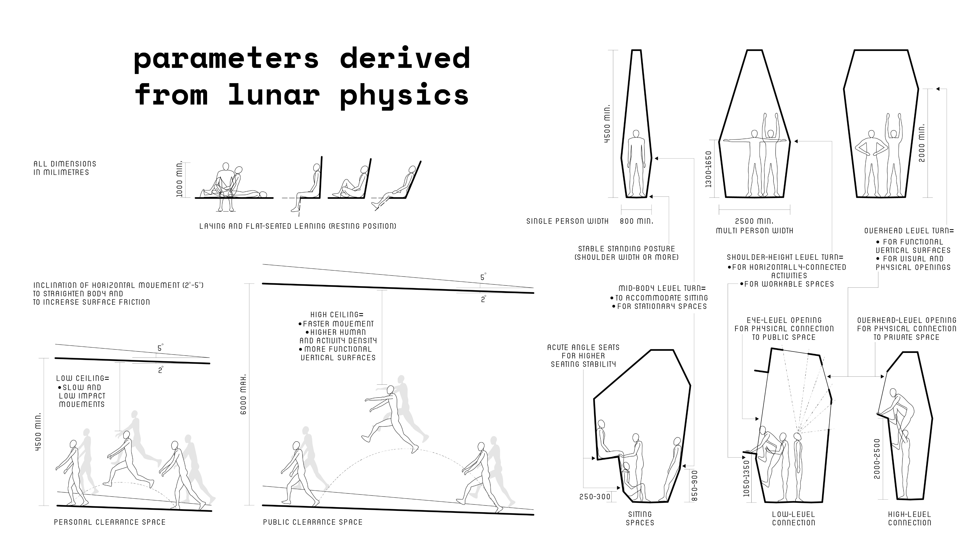
Design Parameter
| New ritual
parameters derived
from lunar physics

Slide 27
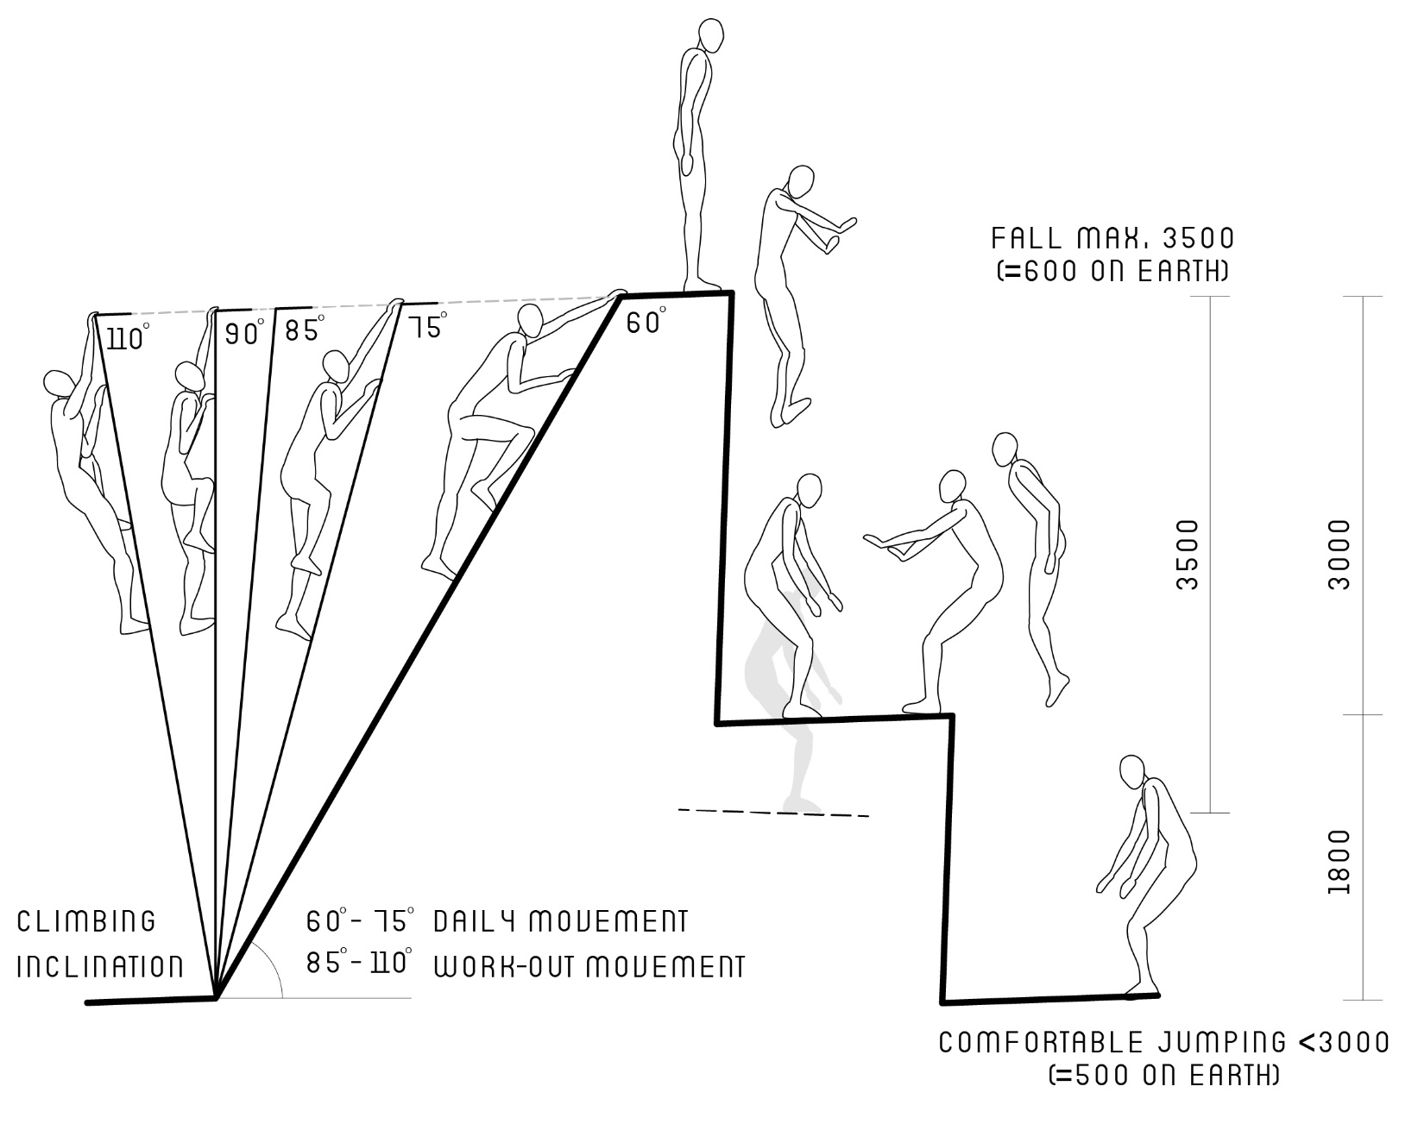
Design Parameter
| New ritual
parameters derived
from lunar physics
Gravity (m/s2)
earth
moon
9.8
1.6
Fall from 1m
Fall from 2m
0.45 sec
1.1 sec
0.64 sec
1.6 sec
v= 4.4m/s
v= 1.8m/s
v= 6.26m/s
v= 2.5m/s
v= 1.8m/s
v= 2.5m/s
0.17m
0.32m
Fall from 3m
Fall from 10m
0.78 sec
1.9 sec
1.43 sec
3.54 sec
v= 7.7m/s
v= 3.1m/s
v= 14m/s
v= 5.6m/s
v= 3.1m/s
v= 5.6m/s
0.49m
1.6m
Jump from ground
0.5 m
2.7 - 3 m

Slide 28
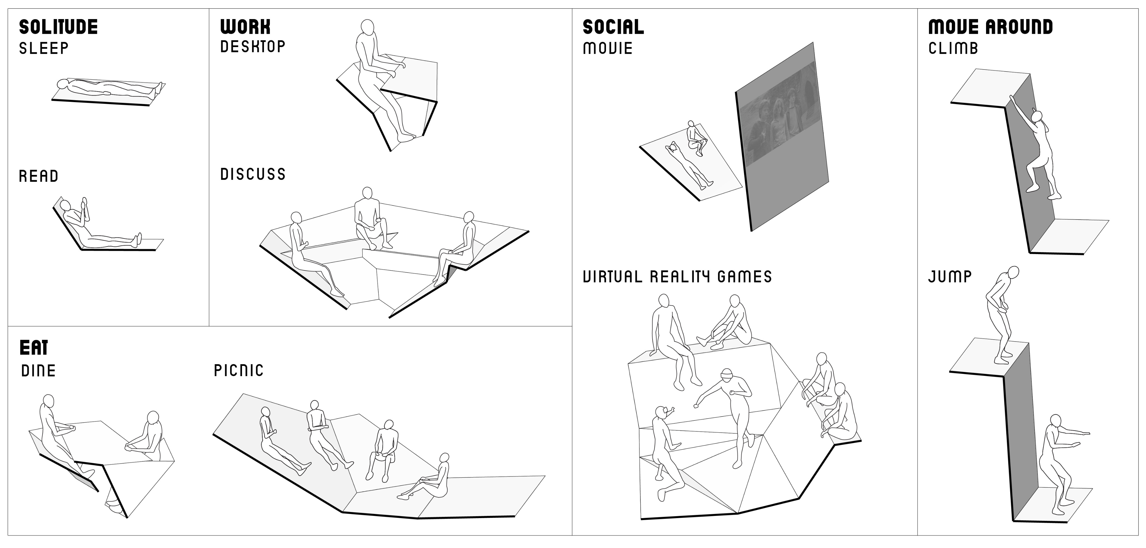
Design Parameter
| New ritual
(assumptive) fundamental postures to activities
Socialise

