Slide 1
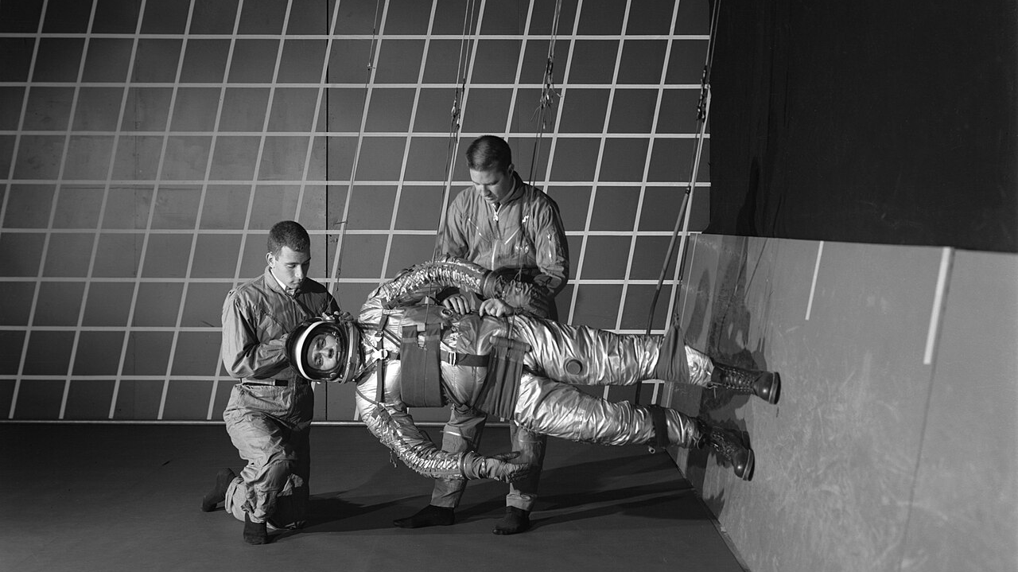
Moon Running *Walking
Week 4: Further refinement of locomotion, programmatic studies

Slide 2
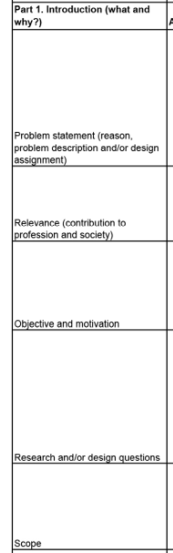
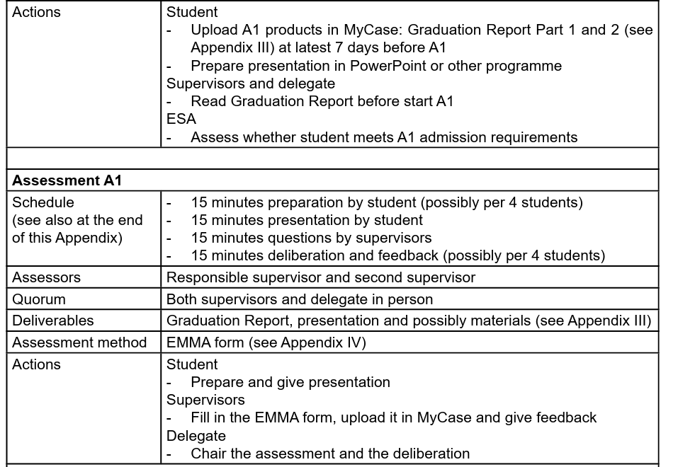
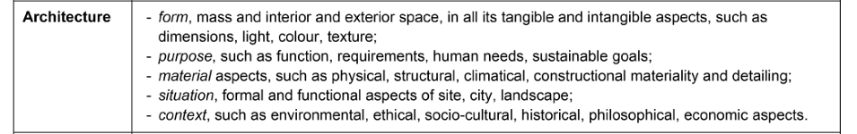

Slide 3
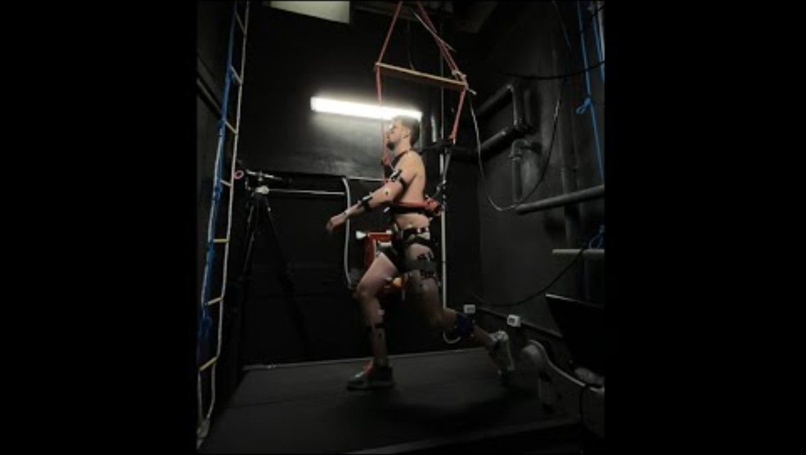
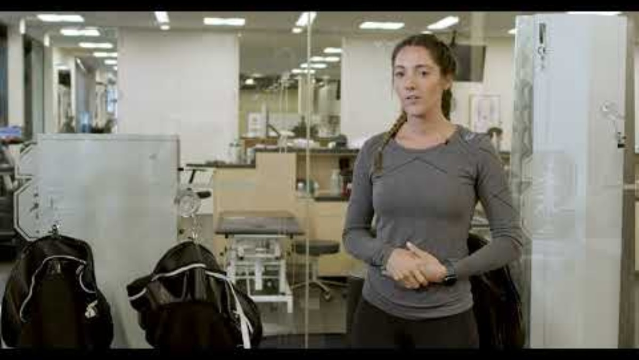
Locomotion: re-defining moon “walking”
When it comes to gait transition, hopping is the new “walking”, while walking is the new “running”
https://www.youtube.com/embed/dmDTTT4OnjE?rel=0
https://www.youtube.com/watch?v=pLbq4S1mnGI

Slide 4
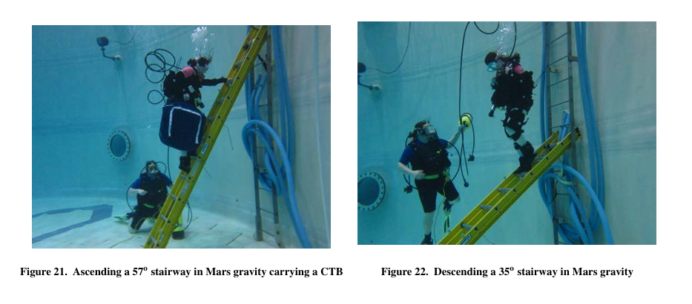
Locomotion: re-defining moon “walking”
The 57° ladder represented a transition case between a staircase/ramp
(35° on Mars)

Slide 5
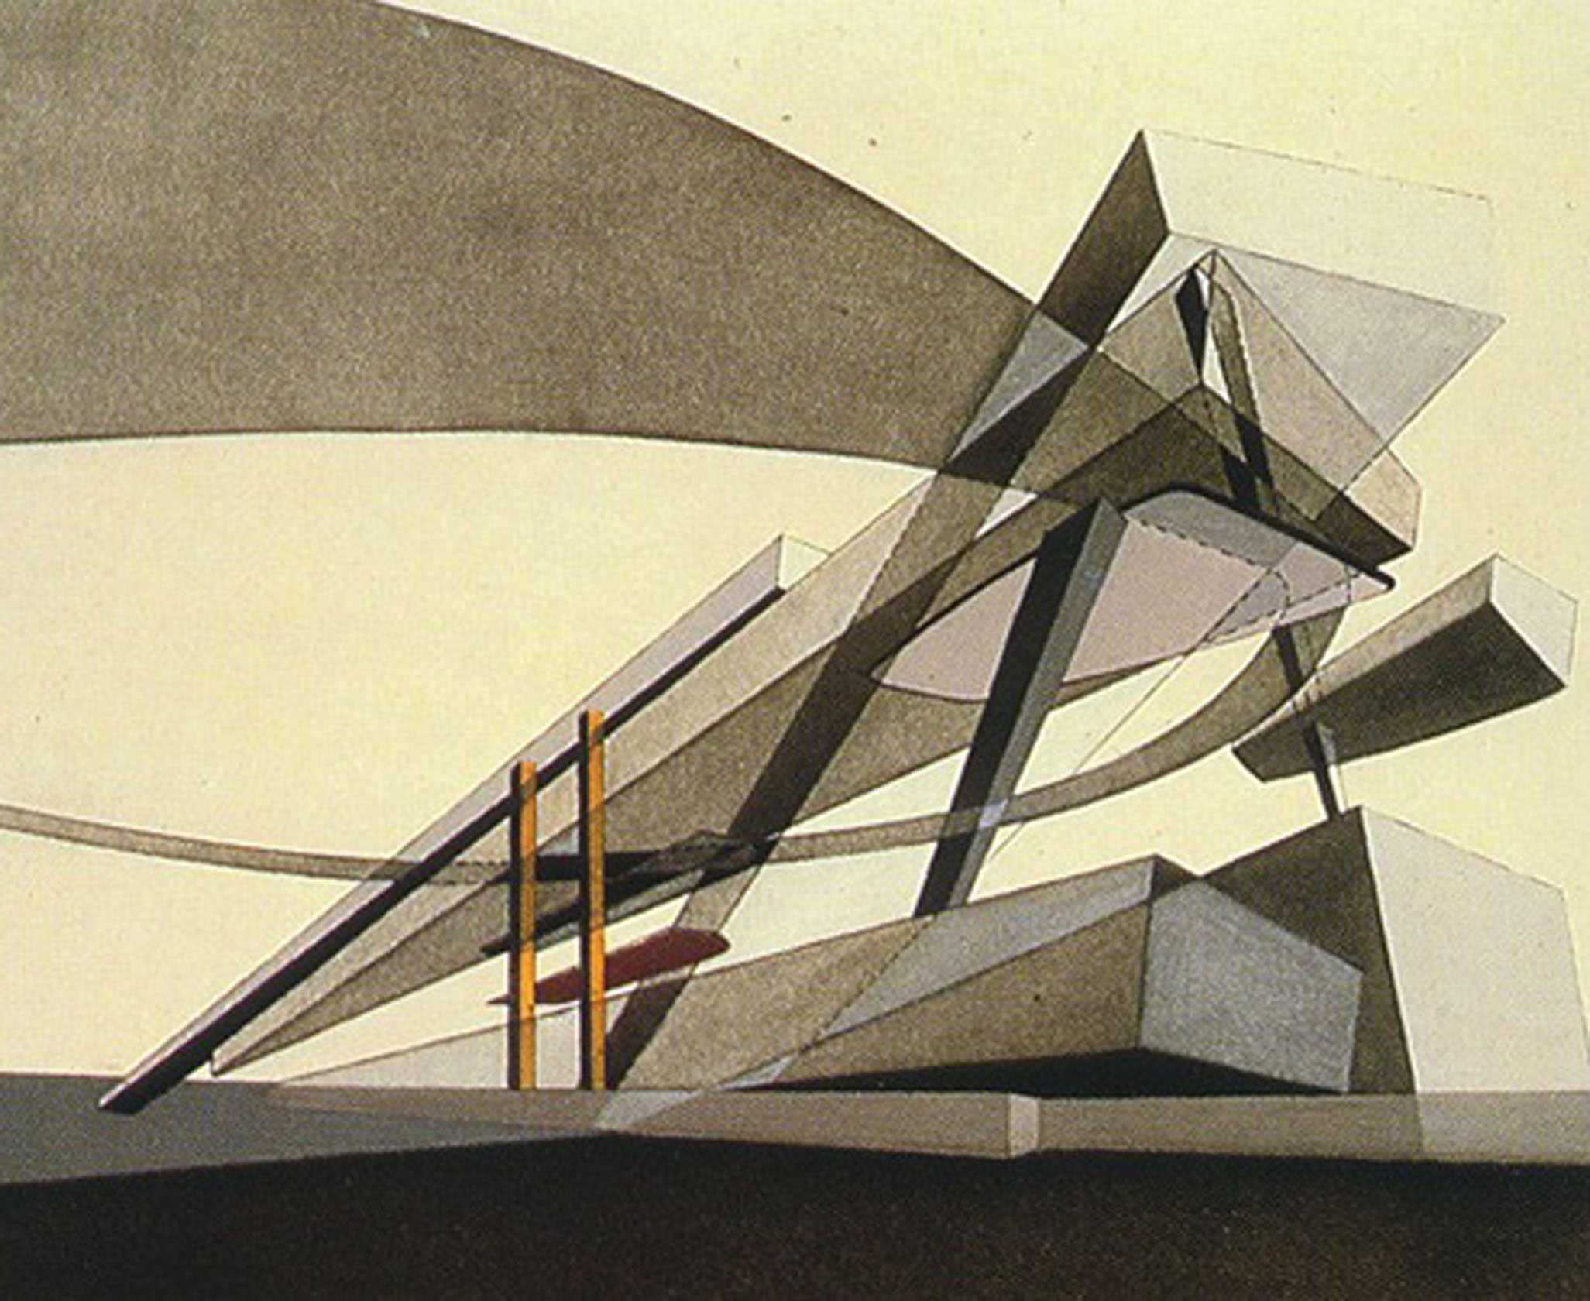
Bootcamp “loop” update*
The loop is in “3D” rather than flat surface
(no more Wall of Death)
People can and will travel further and higher per jump, so the “loop” may may shift from continuous stairs to punctuated “nodes” of platforms of function (balcony, lounge, study etc.), and widening at areas of high traffic and narrowing or disappearing where ballistic movement is discouraged.

Slide 6
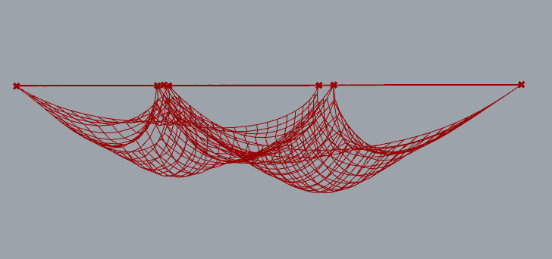
Control and balance of space
“Capture geometries”
Moving beyond rails, geometry is designed to indicate movement: from encouraging or restraining jumps, capturing falls and supporting force

Slide 7
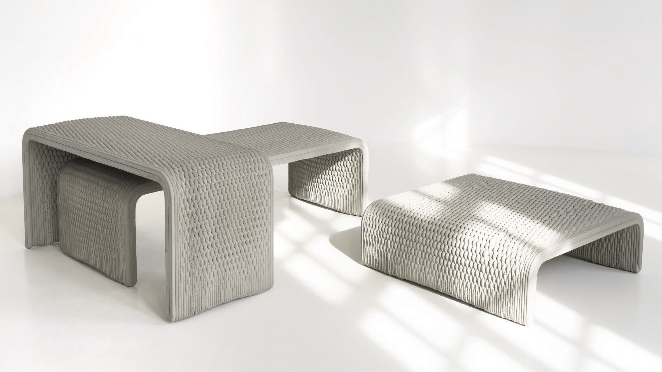
Control and balance of space
Friction patterns

Slide 8
Summary
Locomotion effects
Biomechanical studies and recent exoskeleton work suggest that hopping and jumping in lunar-like gravity can have lower or comparable metabolic cost to walking or running at similar speeds, especially as gravity decreases.
Locomotion itself becomes a core program: daily exercise, research preparation, and movement training all require spaces for repetitive hopping, balance, and posture control in partial gravity.
Bootcamp loop update*
Because people can and will travel further and higher per jump, interior spaces benefit from greater ceiling heights and vertical clearances, with fewer tight overhead obstacles and more in “3D” where movement volumes, not just flat floors.
Lost in space update* - material
Longer flights and reduced friction mean reduced mid-flight control and higher risk of overshooting, so spatial layouts need “capture geometries” (nets, padded, funnels) that passively reorient or decelerate bodies. Circulation elements (ramps, ladders, nets) can be optimized for launch and landing: soft, high-friction, or energy-absorbing floor zones at expected touchdown points, and robust handholds or guide rails where users initiate or arrest motion
Lighting rhythm
Visual cues and lighting become part of movement safety: clear sightlines to landing zones, high-contrast marking of edges, and volumetric lighting that emphasizes safe jump corridors help compensate for altered balance and proprioception.

Slide 9
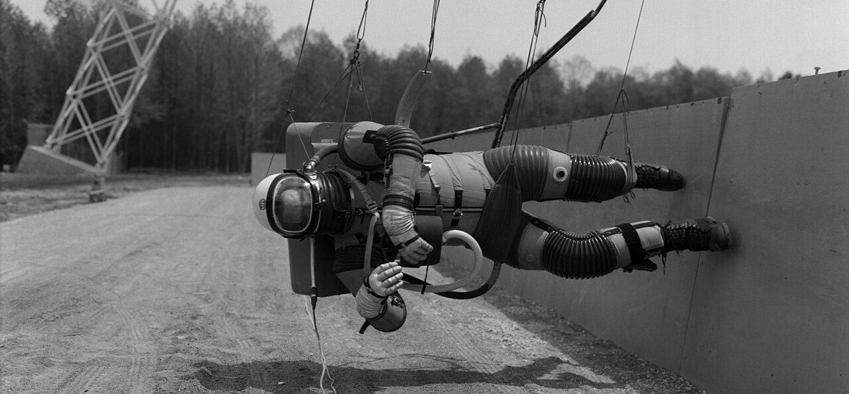
Moon Loop Run
Week 3: Locomotion

Slide 10
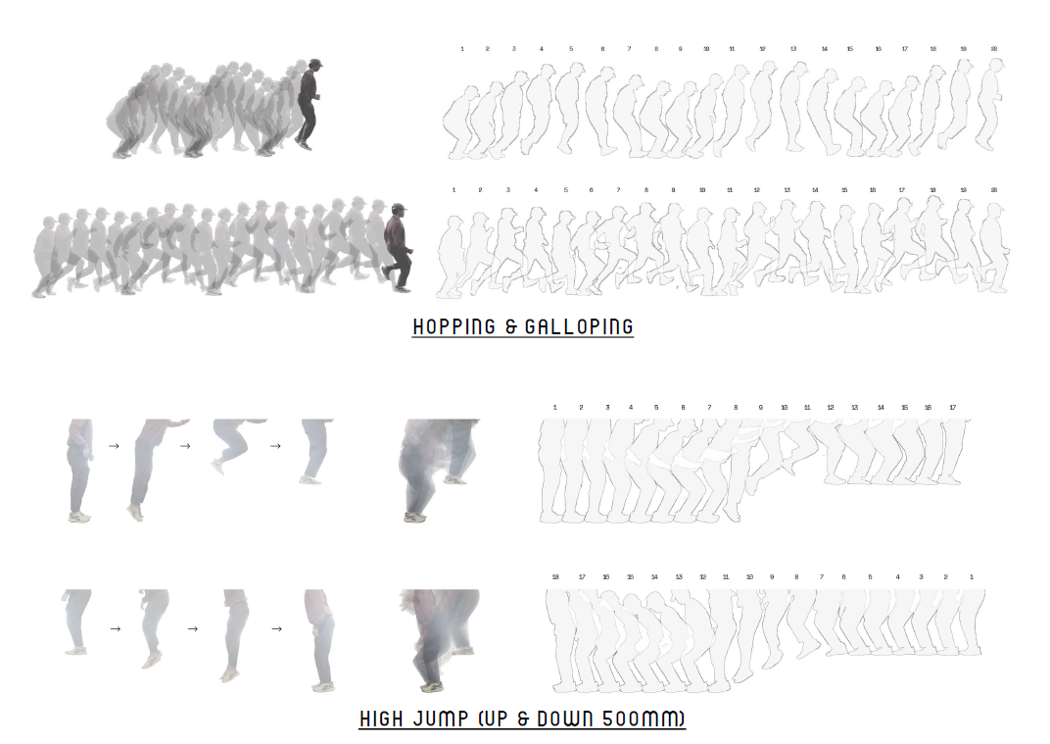
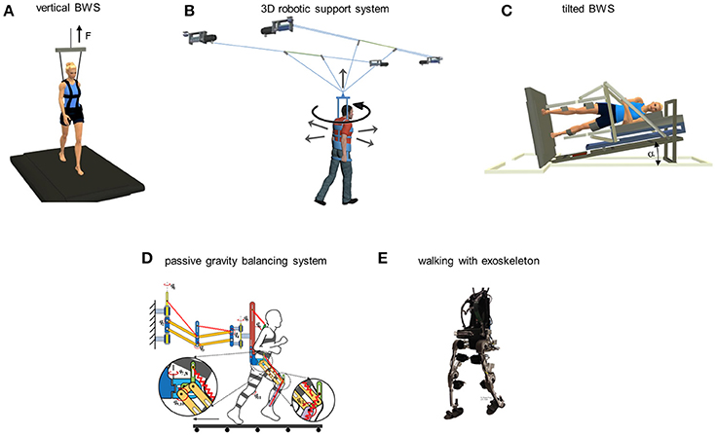
Human Locomotion in Hypo gravity
Hop, skip and jump are more popular
Jonathan’s presentation. Will reproduce mine in the report

Slide 11
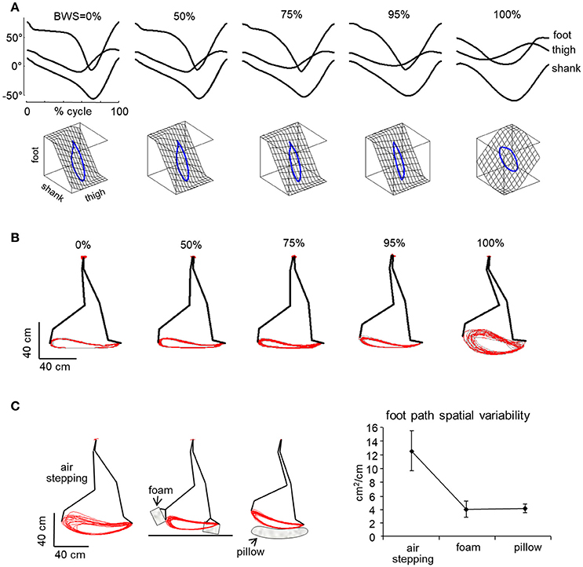
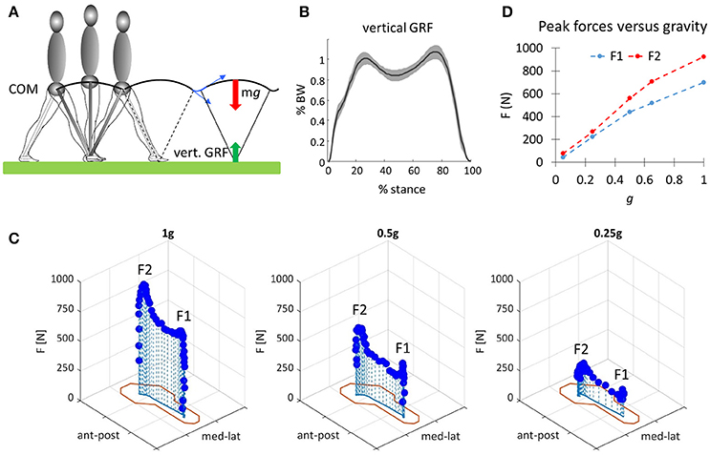
Human Locomotion in Hypo Gravity
Balance, coordination, and falls
https://www.frontiersin.org/journals/physiology/articles/10.3389/fphys.2017.00893/full

Slide 12
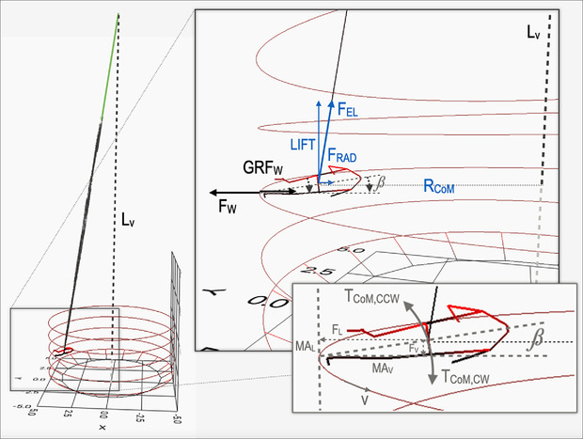
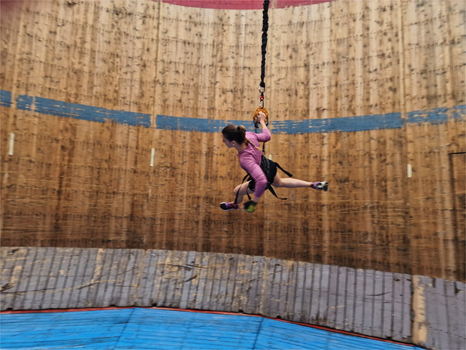
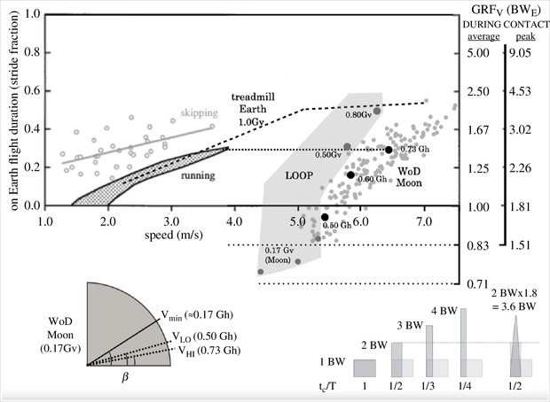
Horizonal running at Wall of Death (WoD)
countermeasure for low-gravity deconditioning
https://royalsocietypublishing.org/doi/10.1098/rsos.231906#d1e4127

Slide 13
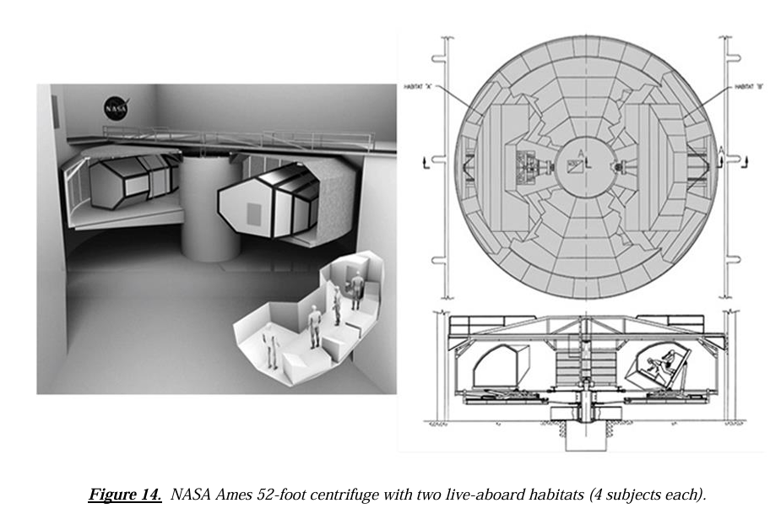
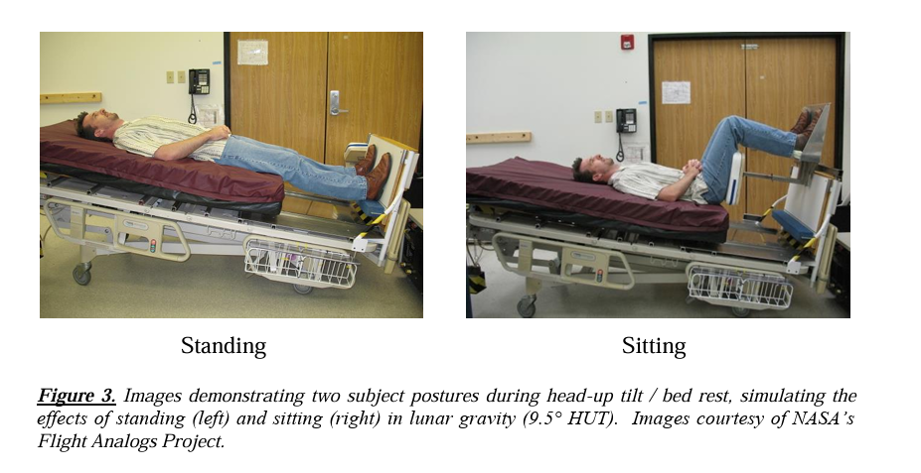
Lost in Space
Sense of direction and spatial cognition
NASA - Human Health Countermeasures – Partial-Gravity Analogs Workshop

Slide 14
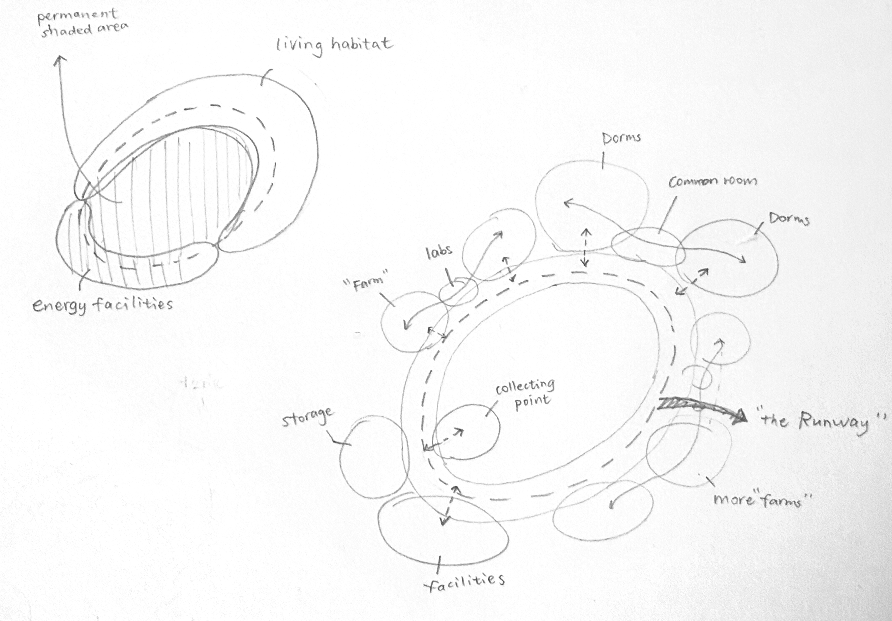
A Coffee Run at Boot Camp
Adapting, training and social in a nutshell

Slide 15
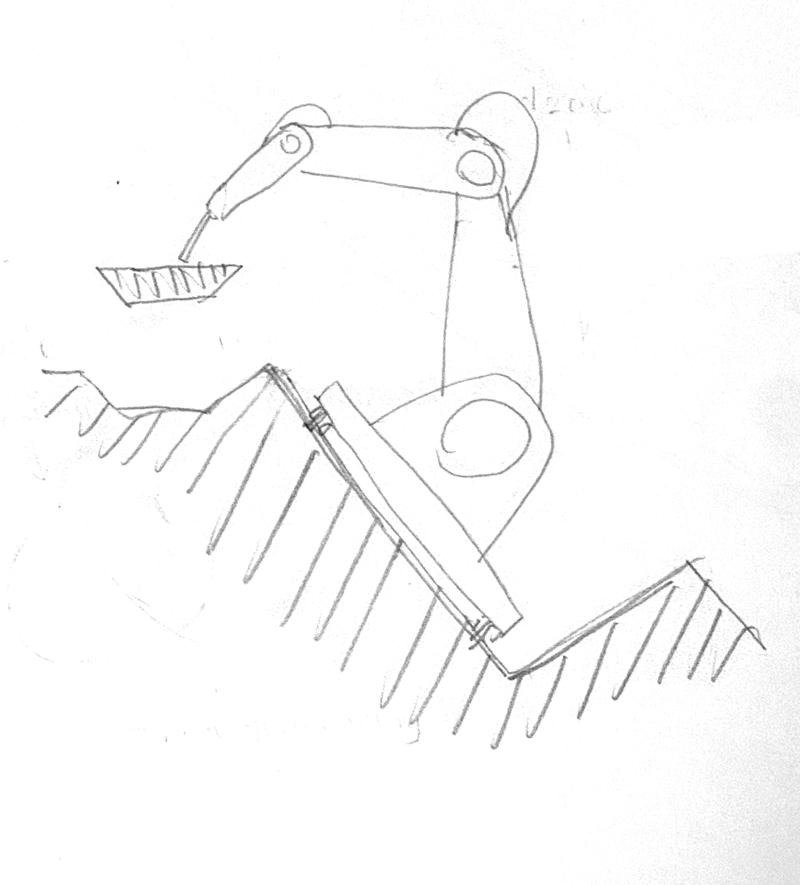
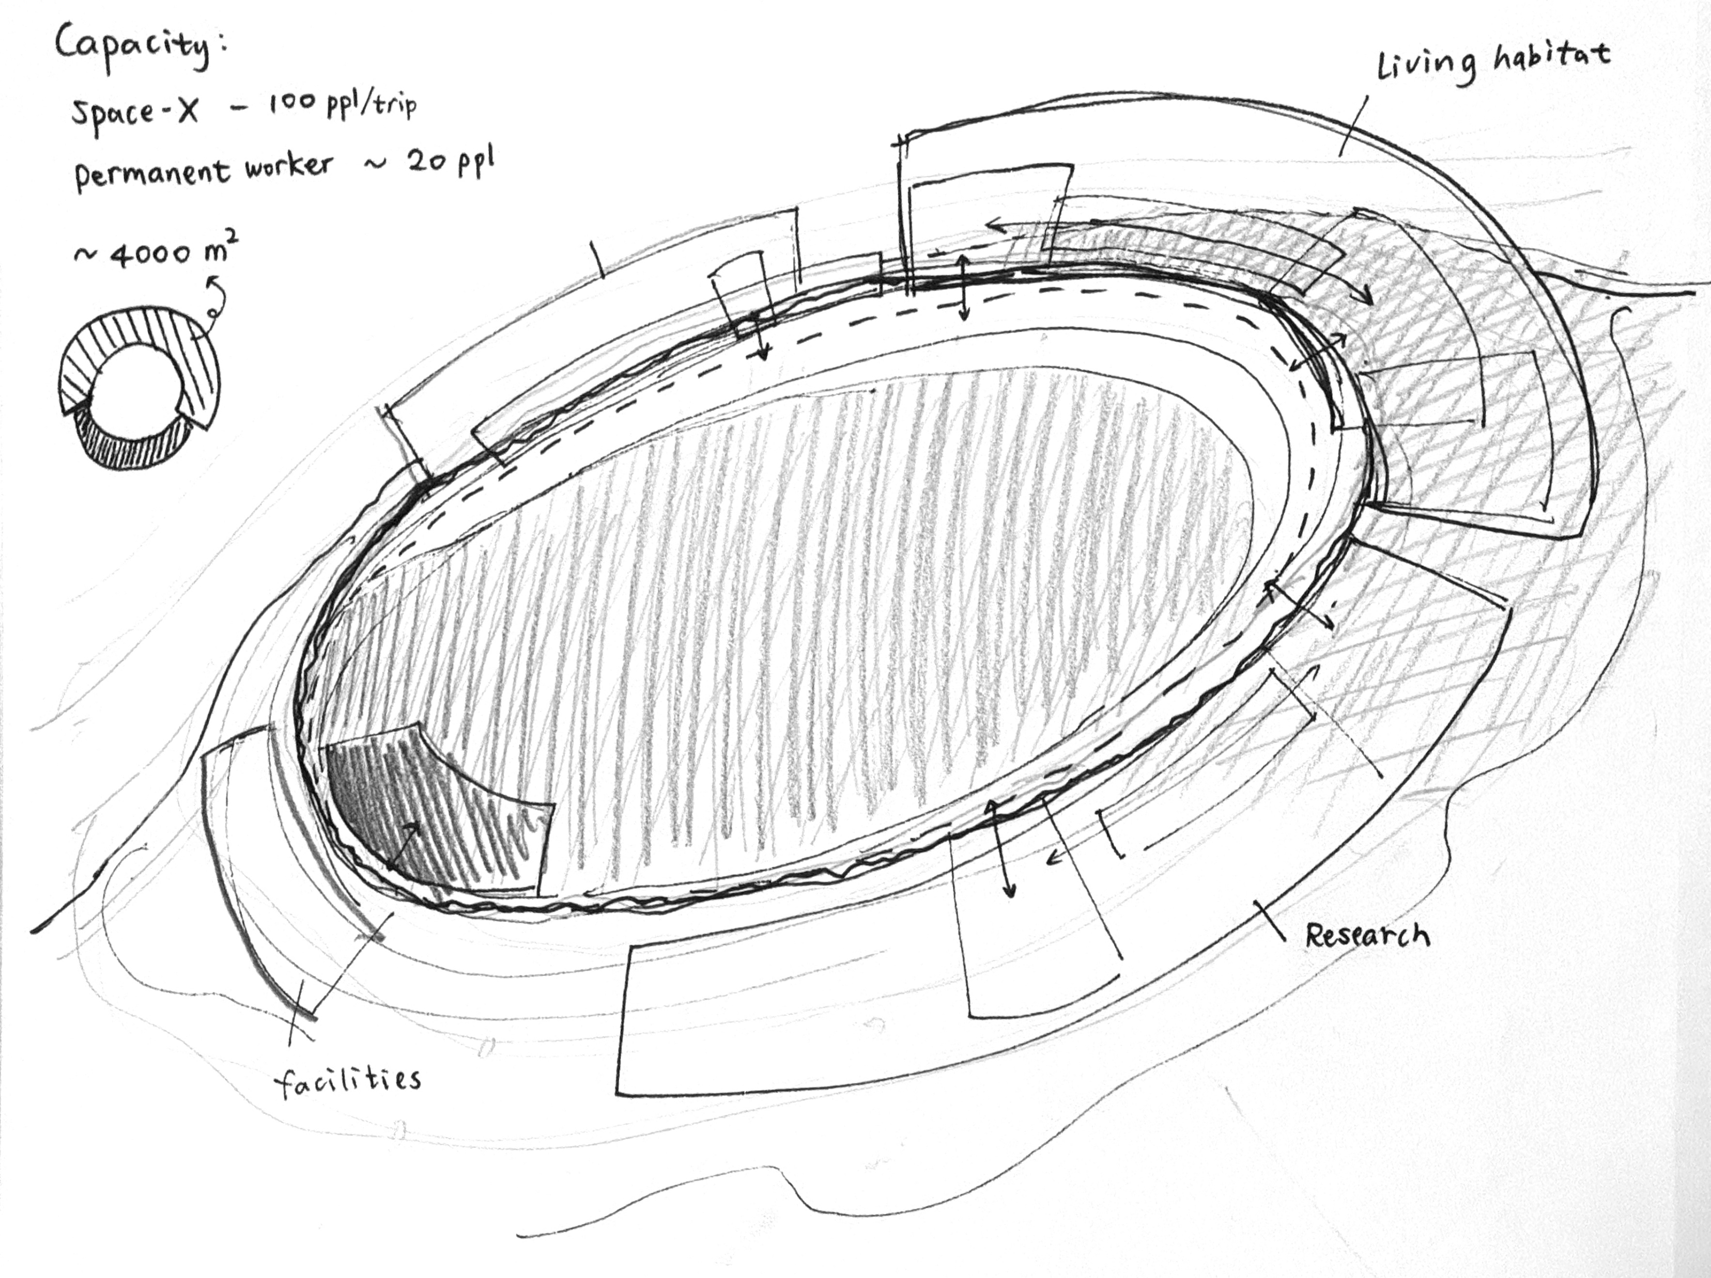
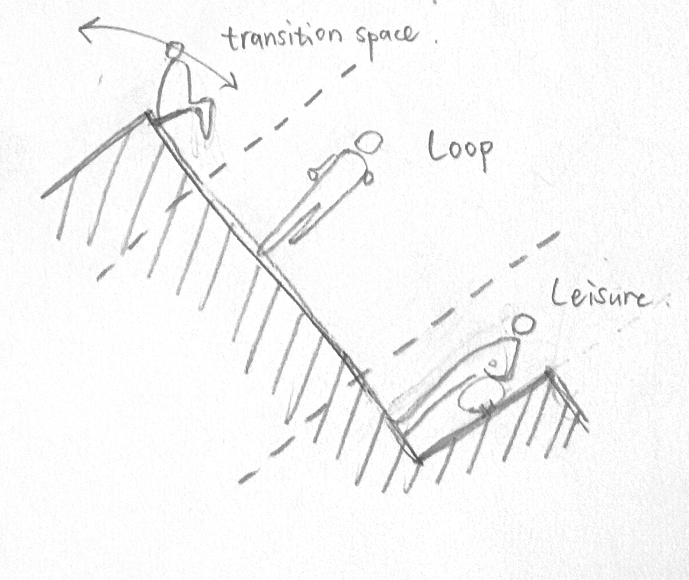
A Coffee Run at Boot Camp

Slide 16
Summary
What low gravity changes
On the Moon, mass and inertia stay the same, but weight is reduced to roughly 0.16 g, so each push against the ground sends the body higher and farther. reports shows astronauts using several distinct gaits: flat‑footed shuffling, loping (a kind of slow run with long aerial phases), skipping, and two‑footed hopping. As astronauts gained experience, they shifted from cautious shuffling to loping and skipping, which allowed higher speeds and felt more comfortable in the suits and low gravity. (Lacquaniti et al, 2017)
Coffee run at Boot Camp
Example used curved “walls of death” tracks where people could run using a combination of gravity and centrifugal forces. (Minetti, 2024)
The loop connects all departments of moon habitats, also functions as training path that offer gravity simulation to prepare for Mars. It combines commute and social needs of inhabitants. It can also be used as delivery channel in construction phase or maintenance.
Lost in space
In low gravity, the brain lacks a downward-pulling gravitational reference point, making it easier for conflicts to arise between the vestibular system, vision, and proprioception. This makes it more difficult for people to quickly determine "which side is up, which side is down" and how much angle they have turned.
Spatial updates (the ability to continuously update one's relative position to surrounding objects) have been shown to rely on gravity cues. Changing gravity will temporarily reduce performance in navigation, turning, and route memorization, which needs to be compensated for through training and alternative cues.
Capacity
The spaces are arranged radially, surrounding the loop. They are categorized into living habitats, life-support research farms, and facilities. While habitats and farms use solar radiation for heat and energy, facilities like nuclear fusion plants and super-computers need to cool down at the permanent shading areas.
Based on the capacity of Elon’s Space-X designed capacity (100 people per ride), this moon base is designed for 100 people to research or prepare their living on Mars, with around 20 permanent (or seasonal) workers for daily operation.
Next Step
The three main design elements—low gravity (loop), enclosed environment (labyrinth), and strong sense of time rhythm (lighting), can be used to create a system that is both fun and functional (health, psychological, social, and cognitive training).

Slide 17
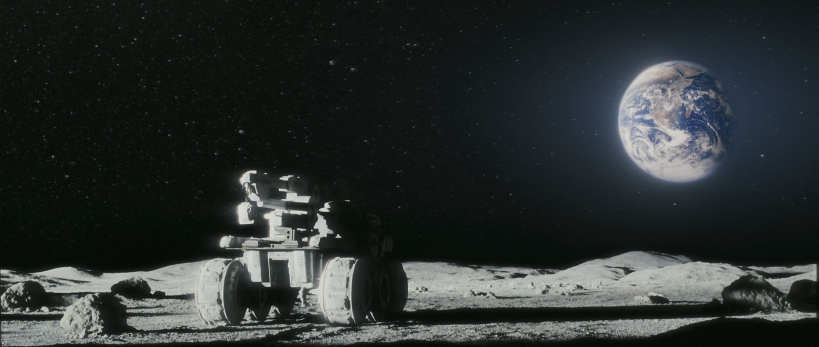
Moonshine cocktail bar
Week 2: First ideas

Slide 18
Vision
MIT MEDIA LAB – SPACE ARCHITECTURE 2024 & 2025
“With NASA’s Artemis program, the surface of the Moon will once again harbor human activities, over fifty years after the final Apollo mission. It is imperative that we design the future of space architecture with not only the best technology and functional performance but also with a primary focus on the human dimension: social, cultural, ecological, and aesthetic values. Up to now, very little of the environments of space exploration have been designed primarily for human experience; rather, they are focused purely on performance and safety. Yet how, and even why we live in space is now a question open to the design fields in collaboration with engineering and others.”
https://www.media.mit.edu/courses/mas-s66/

Slide 19
Topics
In 2024 the collaborative studio prompted students to imagine, design, model, prototype and test their unique proposals. Projects may focus on novel approaches to: construction/assembly, deployability, transportation/logistics, human experience, In-Situ Resource Utilization (ISRU), material performance, or the many components of living and dwelling transformed on another world
(2025) This semester’s collaborative studio prompted students to imagine, design, model, prototype and test their unique proposals. Projects focused on novel approaches to: construction/assembly, deployability, transportation/logistics, human experience, material performance, or the many components of living and dwelling transformed in space.
https://www.media.mit.edu/posts/mas/

Slide 20
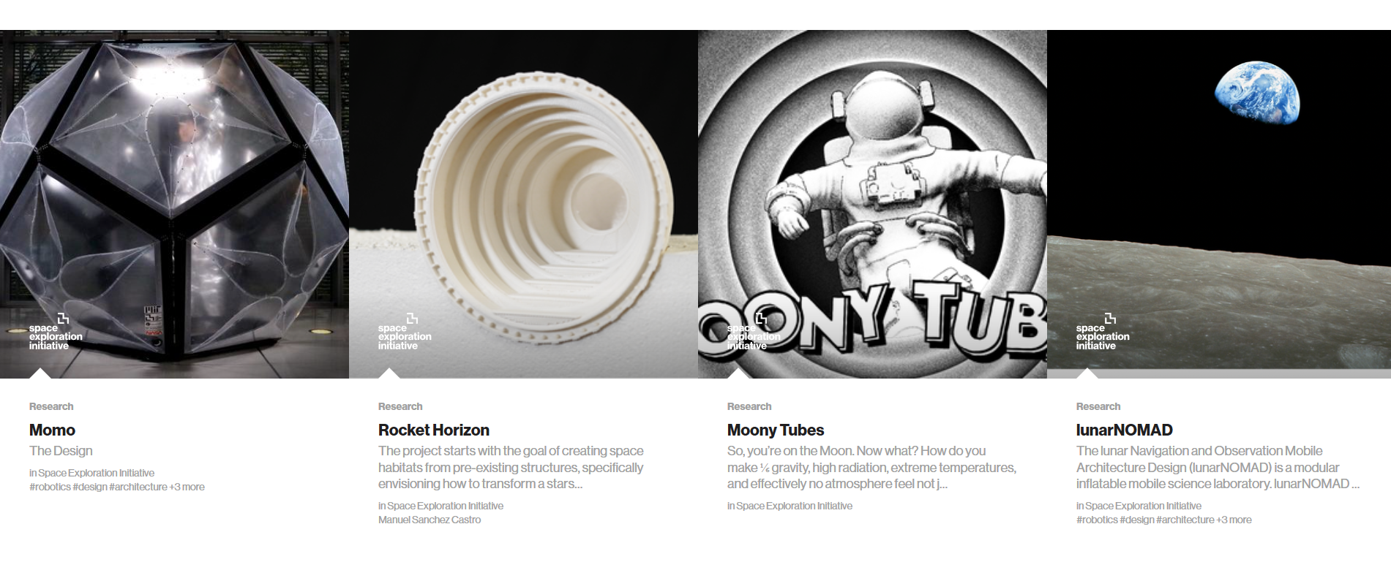
Works

Slide 21
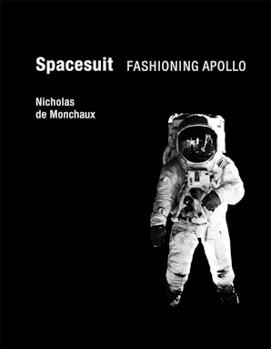
Space colonization*
When designing for extreme conditions, the architect has to consider ‘how you deal with isolation, how you create a sense of community… how you support people in the darkness’. This is worth bearing in mind when we see lunar proposals that resemble a leisure centre or cruise ship.
https://engelsbergideas.com/essays/space-architecture-a-moonage-daydream/

Slide 22
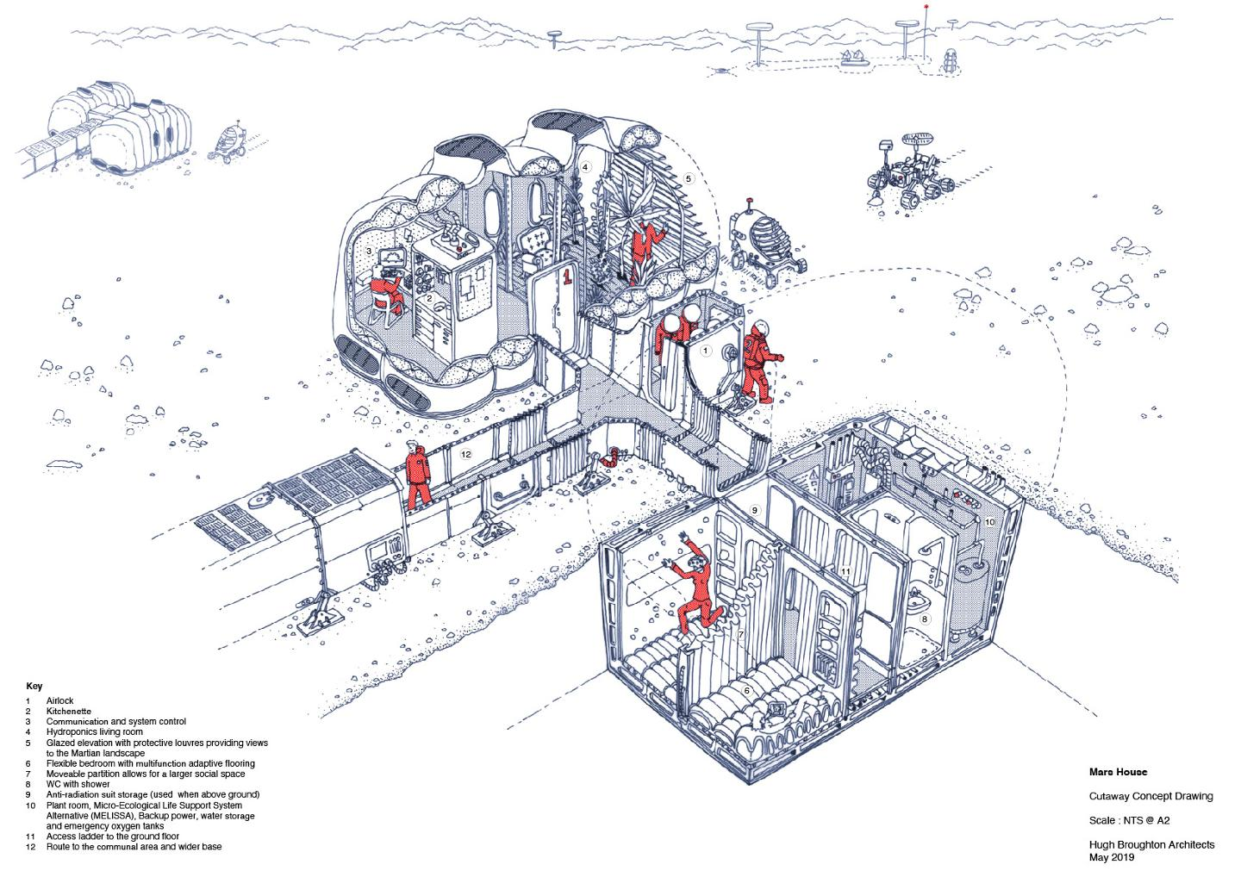
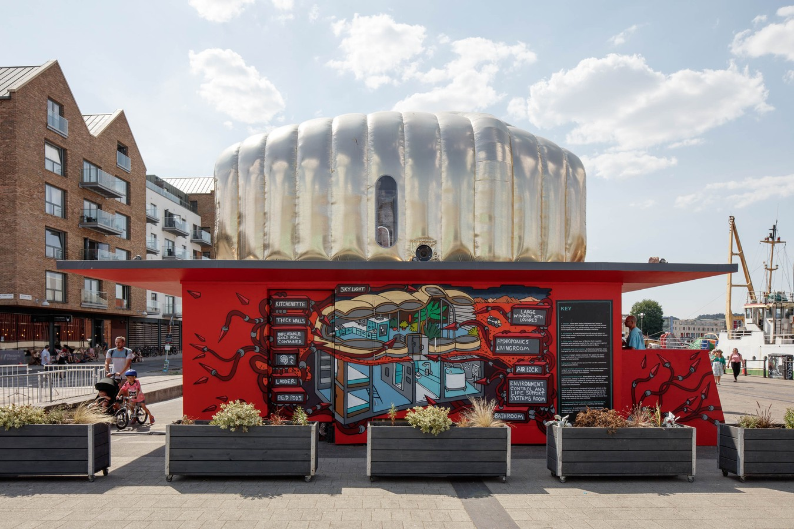
Precedent
Concept Martian House
https://www.duravit.co.uk/inspiration/get_inspired/martian_house.com-en.html

Slide 23
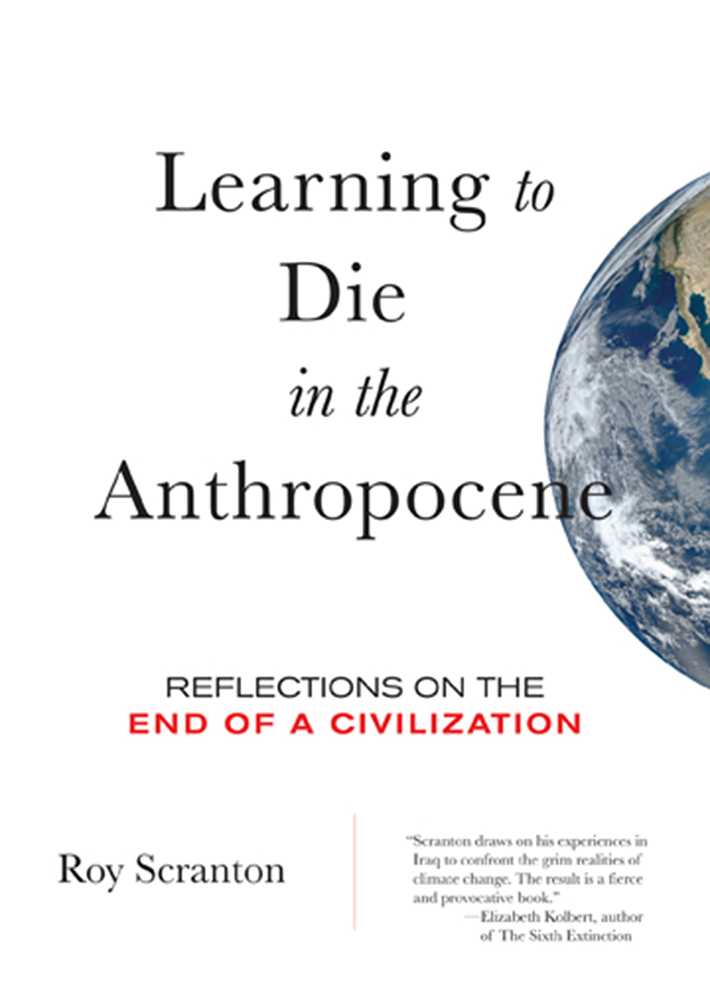
Learn to die in the Anthropocene*
[technological unconsciousness]: “Humanity's awareness that it is a technological entity, and the increasing artificiality of the Earth, is only a matter of the late modern period. In 1967, the ATS-3 satellite transmitted images of Earth, which became the cover of Steward Brand's famous counterculture magazine, *Whole Earth Catalogue*. This symbolically signified a peak of technological consciousness, where humanity was no longer merely living on Earth and working with it, but transforming it from the outside.
https://philosophyandtechnology.network/1150/anthroposcence-yuk-hui-cn/

Slide 24
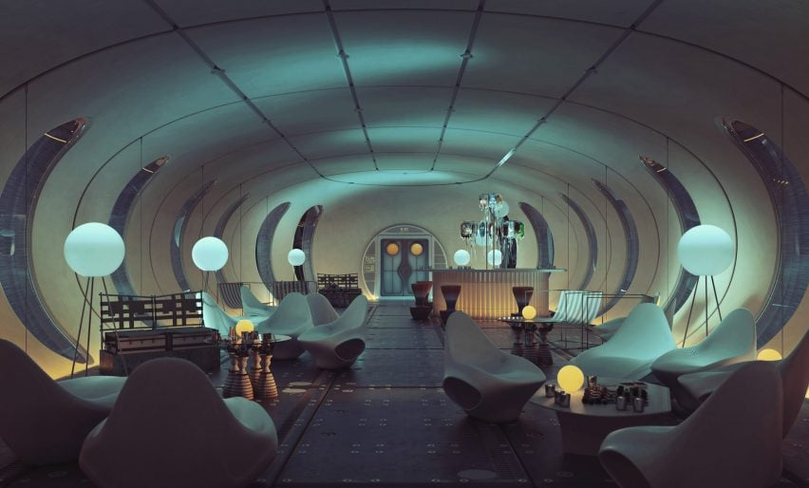
Precedent
Hassel Lunar Master Plan
https://www.dezeen.com/2024/01/19/hassell-inflatable-moon-base-european-space-agency/

Slide 25
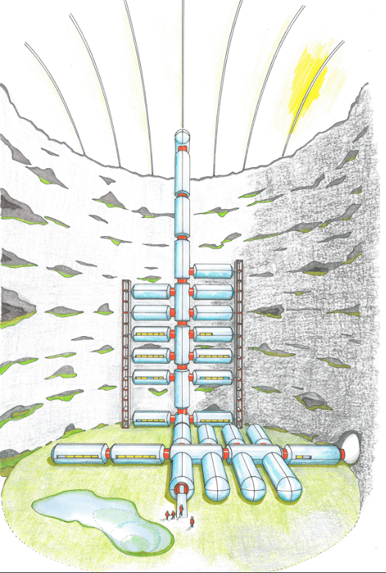
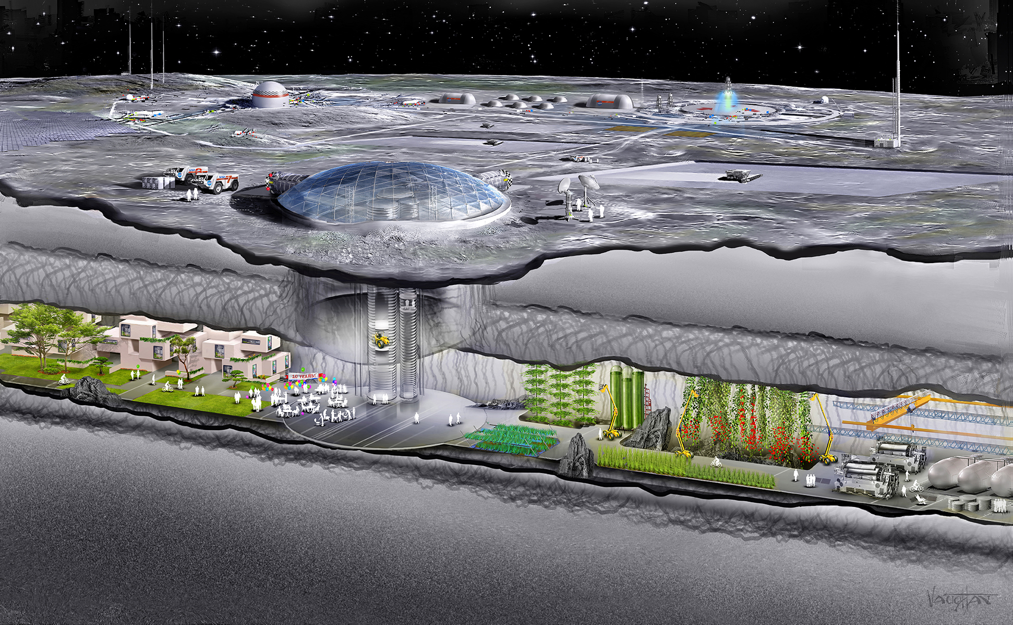
Precedent
When space travel becomes normal
https://www.portsanantonio.us/Leto-Mission

Slide 26
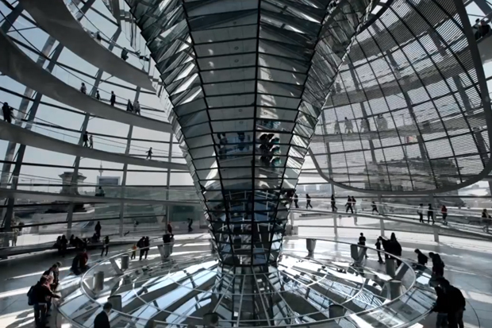
Precedent

Slide 27
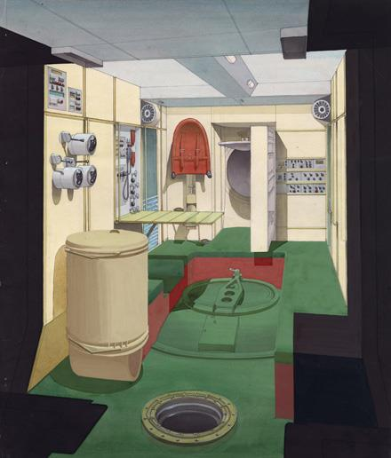
Precedent
Мир
Long stays in weightlessness cause bone demineralization, muscle wasting, immune changes, vision problems, and shifts in body fluids; partial gravity is expected to produce many of the same problems, scaled by how low the gravity is. A NASA review concludes that lunar and Martian gravity will likely still cause significant musculoskeletal and cardiopulmonary deconditioning, and that gravity below about 0.4 g is probably not sufficient to keep these systems fully healthy over years.
https://scifiportal.eu/frankfurt-germany-exhibition-on-design-for-the-soviet-space-program/

Slide 28
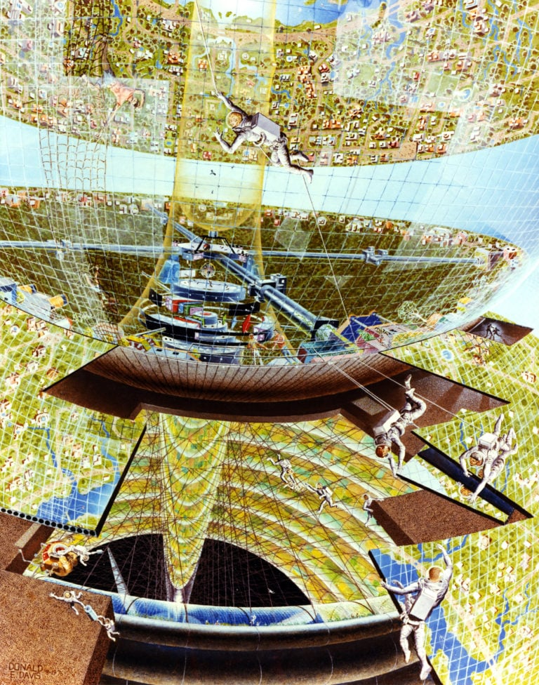
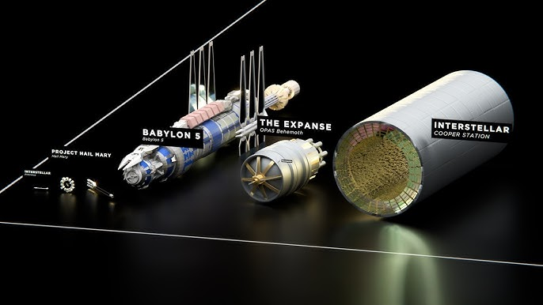
Precedent
The shape of space
https://placesjournal.org/article/the-shape-of-space/

Slide 29
The life of a moon miner
condition
1/6 Gravity
Permanent dusk / dawn
Harvest water ice
Robots / AI heavily involved
Moon (2009)

Slide 30
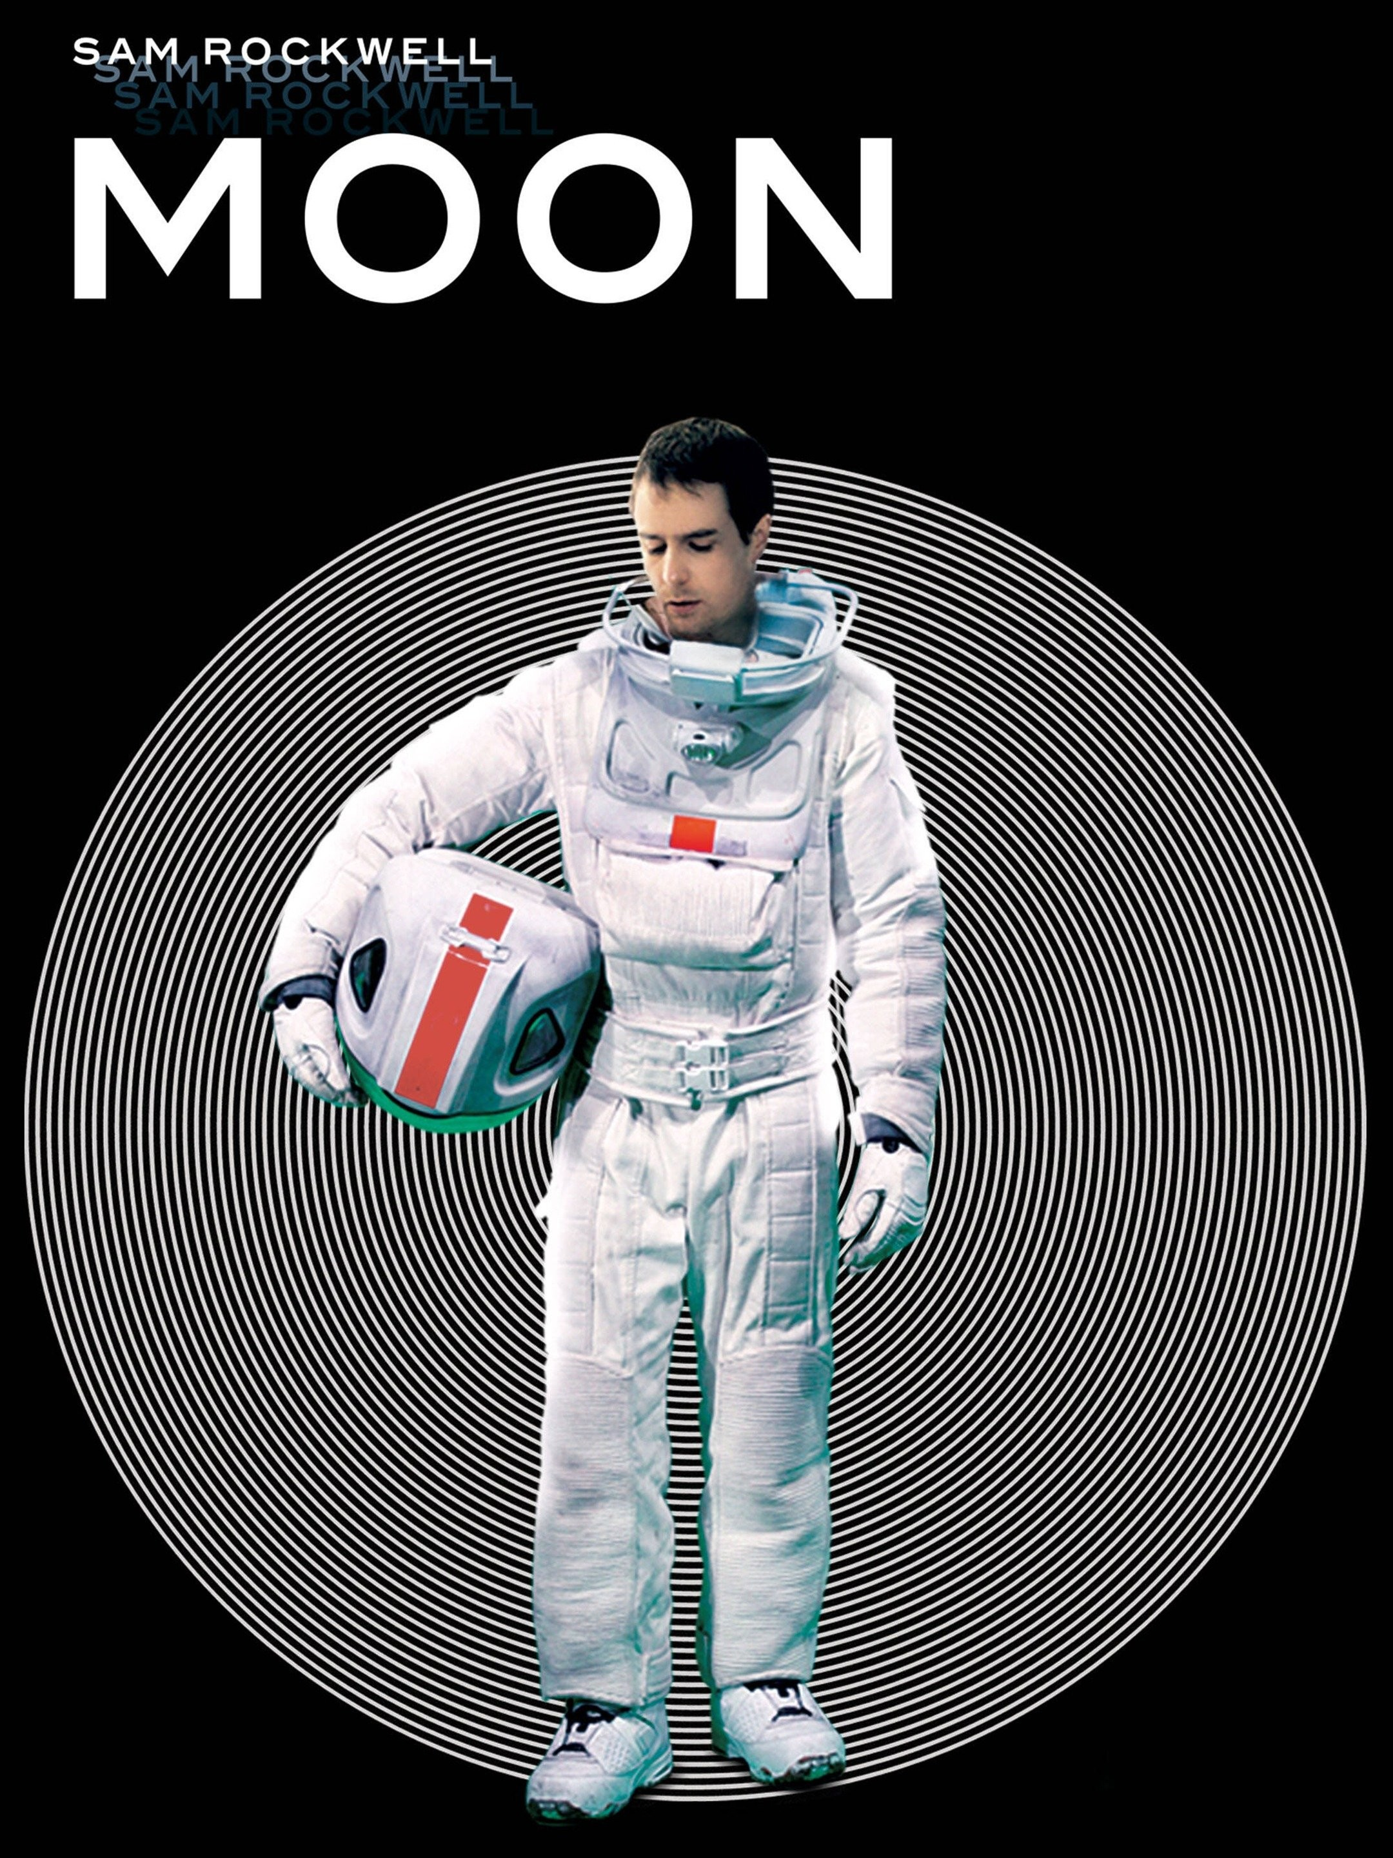
The life of a moon miner
From Gemini 3.0
Being a "moon miner" is not about pickaxes and headlamps. It is a role of high-precision teleoperation, extreme contamination control, and living on the edge of an economic bottleneck. You are not digging for gold; you are harvesting the volatile ice that keeps everyone alive and fuels the rockets home.
The Commute: From Peak to Pit
Your day begins with a jarring visual transition. You live on the "Peak of Eternal Light" (the crater rim), where solar power is abundant and temperatures are manageable (-50°C). Your commute takes you down into the "Cold Trap" (the crater floor), a region of permanent shadow where temperatures plunge to -240°C.​
The Visual Wall: There is no twilight. You drive a pressurized rover from blinding, horizontal sunlight directly into an abyssal blackness that has not seen a photon in billions of years. Your world shrinks to the cone of your floodlights.
The Physical Shift: The descent is treacherous. In 1/6th gravity, your heavy rover has significant mass and inertia but little traction. A sharp turn doesn't skid; it tips. You drive by instrument rating, trusting LiDAR scans more than your eyes, which struggle with the lack of depth perception in the vacuum.​
The Job: Surgical Extraction
You are likely a volatile harvester or a robotics supervisor. The "pickaxe" of the moon is a thermal lance or a sublimation tent.​
No Digging: Violently digging up soil scatters precious ice into the vacuum where it instantly sublimates (vanishes). Instead, you operate PROSPECT-style drills or microwave extractors. You drive a rig over a target zone, lower a heating dome, and gently cook the regolith.​
Capturing Ghosts: The water vapor rises and is trapped in cold fingers (cryotraps). Your screen doesn't show rocks breaking; it shows flow rates. "Striking gold" is seeing the humidity sensor spike.​
The Human Element: Why are you there? Because robots get stuck. The regolith is electrostatically charged and sticky. When a drill bit jams or a wheel seizure occurs, you have to suit up. A 10-minute repair on Earth becomes a 4-hour EVA (Extravehicular Activity) ordeal involving pre-breathe protocols and suit checks.
The Enemy: Lunar Dust
The miners' "black lung" is silicosis from lunar dust.​
Gunpowder Smell: When you return to the airlock and repressurize, the air smells like spent gunpowder. This is the smell of "activated" dust—sharp, jagged microscopic glass shards reacting with oxygen for the first time.​
Decontamination Ritual: You don't just walk inside. You go through electrostatic "showers" to repel the dust. If you track dust into the habitat, it destroys air filters and shreds lung tissue. You are constantly cleaning seals and joints; a single grain of dust can break a vacuum seal, killing you in your sleep.​
The Economy: Water is Life
You are the most essential worker in the solar system.
The Quota: The station needs water for drinking, but mostly for electrolysis (splitting H2O into Hydrogen fuel and Oxygen air). Every launch back to Earth depends on the fuel you harvested.​
Pressure: If your quota drops, the launch window closes. You live with the knowledge that the entire colony's return ticket is locked in the ice beneath your rover's wheels.
Moon (2009)

Slide 31
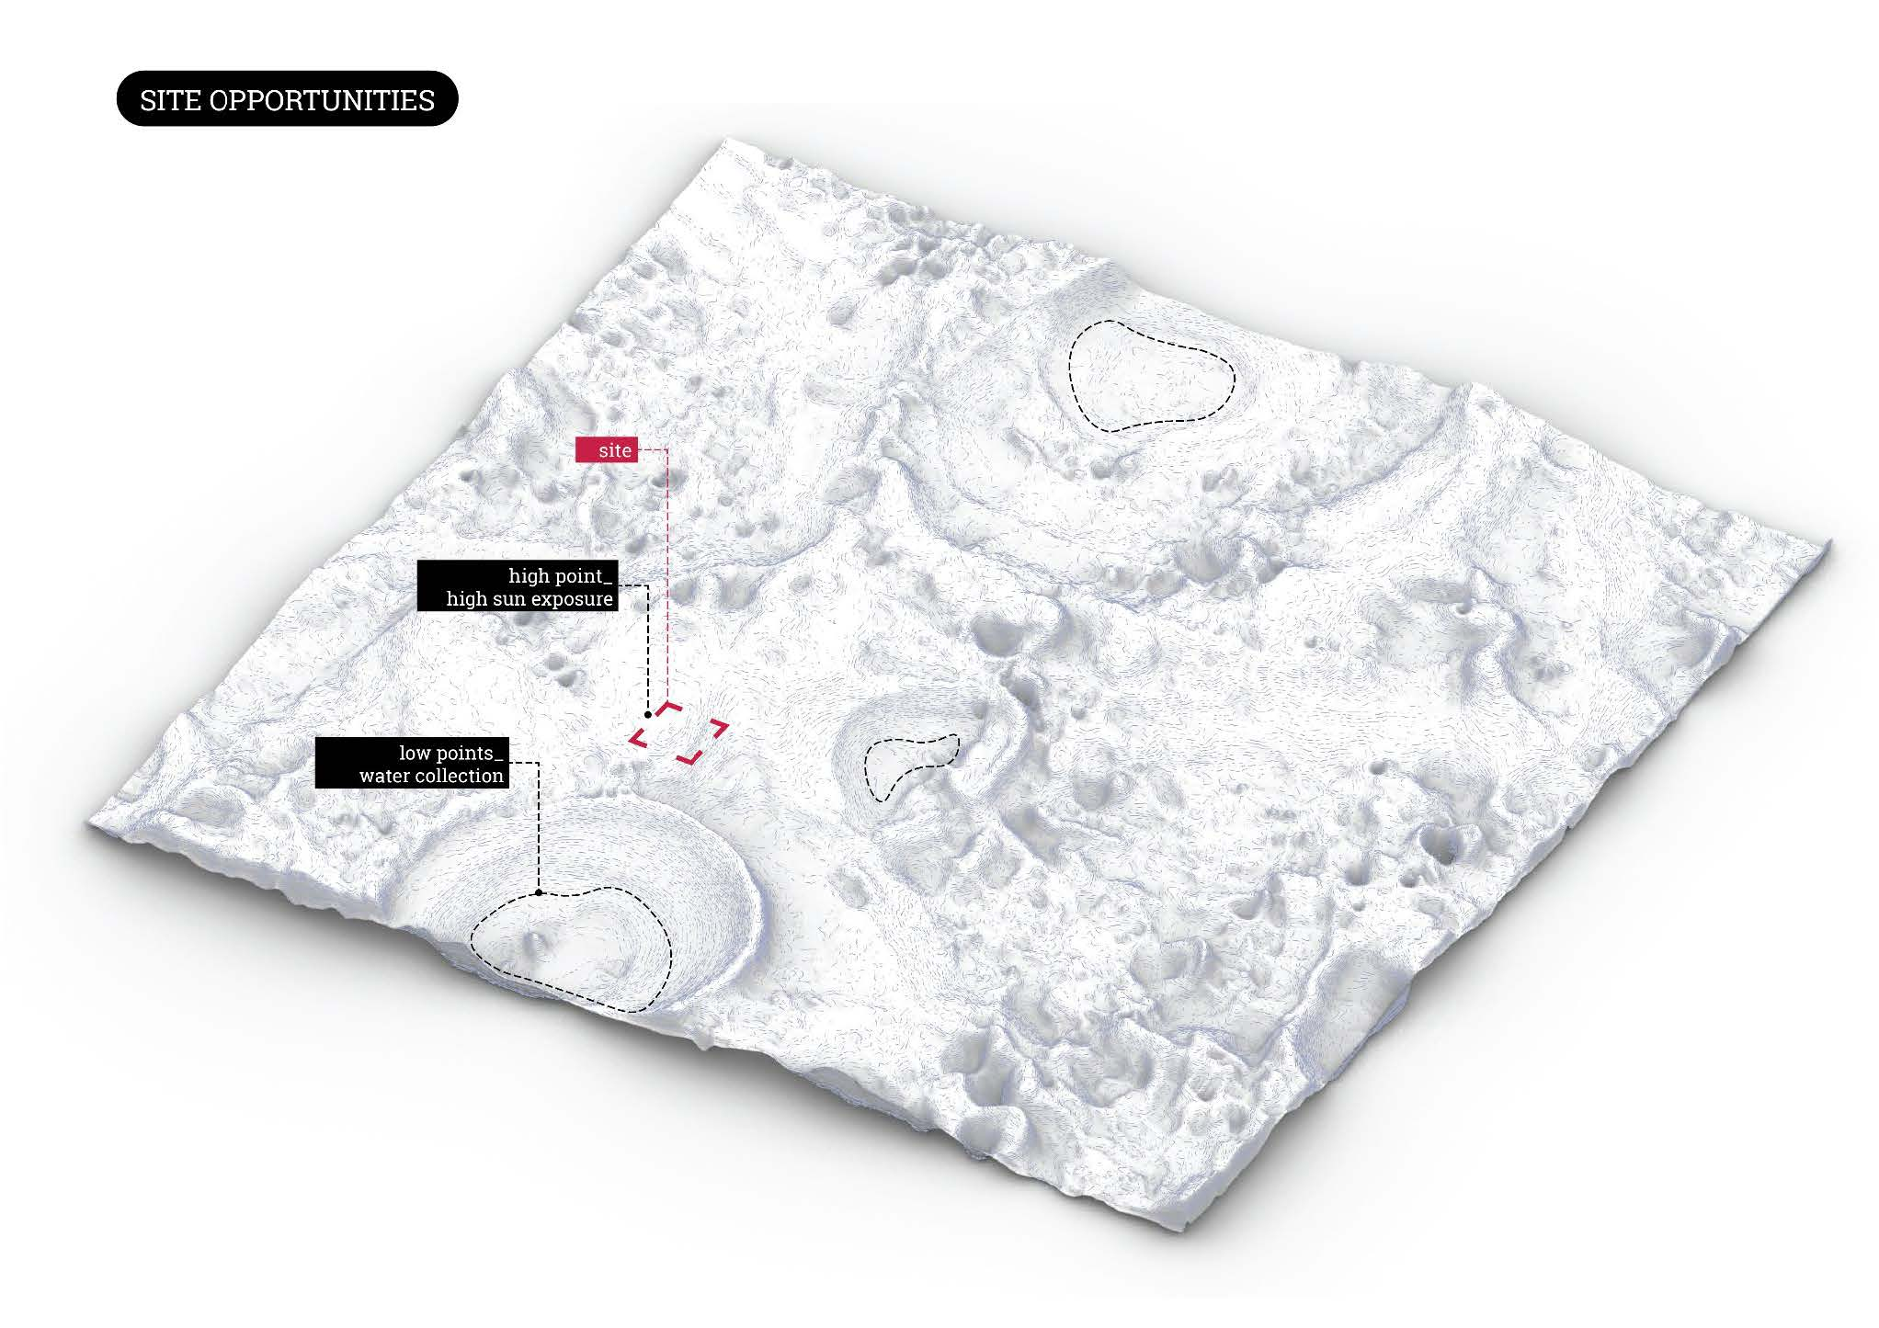
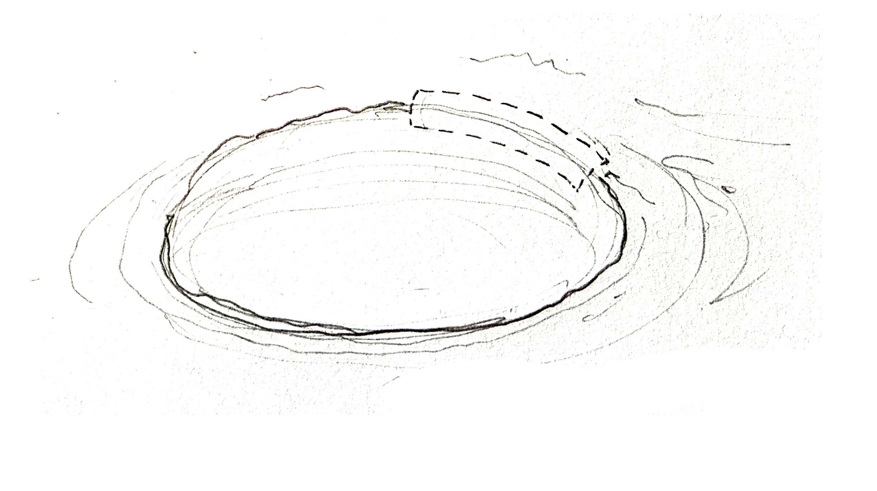
The life of a moon miner
Building habitats on high points of rim at Shackleton Crater (-50 ~ 0 °C)
Moonzome

Slide 32
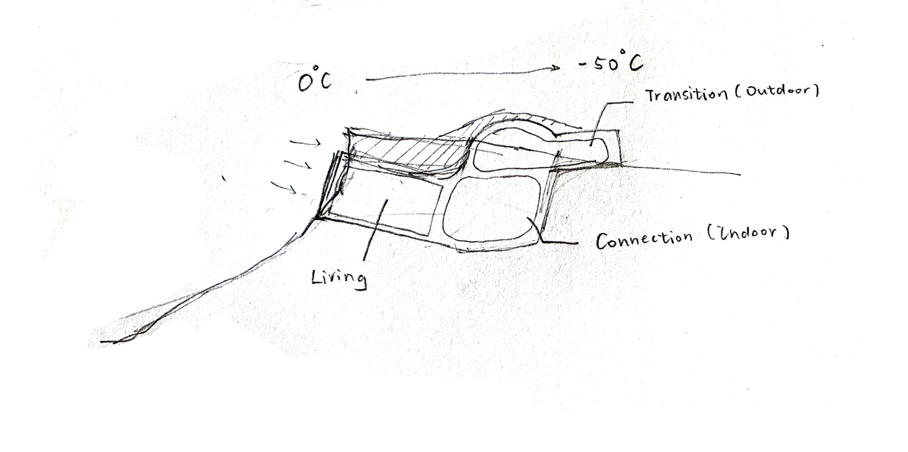
Carving / Melting Possible?

Slide 33
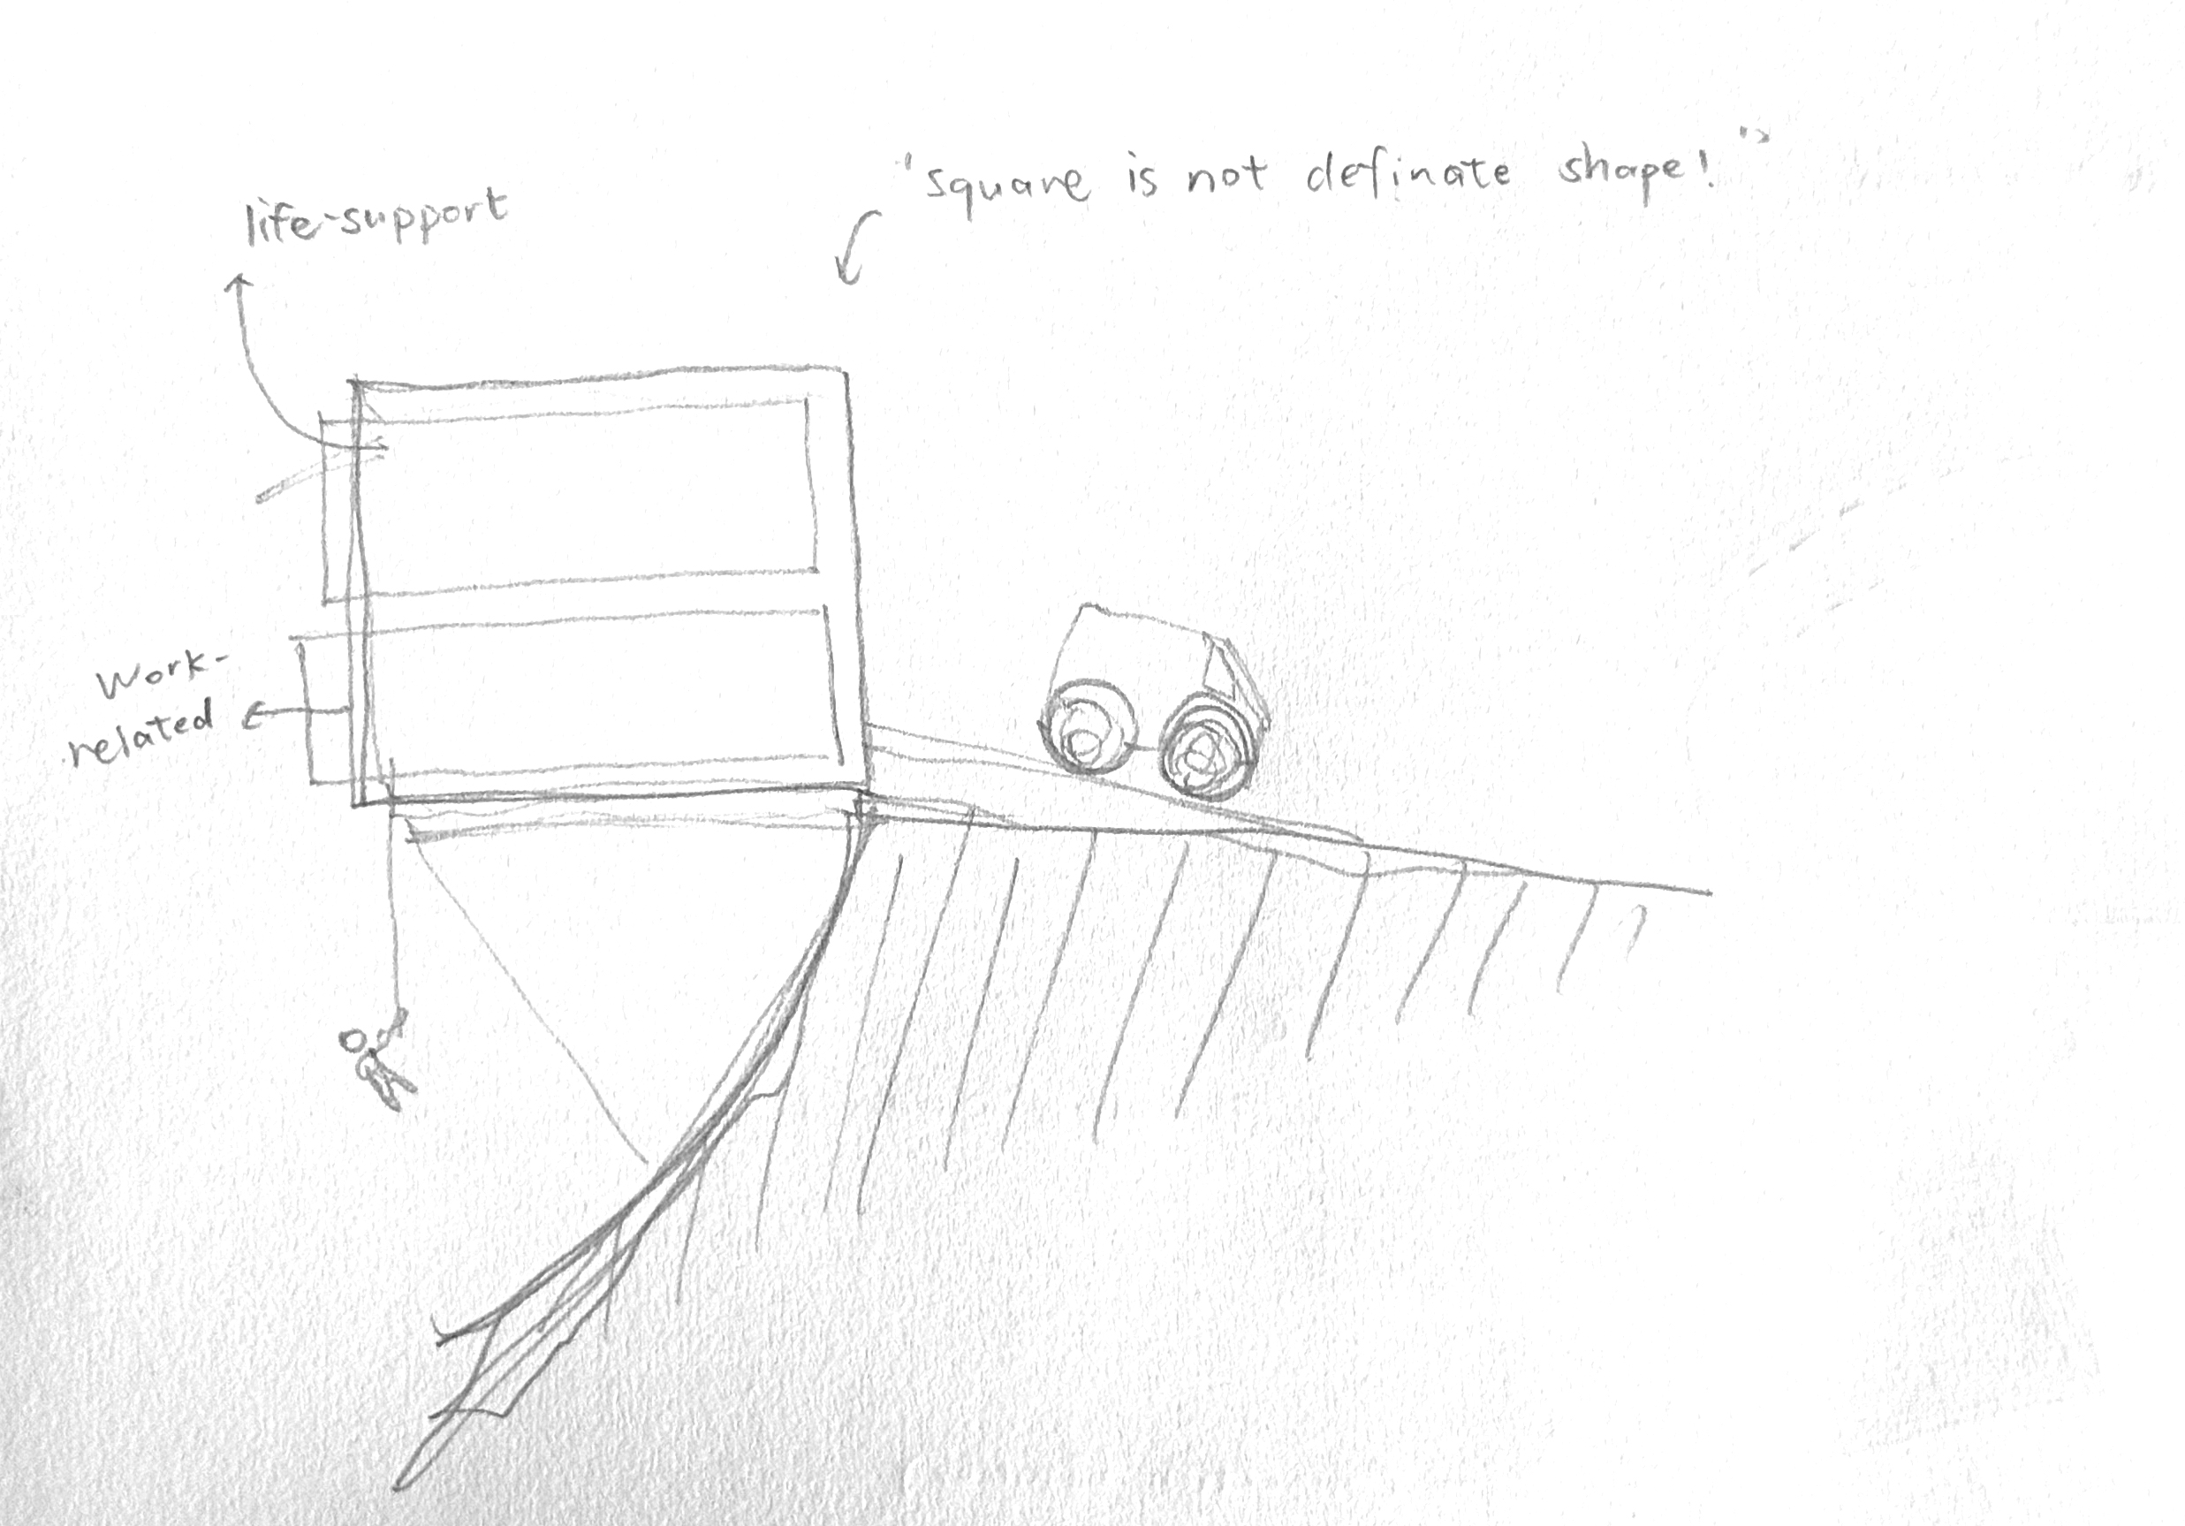
Low gravity construction possible?

Slide 34
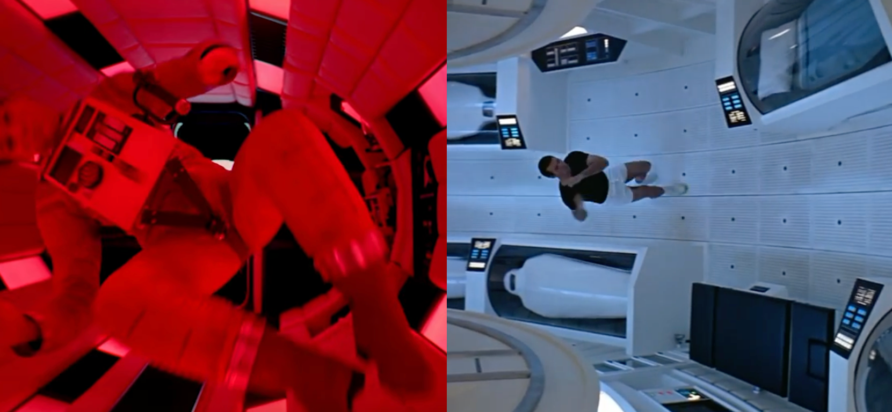
Why we build on the Moon
Week 1: Overview

Slide 35
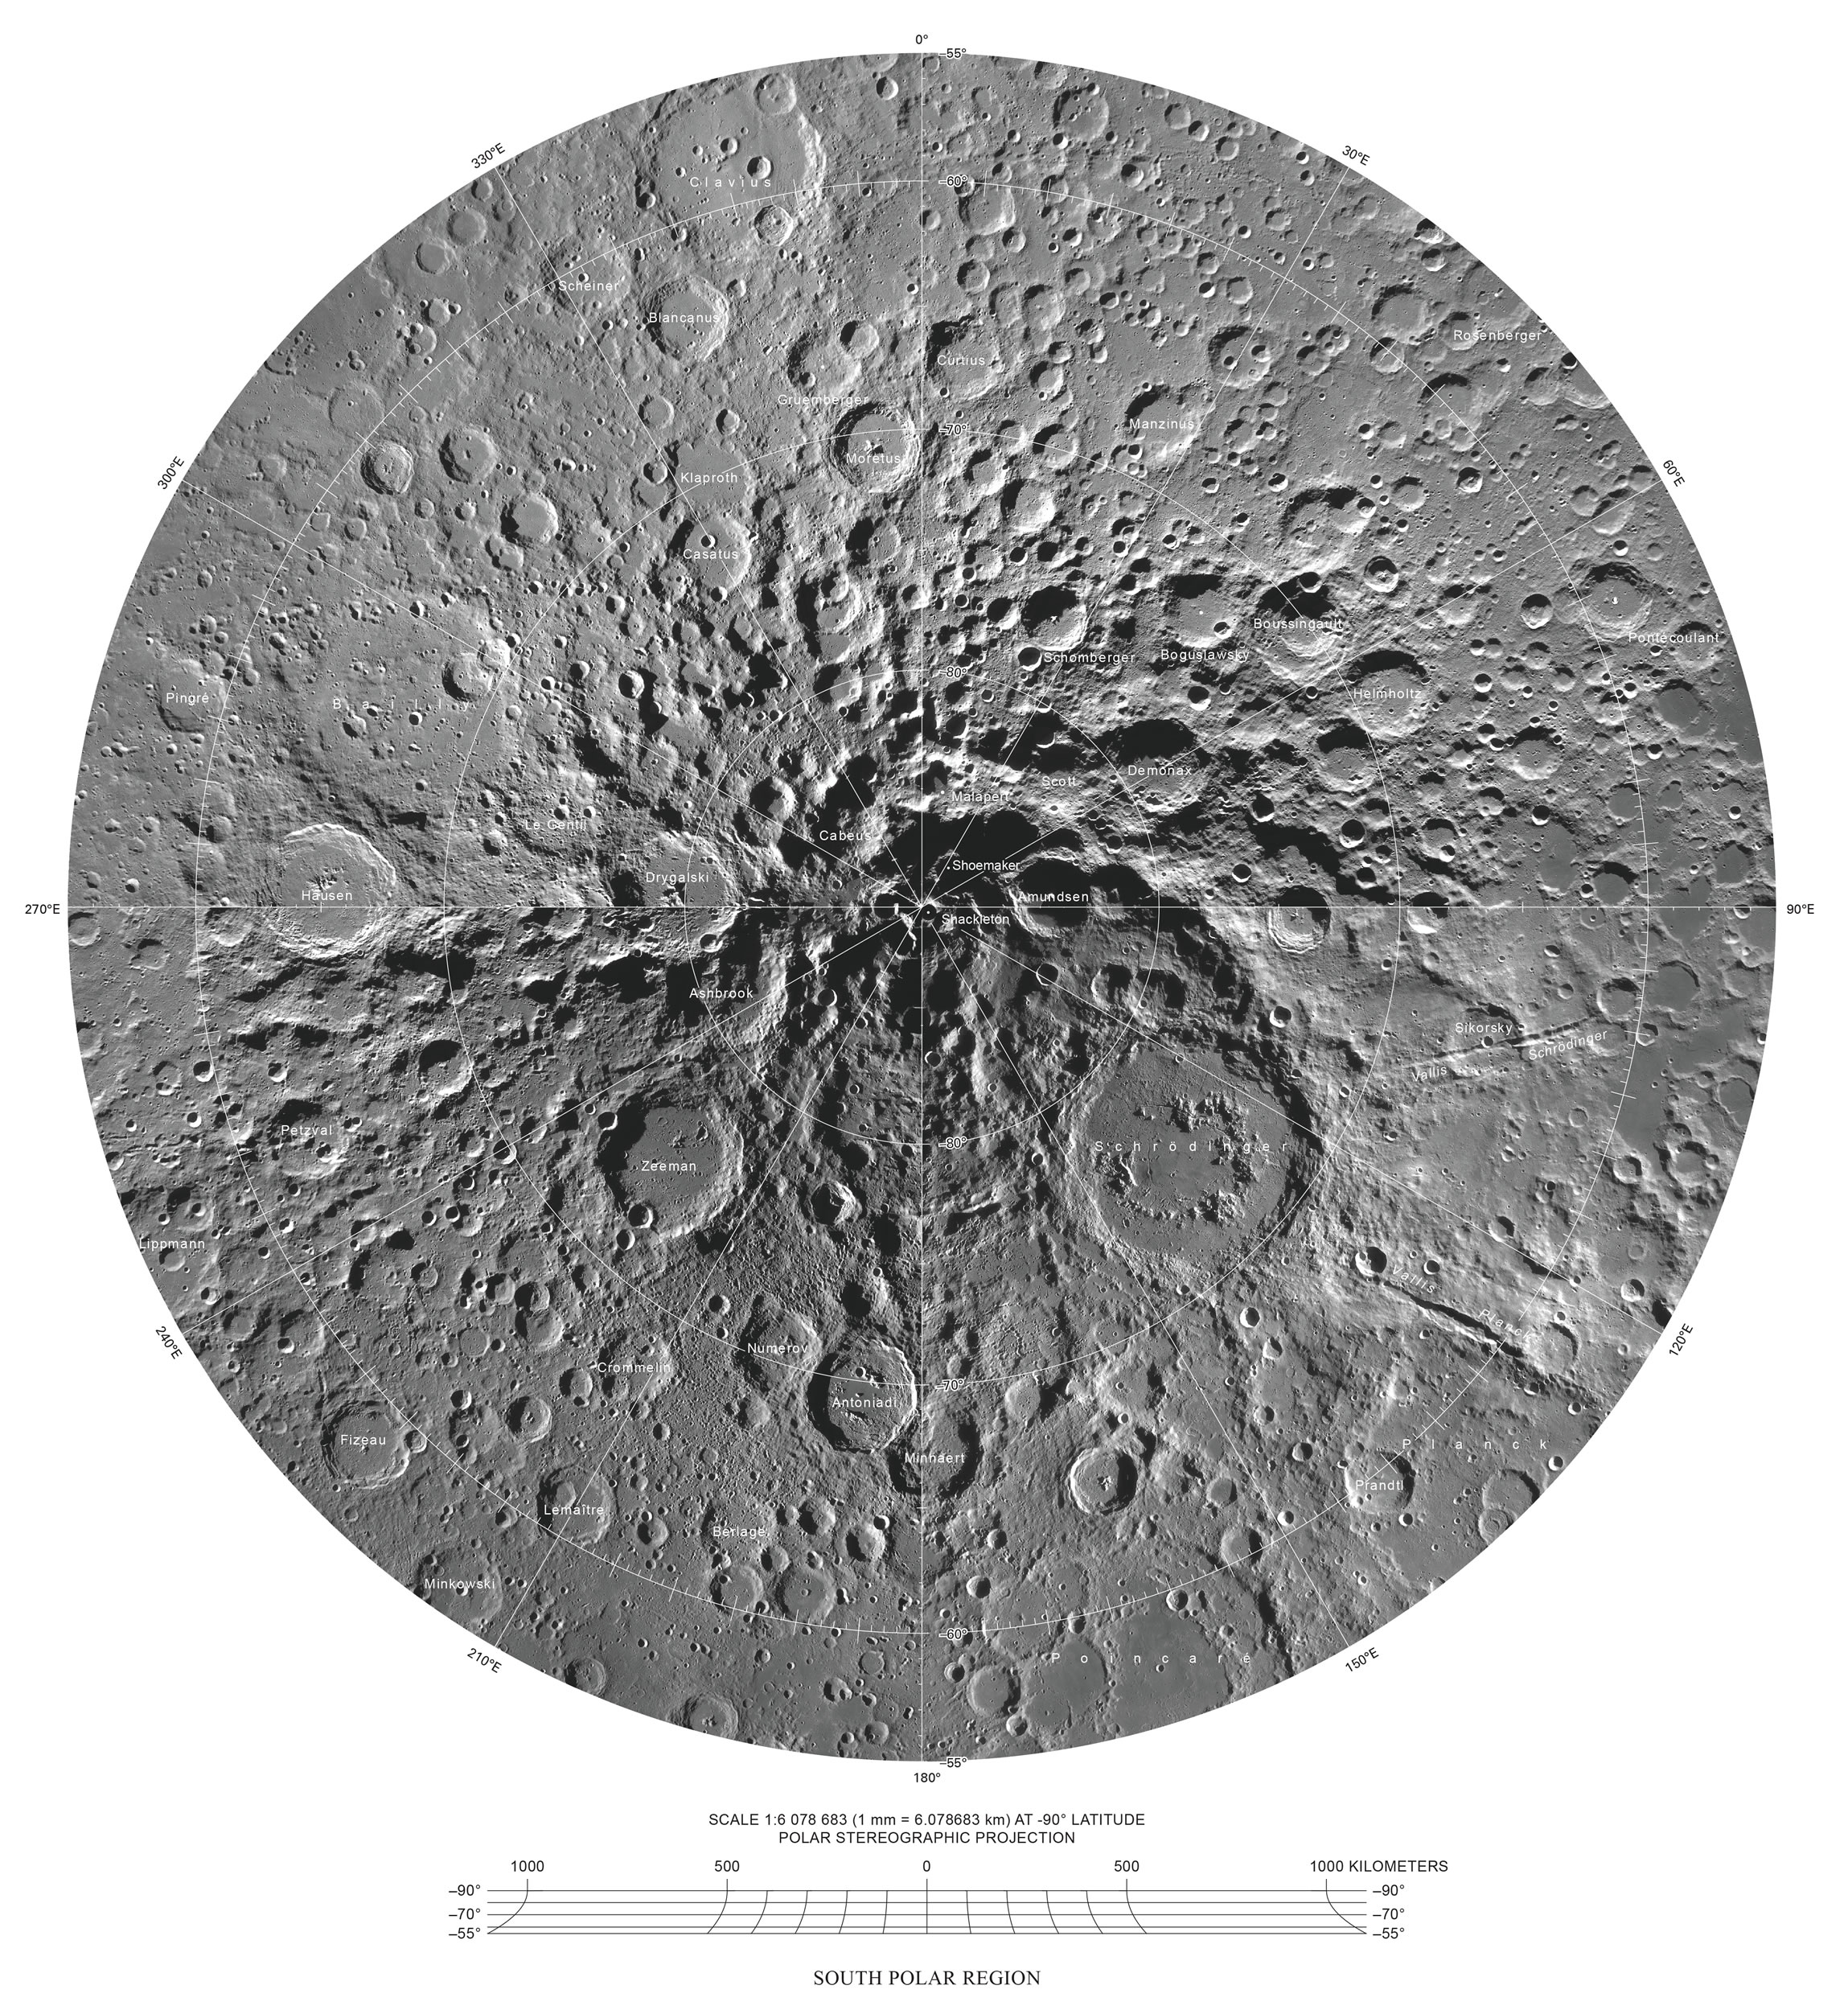
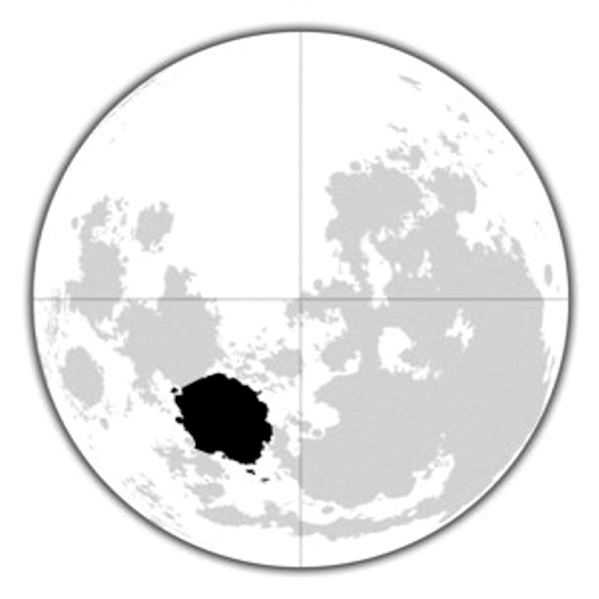
1. Location
South Pole
(Jonathan, Moonzome, Chung, Tan)
Mare Serenitatis (Equator)
(Sophia Benfield)

Slide 36
South Pole
Ridge of Shackleton Crater
+ constant sunlight
+ water ice
@Moonzome

Slide 37
Lunar Pit
Small scale lava tube
Southwest of Shackleton Crater
+ Relatively stable temperature
+ Radiation protection
@Jonathan

Slide 38
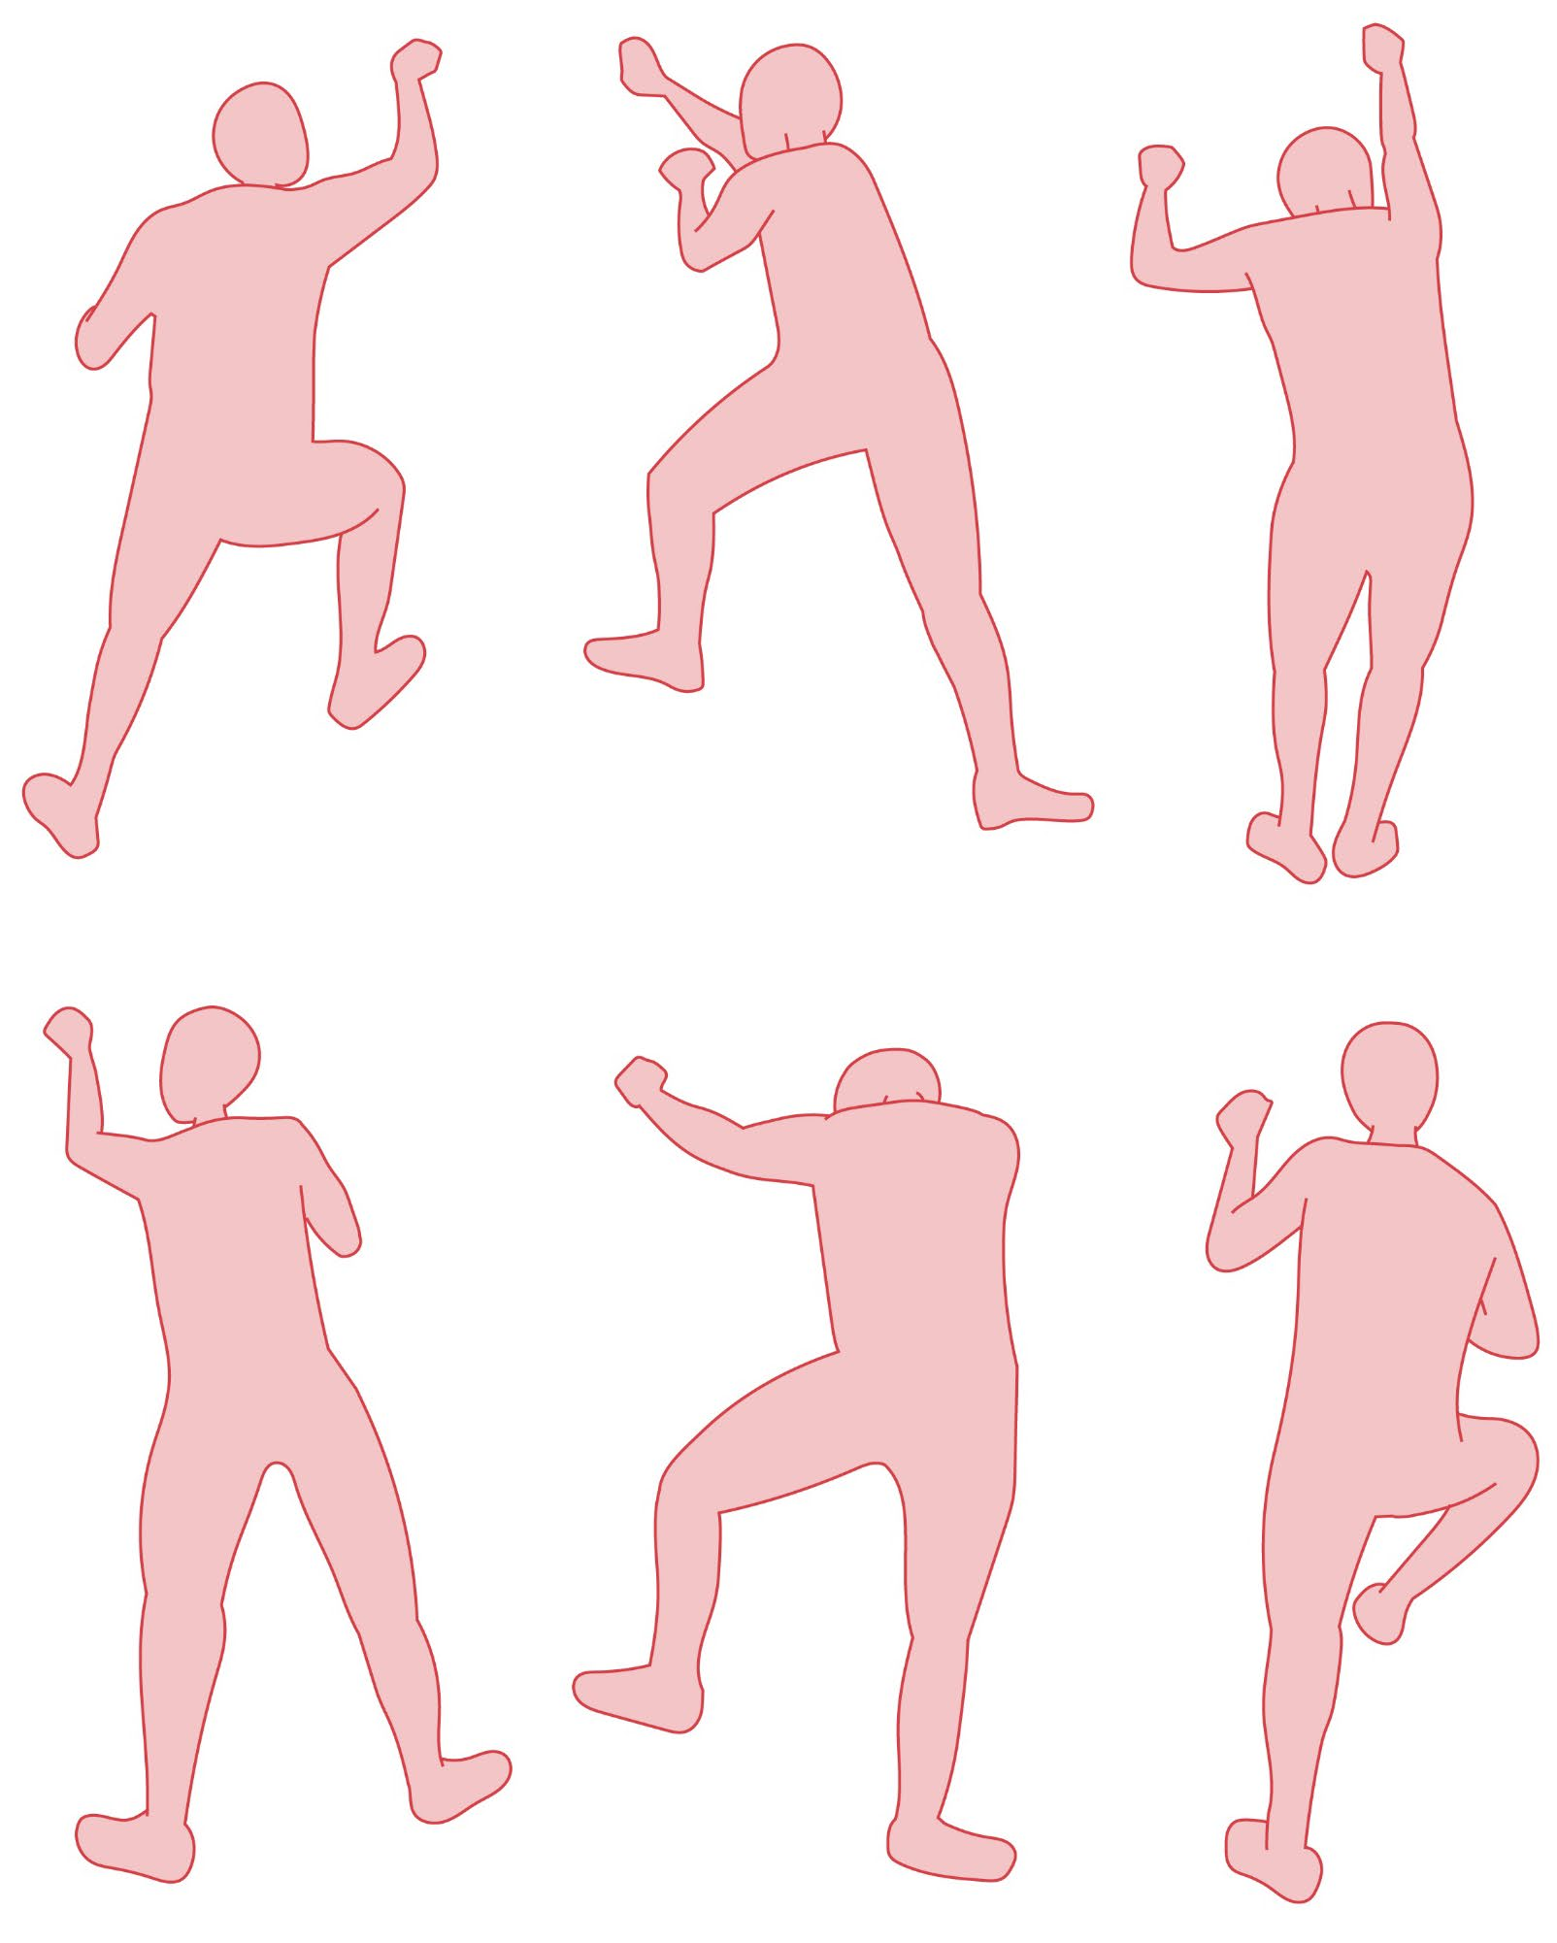
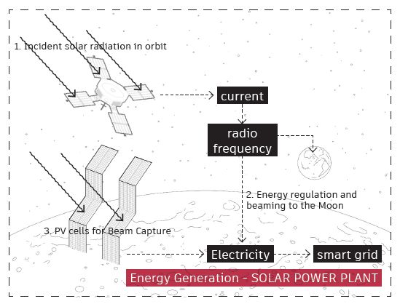
Activities?
Surface
(Moonzome)
Underground
(Jonathan)

Slide 39
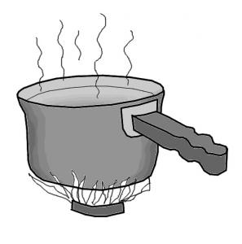
But
A significant portion of our efficient energy is generated simply by boiling water

Slide 40
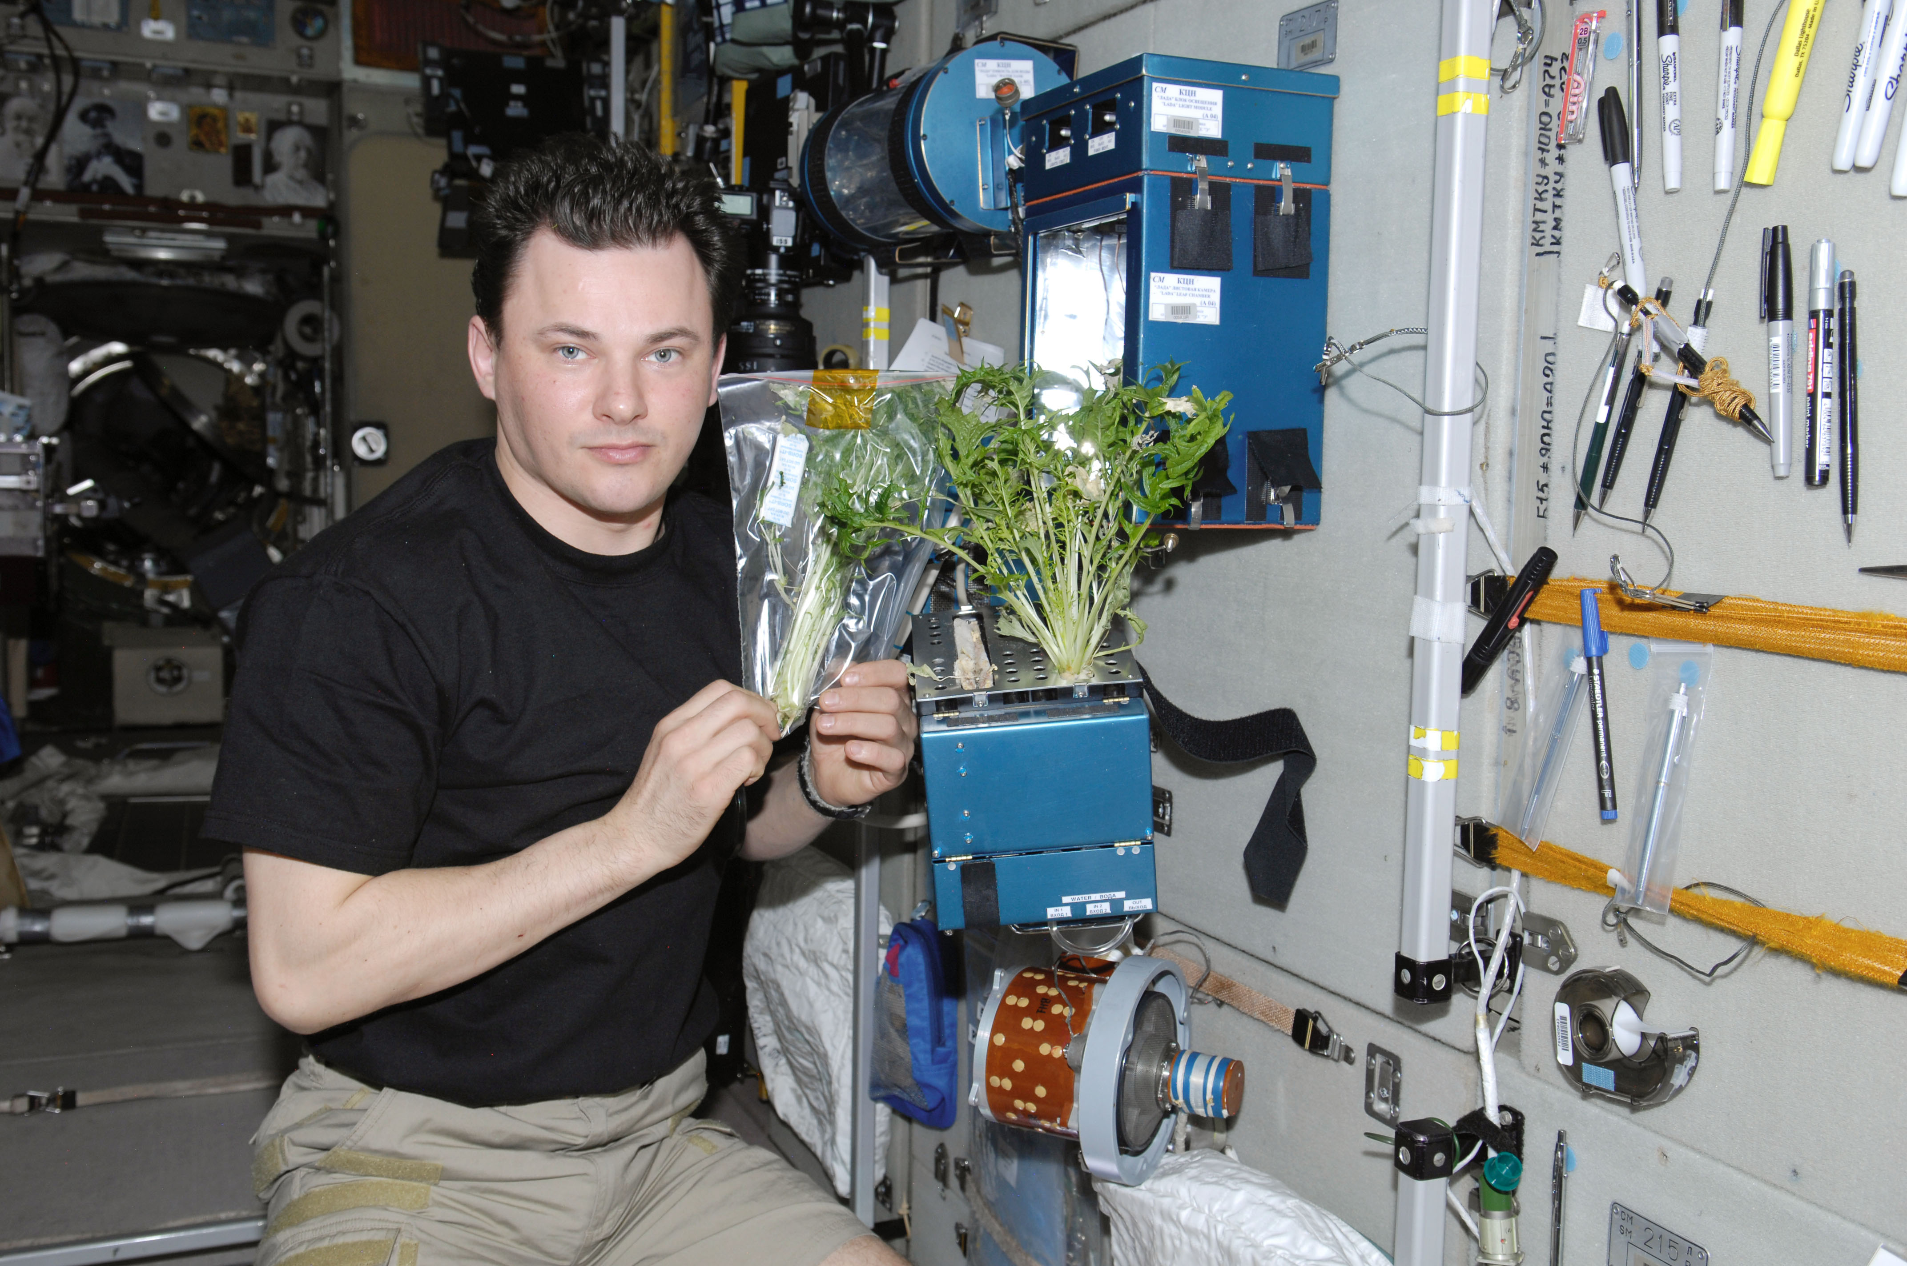
2. Promises
Beyond fresh-produce
It is widely approved that biophilic can help with mental well-being

Slide 41
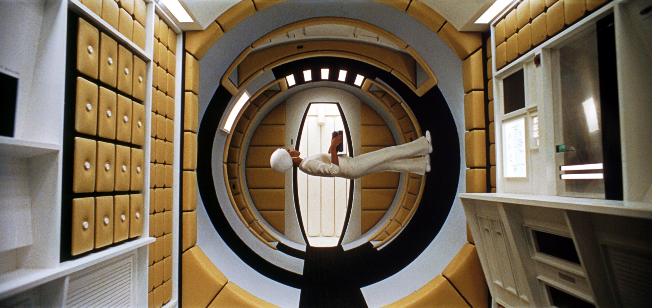
2001: a Space Odyssey (1968)

Slide 42

Space-age

Slide 43



3. Typology
3D-print regolith
Moon bricks
Inflatables or
origami

