Slide 1
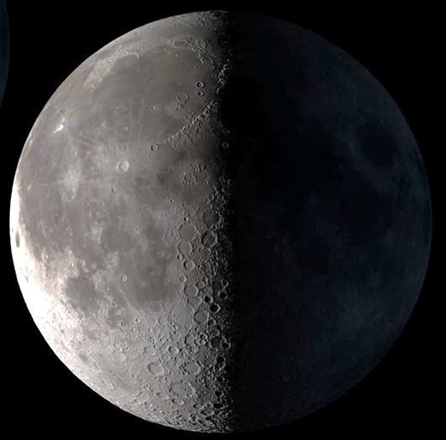
Designing Lunar Architecture
Notes:
Progressing to implementing these ideas into a design it is important to start by choosing the right location.

Slide 2

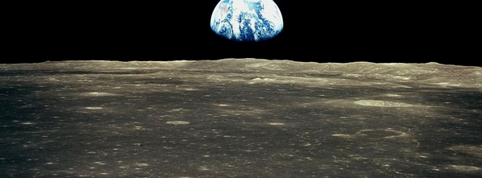
Near side of the Moon Lunar Equator
Location: Earth view
Earth directly overhead
Desirable for earth view from above
Lunar Poles
Earth visible at the horizon
Sometimes drops below horizon – not visible
2/67
Sophia Benfield | MoonSane | Lunar Architecture | Tutors: H. Bier & A. Hidding & F. Adema | 2024/25 | TU Delft
Notes:
To create my earth gazing space I need a good view of our planet. On the Lunar poles the earth is only visible at the horizon, so it makes more sense to choose a location near the equator, where the earth is overhead.

Slide 3
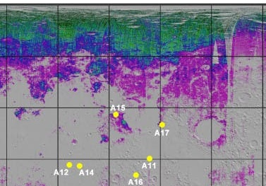
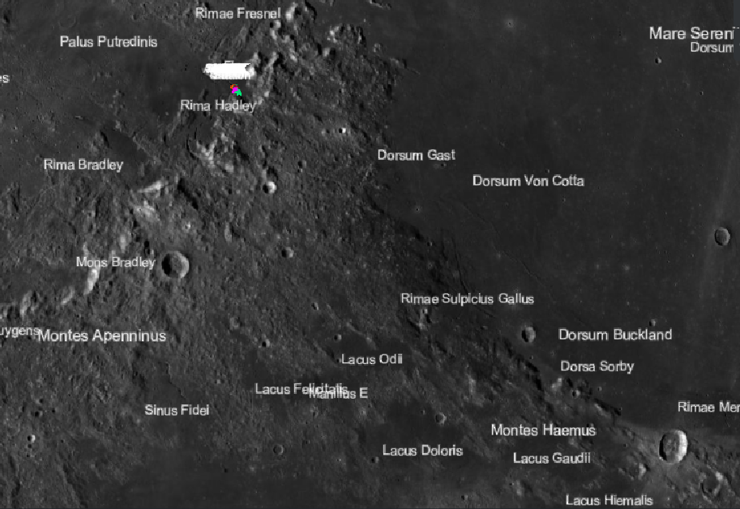

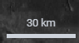
Location: Mare Serenitatis
330 ° 0 ° 30 ° 60 ° 90 °
90 °
60 °
30 °
0 °
Apollo 15
Source: Brown University
Edge of Mare Serenitatis
Presumed water/ice
Near Apollo 15 landing site
Source: Lunar/LROC Quickmap
3/67
Sophia Benfield | MoonSane | Lunar Architecture | Tutors: H. Bier & A. Hidding & F. Adema | 2024/25 | TU Delft
Notes:
It is also important to think about resources so I investigated ice/ water presence and found a spot near the equator, So that is where my habitat will be located, at the edge of Mare serenitatis

Slide 4
Program: main rooms
Main rooms
Private quarters
Sleeping area
Living quarters
Social area, eating area, kitchen
Research facility
Command and control
Workspace
Gym
Bathroom (&toilet)
Medical facility
Antechamber for EVA’s
(regolith cleaning and suit doffing)
Stowage
Additional rooms
Garden
Meditation space
earth viewing
“Minimum volume of 80m3 per person” (ESA)
Source: Moon Village CDF Study Report: CDF-202(A) – Issue 1.1 September 2020, page 60. https://www.lpi.usra.edu/lunar/strategies/ESA-ESTEC_2020_MoonVillageLunarHabitatStudy.pdf
4/67
Sophia Benfield | MoonSane | Lunar Architecture | Tutors: H. Bier & A. Hidding & F. Adema | 2024/25 | TU Delft
Notes:
Next, I looked at the minimum requirements set by ESA for space habitats. I translated this to rooms and added a garden for food and oxygen production and the meditation space I propose. They also set a minimum habitable volume per person.

Slide 5
Program: minimum size
Room | m3 (1 person) | % | Same time use | Multiply factor | m3 (6 persons) | %
Private crew quarters | 2,5 | 3% | Yes - but separate | x 6 | 15 | 3,5%
Living quarters | 13,5 | 15% | Yes | x 6 | 81 | 19,5%
Kitchen | 2,5 | 3 % | Not all | x 2 | 5 | 1%
Research facility | 11 | 13% | Yes | x 6 | 66 | 16%
Garden Gym | 13,5 8 | 15% 9% | Yes Not all | x 6 x 3 | 81 24 | 19,5% 5,5%
Bathroom | 5 | 6% | Not all | x 2 | 10 | 2,5%
Medical facility | 8 | 9% | Not all | x 2 | 16 | 4%
EVA antechamber | 8 | 9% | Not all | x 3 | 24 | 5,5%
Storage general | 8 | 9% | Yes | x 6 | 48 | 11,5%
Subtotal: | 80 | 91% |  |  | 370 | 88,5%
Meditation space | 8 | 9% | Yes | x 6 | 48 | 11,5%
Total: | 88 | 100% |  |  | 418 | 100%
5/67
Sophia Benfield | MoonSane | Lunar Architecture | Tutors: H. Bier & A. Hidding & F. Adema | 2024/25 | TU Delft
Notes:
Of course Lunar habitats will not house just one person but a crew of 4-6 people, so I multiplied the volumes by how many people should be able to use the spaces at once.

Slide 6
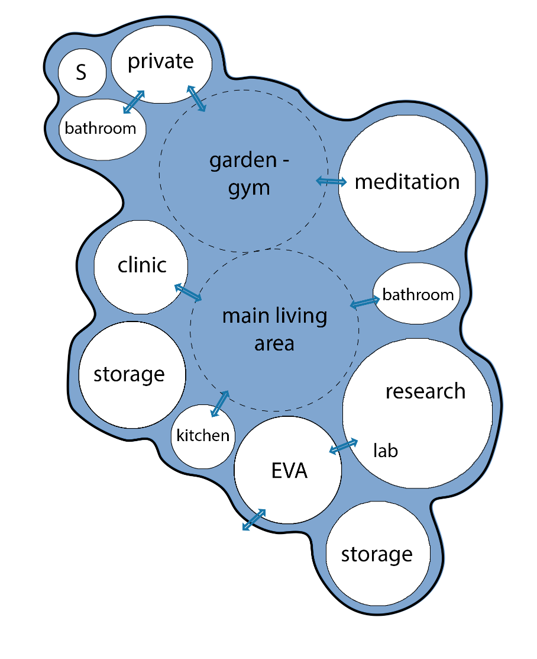
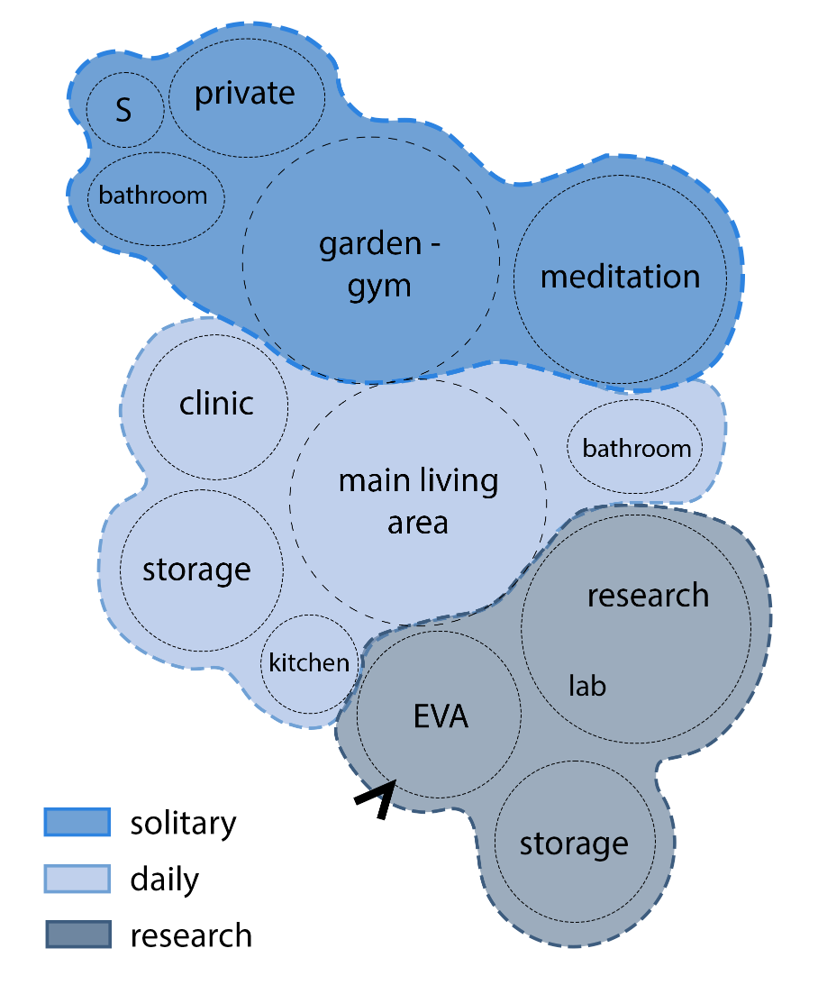
Connecting functions 2D
6/67
Sophia Benfield | MoonSane | Lunar Architecture | Tutors: H. Bier & A. Hidding & F. Adema | 2024/25 | TU Delft
Notes:
I looked at which rooms should be connected to each other. The living area is a connective atrium so most rooms are adjacent to that. I also connected the private rooms together with the garden and meditation space. The work oriented areas are also combined. This creates three zones.

Slide 7
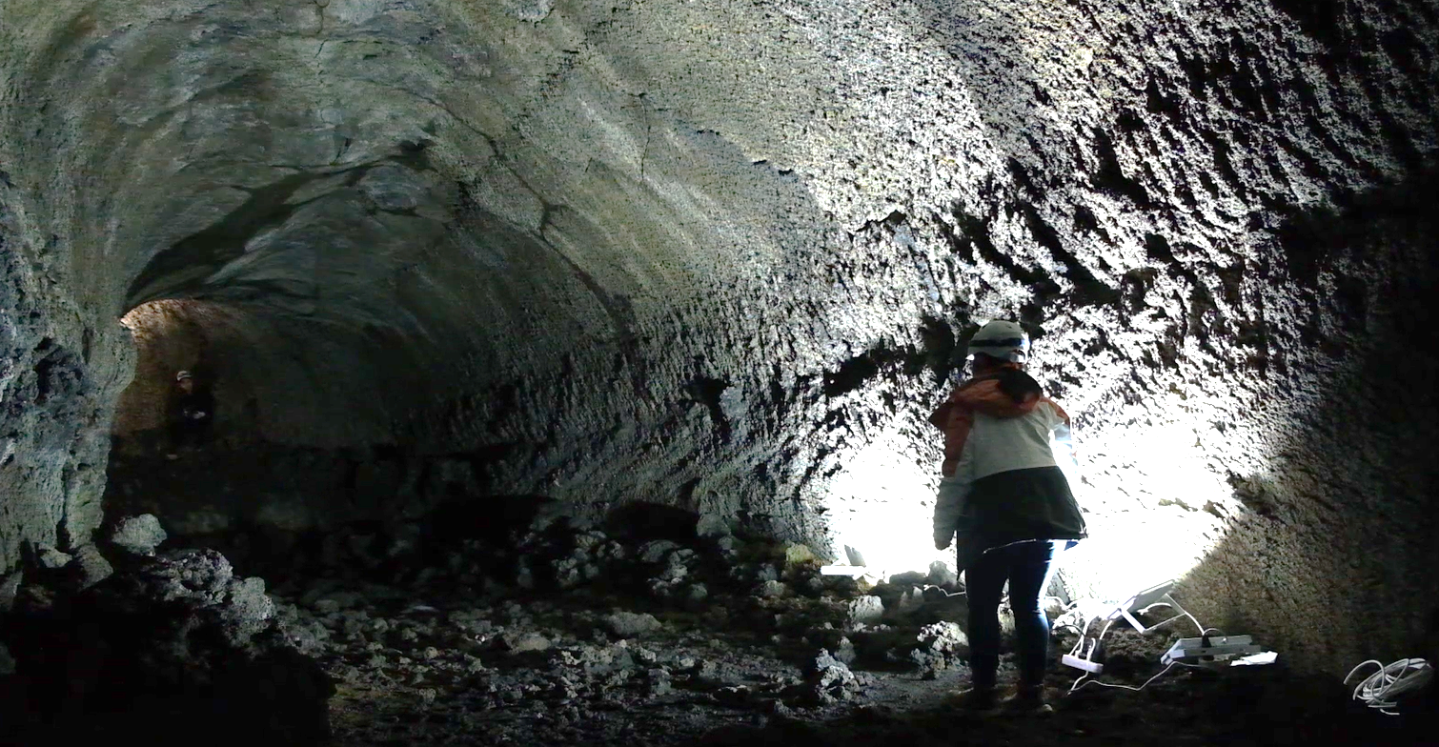
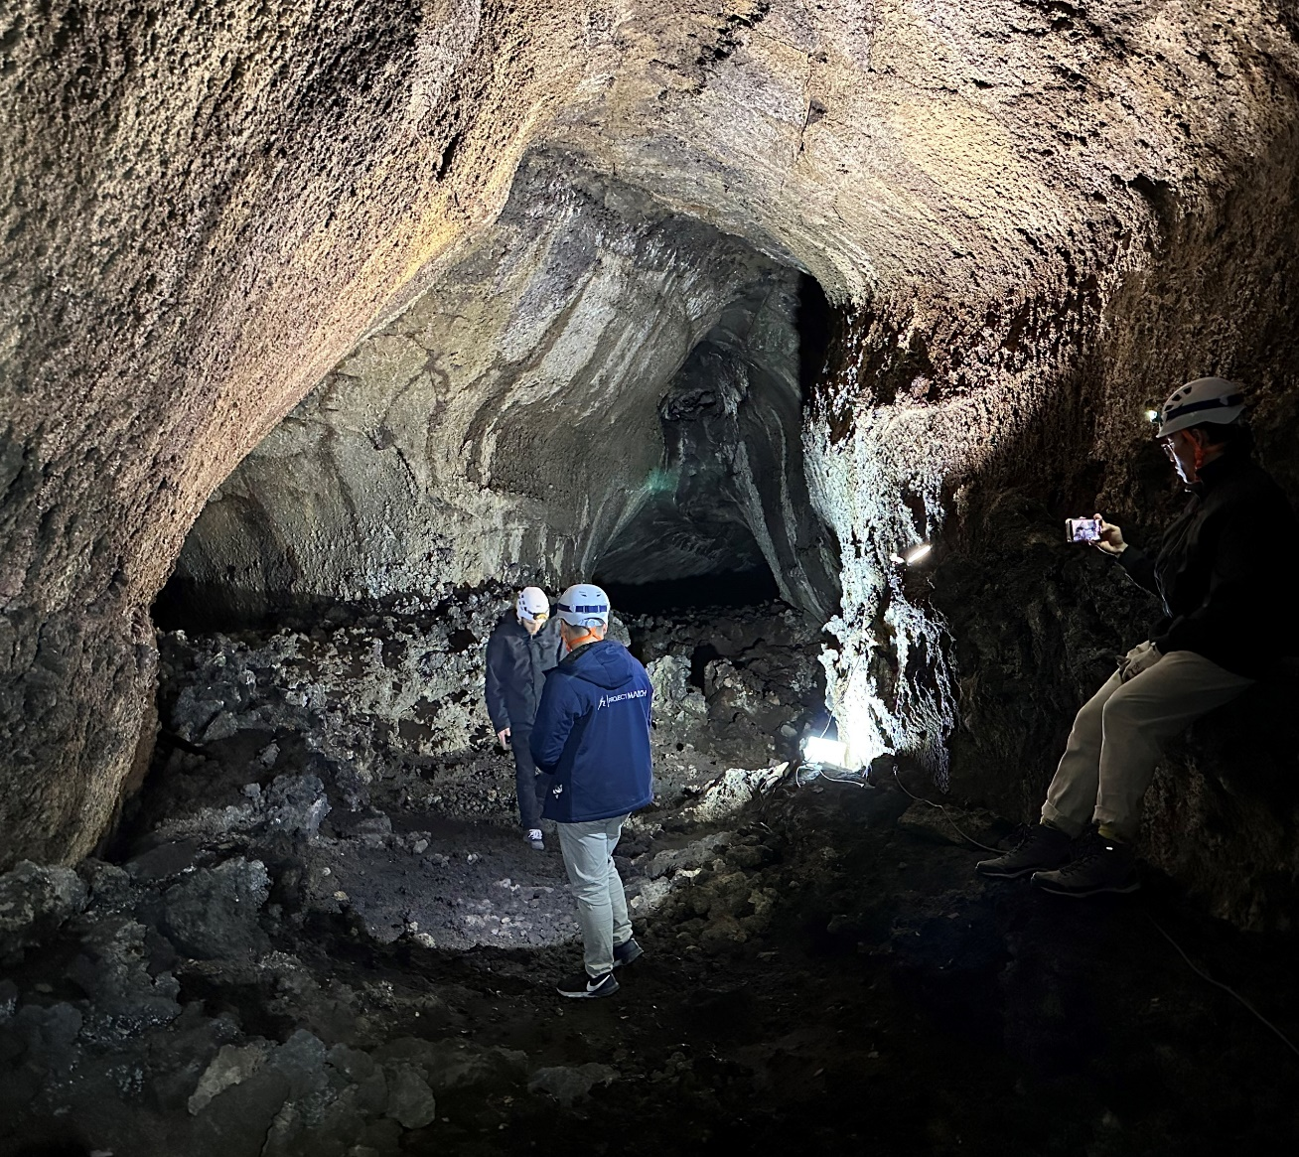
Lava tube mission
Corridors branching out
7/67
Sophia Benfield | MoonSane | Lunar Architecture | Tutors: H. Bier & A. Hidding & F. Adema | 2024/25 | TU Delft
Notes:
Then I needed to connect the spaces in 3D. For this I was very inspired by the images from the Lava Tube Mission. They showed these branching corridors that evoke curiosity and counteract spatial monotony.

Slide 8
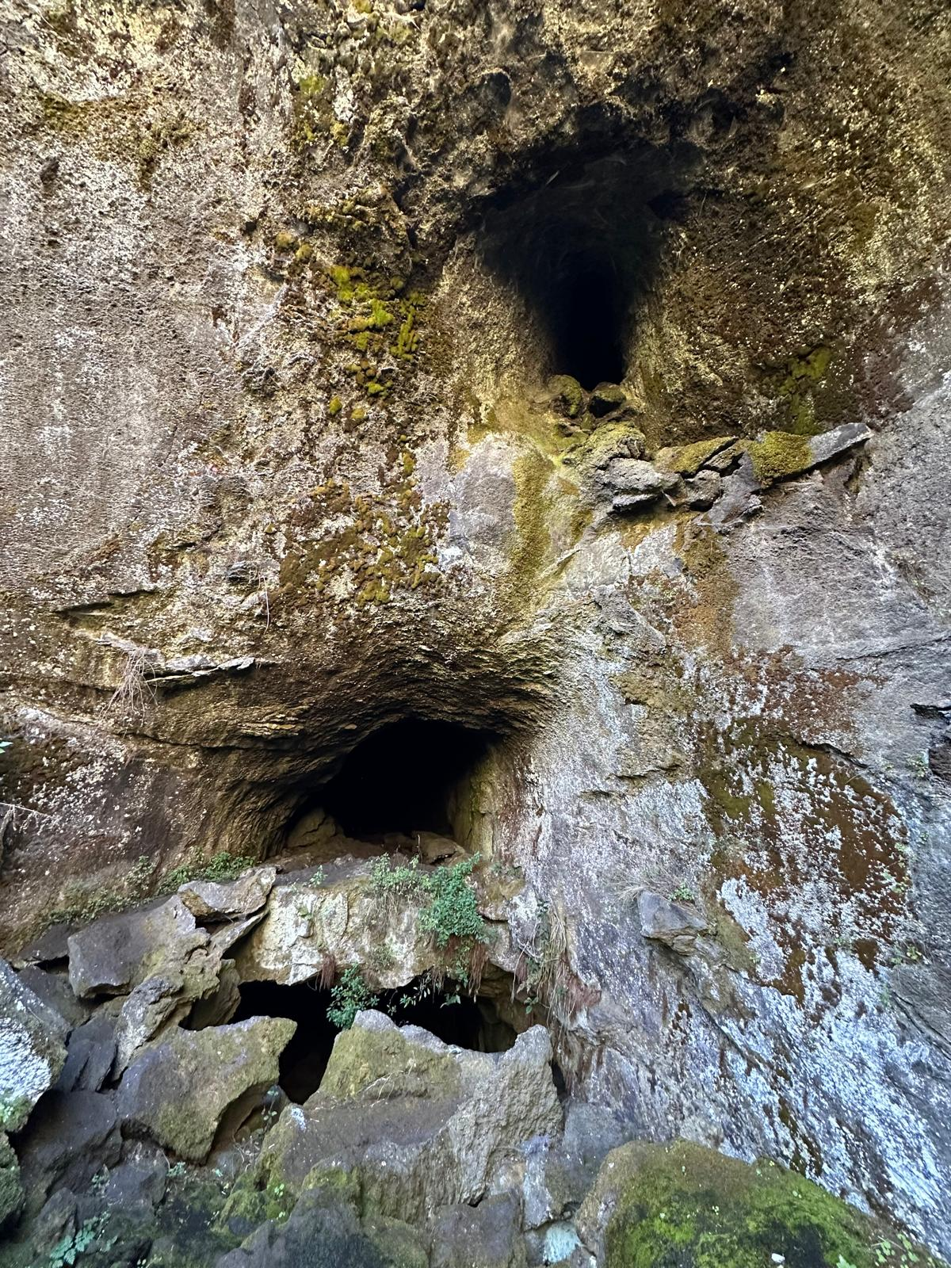
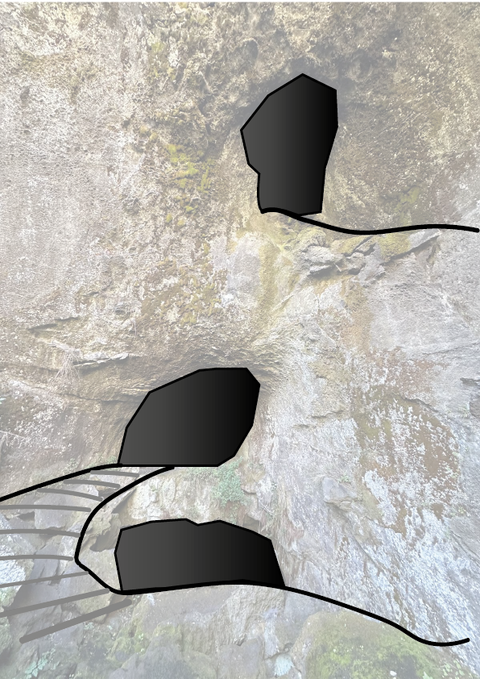
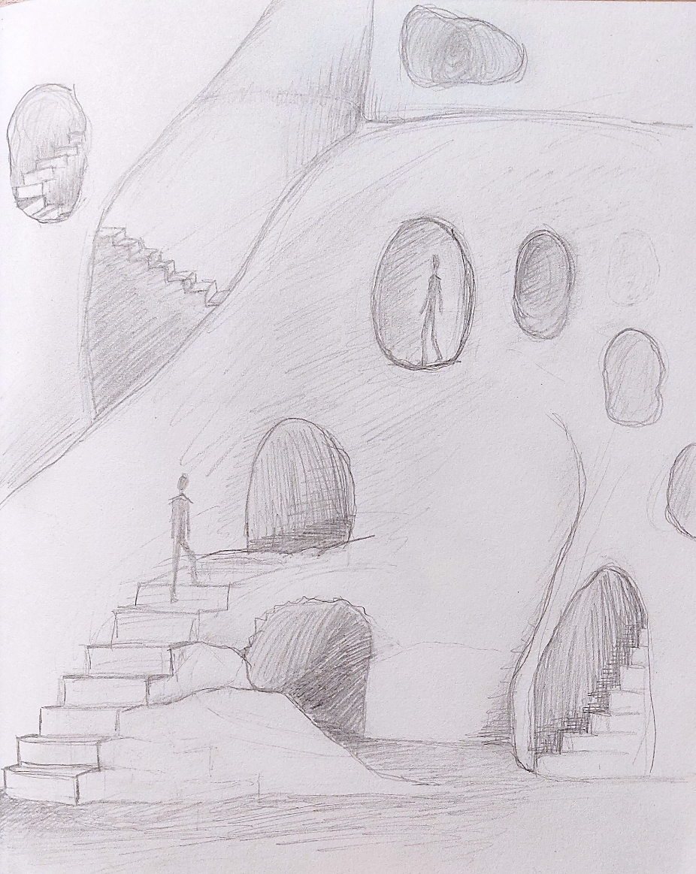
Lava tube mission: sketching
8/67
Sophia Benfield | MoonSane | Lunar Architecture | Tutor: H. Bier & A. Hidding | 2024/25 | TU Delft
Notes:
I did some sketching to see how these different views and corridors would look like in a space, taking a picture from the mission as inspiration. I ended up with an Escher like image, with multiple openings through which you can see people moving through the space.

Slide 9
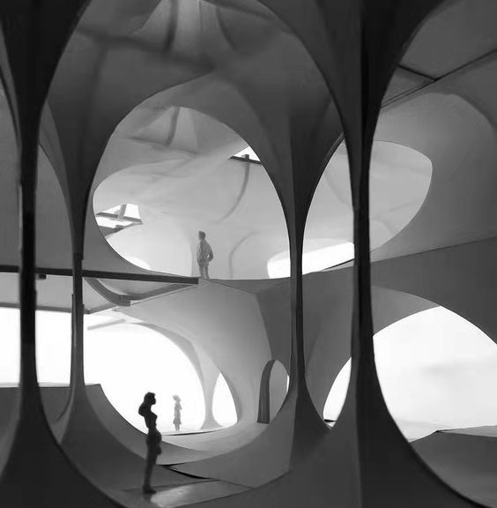
Spatial connection: 3D
Visually connecting spaces– decreasing confinement
Dynamic views
Big atrium that branches out
9/67
Sophia Benfield | MoonSane | Lunar Architecture | Tutors: H. Bier & A. Hidding & F. Adema | 2024/25 | TU Delft
Notes:
So concerning the strategy for spatially connecting the spaces I want to open up the interior visually, creating dynamic views. Using the big atrium as a space from which the smaller rooms branch out.

Slide 10
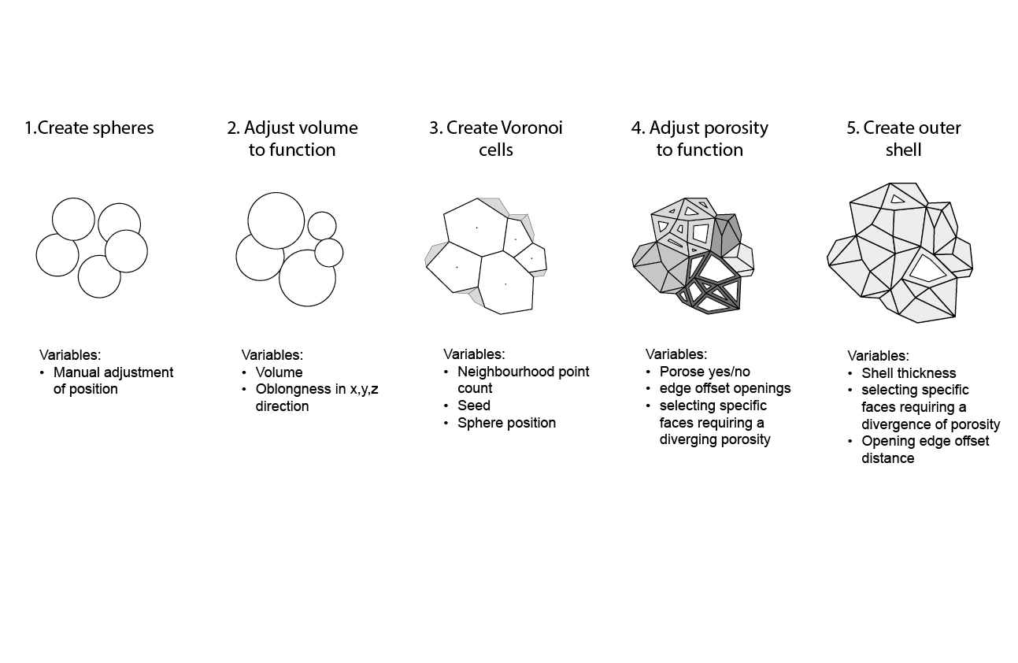
Permeability: computational script
10/67
Sophia Benfield | MoonSane | Lunar Architecture | Tutors: H. Bier & A. Hidding & F. Adema | 2024/25 | TU Delft
Notes:
To visualise this spatial porosity, it was necessary to develop a computational script in grasshopper with variables that could be adjusted to generate iterations and add improvements. Starting with the minimum volumes the script created a 3D bubble diagram that was then made into adjoining Voronoi cells. Next I could adjust the permeability of each cell according to the room function. The last step was to add an outer shell with openings to the outside.

Slide 11
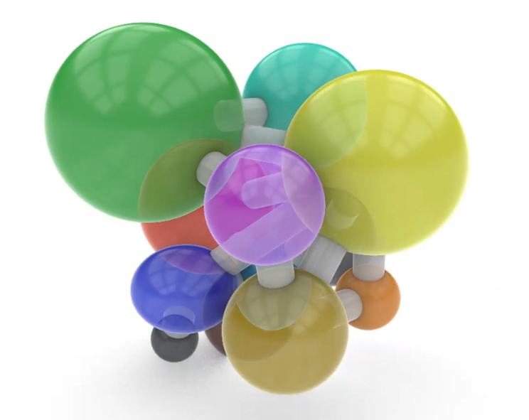
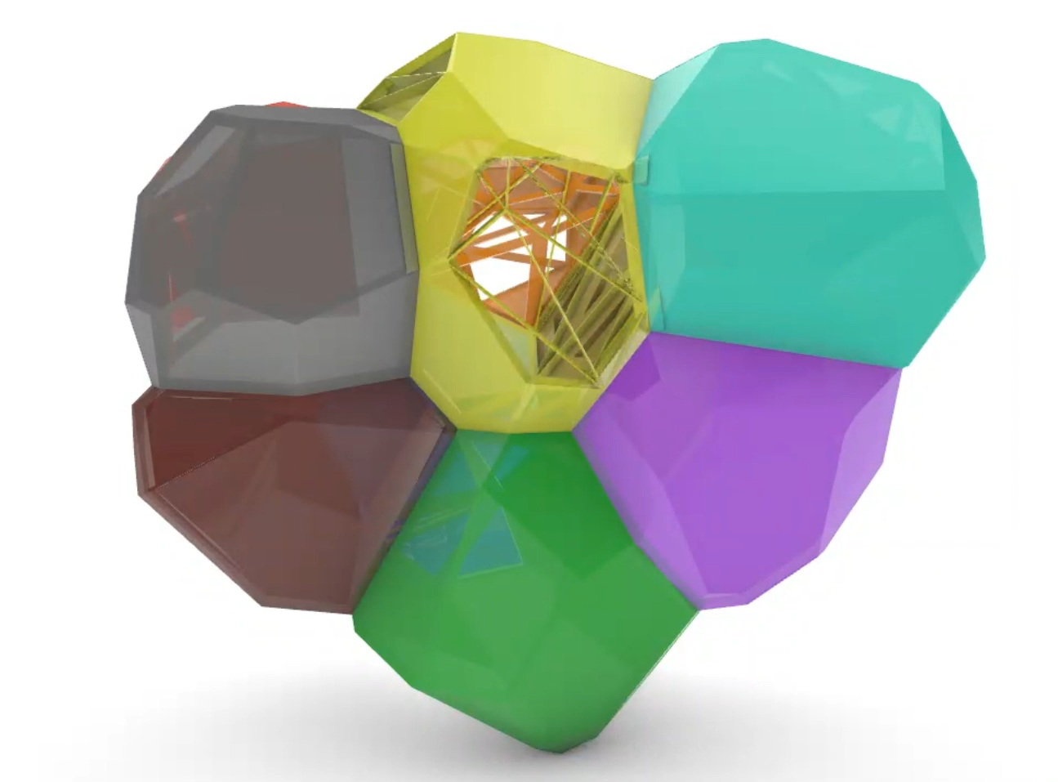
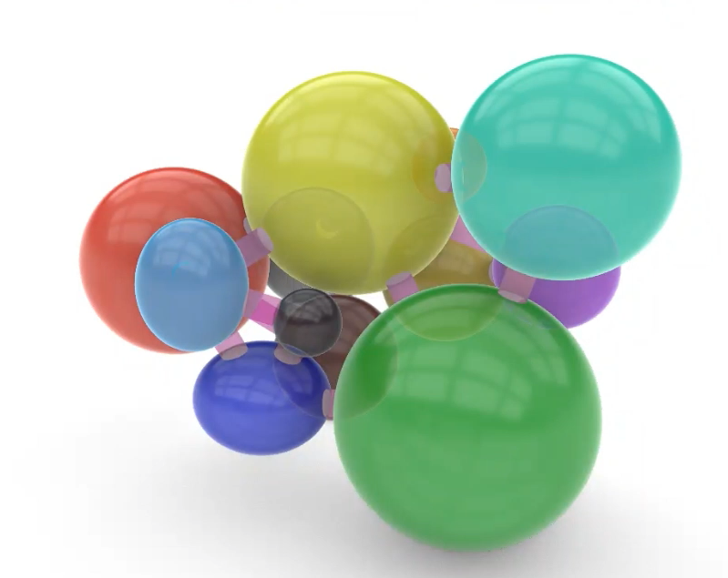
Permeability script: results
 | Function | Permeability
 | Living | 80%
 | Kitchen | 62%
 | Storage main | 16%
 | Meditation | 10%
 | Garden-gym | 50%
 | Medical | 10%
 | Private quarters | 3%
 | Bathroom | 0%
 | Storage private | 0%
 | Research | 8%
 | EVA chamber | 5%
 | Storage research | 0%
Functions
Applying permeability
11/67
Sophia Benfield | MoonSane | Lunar Architecture | Tutors: H. Bier & A. Hidding & F. Adema | 2024/25 | TU Delft
Notes:
So first I did iterations of the different volumes in relation to each other, the connective tubes showing which rooms needed to connected to each other.

Slide 12
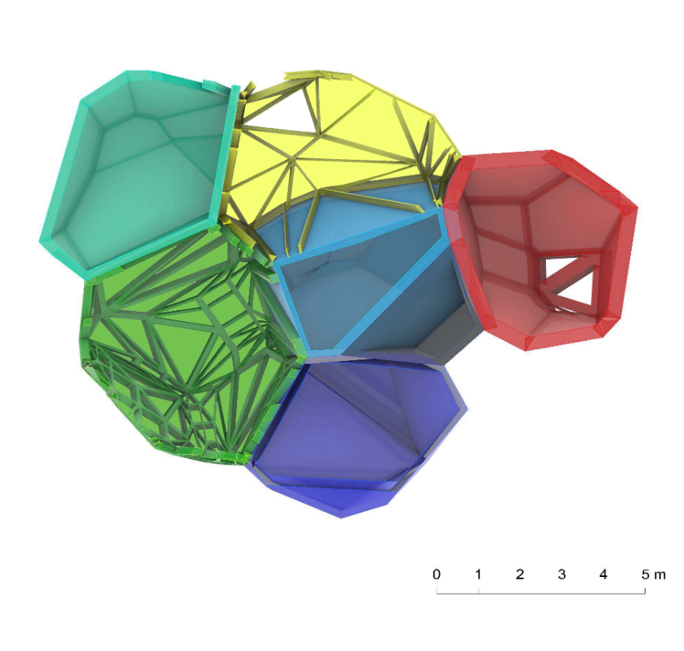
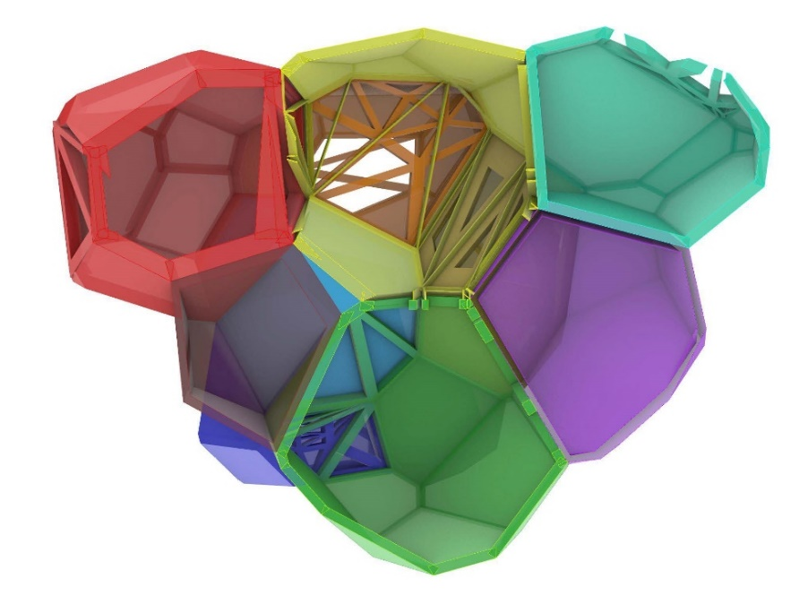
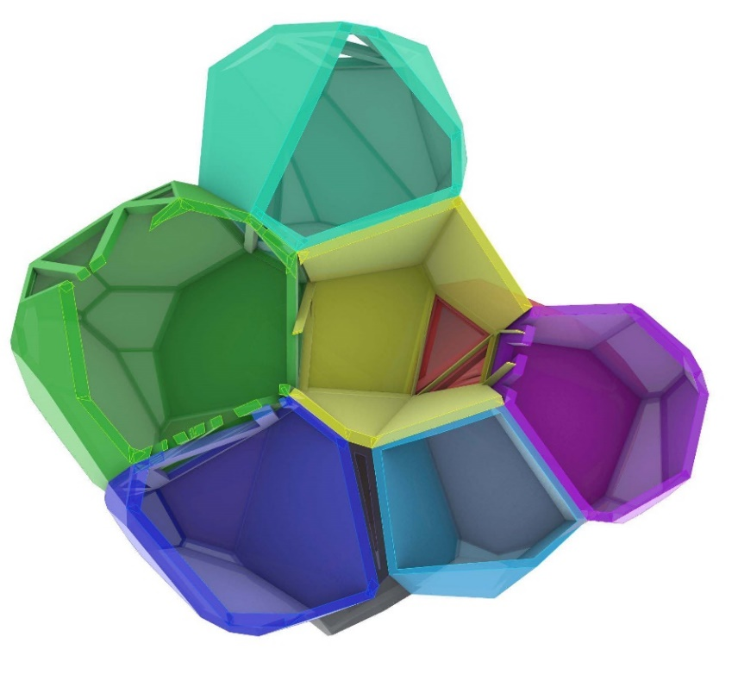

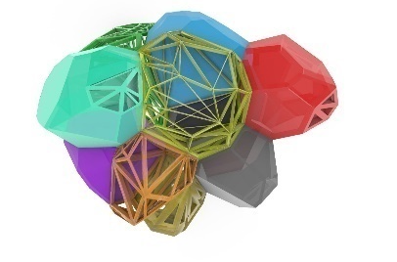
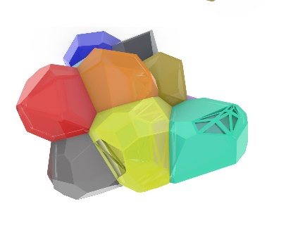
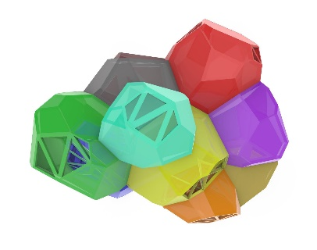
Permeability script: iterations
12/67
Sophia Benfield | MoonSane | Lunar Architecture | Tutors: H. Bier & A. Hidding & F. Adema | 2024/25 | TU Delft
Notes:
With the help of the script, different iterations where generated. I played most with the location of the two atria, garden and living space. These iterations informed my final design.

Slide 13
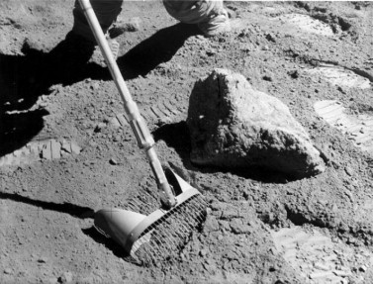
Exterior: Lunar Regolith
Main material:
Lunar Regolith
Radiation protection: will require thick walls (1,5+ m)
Strong compressive properties
Weak tensile properties
13/67
Sophia Benfield | MoonSane | Lunar Architecture | Tutors: H. Bier & A. Hidding & F. Adema | 2024/25 | TU Delft
Notes:
For the outer shell we are making use of the local material, called Lunar Regolith. To protect the astronauts from the radiation on the surface, this outer shell will need to be at least 1,5 m thick.
Lunar Regolith has strong compressive properties, but weak tensile properties, which has an impact on the shape of the building

Slide 14
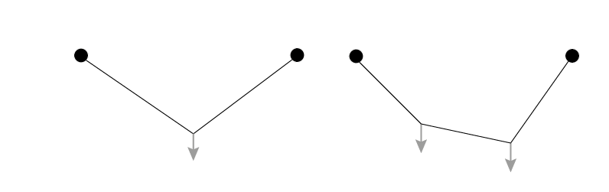
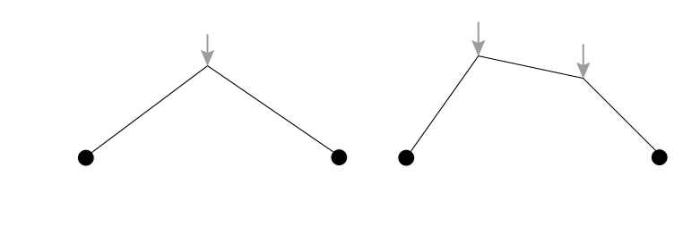
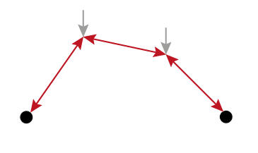
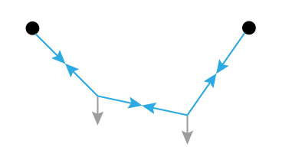
Catenary action
1 weight
2 weights
Mapping tensile forces by hanging weights on a cord
Inverted tension shows compression forces
14/67
Sophia Benfield | MoonSane | Lunar Architecture | Tutors: H. Bier & A. Hidding & F. Adema | 2024/25 | TU Delft
Notes:
To be able to build with regolith safely, we have to use the catenary action principle, which is meant to visualise the most efficient forces. To map tensile forces you create this by hanging weights on a chain. When inverted it shows compression forces. These are the ones we need to design with.

Slide 15
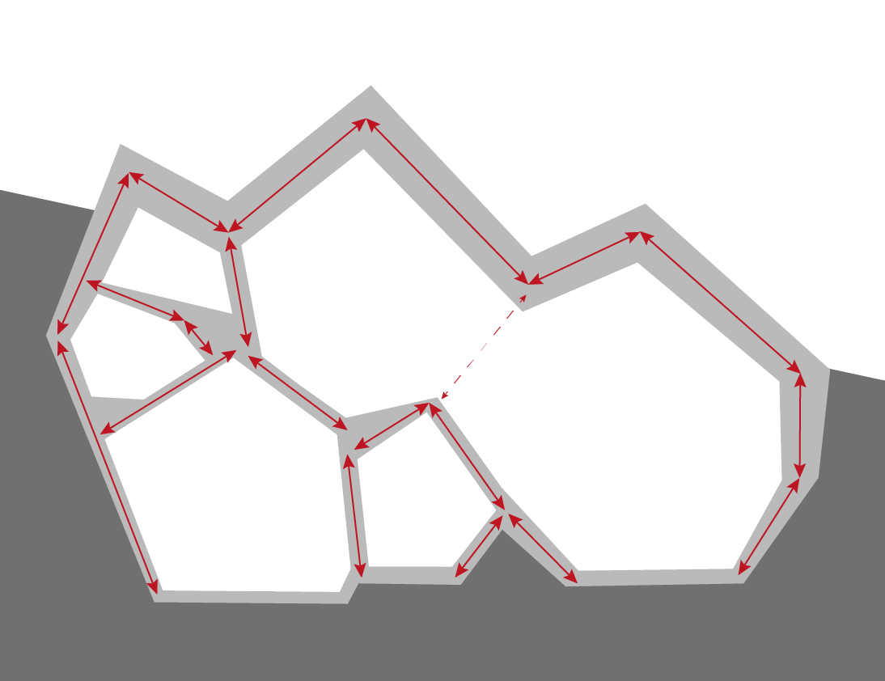
Catenary action: building
Geometry adjusted to generate mainly compressive forces:
15/67
Sophia Benfield | MoonSane | Lunar Architecture | Tutors: H. Bier & A. Hidding & F. Adema | 2024/25 | TU Delft
Notes:
The geometry of the building has been adjusted to facilitate this, with help of the Voronoi geometry.

Slide 16
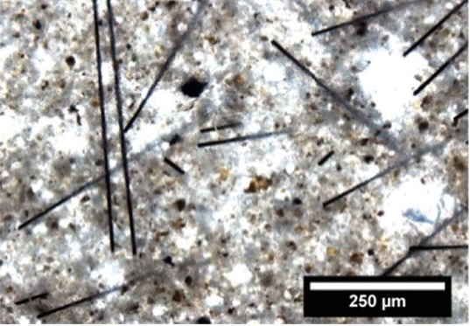
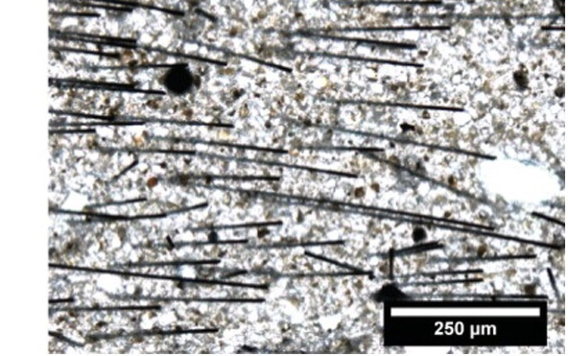
Carbon fibre
Reinforcing Lunar Regolith
Extract carbon to produce small fibres
Already applied in concrete
Add to Regolith mixture
improves tensile strength for static and dynamic loading
disorganised
Hambach, M., Möller, H., Neumann, T., & Volkmer, D. (2016). Portland cement paste with aligned carbon fibers exhibiting exceptionally high flexural strength (> 100 MPa). Cement and Concrete Research, 89, 80-86.
organised
16/67
Sophia Benfield | MoonSane | Lunar Architecture | Tutors: H. Bier & A. Hidding & F. Adema | 2024/25 | TU Delft
Notes:
There is a possibility of enhancing the Regolith’s tensile properties by adding carbon fibre, that based on this study could be extracted from the carbon dioxide in the air.

Slide 17
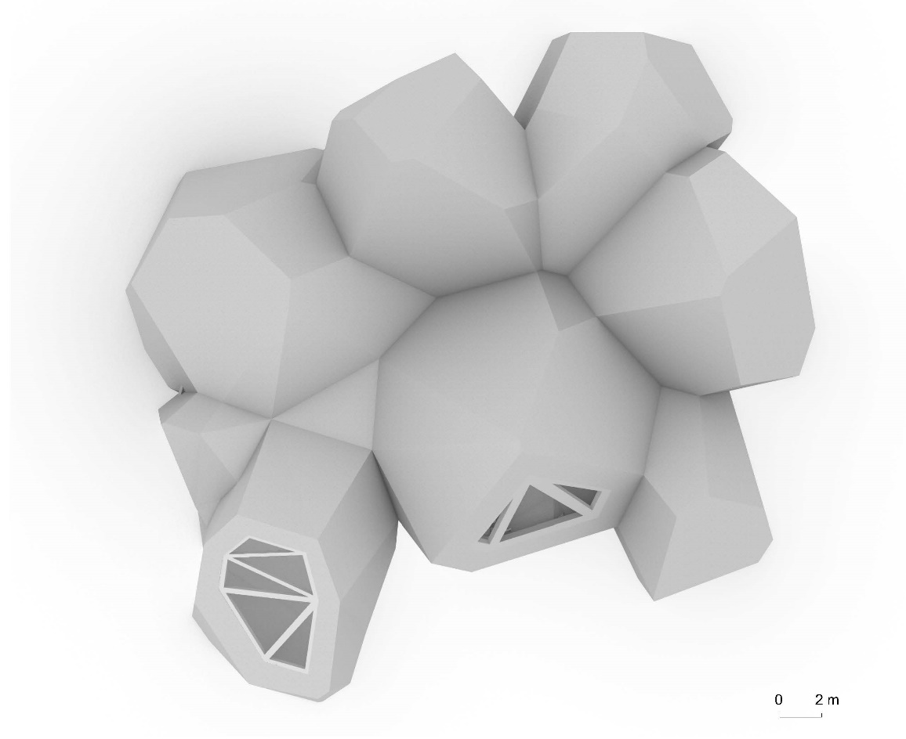

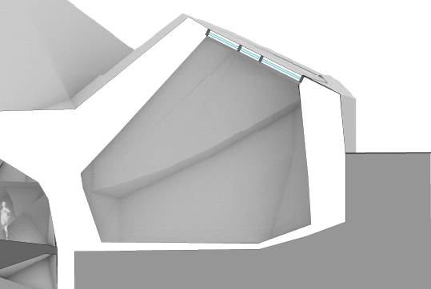

Creating views
Meditation space:
Map Earth view
N
Sky position
Latitude: 20
Zenith
20°
Orientation Longitude: 10
10°
17/67
Sophia Benfield | MoonSane | Lunar Architecture | Tutors: H. Bier & A. Hidding & F. Adema | 2024/25 | TU Delft
Notes:
Another factor that influenced my exterior, was the window placement, especially of the meditation space. This needed to be adjusted to where the earth was visible in the sky. Luckily the Earth is fixed in the Lunar sky, so the position can be mapped and the window adjusted accordingly.

Slide 18
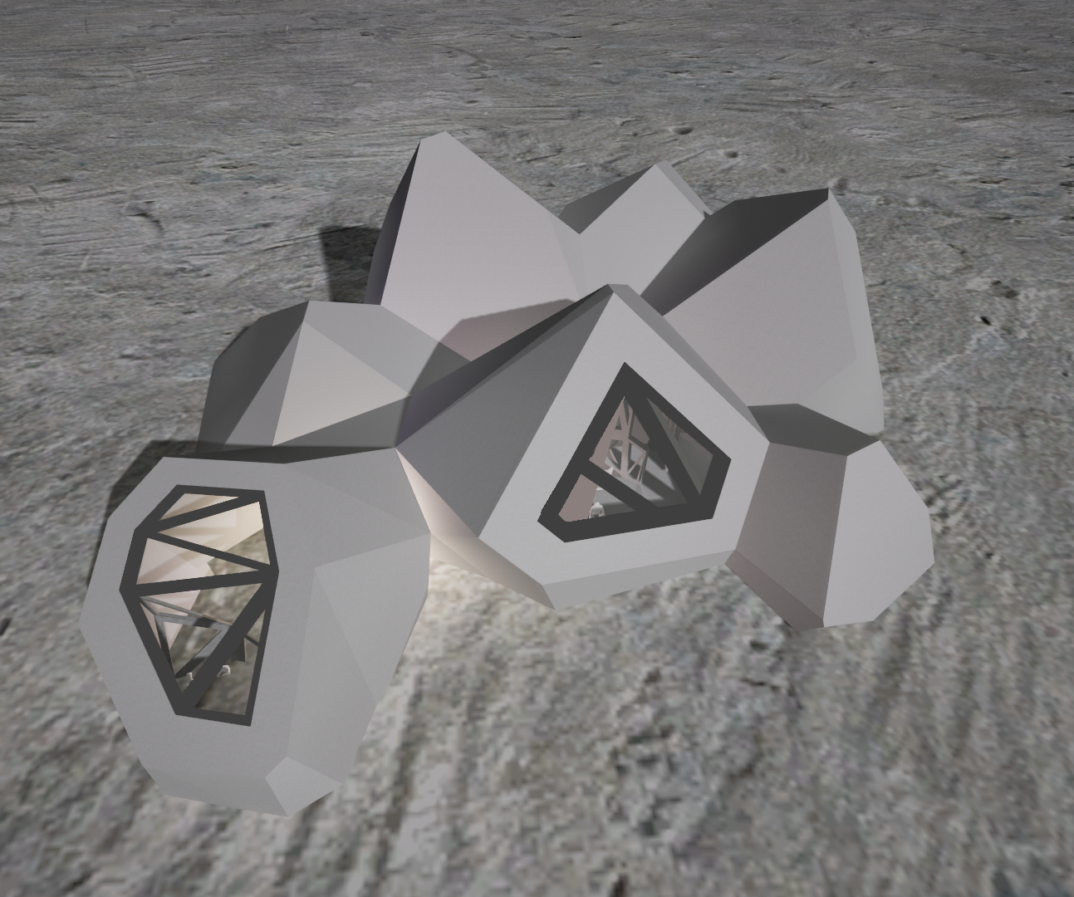
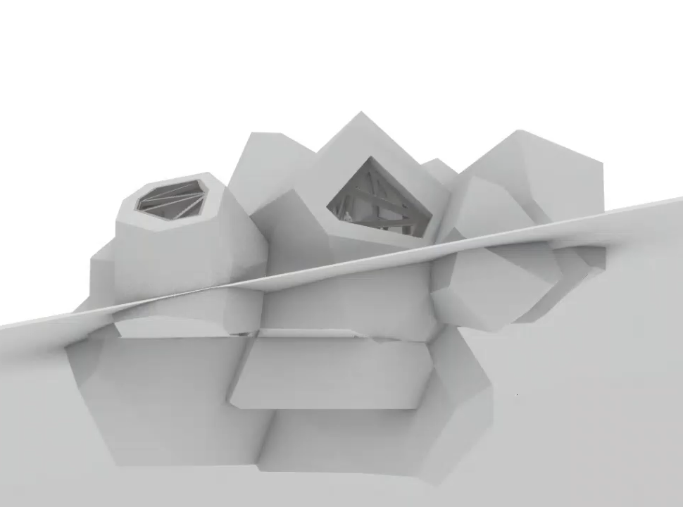
Building in location
Surface view
Dynamic section
18/67
Sophia Benfield | MoonSane | Lunar Architecture | Tutors: H. Bier & A. Hidding & F. Adema | 2024/25 | TU Delft
Notes:
This is how the building is placed in the location. On the right you see a dynamic section, that shows which spaces are above and below ground. The spaces that require views will be above ground while the more private spaces and storage spaces lie below ground.
On the left you see the surface view.

Slide 19
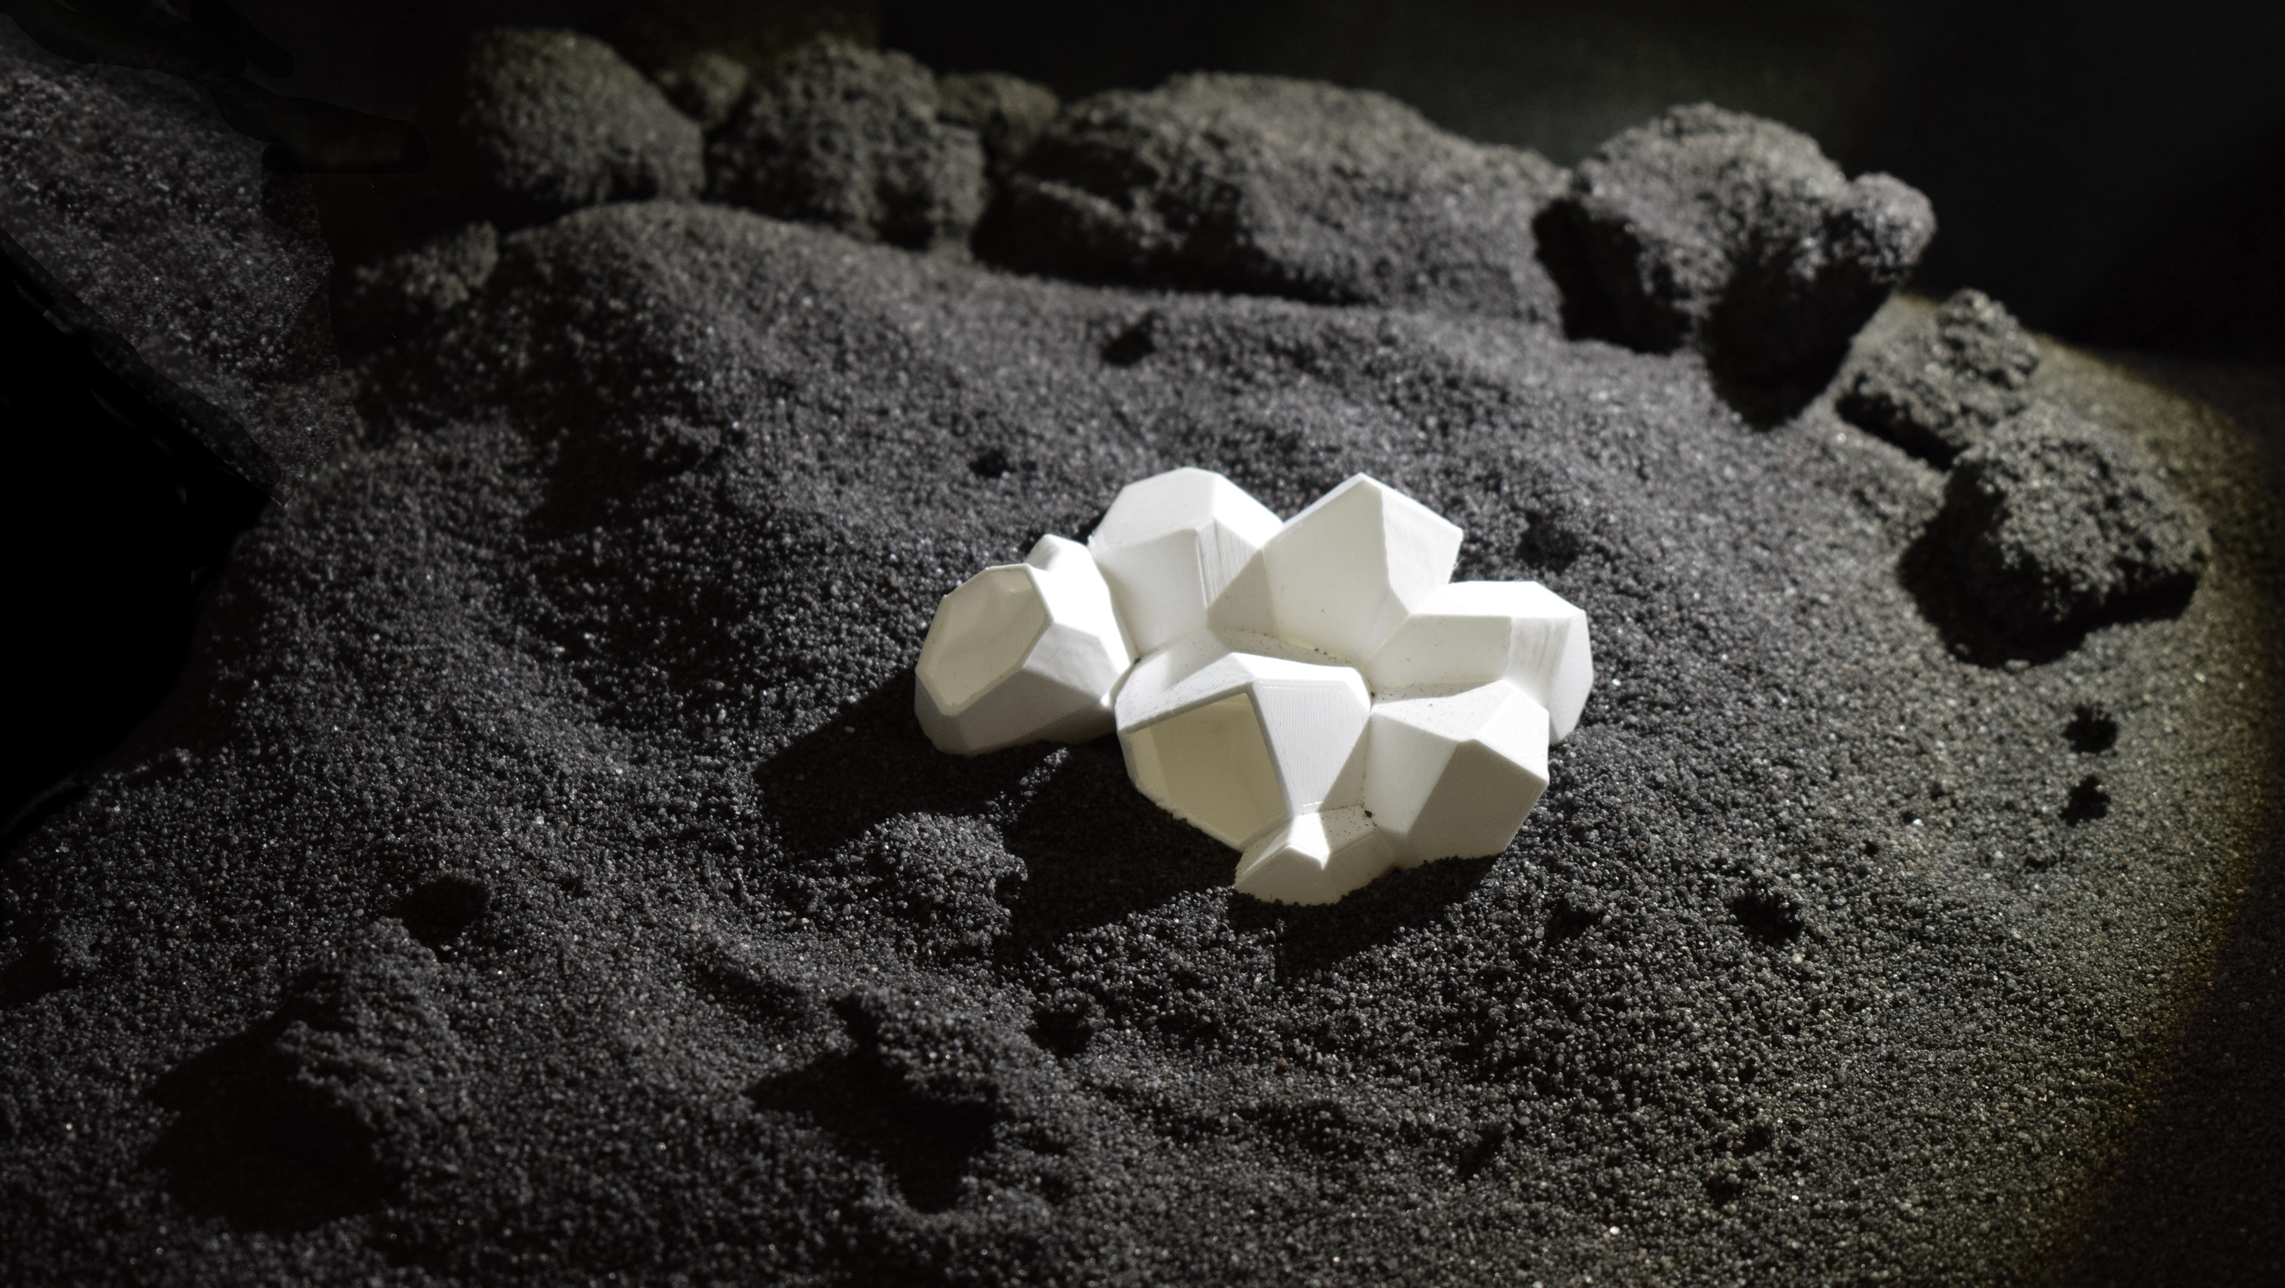
Building in location
Dynamic section
19/67
Sophia Benfield | MoonSane | Lunar Architecture | Tutors: H. Bier & A. Hidding & F. Adema | 2024/25 | TU Delft
Notes:
To test the spatiality in 3D, I also 3D printed a scale model of my building, which I also brought with me.

Slide 20
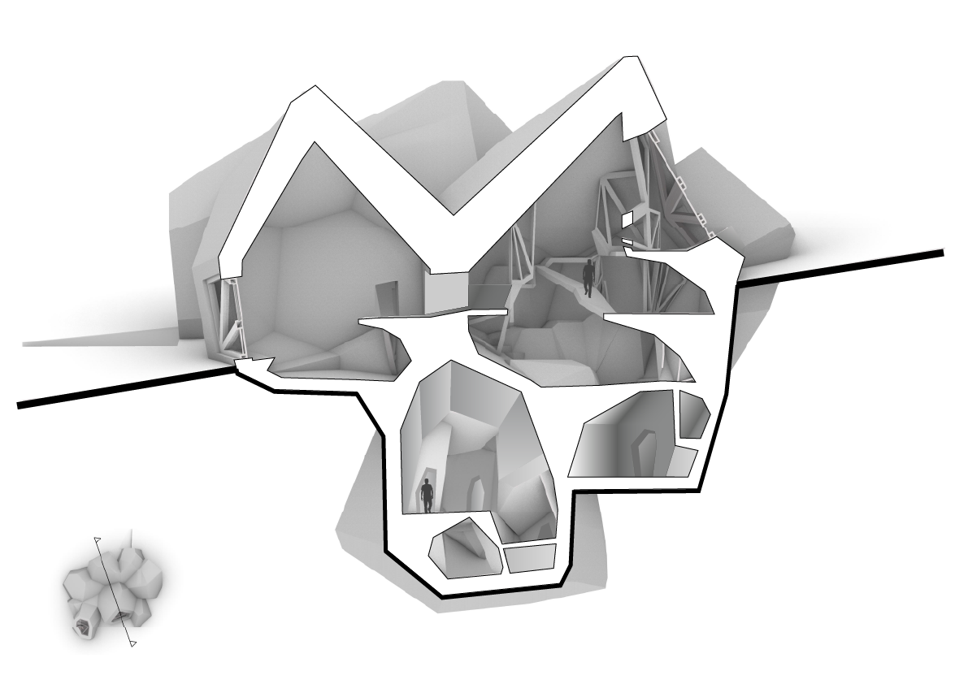
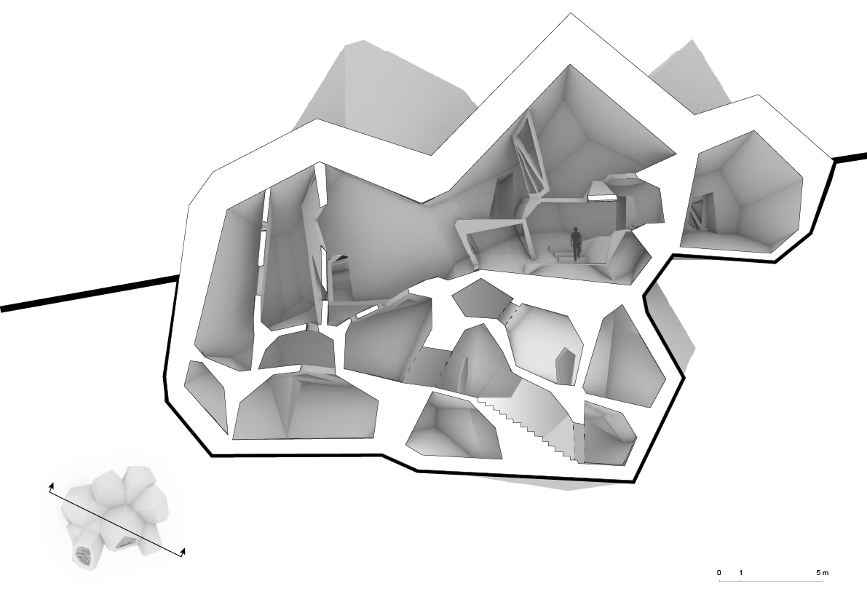
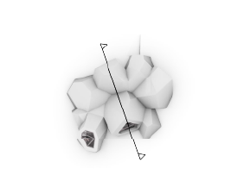
Section
Section A
Section B
1 : 100
20/67
Sophia Benfield | MoonSane | Lunar Architecture | Tutors: H. Bier & A. Hidding & F. Adema | 2024/25 | TU Delft
Notes:
My final building design has different levels, with a main atrium created by the living space (point) and garden. The Garden functions as a transitionary space to the private quarters. When astronauts retreat to their private spaces during or at the end of the day, they have to take a walk through the garden, giving time to reflect and calm down.

Slide 21
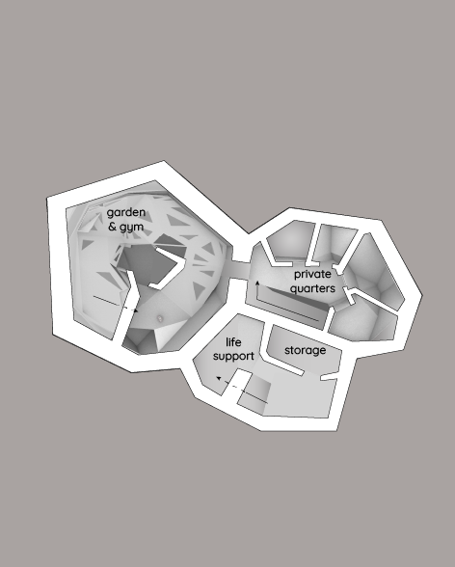
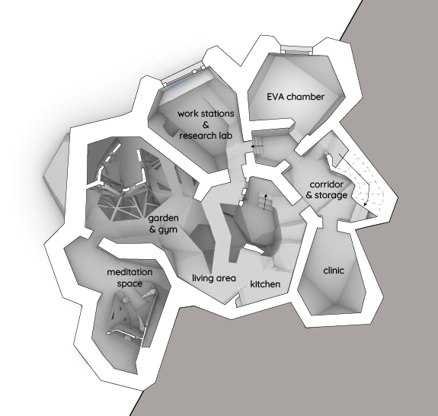
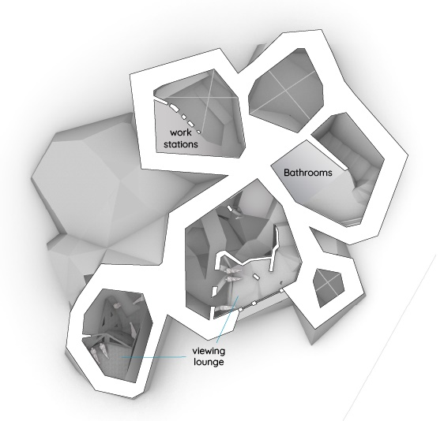


Plans
Plan -1
-6.6 m
Plan 0
0 m
Plan +1
+3.6 m
21/67
Sophia Benfield | MoonSane | Lunar Architecture | Tutors: H. Bier & A. Hidding & F. Adema | 2024/25 | TU Delft
Notes:
Looking at my building plans, most main functions are present on the surface level, with the living area as connective space.
The lower level contains most of the garden, private quarters and life support, while the high level contains mostly viewpoints.

Slide 22

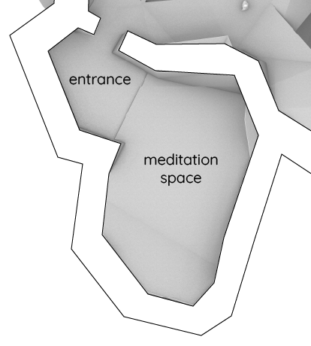

Meditation space
22/67
Sophia Benfield | MoonSane | Lunar Architecture | Tutors: H. Bier & A. Hidding & F. Adema | 2024/25 | TU Delft
Notes:
To develop the interior I chose to focus on the meditation space, as it is most representative of my design. To lessen disturbances from the atrium, I gave it an entrance space.

Slide 23
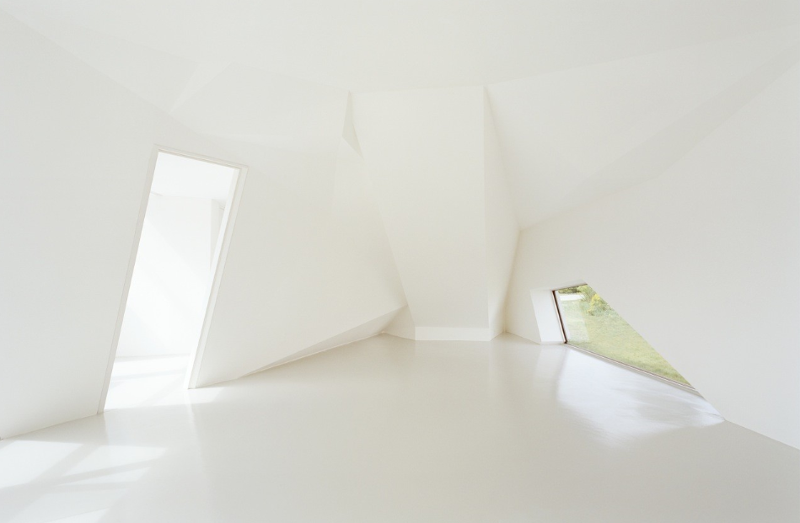
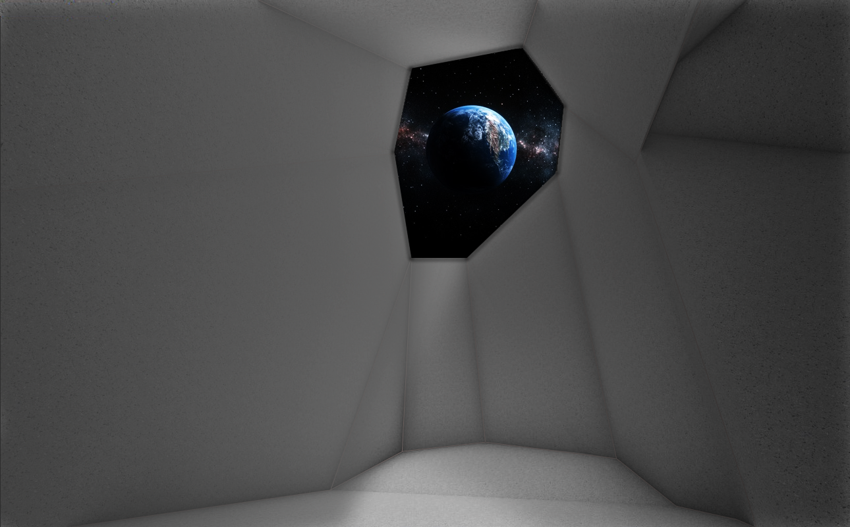
Asymmetric geometry
St. Joseph House - Wolfgang Tschapeller ZT GmbH
Interior meditation space
Source: St. Joseph House / Wolfgang Tschapeller ZT GmbH | ArchDaily
23/67
Sophia Benfield | MoonSane | Lunar Architecture | Tutors: H. Bier & A. Hidding & F. Adema | 2024/25 | TU Delft
Notes:
First I looked for references of asymmetric geometry, to see how it can be implemented. I found this one among others. Using the Voronoi geometry as a base I was able to model the interior similarly. On the left you see the reference and on the right the interior of my mediation space.

Slide 24
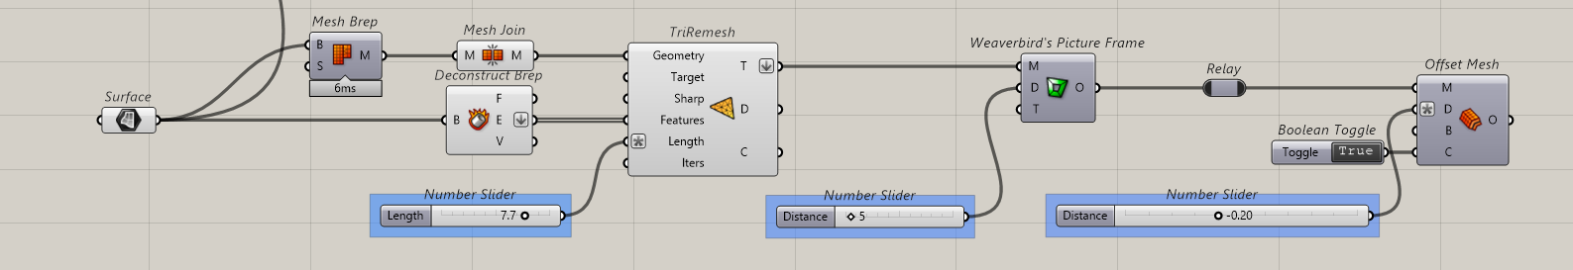
Methodology: computational design
Permeability study: furniture scale
1. triangulation
2. opening size
3. thickness
24/67
Sophia Benfield | MoonSane | Lunar Architecture | Tutors: H. Bier & A. Hidding & F. Adema | 2024/25 | TU Delft
Notes:
I wanted to

Slide 25

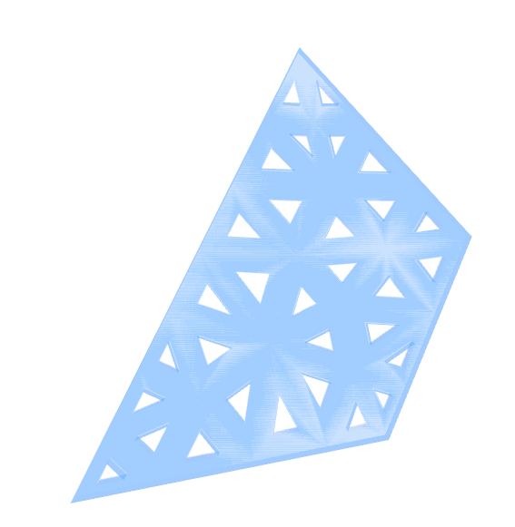



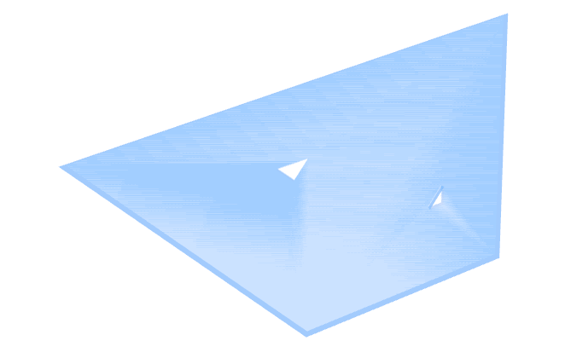
Permeability script
high
low
triangulation
opening size
25/67
Sophia Benfield | MoonSane | Lunar Architecture | Tutors: H. Bier & A. Hidding & F. Adema | 2024/25 | TU Delft
Notes:
Looking at implementing the geometry, the research and medical centre require focus so will have a more angular character, while the other rooms require a more soft character.

Slide 26
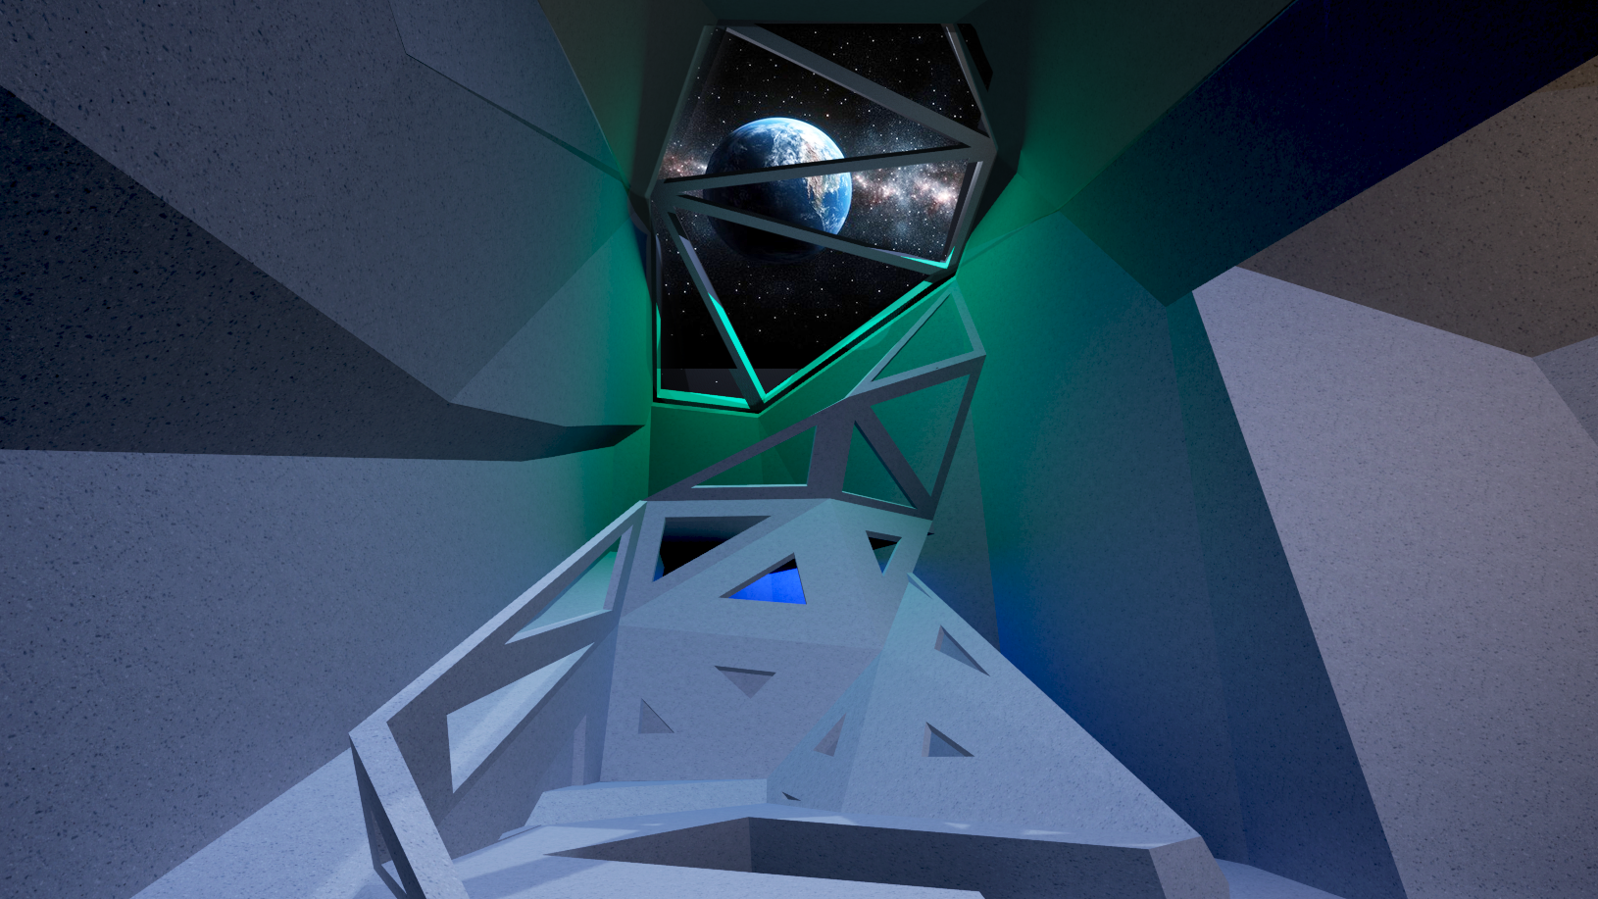
Permeability applied
26/67
Notes:
This is a representation of the relaxing space, which for sharing stories of home and family.

Slide 27
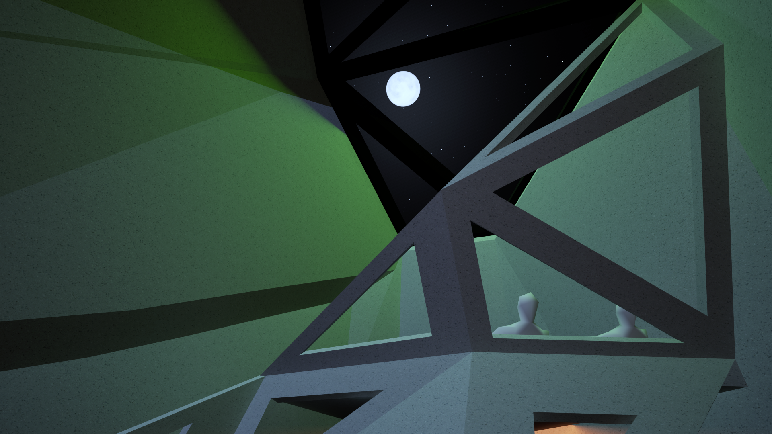



Earth viewing
27/67

Slide 28

Reflecting
28/67
Sophia Benfield | MoonSane | Lunar Architecture | Tutors: H. Bier & A. Hidding & F. Adema | 2024/25 | TU Delft
Notes:
I wanted to apply the permeability in a different way, with dynamic visuals based on the fractal pattern principle.

Slide 29


Interior solitude space
Adjustable colour and size
Monitoring physical state:
Heart rate
Temperature
Indicators of stress can inform visuals
Calming or uplifting effects
29/67
Sophia Benfield | MoonSane | Lunar Architecture | Tutors: H. Bier & A. Hidding & F. Adema | 2024/25 | TU Delft
Notes:
The pattern has adjustable colour and size. The vitals of the crew will be monitored and I want them to inform the variables of the patterns.

Slide 30

Interior solitude space
Flexible OLED screens
Possible in irregular polygons
Lightweight & energy saving
Easy front-side maintenance and replacement
30/67
Sophia Benfield | MoonSane | Lunar Architecture | Tutors: H. Bier & A. Hidding & F. Adema | 2024/25 | TU Delft
Notes:
To achieve this I want to cover the walls with flexible led screens so visuals can be shown based on the mood of the astronaut. They are easy in maintenance and energy saving.

Slide 31




Dynamic daylight simulation
Sunrise
Midday
Sunset
31/67
Sophia Benfield | MoonSane | Lunar Architecture | Tutors: H. Bier & A. Hidding & F. Adema | 2024/25 | TU Delft
Notes:
I also wanted to show a quick impression of the dynamic daylight simulation.

