Slide 1

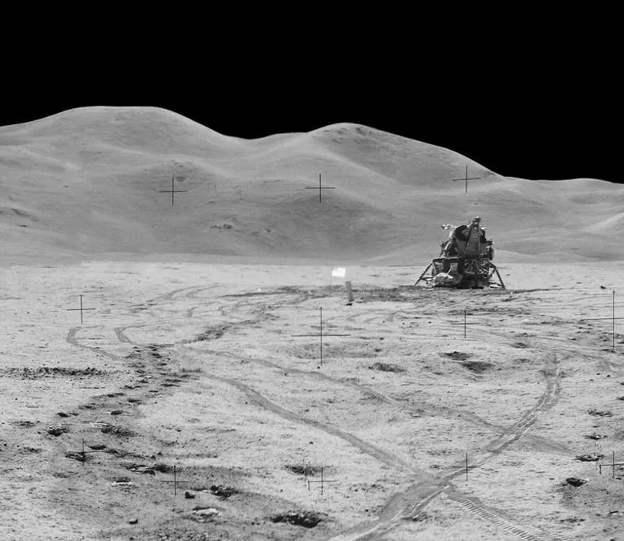


Problem Statement
JIP 2025 Group 1.13.1
TU Delft Space and Robotic Institutes
Building the moon
Simone Guccione - 6171796
Twan Linger - 4869656
Lorenzo Marzolini - 6190561
Manuel Oberhofer - 6564542
Alessandro Vercalli – 6288979
Pieter van der Werf - 5526353

Slide 2
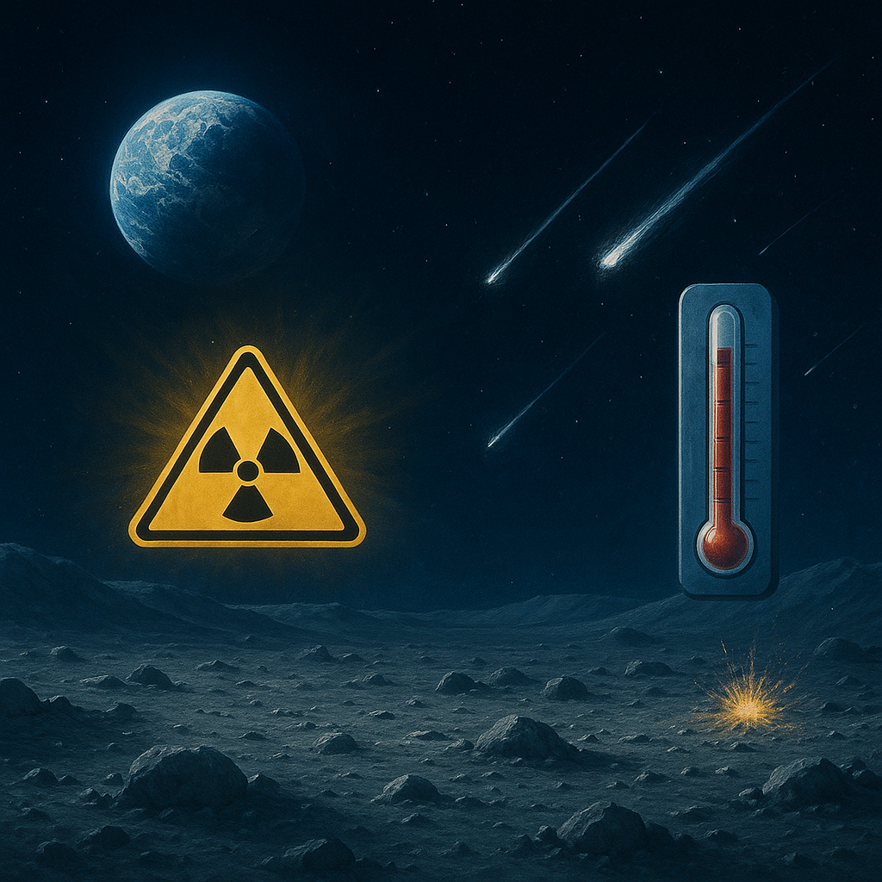
Lunar Environment
Radiation
Temperature
Micro-meteorites
Notes:
0.1 mSv chest X-ray, 2200 mSv biggest event, (121°C) in daylight near the equator and plunging to (-133°C) at night, no atmosphere, no magnetosphere.

Slide 3
Business context
Strategic milestone
Relevant technologies:
Spin-off:
mining automation.
swarm robotics,
additive manufacturing with ISRU,
autonomous assembly
Mars and space exploration
long-term settlement
sustainable construction,
infrastructure development,

Slide 4
Stakeholders
Primary
Secondary
Space agencies
(ESA, NASA, JAXA)
Robotic Companies
(VERTICO)
Private aerospace companies
(SPACE X, BLUE ORIGIN)
Academic researchers
Governments
Mining companies
Future astronauts
Tourists

Slide 5
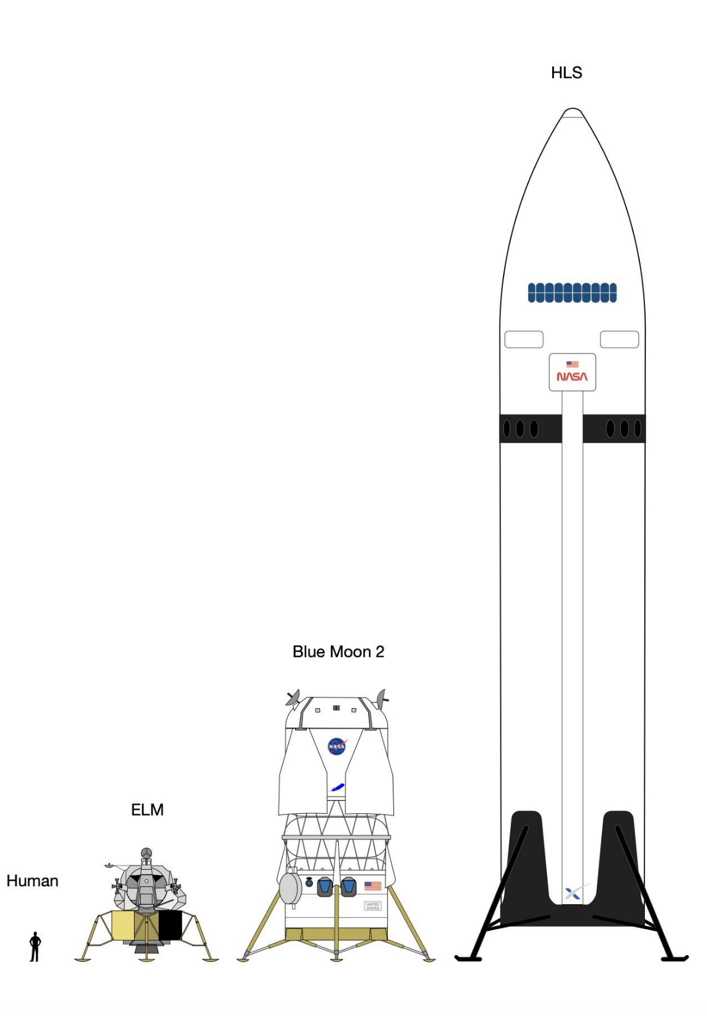
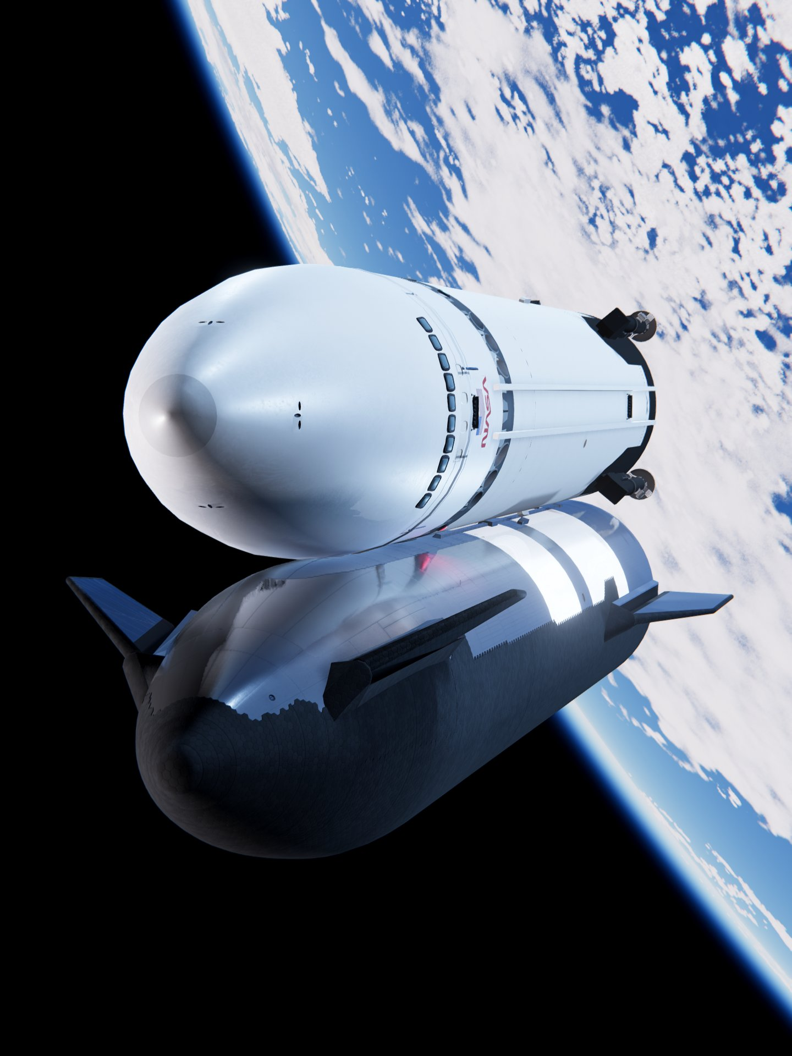
Sustainability – ISRU
Both HLS landers require orbital refueling
SpaceX’s Starship HLS: ∼ 100t, 14 launches
Blue Origin’s Blue Moon (MK2) ∼ 20t, 1-4 launches
Tens of tons of CO₂ per launch
ISRU construction minimizes material needed from Earth

Slide 6
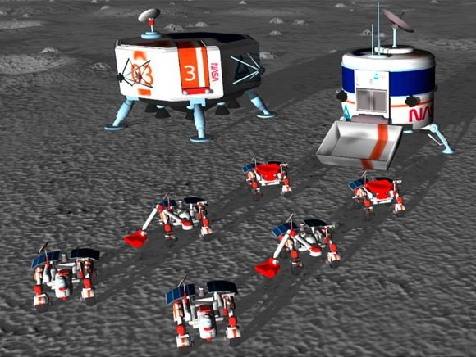
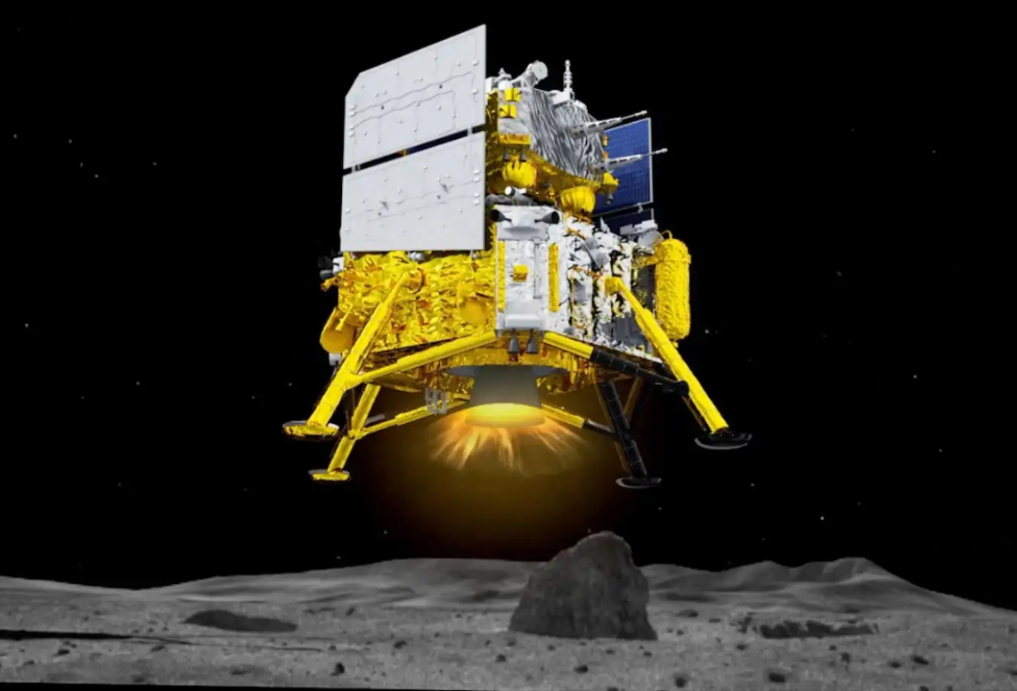
Sustainability – Manual vs Robotic Construction
Manual Construction
Temporary habitats required
Higher costs
Provisions
Highly skilled labor
Astronaut salaries
Robotic Construction
No risk to human life
Lower construction costs
May be able to use simpler/lighter landers

Slide 7
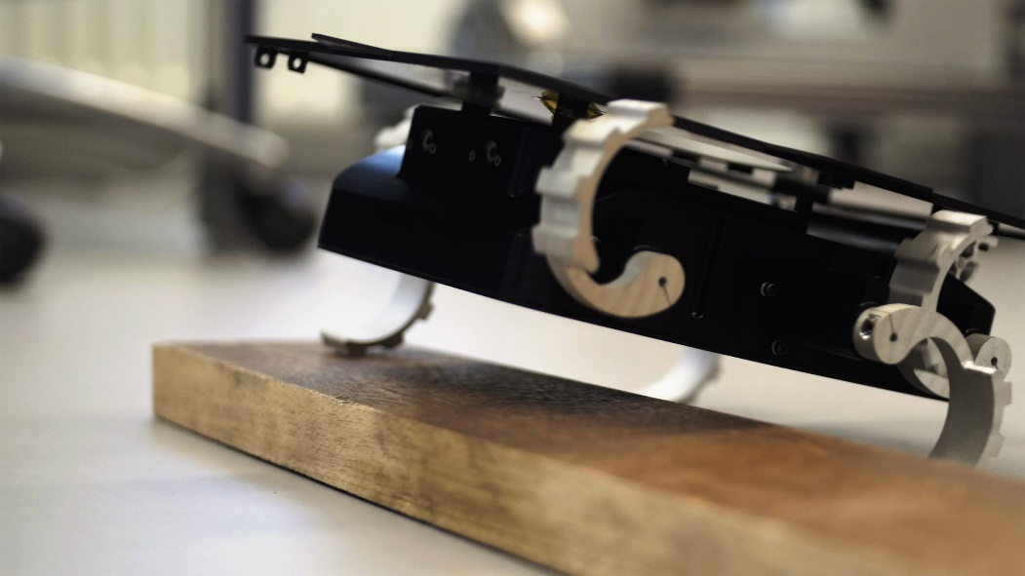
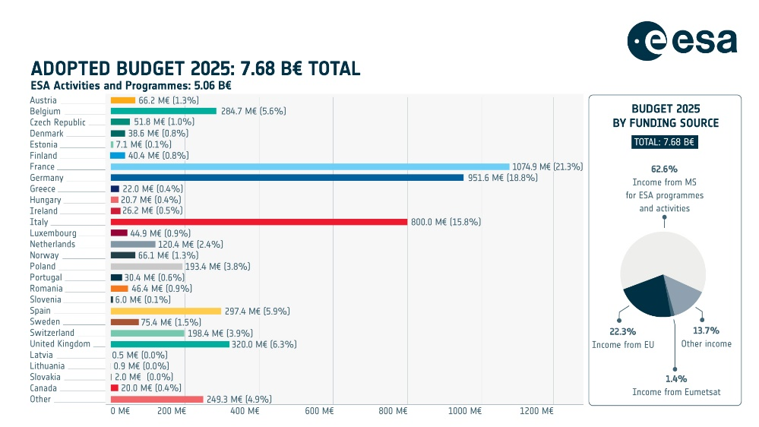
SMART objectives
Specific: Human-less approach to lunar habitat building
Measurable: Shipping cost of materials and equipment is taken as a KPI
Assignable: work assigned based on expertise
Realistic: Current ESA budget not sufficient
Time-step: return to the moon in late 2020’ and first settlement in the first half of the 2030’
Notes:
150+ ISS and 257+ apollo missions,

Slide 8
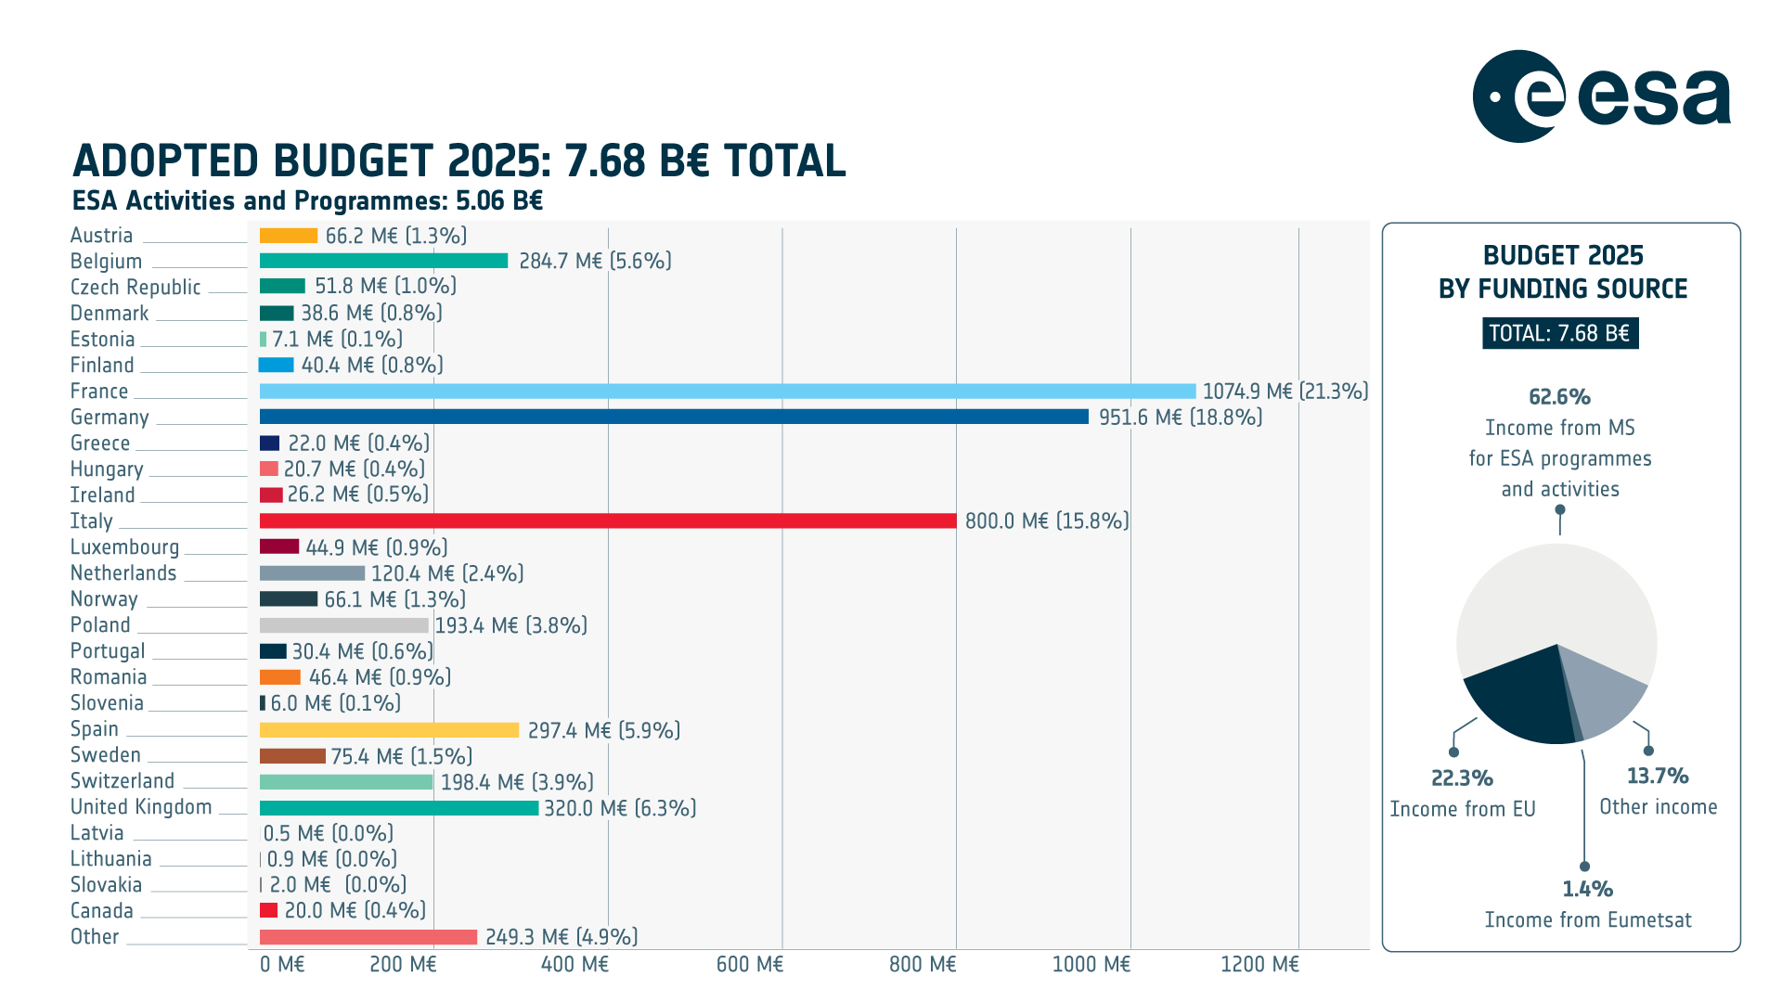

Slide 9
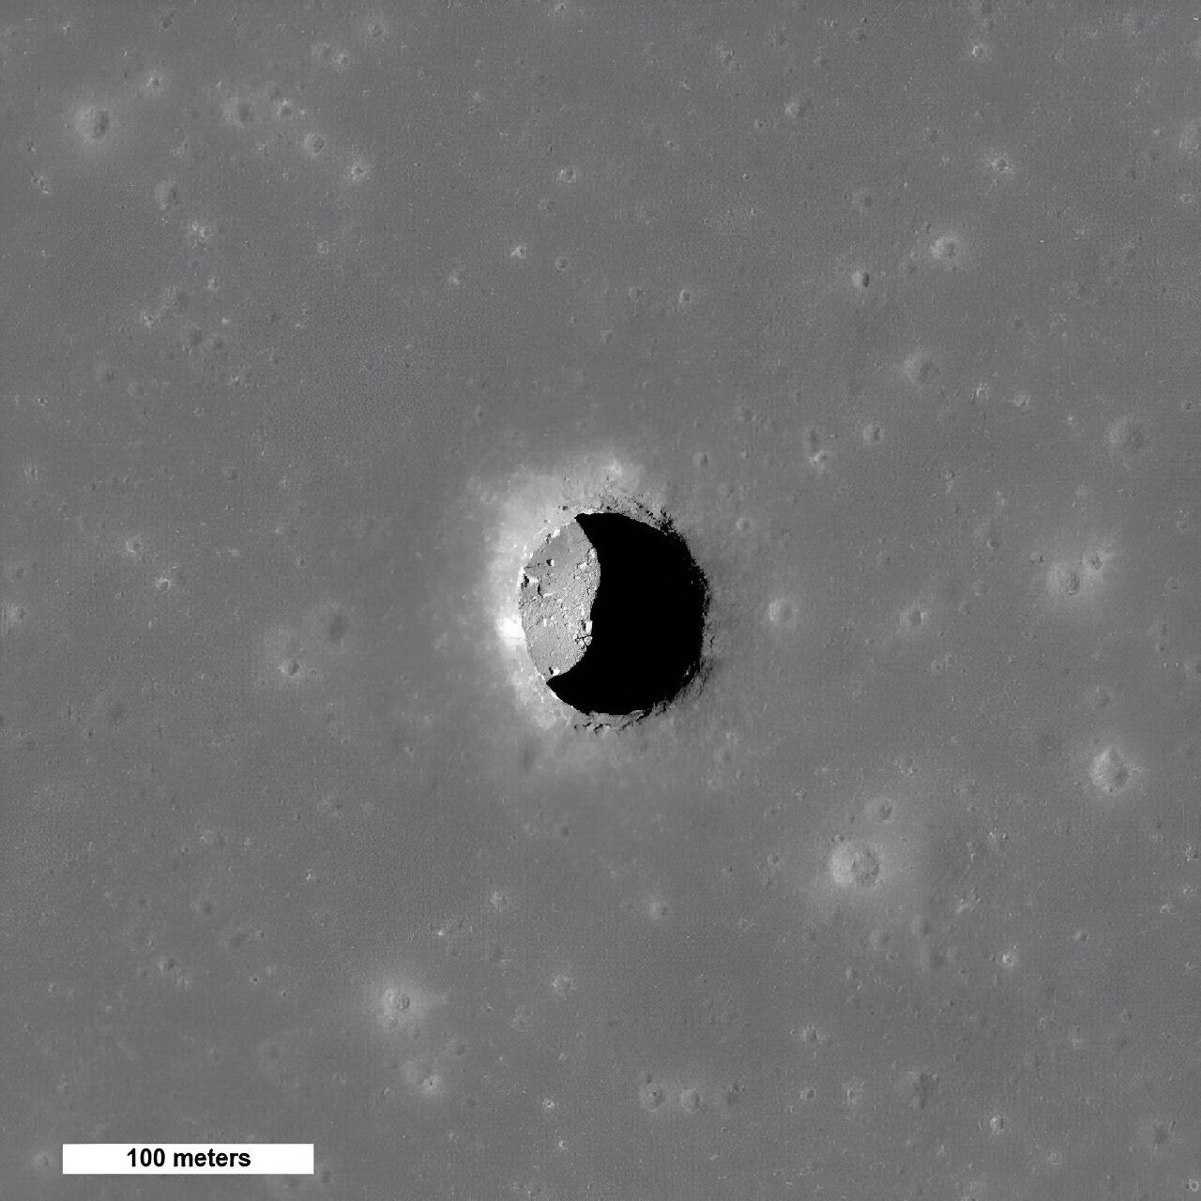
Assumptions
An accessible lava tube exists that is stable enough to host a lunar habitat.
Sufficient energy can be generated
Necessary resources not available on the Moon can be transported from Earth.
Manufacturing process is assumed to be optimized and functional under lunar conditions.
No budget or time constraints for the construction process

Slide 10
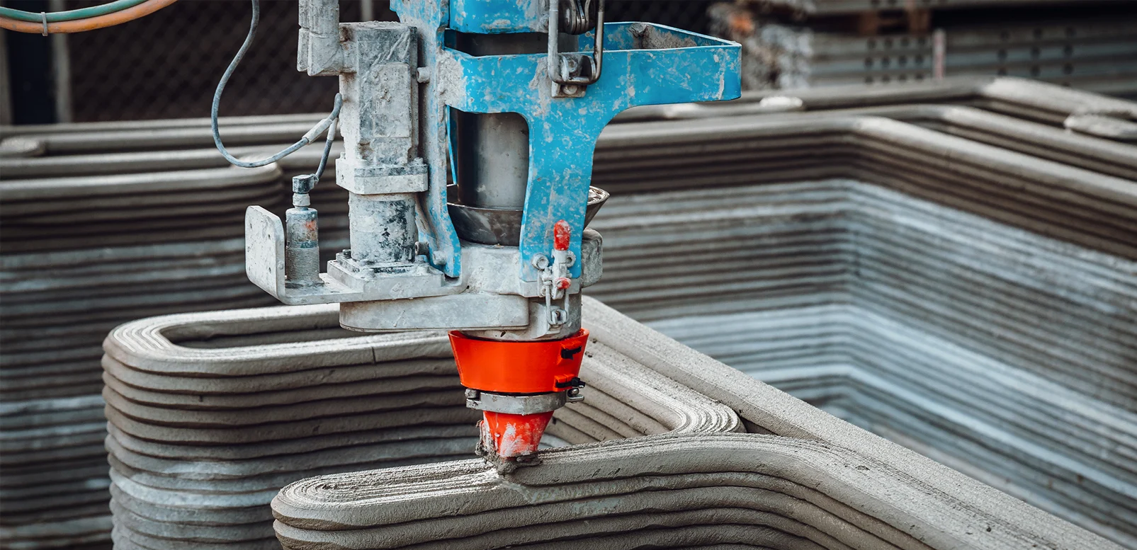
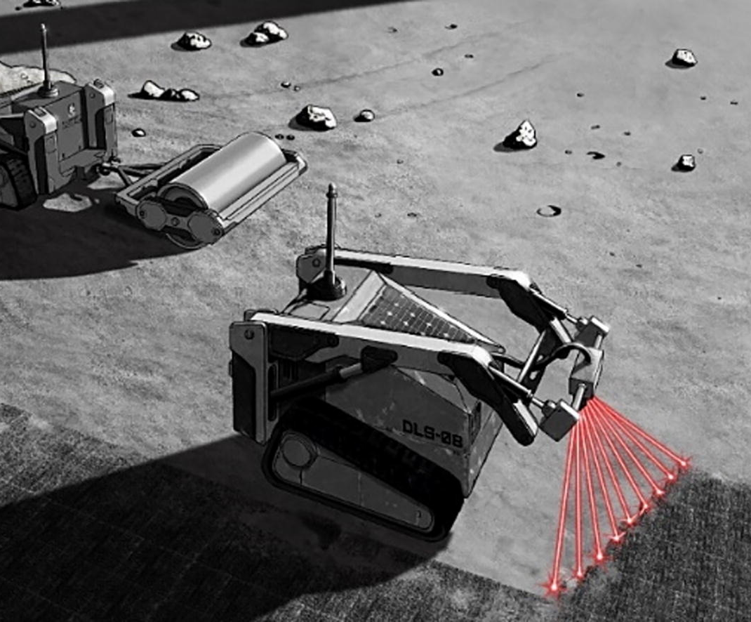
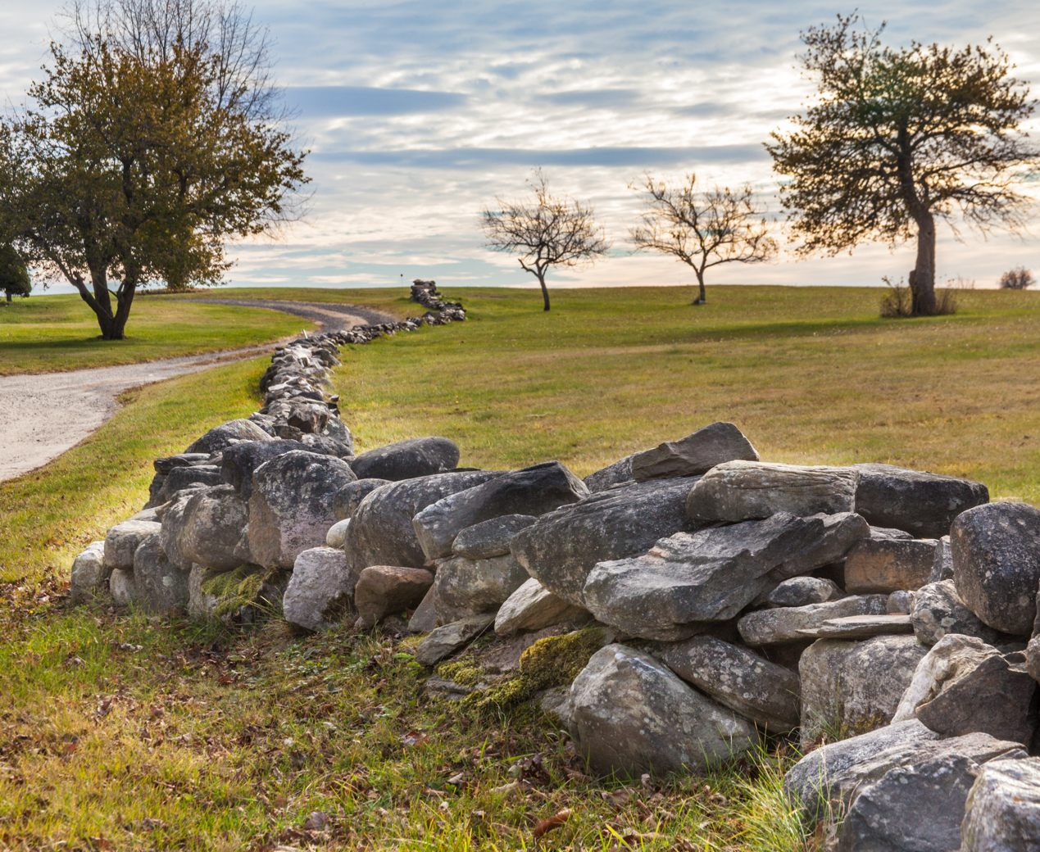
Approach
3 ISRU-based approaches
Concrete extrusion 3D-printing
Selective laser sintering (SLS)
Intelligent use of unprocessed regolith
Goal: design a modular block
Self-supporting structure
Optimized for radiation shielding and robotic production and assembly
Resulting shelter can be scaled in size and number

Slide 11
Research questions
Which additive manufacturing technique is most efficient and feasible for producing these structural elements by leveraging ISRU under lunar conditions?
What block geometry allows for a habitat to be constructed autonomously while at the same time eliminating the need for temporary support during the construction process?
What coordination strategies and operational constraints should a swarm of autonomous robots satisfy to assemble these elements efficiently within the lava tube environment?

Slide 12
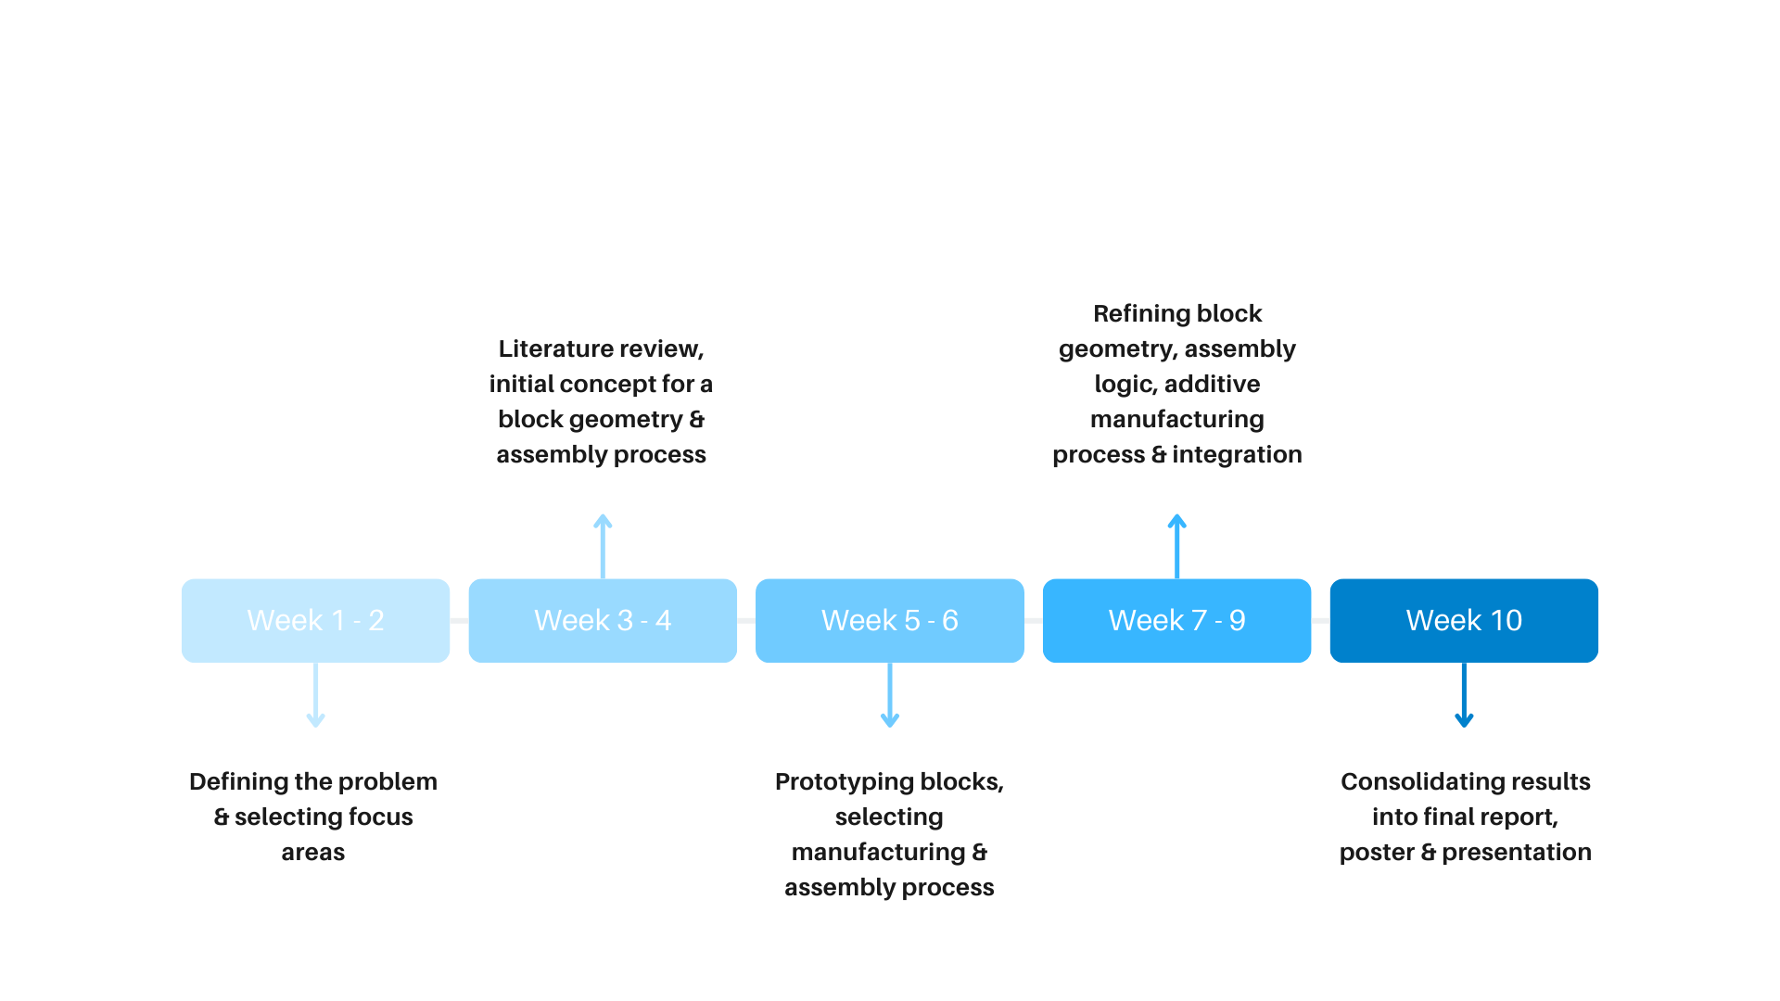
Planning

Slide 13
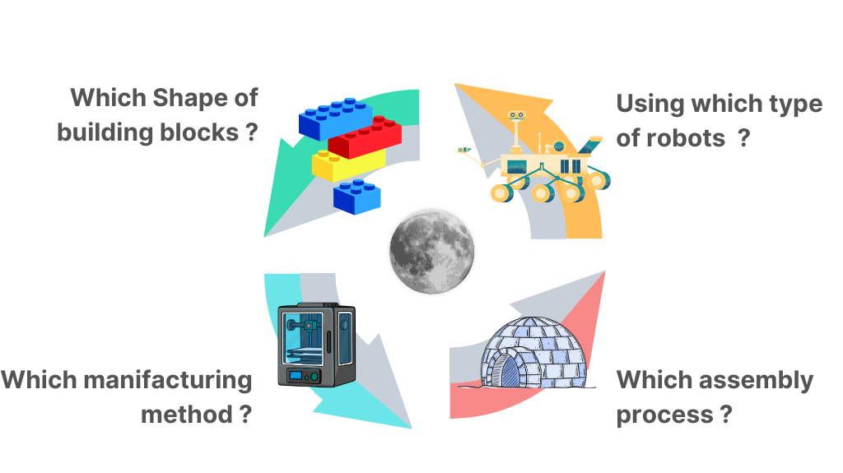
Which shape of building blocks?
Which types of robots?
Which manufacturing method?
Which assembly process?

