Slide 1
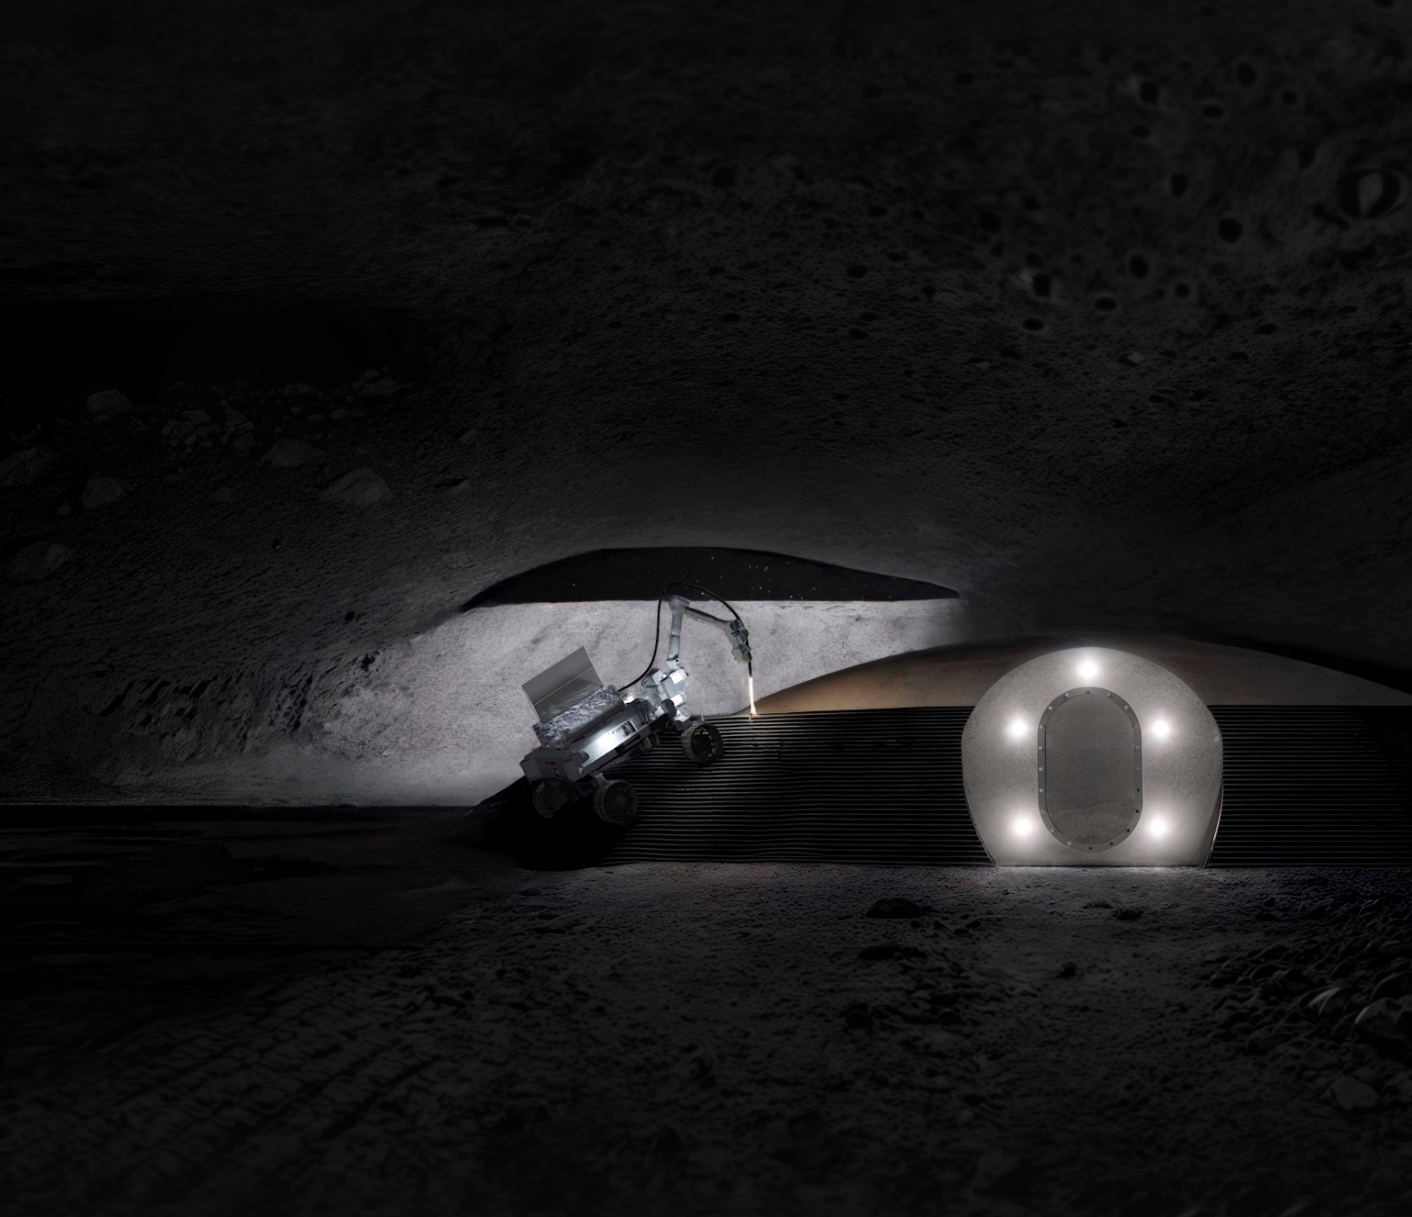
Final Presentation
Back to the Moon
TU Delft Space & Robotic Institutes
JIP 2025 Group 1.13.1
7/11/2025
Simone Guccione - 6171796
Twan Linger - 4869656
Lorenzo Marzolini - 6190561
Manuel Oberhofer - 6564542
Alessandro Vercalli – 6288979
Pieter van der Werf - 5526353
Notes:
Fin on top is emissivity heat exchanger (sending extra heat by the Laser to the walls of the tube 2,6 m^2)

Slide 2
Problem Statement
Return humans
to the moon
WHY?
Scientific research
Notes:
Space agencies and governments want to return humans back to the moon
Shipments to the moon are expensive --> Additives no feasible option
Scientific purpose --> not for bussiness
Infeasible to rely on human labor
Other possibilities if asked are :” Mining, solar farms, Possibility of moving more polluting industries from earth, Refueling post for mars missions and tourism.
Maybe communicate that commercial crewed lunar missions are simply not economically viable yet, and that this venture would not be intended as a commercial service for businesses but instead as a part of a space exploration program such as the Artemis program

Slide 3
Problem Statement
Return humans
to the moon
WHY?
Scientific research
Permanent settlement
Protective habitat
WHAT?
Notes:
Space agencies and governments want to return humans back to the moon
Scientific purpose --> not for business
Why protective habitat → next slide

Slide 4
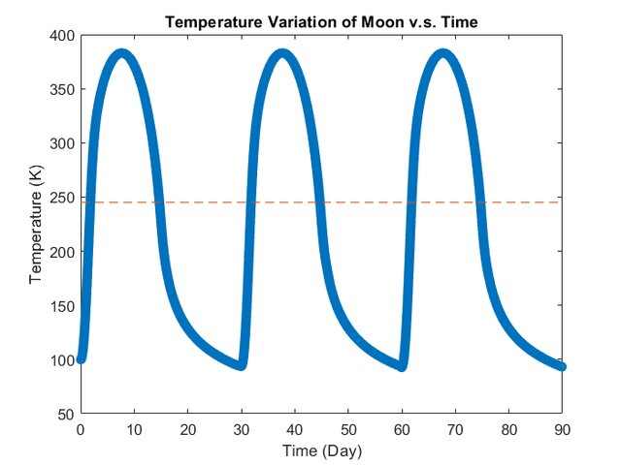
Hazards
Temperature (100 – 375) [K]
Chen, M. et al. (2018). AIAA SPACE Forum, Orlando, FL. DOI: 10.2514/6.2018-5109
Notes:
-170 / +100 celsius across lunar day ( 14 days of light and 14 of darkness) (29.5 earth day == 1 moon day)

Slide 5
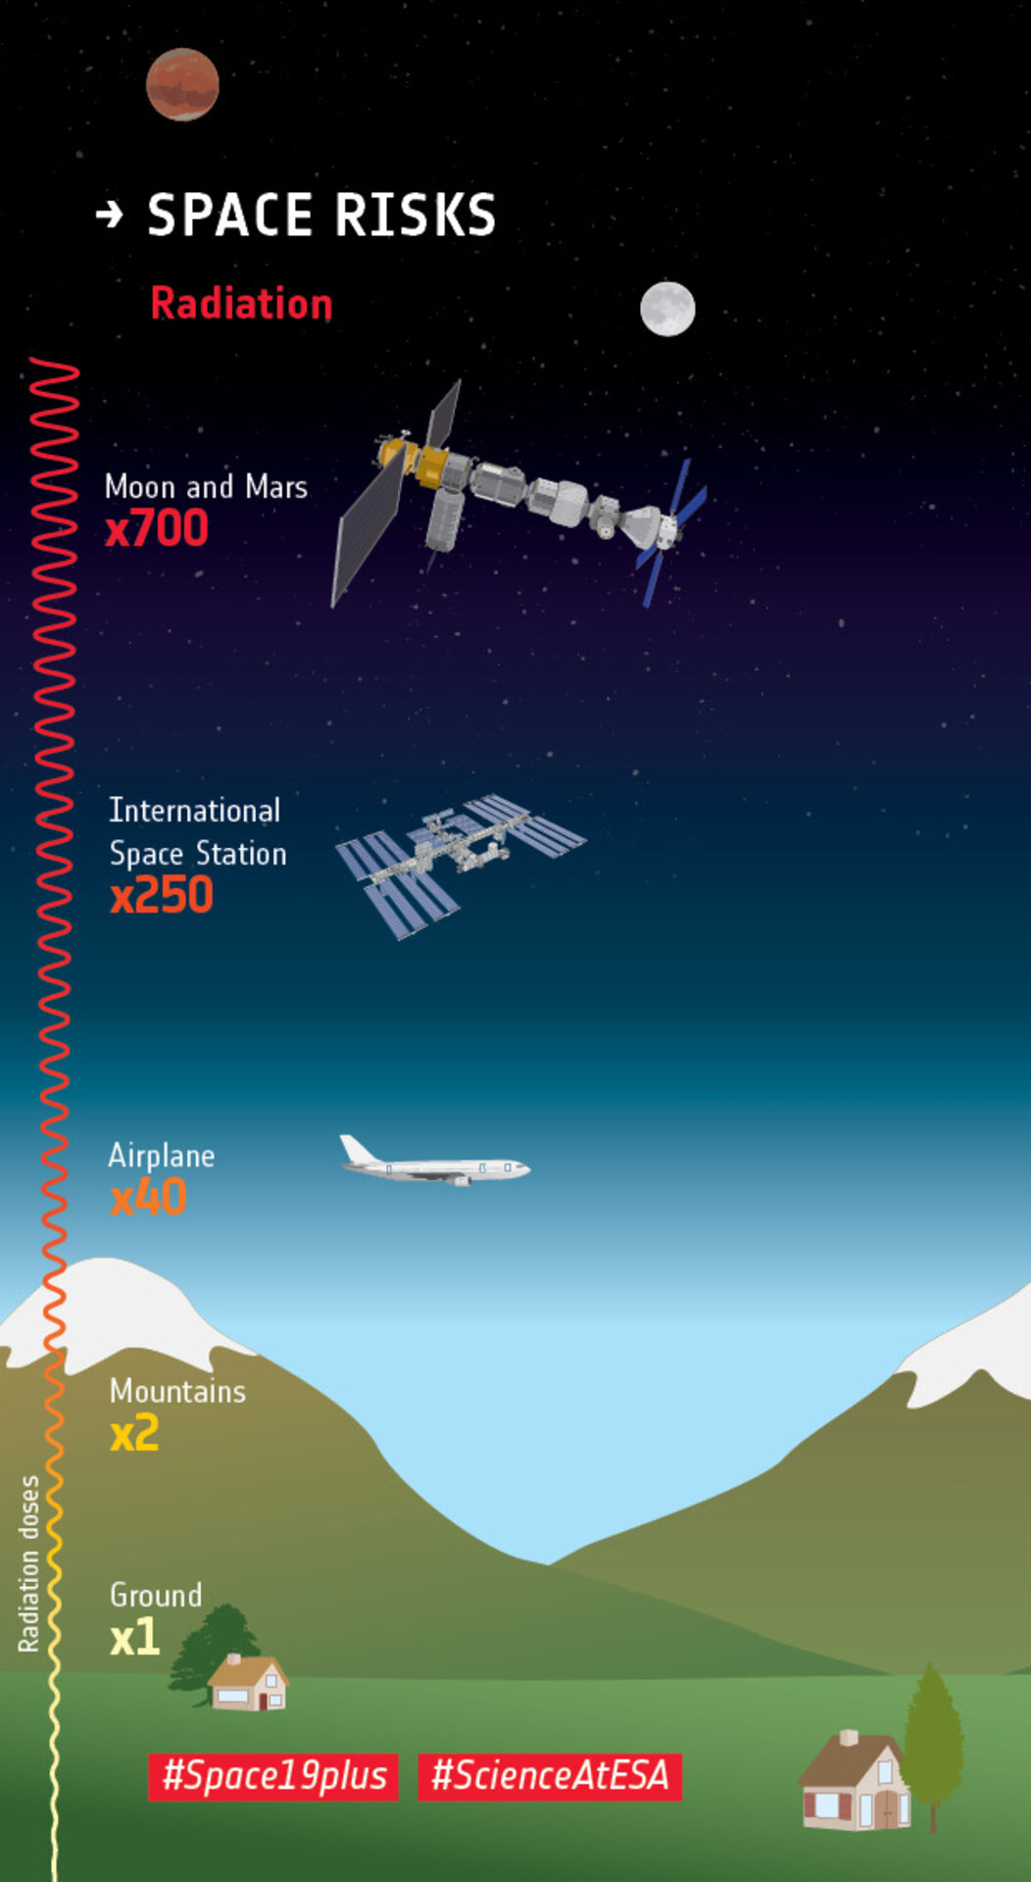
Hazards
Image credits: ESA
Temperature
Radiation (ISS: 190 | Moon: 500 ) [mSv/year]
Astronaut career limit: 600 mSv
Notes:
0.1 mSv = 100 μSv = chest x-ray
Full body CT = 10 mSv
Limits: 600 mSv/career
190mSv/yr ISS
500mSv/yr moon
50 mSv career limit for regular earth worker

Slide 6
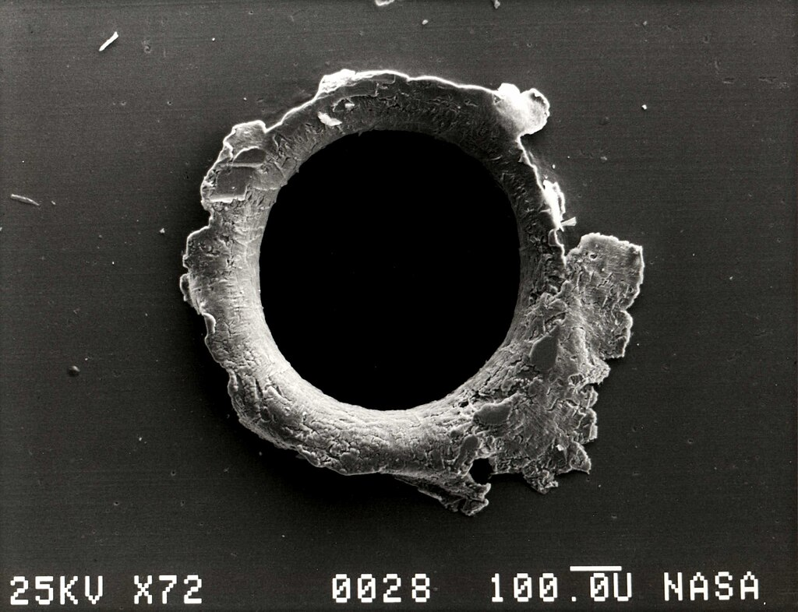
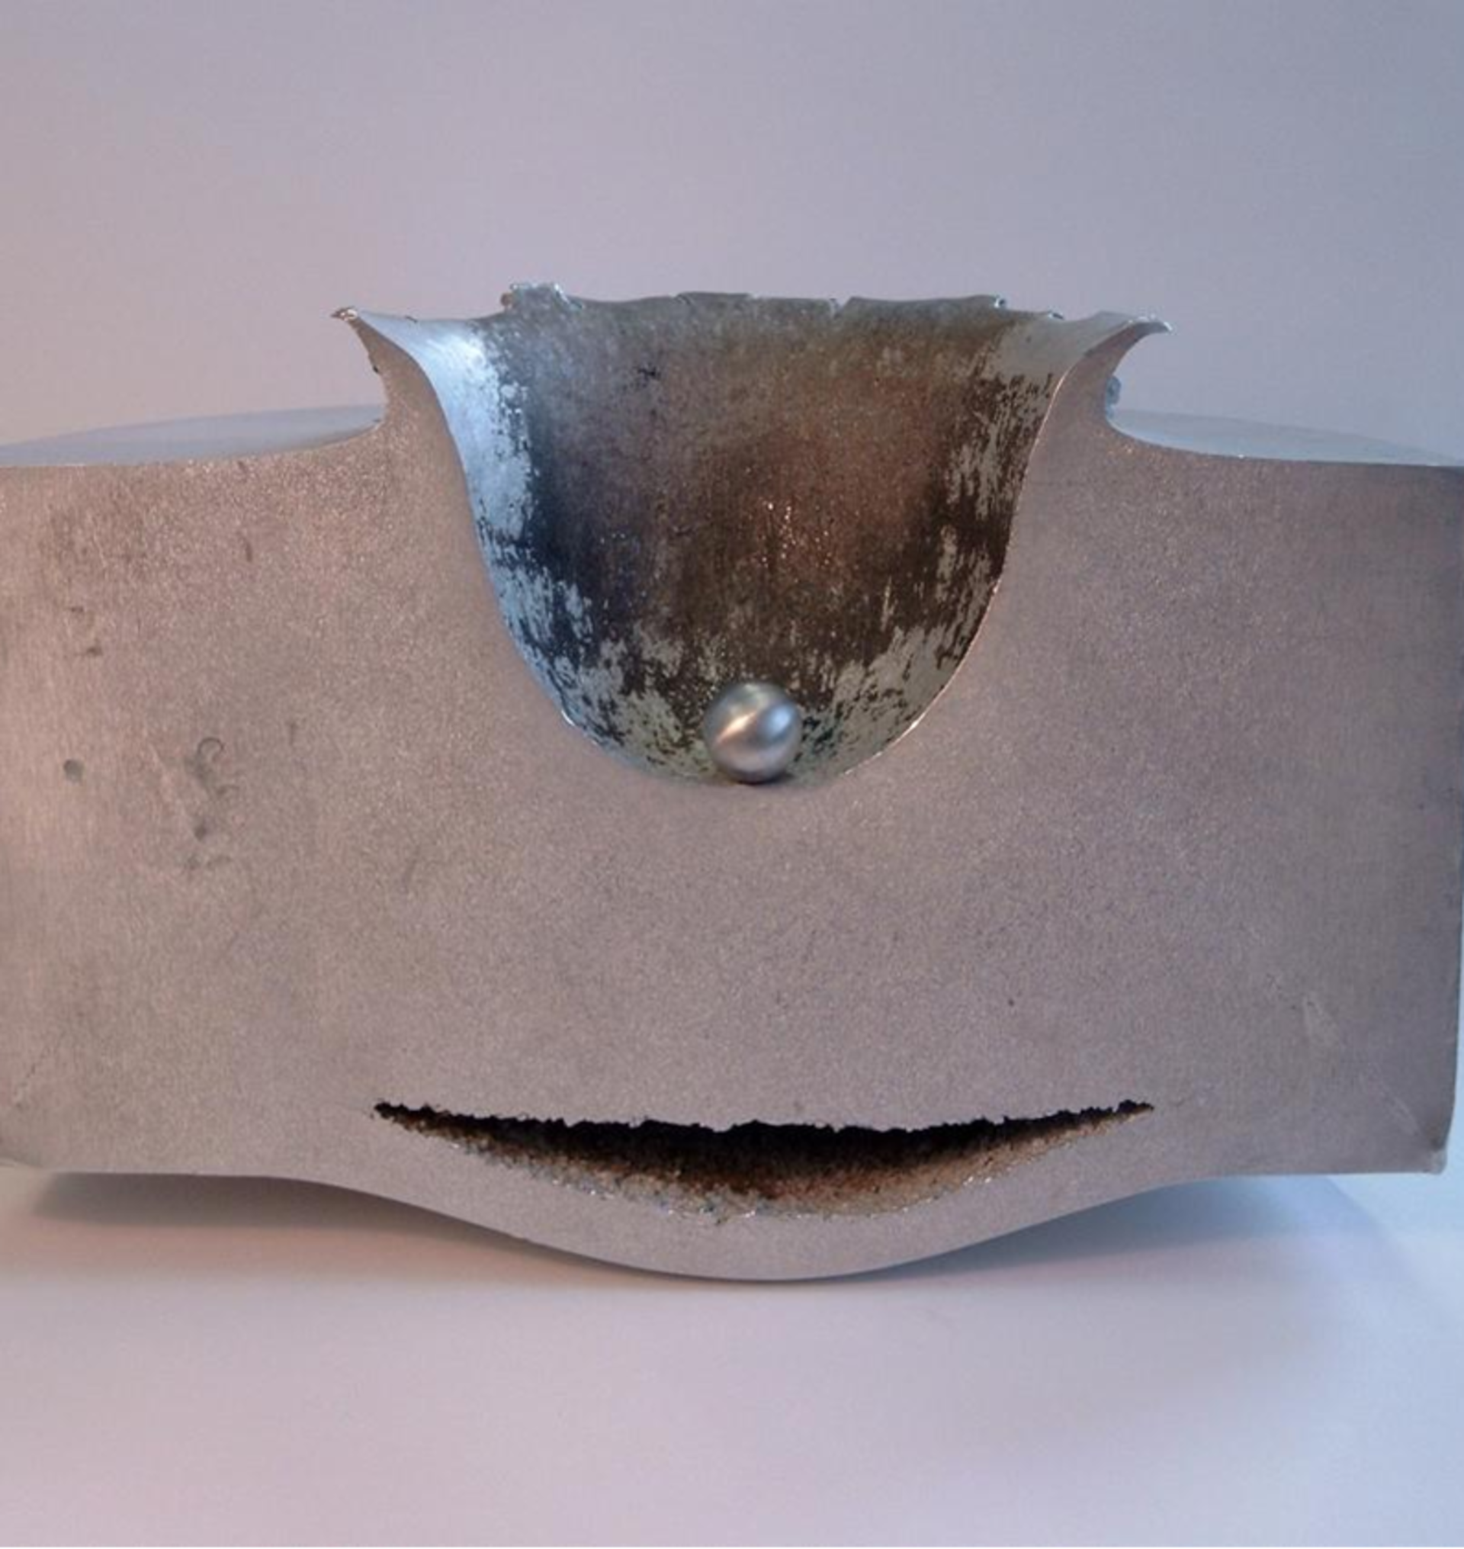
Hazards
Temperature
Radiation
Micrometeorites (15 – 18) [km/s]
Image credits:
SatMagazine (top), ESA (bottom)
Notes:
Top image: Electron micrograph image of an orbital debris hole made in the panel of the Solar Max satellite
This image shows the results of a lab test impact between a small sphere of aluminium travelling at approximately 6.8 kilometres per second and a block of aluminium 8 centimetres thick. This test simulates what can happen when a small space debris object hits a spacecraft.
Velocities up to 20 Km/s.
Size varies but it’s in the ballpark of a speckle of dust.

Slide 7
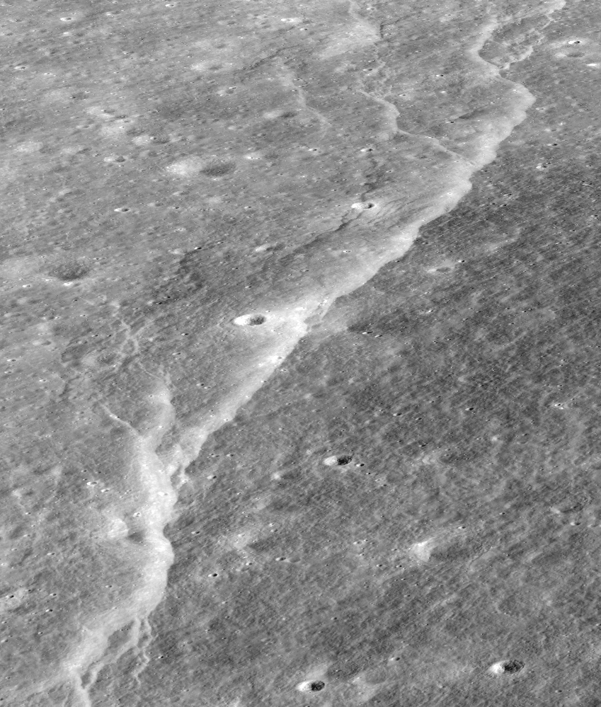
Hazards
Temperature
Radiation
Micrometeorites
Moonquakes (up to 5) [m_{b}]
Image credits to:
NASA/GSFC/Arizona State University
Notes:
Maximum magnitude 5, usually 3.

Slide 8
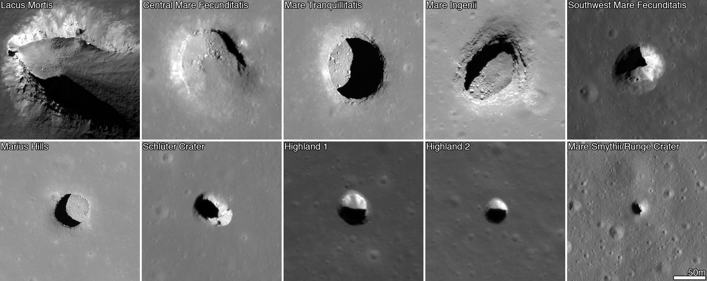
Lava Tubes
Image credits: NASA
Notes:
Researcher have already found that a big part of the solution is to built the habitat inside a lava tube. Here it is already shielded partly against radiation and micro-meteorites. The lava tube also provides a more stable temperature of around –20 degrees.
Lunar lava-tubes have only being analyzed using pictures taken from the sky at different angles, the morphology of the inside space it’s still not certain to this day.
Experiment on Using LiDAR and Robotics to map lava-tunnel has being done on earth.

Slide 9
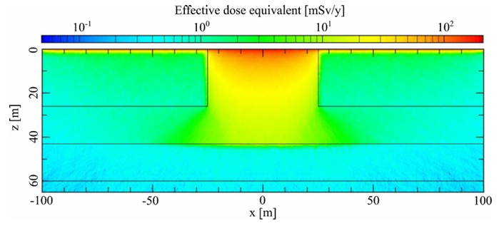
Lava Tubes
Radiation
Masayuki Naito et al 2020 J. Radiol. Prot. 40 947
Notes:
Lava tube naturally protects form meteorites impacts, radiation levels substantially lower.
Image: Spatial distribution of the effective dose equivalent at the vertical hole due to GCR protons during the solar minimum phase.
Image generated trough simulation.

Slide 10
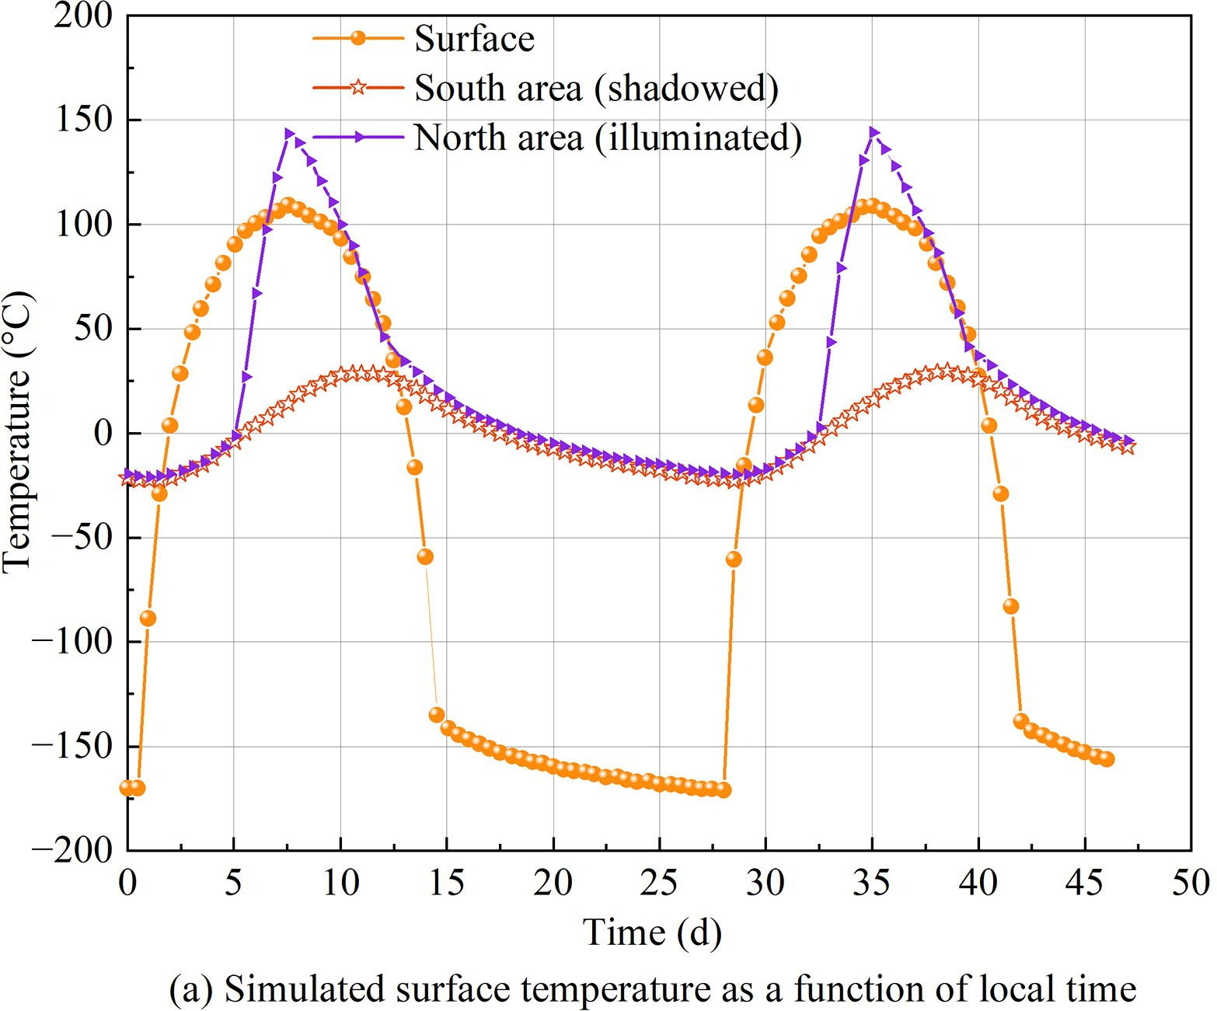
Lava Tubes
Radiation
Thermal environment
Ding, J. et al. (2022). Space: Science & Technology. DOI: 10.34133/2022/9875780
Notes:
Simulation of the inside temperature of a lava tube, shadowed/illuminated area of the tube

Slide 11
HOW?
High logistical
costs (1000 $/gram)
In-situ resource utilization
Notes:
Shipments to the moon are expensive --> Additives no feasible option
Infeasible to rely on human labor

Slide 12
HOW?
High logistical
costs (1000 $/gram)
In-situ resource utilization
Using manual labor infeasible
Autonomous robotic construction
Notes:
Shipments to the moon are expensive --> Additives no feasible option 1000€/Kg
Infeasible to rely on human labor: need shielding while building

Slide 13
By combining swarm robotics and additive manufacturing of lunar regolith we aim to autonomously construct a protective habitat inside a lava tube to facilitate permanent human presence on the moon.

Slide 14
Additive Manufacturing techniques
Binder-based​ methods | Selective Laser Melting | Selective Laser Sintering
Notes:
Three possible AM solution were considered

Slide 15
Additive Manufacturing techniques
Binder-based​ methods | Selective Laser Melting | Selective Laser Sintering
Terrestrial resources | 100% ISRU | 100% ISRU
Notes:
Bider-based needs a solid percentage of the 306 t of material to be shipped from earth, or in alternative heavy machinery to produce the binders on site (still uncertain process but it is being investigated by someone)

Slide 16
Additive Manufacturing techniques
Binder-based​ methods | Selective Laser Melting | Selective Laser Sintering
Terrestrial resources | 100% ISRU | 100% ISRU
Continuous operation | Discrete operation | Discrete operation
Notes:
Binder-based by design needs to be continuous due to the solidifying of the materials in the pipes and blockage

Slide 17
Additive Manufacturing techniques
Binder-based​ methods | Selective Laser Melting | Selective Laser Sintering
Terrestrial resources | 100% ISRU | 100% ISRU
Continuous operation | Discrete operation | Discrete operation
- | Melted > 1500 °C; not porous | Very porous
Notes:
SLM material is naturally porous if produced in a vacuum , the problem can be solved by either melting up to 1500 or melting twice as the Laser hannover guy said.

Slide 18
Additive Manufacturing techniques
Binder-based​ methods | Selective Laser Melting | Selective Laser Sintering
Terrestrial resources | 100% ISRU | 100% ISRU
Continuous operation | Discrete operation | Discrete operation
- | Melted > 1500 °C; not porous | Very porous
- | Compressive strenght > 90 [MPa] | ~ 60 [MPa]
Notes:
As the ESA guy said, you can get better properties with melting.
90 Mpa is better then most concrete making it a good material for construction.

Slide 19
Additive Manufacturing techniques
Binder-based​ methods | Selective Laser Melting | Selective Laser Sintering
Terrestrial resources | 100% ISRU | 100% ISRU
Continuous operation | Discrete operation | Discrete operation
- | Melted > 1500 °C; not porous | Very porous
- | Compressive strenght > 90 [MPa] | ~ 60 [MPa]
- | High energy; 1,5 kW | -
Notes:
Higher energy use then sistering.

Slide 20
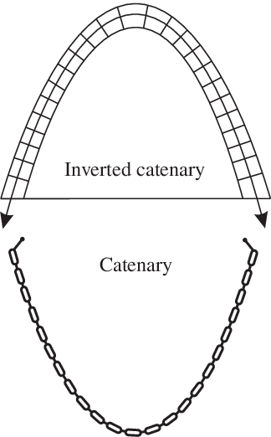
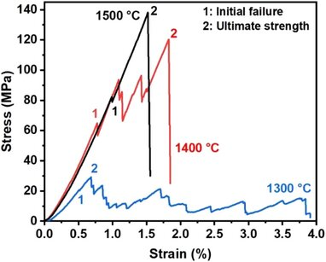
General Requirements
Compressive structure
Guo, Z.-S., Li, M., Xing, D., Liang, C.-G., Hao, B., & Ma, P.-C. (2025). Melting and solidifying behavior of lunar regolith simulant under a vacuum environment. Journal of the American Ceramic Society, 108(8), e20566. DOI: 10.1111/jace.20566
Notes:
Compressive structure --> lunar regolith = good in compression, bad in tension

Slide 21
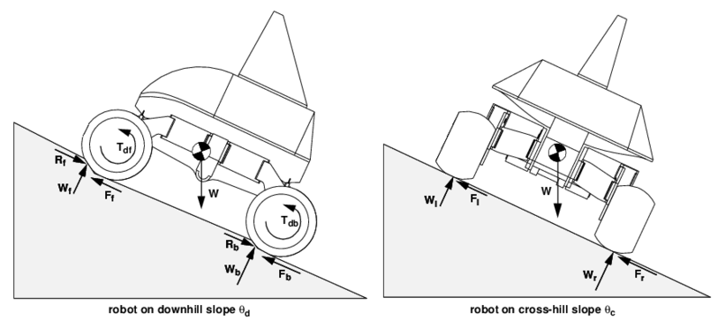
General Requirements
Compressive structure
Allow for robot traversal
Analytical Configuration of Wheeled Robotic Locomotion. Retrieved from: https://www.researchgate.net/publication/2378232_Analytical_Configuration_of_Wheeled_Robotic_Locomotion
Notes:
Compressive structure --> lunar regolith = good in compression, bad in tension
Allow for robot traversal: Shallow walls OR ramp/stairs
Narrow ramps create a potential bottleneck for the process

Slide 22
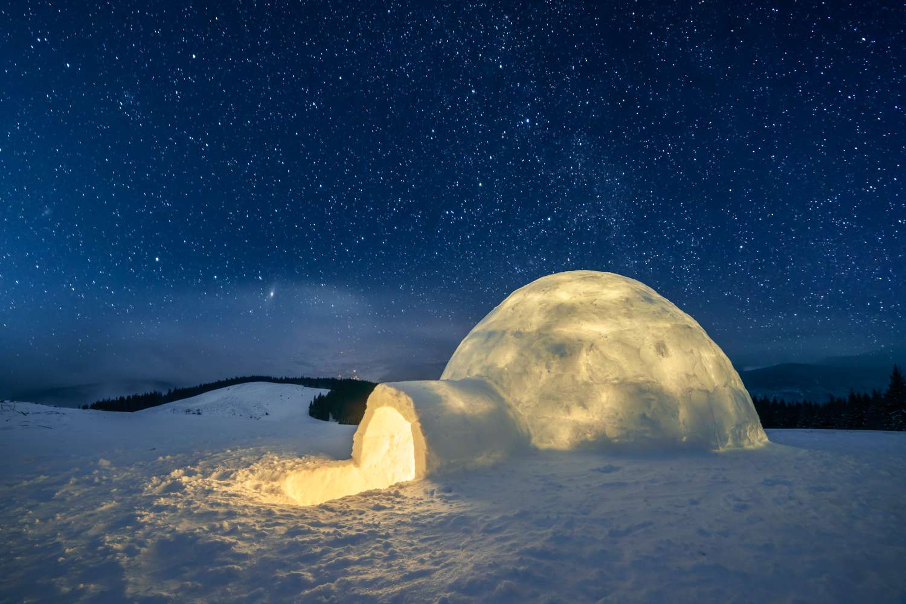
General Requirements
Compressive structure
Allow for robot traversal
Sufficient living space
40 m³ per astronaut
2,3 m height (2/3 total area)
Image credits: Smitt / Getty Images
Notes:
Compressive structure --> lunar regolith = good in compression, bad in tension
Allow for robot traversal: Ramps or shallow walls
Sufficient living space: 24 to 70 m^3 per astronaut, 40 is already optimal for the mission

Slide 23
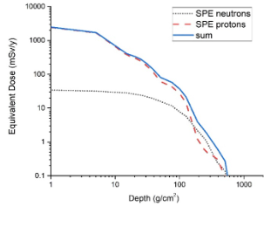
General Requirements
Compressive structure
Allow for robot traversal
Sufficient living space
Shield from radiations
Meurisse, A., Cazzaniga, C., Frost, C., Barnes, A., Makaya, A., & Sperl, M. (2020). Neutron radiation shielding with sintered lunar regolith. Radiation Measurements, 132, 106247. https://doi.org/10.1016/j.radmeas.2020.106247
Notes:
Compressive structure --> lunar regolith = good in compression, bad in tension
Allow for robot traversal: Ramps or shallow walls
Sufficient living space: 24 to 70 m^3 per astronaut, 40 is already optimal for the mission

Slide 24
Radiation Protection
Structure 50 m in
lava tube
Radiation reduced
by 40x
Notes:
Assuming linearity factor of radiation reduction is always 40.
10 mSv/y is pretty strict actually

Slide 25
Radiation Protection
Structure 50 m in
lava tube
10 mSv/year
Radiation reduced
by 40x
Walls: 26 cm
Notes:
Assuming linearity factor of radiation reduction is always 40.
10 mSv/y is pretty strict actually

Slide 26
Radiation Protection
Structure 50 m in
lava tube
10 mSv/year
Safety factor: 2x
Radiation reduced
by 40x
Walls: 26 cm
Walls: 54 cm
Notes:
Assuming linearity factor of radiation reduction is always 40.
10 mSv/y is pretty strict actually

Slide 27
Concepts
Concept 1
Prefabricated
Blocks
Notes:
2 Feasible concepts:
Concept 1: Prefabricating blocks in controlled environment and interlocking this into the final structure
Concept 2: Printing the final structure in place
In both cases:
Maximizing the use of local resources to reduce the logistical costs
Both concepts leverage the use of SLS to allow construction without bringing additives/binders
Membrane first inflated primairly since it is easier, compared to moving in some airtight internal structure after construction
secondarily to support the structure a bit during construction
Speak about the airlock

Slide 28
Concepts
Concept 1
Prefabricated
Blocks
Concept 2
In-Situ
Melting
Notes:
2 Feasible concepts:
Concept 1: Prefabricating blocks in controlled environment and interlocking this into the final structure
Concept 2: Printing the final structure in place
In both cases:
Maximizing the use of local resources to reduce the logistical costs
Both concepts leverage the use of SLS to allow construction without bringing additives/binders
Membrane first inflated primairly since it is easier, compared to moving in some airtight internal structure after construction
secondarily to support the structure a bit during construction
Speak about the airlock

Slide 29
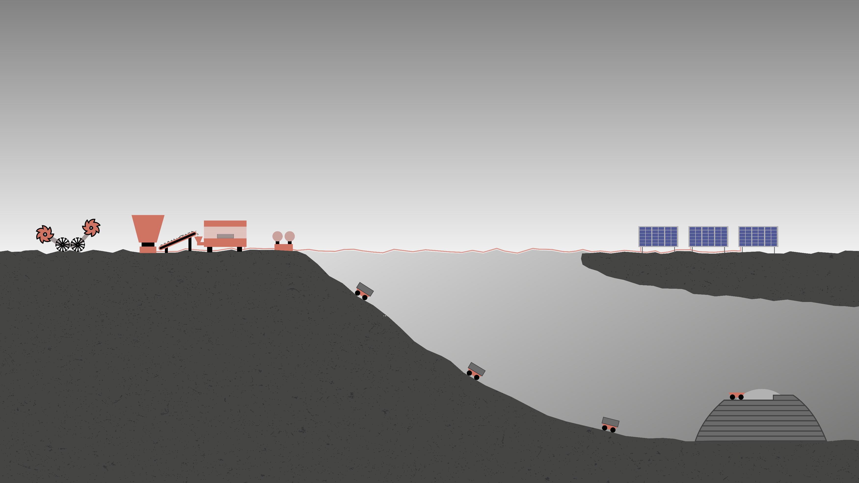
Concept 1: Prefabricated Blocks
Notes:
Manufacturing of blocks on the surface, the printing machine can be inside the landers--> more controlled environment and we don't have to move them since are quite heavy (The earth one can reach 2000kg)
Transport of blocks to the construction site

Slide 30
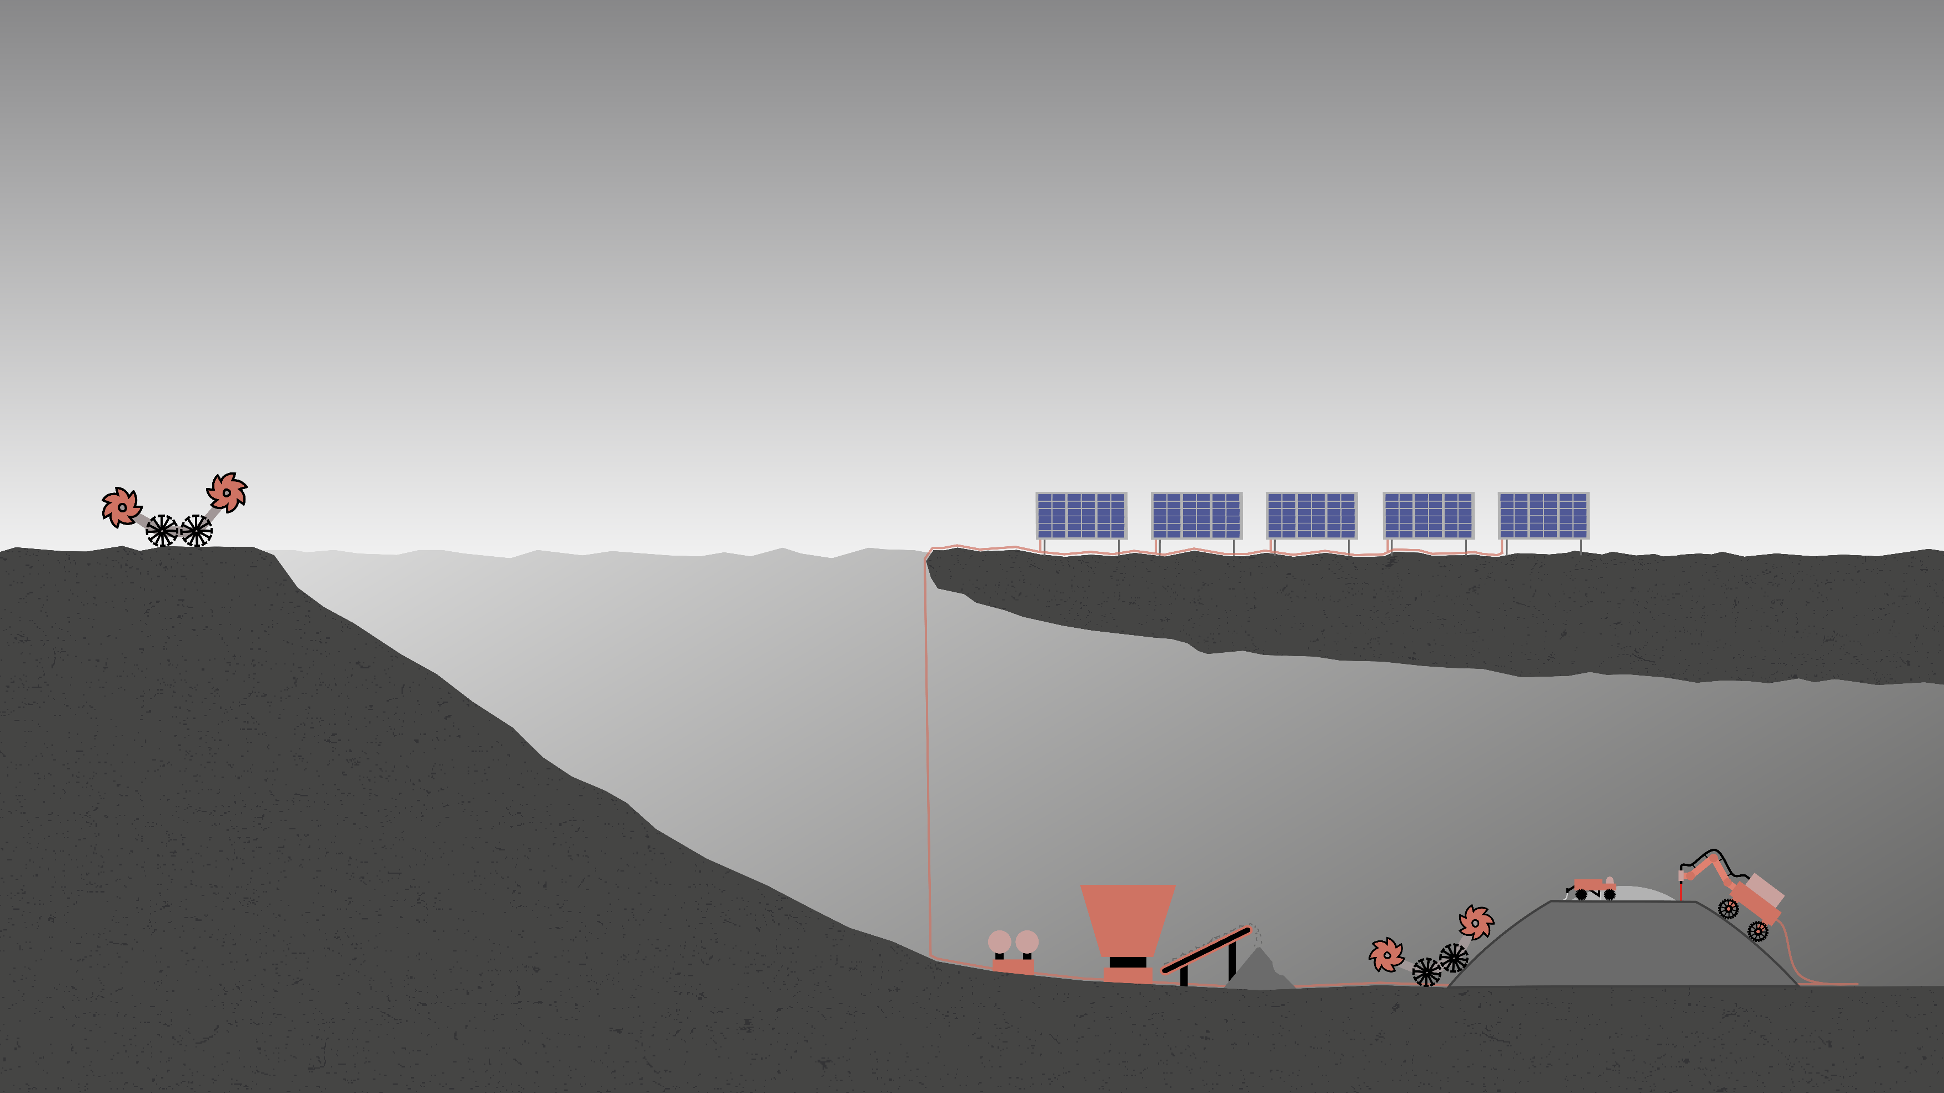
Concept 2: In-Situ Melting
Notes:
Regolith is collected outside the lava tube
Transported into the lava tube where it is then processed

Slide 31
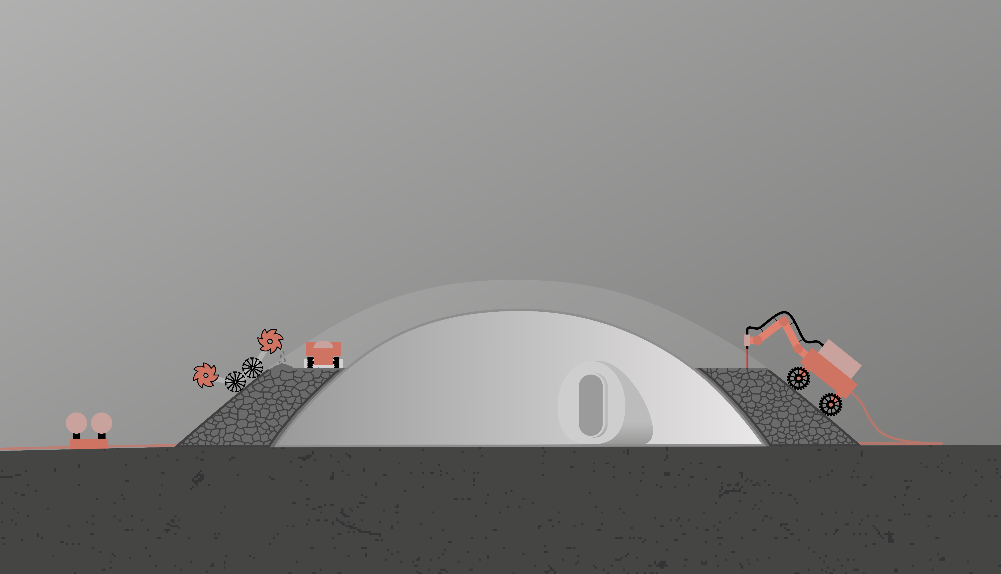
Concept 2: In-Situ Melting
Notes:
Two ways of in situ Melting depending on the thickness of each layer:
Thin layers(≈ 200 µm):
Simultaneous depositing and sintering
Laser(≈ 50W) on the robot
Thick layer(≈ 1 cm)
Depositing at once and then sintering
Fixed laser(≈5kW) reflected with mirrors

Slide 32

Concept 2: In-Situ Melting
Newly deposited layer
Melted regolith
Loose regolith
Notes:
Two ways of in situ sintering depending on the thickness of each layer:
Thin layers(≈ 200 µm):
Simultaneous depositing and sintering
Laser(≈ 50W) on the robot
Thick layer(≈ 1 cm)
Depositing at once and then sintering
Fixed laser(≈5kW) reflected with mirrors
Total construction time will be heavily dependent on the sintering speed of the laser and the total infill of the Voronoi pattern (now assuming 15%)

Slide 33

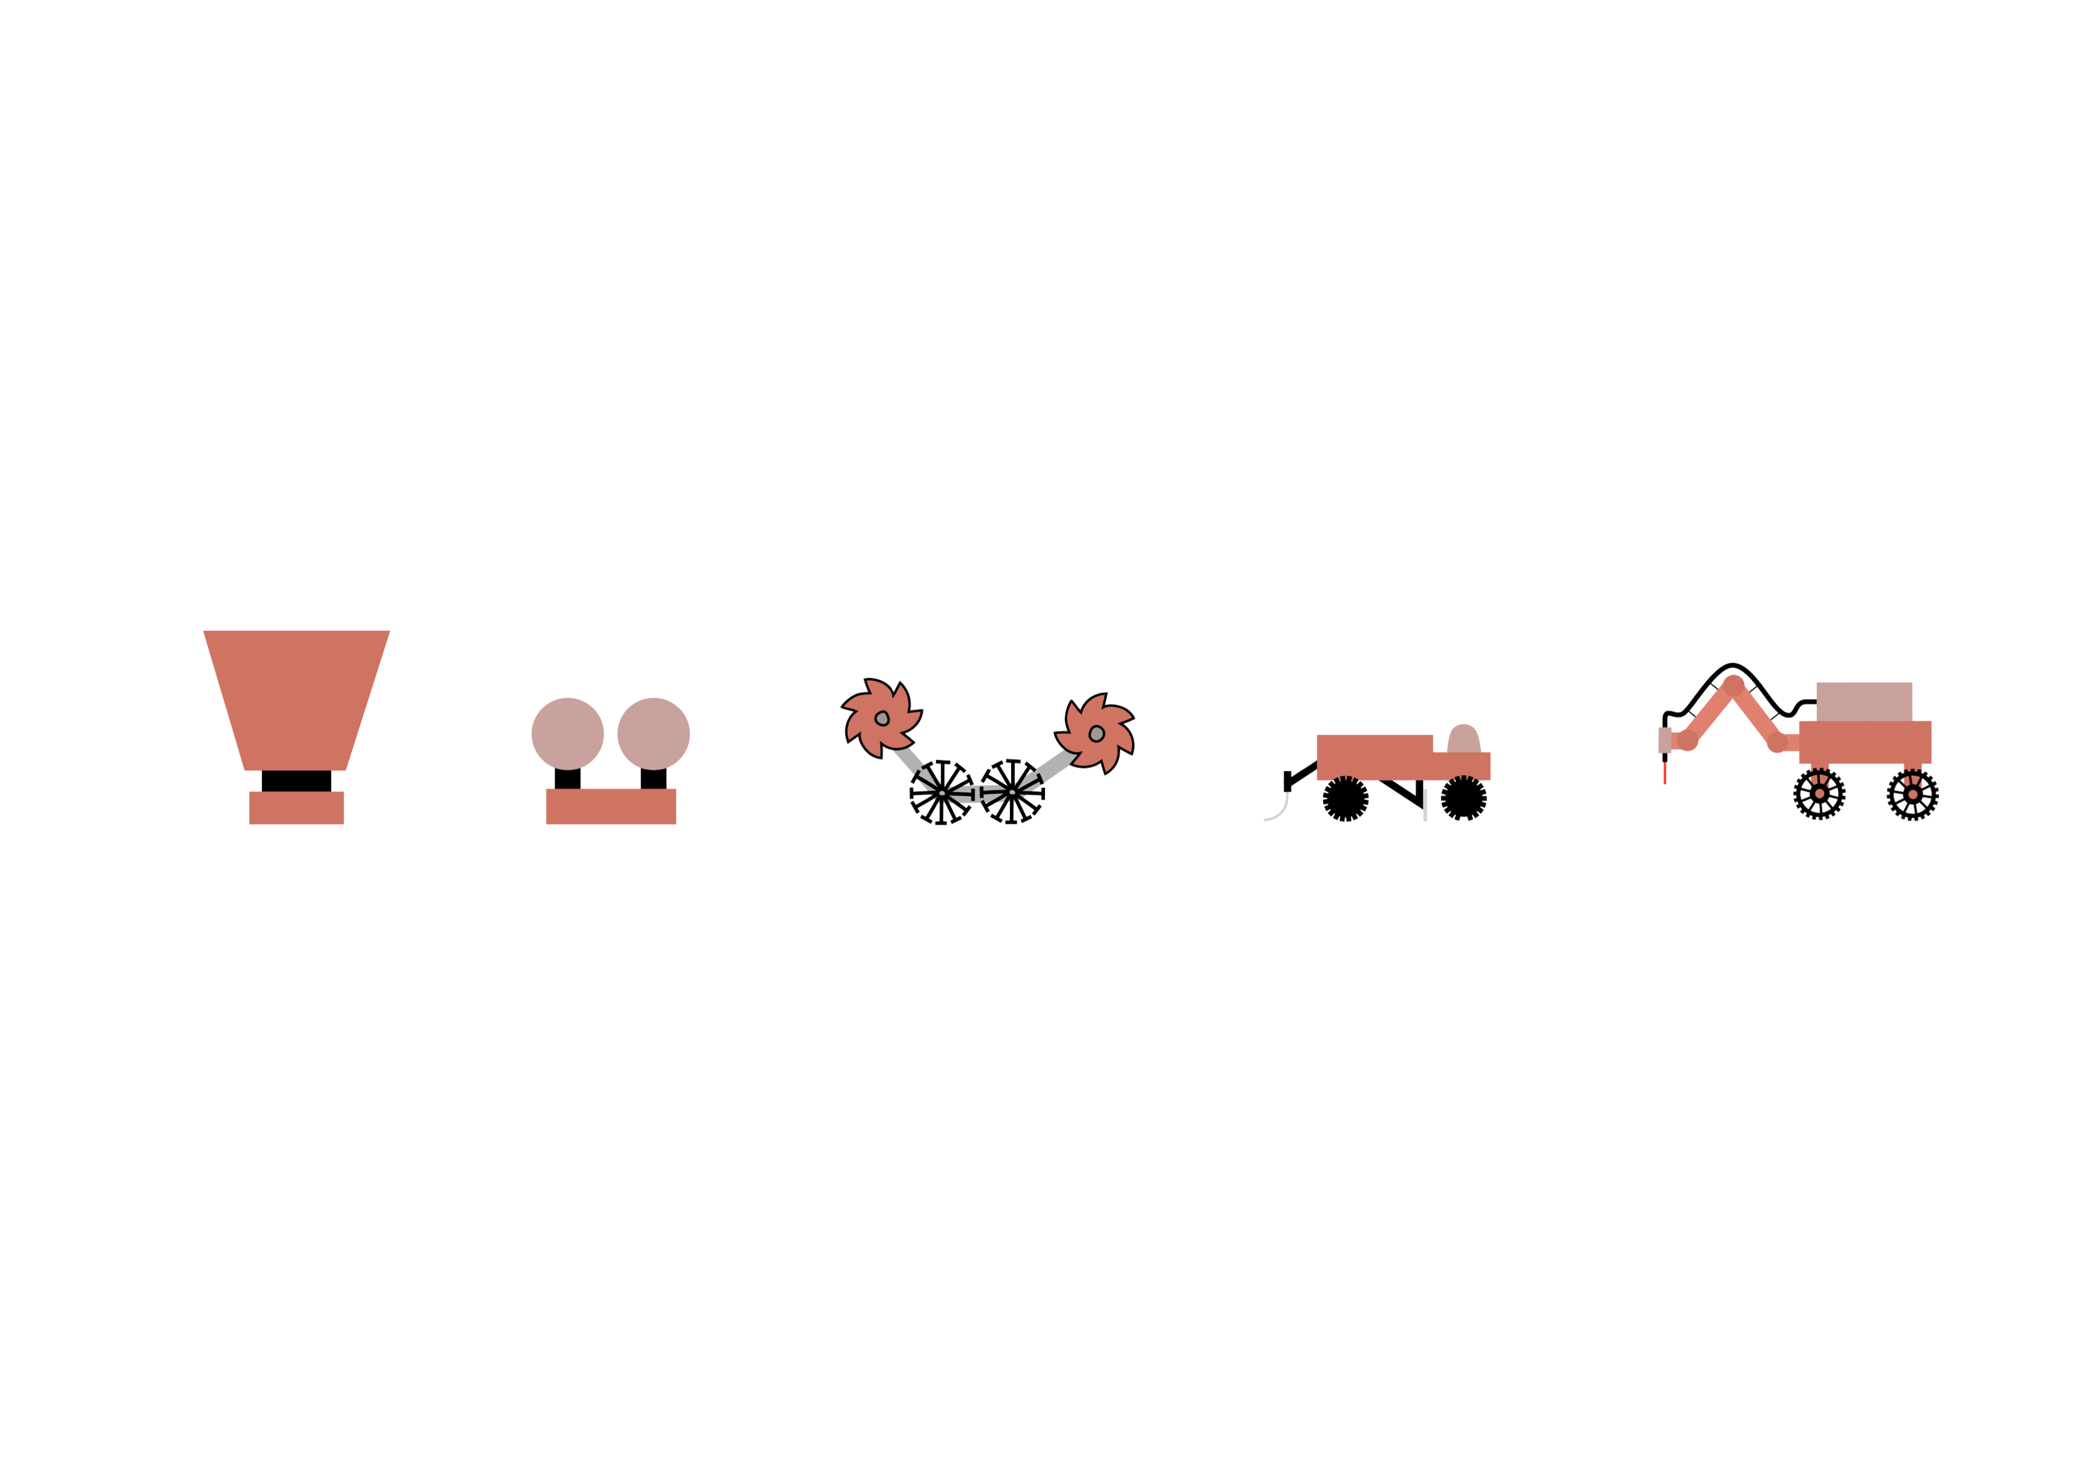

Concept Selection
 | Concept 1 | Concept 2
Technical complexity |  | X
Technological maturity & risk
Adaptability |  | ✓
Reliability & maintenance |  | X
Structural integrity & durability |  | X
Construction time |  | X
Logistical cost |  | X
Notes:
So to conclude: according to our argumentation concept 2 outperforms concept 1 on basically all of the 7 criteria except the technical maturity of the sintering techniques and and additional risks.
Full-scale in-situ laser sintering has never been attempted; while sintering components in a stationary SLS machine is already a recognized industrial process.

Slide 34
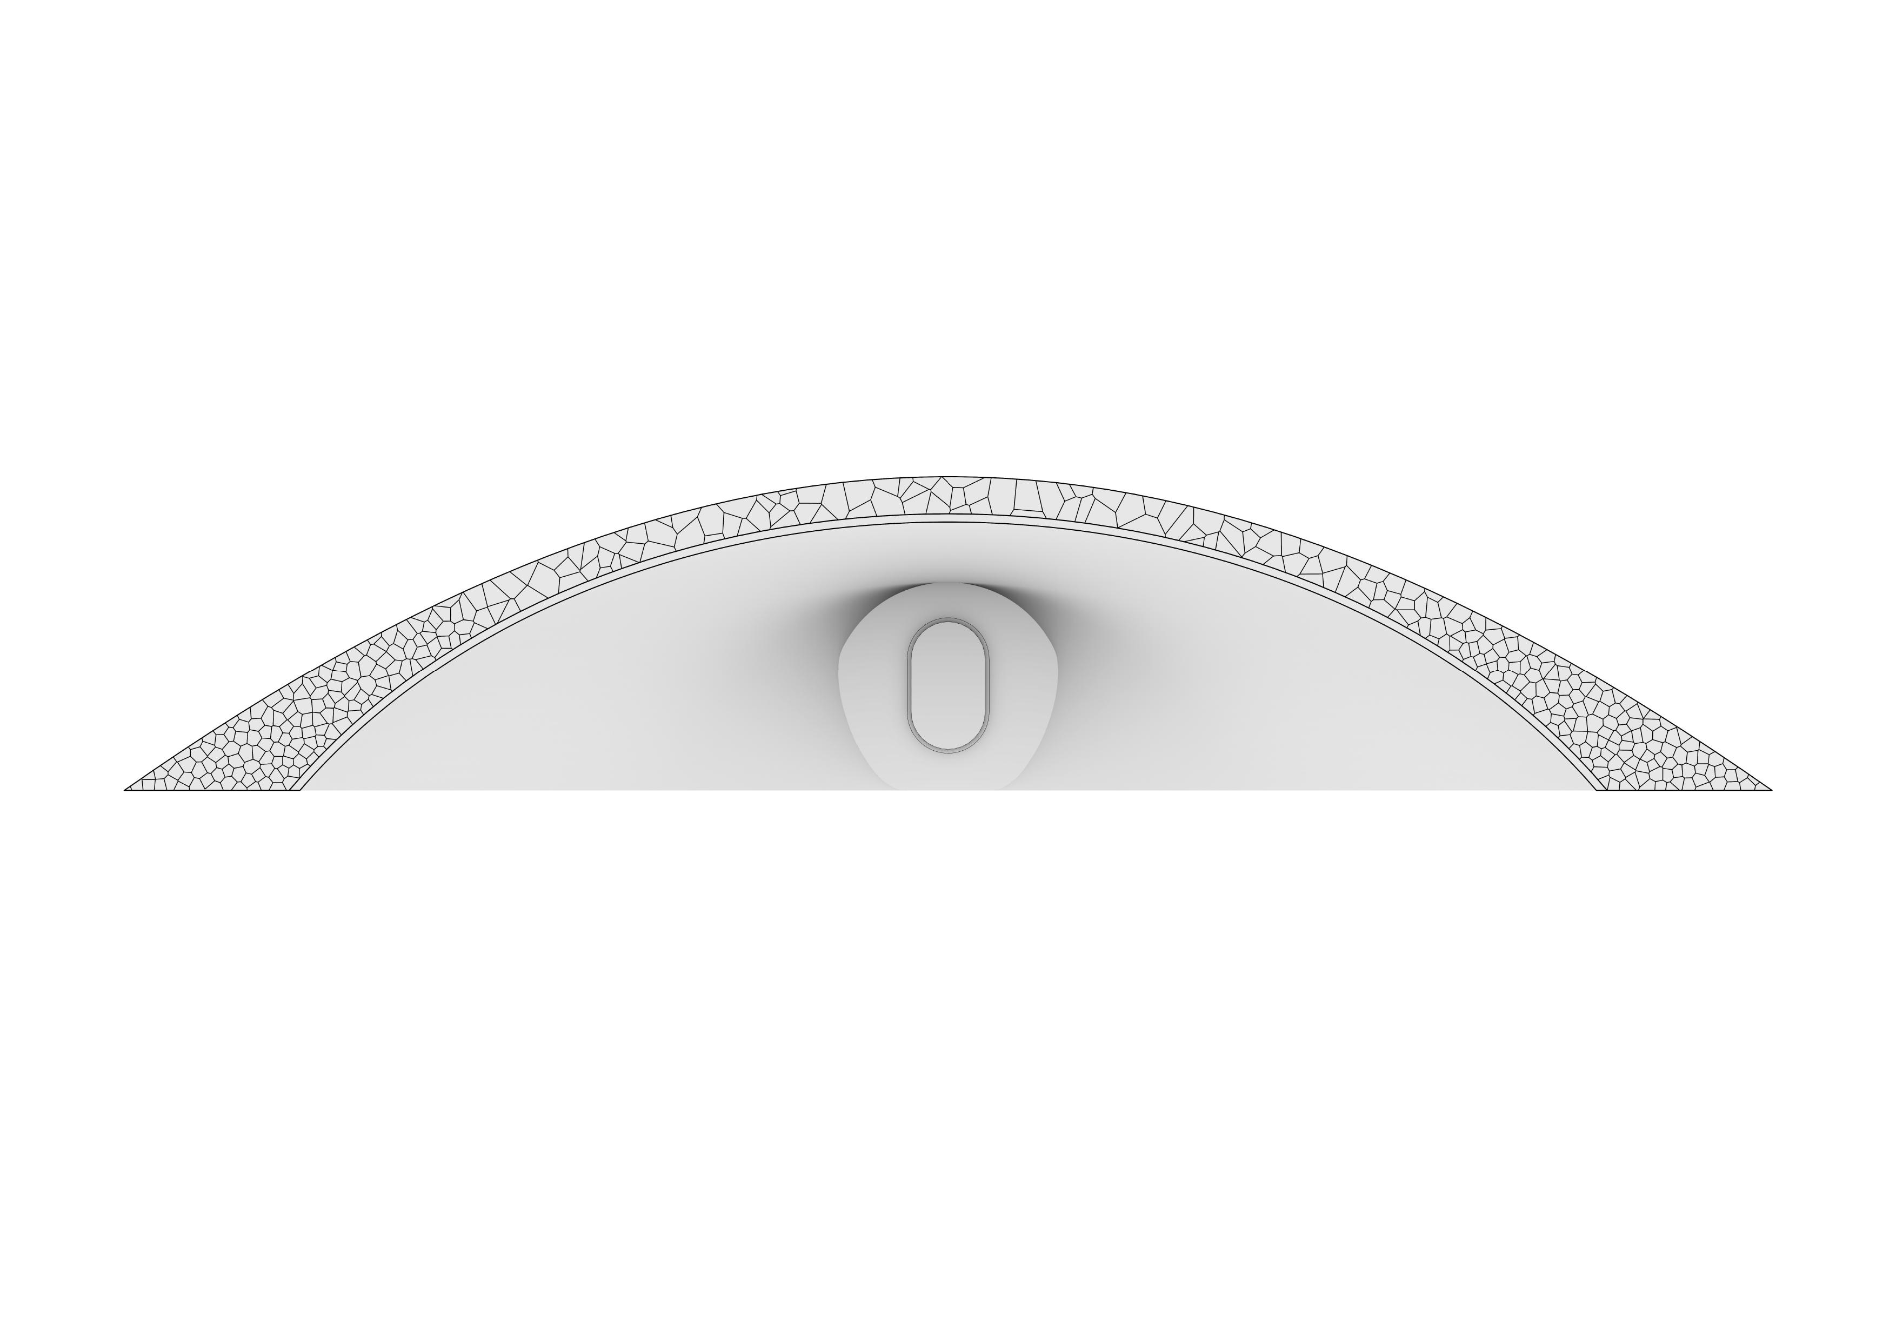
Habitat Shape
3,8 m
20 m

Slide 35
Habitat Shape
3,8 m
20 m
Works in compression
Req 1

Slide 36
Habitat Shape
3,8 m
20 m
Works in compression
Req 1
Maximum slope = 35°
Req 2

Slide 37
Habitat Shape
3,8 m
20 m
Works in compression
Req 1
Maximum slope = 35°
Req 2
Internal habitable
Volume = 120 m³
Req 3

Slide 38
Habitat Shape
3,8 m
20 m
Works in compression
Req 1
Maximum slope = 35°
Req 2
Internal habitable
Volume = 120 m³
Req 3
Minimum wall
Thickness = 54 cm
Req 4

Slide 39
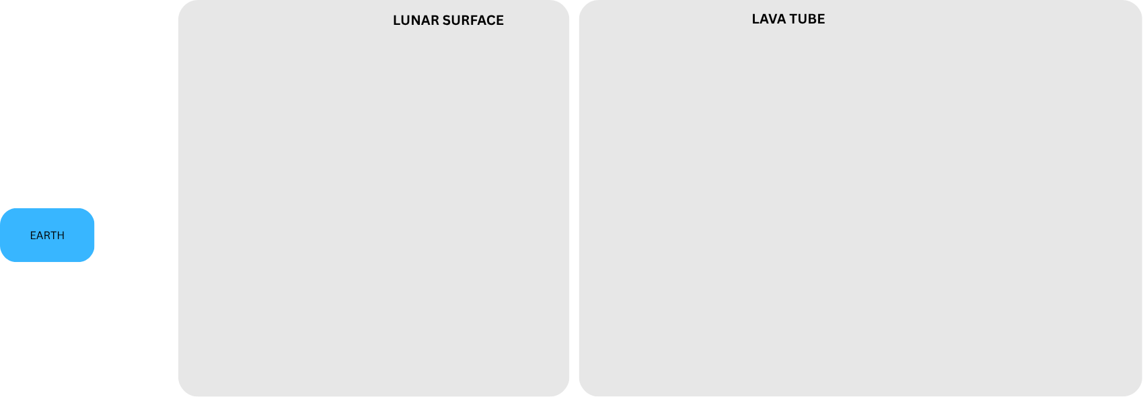

System Overview

Slide 40
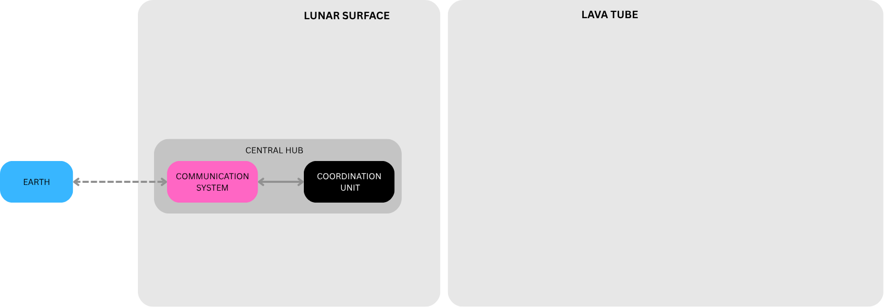
System Overview
Notes:
In the HUB communication with earth is done (1300 ms average latecy) and most of the Math for task planning and robot coordination is done.

Slide 41
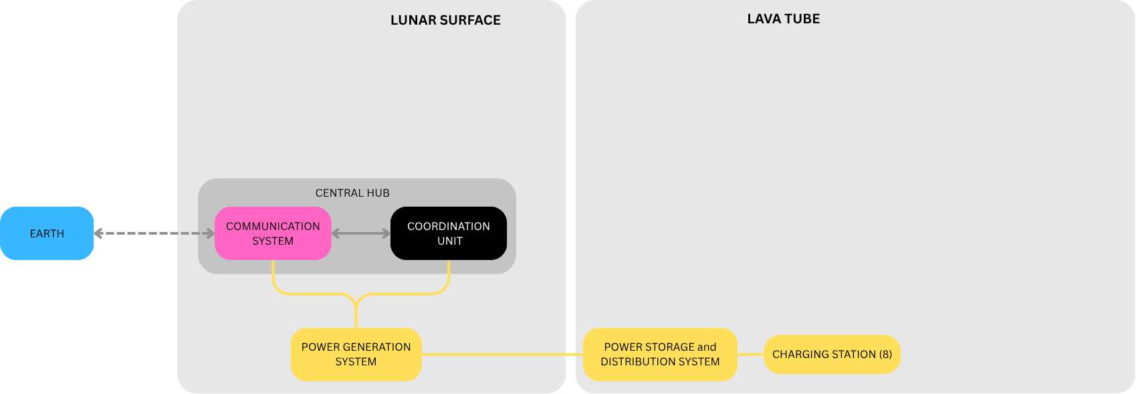
System Overview
Notes:
Power is made on the surface and cables bring it to the various stations.

Slide 42
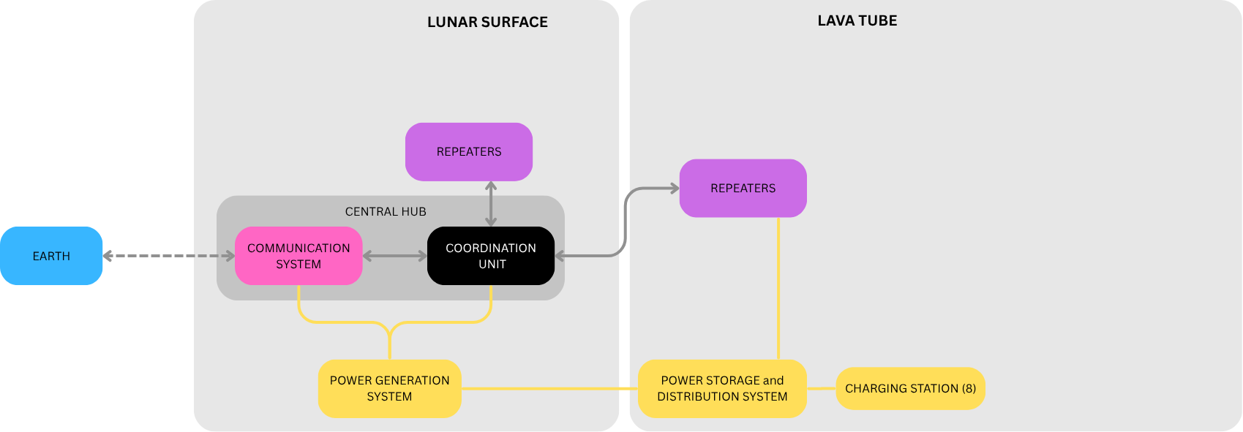
System Overview
Notes:
Repeaters are there to bounce the robot signal between the robots and the HUB.

Slide 43
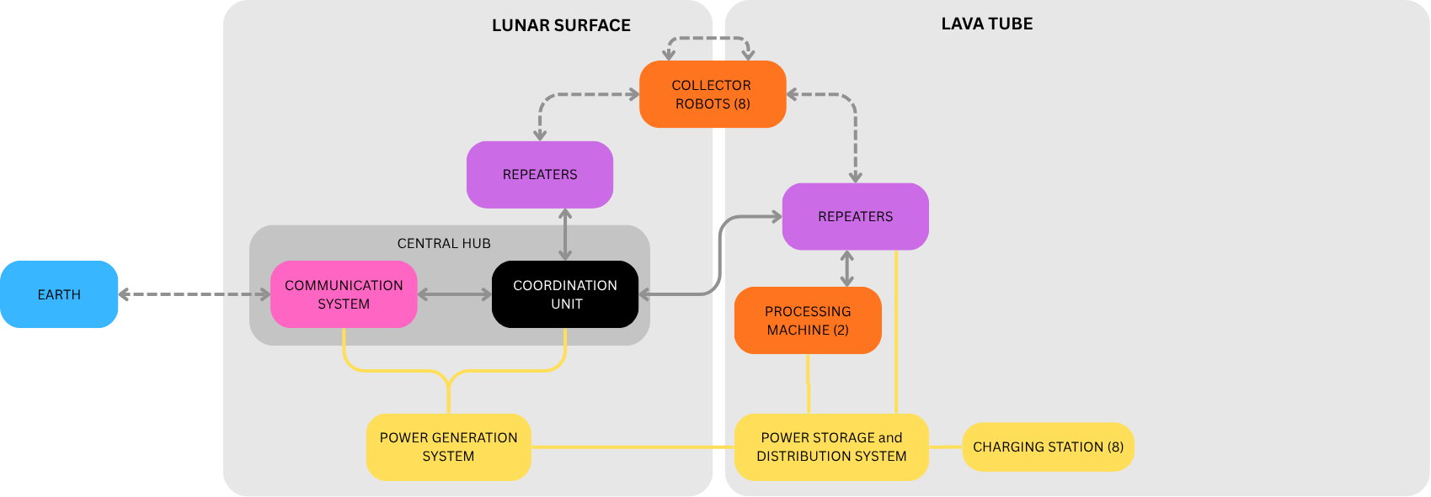
System Overview
Notes:
Collector Robots are 8 and with the assumed distance they are the faster component of the process, needing just around half a year (of continuous op) to collect all material with the tightest availability of 0,8 given the rough working conditions.

Slide 44
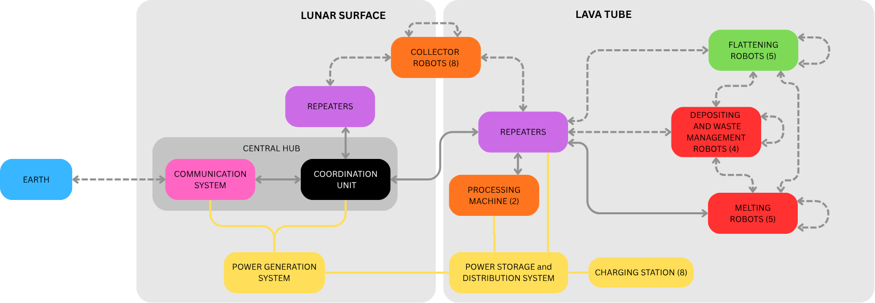
System Overview

Slide 45
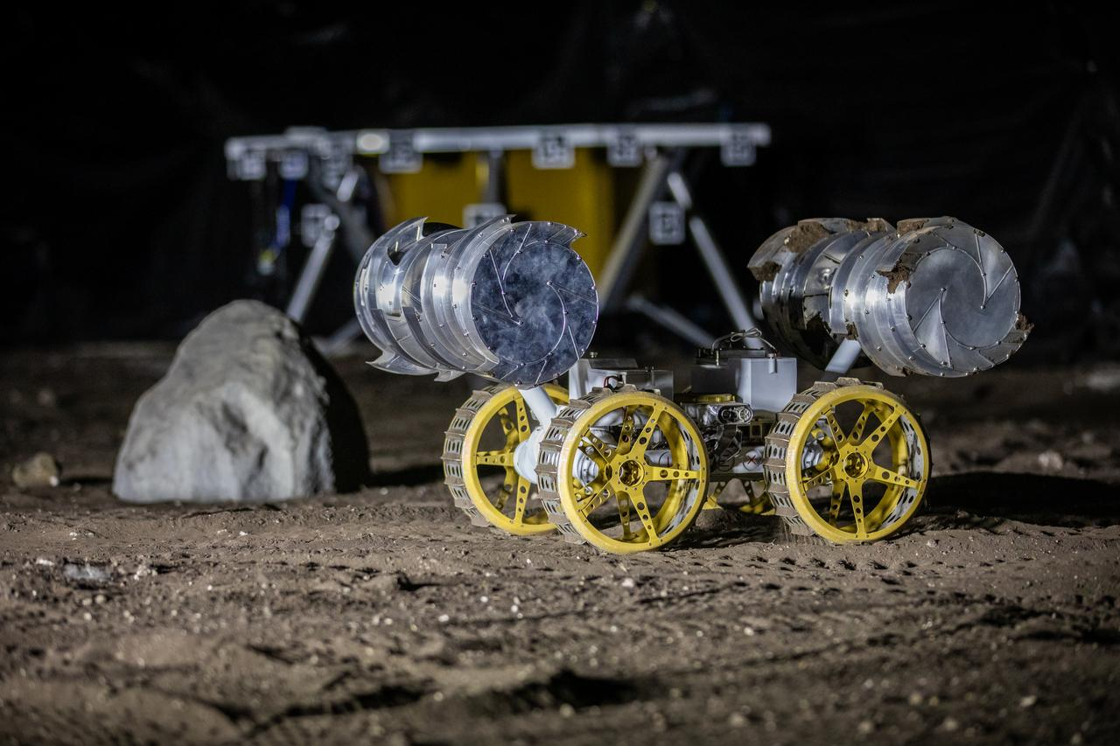
Robot Types & Systems
Collector – depositor – waste management
Number | 12 [-]
Weight | 30 [kg]
Speed | 0,3 [m/s]
Capacity | 30 [kg]
Energy | Battery
Image credits: NASA
Notes:
Charging: 68 min 90 min/charge
PCM heat-sink; Thermal reset: 121 min
Collection rate: 0.15 kg/s
Counter rotating drums

Slide 46
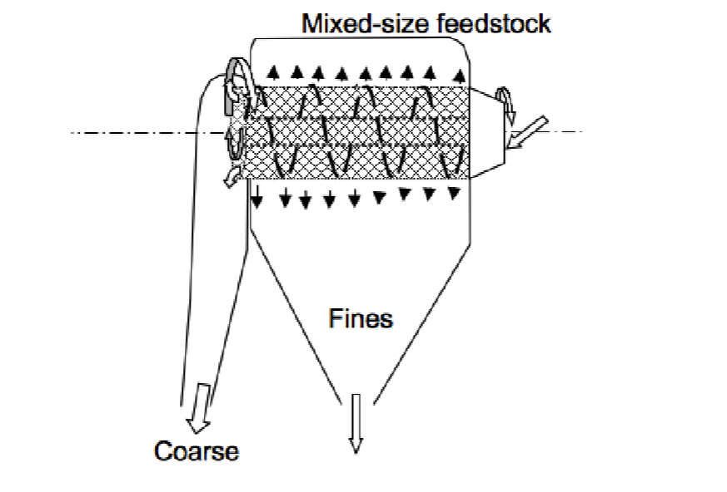
Robot Types & Systems
Processing machine
Number | 2 [-]
Output | 150 [kg]
Input buffer | 750 [kg]
Output buffer | 750 [kg]
Energy | Plugged-in
Dreyer, C. B., Walton, O., & Riedel, E. P. (2012). Centrifugal Sieve for Size-Segregation and Beneficiation of Regolith. Earth and Space 2012, ASCE. DOI: 10.1061/9780784412190.004
Notes:
Sieve incoming regolith and split fine (0–2 mm) vs coarse (waste)
Expected total processed regolith: ~363 t

Slide 47
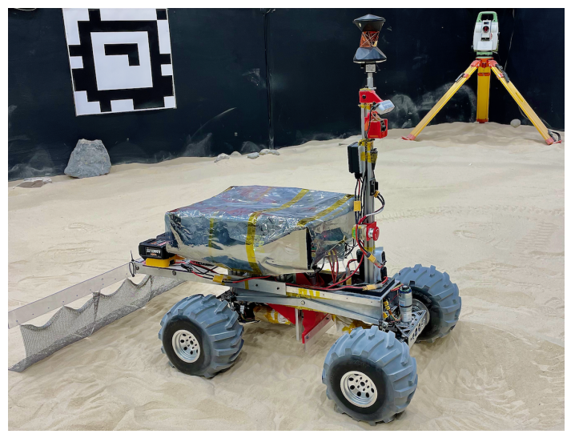
Robot Types & Systems
Flattening Robot
Number | 5 [-]
Weight | 25 [kg]
Capacity | 50 [m²/h]
Energy | Battery
Lee, R., Younes, B., Pletta, A., Harrington, J., Wong, R. Q., & Whittaker, W. R. (2023). CraterGrader: Autonomous robotic terrain manipulation for lunar site preparation and earthmoving. arXiv, abs/2311.01697. URL: https://api.semanticscholar.org/CorpusID:265019081
Notes:
Charging: 45 min 180 min/charge
250 mmgrading blade; Chain-mail drag mat
300 Wh battery

Slide 48
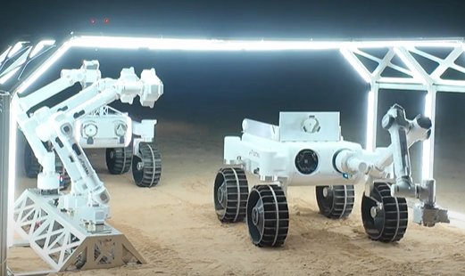
Robot Types & Systems
Melting Robot
Number | 5 [-]
Weight | 330 [kg]
Printing speed | 1,725 [L/h]
Energy | Plugged-in
Image credits: GITAI
Notes:
The robot is originally designed to assemble structures, and the arms are interchangeable.
Robot 280 Kg, dimensions (1800 x 1492 x 942,5 mm )(LxWxH)
Robotic arm 50 Kg and has a total length of around 2 m
High emissivity panels 2,6 m2 ops temperature 77 °C

Slide 49
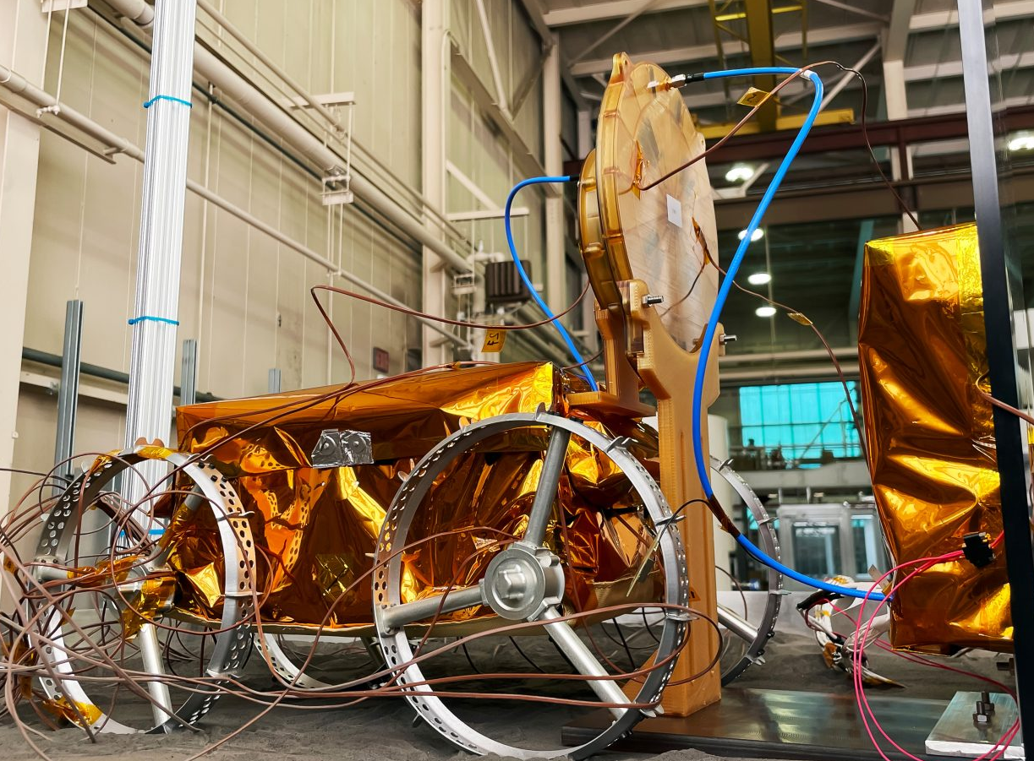
Robot Types & Systems
Charging Station
Number | 8 [-]
Weight | 2,9 [kg]
Capacity | 400 [W]
Energy | Plugged-in
Image credits: Astrobotic
Notes:
85% efficiency (really good, wireless phone chargers are usually 66%)
Number 8 chosen using Queueing theory with a 2,82 min expected waiting time
All wireless robots use this charging infrastructure

Slide 50
Construction Process
Preparation mission
Notes:
Surveying and setting up the necessary infrastructure using the GITAI robots

Slide 51
Construction Process
Preparation mission
Construction mission

Slide 52
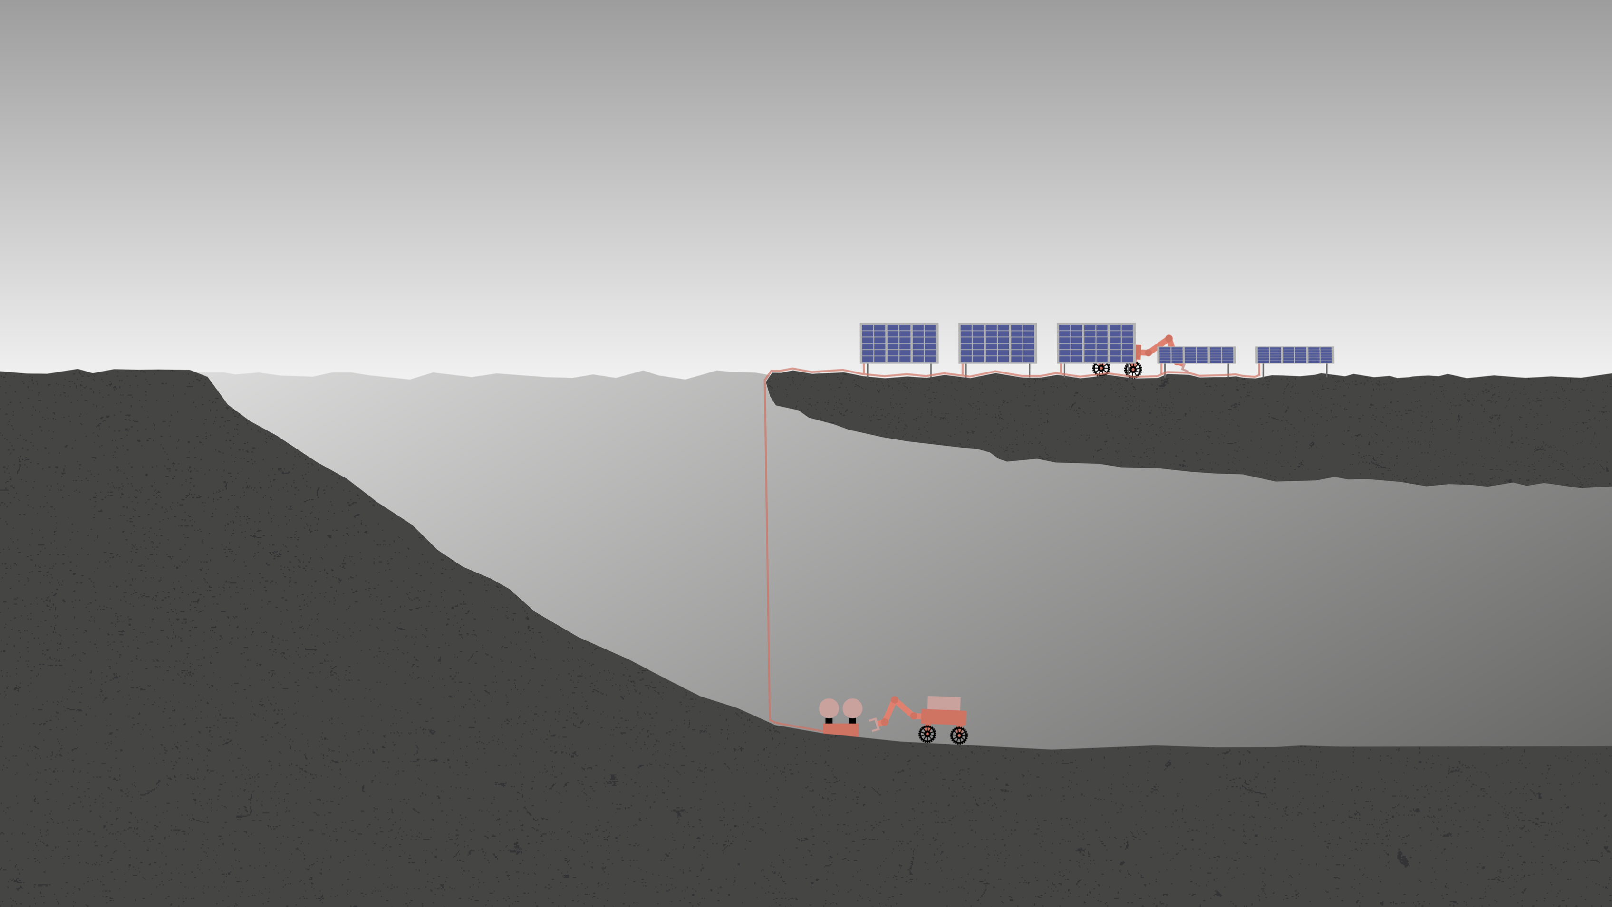
Preparation Mission

Slide 53
Power setup
Step 1: Solar panels
Notes:
Mounting the solar panels and charging stations in a easy task for the GITAI rovers operating on battery

Slide 54
Power setup
Step 2: Power distribution system

Slide 55
Power setup
Step 3: Testing
Notes:
Testing automatically the system

Slide 56
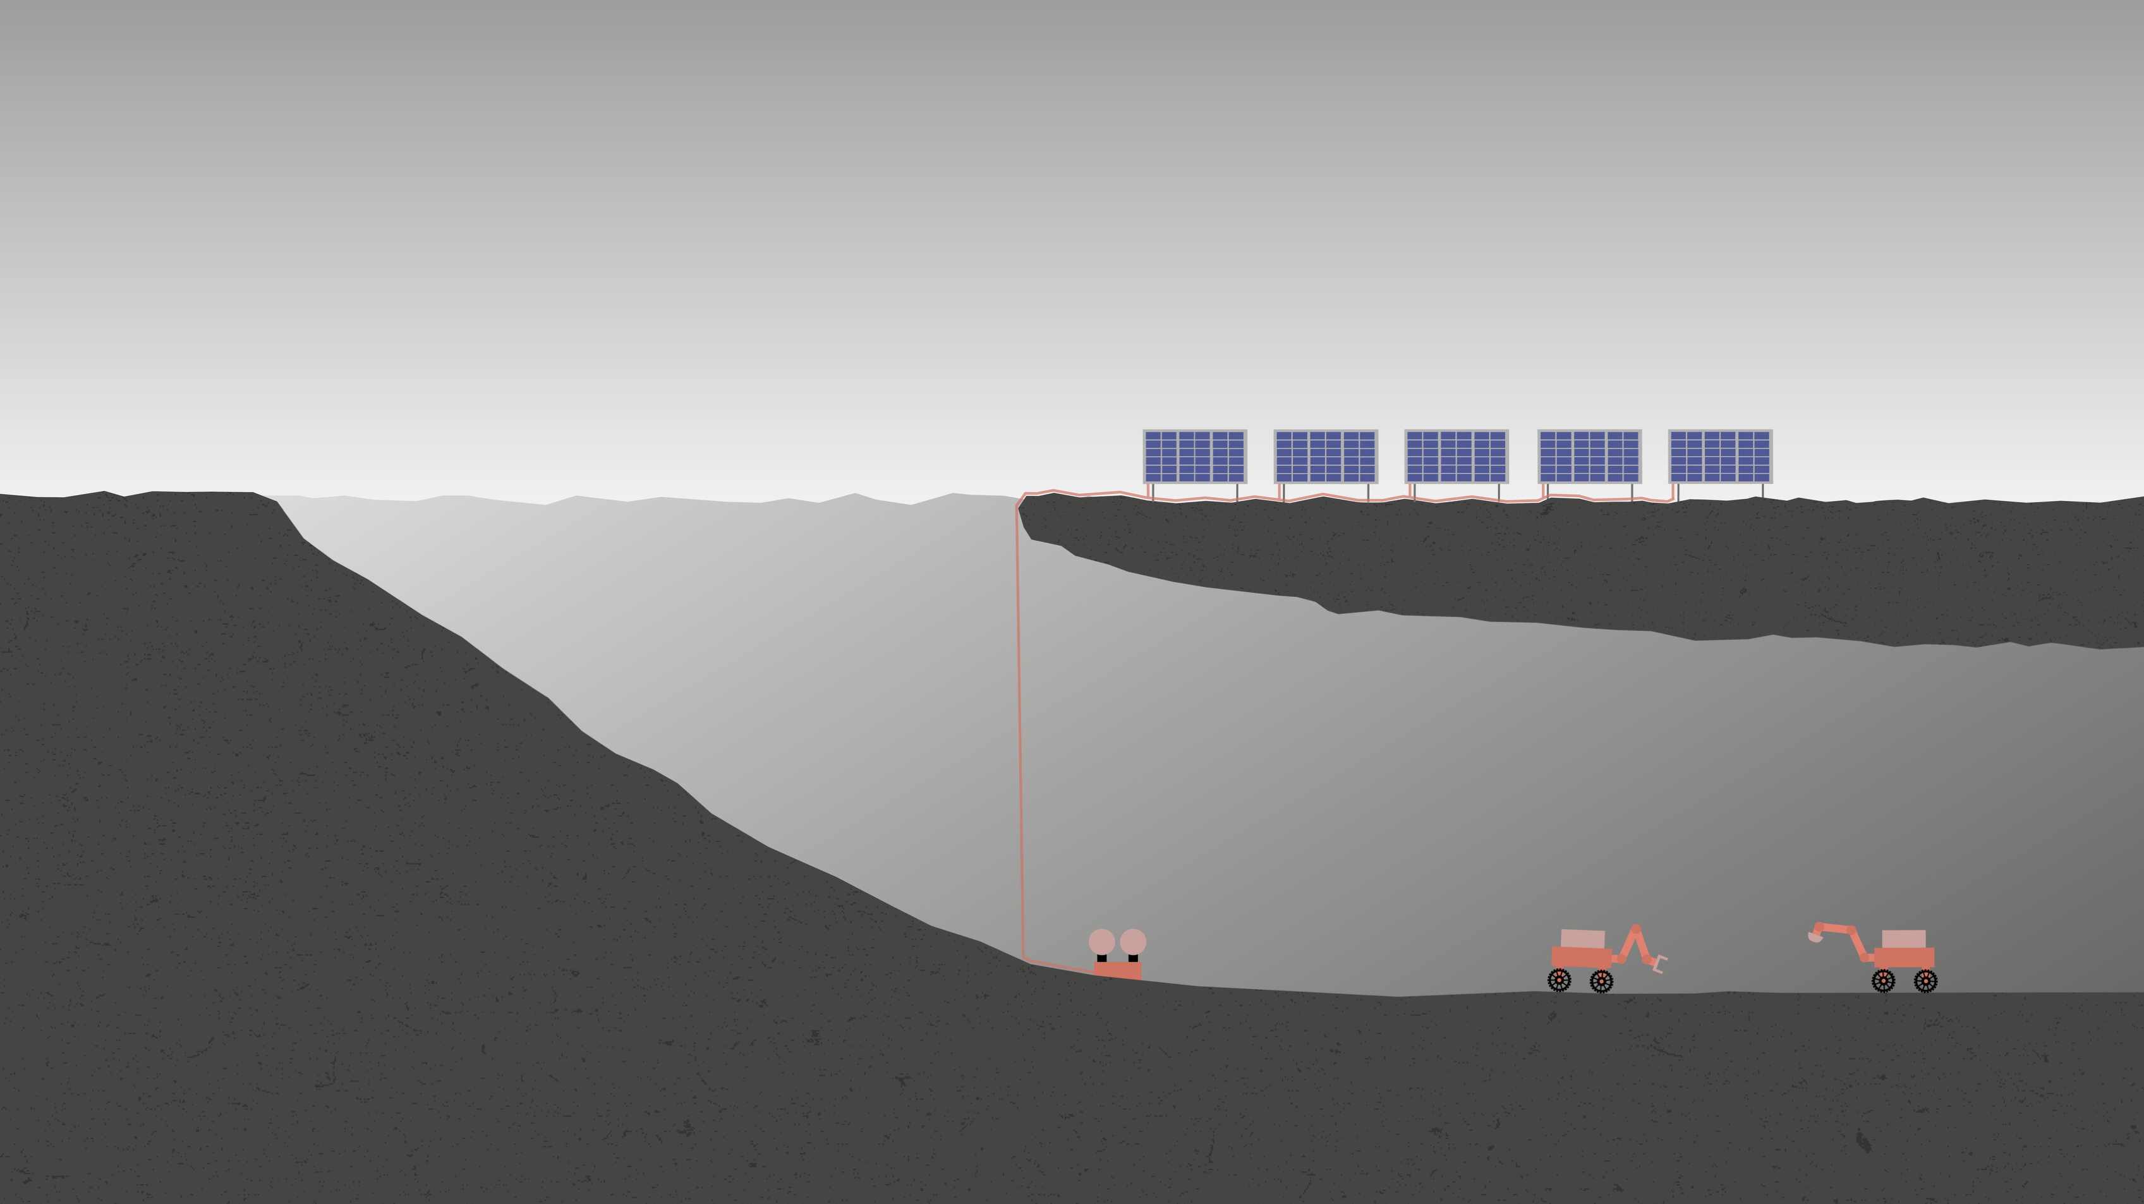
Site preparation
Step 4: Surveying and assessing site
Notes:
Find a flat spot and clear debris and rocks

Slide 57
Site preparation
Step 5: Clearing the site

Slide 58
Site preparation
Step 6: Scanning the site

Slide 59
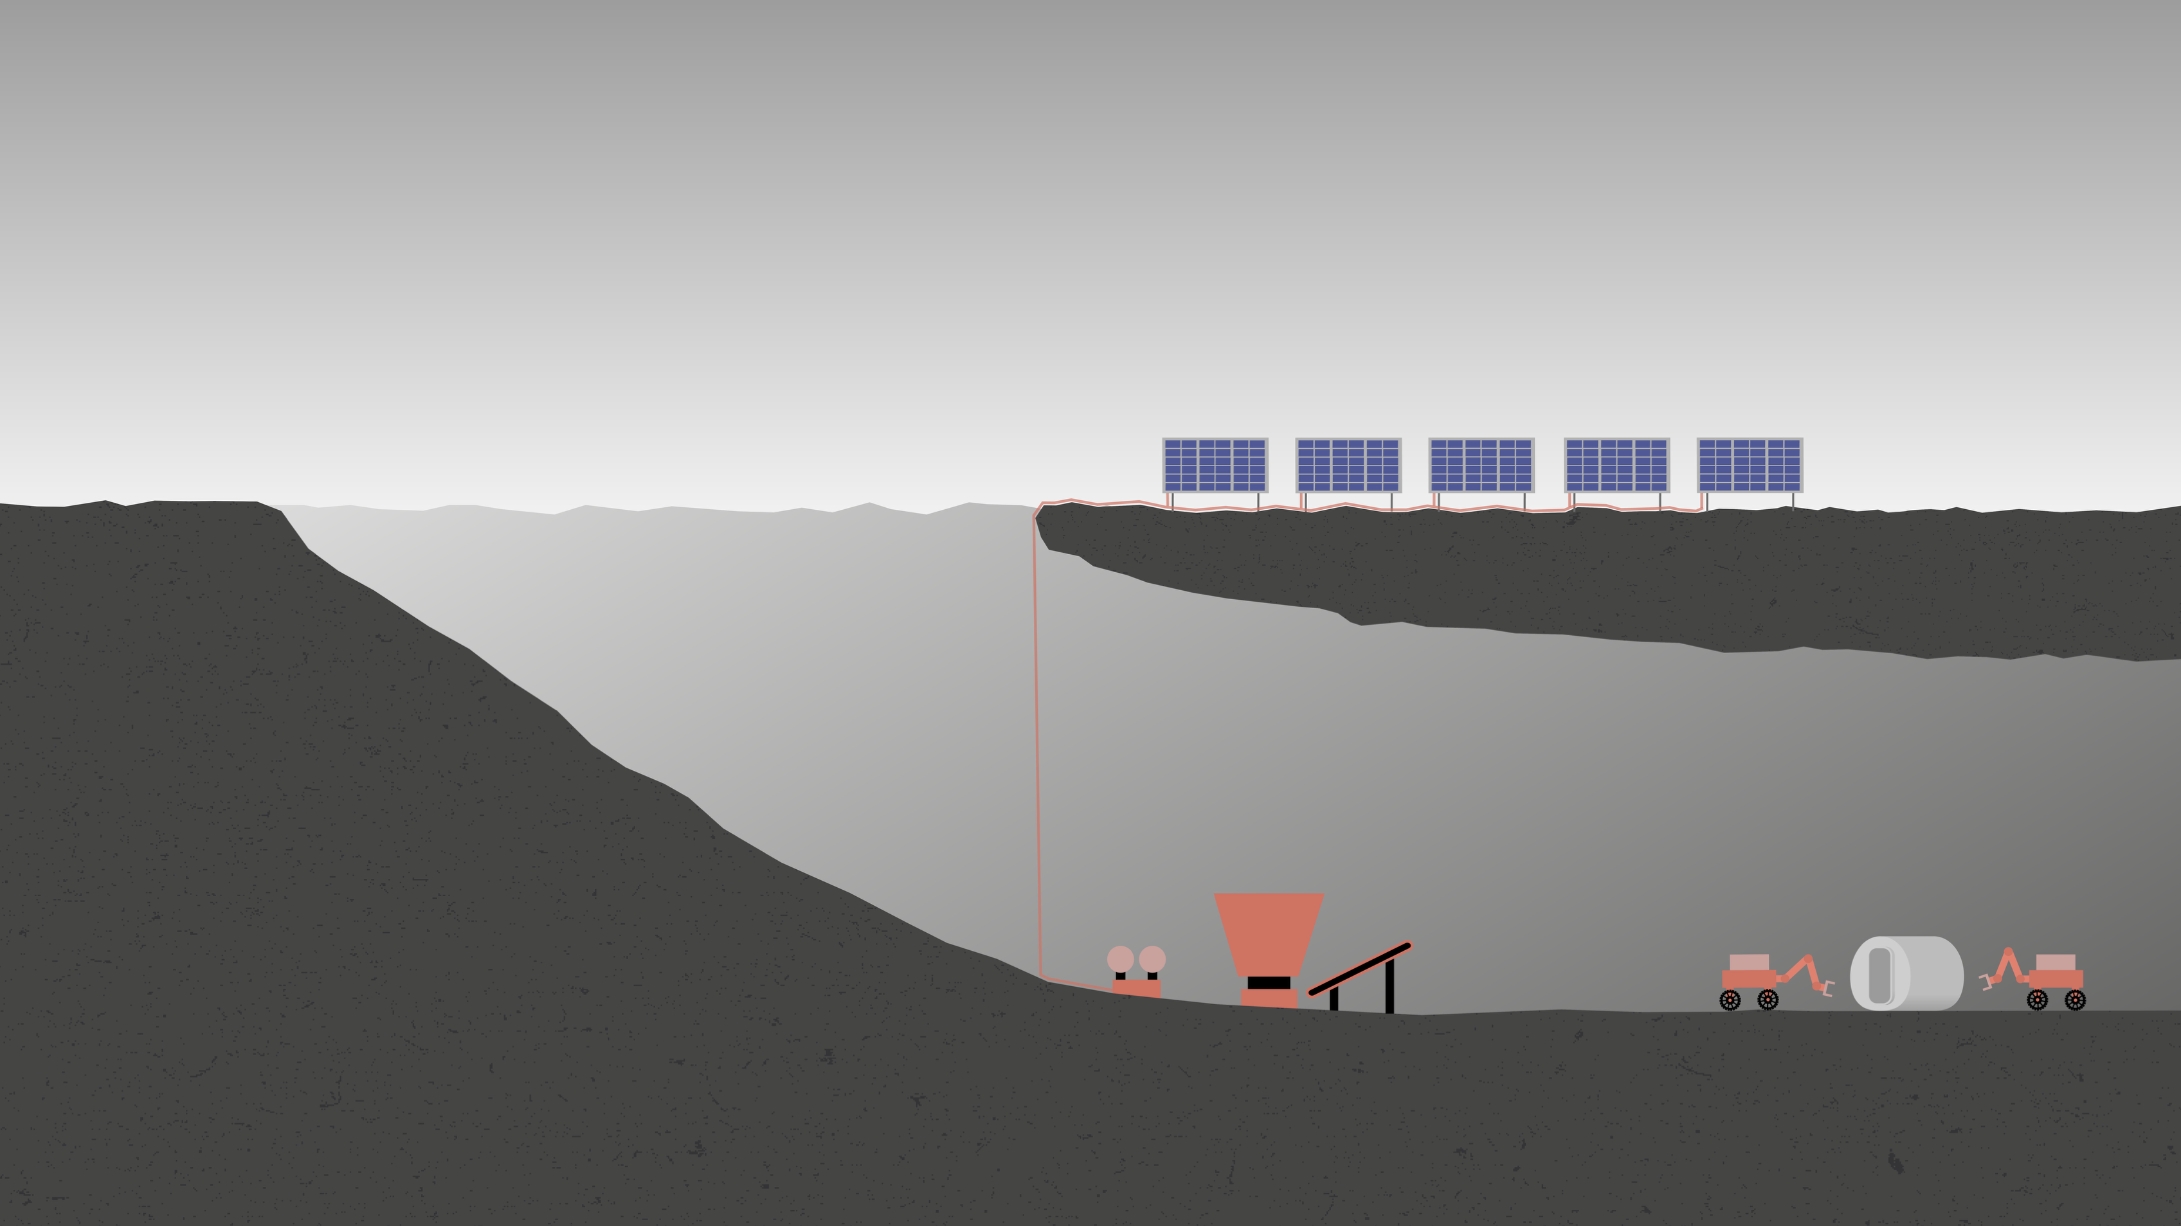
Construction mission

Slide 60
Installation membrane​
Step 7: Transporting membrane & airlock
Notes:
Towing from the ship the airlocks in place, membrane is already attached to the airlocks and ready to be deployed.

Slide 61
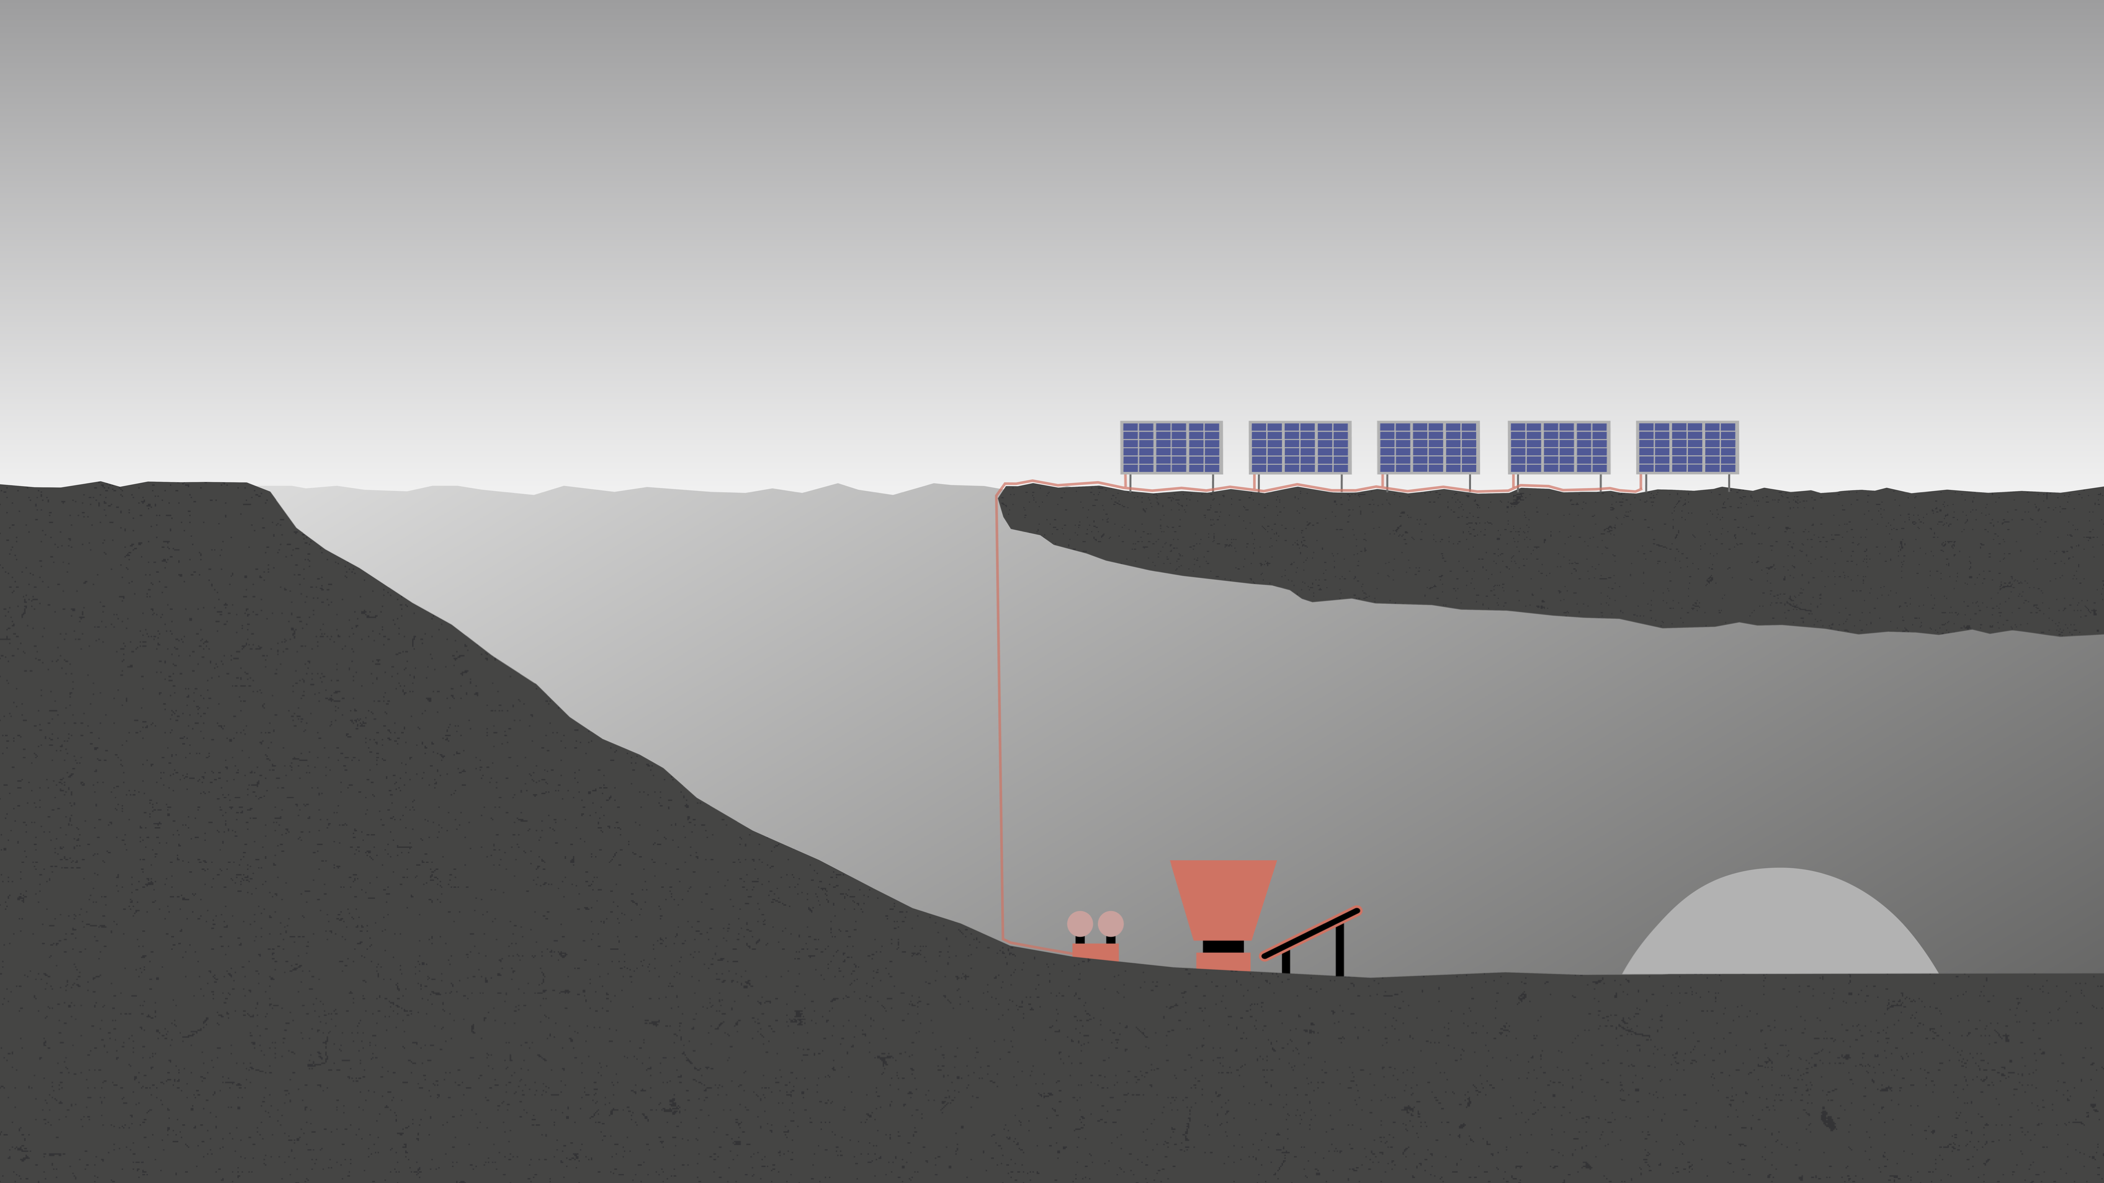
Installation membrane​
Step 8: Deploying inflatable membrane

Slide 62
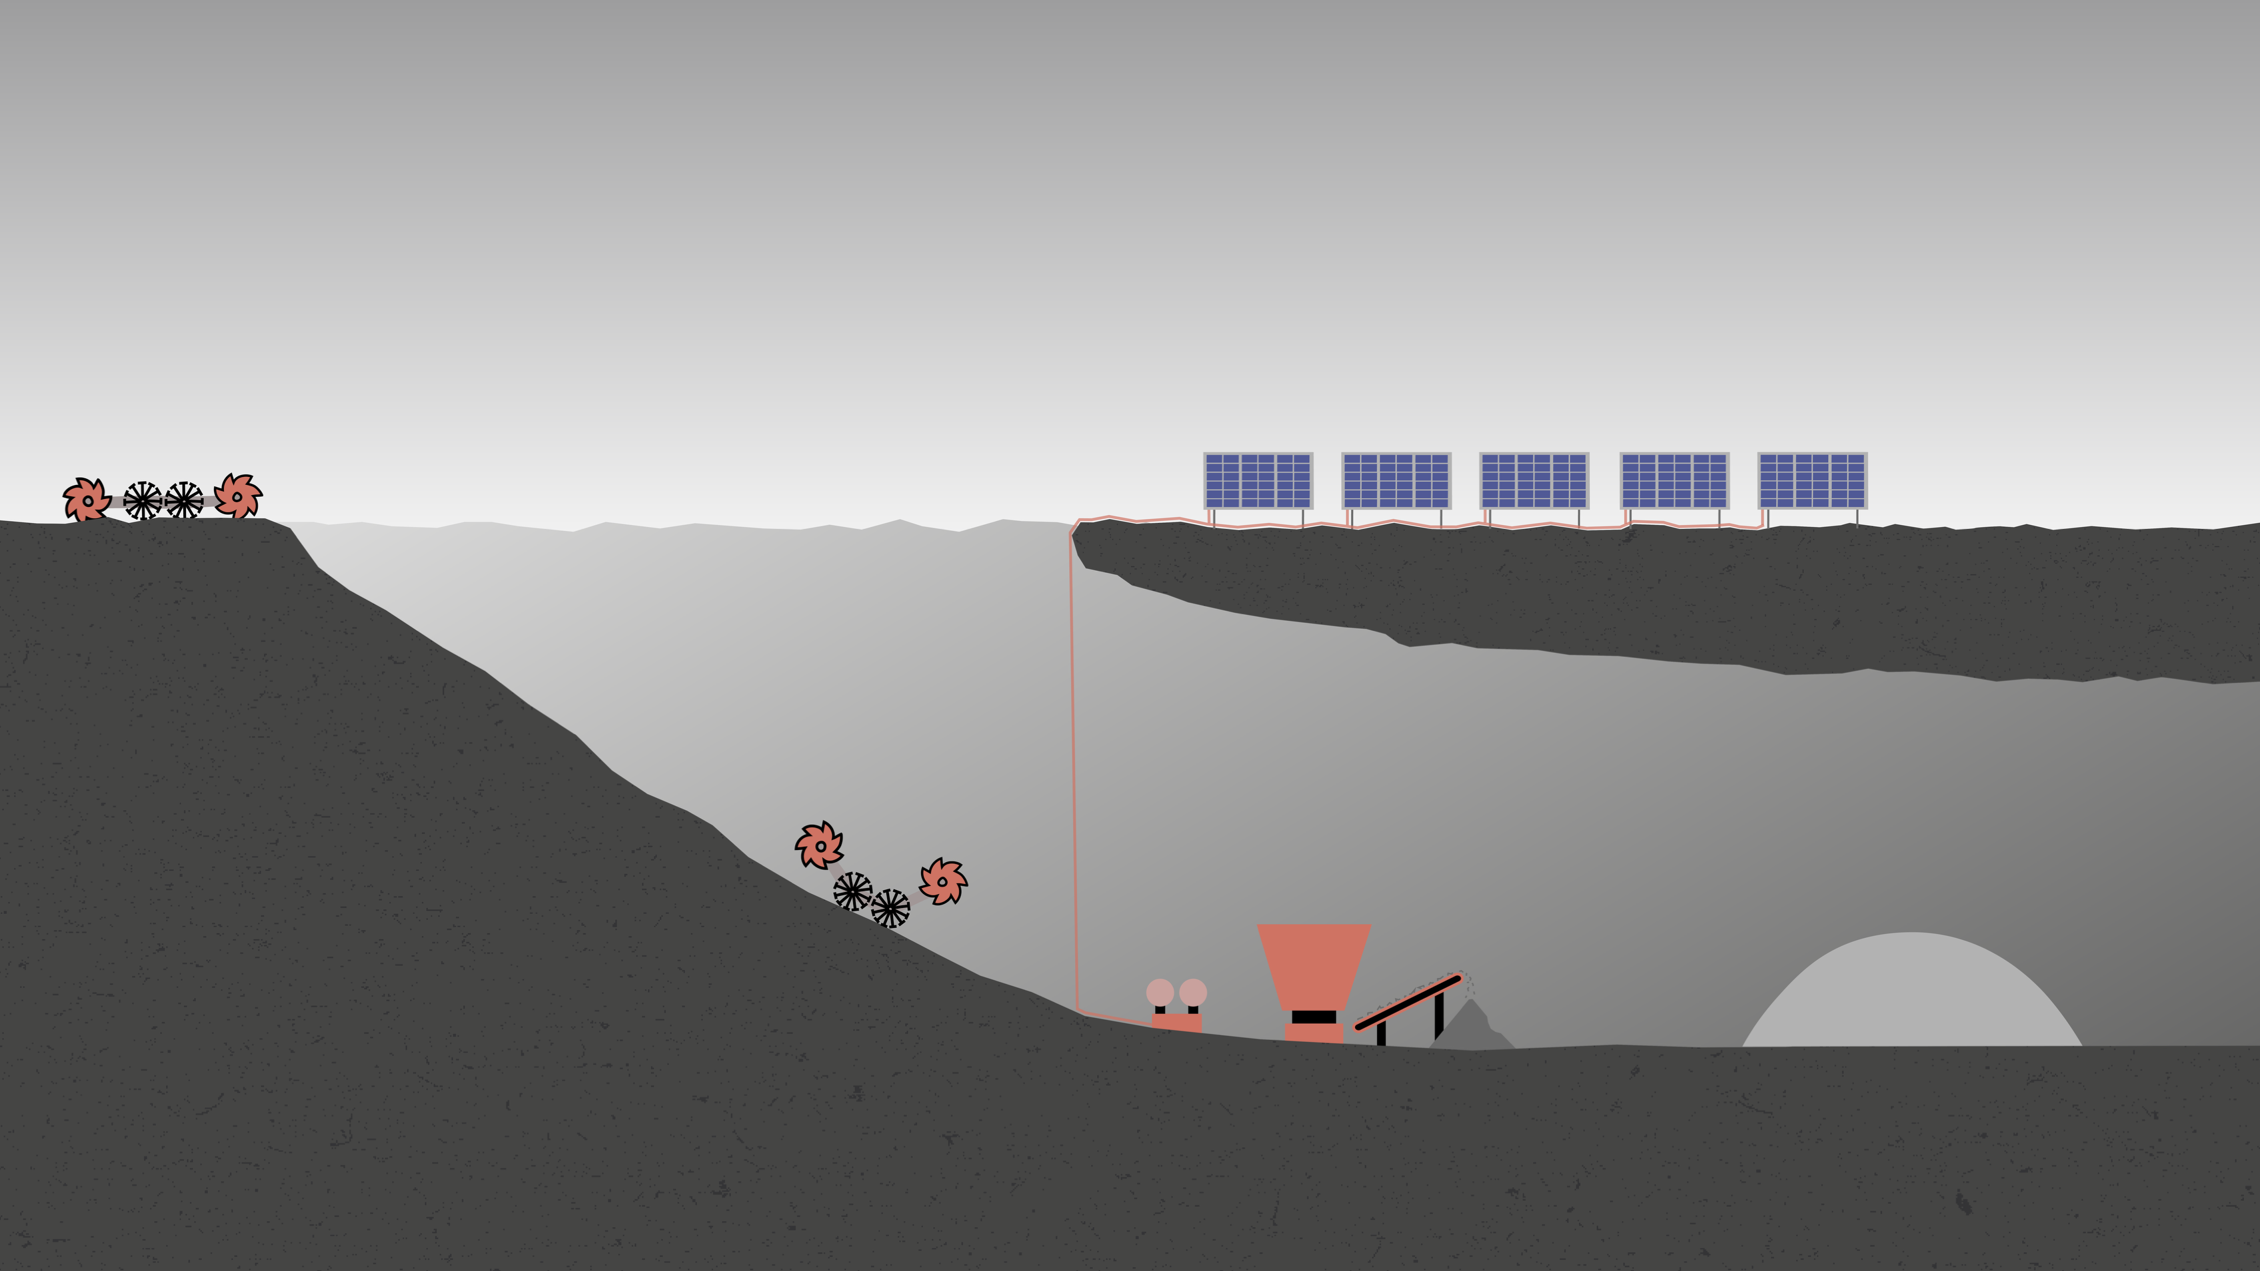
Collection & processing
Step 9: Collecting regolith

Slide 63
Collection & processing
Step 10: Transporting regolith

Slide 64
Collection & processing
Step 11: Processing regolith

Slide 65
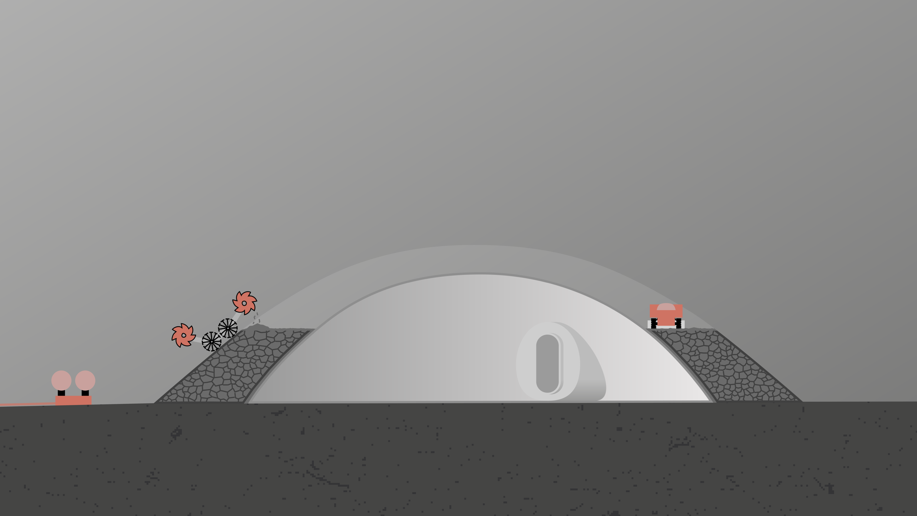
Habitat construction
Step 12: Depositing layer of regolith
Notes:
Each layer is deposited of the correct mass ammount on the structure and then flattened

Slide 66
Habitat construction
Step 13: Flattening the layer of regolith

Slide 67
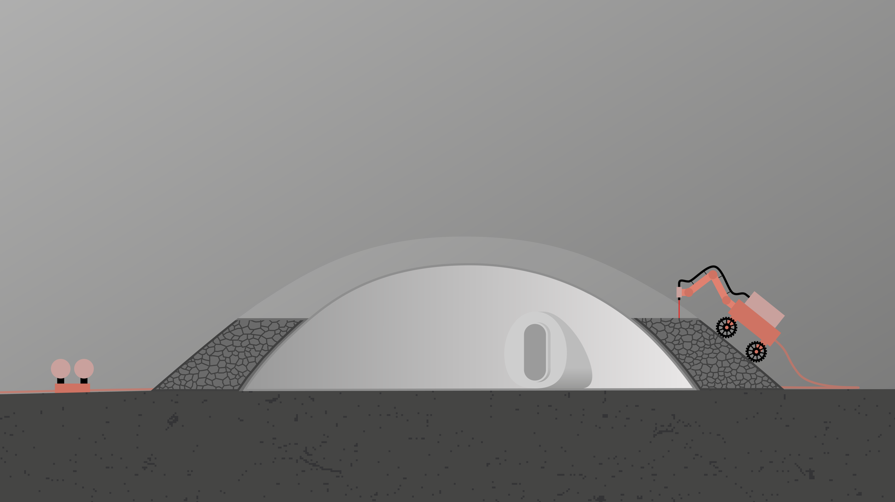
Habitat construction
Step 14: Melting the fresh regolith

Slide 68
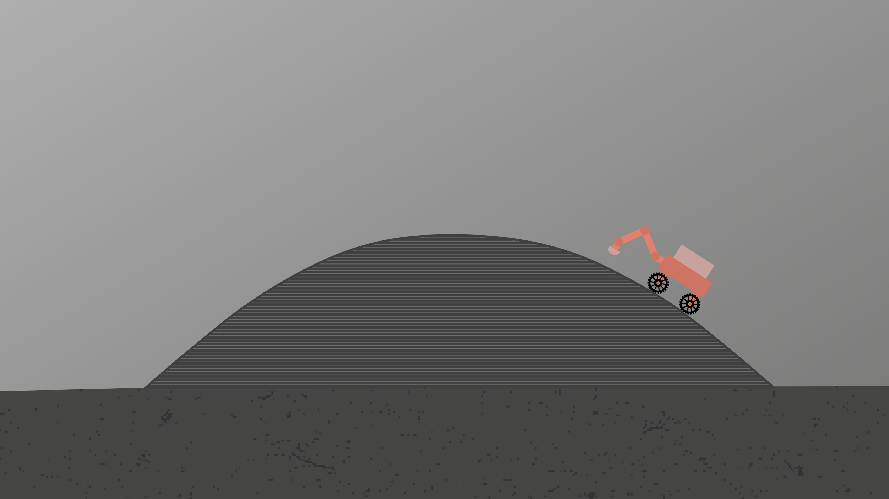
Post construction
Step 15: Robot maintenance & cleaning

Slide 69
Post construction
Step 16: Final inspection completed structure

Slide 70
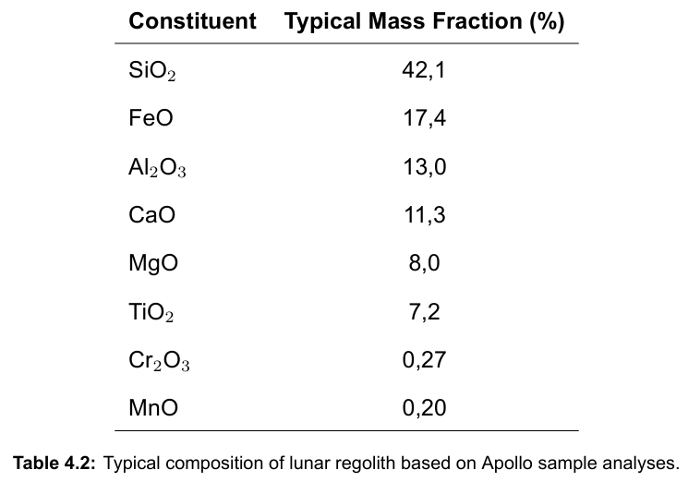
Regolith Melting Process
Silicon & oxides
Thermophysical properties
Notes:
required -> 1.5 kW of power -> 3 kW laser (50% efficiency)
Regolith rich in silicon andoxides
Required laser powercalculated based onthermophysical properties
Temperature target of 1500 C

Slide 71
Regolith Melting Process
Silicon & oxides
Thermophysical properties
Target temp: 1500 °C
Target speed: 1,725 L/h
Power needed: 1,5kW
Notes:
required -> 1.5 kW of power -> 3 kW laser (50% efficiency)
Regolith rich in silicon andoxides
Required laser powercalculated based onthermophysical properties
Temperature target of 1500 C

Slide 72
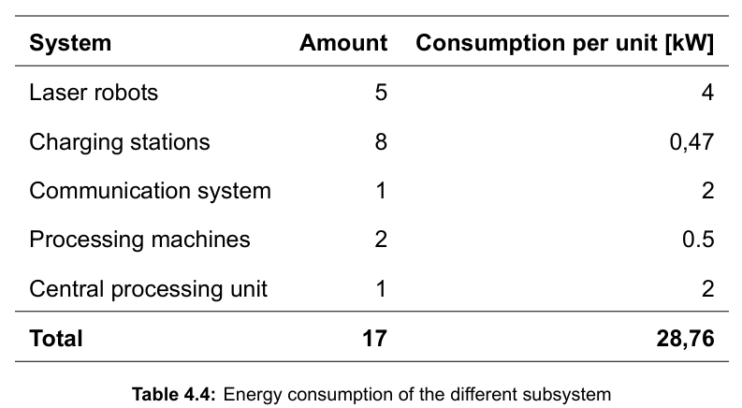
Power generation
Solar energy
Fuel cells
RTG's
Nuclear fission
Notes:
Total power requirement of ~30 kW
Lasers are around half the power req

Slide 73
Power generation
Solar energy
Fuel cells
RTG's
Nuclear fission
Notes:
Total power requirement of ~30 kW
Fuel cells still new tech
RTG need a specific material that is produced very little a year making it very hard and long to acquire for a mission.
Nuclear fission is really practical idea but regulations prohibit to launch fission material into space.

Slide 74

Power managing scenarios
Continuous operation

Slide 75
Power managing scenarios
Continuous operation
68 tons of batteries
280 days to completion

Slide 76


Power managing scenarios
Continuous operation
2. Day-time only operation
68 tons of batteries
280 days to completion

Slide 77
Power managing scenarios
Continuous operation
2. Day-time only operation
68 tons of batteries
280 days to completion
1,1 tons of batteries
560 days to completion

Slide 78

Cost Comparison
Category | Cost [€] | Cost [€]
Robotics | 22.100.000 | 22.100.000
Equipment | 160.015.500 | 140.745.939
Shipment | 74.043.000.000 | 5.238.129.360
Operational | 1.900.000.000 | 1.900.000.000
Total | 76.125.115.500 | 7.300.975.299

Slide 79
Cost Comparison
Category | Cost [€] | Cost [€]
Robotics | 22.100.000 | 22.100.000
Equipment | 160.015.500 | 140.745.939
Shipment | 74.043.000.000 | 5.238.129.360
Operational | 1.900.000.000 | 1.900.000.000
Total | 76.125.115.500 | 7.300.975.299

Slide 80
Cost Comparison
Category | Cost [€] | Cost [€]
Robotics | 22.100.000 | 22.100.000
Equipment | 160.015.500 | 140.745.939
Shipment | 74.043.000.000 | 5.238.129.360
Operational | 1.900.000.000 | 1.900.000.000
Total | 76.125.115.500 | 7.300.975.299

Slide 81
Construction Time: Simulation set-up

Slide 82

Construction Time: Simulation set-up

Slide 83
Construction Time: Simulation set-up

Slide 84
Construction Time: Results
Total construction time: 536 Earth days (268 of work)

Slide 85
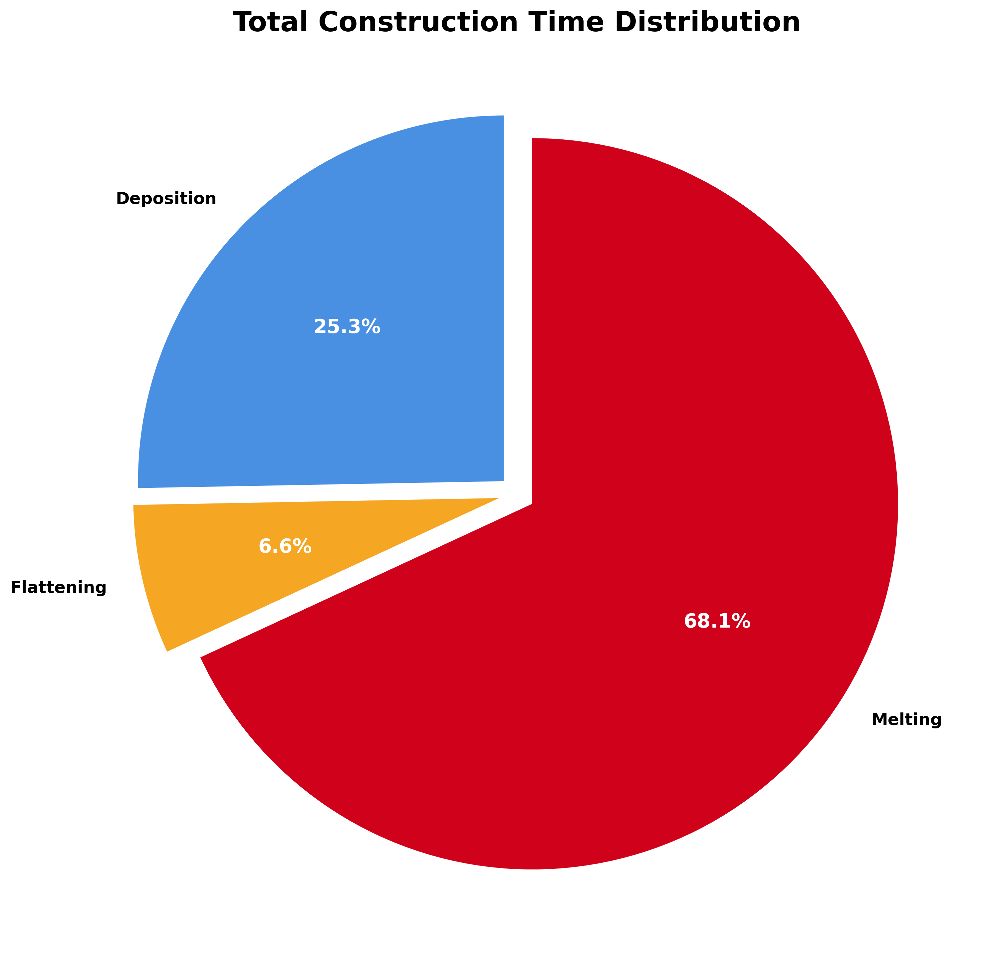
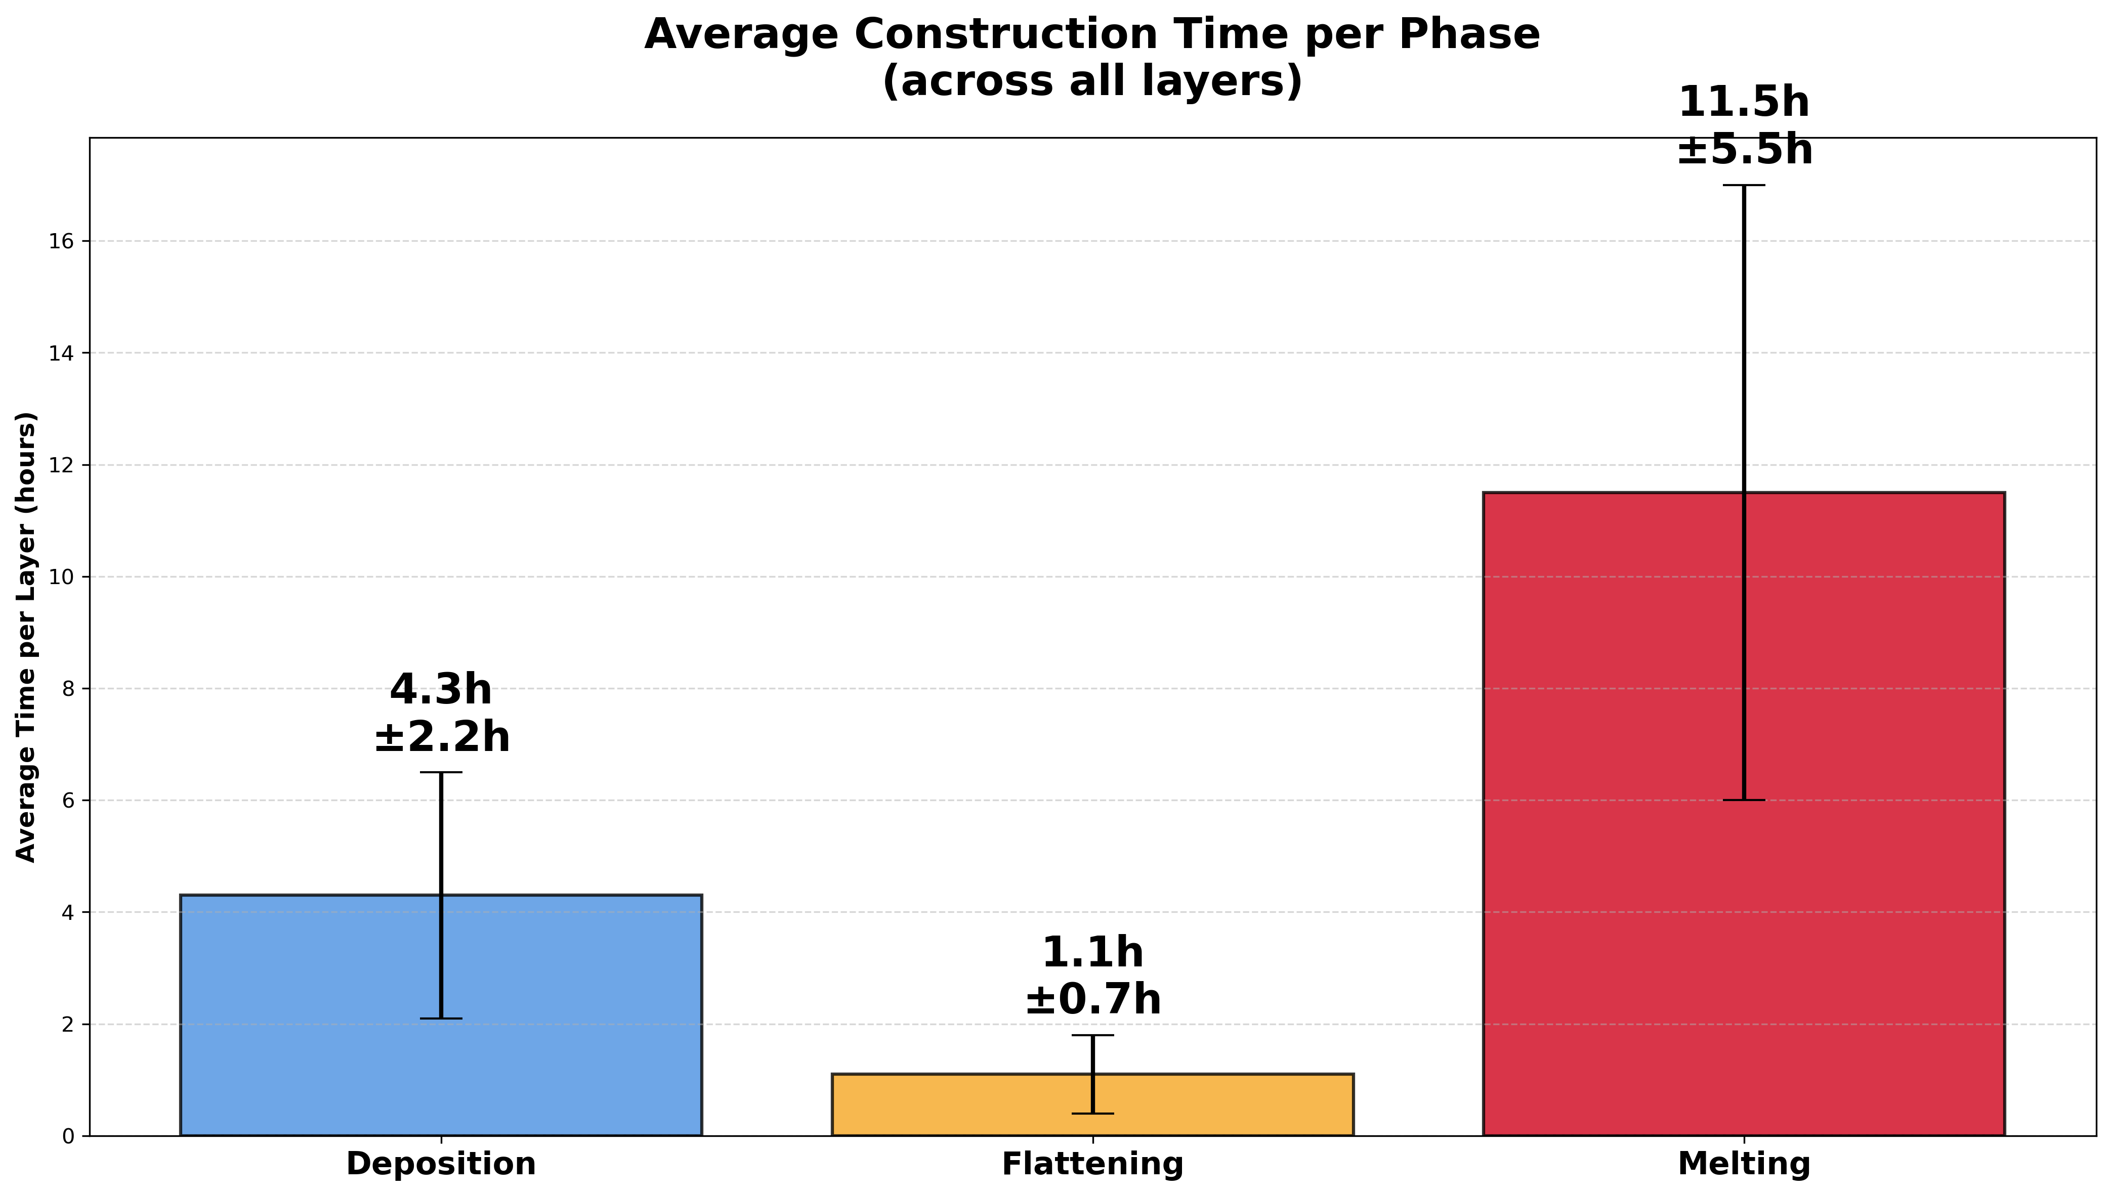
Construction Time: Results
Total construction time: 536 Earth days (268 of work)
Notes:
Flattening robots are the faster at they work, Deposition gets a big improvement going from 2 to 3 robots, while malting takes the majority of the time

Slide 86
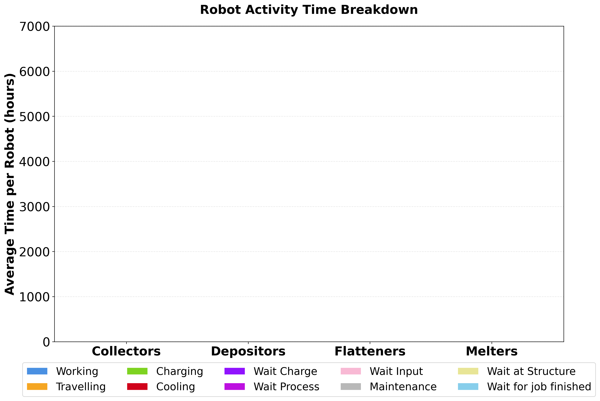
Construction Time: Results
ROBOT TYPE
Activity | [h] | [%]
Working
Taveling
Charging
Cooling
Waiting Charge
Waiting process
Waiting input
Maintenance
Waiting Structure
Job finished

Slide 87
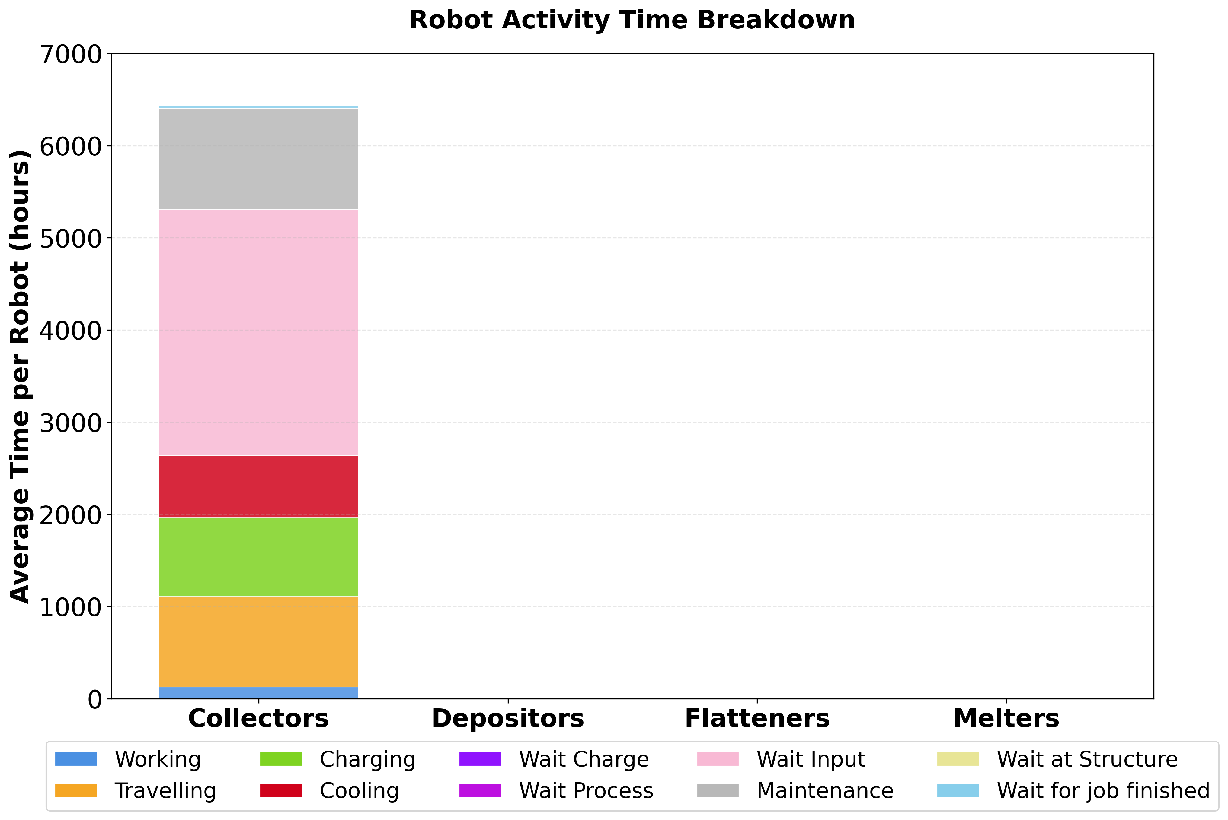
Construction Time: Results
COLLECTORS
Activity | [h] | [%]
Working | 126 | 2
Traveling | 981 | 15,3
Charging | 857 | 13,3
Cooling | 668 | 10,4
Waiting Charge | 4 | 0,1
Waiting process | - | -
Waiting input | 2669 | 41,5
Maintenance | 1097 | 17,1
Waiting Structure | - | -
Job finished | 27 | 0,4
Notes:
Since the collection is fast, with a finite buffer, robots spend a lot of time waiting to unload in front of the machine

Slide 88
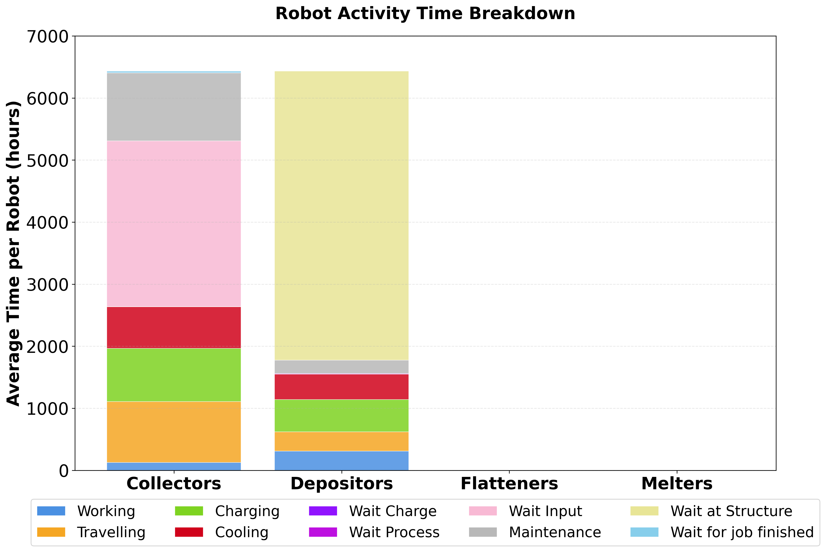
Construction Time: Results
DEPOSITORS
Activity | [h] | [%]
Working | 309 | 4,8
Traveling | 310 | 4,8
Charging | 523 | 8,1
Cooling | 407 | 6,3
Waiting Charge | 2 | 0,0
Waiting process | 7 | 0,1
Waiting input | - | -
Maintenance | 218 | 3,4
Waiting Structure | 4657 | 72,4
Job finished | 0,18 | 0,0
Notes:
With three depositors 70%+ of the time is waiting

Slide 89
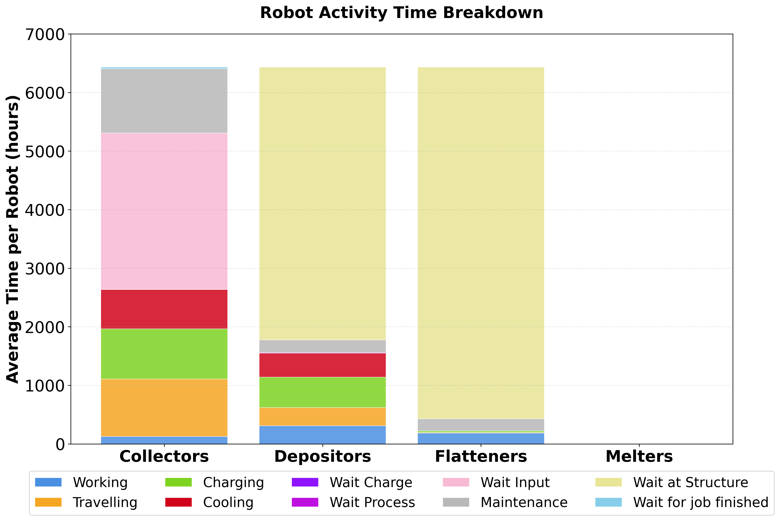
Construction Time: Results
FLATTENERS
Activity | [h] | [%]
Working | 186 | 2,9
Traveling | 9 | 0,1
Charging | 26 | 0,4
Cooling | - | -
Waiting Charge | 0,52 | 0,52
Waiting process | - | -
Waiting input | - | -
Maintenance | 207 | 3,2
Waiting Structure | 6006 | 93,4
Job finished | 0,17 | 0,0
Notes:
Flatteners spend most of their time waiting.

Slide 90
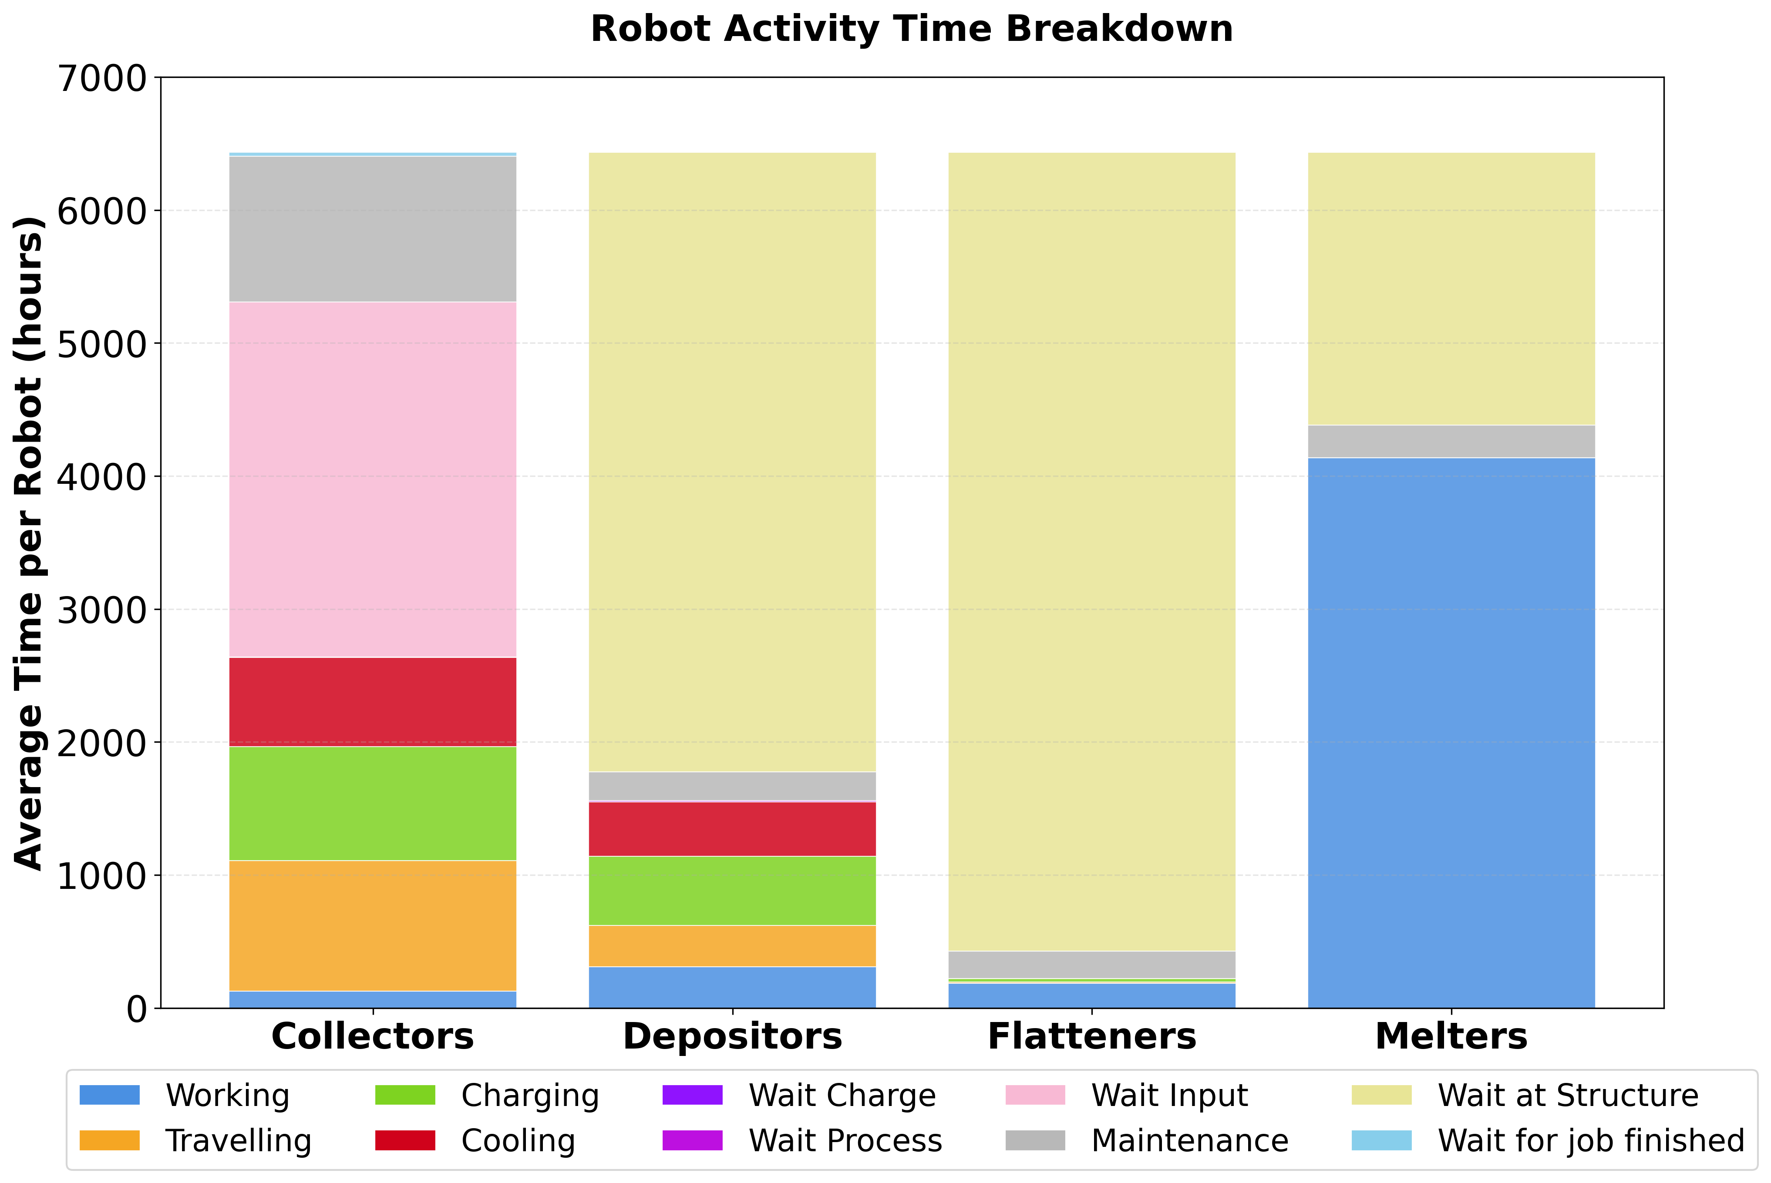
Construction Time: Results
MELTERS
Activity | [h] | [%]
Working | 4138 | 64,3
Traveling | - | -
Charging | - | -
Cooling | - | -
Waiting Charge | - | -
Waiting process | - | -
Waiting input | - | -
Maintenance | 244 | 3,8
Waiting Structure | 2050 | 32
Job finished | - | -
Notes:
Melters are the busiest robots

Slide 91
Risk Management – Process
Framework: NASA CRM
Identification
Safety
Technical
Cost
Schedule
Notes:
The risk management framework used in this project is largely based on the Continuous Risk Management Framework developed by NASA, but it has been adapted a bit to be more in line with the scope of this project.
First risks are identified and categorized as either a safety, technical, cost or schedule risk

Slide 92
Risk Management – Process
Framework: NASA CRM
Identification
Analysis
Likelihood & severity rating (1-5)
Notes:
The second step is risk analysis.
This starts by giving each risk two ratings; based on the risk’s severity and likelihood of it to occur

Slide 93
Risk Management – Process
Framework: NASA CRM
Identification
Analysis
Likelihood & severity rating (1-5)
Risk score
Safety
Technical
Cost
Schedule
|2
|1,7
|1,4
|1
Notes:
By multiplying the likelihood and severity rating, the risk score is obtained, which gives a measure of the actual risk level.
This risk score is then multiplied by a factor that based on its category, since certain risk categories have inherently greater potential to compromise mission success or safety.

Slide 94
Risk Management – Process
Framework: NASA CRM
Identification
Analysis
Response
Accept
Mitigate
Watch
Research
Notes:
Finally, a risk response is recommended, which are:
Accept: if the risk is low enough
Mitigate: Performing actions to reduce the risk
Watch:
Research: If the uncertainty about the underlying risk driver is large enough and more research is required to understand it

Slide 95
Risk Management - Results
Technical
Majority of risks
Notes:
The majority of the risks identified were technical risks

Slide 96
Risk Management - Results
Technical
Majority of risks
Uncertainty about performance in lunar environment
Notes:
Most of these risks centered around the performance of the systems in the lunar environment, since there are still a lot of uncertainties about it.
One big factor of uncertainty is also the degradation of the performance of systems over the 2 year duration of the mission

Slide 97
Risk Management - Results
Technical
Majority of risks
Uncertainty about performance in lunar environment
Majority can be mitigated
Notes:
Fortunately, we believe that the majority of these risks can be mitigated by either increasing redundancy in the system, or by including margins.
Some of these risks could also be mitigated by slightly altering some operational procedures

Slide 98
Risk Management - Results
Technical
Safety
Biggest risks
Notes:
The biggest risks to the project are safety risks

Slide 99
Risk Management - Results
Technical
Safety
Biggest risks
Damage to (sub)structure
Notes:
Most of these risks center about the inflatable substructure or the outer shell getting damaged.
The biggest risk is the possibility of the structure to get damaged by moon quakes
Other risks for damage include collisions between robots and the membrane or structure, or heat damage to the membrane caused by accidental laser misdirection.

Slide 100
Risk Management - Results
Technical
Safety
Schedule
Uncertainty about performance in lunar environment
Notes:
Finally, we identified a bunch of schedule risk, which were, like the technical risks, mostly caused by uncertainty about some aspects of the system’s performance in the lunar environment.

Slide 101
Risk Management - Results
Technical
Safety
Schedule
Uncertainty about performance in lunar environment
Mitigated by including margins
Notes:
But fortunately, most of these risks are fairly straight forward to mitigate by including margins in the schedules

Slide 102
Discussion - Considerations
Focus on exploration, not exploitation
Notes:
Beyond all the technical considerations that we had to make, there are also several ethical, societal and environmental considerations that are relevant to our project.
The habitat that we are proposing is generally meant for the early scientific and exploration missions, but these missions are likely going to function as a stepping for future commercial missions. While space agencies will likely put extra care into respectfully interacting with the lunar environment, later commercial missions may not care about that. Therefore it is important to ensure that exploration does not turn into exploitation.
Finally, another large issue is that the new race to the moon is only a contest between the very richest and most advanced of nations, even more so than the current LEO space race, so international frameworks that ensure that the benefits of lunar exploration are shared equally amongst humanity should be considered

Slide 103
Discussion - Considerations
Focus on exploration, not exploitation
Equally shared benefits
Notes:
Beyond all the technical considerations that we had to make, there are also several ethical, societal and environmental considerations that are relevant to our project.
The habitat that we are proposing is generally meant for the early scientific and exploration missions, but these missions are likely going to function as a stepping for future commercial missions. While space agencies will likely put extra care into respectfully interacting with the lunar environment, later commercial missions may not care about that. Therefore it is important to ensure that exploration does not turn into exploitation.
Finally, another large issue is that the new race to the moon is only a contest between the very richest and most advanced of nations, even more so than the current LEO space race, so international frameworks that ensure that the benefits of lunar exploration are shared equally amongst humanity should be considered

Slide 104
Discussion - Considerations
Focus on exploration, not exploitation
Equally shared benefits
Shared use through global dialogue
Notes:
Beyond all the technical considerations that we had to make, there are also several ethical, societal and environmental considerations that are relevant to our project.
The habitat that we are proposing is generally meant for the early scientific and exploration missions, but these missions are likely going to function as a stepping for future commercial missions. While space agencies will likely put extra care into respectfully interacting with the lunar environment, later commercial missions may not care about that. Therefore it is important to ensure that exploration does not turn into exploitation.
Finally, another large issue is that the new race to the moon is only a contest between the very richest and most advanced of nations, even more so than the current LEO space race, so international frameworks that ensure that the benefits of lunar exploration are shared equally amongst humanity should be considered

Slide 105
Discussion - Considerations
Focus on exploration, not exploitation
Equally shared benefits
Shared use through global dialogue
Protect pristine landscape
Notes:
Beyond all the technical considerations that we had to make, there are also several ethical, societal and environmental considerations that are relevant to our project.
The habitat that we are proposing is generally meant for the early scientific and exploration missions, but these missions are likely going to function as a stepping for future commercial missions. While space agencies will likely put extra care into respectfully interacting with the lunar environment, later commercial missions may not care about that. Therefore it is important to ensure that exploration does not turn into exploitation.
Finally, another large issue is that the new race to the moon is only a contest between the very richest and most advanced of nations, even more so than the current LEO space race, so international frameworks that ensure that the benefits of lunar exploration are shared equally amongst humanity should be considered

Slide 106
Discussion - Considerations
Focus on exploration, not exploitation
Equally shared benefits
Shared use through global dialogue
Protect pristine landscape
ISRU minimizes environmental impact
Notes:
Beyond all the technical considerations that we had to make, there are also several ethical, societal and environmental considerations that are relevant to our project.
The habitat that we are proposing is generally meant for the early scientific and exploration missions, but these missions are likely going to function as a stepping for future commercial missions. While space agencies will likely put extra care into respectfully interacting with the lunar environment, later commercial missions may not care about that. Therefore it is important to ensure that exploration does not turn into exploitation.
Finally, another large issue is that the new race to the moon is only a contest between the very richest and most advanced of nations, even more so than the current LEO space race, so international frameworks that ensure that the benefits of lunar exploration are shared equally amongst humanity should be considered

Slide 107
Discussion - Considerations
Focus on exploration, not exploitation
Equally shared benefits
Shared use through global dialogue
Protect pristine landscape
ISRU minimizes environmental impact
Design for reuse, robustness & high efficiency
Notes:
Beyond all the technical considerations that we had to make, there are also several ethical, societal and environmental considerations that are relevant to our project.
The habitat that we are proposing is generally meant for the early scientific and exploration missions, but these missions are likely going to function as a stepping for future commercial missions. While space agencies will likely put extra care into respectfully interacting with the lunar environment, later commercial missions may not care about that. Therefore it is important to ensure that exploration does not turn into exploitation.
Finally, another large issue is that the new race to the moon is only a contest between the very richest and most advanced of nations, even more so than the current LEO space race, so international frameworks that ensure that the benefits of lunar exploration are shared equally amongst humanity should be considered

Slide 108
Conclusion
Selective Laser Melting
Notes:
Initially, two preliminary concept were developed simultaneously and evaluated
Here, concept 2 came out on top due to its lower technical complexity, higher flexibility and adaptability, quicker construction time and lower cost.

Slide 109
Conclusion
Selective Laser Melting
Concept Evaluation
Notes:
Next, several additive manufacturing methods were investigated; here, selective laser melting was found to be the best option, due to its ability to create strong, geometrically complex shapes without the needs for any additives.

Slide 110
Conclusion
Selective Laser Melting
Concept evaluation
Catenary dome with infill pattern
Notes:
Since it is not possible to use manual labor in the construction process, it was necessary to rely on construction using robotic swarms
For this, requirements were devised for all the robots and supporting systems
Furthermore, several options for the collector/depositor, flattening and melting robots were investigated, by investigating real robotic systems under development that aim to perform the same functions as the ones we are envisioning

Slide 111
Conclusion
Selective Laser Melting
Concept evaluation
Catenary dome with infill pattern
Robotic swarm construction
Notes:
Since it is not possible to use manual labor in the construction process, it was necessary to rely on construction using robotic swarms
For this, requirements were devised for all the robots and supporting systems
Furthermore, several options for the collector/depositor, flattening and melting robots were investigated, by investigating real robotic systems under development that aim to perform the same functions as the ones we are envisioning

Slide 112
Conclusion
Selective Laser Melting
Concept evaluation
Catenary dome with infill pattern
Robotic swarm construction
Day-time only operations only viable option
Notes:
During development of the construction process and analysis of the power requirements, we came to the conclusion that limiting construction if the construction process would be continuous, a staggering 67 tons of batteries would be required, ballooning the total mission cost to roughly 76 billion, in comparison, limiting construction to only during the day, total mission costs can be reduced by over 90% to 7,6 billion

Slide 113
Limitations & Future Work
Feasibility of large-scale multi-layer SLM
Notes:
There are still several big questions and research topics that need to be answered before a real mission aimed at constructing a habitat on the moon can begin.
One of the biggest possible hurdles facing such a project are the questions that remain about the feasibility of large-scale multi-layer SLM in a lunar environment.
Although many experiments have been conducted that successfully melted small samples of lunar regolith together, not many tests have been conducted that try to create multi layer structures using this method.
That’s why many
questions remain about aspects like melting performance under vacuum conditions, layer adhesion and optical particle size range.
One promising solution that was mentioned by one of the experts that we spoke to was to perform multiple passes.

Slide 114
Limitations & Future Work
Feasibility of large-scale multi-layer SLM
Lunar environment
Notes:
Another big area of uncertainty remains the lunar environment and its effects.
One of the biggest risks that we do not really have an answer for is the danger from moon quakes. Much is still unknown about their nature, frequency and maximum magnitudes.
Another such area is the performance of the robotic systems in the actual lunar environment; it is possible that systems behave in unexpected ways once they operate in a real lunar environment, especially the long-term durability and rate of performance degradation of systems remains a question

Slide 115
Limitations & Future Work
Feasibility of large-scale multi-layer SLM
Lunar environment
Power generation systems
Notes:
Finally, future studies could look into the possibility of utilizing other power systems. The big limitation of the solar + battery option is that it would need a prohibitive amount of battery storage capacity, which is the main cost driver in our continuous printing scenario, although we were able to mitigate that by limiting printing to the lunar day, when the habitat will eventually be inhabited by human occupants, it will likely not be an option to limit power consumption that drastically during the lunar night.
Possible alternatives include nuclear power generation or replacing the battery system with a regenerative fuel cell (RFC) system.

Slide 116
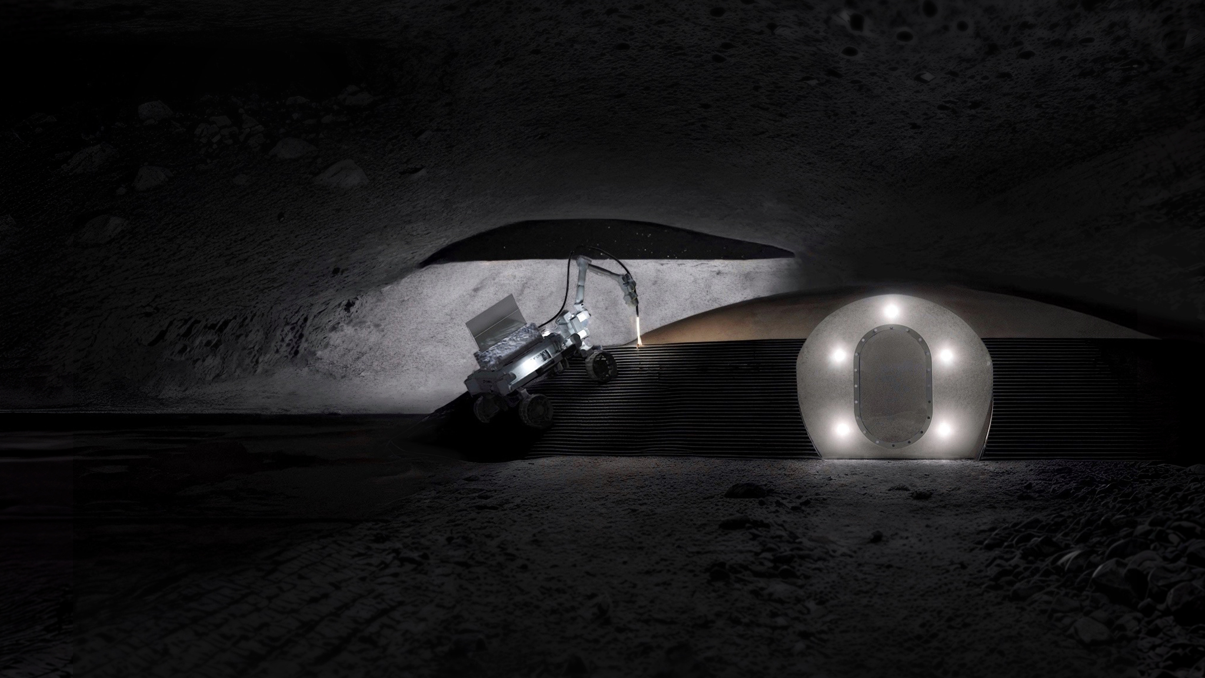
Back to the Moon
Notes:
So that was our presentation, we hope that we have demonstrated that, although many challenges still remain, lunar construction is not as infeasible as it may seem at first glance, and we hope that our findings may be of use when humans one day will go back to the moon

Slide 117
Back to the Moon
By combining swarm robotics and additive manufacturing of lunar regolith we have developed a solution to autonomously construct a protective habitat inside a lava tube to facilitate permanent human presence on the moon.

Slide 118
Concept Selection: Relative Importance
 | TC | TM&R | A | R&M | SI&D | CT | LC
TC | X | 1 | 5 | 4 | - | 7 | -
TM&R | - | X | 5 | 4 | - | 7 | -
A | - | - | X | - | - | 2 | -
R&M | - | - | 5 | X | 1 | 5 | -
SI&D | 2 | 2 | 6 | - | X | 6 | -
CT- | - | - | - | - | - | X | -
LC | 3 | 3 | 7 | 2 | 2 | 8 | X
-Technical Complexity (TC)
-Technological Maturity and Risk (TM&R)
-Adaptability (A)
-Reliability and Maintenance (R&M)
-Structural Integrity and Durability (SI&D)
-Construction Time (CT)
-Logistical Cost (LC)

Slide 119
Concept Selection: Score assignment
Criteria | Weight | Rank | Score |  | Weighted Score
 |  |  | Blocks | In-Situ | Blocks | In-Situ
TC | 0,169 | 3 | 2 | 2,2 | 0,34 | 0,37
TM&R | 0,169 | 3 | 2,8 | 1,8 | 0,47 | 0,30
A | 0,032 | 6 | 1,6 | 3,4 | 0,05 | 0,11
R&M | 0,107 | 5 | 1,6 | 2,6 | 0,17 | 0,28
SI&D | 0,192 | 2 | 2,8 | 3,2 | 0,54 | 0,61
CT- | 0,024 | 7 | 2,2 | 2,4 | 0,05 | 0,06
LC | 0,306 | 1 | 2,4 | 3 | 0,73 | 0,92
Total |  |  |  |  | 2,36 | 2,95

Slide 120
Robot characteristics
COLLECTORS
Weight | 30 | [kg]
Speed | 0,3 | [m/s]
Collecting time | 200 | [s]
Unloading time | 100 | [s]
Mass collected per trip | 30 | [kg]
Charging time | 68 | [m]
Cooling time | 121 | [m]
Operating time | 90 | [m]
Maintenance time | 20 | [%]
FLATTENERS
Weight | 25 | [kg]
Speed | 0,3 | [m/s]
Flattening speed | 50 | [m²/h]
Charging time | 45 | [m]
Operating time | 180 | [m]
Maintenance time | 4 | [%]
MELTERS
Weight | 330 | [kg]
Printing speed | 1,725 | [l/h]
Unloading time | 100 | [s]
Maintenance time | 4 | [%]

Slide 121
Systems characteristics and distances
PROCESSING
Output Rate | 150 | [kg/h]
Output Buffer | 750 | [kg]
Input Buffer | 750 | [kg]
CHARGING STATIONS
Weight | 2,9 | [kg]
Charging Power | 470 | [W]
Efficiency | 0,85
DISTANCIES | Excavation site | Structure
Charging stations/ processing machine | 350 [m] | 45 [m]

Slide 122
Laser Power Calculation
Regolith properties
Density (ρ) | 1500 [kg/m3]
Specific heat capacity (C_{p}) | 1000 [J/K/kg]
Laten heat of fusion (L_{f}) | 4,6 × 105 [J/kg]
Temperature
∆T | 1520 [kg]
Laser
Efficiency (η) | 0,5
Printing rate (V) | 0,5 [cm³/s]
E_{kg} = C_{p}∙∆T + L_{f} = 1,98 × 10⁶ J/kg
E_{vol} = ρ∙ E_{kg} = 2,97 × 10⁹ J/m³
P_{ideal} = E_{vol} ∙V = 1485 W
P_{actual} = P_{ideal} ∙ η = 2970 W
Guo, Z.-S., Li, M., Xing, D., Liang, C.-G., Hao, B., & Ma, P.-C. (2025). Melting and solidifying behavior of lunar regolith simulant under a vacuum environment. Journal of the American Ceramic Society, 108(8), e20566. https://doi.org/10.1111/JACE.20566

Slide 123
Detail cost
 | Price per unit [ € ] | Number of units [-] | Total [ € ]
Collector Robot | 800.000 | 12 | 9.600.000
Melting Robot | 2.000.000 | 5 | 10.000.000
Flattening Robot | 500.000 | 5 | 2.500.000
Power system | 465.938,81 | 1 | 465.938,81
Processor | 100.000 | 2 | 200.000
Airlock & Membrane | 100.000.000 | 1 | 100.000.000
Comms system | 20.000.000 | 1 | 20.000.000
Charging station | 10.000 | 8 | 80.000
R&D & Testing | 1.000.000.000 | 1 | 1.000.000.000
Software | 100.000.000 | 1 | 100.000.000
Mission control | 800.000.000 | 1 | 800.000.000
Total |  |  | 2.062.845.938,81

Slide 124
Detail cost
Shipment | Mass [Kg] | Total [ € ]
Collector Robot | 360 | 360.000.000
Melting Robot | 1700 | 1.700.000.000
Flattening Robot | 125 | 125.000.000
Power system | 1553 | 1.553.000.000
Processor | 200 | 200.000.000
Airlock & Membrane | 1100 | 1.100.000.000
Comms system | 200 | 200.000.000
Total |  | 5.238.000.000

Slide 125
Energy system
Required Systems and Corresponding Mass for a 28.5 kW Setup
System | Mass [Kg]
Battery | 63305
Thermal Control system | 1933
Panel array | 360
Structure | 124
Battery charge controller | 32
Junction and breaker boc | 17
Wire | 14
Total | 65785
Colozza, A. J. (2020). Small Lunar Base Camp and In Situ Resource Utilization Oxygen Production Facility Power System Comparison. NASA. Retrieved from http://www.sti.nasa.gov

Slide 126
Risk Management Rating
Rating | Likelihood |  | Severity
1 | Rare | (10⁻⁵ - 10⁻⁴) | Negligible (minimal impact on project objectives)
2 | Very unlikely | (10⁻⁴ - 10⁻³) | Minor (limited impact with manageable consequences)
3 | Unlikely | (10⁻³ - 10⁻²) | Significant (noticeable impact requiring mitigation)
4 | Possible | (10⁻² - 10⁻¹) | Major (serious impact affecting key project goals)
5 | Probable | (> 10⁻¹) | Catastrophic (would result in end of mission)

Slide 127
Risk Management Overview
Technical | 20 |  | Mitigate | 11
 |  |  | Research | 5
 |  |  | Watch | 0
 |  |  | Combination | 4
Safety | 7 |  | Mitigate | 4
 |  |  | Research | 3
 |  |  | Watch | 0
 |  |  | Combination | 0
Schedule | 13 |  | Mitigate | 13
 |  |  | Research | 0
 |  |  | Watch | 0
 |  |  | Combination | 1

Slide 128
Slide division
Manuel: 1 - 27
Alessandro: 28 - 54
Pieter: 55 - 74
Lorenzo: 75 - 95
Twan: 96 - end

