Slide 1
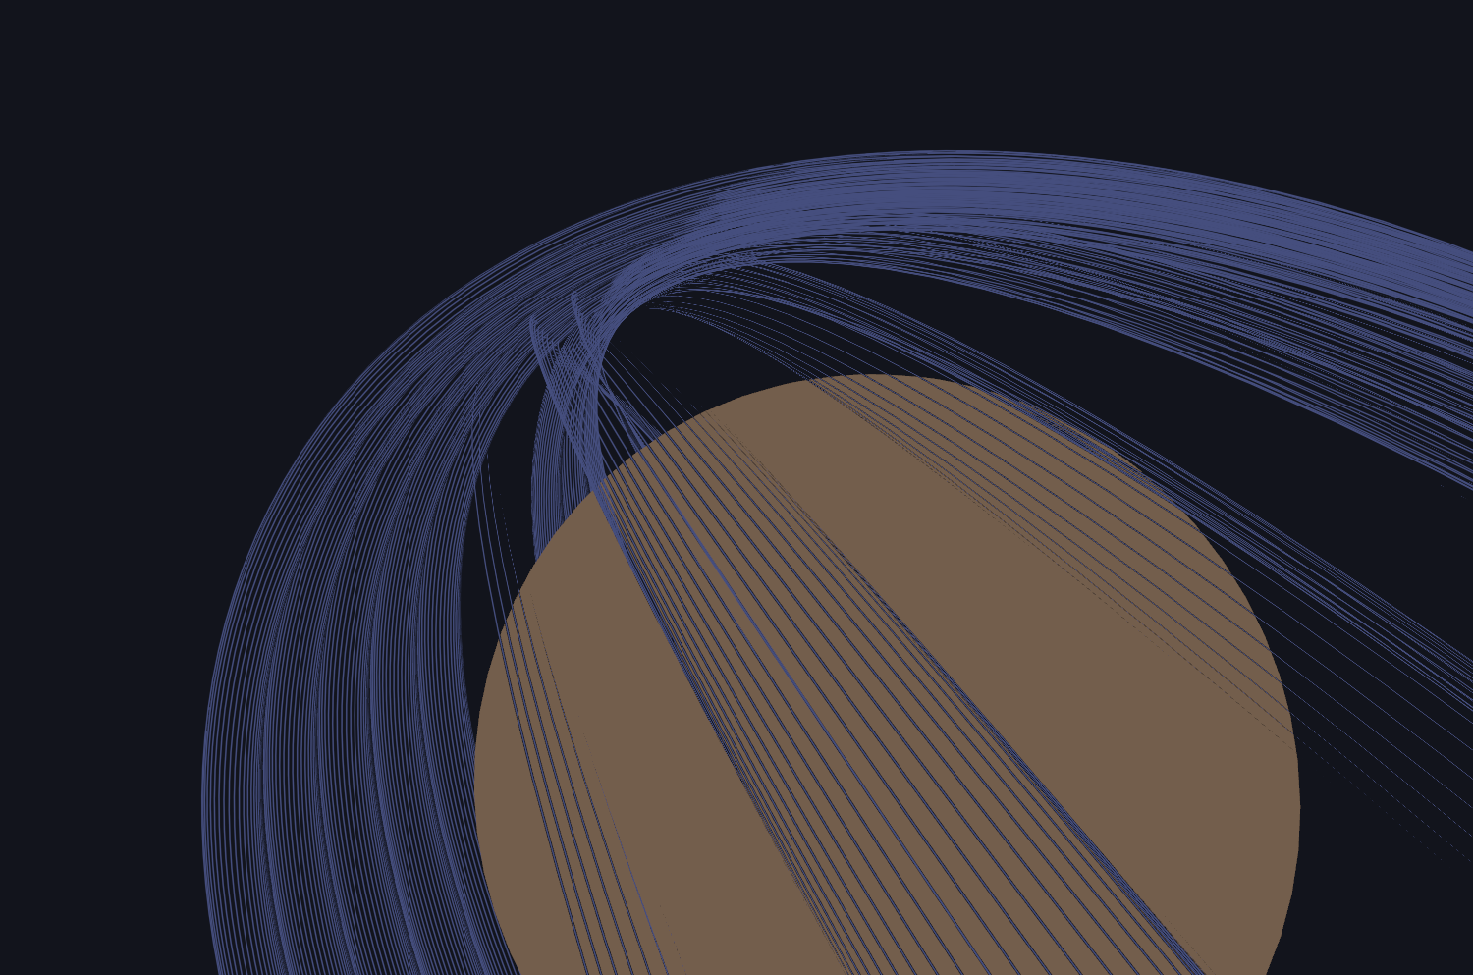
Title slide + image
Lunar Space-Based
Solar Power
Nick Felten

Slide 2
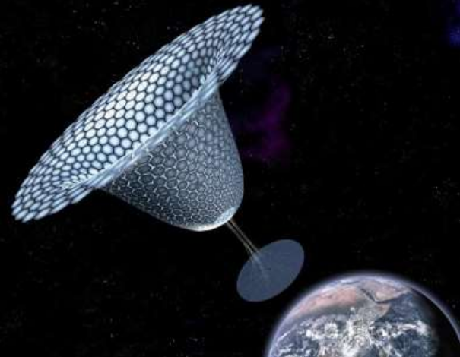
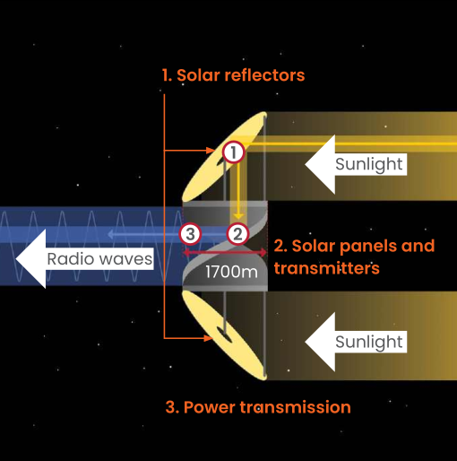
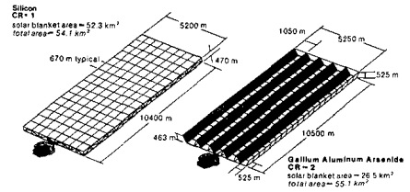
Space Based Solar Power History
Alpha (2012)
Cassiopeia (2017)
Concept from 1989

Slide 3
Why SBSP on the Moon?
Lunar night lasts 14 days … in the best case
The most interesting places are the ones never illuminated (Craters of eternal darkness)
Energy storage for 14 days is extremely heavy
Best candidate currently is nuclear reactor. Still heavy + A lot of engineering challenges
Good demonstration environment: No competition with traditional energy market

Slide 4
The Lunar Context
3 Base location considered: South pole, equator (0°N 0°E) and Malapert region (82°S 2°E)
Goal: 100 kW of continuous power over 20 years
The space element must be highly reliable and independant (no maintenance) at the same time
Launch cost for ground element much larger (13 x) than launch cost for spacecraft

Slide 5
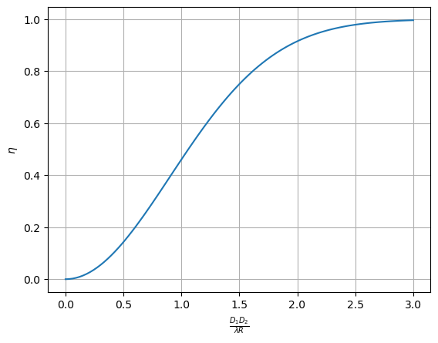
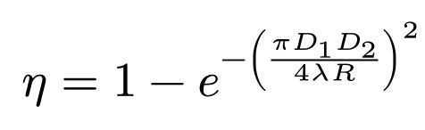
Transmission efficiency: a fundamental restriction
Larger transmitter can generate a more ‘focused’ beam
Transmitter
Diameter
Receiver
Diameter
Transmitter
Diameter
Transmitter
Diameter
Efficiency
Ideally > 2
Wavelength
Transmission
Distance

Slide 6

Microwave vs. Laser
Earth Microwave power transmission: 2 * 0.12 m * 36 000 000 m = 8 640 000 m²
=> 3 km Diameter for receiver and transmitter
Earth SBSP is limited to these wavelengths to penetrate clouds. A problem absent on the Moon
Microwave Wavelength can be reduced to 3 mm
Laser Wavelength much shorter: 880 nm an 1056 nm are common
So what is ‘R’ ?

Slide 7
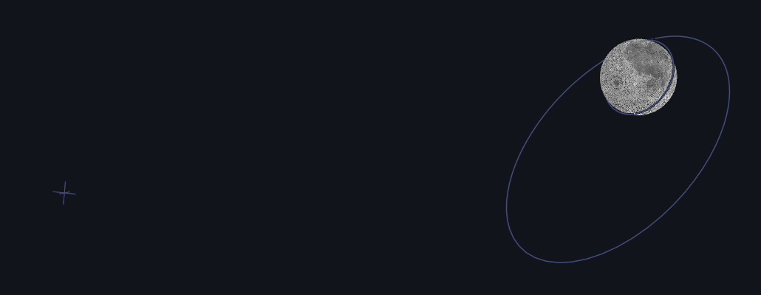
Orbital configurations
Lagrange point :
R=58 000 km,
Always in contact
High, elliptical orbit:
R<6500 km, At least half the satellites in contact
Low orbit:
R=100-600 km
Very little contact

Slide 8
Candidates: Lagrange point and Lunar polar orbit
Lagrange point
Single, large satellite
L1 for earth-facing side, L2 for ‘dark’ side
Better visibility at equator
Consistent light direction
Microwave: D1*D2 = 348 000 m²
Laser: D1*D2 = 102 m²
Polar orbit
Constellation of e.g. 6 satellites
Better visibility at the poles
Light can come from any angle
Microwave: D1*D2 = 39 000 m²
Laser: D1*D2 = 11.4 m²

Slide 9
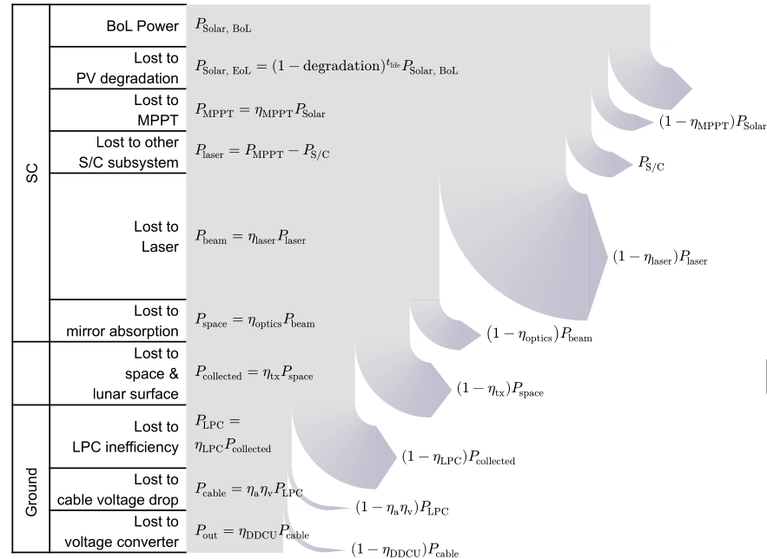
Laser Complications
More energy lost at other stages
Resulting heat needs to be dealt with
Large mirrors that keep a small diffraction are much harder to build than large radio/MW antennae
James Webb space telescope costed $B10 in no small part due to its 6m diffraction-limited mirror

Slide 10
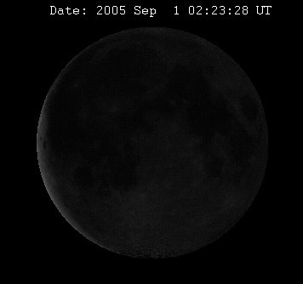
Complications
Liberation comlicates the coverage of both orbits
Terrain may block satellites
Small jitter inside Spacecraft leads to large amplitude beam jitter over long distances
Beams may arriving at an angle may waste a lot of energy
Receiver panels may cast shadows on each other at certain angles

Slide 11
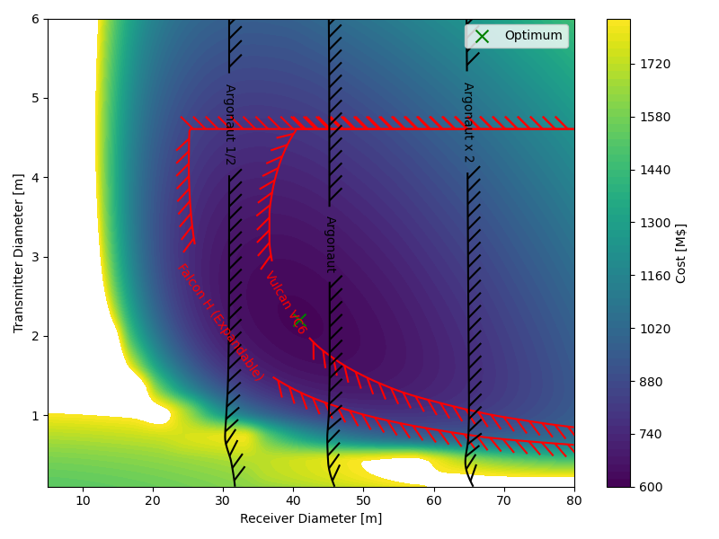
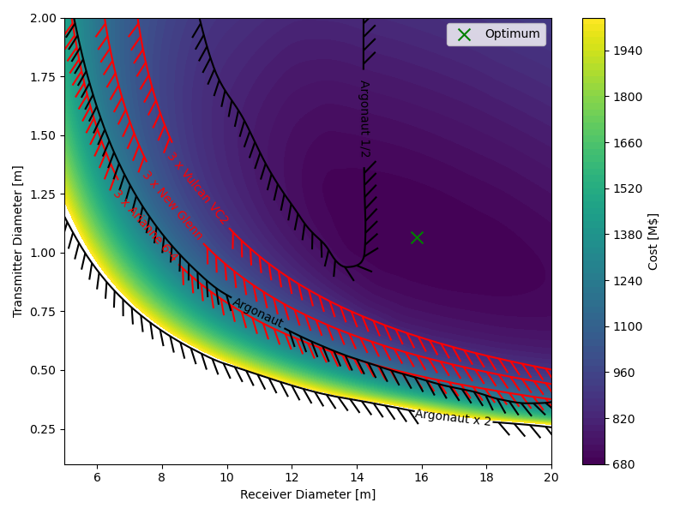
Sizing approach: Cost estimates

Slide 12
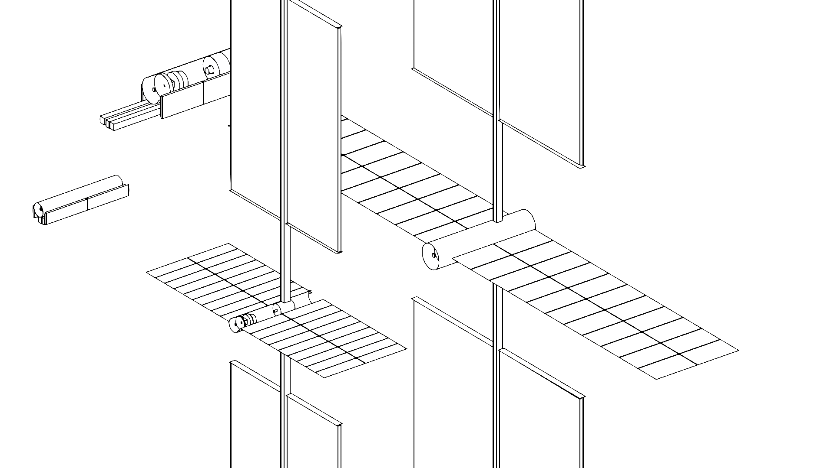
The Spacecraft: a sketch
Laser Source
Solar Array
Optics
Thermal Control
System

Slide 13
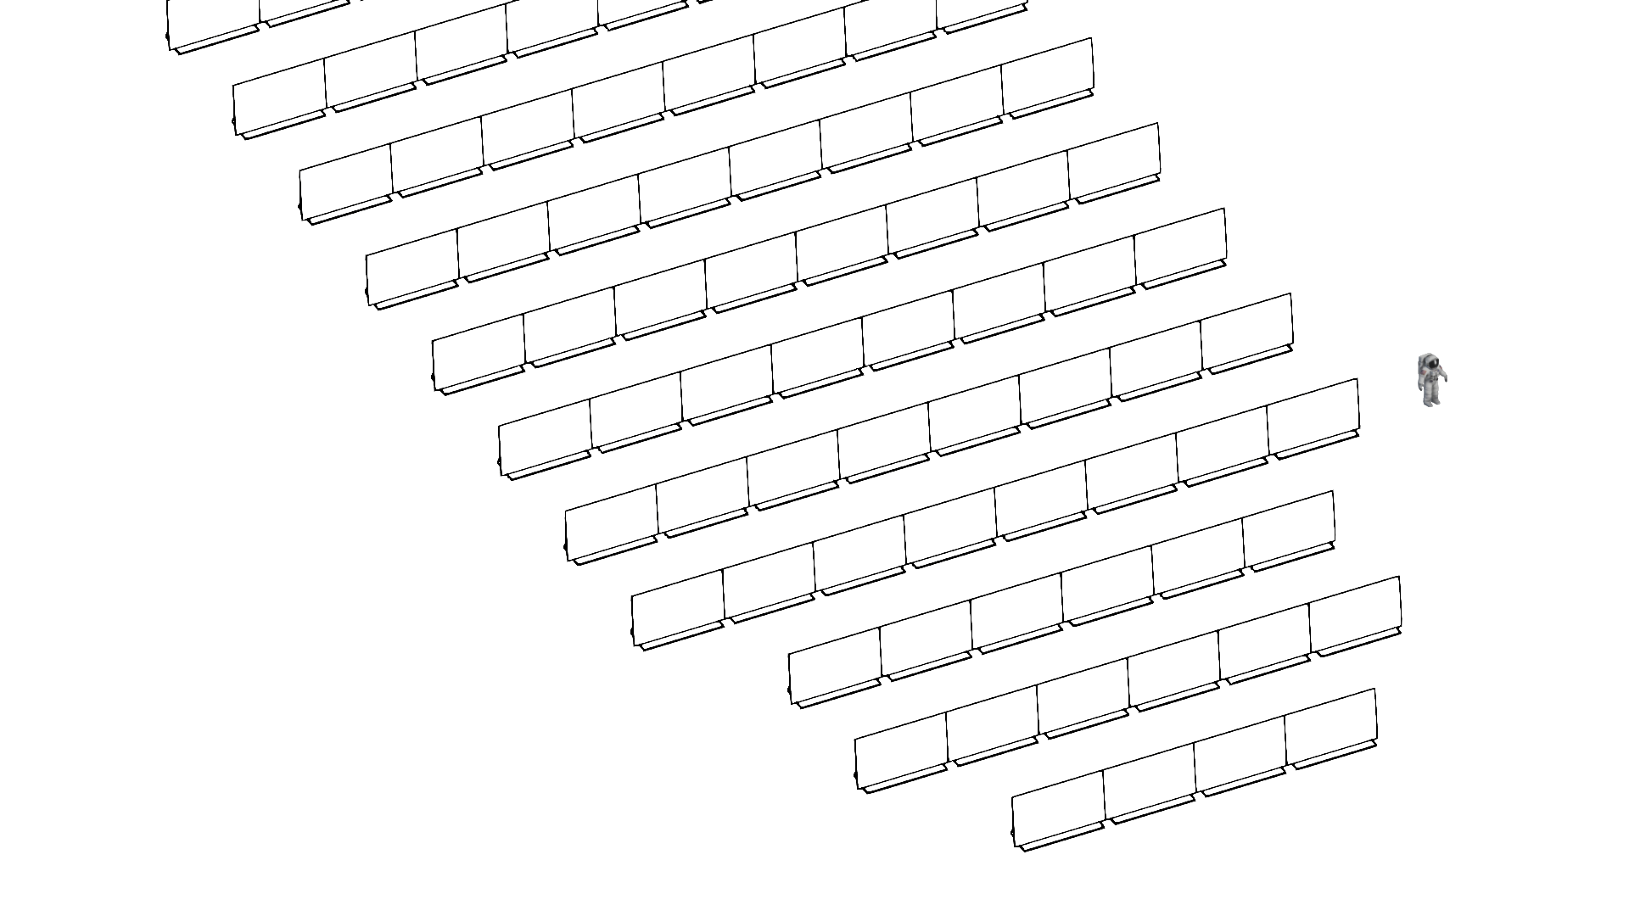
The ground element (L1)
Made from replaceable modules
Simplistic and mass-producible
Small variations in Light direction allow for Streched-Lense Array (SLA)
Needs to cover a larger area
Low intensity and SLA allow for very light panels
Ergonomics of transporting and aligning modules on a slope in lunar gravity are unclear

Slide 14
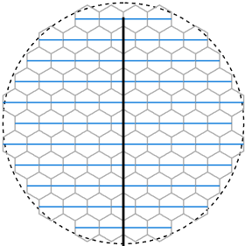
The ground element: Lunar constellation
Modules flat and hexagonal
Relies on regular photovoltaics
Beam intensity can become quite high
=> Complex thermodynamics to distribute heat load between parts
Actually heavier despite smaller size

Slide 15
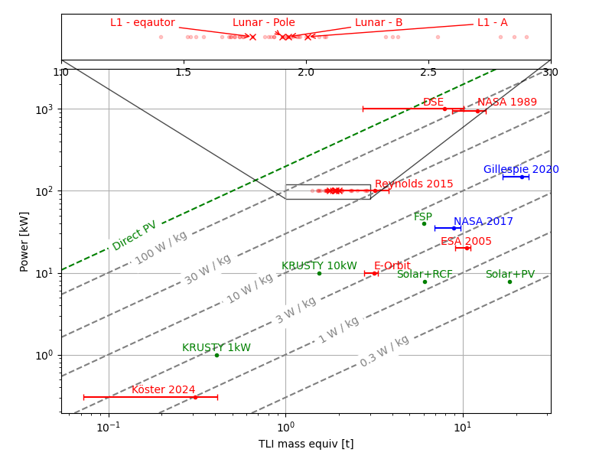
Comparison between Energy Systems
Laser
SBSP
Microwave
SBSP
Nuclear Reactors
Solar + Battery

Slide 16
Summary of both systems
Lagrange satellite
Very limited options below 80°S
By default: single point of failure
Spacecraft mass 13-15 t
Ground mass 800 – 850 kg
Highest specific power
Polar constellation
Works well within craters
Build-in redundancy
Limited to polar regions (60-70°S)
Spacecraft masses: 6 x 2.7 t
Ground mass: 680 -740 kg

