Slide 1
Vertical Moonbase
Vertical Living Habitats for Space Settlers
Workshop 1 Documentation
Jonathan & Walter
Tutor: Henriette Bier, TA: Arwin Hidding

Slide 2
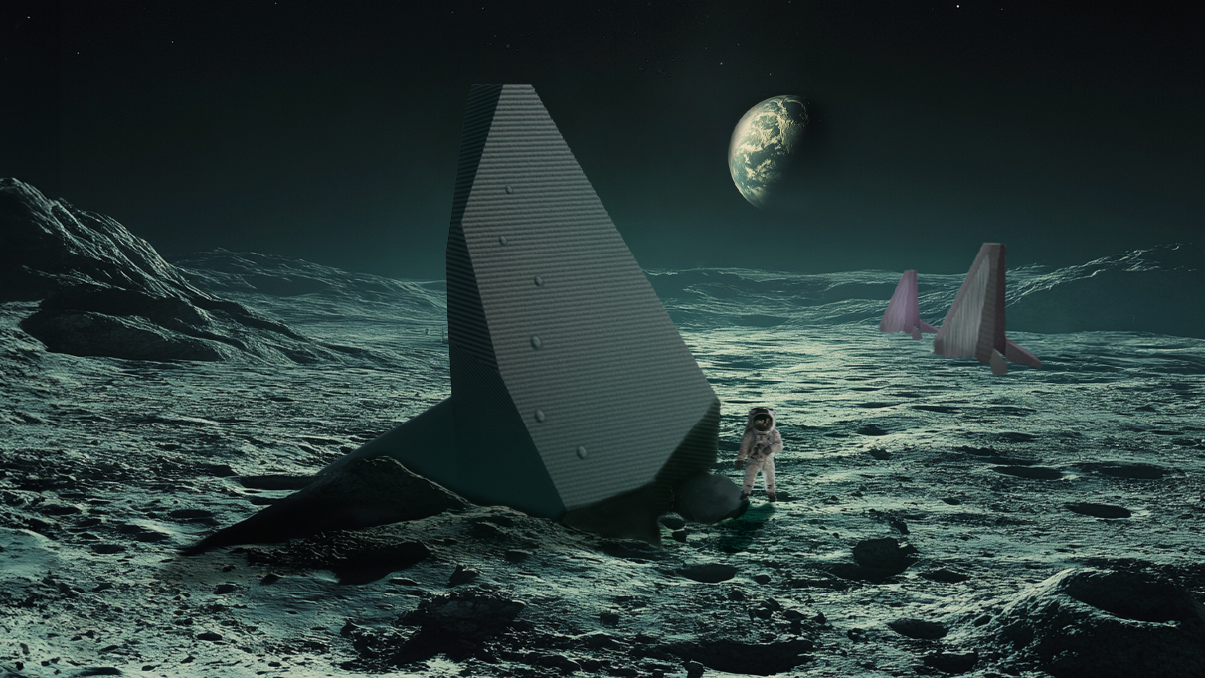

Slide 3
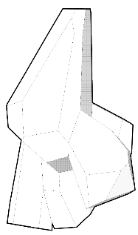
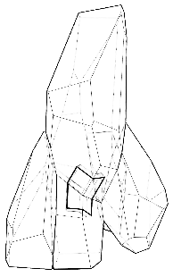
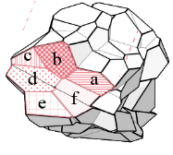

Slide 4
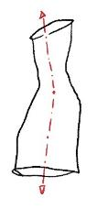
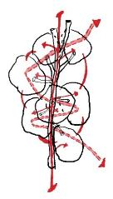
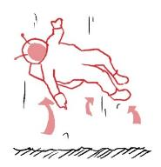
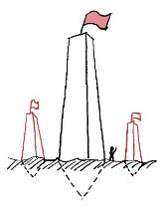
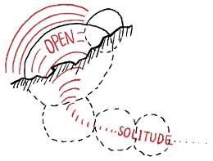
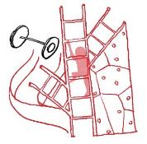
Form Logic
Vertical Structure
Micro Gravity
Central Core &
Spiral Configuration
Physical Workout Optimization
Monumentality of
Humanity Presence
Levels = Privacy Degrees

Slide 5
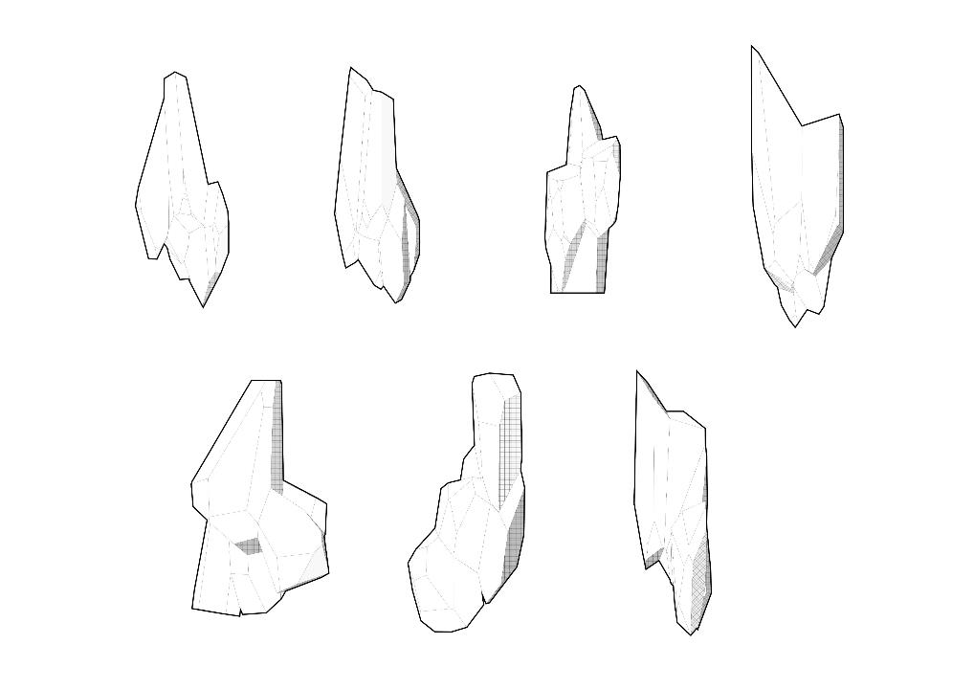
Overall Form Trials

Slide 6
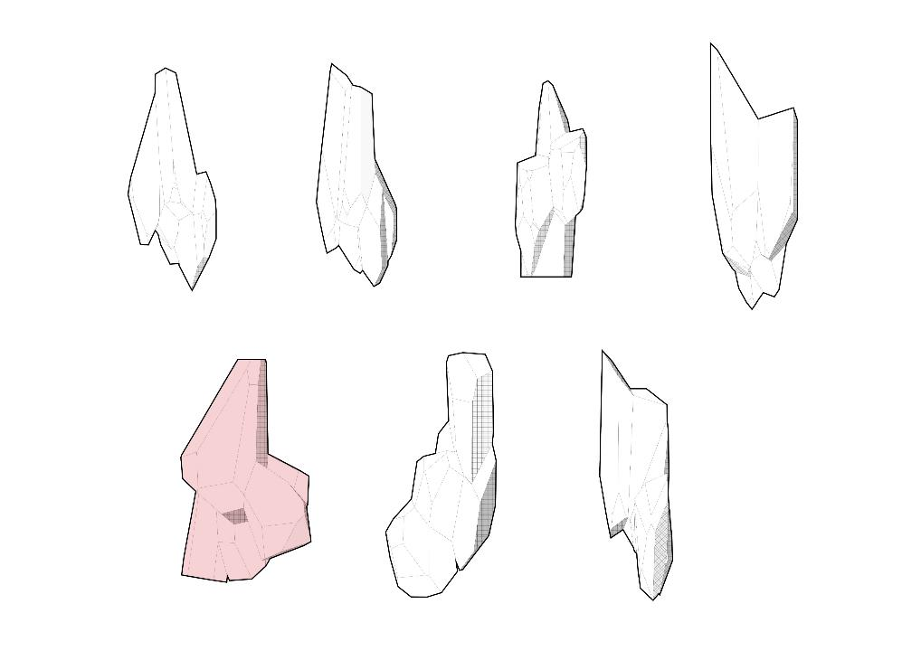
Overall Form Trials

Slide 7
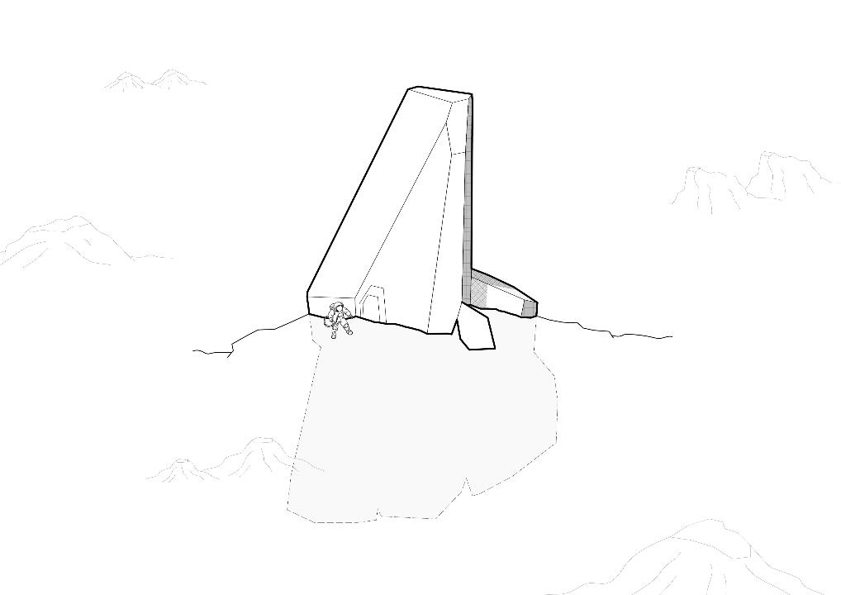
Building Tectonics

Slide 8
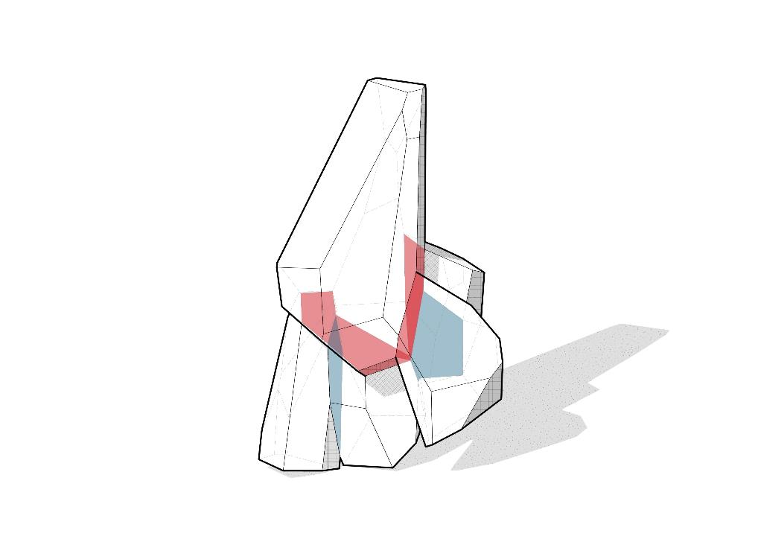
Spatial Programs

Slide 9
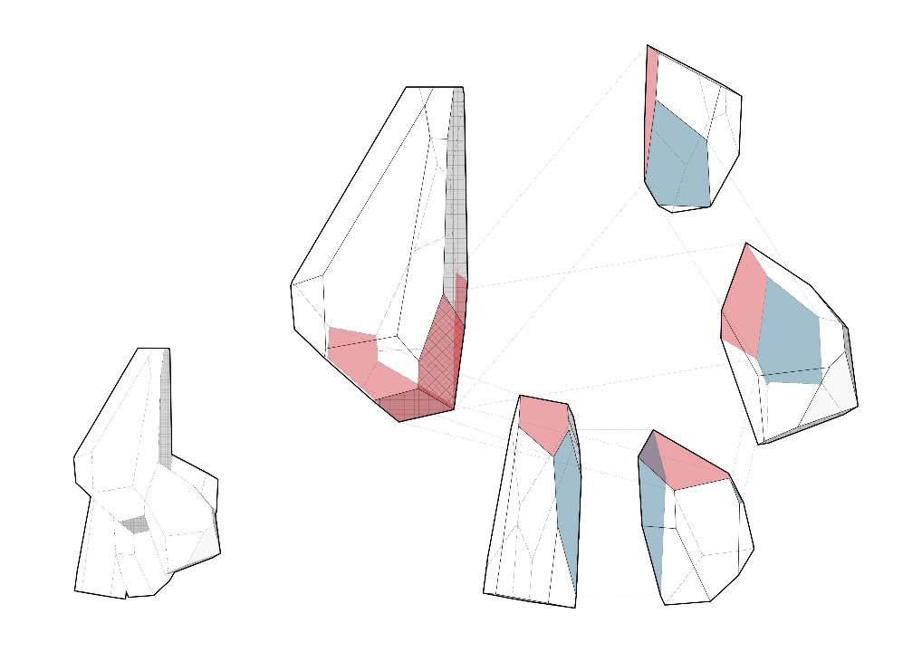
Spatial Programs

Slide 10
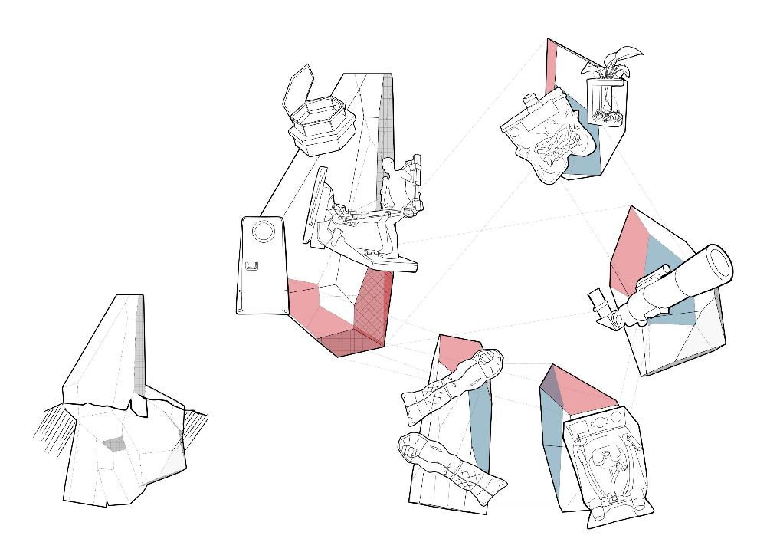
Spatial Programs
kitchen & food
entrance area,
major opening,
living room
work & research
sleep & rest
bath & wc

Slide 11
Spatial Connectivity

Slide 12
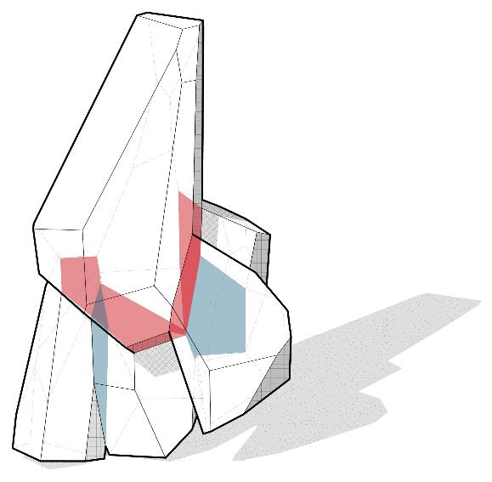
Spatial Connectivity

Slide 13
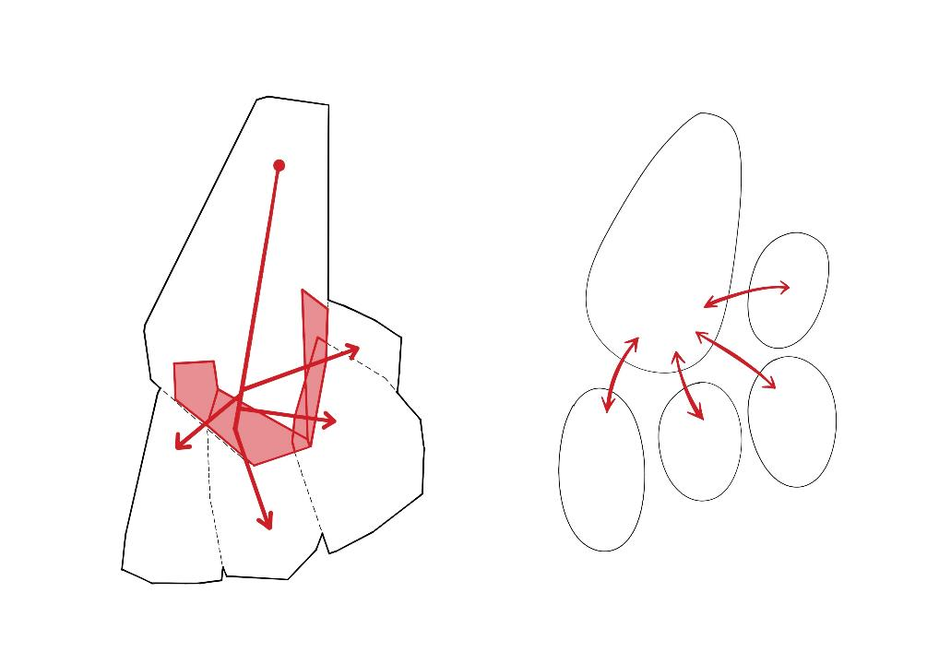
Spatial Connectivity
living
food
work
hygiene
solitude

Slide 14
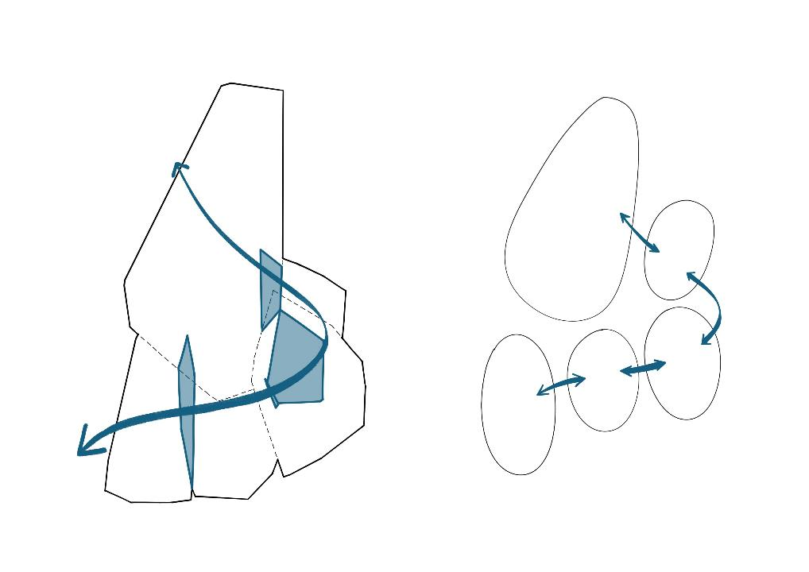
Spatial Connectivity
living
food
work
hygiene
solitude

Slide 15
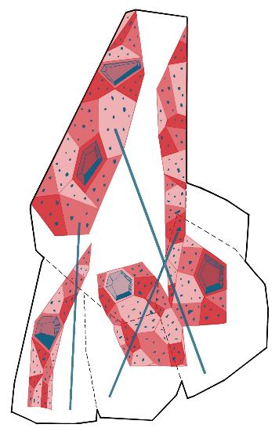
Spatial Connectivity
climbing walls
void spaces
poles

Slide 16
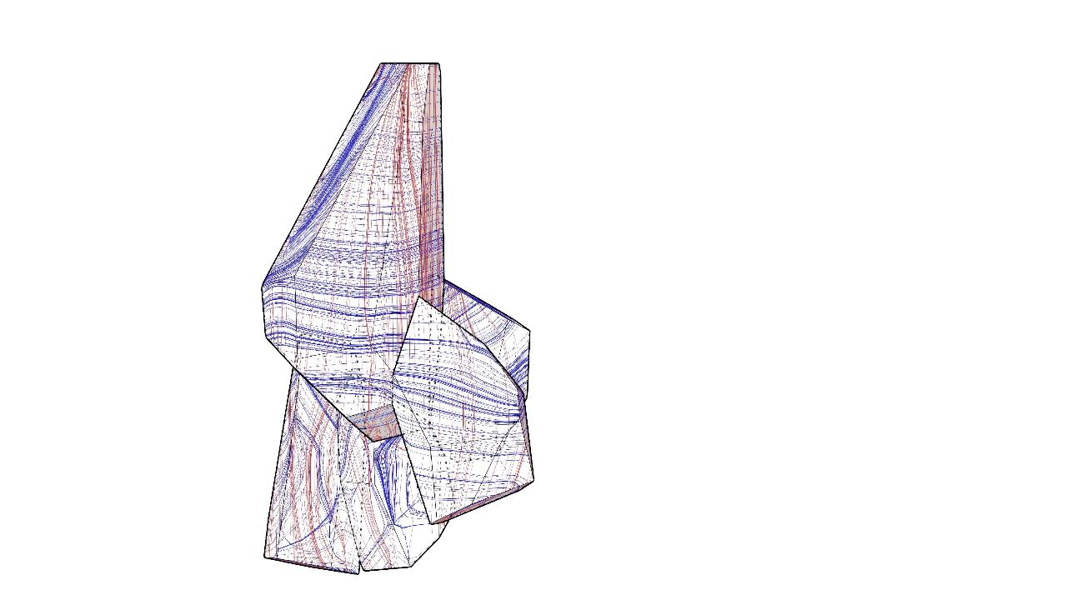
Stress Lines

Slide 17
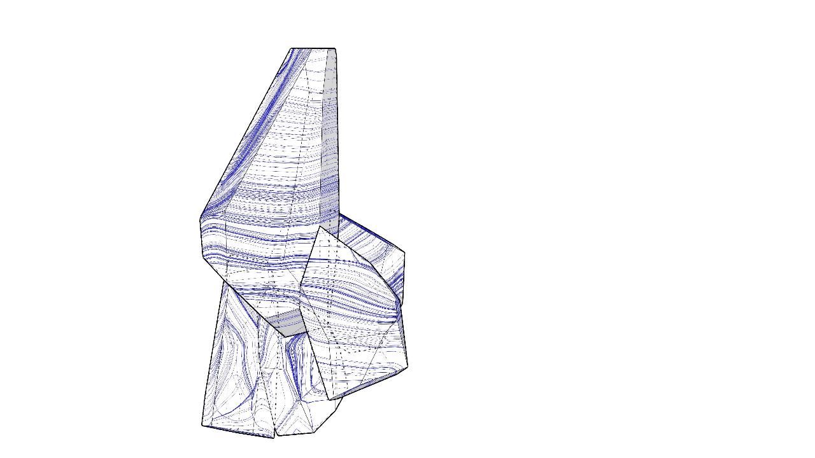
Tension Lines
Assuming regolith-based 3D printing material has a similar structural performance to concrete

Slide 18
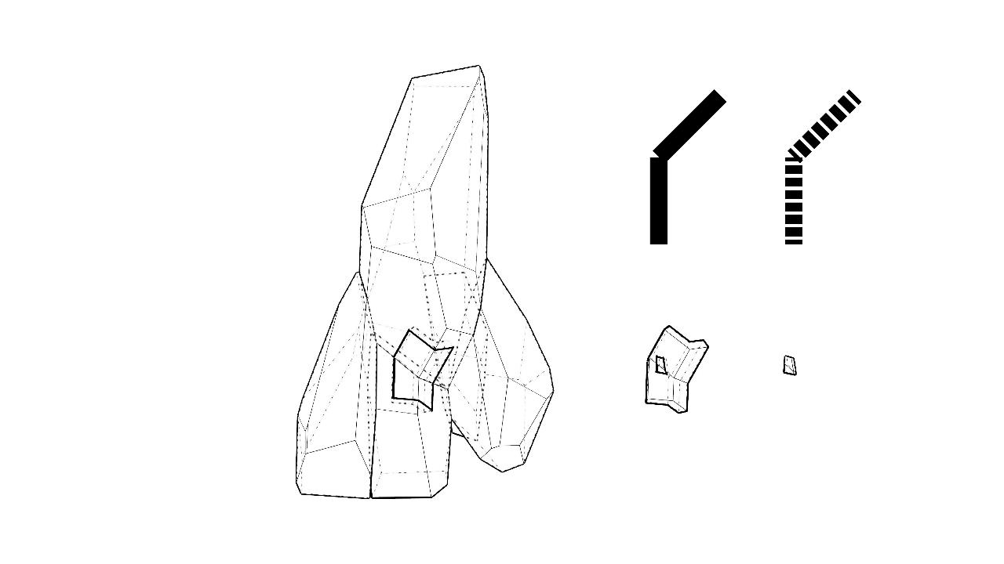
Fragment
From vertical to inclined plane

Slide 19
Sub-fragment
Why Voronoi?

Slide 20
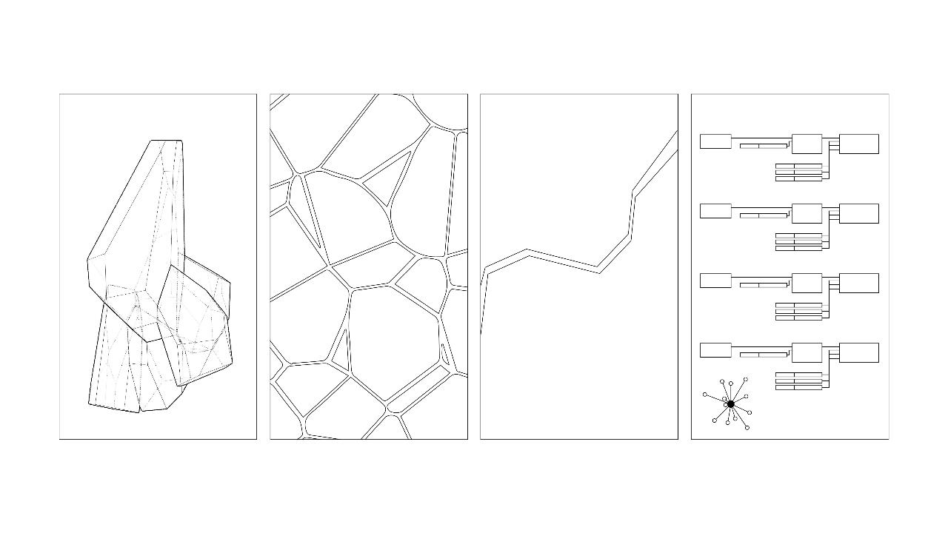
Sub-fragment
design language
consistency
resemblance to
nature
natural interlocking
properties
flexibility on rapid computational generation

Slide 21
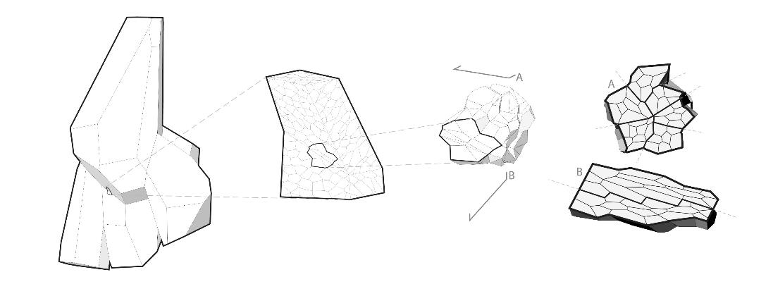
Sub-fragment
architecture
component
material
design language consistency
natural interlocking properties
resemblance to nature
flexible & rapid computational generation
material efficiency on complex geometry

Slide 22
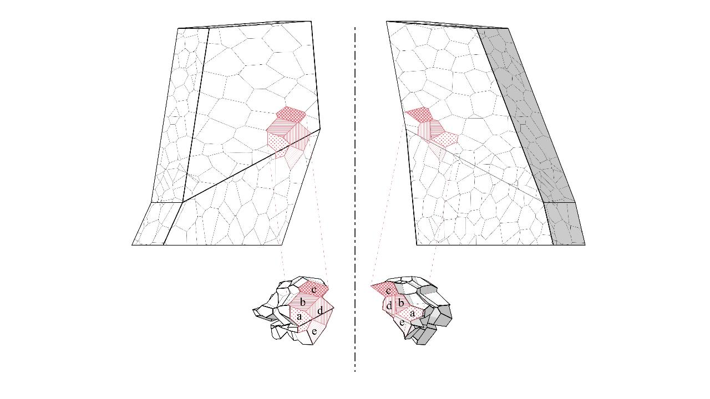
Sub-fragment
back
front

Slide 23
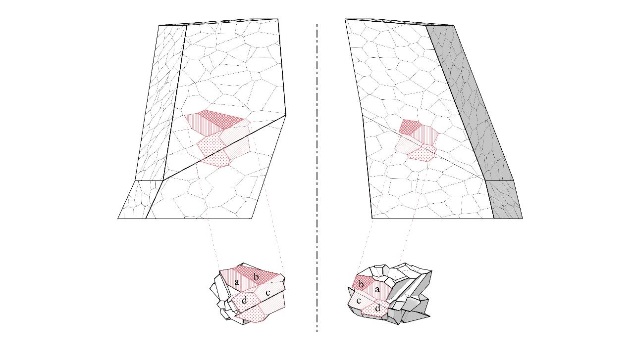
Sub-fragment
back
front

Slide 24
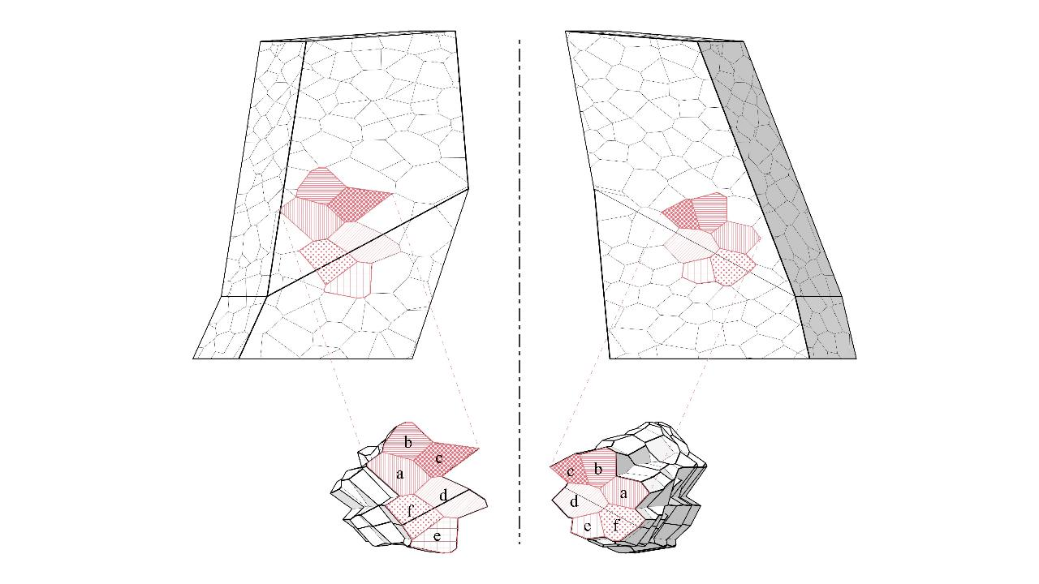
Sub-fragment
back
front

Slide 25
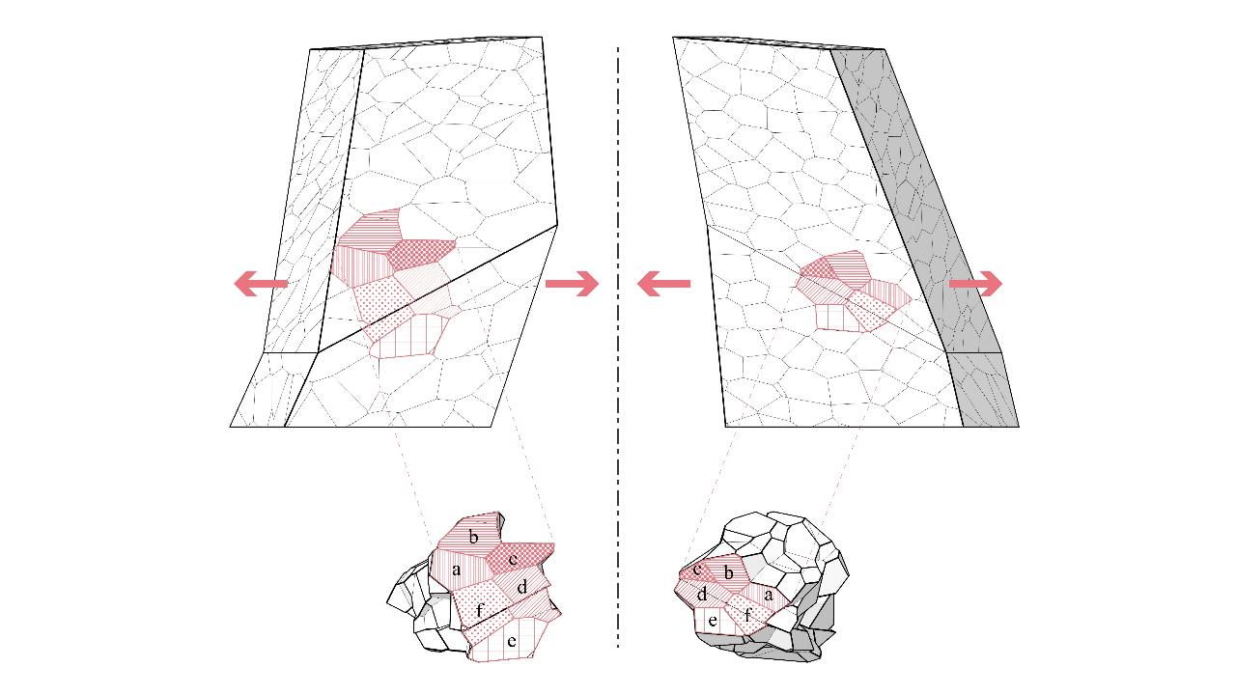
Sub-fragment
back
front

Slide 26
Sub-fragment
Sub-fragment
back
front

Slide 27
Sub-fragment
Sub-fragment
back
front

Slide 28
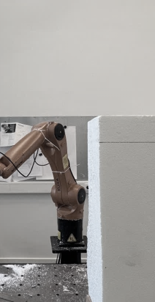
Fabrication: Milling

Slide 29
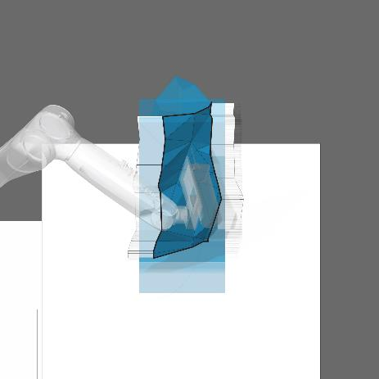
Fabrication: Main Sides

Slide 30
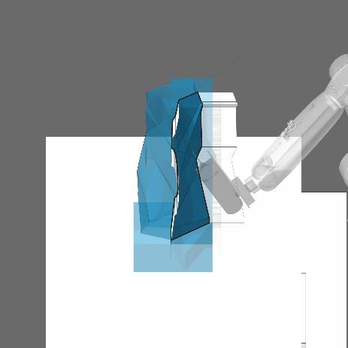
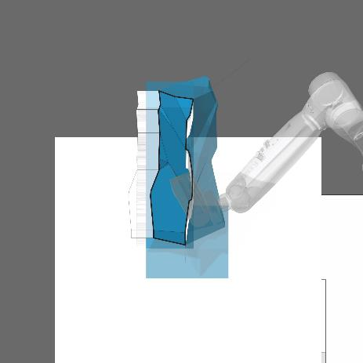
Fabrication: Main Sides

Slide 31
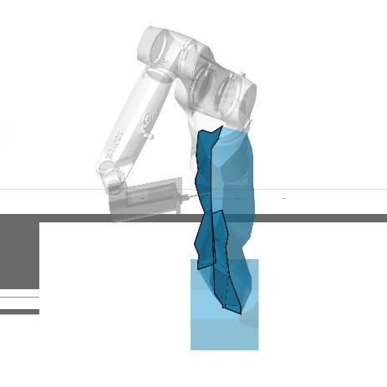
Fabrication: Far-reaching Sides

Slide 32
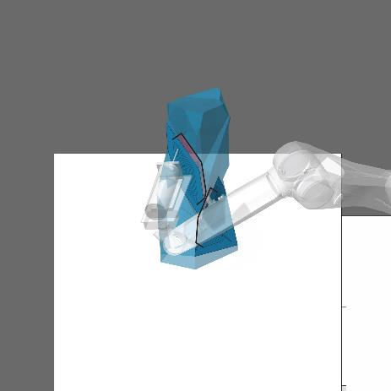
Fabrication: Holding Holes

Slide 33
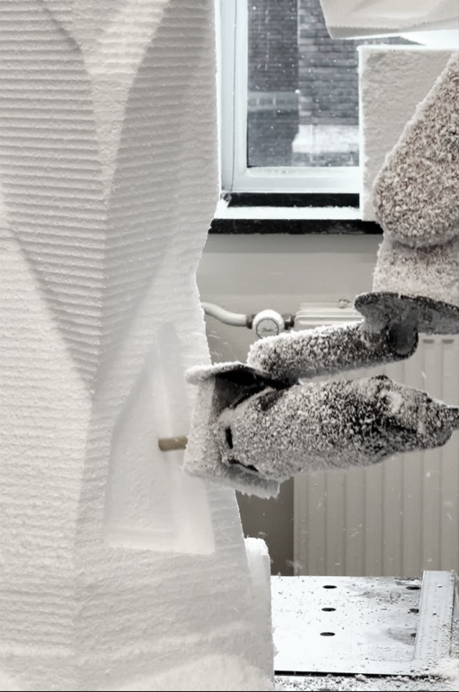
Fabrication: Holding Holes

Slide 34
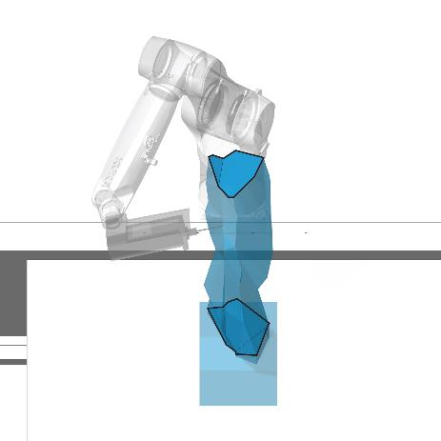
Fabrication: Top and Bottom

Slide 35
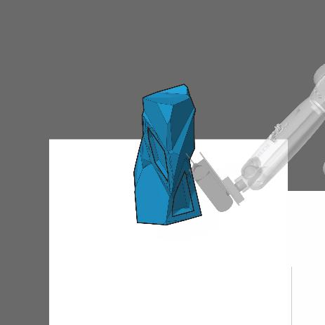
Fabrication: Finished Piece

Slide 36
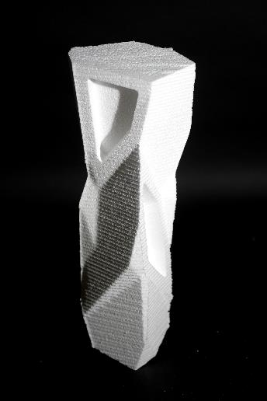
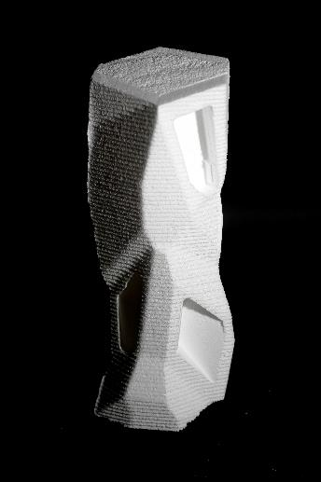
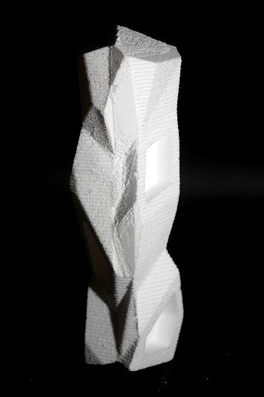
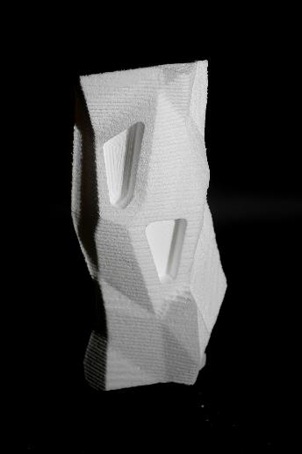
Fabrication: Finished Pieces

Slide 37
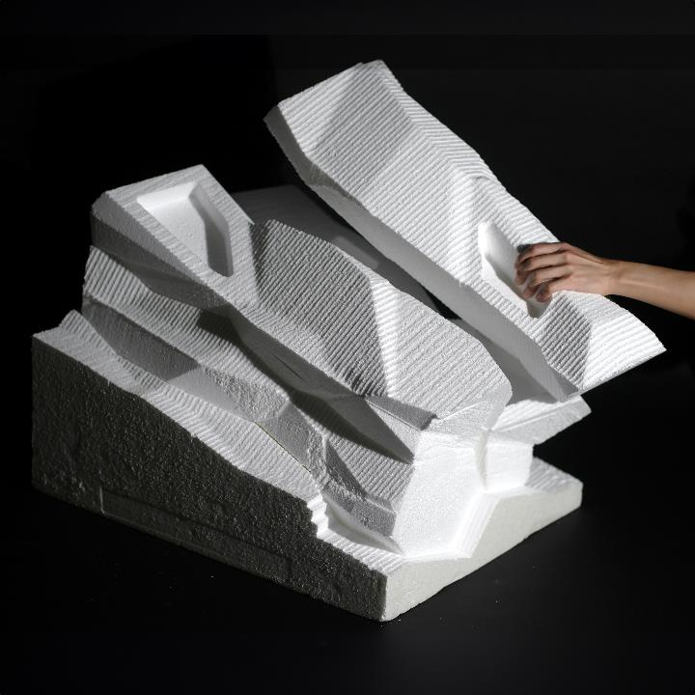
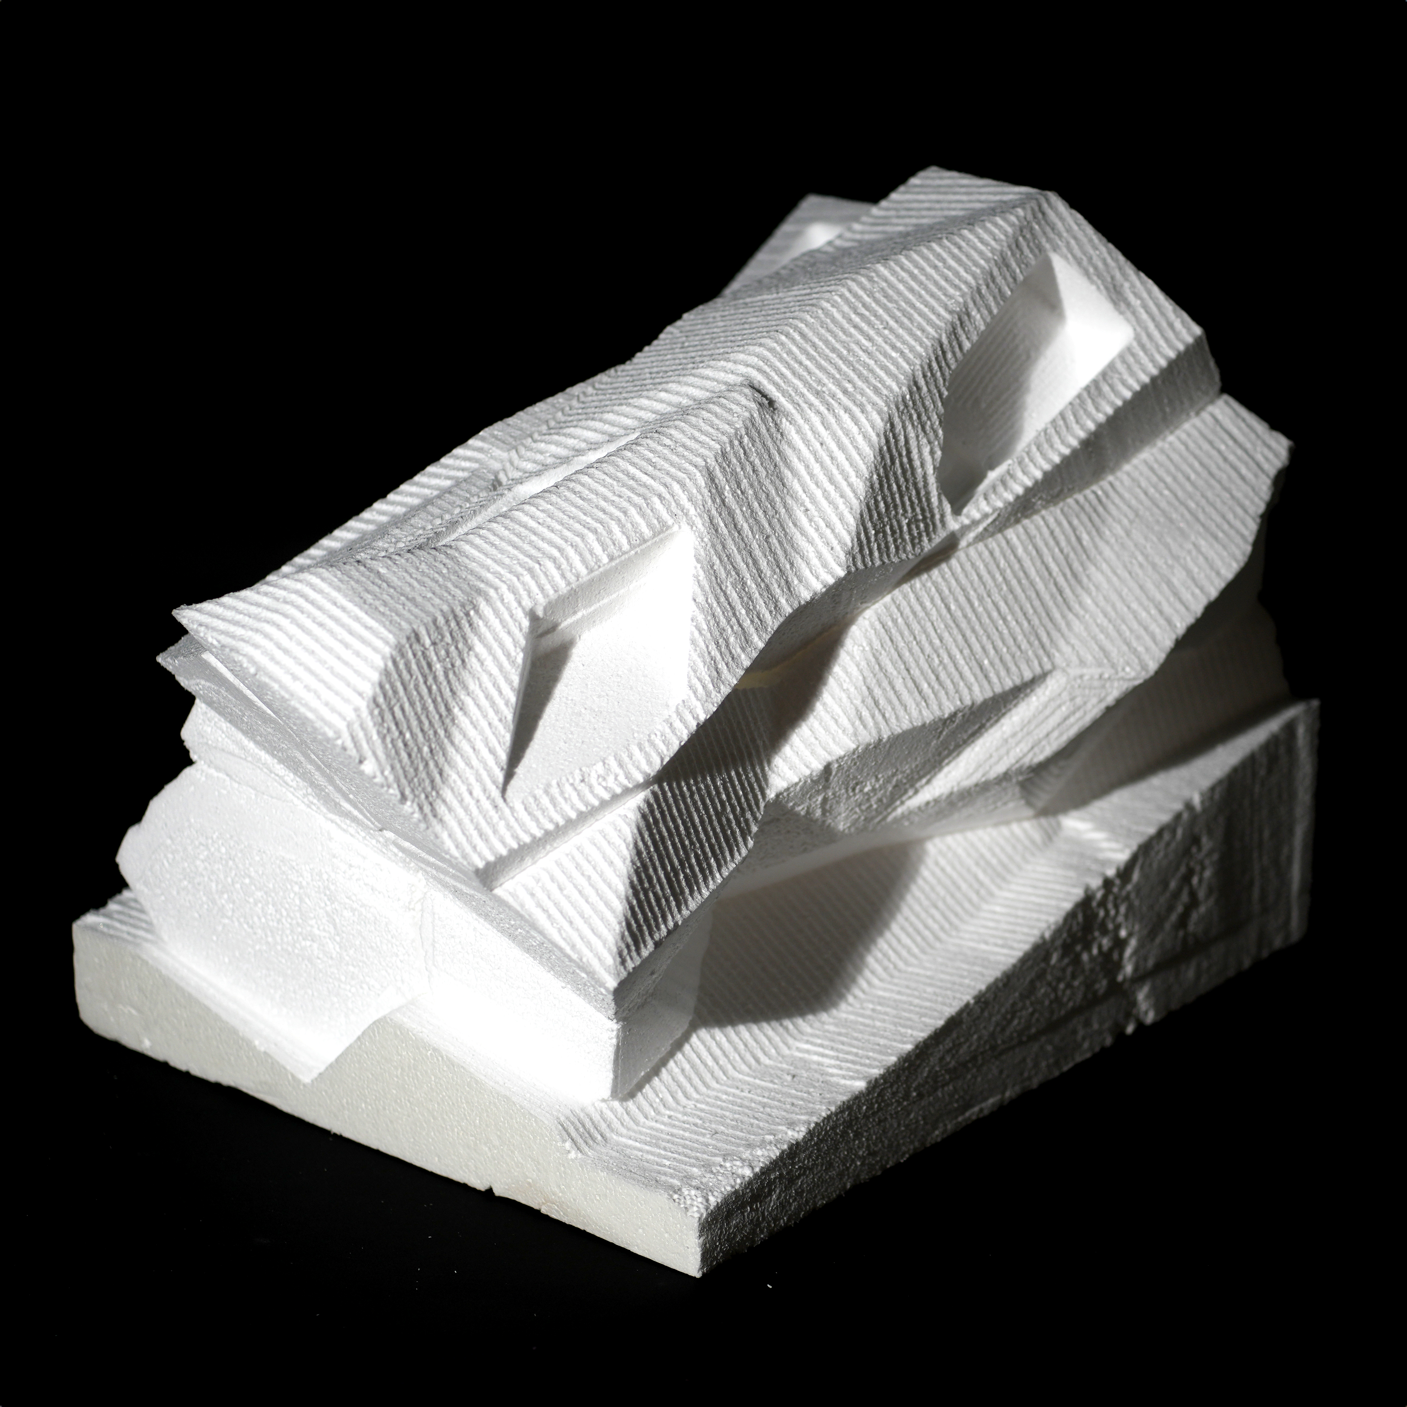
Fabrication: Finished Pieces

Slide 38
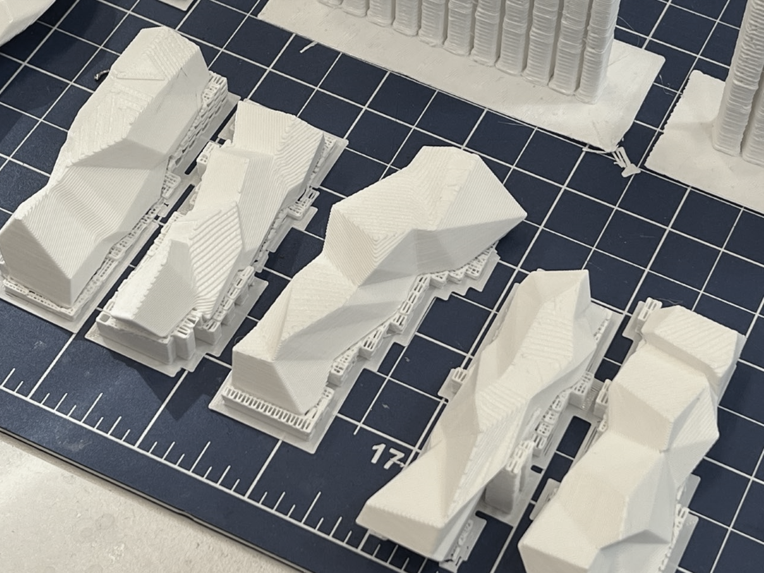
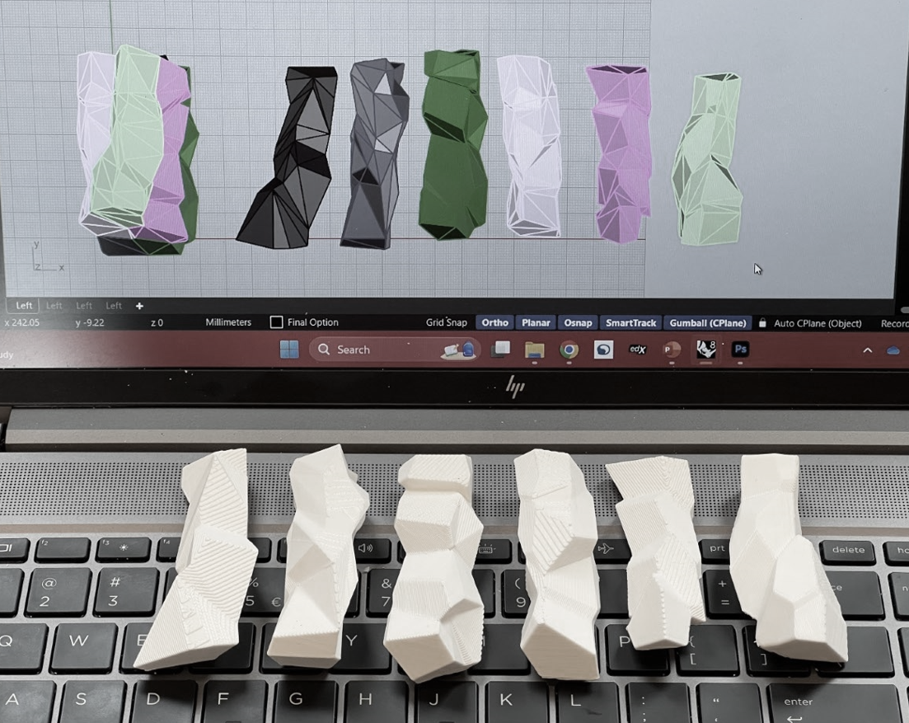
Fabrication: 3D Print

Slide 39
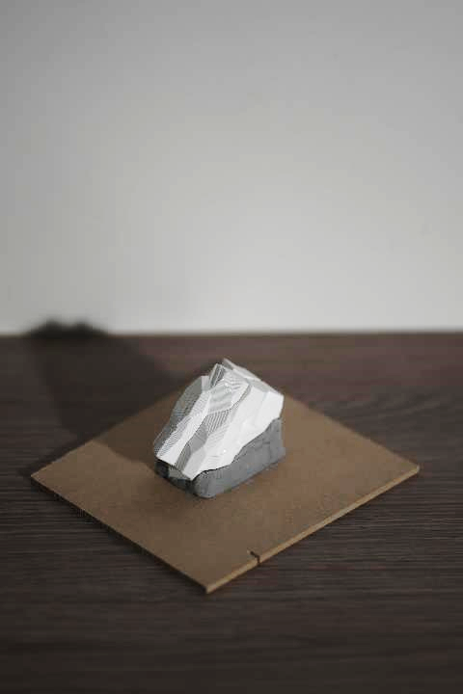
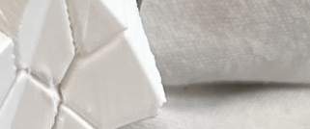
3D Print Stacking

