Slide 1
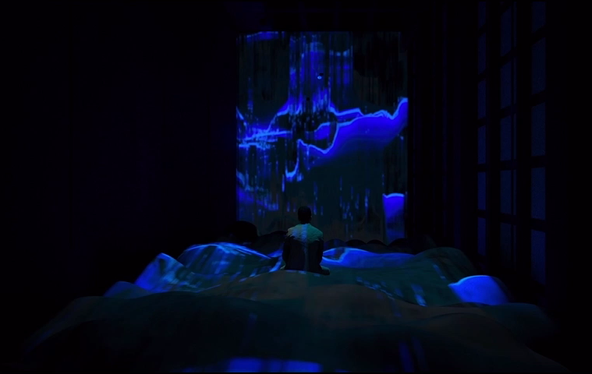
Colour projection
“EMO”- Xiying Bao
AI technology: facial recognition
Changes colours and shapes based on perceived emotion
Adaptive system that monitors wellbeing of crew members
  influence/transform emotions as well?
https://studentawards.mediaarchitecture.org/mab/project/11
1
Sophia Benfield | MoonSane | Lunar Architecture | Tutor: H. Bier & A. Hidding | 2024/25 | TU Delft

Slide 2
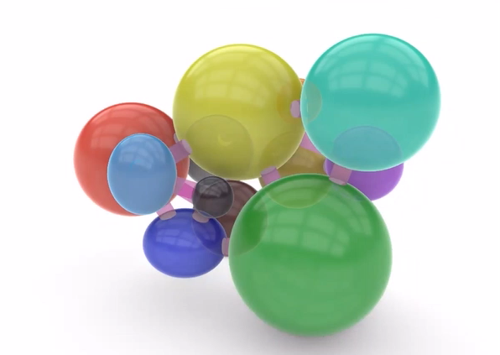
Connecting 3D: double atrium
 | Function
 | Living
 | Kitchen
 | Storage main
 | Meditation
 | Garden-gym
 | Medical
 | Private quarters
 | Bathroom
 | Storage private
 | Research
 | EVA chamber
 | Storage research
Garden new atrium – lower level
Views: needs met
2
Sophia Benfield | MoonSane | Lunar Architecture | Tutor: H. Bier & A. Hidding | 2024/25 | TU Delft
Notes:
So I integrated the garden as a second atrium and made sure all rooms that could use outside views had this access, like the meditation space. This worked better.

Slide 3
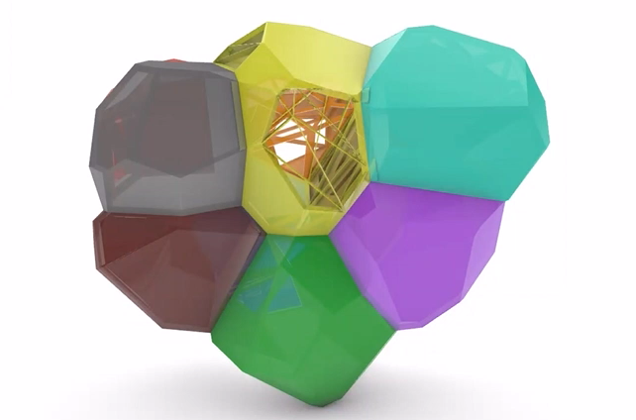
Porosity: Voronoi
 | Function | Porosity
 | Living | 80%
 | Kitchen | 62%
 | Storage main | 16%
 | Meditation | 7%
 | Garden-gym | 40%
 | Medical | 0%
 | Private quarters | 3%
 | Bathroom | 0%
 | Storage private | 0%
 | Research | 8%
 | EVA chamber | 5%
 | Storage research | 0%
3
Sophia Benfield | MoonSane | Lunar Architecture | Tutor: H. Bier & A. Hidding | 2024/25 | TU Delft

