Slide 1
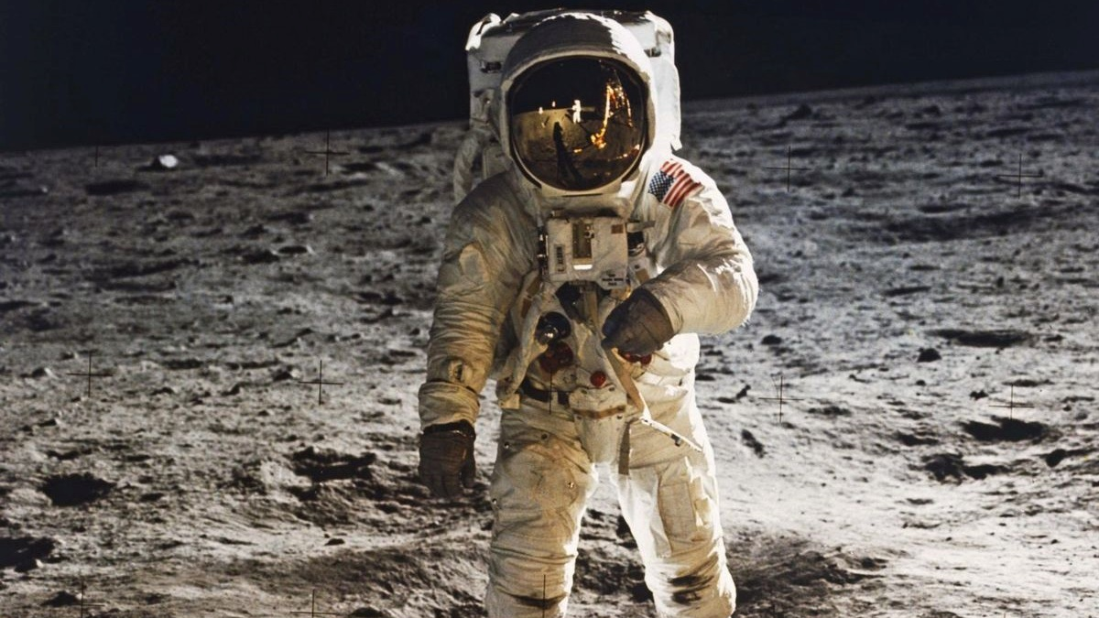
Construction & Materialization

Slide 2
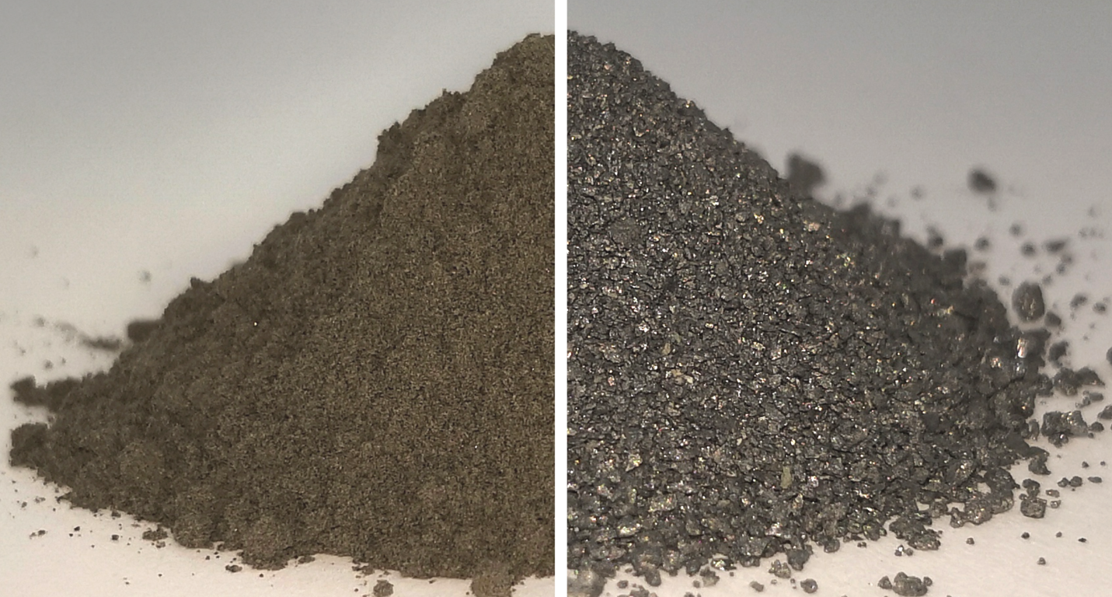
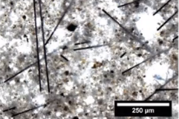
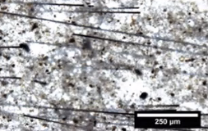
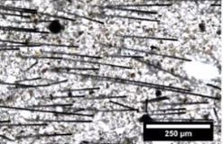
Construction & Materialization
Building Material
In-situ Resource Utilization
Regolith (top left)
Radiation protection (Savage & Schmitz, 2024)
Strong compressive strength
Regolith derivated materials (top right)
Oxygen
Metal
Silica (for glass)
Water
Carbon fibre (top right)
Substrate of regolith geopolymer, to mitigate tensile forces (Rutzen et al., 2021)

Slide 3
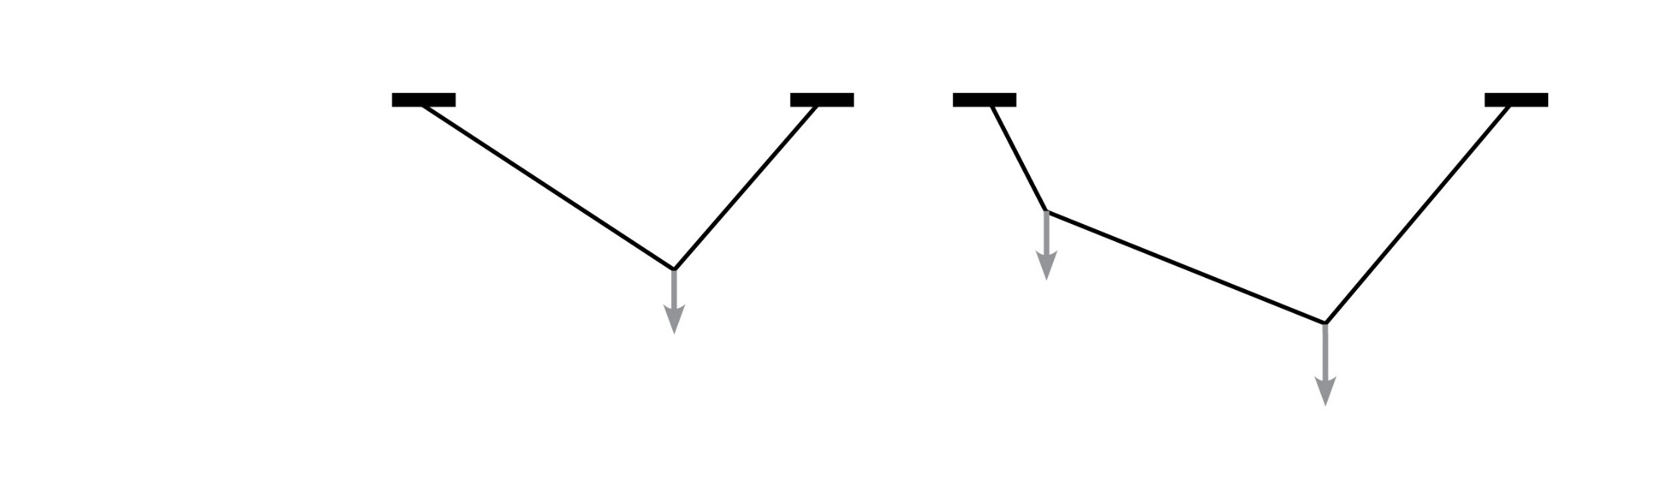
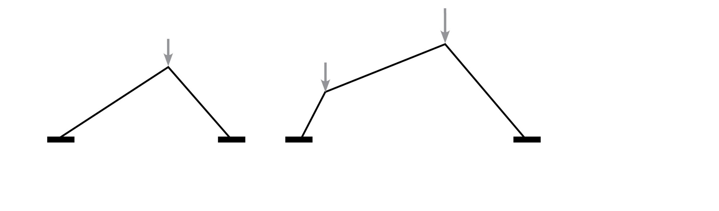
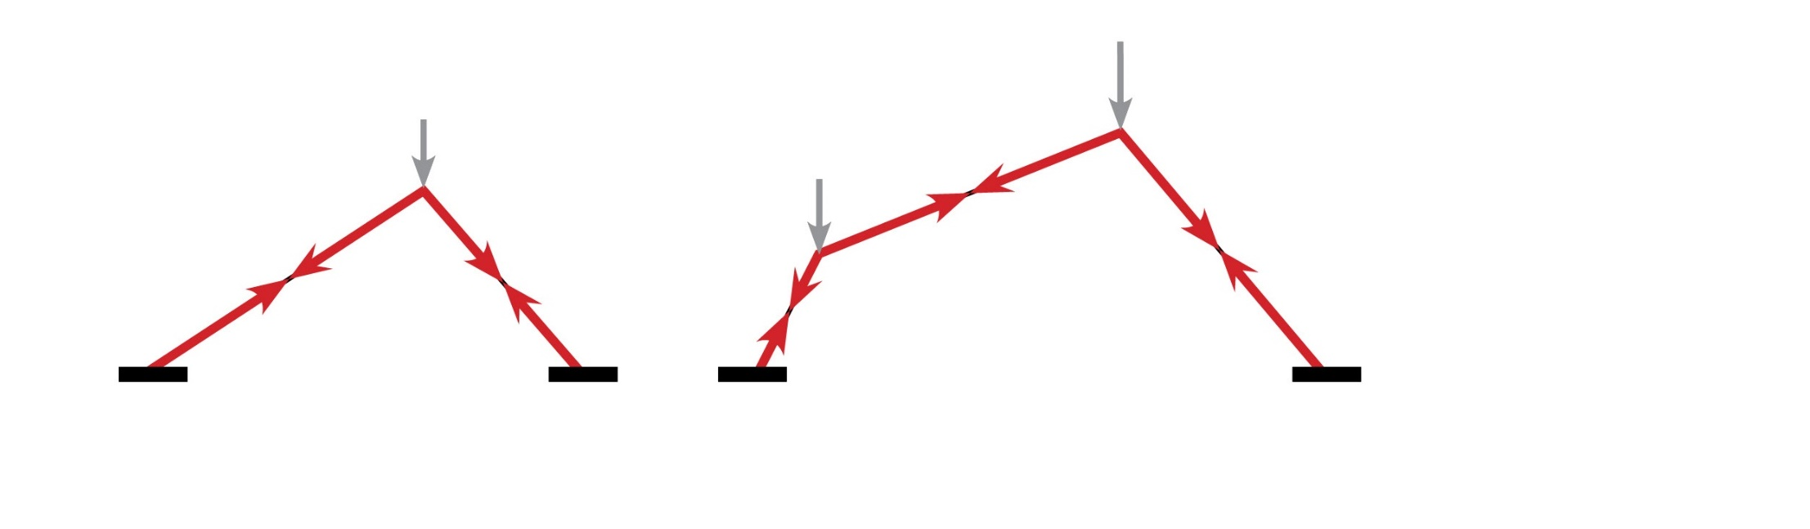
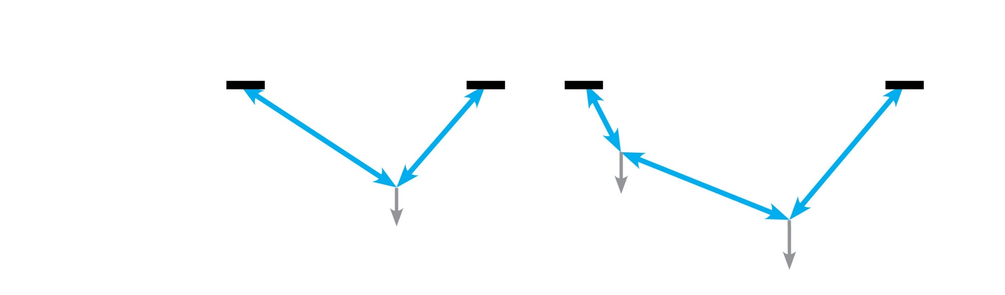
Construction & Materialization
Structure
Catenary principle
Catenary
Reverse Catenary
Tension Forces
Compression Forces

Slide 4
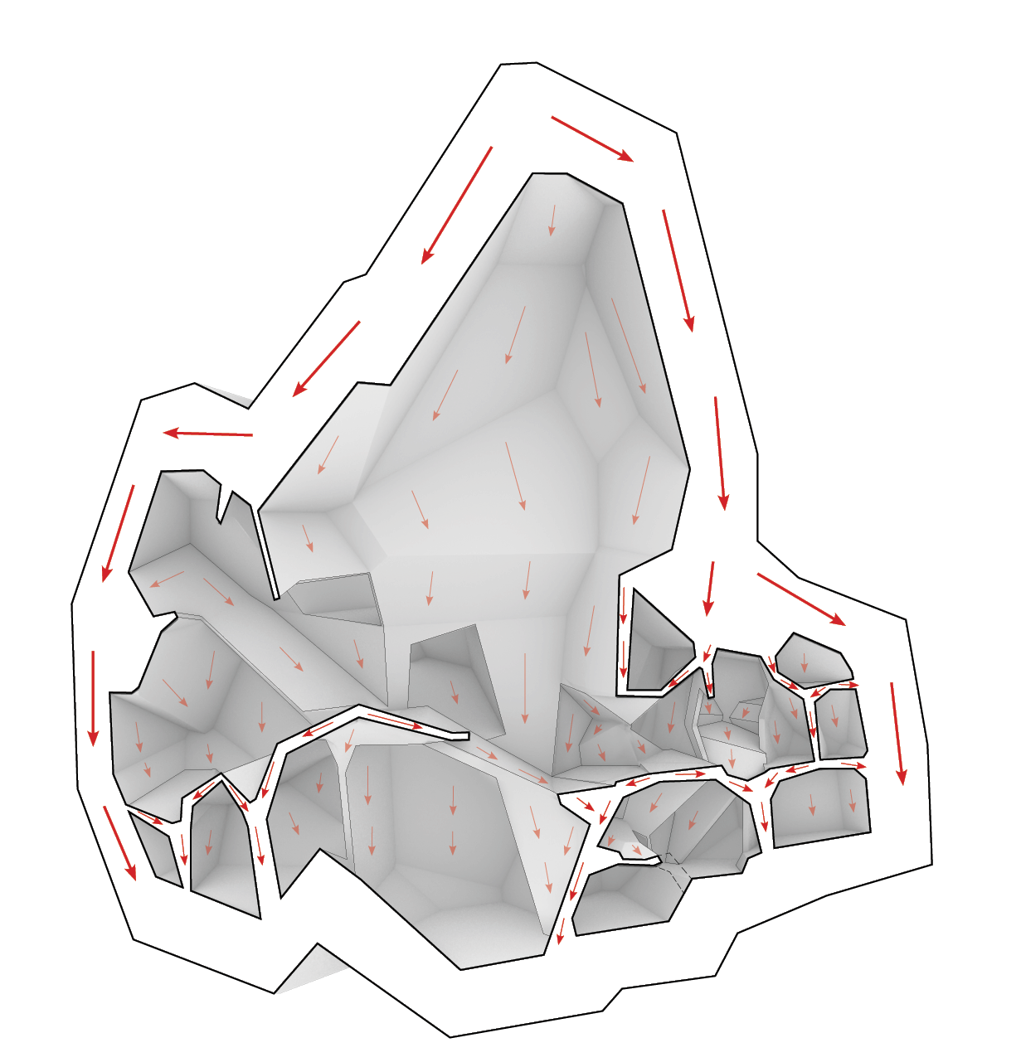
Construction & Materialization
Structure
Distribution of forces
Load transfer direction

Slide 5
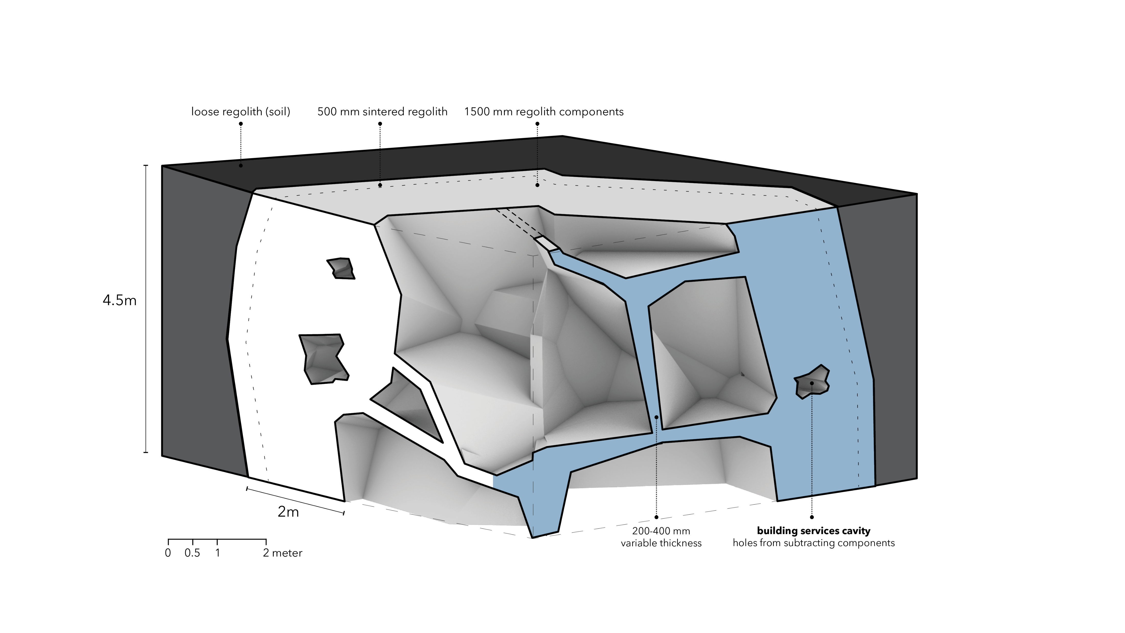
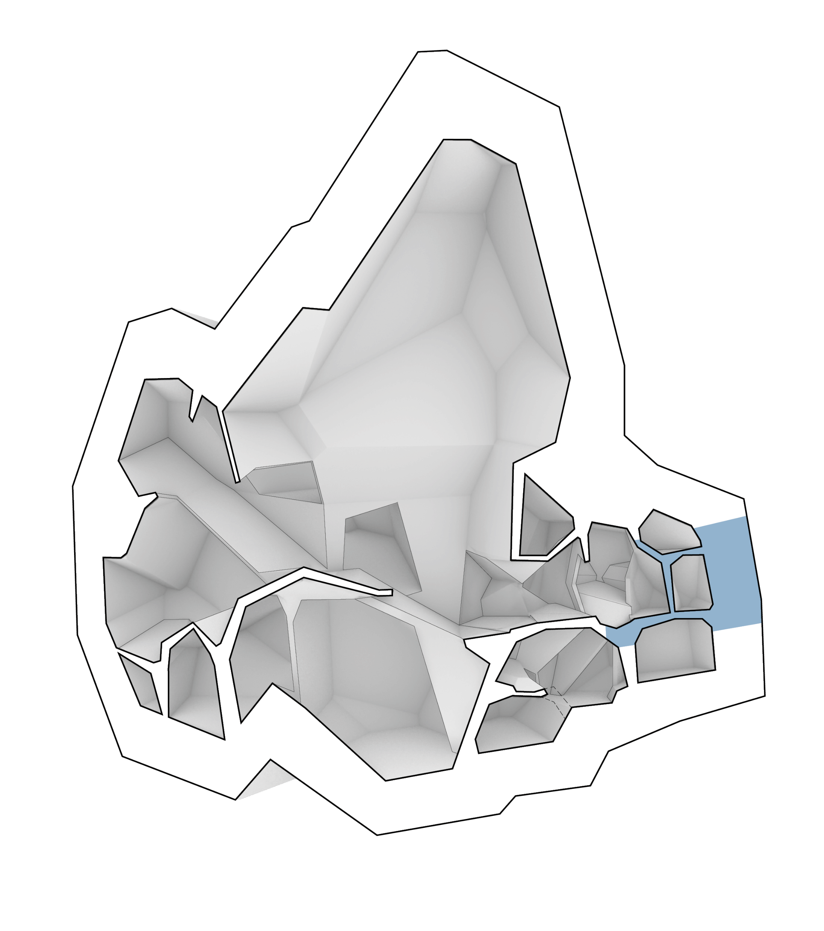
Construction & Materialization
Fragment
Private Quarters

Slide 6
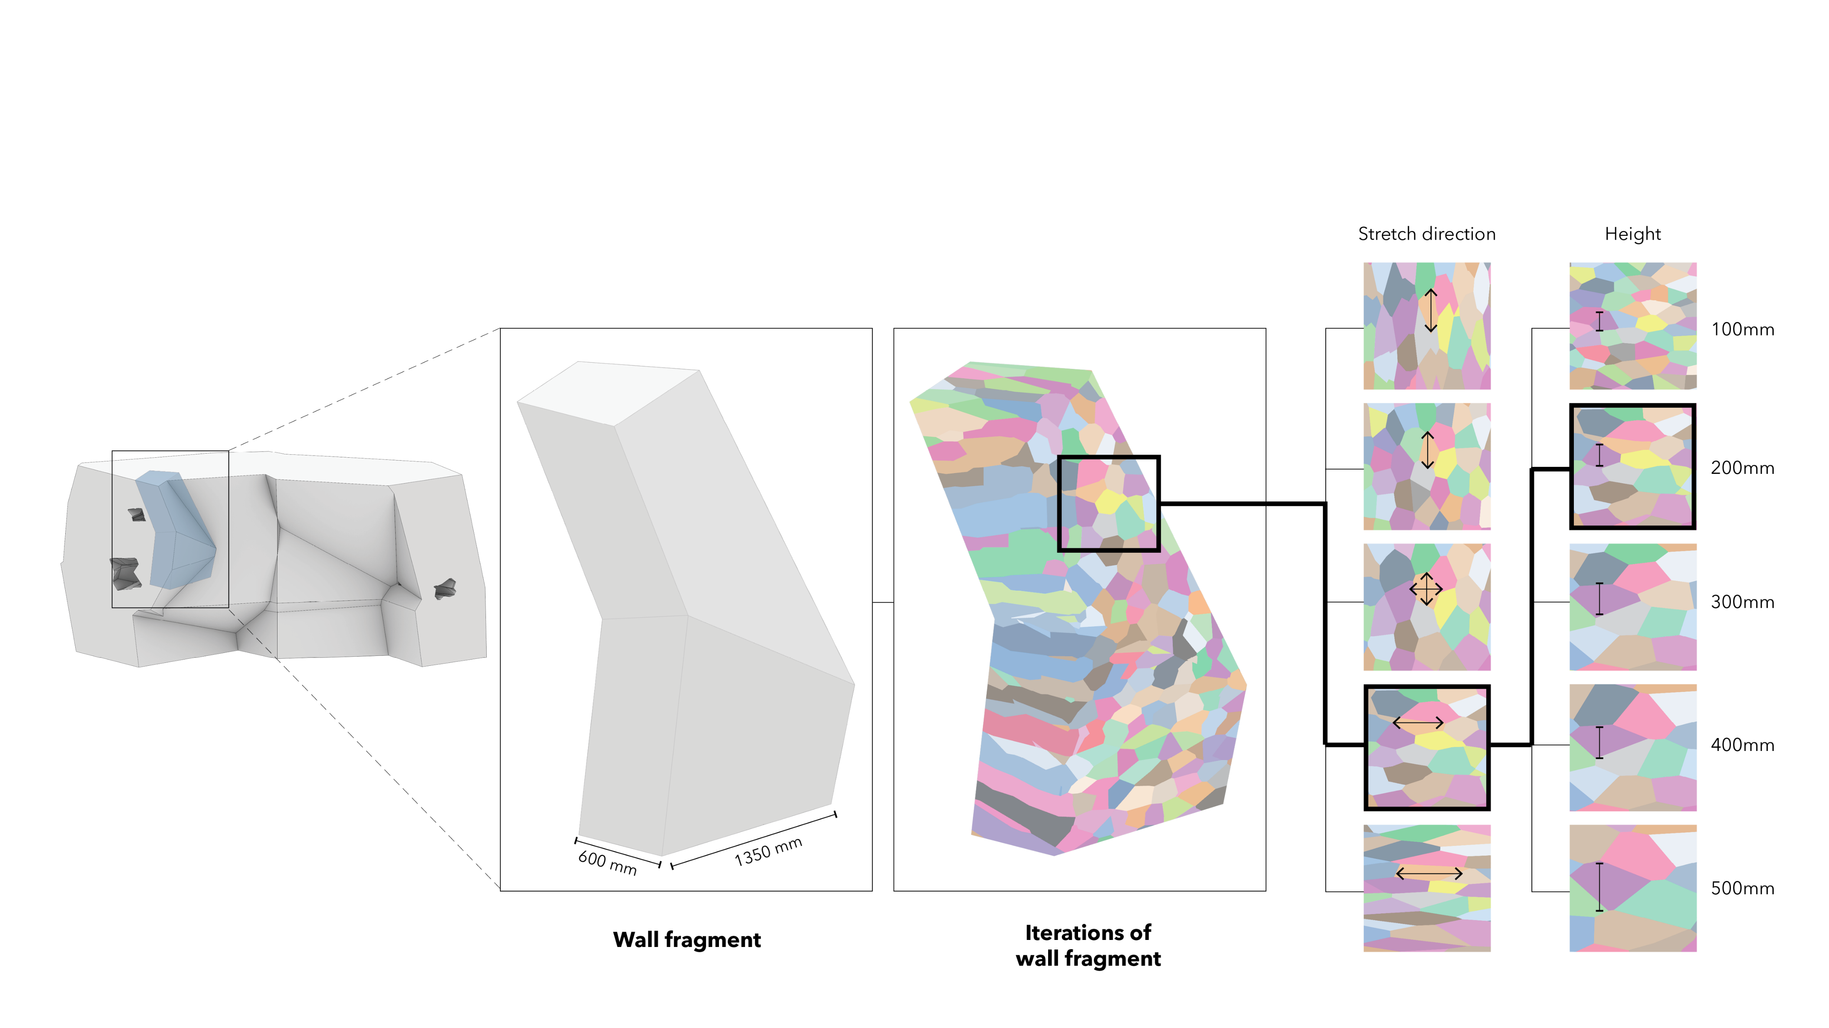
Construction & Materialization
Fragment
Wall
Wall of Private Quarters

Slide 7
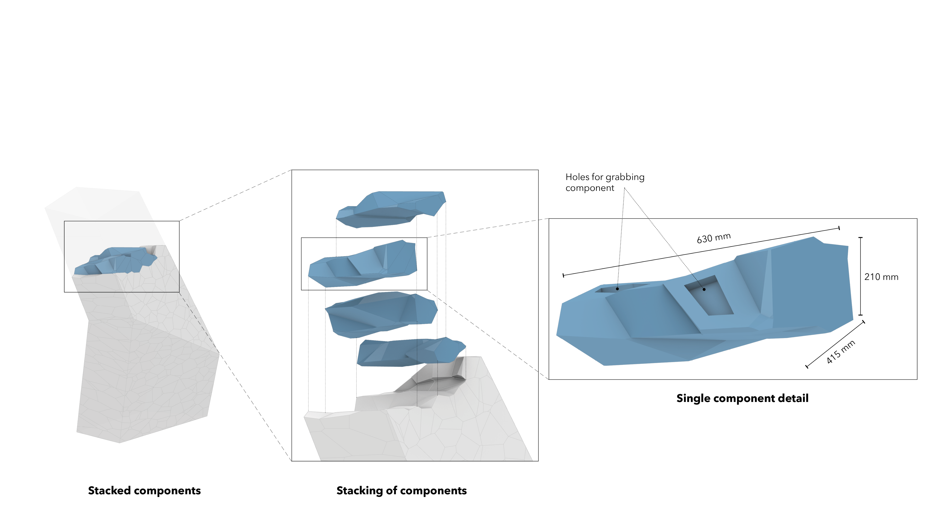
Construction & Materialization
Fragment
Component

Slide 8
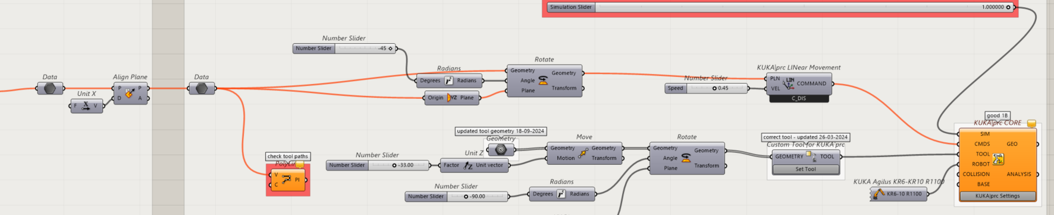
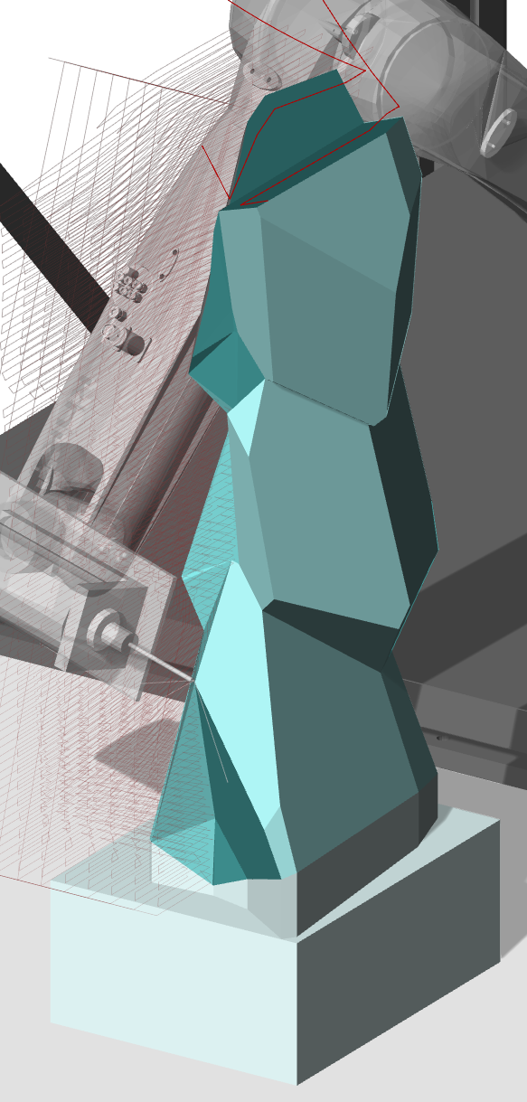
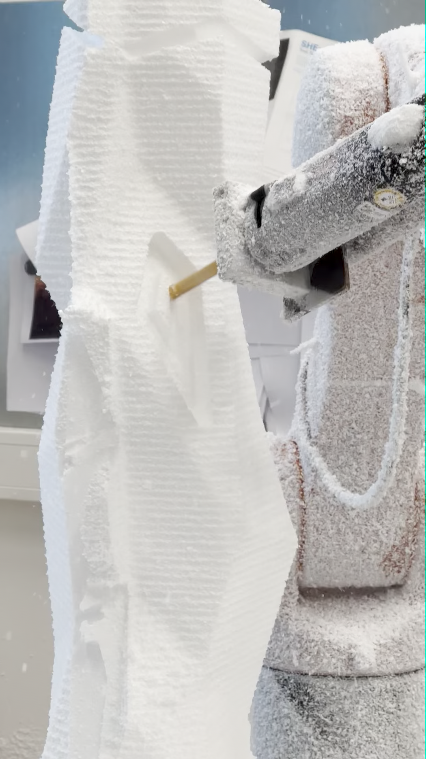
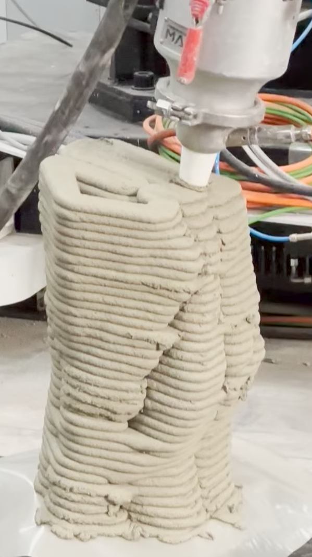
Construction & Materialization
Building Method: Primary
Fabrication of components
Digital Computation
Robot toolpath
Mock-up
Implementation
Mock-up using subtractive method
3D-printing using additive method
Robotic Fabrication
Digital Simulation
EPS Milling (Workshop 1)
Concrete 3D Printing (Vertico)
Notes:
Robot-assisted assembly → good for lunar condition
Transferable and suitable for digital computation to production process

Slide 9
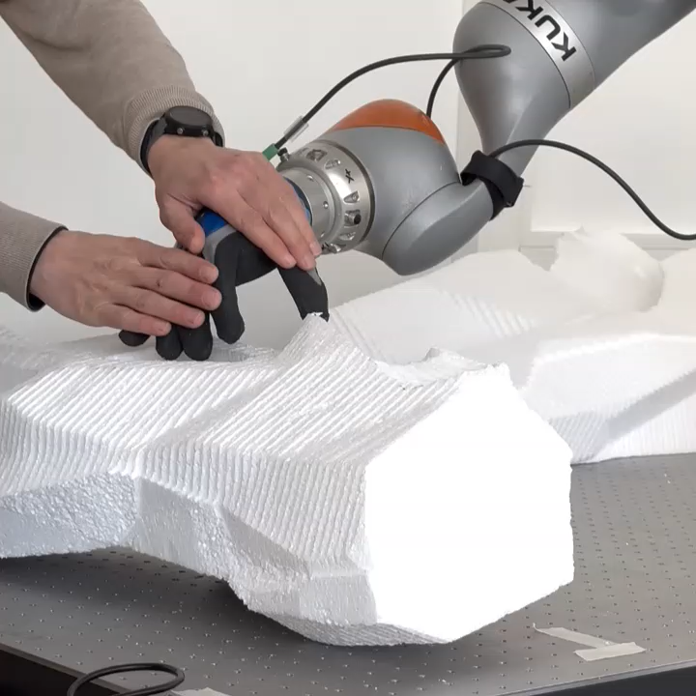
Construction & Materialization
Building Method: Primary
Assembly of components
HUMAN-ROBOT INTERACTION
Robot’s Strength + Human’s Adaptability
Approaching component
Picking component
Transporting component
assisted
Placing component
HRI Workshop, 4 April 2025
Notes:
Robot-assisted assembly → good for lunar condition
Transferable and suitable for digital computation to production process

Slide 10
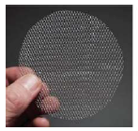
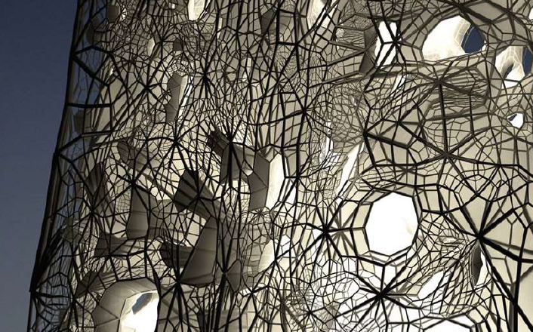

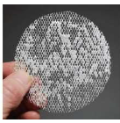
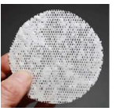
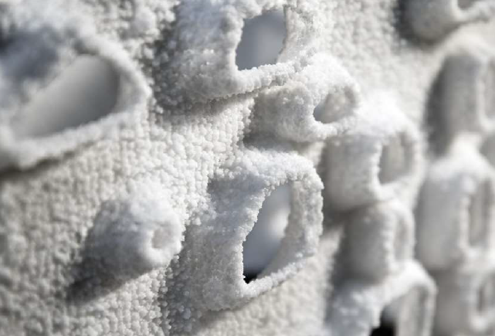
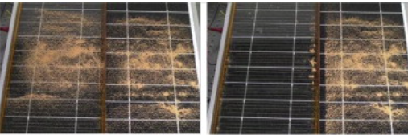
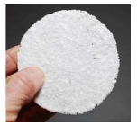
Construction & Materialization – Conceptual Future Expansion
Building Method: Supplementary
Regolith Accretion
Regolith
Accretion with electrostatic, sintered with laser heat
Aluminum Metallic Structure
Medium to conduct electricity
3d-printed
Metal-regolith gradient
Titanium alloy, based on current research by Ina Cheibas (2024)
Technology reference
Transparent material
Glass (silica extracted from regolith)
EFTE, water jacket, and 3d-printed ice
BEFORE
AFTER
Electrostatic cleaning system for sand removal from solar panels (2015), H. Kawamoto & T. Shibata
Current technology: use electrostatic to repel regolith
Reverse principle: use electrostatic to attract regolith
*based on in class discussion with expert
Vertical Salt Deposit Growth System
GEOtube Tower (2009), Faulders Studio, Dubai
Cheibas et. al.,Towards Additive Manufactured Off-Earth Habitats with Functionally Graded Multi-materials, p. 84
Notes:
Regolith build-up system

Slide 11
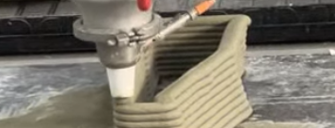
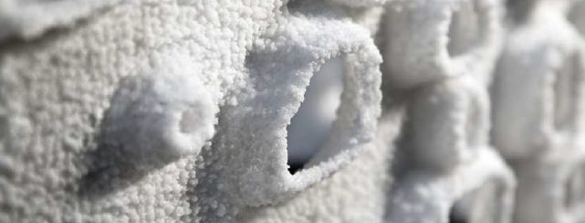
Construction & Materialization – Conceptual Future Expansion
3D Printing + Regolith Accretion
Close-up view of concrete additive 3d-printing, Vertico
Close-up view of salt accretion in scaled prototype, GEOtube Tower
For 1m thickness | 3D Printing | Regolith Accretion
Energy | ~135 MWh | ~72 MWh (+) consume less energy
Time | ~1 day (+) faster Construction rate (1-2 meters/day) | ~20 days Construction rate (5 cm /day)
Machine complexity | High (3D Printer + assembly robot) | Moderate (low energy continuous electrostatic field + laser_high energy) Minimal machinery required
Scalability | Highly scalable | Limited by charge dissipation
Structural integrity | Geopolymer highly durable | Sintered layered are dense
Conclusion | Better for core building construction | Slower but more autonomous → ideal for no human supervision
Notes:
3d printing → ideally with human supervision
Eventhough the moon has no wind, lunar dust gets everywhere (flurries everywhere) as if there is wind. This is due to lack of atmosphere, causing the lunar dust

Slide 12
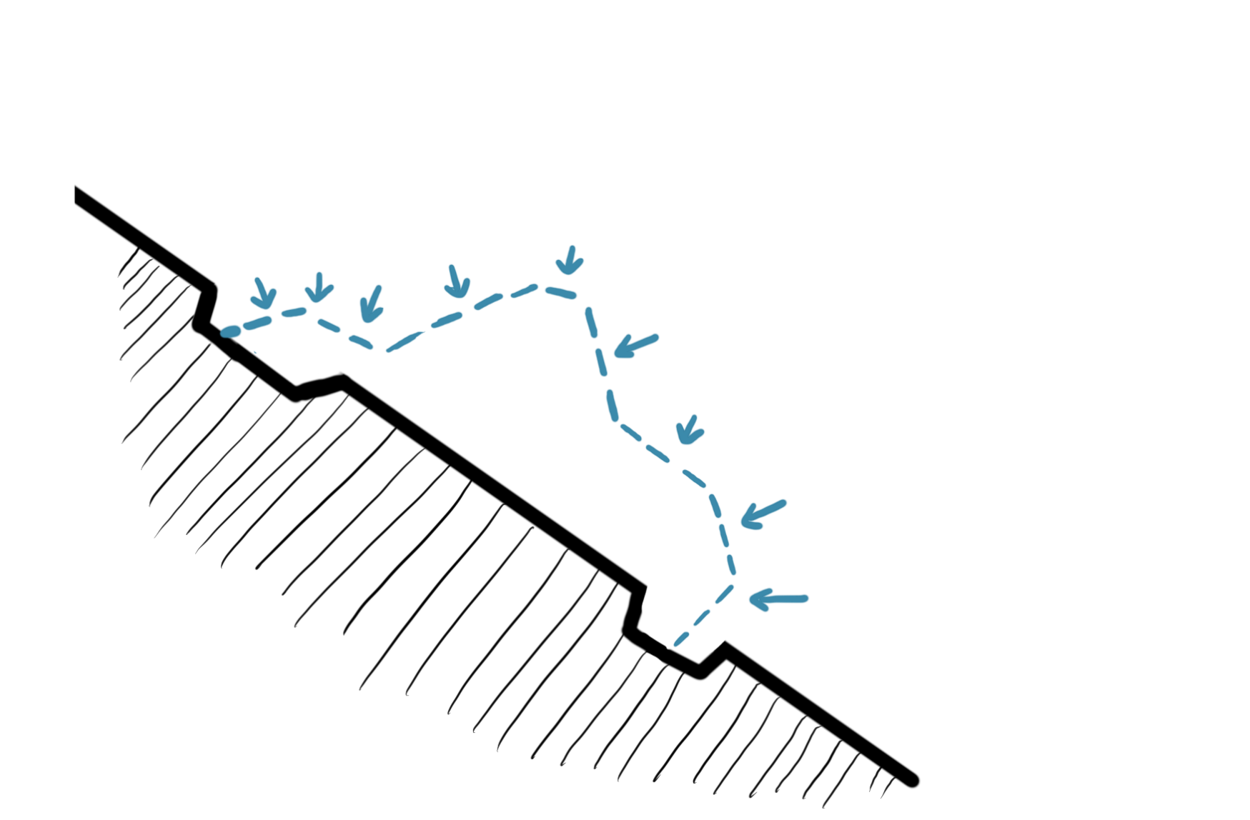

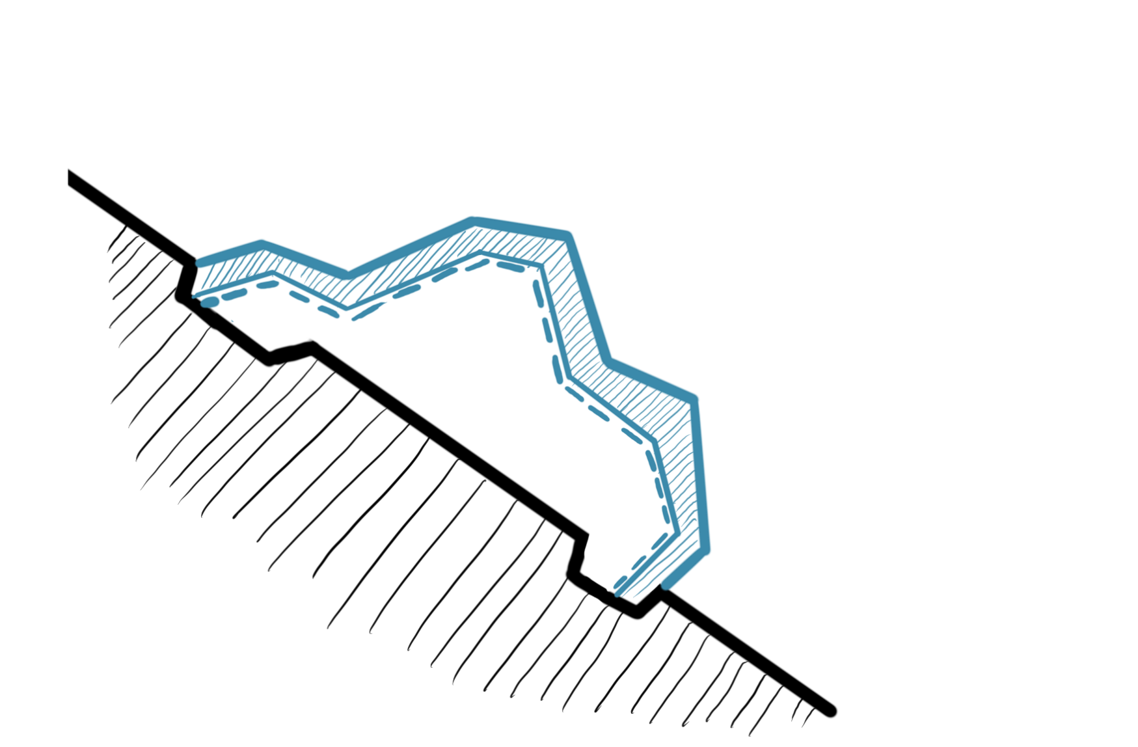
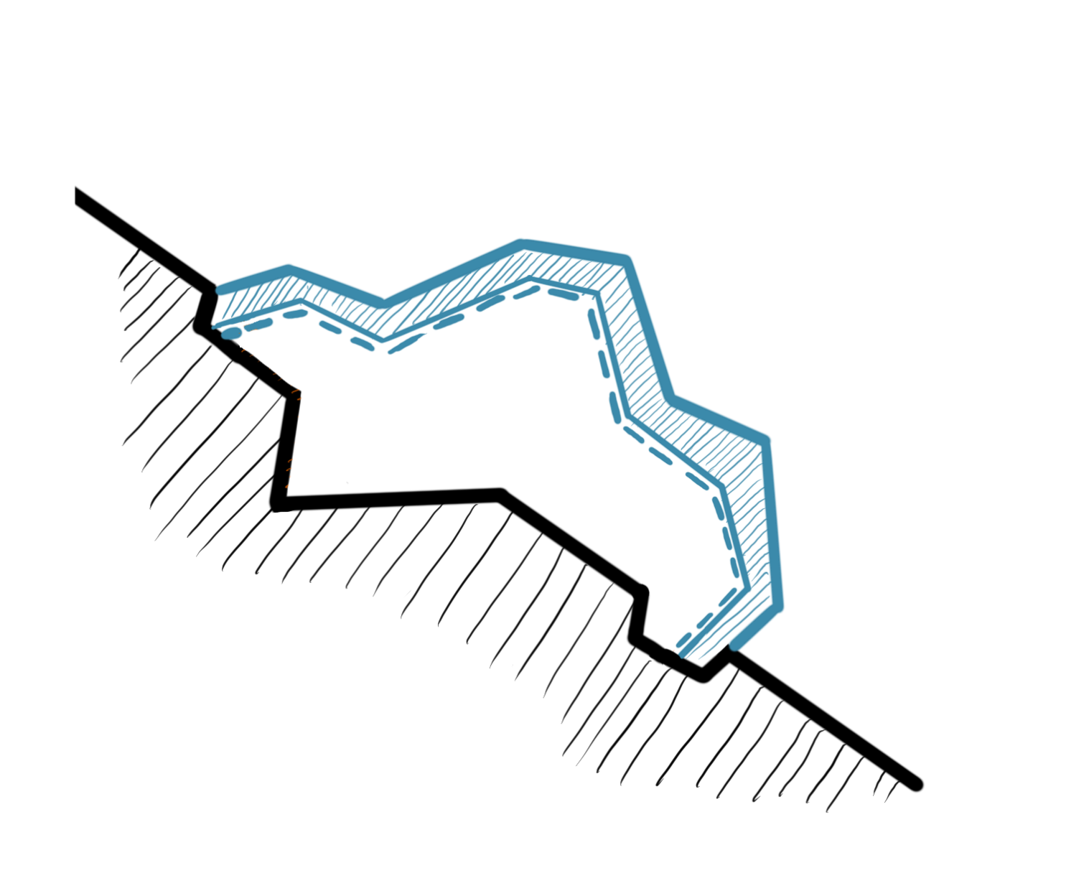

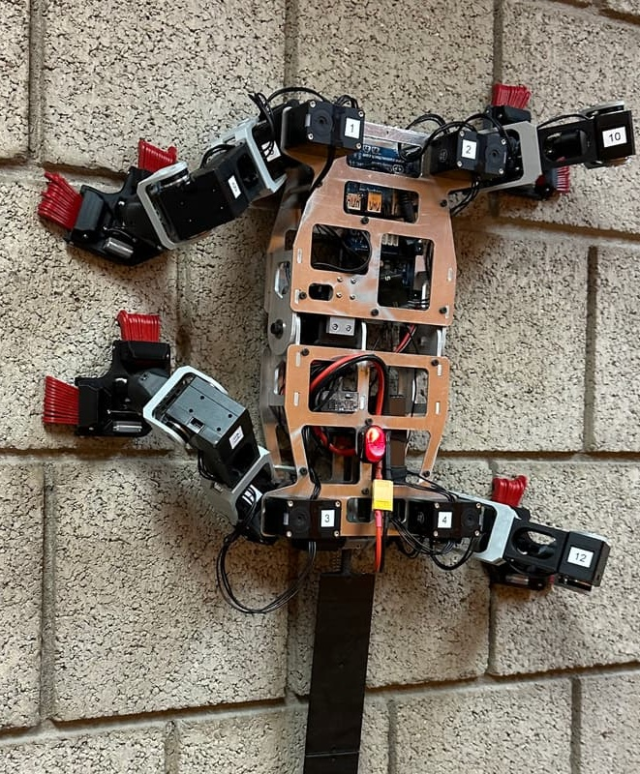
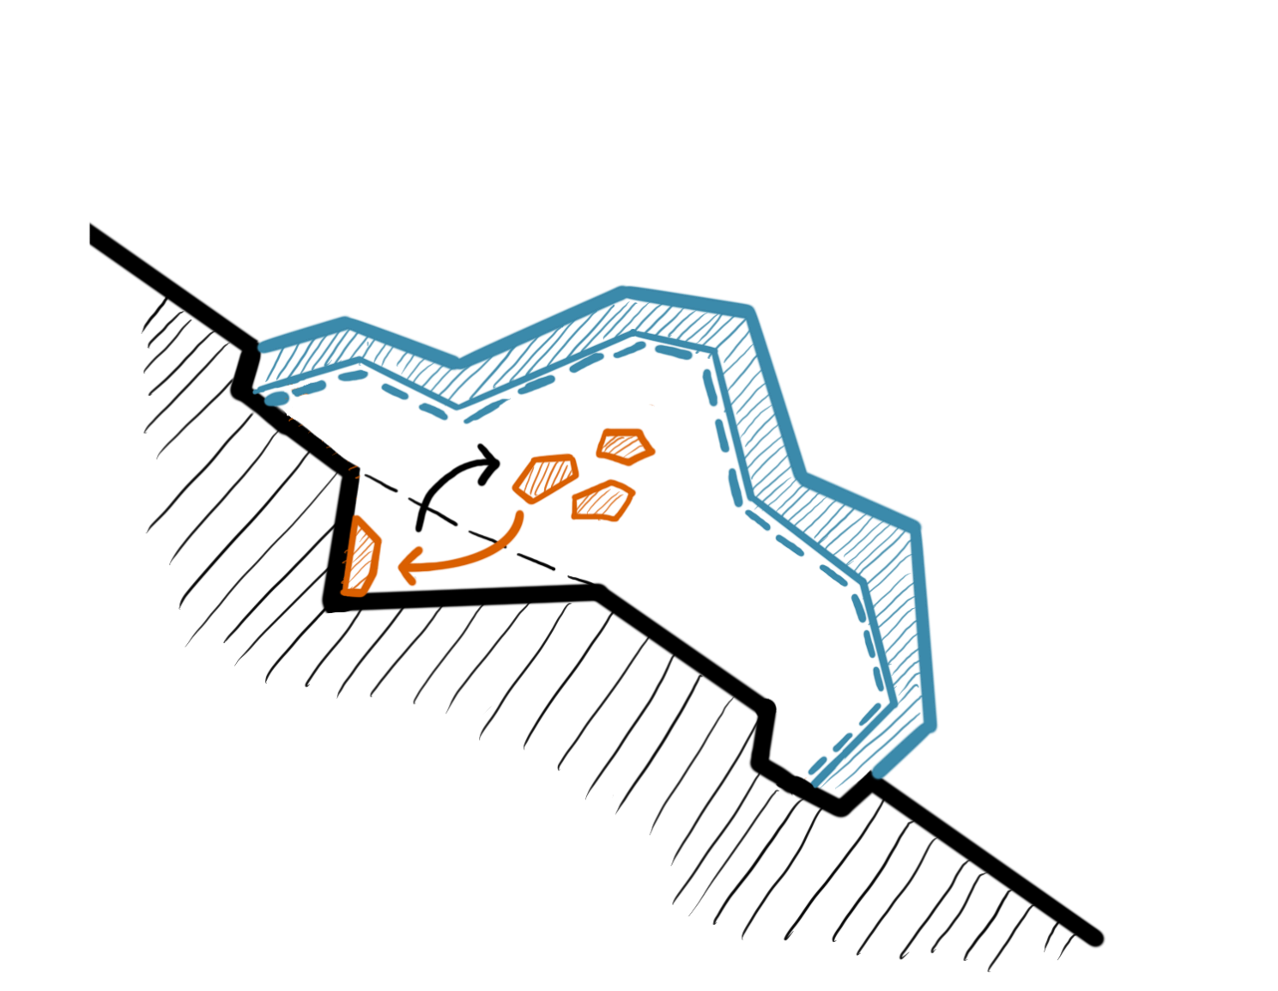
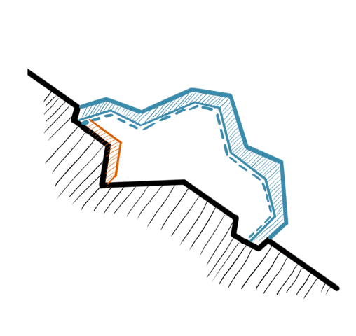

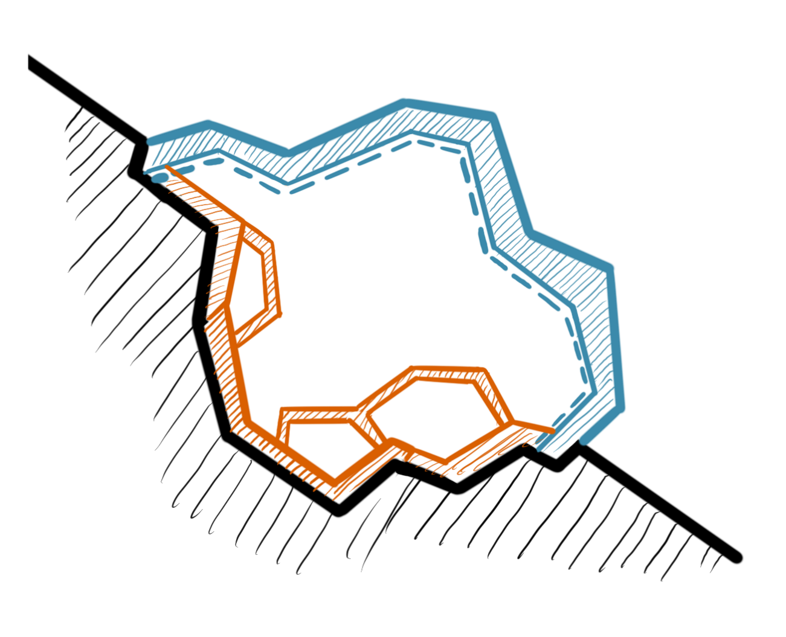
Construction & Materialization – Conceptual Future Expansion
3D Printing + Regolith Accretion
Application scheme (developed in discussion with Chris Verhoeven TU Delft)
(1) Build envelope
Attract regolith with electrostatically charged metal structure
(2) Laser sintering
with robot
(3) Level-by-level excavation
(4) Build 3D-printed walls
using materials from excavation
(5) Repeat process
(6) Extend habitat
Climbing robot LORIS
Notes:
3d-printed walls that retains the soil and also acts as the habitat wall

Slide 13
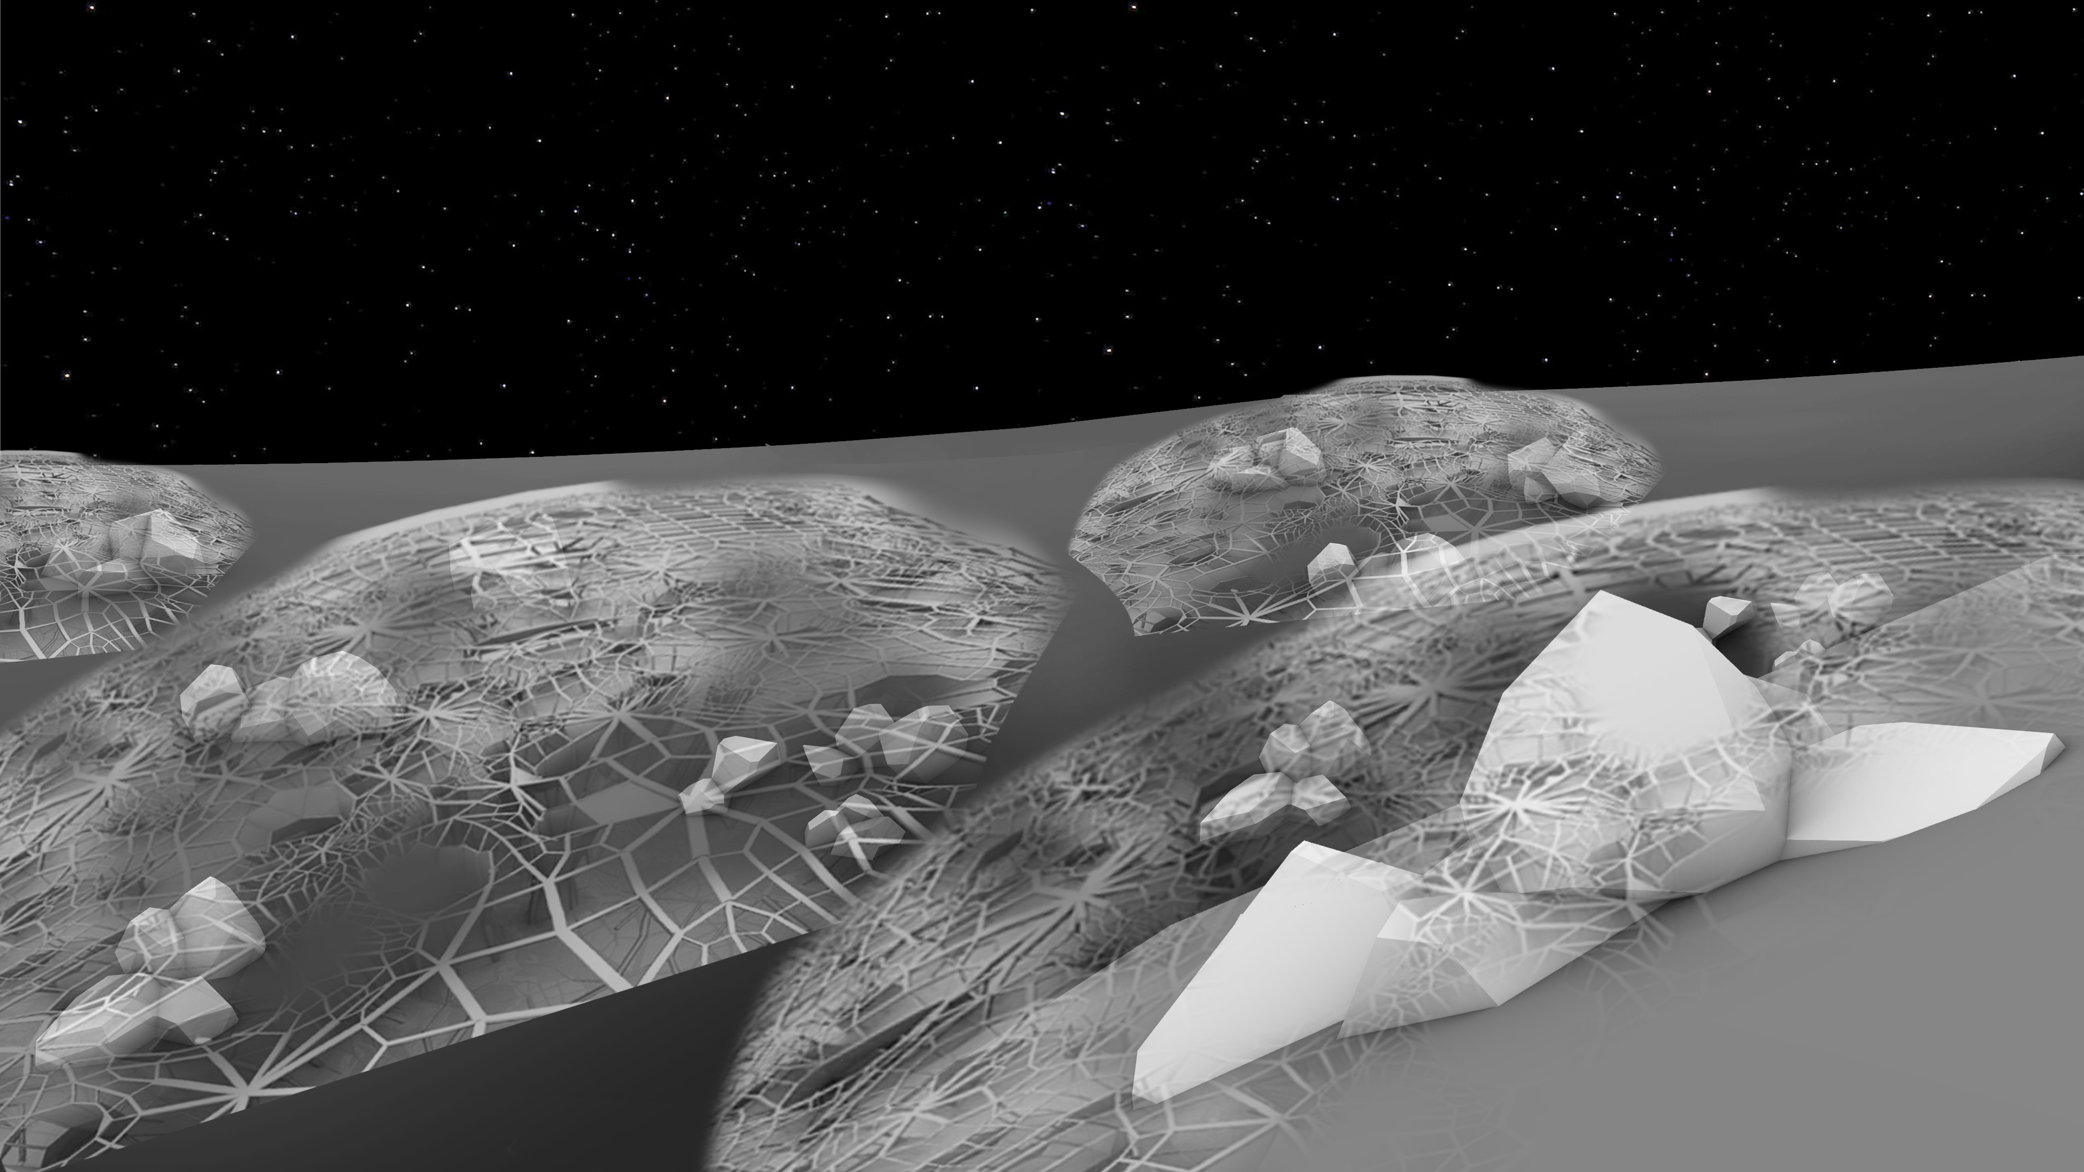
Construction & Materialization – Conceptual Future Expansion
Conceptual Habitat Complex

Slide 14
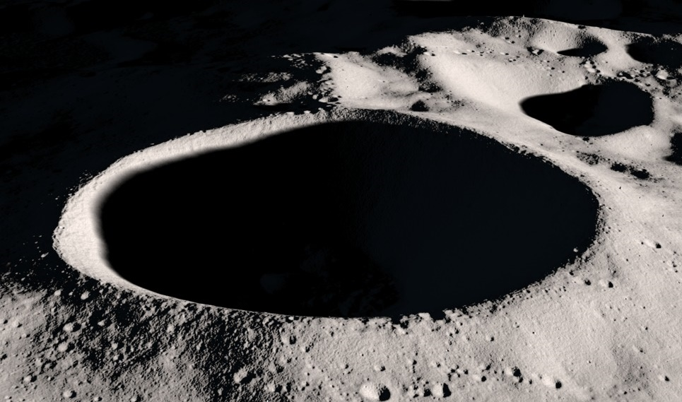
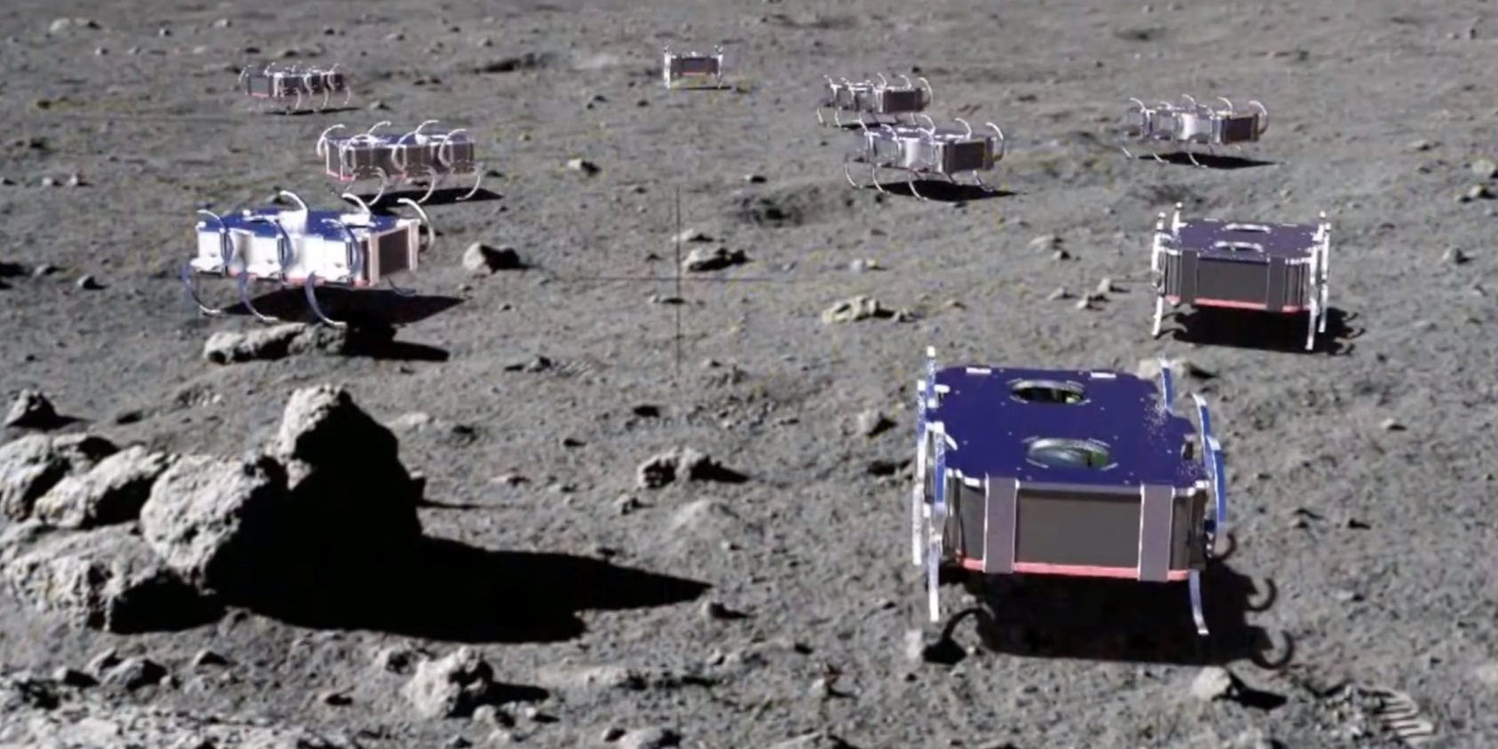
Construction & Materialization
Energy & Resources Collection
In-situ resource utilization
Eternal Light Areas
Site
Permanently Shadowed Region
Location
SUN EXPOSURE
REGOLITH
ICE
MINERALS & VOLATILES
Main Resources
PV cells
In-situ collection using swarm robots
Collection Methods
ENERGY
CENTRAL PROCESSING SYSTEM
Production & Storage
Treatment
Heat Exchange System
Hydrogen
Water
Oxygen
Carbon
Silica
Metals
3D Print
Storage
Distribution
BUILDING MATERIALS
HABITAT
Shackleton Crater (top), Swarm Robots (bottom)
Space-based Solar Power, ESA; Heat storage and electricity generation in the Moon during the lunar night, Blai Climent et. al., Acta Astronautica; Power and Energy for the Lunar Surface, NASA; Moonshot Symposium, TU Delft, 2024; Adaptive On- and Off- Earth Environments.
Notes:
references

Slide 15
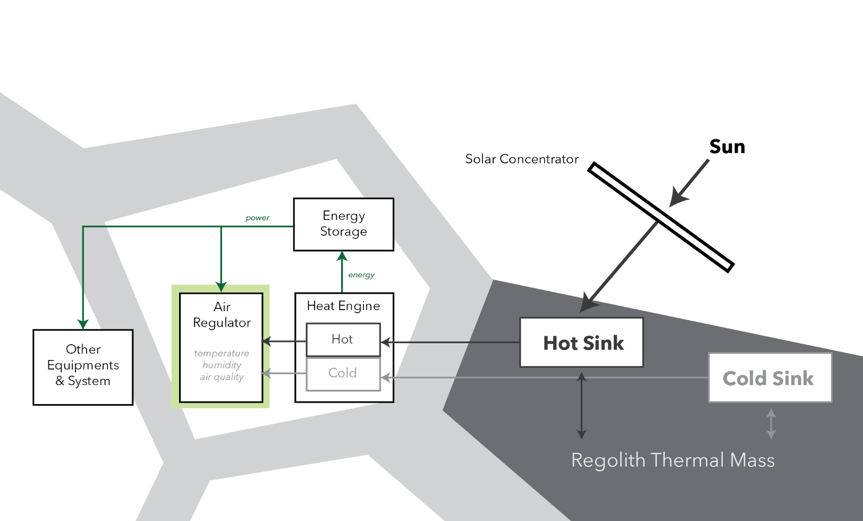
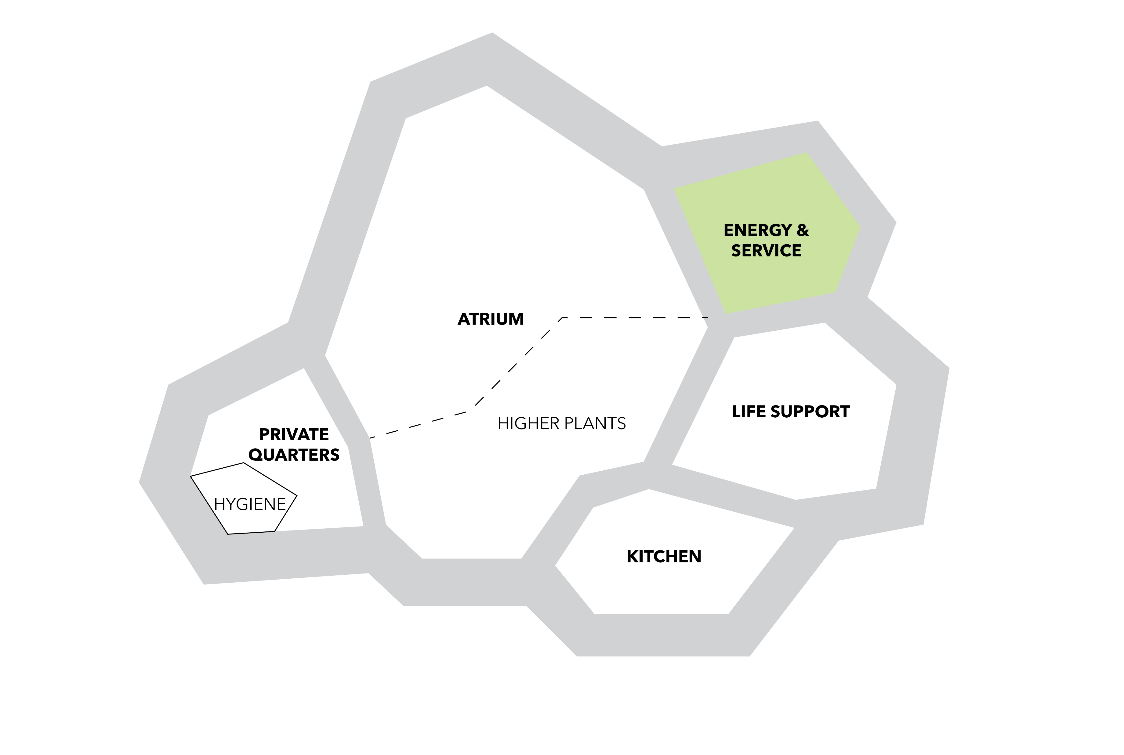
Construction & Materialization
Life Support
Heating/Cooling
Enclosed compartment
Open
Viable product
Waste product
ESA Heat Engine System

Slide 16
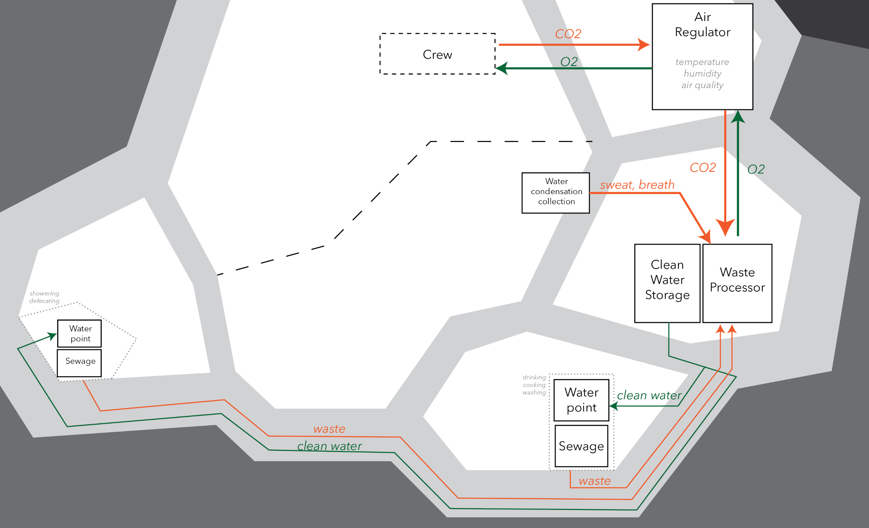
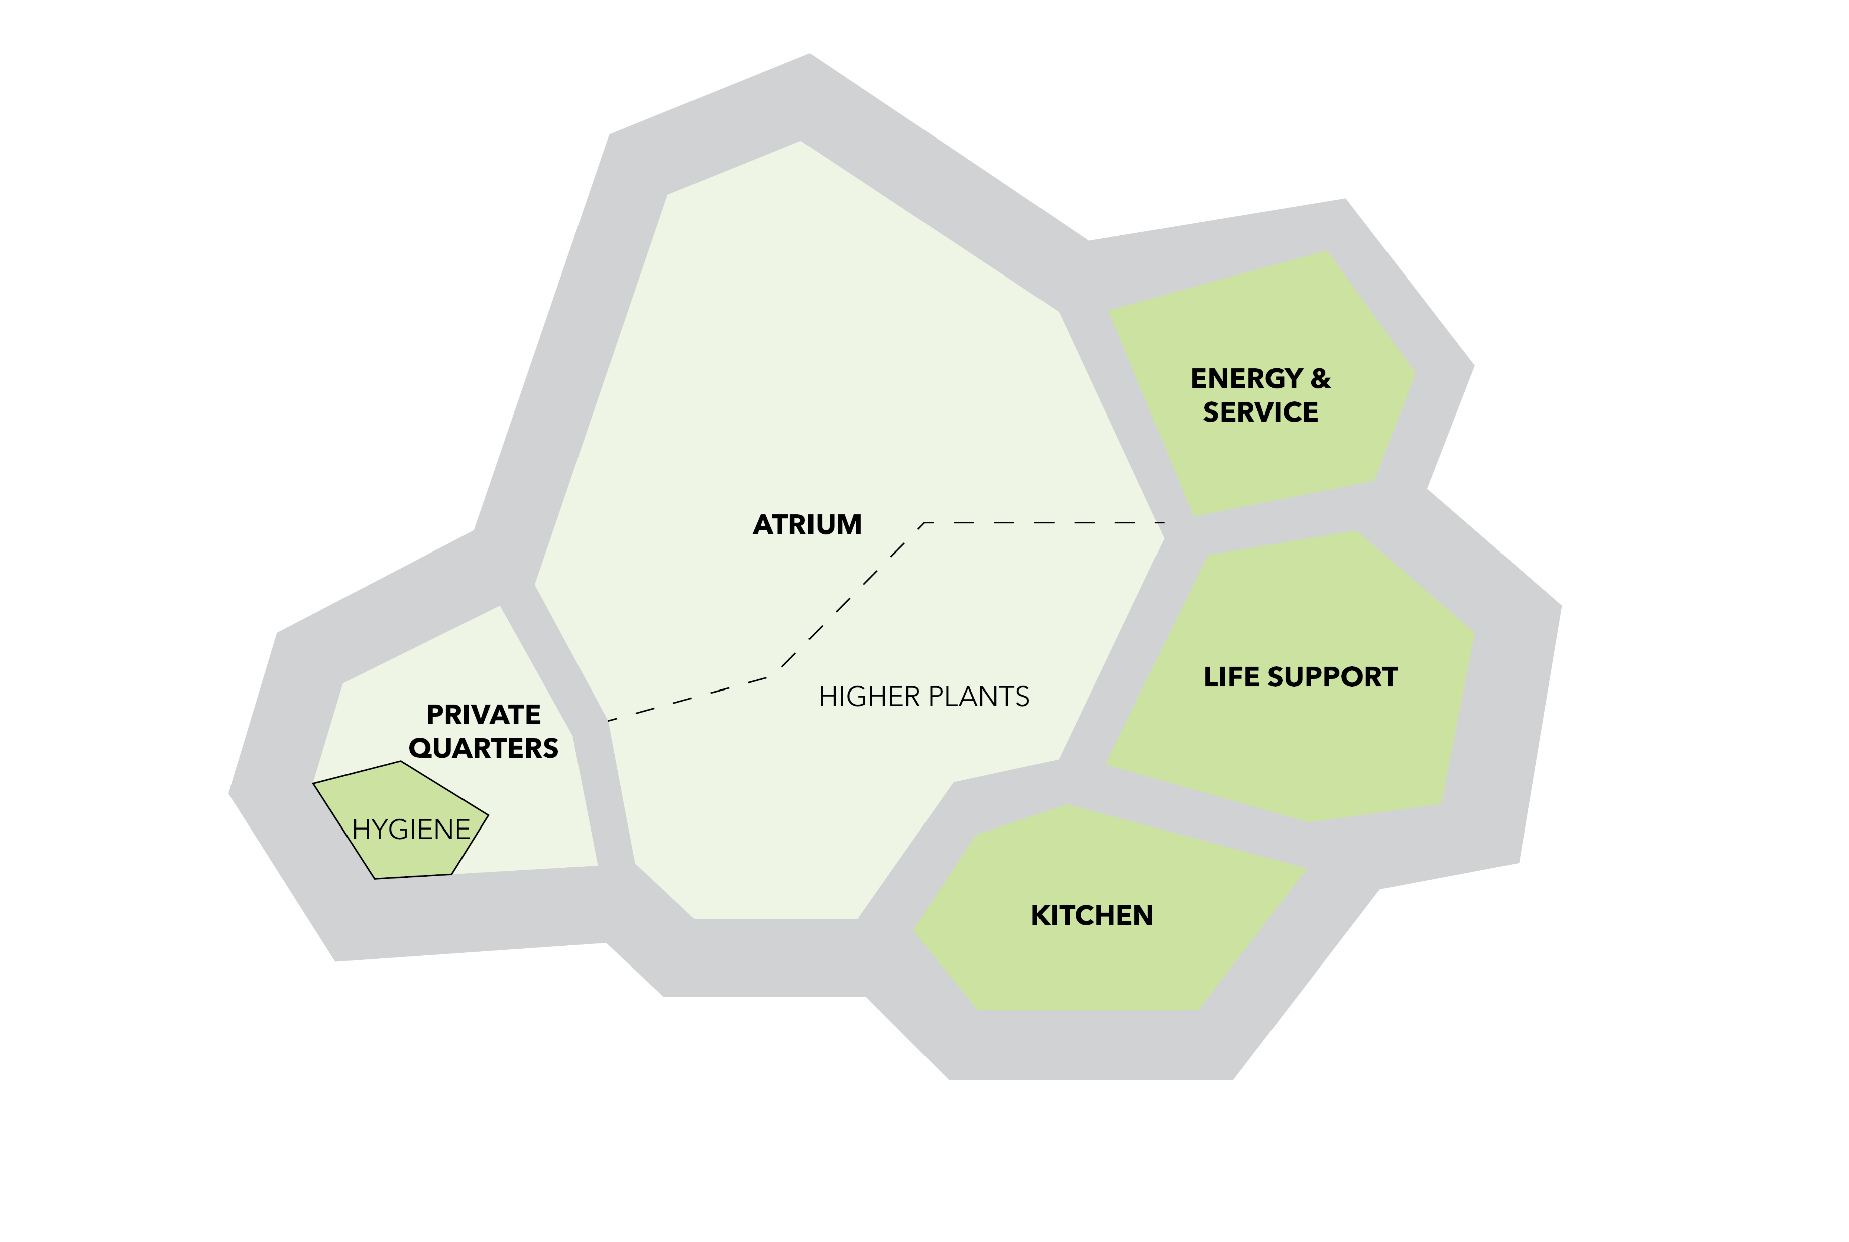
Construction & Materialization
Life Support
Habitat Main Mechanical Distribution
Enclosed compartment
Open
Viable product
Waste product

Slide 17
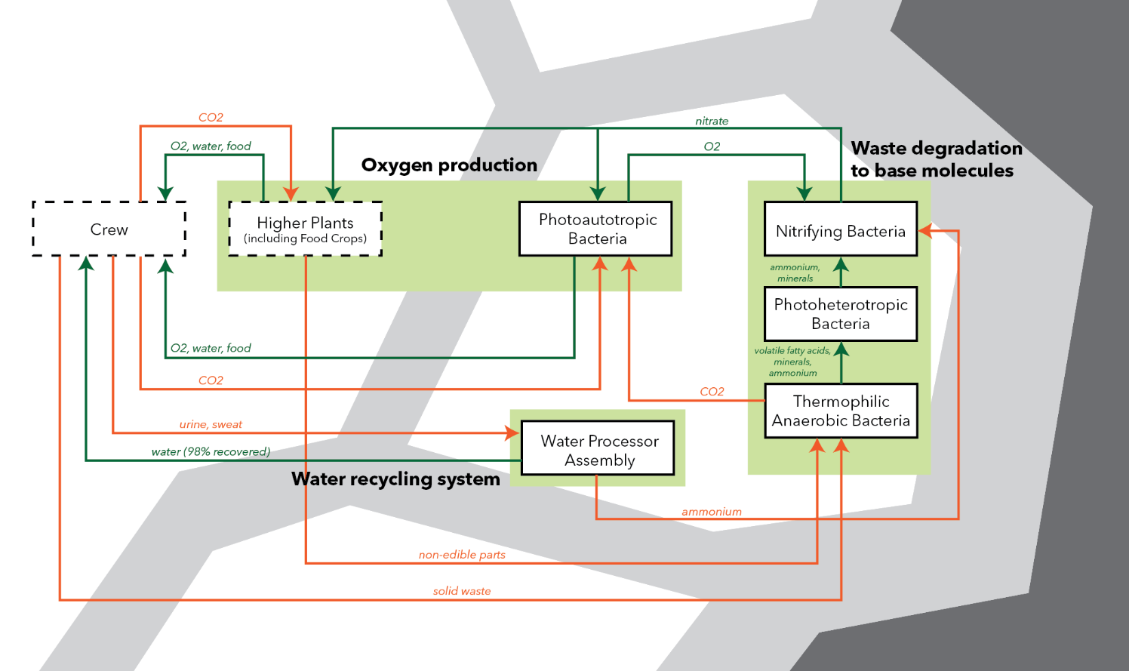
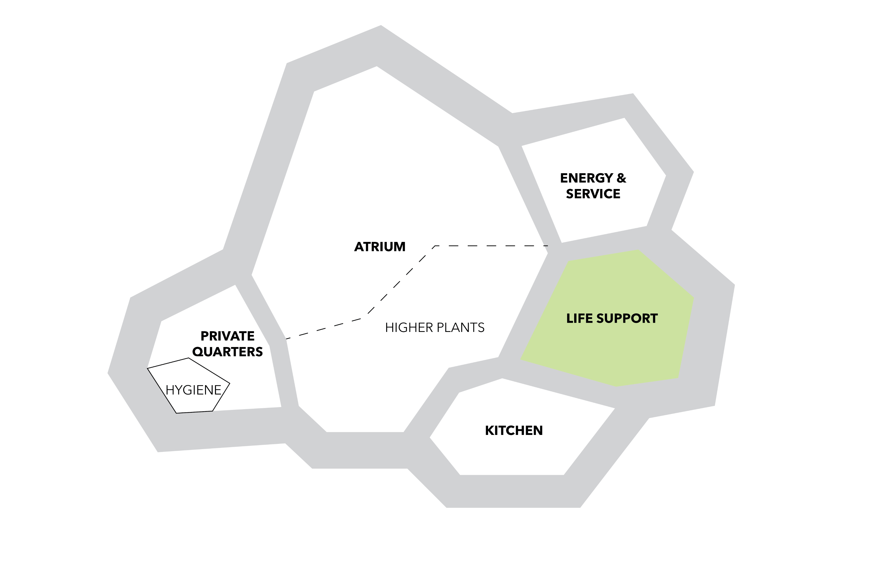
Construction & Materialization
Life Support
Close-the-loop waste recovery system
Enclosed compartment
Open
Viable product
Waste product
MELiSSA (Micro-Ecological Life Support System Alternative), ESA; Water Processor Assembly (WPA), NASA

Slide 18
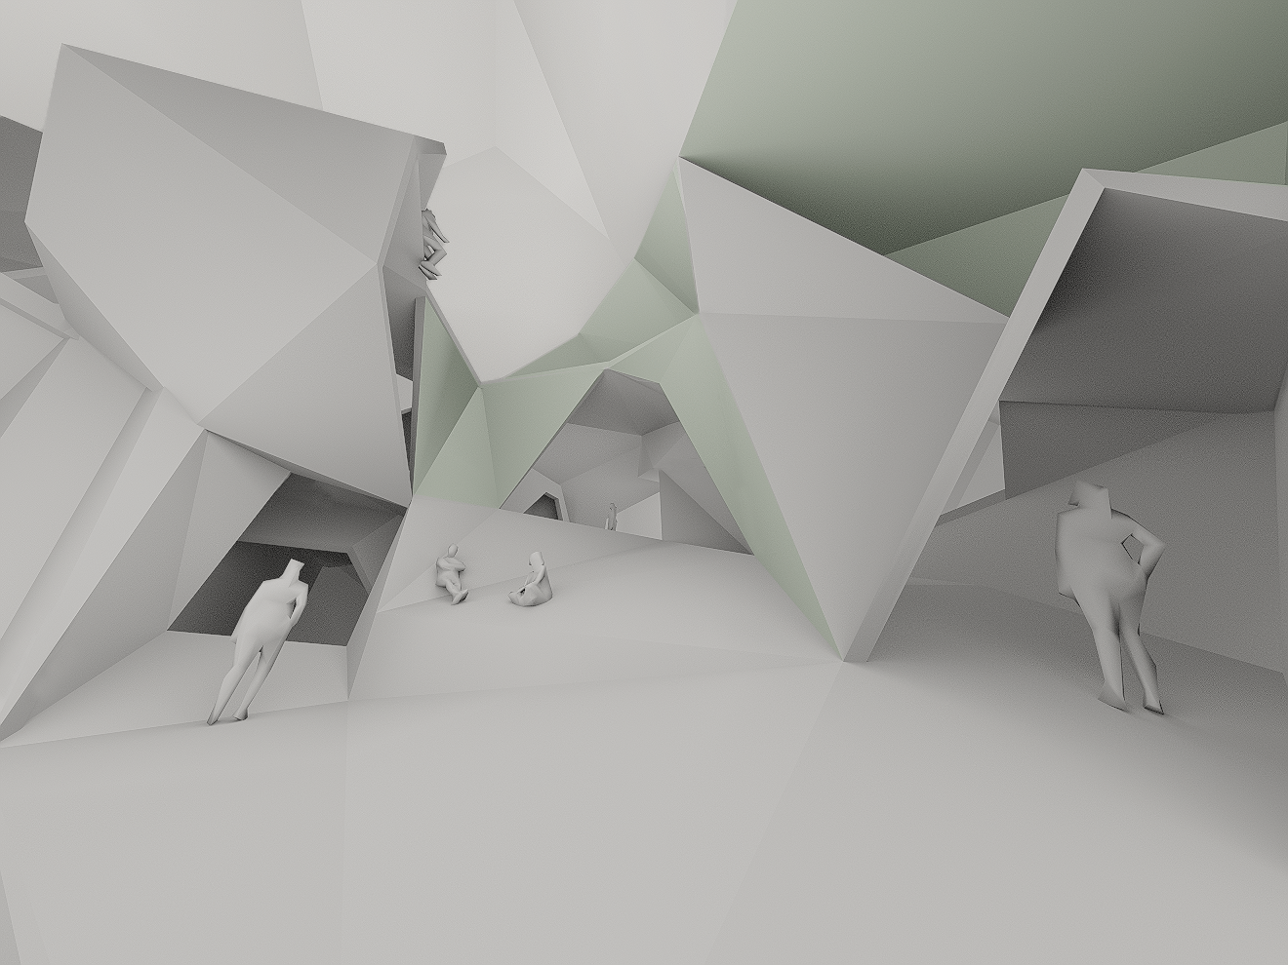
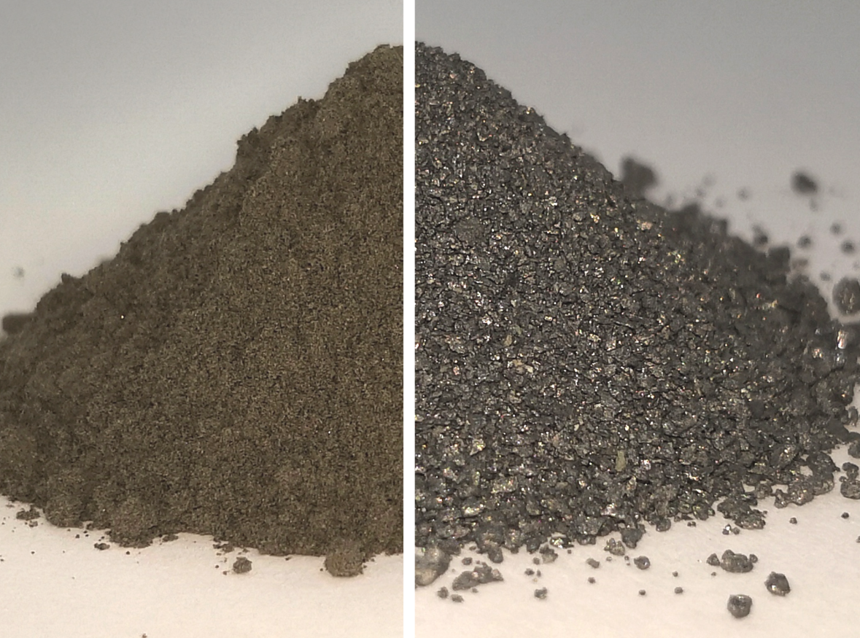
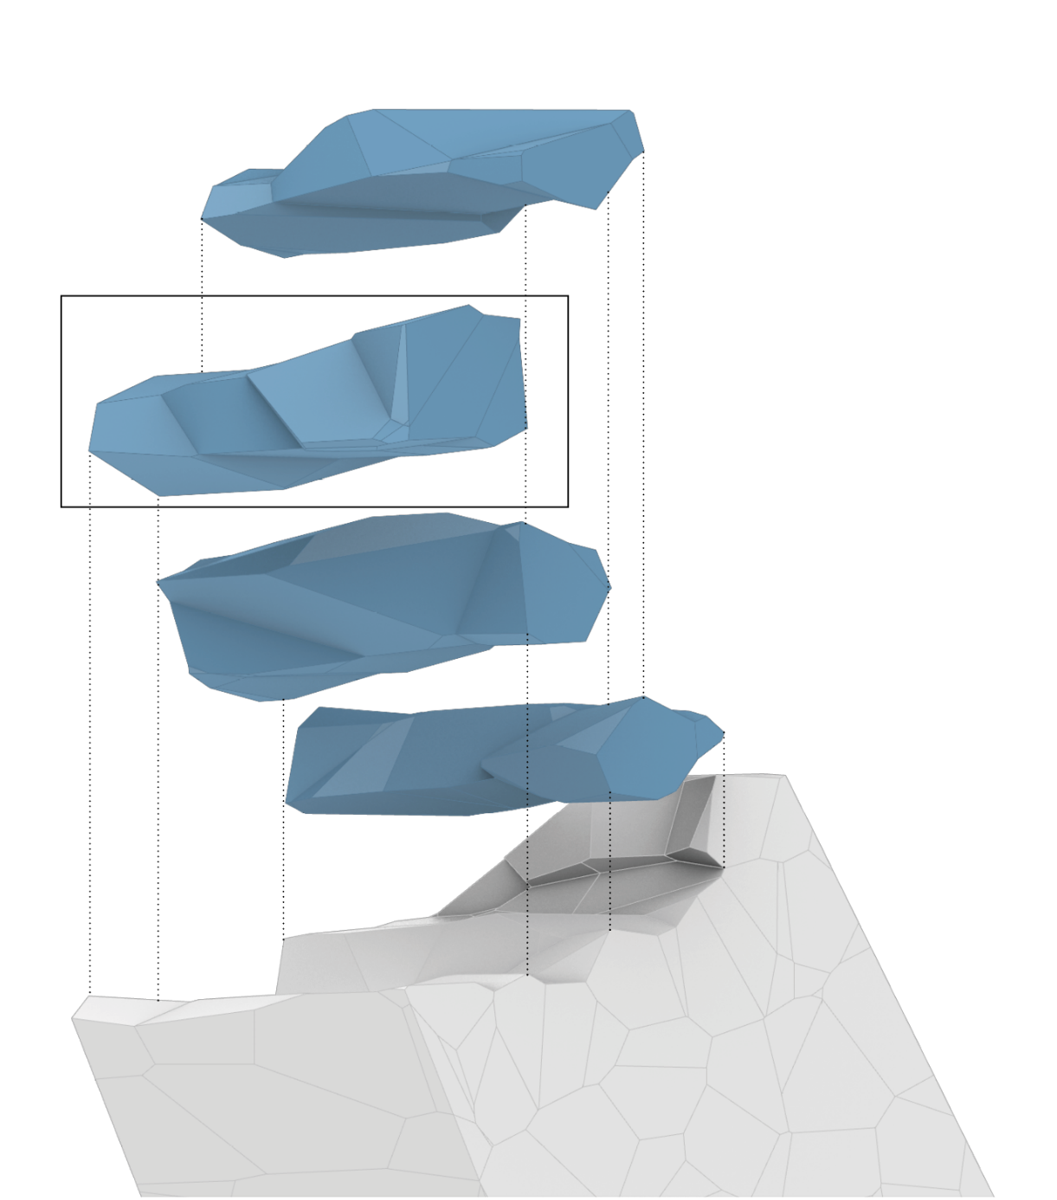
Reflection
Human-centric design
In-situ Resource Utilization
Design to Robotic Production and Assembly
Notes:
What I aim to do design from a human perspective
Where social spaces and private spaces are important, but it should not be dichotomic, rather diverse, especially in a long-term lunar habitat where can only find your escape from within.
Tackles lack of variety in privacy in space habitats: spaces of social condenser and recluse
Spectrum of interaction to solitude spaces can enhance cognitive and emotional resilience in isolated environments.
Speculating needs of future lunar community
Minimal social context on the moon → back to basic, human as social creature need spaces for varied social interactions
No-exit by jean-paul satre

Slide 19
Thank you!
Q&A

