Slide 1
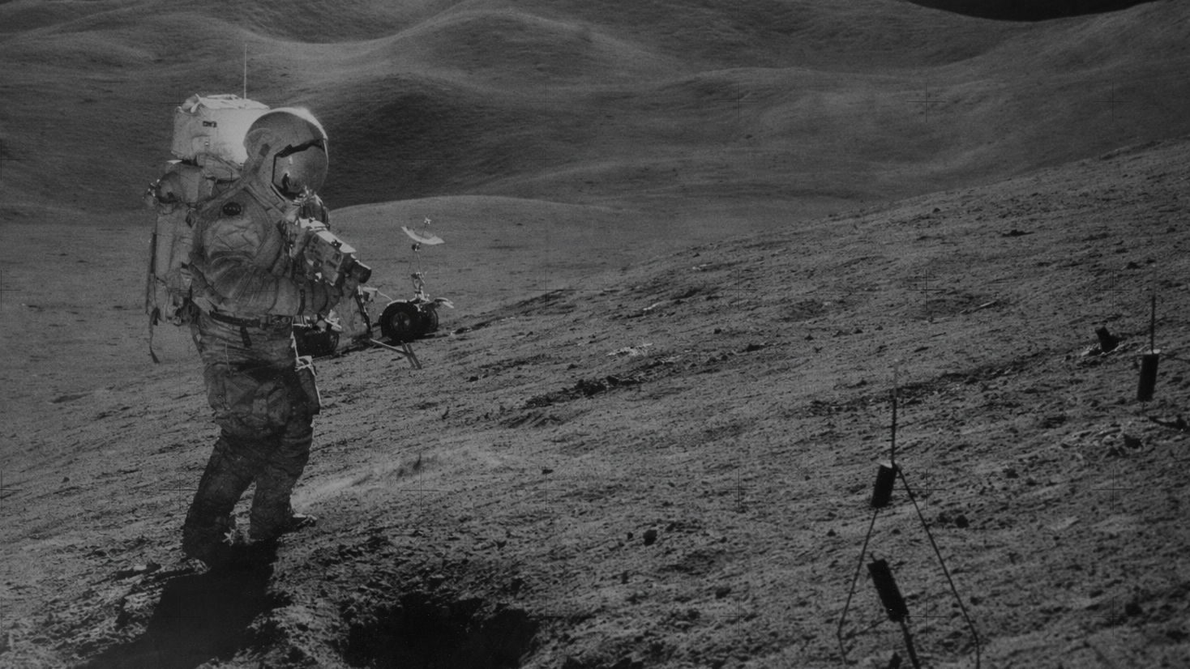
Biomorphed
Lunar Habitat Design
Biophilic Design for Astronaut Well-being
Tutors: Dr. Dipl.-Ing. Henriette Bier, Ir. F. Adema, Ir. A. Hidding
Extra-/Terrestrial Architecture Graduation Studio
Maurits Roijen | 5238153
Notes:
Good morning, my name is Maurits and today I will be presenting my project called EDEN which focuses on designing a lunar lava tube habitat rooted in biophilic design

Slide 2
Contents
Introduction & Background
Site Analysis
Construction & Materialisation
Mental Health & Well-being
Biophilic Design
Programme
Proof of Concept (Fragment)
Conclusion
3
13
17
26
29
42
44
64
Extra-/Terrestrial Architecture Graduation Studio
Maurits Roijen
‹#›

Slide 3
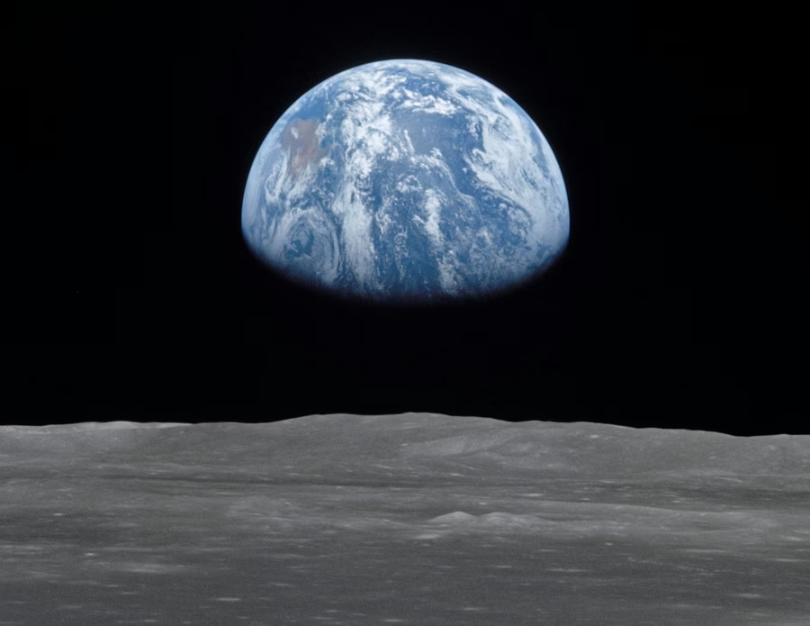
INTRODUCTION / BACKGROUND
Return to the Moon

Slide 4
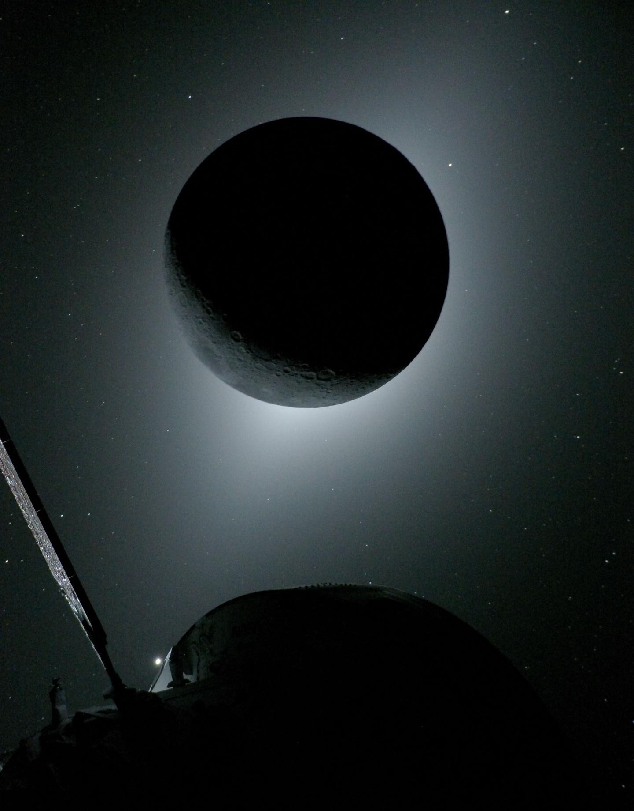
Return to the Moon
Introduction
Why is this topic relevant?
A second space race to put humans on the Moon again
Involving many space agencies like NASA, ESA, ROSCOSMOS, CNSA, etc.
Aim for longer term Moon missions
Eventually leading to colonising of the Moon and beyond
https://www.nasa.gov/news-release/nasas-artemis-ii-crew-beams-official-moon-flyby-photos-to-earth/
Extra-/Terrestrial Architecture Graduation Studio
Maurits Roijen
‹#›

Slide 5
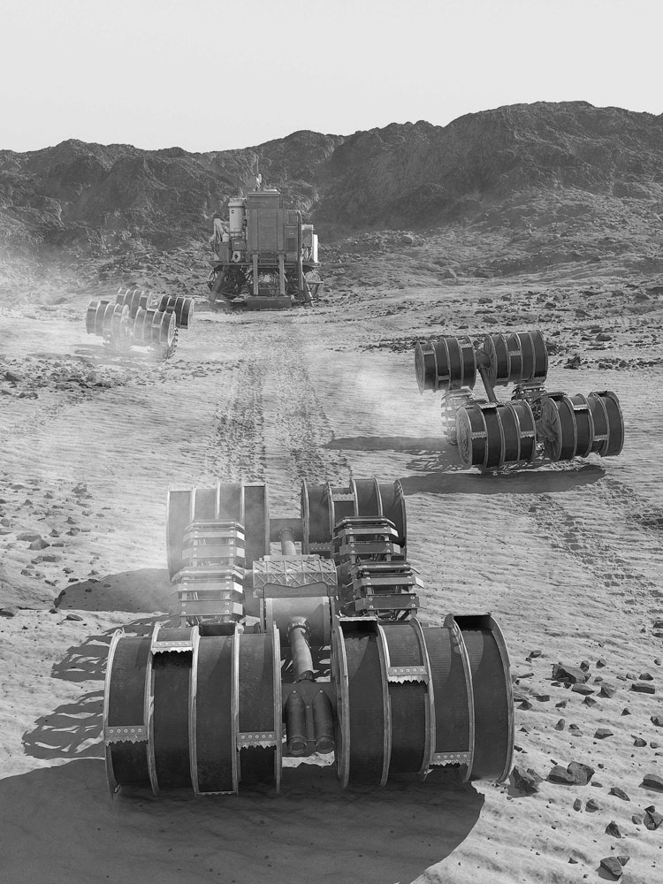
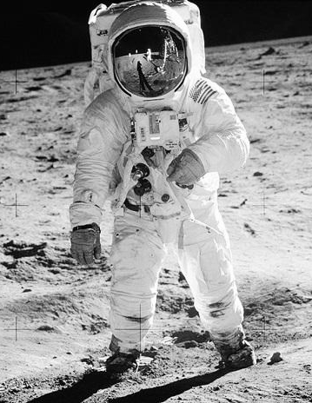
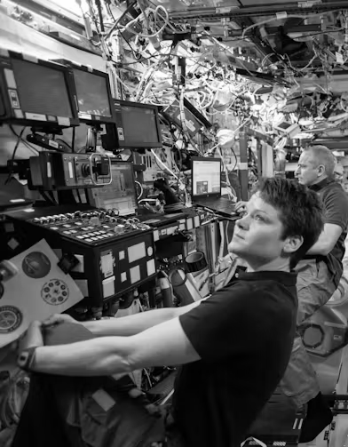
Problem Statement
Background
Lunar habitation faces 3 main challenges
Transportation Costs
Hostile Environment
Mental Health
Extra-/Terrestrial Architecture Graduation Studio
Maurits Roijen
‹#›

Slide 6
Problem Statement
Background
Transportation Costs
In-Situ Resource Utilization (ISRU)
poses a solution by reducing the need for transporting materials from earth
Expensive to launch rockets
Price/kg has decreased with reusable rockets
Building materials are heavy
https://www.nasa.gov/overview-in-situ-resource-utilization/
Extra-/Terrestrial Architecture Graduation Studio
Maurits Roijen
‹#›

Slide 7
Problem Statement
Background
Hostile Environment
Lava Tubes
poses a solution by creating a protective cover from the environment in combination with the shelter provided by the habitat
Abrasive lunar dust
Moonquakes
Micro meteorites
Radiation
Solar wind
Long lunar nights
No atmosphere
Extreme temperature fluctuations
https://bsmedia.business-standard.com/_media/bs/img/article/2019-07/18/full/1563434814-8966.jpg
Extra-/Terrestrial Architecture Graduation Studio
Maurits Roijen
‹#›

Slide 8
Problem Statement
Background
Mental Health
Biophilia
poses a solution by adding more greenery and reminding people of earth. Biophilic design can improve mental health.
Stuck with the same people
High stress environment
Away from family and home
Little privacy
https://www.nasa.gov/image-article/expedition-59-crew-members-inside-u-s-destiny-laboratory/
Extra-/Terrestrial Architecture Graduation Studio
Maurits Roijen
‹#›

Slide 9
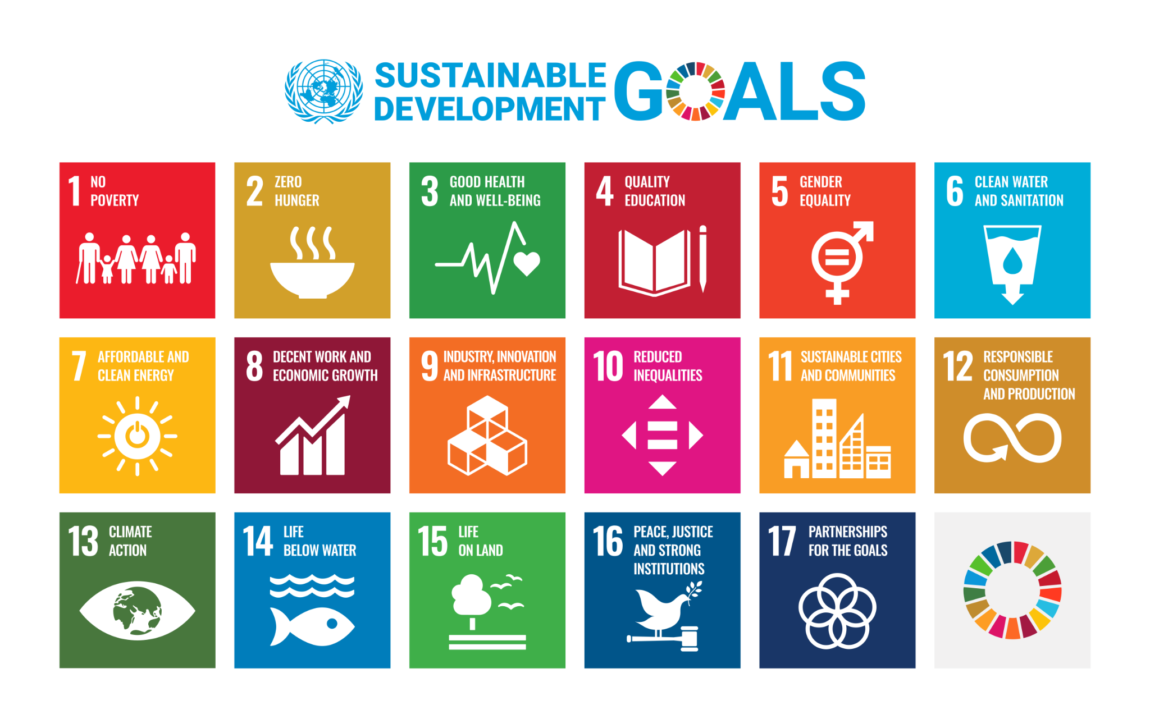
Terrestrial Relevance
Background
UN Sustainable Development Goals
Health & well-being → Biophilic (human-centric design)
Innovation → Design-To-Robotic-Production and 3D printing advancements
Sustainable cities and responsible consumption → ISRU to reduce pollution from transport
Extra-/Terrestrial Architecture Graduation Studio
Maurits Roijen
‹#›

Slide 10
Objective
Background
Goals
To design a functional, safe and effective ISRU Lunar habitat
To explore the relationship between biophilic design and 3D printing
To create a habitat with a healthy indoor environment for mental wellbeing
To contribute to the study of future habitats designs on and off Earth
Extra-/Terrestrial Architecture Graduation Studio
Maurits Roijen
‹#›

Slide 11
Research Question
Background
“How can biophilic design principles be adapted to a lunar lava tube habitat using ISRU 3D-printed architecture to support astronaut mental health and well-being?”
Extra-/Terrestrial Architecture Graduation Studio
Maurits Roijen
‹#›

Slide 12
Scope
Background
TEAM SIZE
6 person team, rotate 3 at a time for knowledge transfer
LOCATION
South pole → Lava tube
MISSION TYPE
Longer term research missions on the south pole of the moon
MATERIAL
3D printed lunar regolith
TIMELINE
First lunar base already established. Now in the longer term stay phase.
BUILD
ISRU 3D printing Selective Laser Melting
DESIGN
Different aspects: human-centric, biophilic, circular, computational, advanced manufacturing, life support systems, etc.
Extra-/Terrestrial Architecture Graduation Studio
Maurits Roijen
‹#›

Slide 13
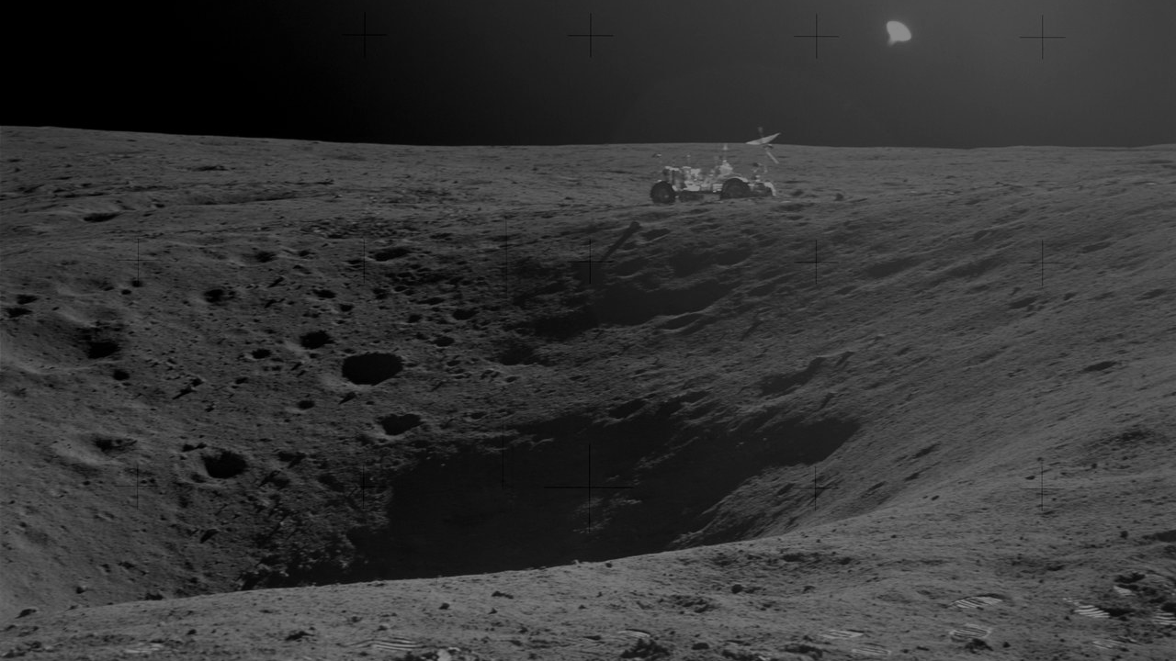
SECTION
Site Analysis

Slide 14

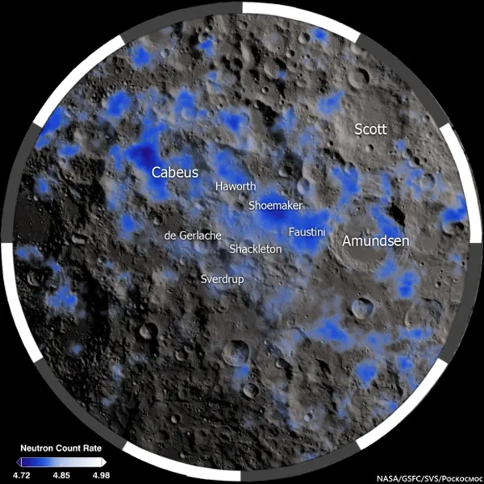
Lunar South Pole
Site Analysis
Sunlight
Water Ice deposits
https://svs.gsfc.nasa.gov/4930/
https://science.nasa.gov/image-detail/svs-lend-20130601-580-2/
Extra-/Terrestrial Architecture Graduation Studio
Maurits Roijen
‹#›
Notes:
The lunar south pole is the site and has been chosen by space agencies for future missions due to two reasons. Firstly the low angled sunlight creates dark pits of constant shade, while leaving the rims of craters illuminated for long periods of time. This is important for two reasons. Firstly, sunlight can be harvested for energy using solar panels on the crater rims. Secondly, the constantly shaded areas can potentially hold water ice, a vital resource for long term missions.

Slide 15
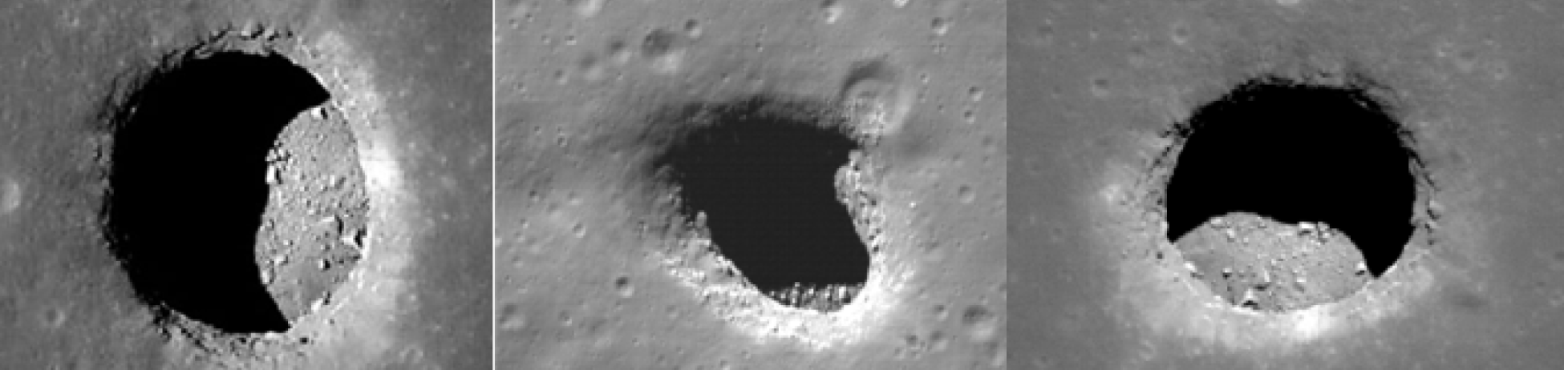
Lunar Lava Tubes
Site Analysis
Skylights of theorised lava tubes
https://phys.org/news/2020-07-lava-tubes-exploration-priority-worlds.html
Extra-/Terrestrial Architecture Graduation Studio
Maurits Roijen
‹#›
Notes:
The lunar south pole is the site and has been chosen by space agencies for future missions due to two reasons. Firstly the low angled sunlight creates dark pits of constant shade, while leaving the rims of craters illuminated for long periods of time. This is important for two reasons. Firstly, sunlight can be harvested for energy using solar panels on the crater rims. Secondly, the constantly shaded areas can potentially hold water ice, a vital resource for long term missions.

Slide 16
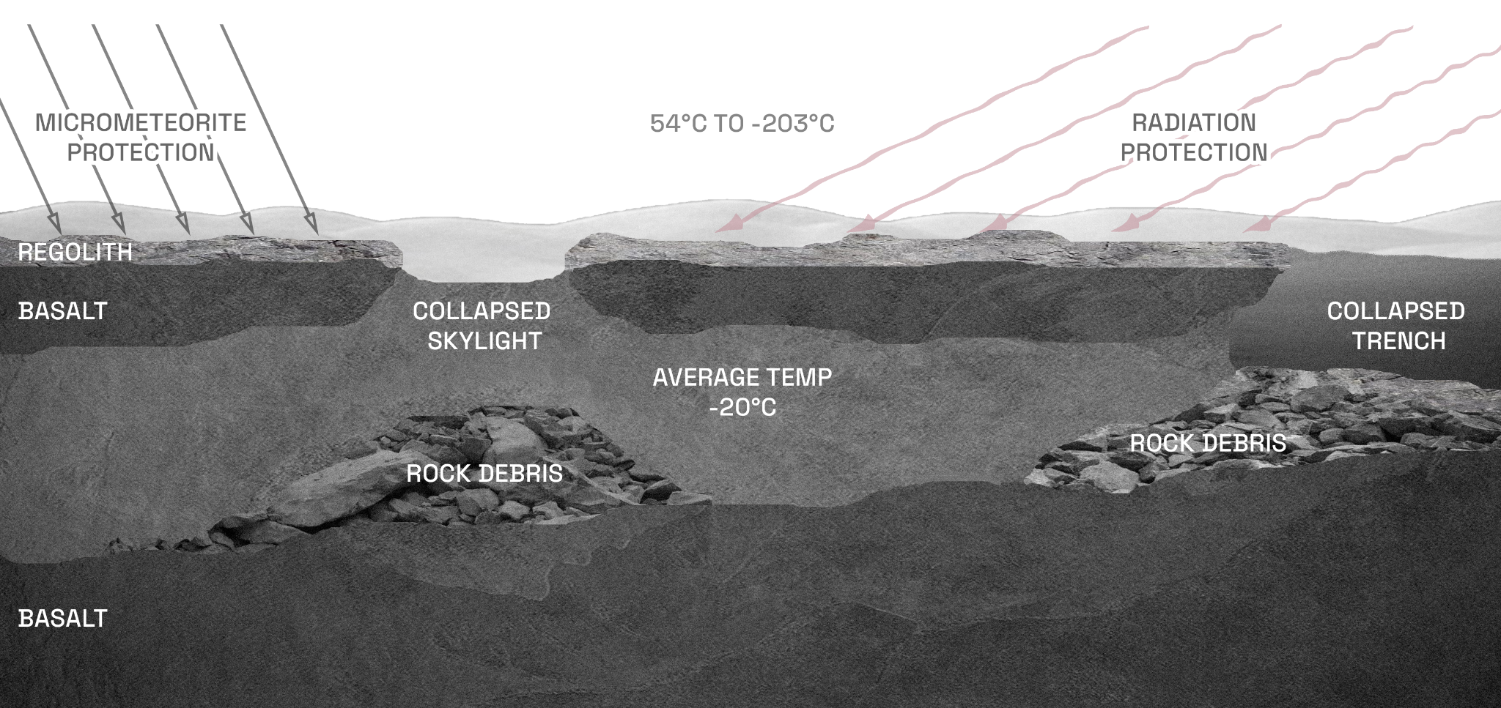
Lunar Lava Tubes
Site Analysis
Extra-/Terrestrial Architecture Graduation Studio
Maurits Roijen
‹#›
Notes:
The lunar south pole is the site and has been chosen by space agencies for future missions due to two reasons. Firstly the low angled sunlight creates dark pits of constant shade, while leaving the rims of craters illuminated for long periods of time. This is important for two reasons. Firstly, sunlight can be harvested for energy using solar panels on the crater rims. Secondly, the constantly shaded areas can potentially hold water ice, a vital resource for long term missions.

Slide 17
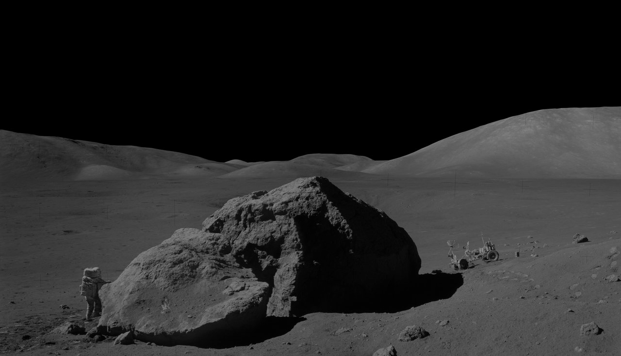
Section
Construction & Materialisation

Slide 18
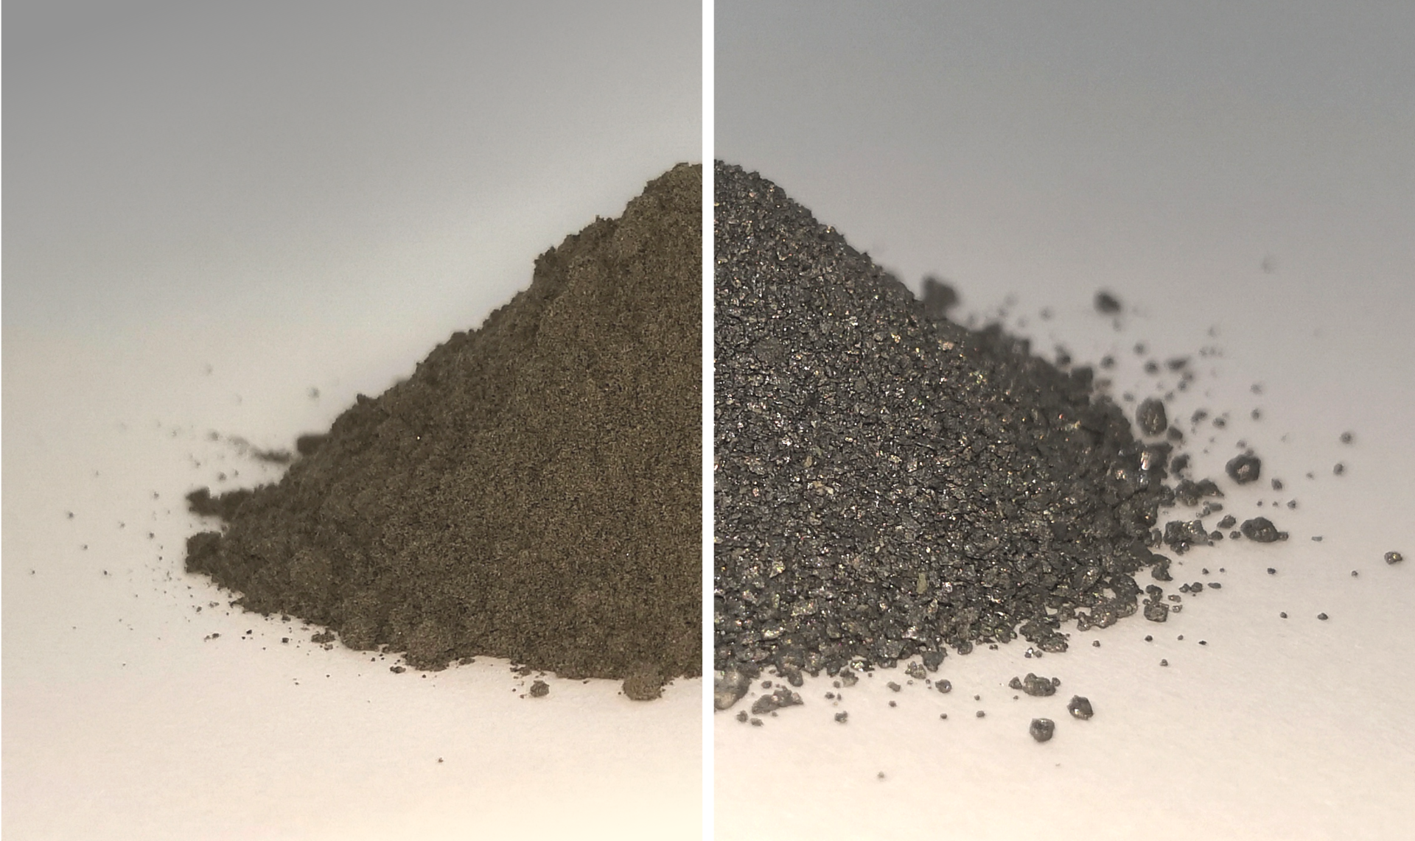
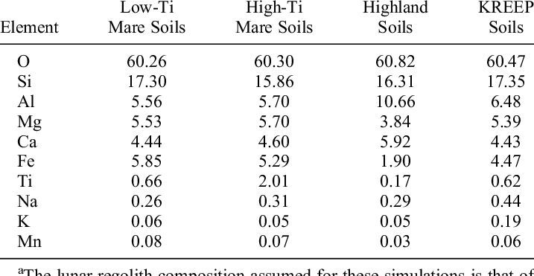
ISRU
Construction & Materialisation
Extracting Materials
Lunar Regolith Composition
Water (life support)
Oxygen (life support)
Silica (for glass)
Metal (construction)
https://www.researchgate.net/figure/Assumed-Composition-of-the-Lunar-Regolith-and-Variation-Across-Soil-Types-a_tbl1_258661774
https://ntrs.nasa.gov/api/citations/20250003730/downloads/Progress%20Review%20NASA%20Lunar%20ISRU_Sanders.pdf
Extra-/Terrestrial Architecture Graduation Studio
Maurits Roijen
‹#›

Slide 19
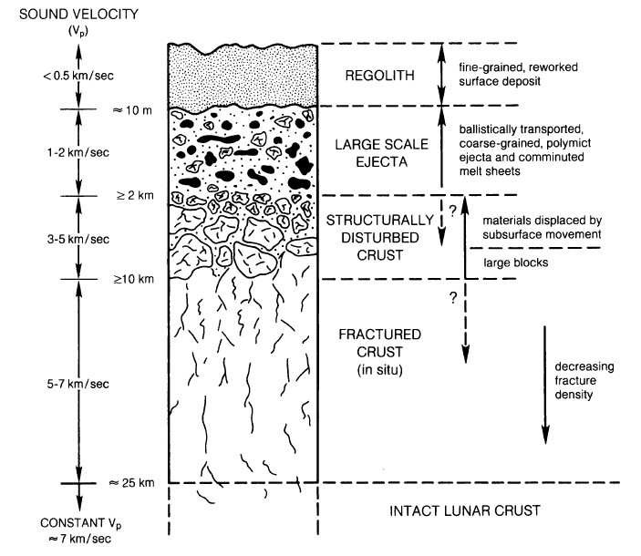
ISRU
Construction & Materialisation
3D Printing
Using the top layer of regolith
Easy to mine with robots
Need a way to ‘print’ the dust without additives
https://www.researchgate.net/figure/The-vertical-structure-of-the-Lunar-regolith-and-crust_fig7_264340952
Extra-/Terrestrial Architecture Graduation Studio
Maurits Roijen
‹#›

Slide 20
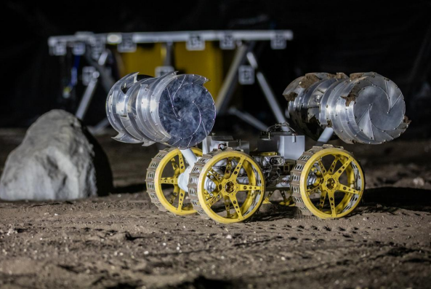
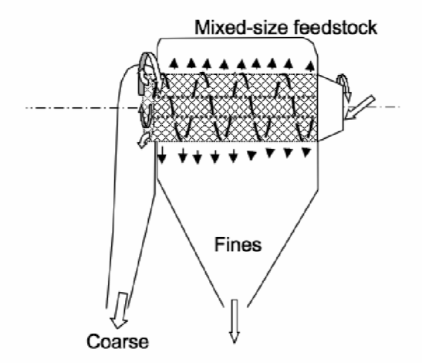
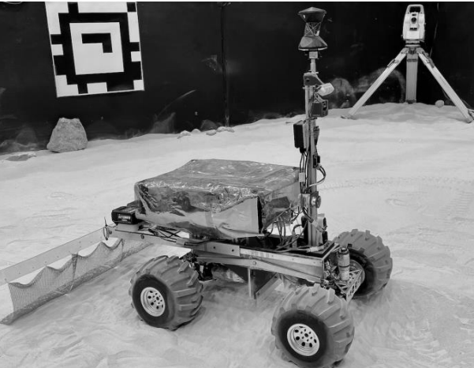
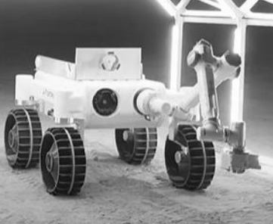
ISRU
Construction & Materialisation
Robotic Process
COLLECTING
PROCESSING
FLATTENING
MELTING
https://moonshotplus.tudelft.nl/images/7/7f/1.13.1_Space%26Robotics_FinalPresentation_JIP2025.pdf
Extra-/Terrestrial Architecture Graduation Studio
Maurits Roijen
‹#›

Slide 21
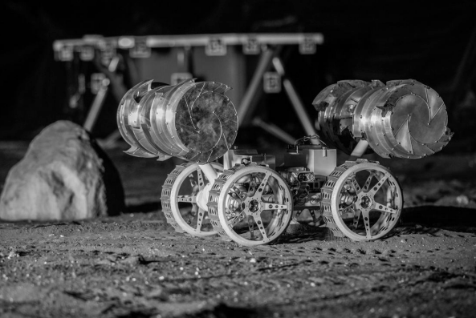
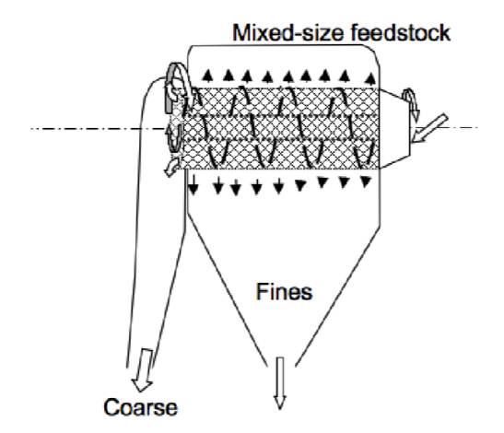
ISRU
Construction & Materialisation
Robotic Process
COLLECTING
PROCESSING
FLATTENING
MELTING
https://moonshotplus.tudelft.nl/images/7/7f/1.13.1_Space%26Robotics_FinalPresentation_JIP2025.pdf
Extra-/Terrestrial Architecture Graduation Studio
Maurits Roijen
‹#›

Slide 22
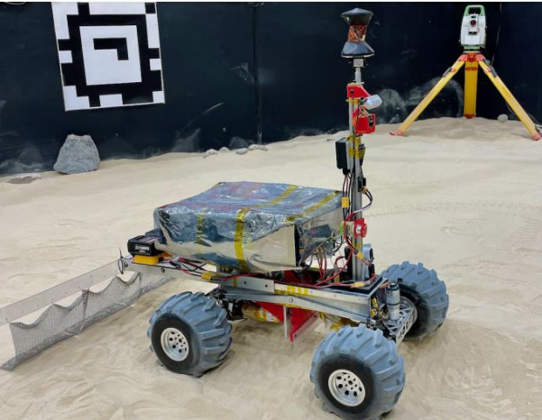
ISRU
Construction & Materialisation
Robotic Process
COLLECTING
PROCESSING
FLATTENING
MELTING
https://moonshotplus.tudelft.nl/images/7/7f/1.13.1_Space%26Robotics_FinalPresentation_JIP2025.pdf
Extra-/Terrestrial Architecture Graduation Studio
Maurits Roijen
‹#›

Slide 23
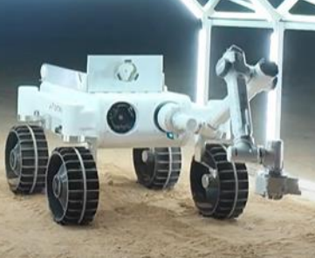
ISRU
Construction & Materialisation
Robotic Process
COLLECTING
PROCESSING
FLATTENING
MELTING
https://moonshotplus.tudelft.nl/images/7/7f/1.13.1_Space%26Robotics_FinalPresentation_JIP2025.pdf
Extra-/Terrestrial Architecture Graduation Studio
Maurits Roijen
‹#›

Slide 24
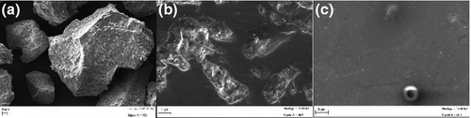
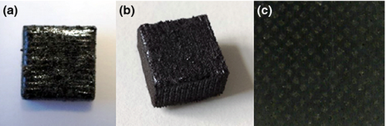
3D Printing
Construction & Materialisation
Selective Laser Melting (SLM)
Melts regolith into a glass-like solid
No additives required
Energy-intensive
1500 degrees celcius
Less porous than SLS so better structural integrity
Powder
Sintered
Melted
Fateri, M., & Gebhardt, A. (2015). Process parameters development of selective laser melting of lunar regolith for on‐site manufacturing applications. International Journal of Applied Ceramic Technology, 12(1), 46-52.
Extra-/Terrestrial Architecture Graduation Studio
Maurits Roijen
‹#›

Slide 25
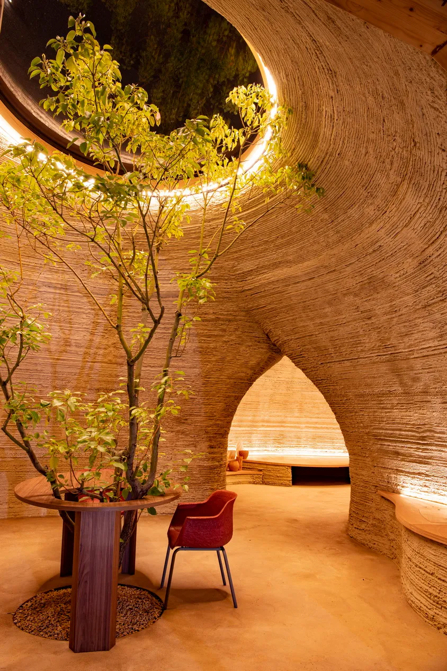
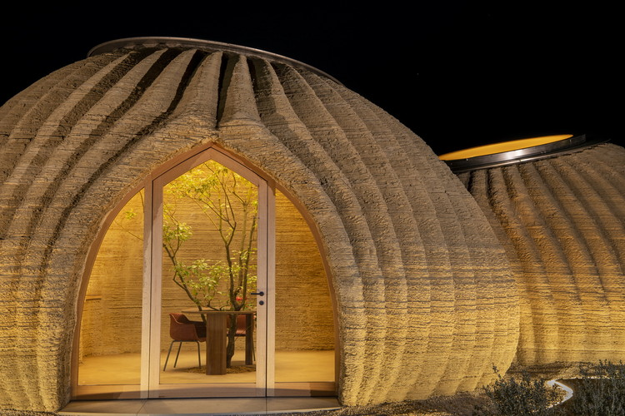
3D Printing
Construction & Materialisation
Case Study
TECLA by Mario Cucinella Architects
Used material extrusion not SLM
Organic shapes
Custom unique texture on the exterior
Integrated strip lighting
Compressive dome shape
Melted
Mario Cucinella Architects. (2020). TECLA: The first eco-sustainable housing prototype 3D printed from raw earth. https://www.mcarchitects.it/en/projects/tecla-technology-and-clay
Extra-/Terrestrial Architecture Graduation Studio
Maurits Roijen
‹#›

Slide 26
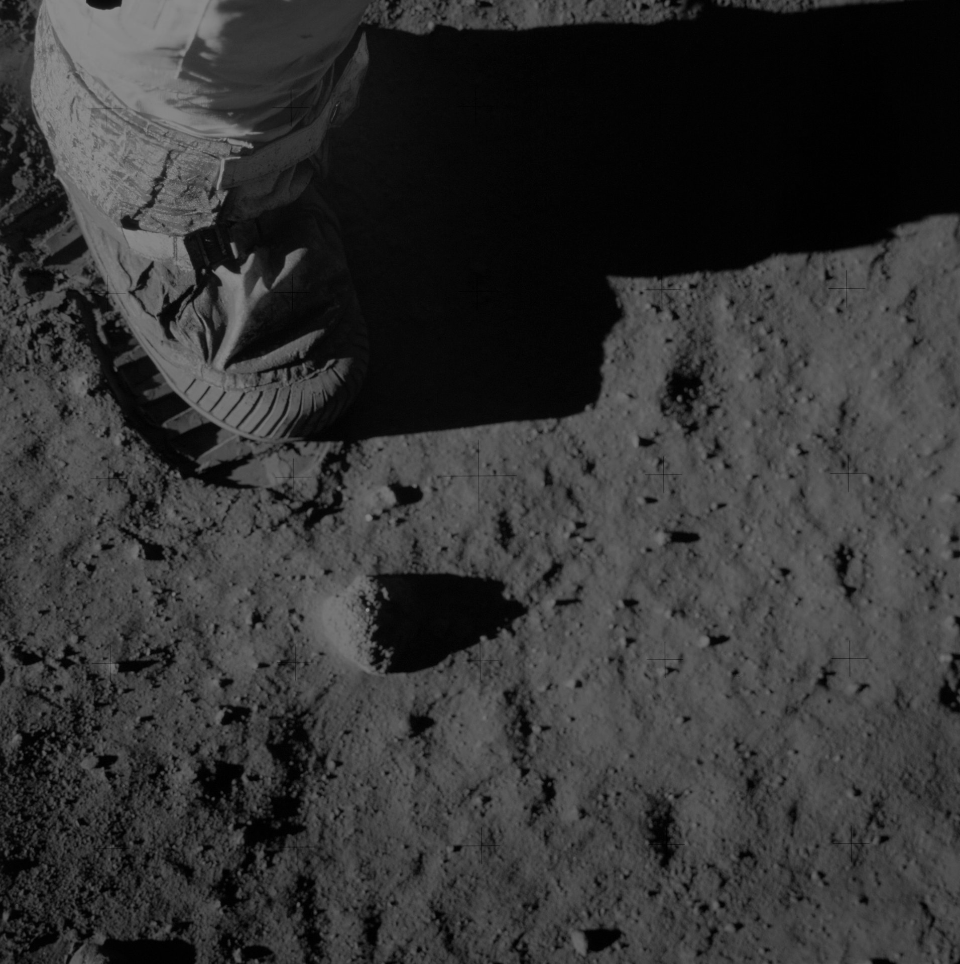
Section
Mental Health & Well-being

Slide 27
Drivers
Mental Health & Well-being
Missions in Space
Sick Building Syndrome
Stuck with the same people
High stress environment
Away from family and home
Little privacy
Monotonous environment
Improper, harsh lighting
Thermal/humidity discomfort
Bad acoustic quality → noise
Bad air quality
Extra-/Terrestrial Architecture Graduation Studio
Maurits Roijen
‹#›

Slide 28
Response
Mental Health & Well-being
Biophilic Design Interventions Should Respond through:
Non-monotonous, dynamic spaces
Seperation between public & private spaces → ability to retreat
Lighting comfort
Acoustic comfort
Thermal comfort
Air quality
Extra-/Terrestrial Architecture Graduation Studio
Maurits Roijen
‹#›

Slide 29
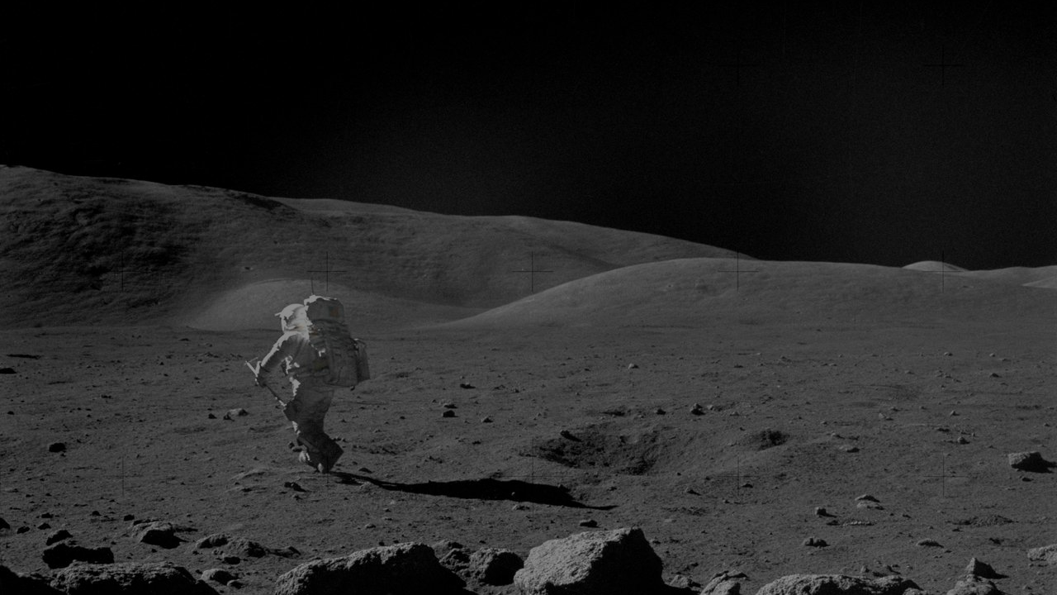
Section
Biophilic Design

Slide 30
Biophilic Design
Biophilic Design
Definition
An approach to architecture and interior design that connects people with nature within built environments, using natural elements, forms, and processes to improve human health, well-being, and productivity, stemming from our innate love for nature
Extra-/Terrestrial Architecture Graduation Studio
Maurits Roijen
‹#›

Slide 31

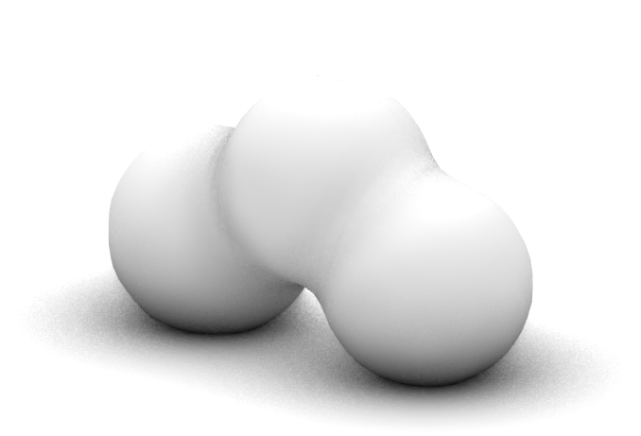
Computational Systems
Biophilic Design
At the building level biophilic design comes through 2 main design systems
Lindemayers L-System
Metaballs
A mathematical system that describes plant growth and allows us to model it.
A modelling technique involving spheres to create organic looking shapes.
Extra-/Terrestrial Architecture Graduation Studio
Maurits Roijen
‹#›

Slide 32
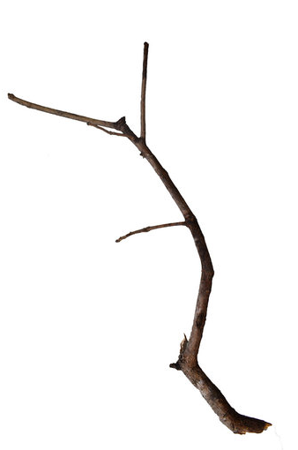
L-System
Biophilic Design
Why L-System?
Biomimicry → mimic plant growth
Modular design
Building can grow and branch out in the future
Efficient pathing
L-system branches create pathing for humans and LSS
Spatial Hierarchy
Compartmentalization (safety)
Extra-/Terrestrial Architecture Graduation Studio
Maurits Roijen
‹#›

Slide 33
L-System
Biophilic Design
Why L-System?
Biomimicry → mimic plant growth
Modular design
Building can grow and branch out in the future
Efficient pathing
L-system branches create pathing for humans and LSS
Spatial Hierarchy
Compartmentalization (safety)
Extra-/Terrestrial Architecture Graduation Studio
Maurits Roijen
‹#›

Slide 34
L-System
Biophilic Design
Why L-System?
Biomimicry → mimic plant growth
Modular design
Building can grow and branch out in the future
Efficient pathing
L-system branches create pathing for humans and LSS
Spatial Hierarchy
Compartmentalization (safety)
Extra-/Terrestrial Architecture Graduation Studio
Maurits Roijen
‹#›

Slide 35
L-System
Biophilic Design
Why L-System?
S
S
Biomimicry → mimic plant growth
Modular design
Building can grow and branch out in the future
Efficient pathing
L-system branches create pathing for humans and LSS
Spatial Hierarchy
Compartmentalization (safety)
S
S
M
M
L
S
S
L
L
Extra-/Terrestrial Architecture Graduation Studio
Maurits Roijen
‹#›

Slide 36
L-System
Biophilic Design
Why L-System?
Biomimicry → mimic plant growth
Modular design
Building can grow and branch out in the future
Efficient pathing
L-system branches create pathing for humans and LSS
Spatial Hierarchy
Compartmentalization (safety)
Extra-/Terrestrial Architecture Graduation Studio
Maurits Roijen
‹#›

Slide 37
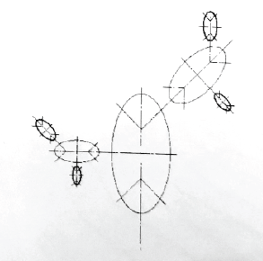
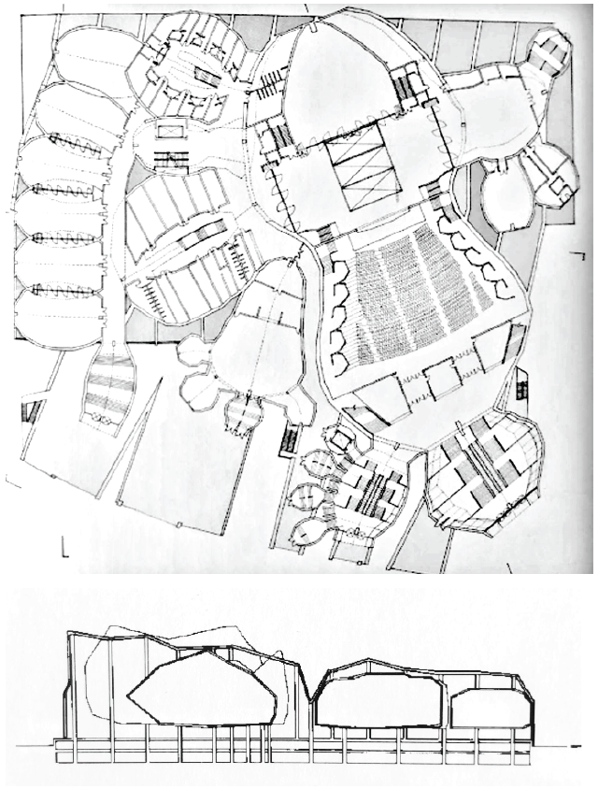
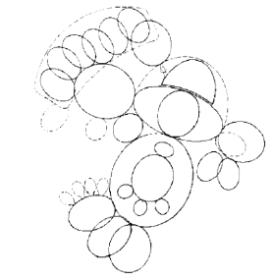
L-System
Biophilic Design
Case Study
Cardiff Bay Opera House by Greg Lynn
Precedent for designing with L-systems
Uses the L-system to define the floorplan
Clear spatial hierarchy through size differences
Extra-/Terrestrial Architecture Graduation Studio
Maurits Roijen
‹#›

Slide 38
Metaballs
Biophilic Design
Why Metaballs?
3D printing allows us to step away from more typical orthogonal architectural designs
Easy way to achieve an organic look
Spheres are ideal shapes when dealing with pressure
Domes work well in compression, ideal for 3D printing
Extra-/Terrestrial Architecture Graduation Studio
Maurits Roijen
‹#›

Slide 39
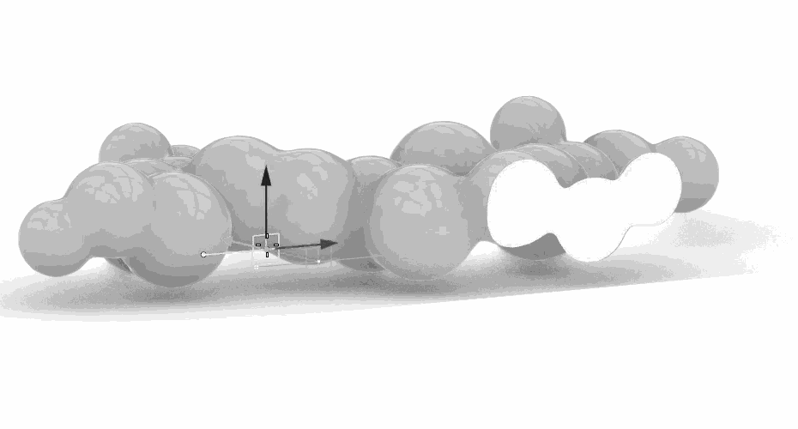
Metaballs
Biophilic Design
Why Metaballs?
3D printing allows us to step away from traditional blocky looks you find on Earth at the moment
Easy way to achieve a dynamic organic form
Spheres are ideal shapes when dealing with pressure
Domes work well in compression, ideal for 3D printing
Extra-/Terrestrial Architecture Graduation Studio
Maurits Roijen
‹#›

Slide 40
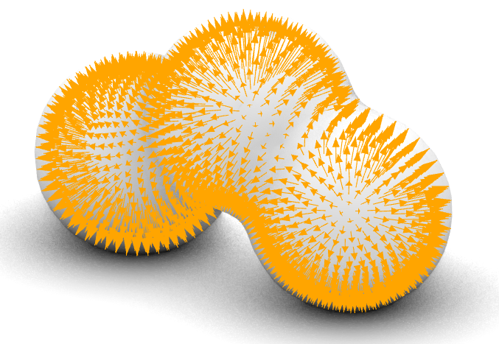
Metaballs
Biophilic Design
Why Metaballs?
3D printing allows us to step away from traditional blocky looks you find on Earth at the moment
Easy way to achieve an organic look
Spheres are ideal shapes when dealing with pressure
Domes work well in compression, ideal for 3D printing
Extra-/Terrestrial Architecture Graduation Studio
Maurits Roijen
‹#›

Slide 41
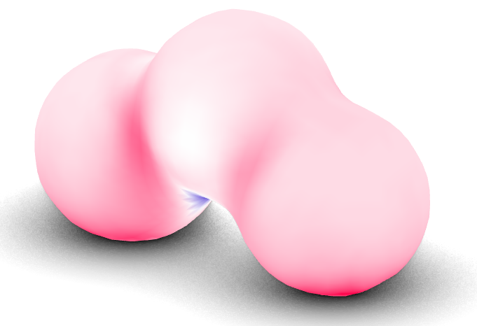
Metaballs
Biophilic Design
Why Metaballs?
3D printing allows us to step away from traditional blocky looks you find on Earth at the moment
Easy way to achieve an organic look
Spheres are ideal shapes when dealing with pressure
Domes work well in compression, ideal for 3D printing
Extra-/Terrestrial Architecture Graduation Studio
Maurits Roijen
‹#›

Slide 42
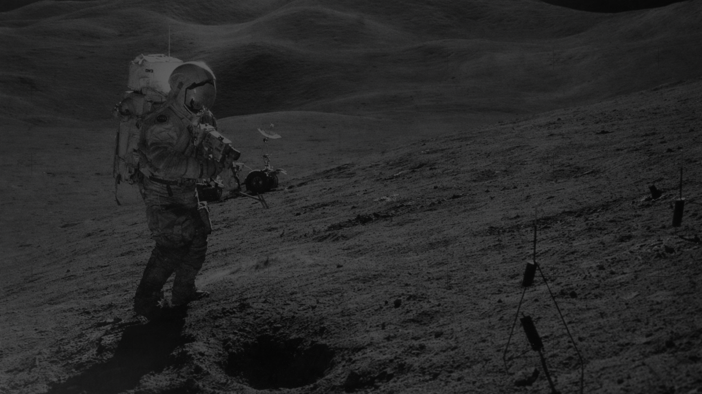
Section
Programme

Slide 43
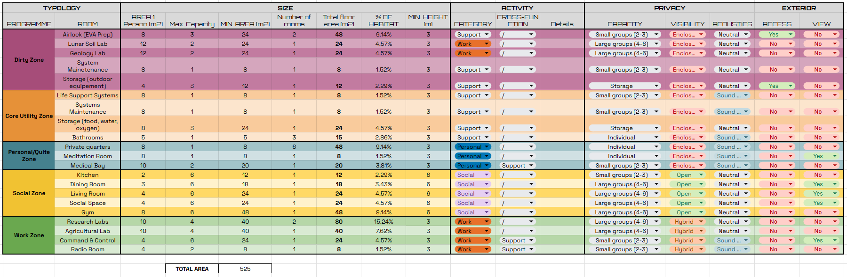
Programme
Programme
Long-Term Research Mission For A Crew Of 6
Extra-/Terrestrial Architecture Graduation Studio
Maurits Roijen
‹#›

Slide 44
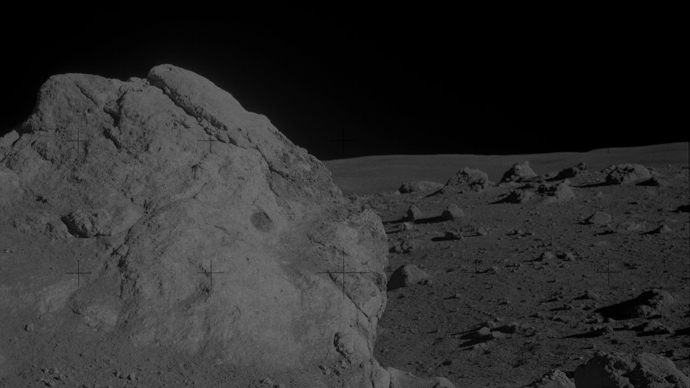
Section
Proof of Concept

Slide 45
L-System
Fragment
S
S
S
S
M
M
L
S
S
L
L
Extra-/Terrestrial Architecture Graduation Studio
Maurits Roijen
‹#›

Slide 46
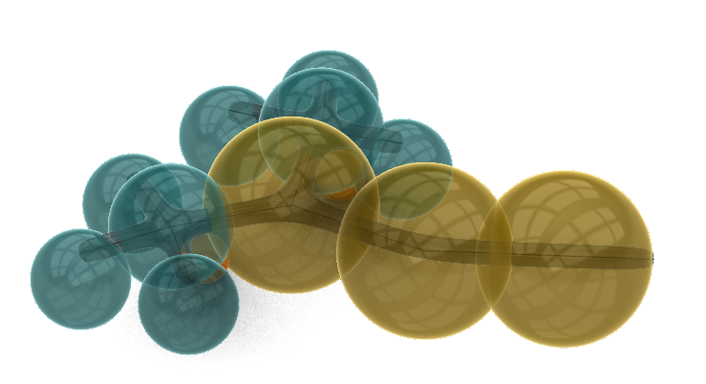
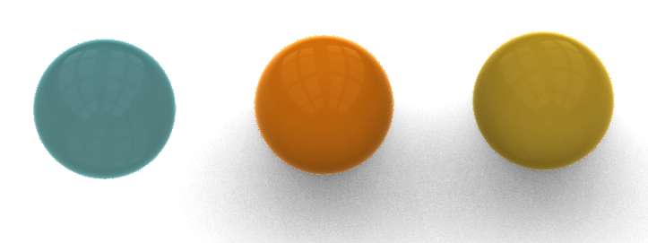
Bubble Diagram
Fragment
Bedroom
Bedroom
Bedroom
Bedroom
Dining Room / Kitchen
*
*
Bedroom
Bedroom
Living Room
*Bathroom
Social Space
Private
Bathroom
Social
Extra-/Terrestrial Architecture Graduation Studio
Maurits Roijen
‹#›

Slide 47
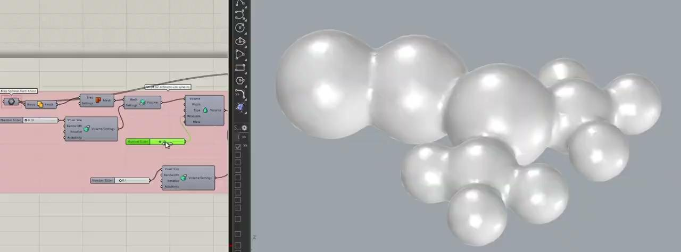
Metaball
Fragment
Grasshopper Metaball Script
Extra-/Terrestrial Architecture Graduation Studio
Maurits Roijen
‹#›

Slide 48
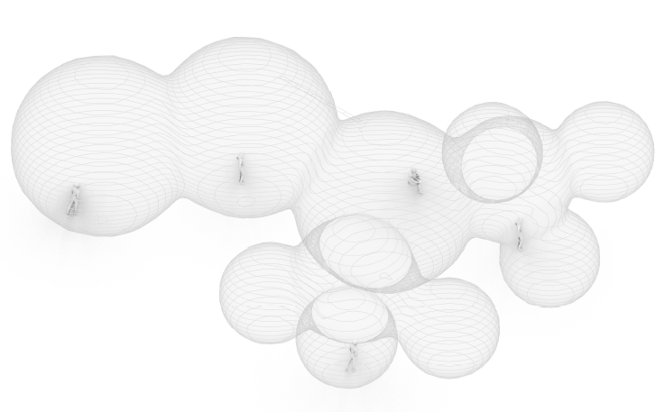
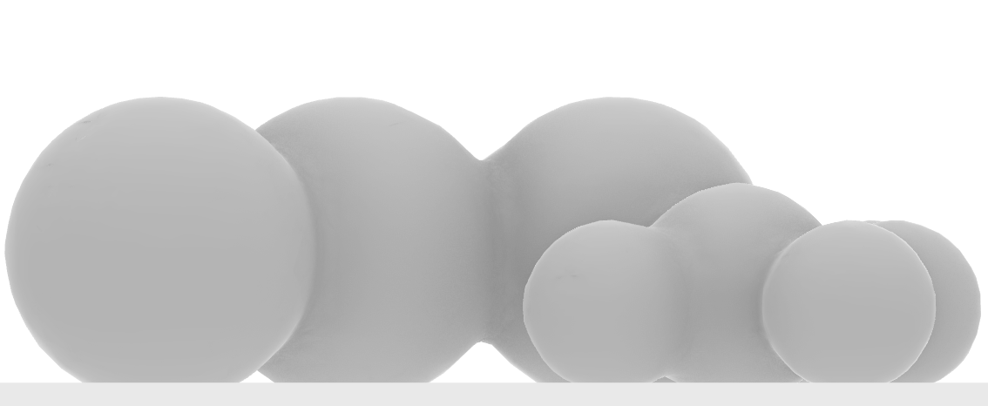
Metaball
Fragment
Bubble diagram → metaball volumes
Extra-/Terrestrial Architecture Graduation Studio
Maurits Roijen
‹#›

Slide 49
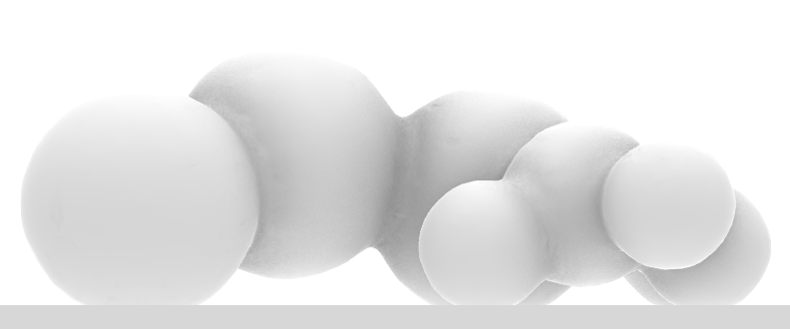
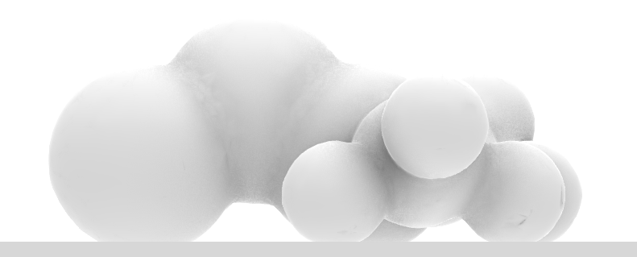
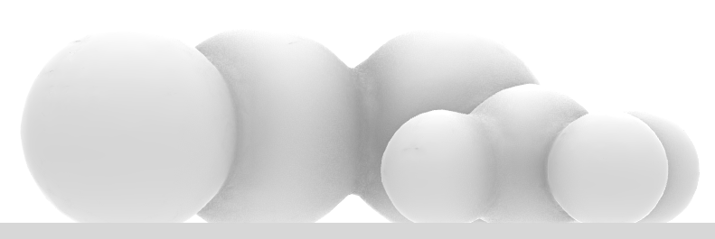
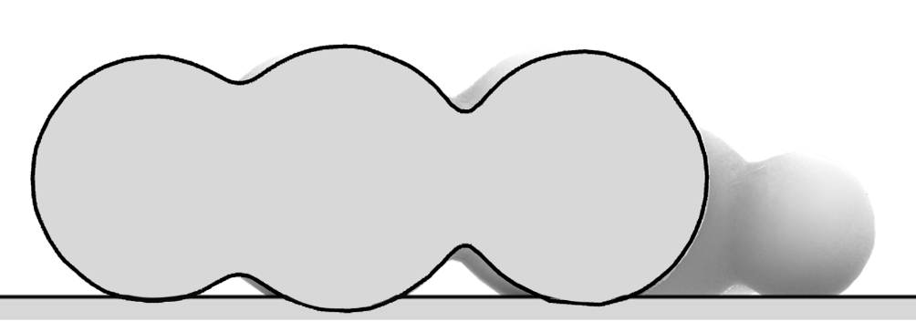
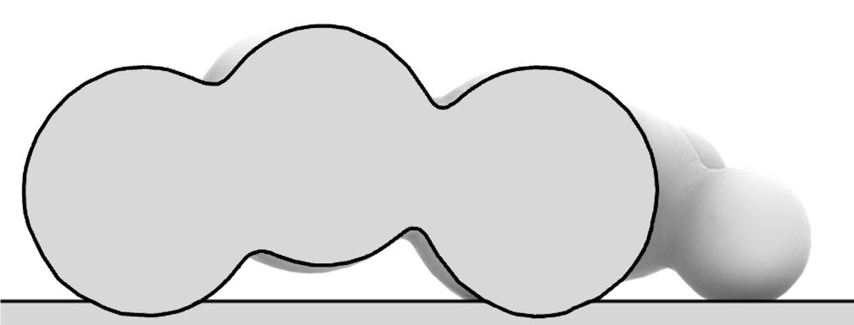




Metaball Adjustments
Fragment
Increasing dynamic height and metaball smoothing
V1
V2
V3
Extra-/Terrestrial Architecture Graduation Studio
Maurits Roijen
‹#›

Slide 50

Metaball Adjustments
Fragment
V3
Extra-/Terrestrial Architecture Graduation Studio
Maurits Roijen
‹#›

Slide 51

Structural Justification
Fragment
Radiation protection
Lava tubes significantly reduce radiation exposure
54 cm of regolith shielding is required for a safe habitat
Simulation of effective radiation dose equivalent inside a lava tube. (from M. Naito et al. She et al., 2025)
https://moonshotplus.tudelft.nl/images/f/f4/1.13.1_RoboticsInstitute_FinalReport_JIP2025.pdf
Extra-/Terrestrial Architecture Graduation Studio
Maurits Roijen
‹#›

Slide 52


Structural Justifications
Fragment
Design V1 - Force of Gravity
Max Compression
0.00869 < 9.250 kN/cm²
Max Tension
0.00236 < 0.925
Structure performs well in low gravity
Overengineered thanks to the thickness required for radiation protection
Forces: Gravity
https://www.researchgate.net/publication/390602870_Melting_and_solidifying_behavior_of_lunar_regolith_simulant_under_a_vacuum_environment
Extra-/Terrestrial Architecture Graduation Studio
Maurits Roijen
‹#›

Slide 53


Structural Justification
Fragment
Design V2 - Cantilevers
Raising the metaballs
→ More dynamic interior facilitating jumpy lunar movement
Forces: Gravity
Extra-/Terrestrial Architecture Graduation Studio
Maurits Roijen
‹#›

Slide 54


Structural Justification
Fragment
Design V2 - Pressurised
Air pressure pushes the shell out
Peak tension 1.7% → 14.1%
Forces: Pressure
Extra-/Terrestrial Architecture Graduation Studio
Maurits Roijen
‹#›

Slide 55

Structural Justification
Fragment
Design V3 - Metaball smoothing
Metaballs are moved closer together and blended
→ More efficient load path to the ground
→ ‘necks’ are reduced
→ Reduce peak stress in the hotspots
Forces: Gravity + Presure
Extra-/Terrestrial Architecture Graduation Studio
Maurits Roijen
‹#›

Slide 56

Porosity
Fragment
Window Type Exploration
Small
Large
Mixed
Metaball
Extra-/Terrestrial Architecture Graduation Studio
Maurits Roijen
‹#›

Slide 57



Porosity
Fragment
Window Type Exploration
Round
Mixed
Metaball
Extra-/Terrestrial Architecture Graduation Studio
Maurits Roijen
‹#›

Slide 58


Porosity
Fragment
Porosity levels
Dependent on function
Private vs Public
Large Social
Space Window
Small Bedroom
Window
Extra-/Terrestrial Architecture Graduation Studio
Maurits Roijen
‹#›

Slide 59


Porosity
Fragment
Windows generally follow L-system axis
Extra-/Terrestrial Architecture Graduation Studio
Maurits Roijen
‹#›

Slide 60

Porosity
Fragment
Extra-/Terrestrial Architecture Graduation Studio
Maurits Roijen
‹#›

Slide 61

Porosity
Fragment
Extra-/Terrestrial Architecture Graduation Studio
Maurits Roijen
‹#›

Slide 62


Interior - Lunar Playground
Fragment
Extra-/Terrestrial Architecture Graduation Studio
Maurits Roijen
‹#›

Slide 63


Circadian Lighting
Fragment
Extra-/Terrestrial Architecture Graduation Studio
Maurits Roijen
‹#›

Slide 64
SECTION
Conclusion

Slide 65

Concept Summary
Conclusion
Design Steps
L-system
Bubble diagram
Metaballs
Metaball structure optimization
Porosity
Integrated Circadian Lighting
Extra-/Terrestrial Architecture Graduation Studio
Maurits Roijen
‹#›

Slide 66
Biophilic Response
Conclusion
Checklist
Next Steps
Non-monotonous, dynamic spaces
Seperation between public & private spaces → ability to retreat
Lighting comfort
Acoustic comfort
Thermal comfort
Air quality
Integrate plant life into the indoor climate system to help with life support, food production, waste stream management and air quality
Show thermal massing, heat sinks and plant cooling to increase thermal comfort
Integrate biophilic inspired acoustic pattern on the interior
Integrate biophilic pattern for the exterior
Extra-/Terrestrial Architecture Graduation Studio
Maurits Roijen
‹#›

