Slide 1
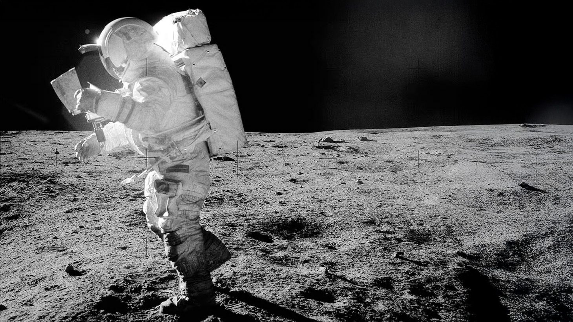
P5 Presentation
Terraforming Moon
Humanizing Lunar Living through Human-centric Design
Regina Tania Tan
Lunar Architecture and Infrastructure Graduation Studio 2024/25 | TU Delft Faculty of Architecture
Tutors: H. Bier, F. Adema, A. Hidding
Notes:
https://www.lpi.usra.edu/resources/lunarorbiter/frame/?5065
LUniversal
Terraforming Moon
Humanizing Lunar Living through Inclusive Habitat Design
Designing an Inclusive Lunar Habitat for Various Social Interaction
Humanizing Lunar Habitat through Human-centric Design

Slide 2
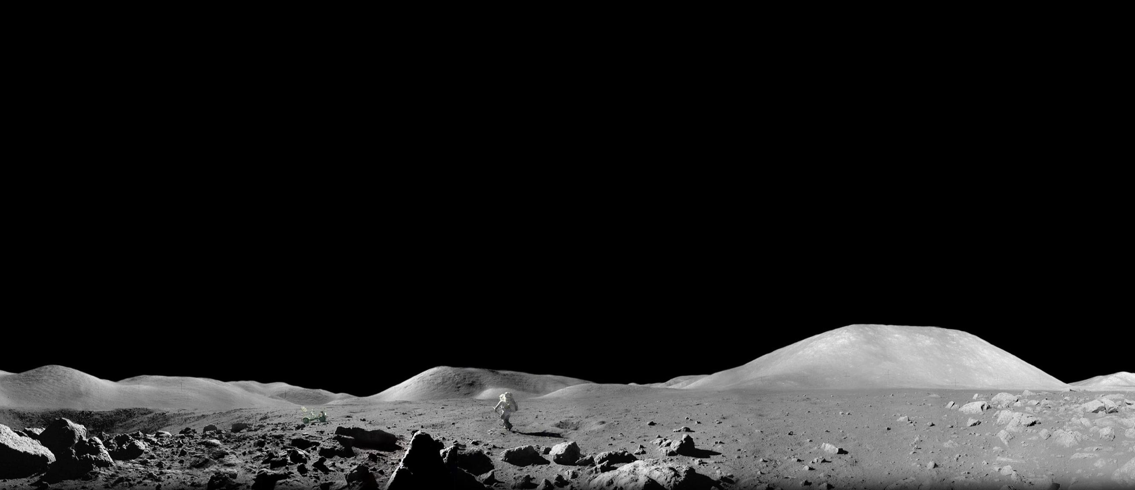
Background | Requirements
Settling in the unknown…
Astronaut Harrison Schmitt exploring lunar surface, Apollo 17 (1972), NASA.
Notes:
astronaut Harrison Schmitt exploring the lunar surface during the Apollo 17 mission in 1972
https://www.facebook.com/photo.php?fbid=1123171029169351&set=a.808655730620884&type=3

Slide 3
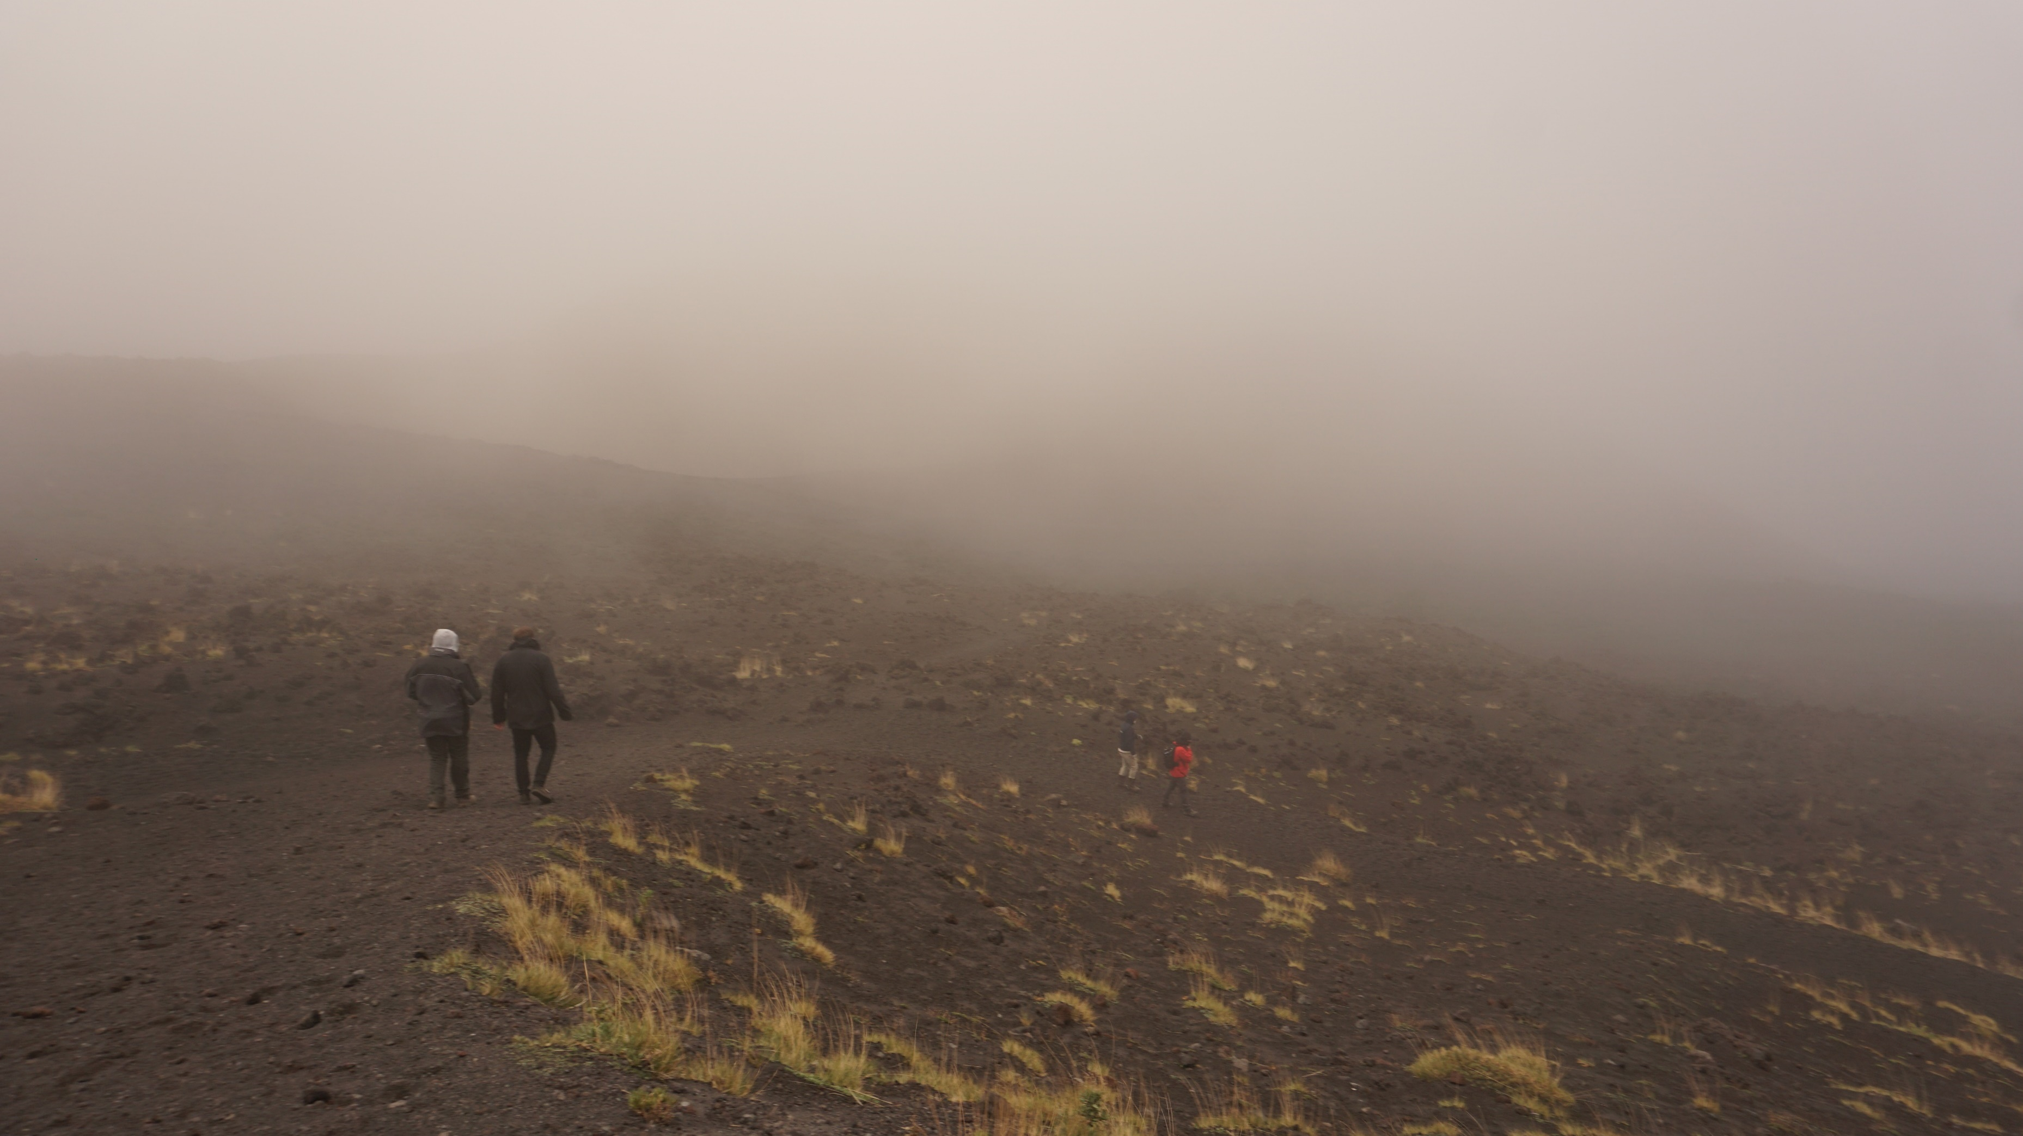
Background | Requirements
Settling in the unknown…
Mount Etna, Sicily, TU Delft Lava Tube Mission (2024)

Slide 4
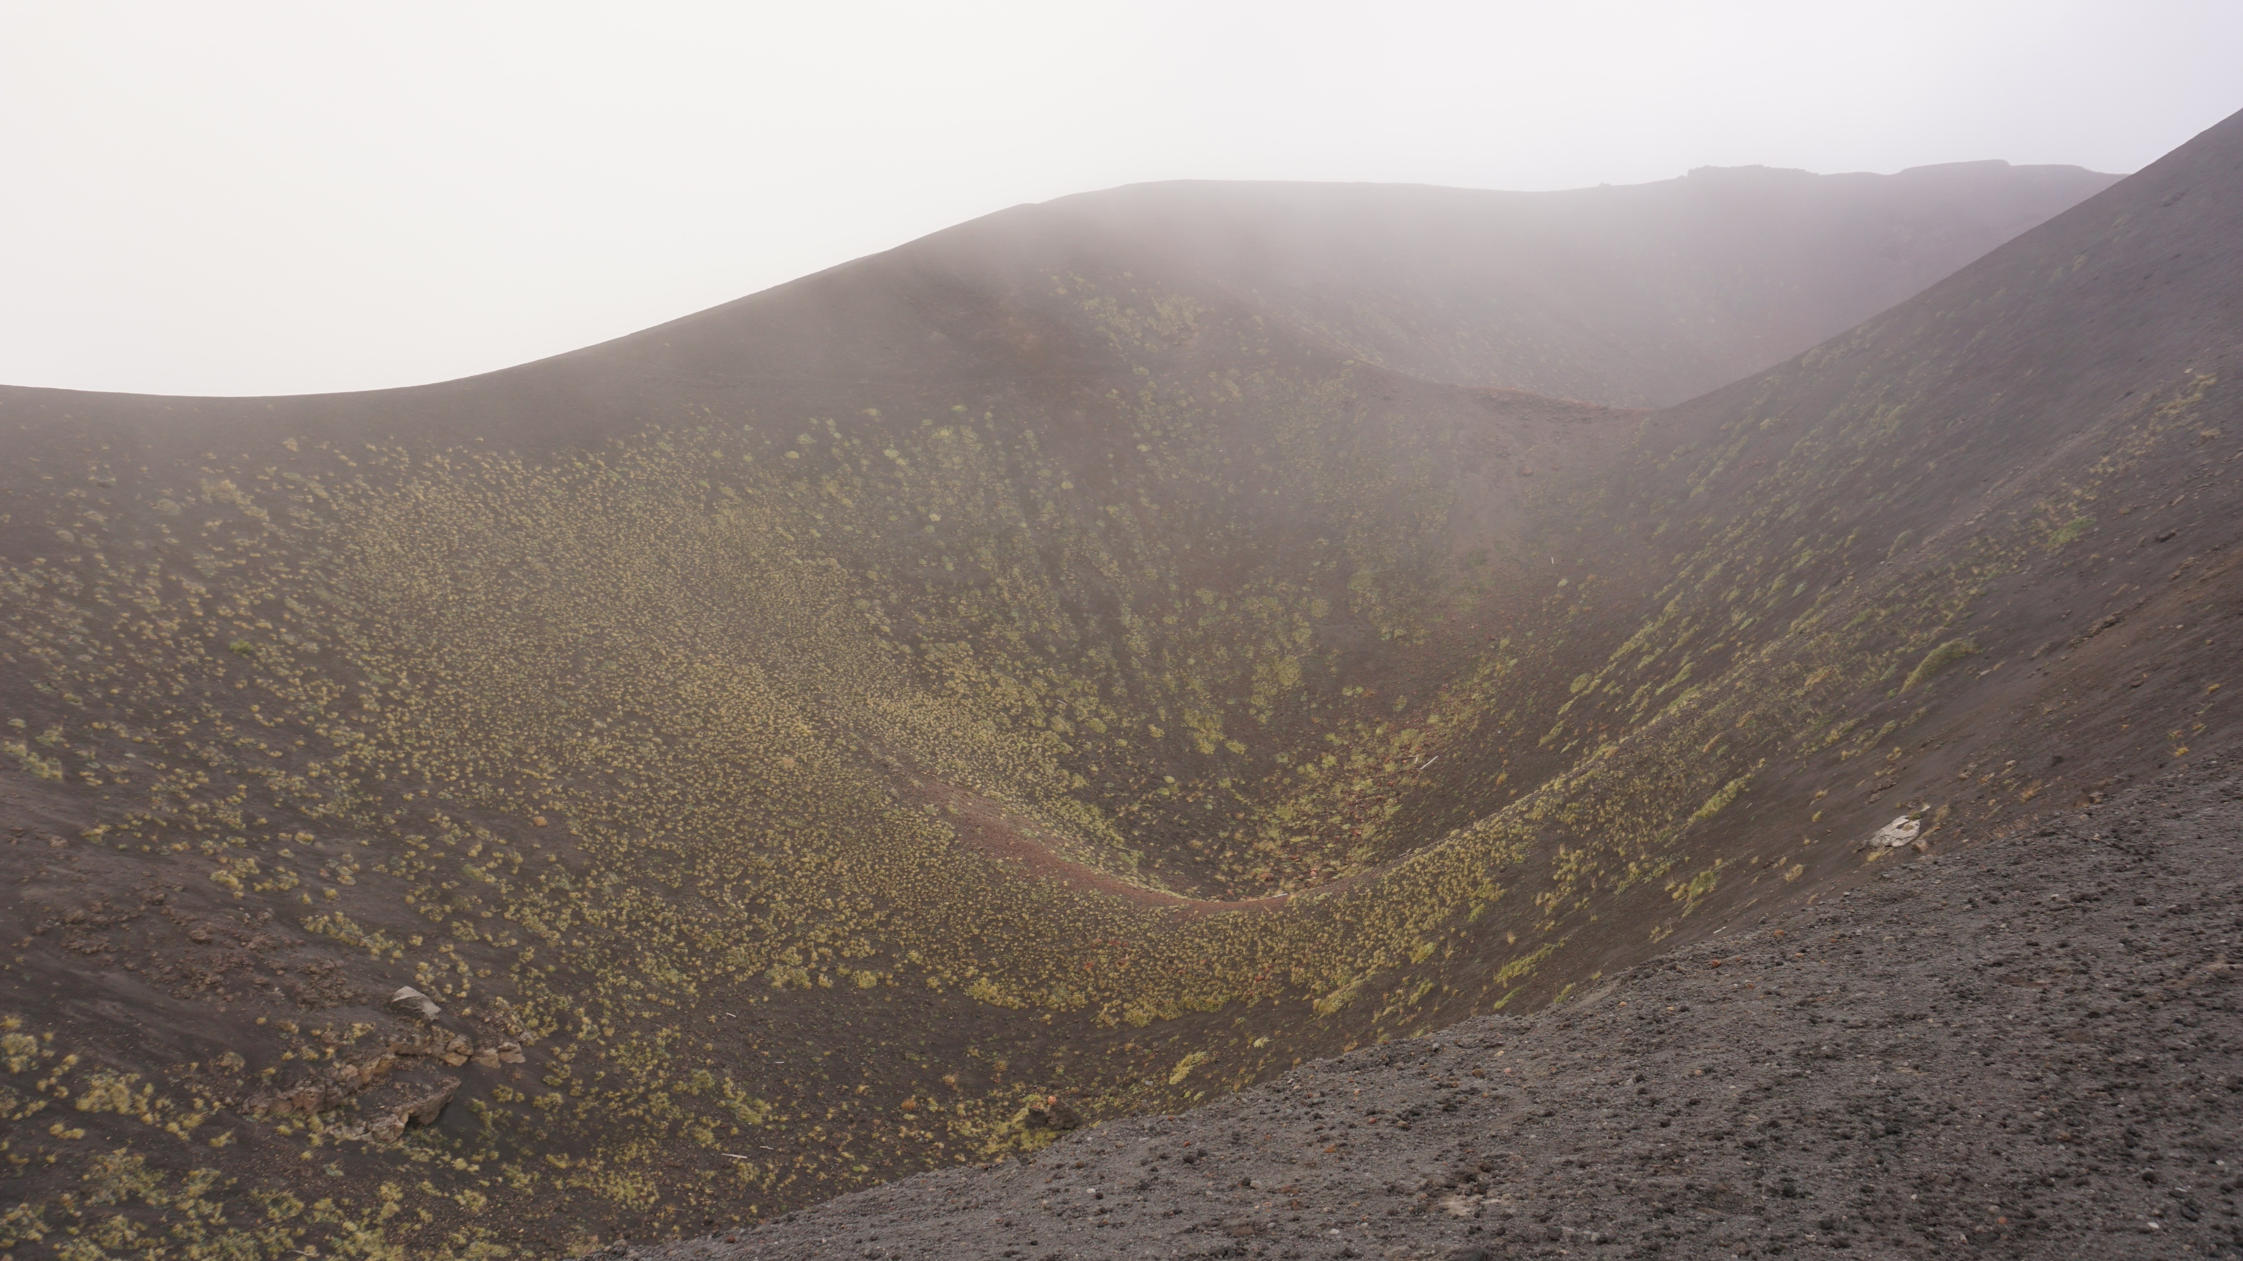
Background | Requirements
Settling in the unknown, on Earth
Expansive landscape…no human touch
Mount Etna, Sicily, TU Delft Lava Tube Mission (2024)
Notes:
Site – personal experience, analogue mission

Slide 5
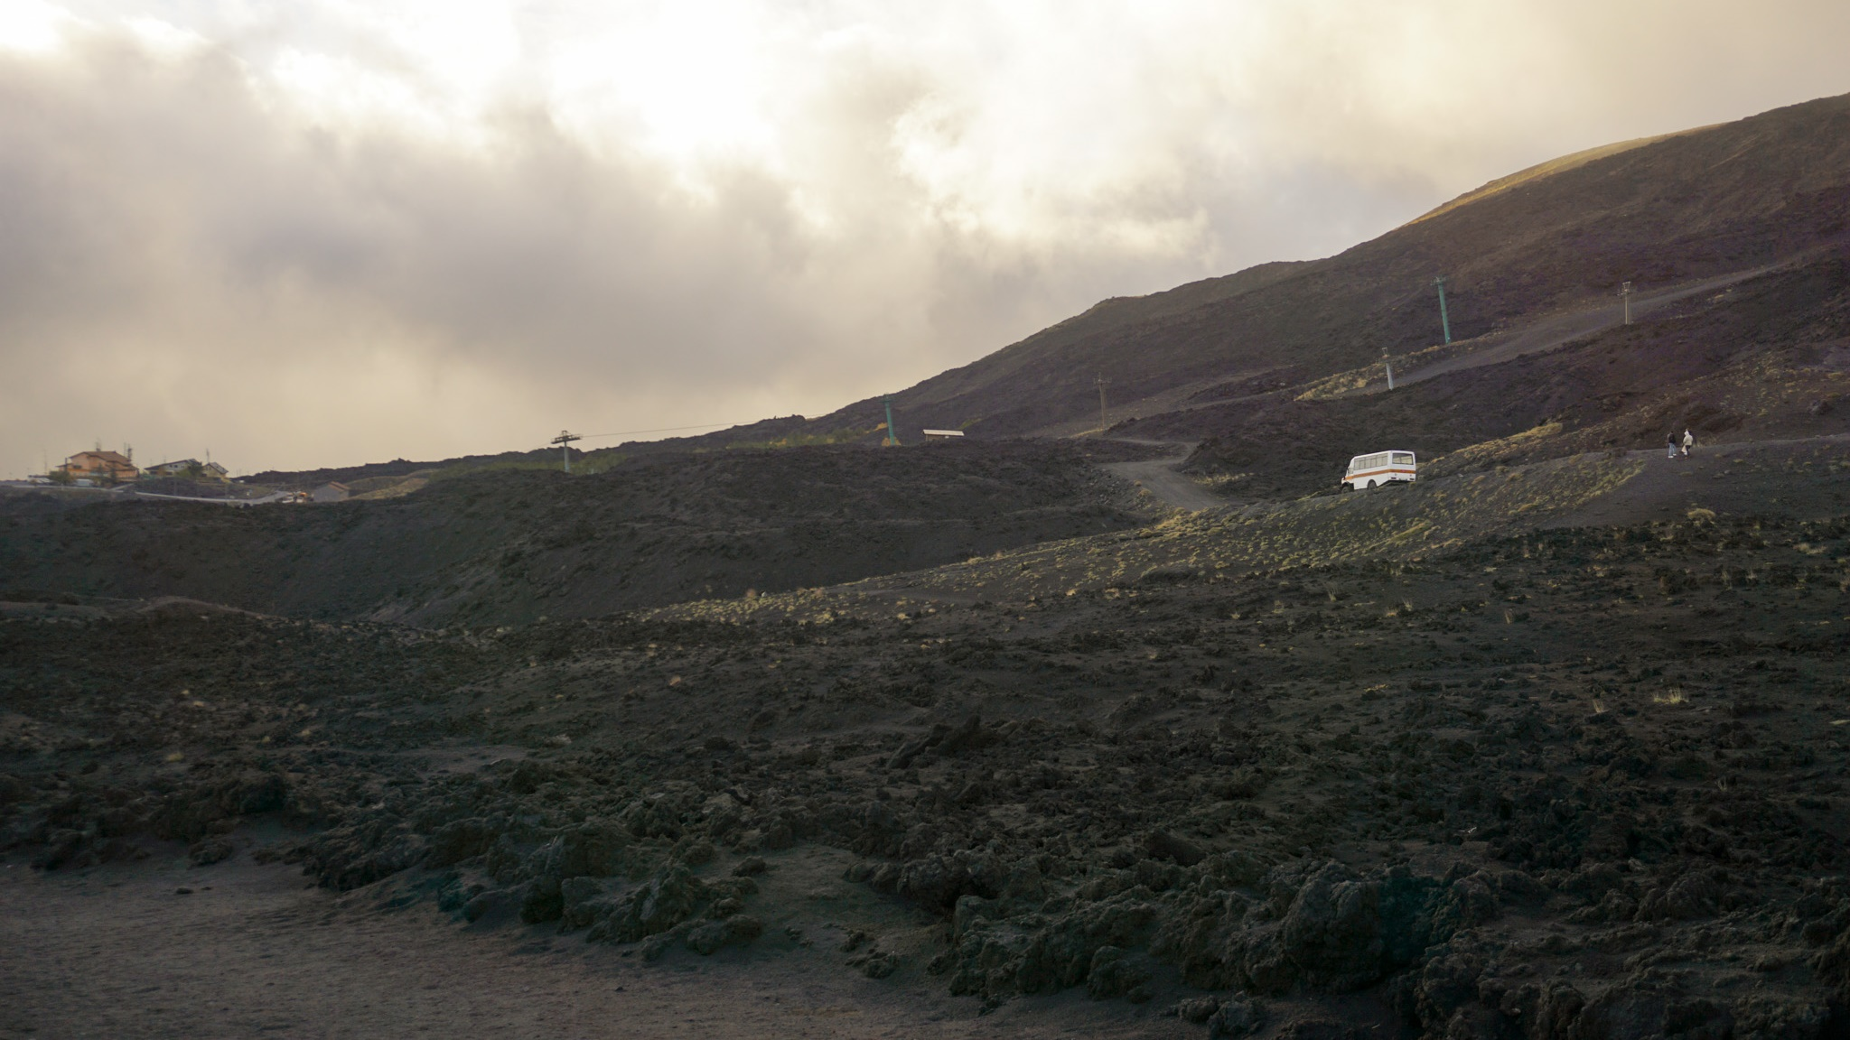
Background | Requirements
Need of something familiar…
human infrastructure as marker
Mount Etna, Sicily, TU Delft Lava Tube Mission (2024)
Notes:
Marker of scale, life,

Slide 6
Background | Requirements
Source: Architecture for Astronauts, last column added by author
Condition | Earth | Moon | Design Implications
Gravity | 1 g | 1/6 g | Consider low gravity effects
Atmosphere | 1 bar (O2, N2, CO2) | ~0 bar (almost vacuum) | Pressurized vessel
Length of day | 24 hours | 28 Earth days (14 days light / 14 days dark) | Site selection
Temperature | Mean 15°C Range: -89°C – 60°C | Mean -20°C Range: -233°C – 123°C | Thermal enclosure
Radiation | Protection by Earth’s atmosphere | Exposure to space radiation, secondary radiation from surface | Radiation enclosure
Water | 70.8% surface | In deep permanently shadowed craters & binded in regolith | Limited water
Dust | Generaly not harmful | Pervasive & potentially toxic, electromagnetic cling, lofts above surface | Physical enclosure
Others | - | Micrometeoroids, bright light & glare | Physical enclosure
Lunar environment:
physically hostile
Habitat = protection
Astronaut Harrison Schmitt exploring lunar surface, Apollo 17 (1972), NASA.
Notes:
What this means also is you would always stay inside the habitat
astronaut Harrison Schmitt exploring the lunar surface during the Apollo 17 mission in 1972
https://www.facebook.com/photo.php?fbid=1123171029169351&set=a.808655730620884&type=3

Slide 7
Background | Requirements
Lunar environment:
mentally hostile
“The most frightening aspect (of partaking the analogue testing) was not the lethal cold outside, but the isolation inside,”
Habitat = protection + habitability
Habitability: the suitability and value of a built habitat (lunar habitation) for its inhabitants (researchers) in a specific environment (lunar surface) and over a certain period of time (long-term >1 year)
Adapted from Sandra Hauplik-Meusburger, Architecture for Astronauts
Beth Healey, comment on her 14-month stay in Concordia Station analogue mission.
Astronaut Harrison Schmitt exploring lunar surface, Apollo 17 (1972), NASA.
Notes:
When we think about long-term, mental factors becomes important

Slide 8
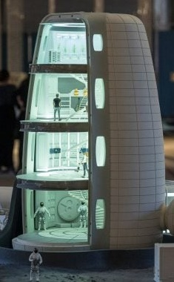
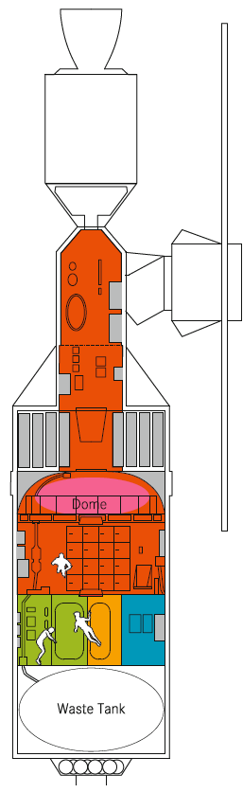
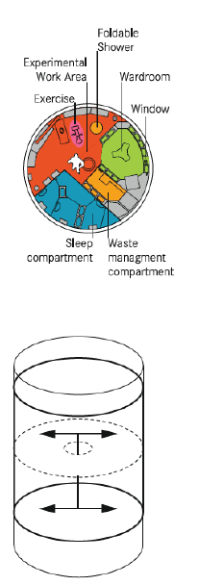
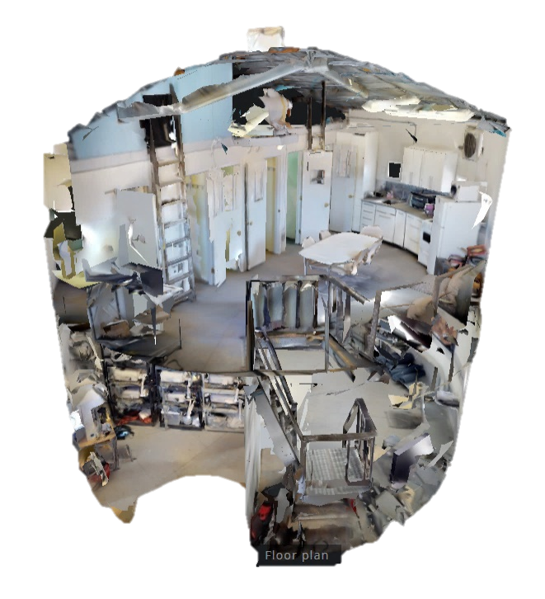
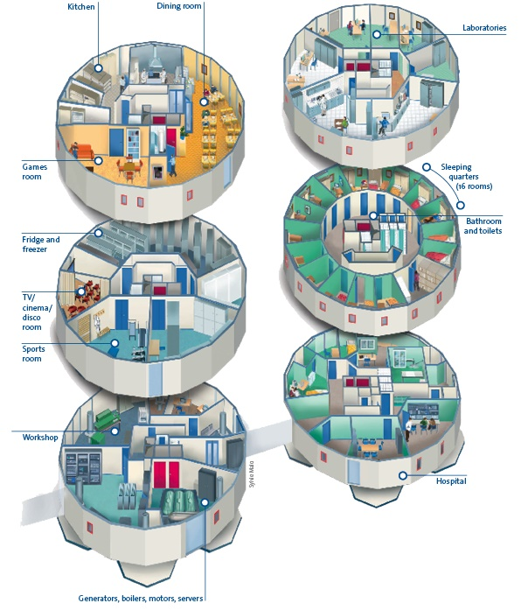
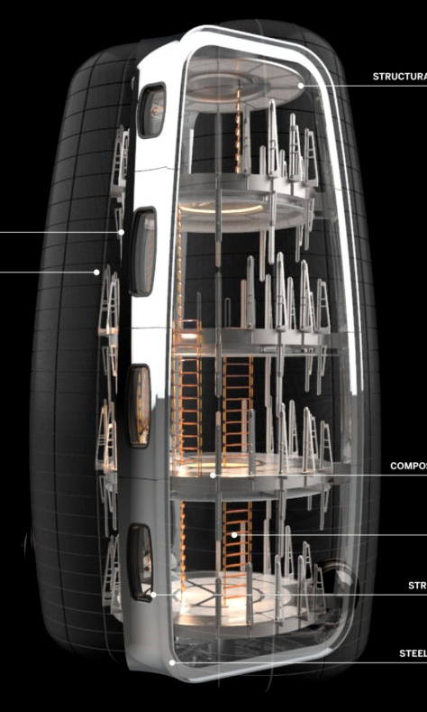
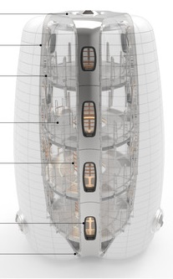
Engineered for non-human subjects, limited to feasibility
Background | Problem
Efficient form for transportability and environment protection (non-human actor)
Human de-centered design
Current schemes developed from functional aspect (not focusing on human behavior)
Spatial similarity of ISS TransHab and The Panopticon
Efficient form
Unit size
“We were stuffed in the capsule [Salyut] like sardines in a can.”
Jerry Linenger, 2000
[not to include– unit size]
US prison standard minimum 6.5 sqm
Europe prison standard minimum 6 sqm
UK cell sharing minimum 4.5 sqm/person
ISS sleeping quarter 2.5 sqm/person (2.5x1x1)
Recommended minimum NHV 25 sqm/person
Mars Desert Research Station, Utah, USA
Concordia Research Station, Antarctica
Skylab Space Station
Notes:
Current schemes developed from functional aspect (not focusing on human behavior)
However when we looked at current developments of space architecture, most schemes are developed from functional aspect, which de-center humans from the design
Engineered for non-human subjects, designed for efficiency / uniform spaces
While efficient, it creates monotonous spaces / lack of private space
Spatial arrangement /
Understandable for current timeline, but how about designing in the future where ISRU is already possible?
If only meet the demand for protection and efficiency, it decenters the human from the design
Not humane in long term
Panopticon = allocate same size of cells & rooms 19m2
This creates functional lunar habitait
Understandable when going to hostile environment
The Panopticon (Jeremy Bentham)
Space habitat built precedents are space stations, geared towards functionality for short-term living, which should not be the baseline for long term lunar surface habitats.
ISS TransHab: form given through structural properties of inflatable and centralized functional distribution for efficiency
The Panopticon: highly centralized, enabling surveillance of every inmate’s cell from a vantage point [form follows function]

Slide 9
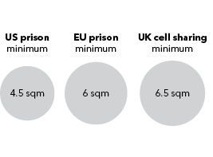

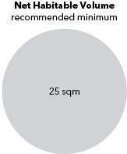
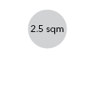
Background | Problem
Human de-centered design
Limited private area
[not to include– unit size]
US prison standard minimum 6.5 sqm
Europe prison standard minimum 6 sqm
UK cell sharing minimum 4.5 sqm/person
ISS sleeping quarter 2.5 sqm/person (2.5x1x1)
Recommended minimum NHV 25 sqm/person
“We were stuffed in the capsule [Salyut] like sardines in a can.”
Jerry Linenger, 2000
2.5 m³
25 m³
NHV for long-term mission
130 m3
NHV private-only areas?
Notes:
A very real example of human de-centered design is the very small private area allocation.
In the International Space Station, the sleeping quarter is even smaller than the minimum size of a prison cell.

Slide 10
No mutual consent on specific number for habitation size
Marc M. Cohen, book, p.28
Research Argument
How have existing developments meet the demands for long-term lunar settlement?
Short-term missions
Long-term habitation
Designing with human instinct in mind
Functional design
Human-centric design
“surviving”
“living”
Kyknya flow agak kepecah disini. Coba bbrp example aja
Mitigation AND enhancement
Technical requirements is not enough. Habitats need to consider psychological requirements.
Notes:
Function is undoubtedly important, but looking towards long-term, we have to move to human-centric design

Slide 11
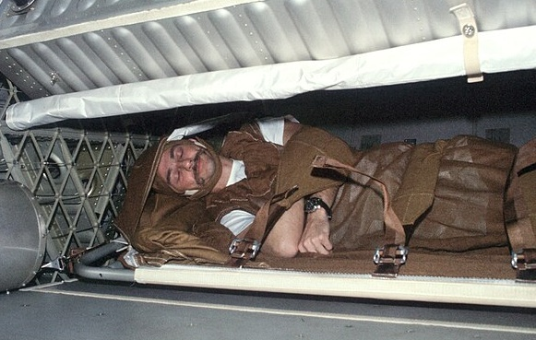
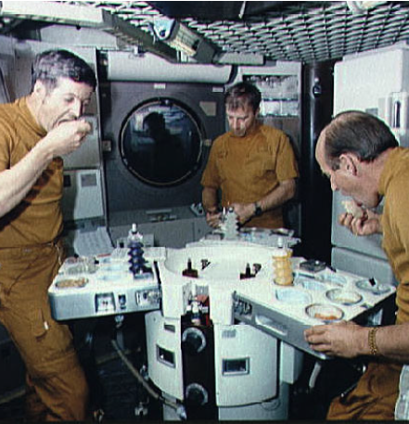
No mutual consent on specific number for habitation size
Marc M. Cohen, book, p.28
Research Argument
Human-centric design
in an Isolated, Confined, and Extreme (ICE) habitat
How have existing developments meet the demands for long-term lunar settlement?
Personalization
“(On sleeping) It’s got to be a place that can be modified in the way any individual desires.”
Gerald Carr, Skylab 4, NASA. 1974
Designing with human instinct in mind
Variety Social Interaction
Kyknya flow agak kepecah disini. Coba bbrp example aja
“…availability of an open, communal area is very important for crew morale and productivity during long duration isolation and confinement in space.”
Excerpts from NASA Human Integration Design Handbook, on Skylab and Shuttle-Mir experience.
Owen Garriott, Skylab 3
Dedicated dining table, Skylab Station.
Mitigation AND enhancement
Technical requirements is not enough. Habitats need to consider psychological requirements.
Notes:
Crucial to human-centric design is personalization, catering to each individuals’ needs, and providing variety of social interaction which has positive impact on crew morale and productivity
Success in design for human behavior in ICE environment
When we look into astronaut excerpts, human aspects notably personalization and variety of social interaction is important and even boost the crew productivity
https://commons.wikimedia.org/wiki/File:Owen_Garriott_sleeping_during_SKylab_3.jpg

Slide 12
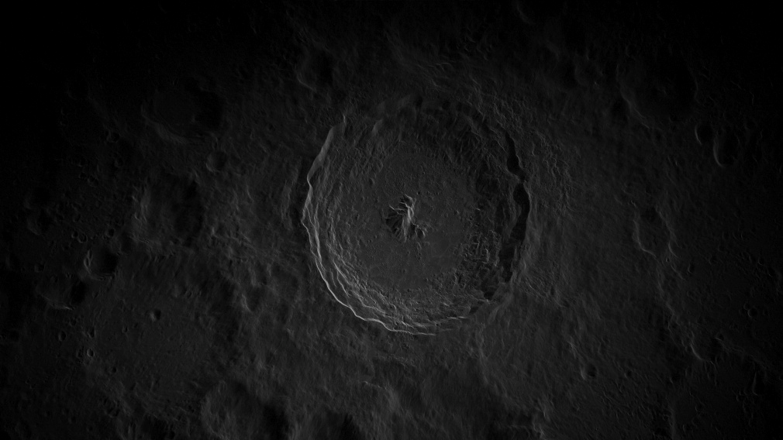
Research Argument
Problem Statement
Lack of space architecture precedents that prioritizes human behaviour in the design.
The social and psychological effects of long-term isolated nature of lunar habitation requires more human-centric design approaches.
Research Question
How to incorporate user-defined spaces based on human-centric design principles in designing long-term lunar habitation that balances social interaction and private boundaries, for the psychosocial well-being of the inhabitants?
Design Direction
A lunar habitat with heterogeneous spatial configurations to facilitate graduated access, ranging from communal engagement to secluded privacy.
Notes:
How to incorporate personal preferences in designing for long-term lunar habitation?
How can human experiences be incorporated in designing for a long-term lunar habitation for a more humanized lunar habitation?
How to incorporate human-centric design principles in the transitional spaces of long-term lunar habitation to create a more humanized space architecture?
Lack of space architecture precedents that prioritizes human behaviour in the design. Transitional spaces which has potential to enhance the spatial and social experience of lunar habitation are typically generalized to corridors.
Lack of space architecture precedents that prioritizes human behaviour in the design. Long-term habitation requires functionality, efficient use of resource, and habitability. This research will focus on habitability,
Spaces which has potential to enhance the spatial and social experience of lunar habitation are typically reduced to functionality

Slide 13
Research Argument
Limitations & Assumptions
Timeline
Earth-based technologies
HIGH-TECH
Swarm robots
2070
Nuclear facility
Water and regolith processing facility
2060
Terraforming Moon
Regolith accretion
2080
First families settle
2099
First lunar human birth
3D printing
2033
Permanent lunar base
PIONEER
Moon civilization
SETTLERS
2027
Artemis III Lunar Landing
Full In-situ Resource Utilization
Civilization size
PRIMITIVE
Notes:
Due to the high-level assumptions regarding feasibility (such as provision of metal extraction facilities – gausah disebut, ini di paper aja), the project will take place on the later stage of space habilitation

Slide 14
Research Framework
Human-centric Design
Using human experiences as data and human preferences as design guide
Meeting variations
Open space vs small niches?
Private quarters prioritization
Bed or desk?
Furniture arrangement
Flexible or fixed?
What?
Who?
How?
Experience
Personas
Activity-based design
Design parameters
Evaluate
Spatial quality (Design)
Analyse long-term missions
(Hi-SEAS, Antarctic Station)
Embody diverse preferences
Formulate desired spaces
Translate to tangible requirement
Iterations and development
Personal Maintenance
Sleep / Hygiene / Food / Leisure
Mission Operations
Habitat Maintenance
Personal
Preferences
Behaviours
Community
Interactions
Activities
6-crew members
3 men + 3 women
(1 couple)
1 robot
Work
Social
Personal
Openness
HOW TO REPRESENT HUMAN INTERACTION & PERSONAL PREFERENCES ARCHITECTURALLY?
Open / Enclosed
Size
Private / Small Groups / All
Access
Direct / Indirect
HOW TO DESIGN FOR IT?
Spatial arrangement with
specific requirements
Notes:
Phenomenology human experience and perception as basis to design spaces
Proxemics privacy gradient
mitigate confinement through setting spatial adjacencies based on privacy gradients
Third Place Theory essential to form community
creation of a third place (between work and home) → the social/leisure space
Affordances visual cue to an object’s function and use

Slide 15
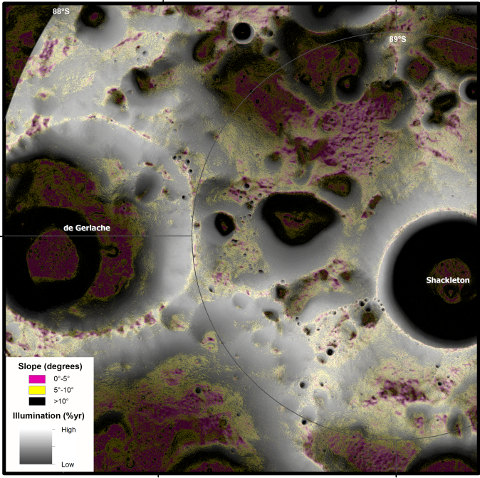
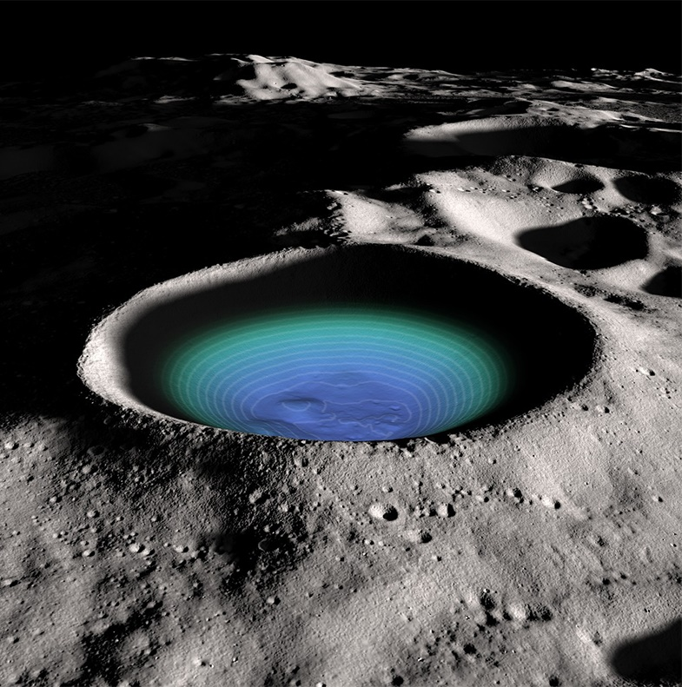
Site
Site: Lunar South Pole, Ridge of Shackleton Crater
1. Candidate for lunar base
2. Proximity to resources:
Eternal sunlight area → energy source and daylight utilization
Permanently Shadowed Region → hosts water-ice, hydrogen, and early Solar System volatiles (for ISRU)
10 km
Annual Illumination and Topographic Slope, LPI
*Eternal sunlight areas has >80% illumination/year
Shackleton Crater, NASA Goddard
Water-ice & volatiles
Notes:
provide water-ice (possible water collection system and ISRU) and fossil records of hydrogen and other early Solar System volatiles (planetary research)

Slide 16
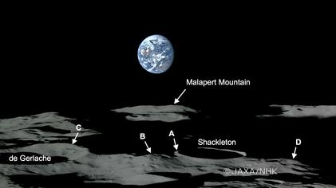
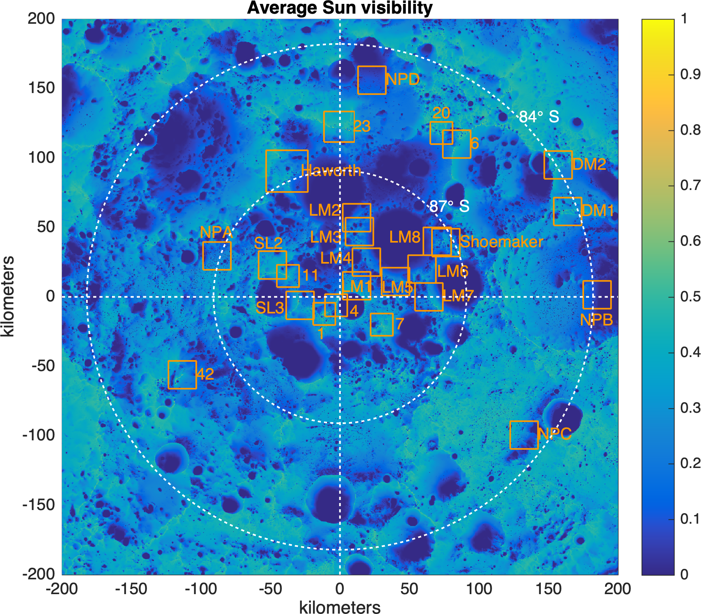
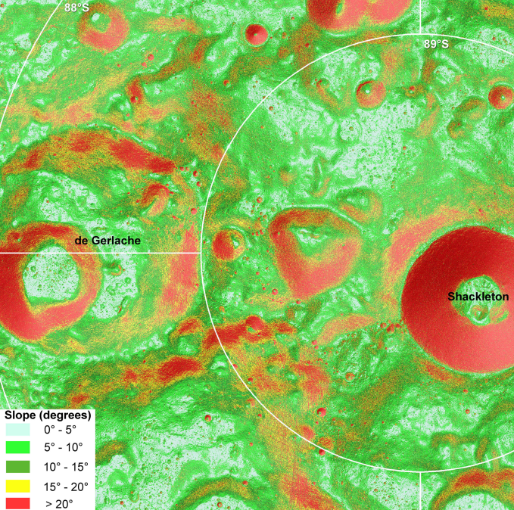
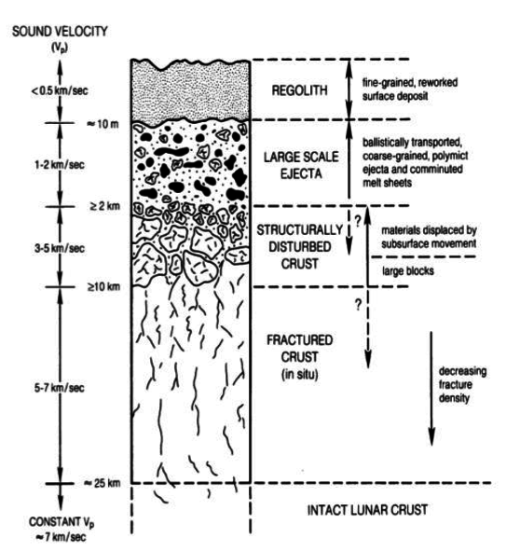
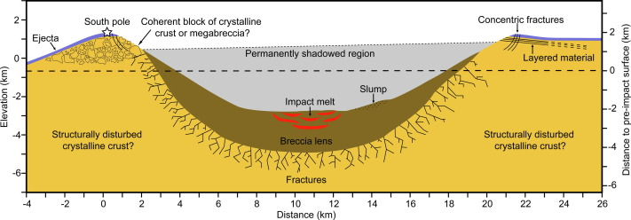
Site
Site Condition
Peaks of Eternal Sunlight, Paul Spudis
Lunar South Pole, Ridge of Shackleton Crater
Eternal sunlight areas (South Pole)
Seasonal constant sunlight areas (North Pole)
Eternal darkness areas in craters
Deep craters protect from micrometeorites
Slope 15° - 20°
Going underground provides protection from radiation, extreme temperature, and lunar dust
Loose regolith layer → allows possible excavation & collection of material for in-situ construction (geopolymer binder)
10 km
Slope Map of Lunar South Pole
Polarsteregoraphic Projection, Lunar Planetary Institute
Assumed ground composition from Lunar Stratigraphy,
Sakshi Namdeo et. Al.
Cross section of Shackleton Crater,
A.J. Gawronska et. al.

Slide 17
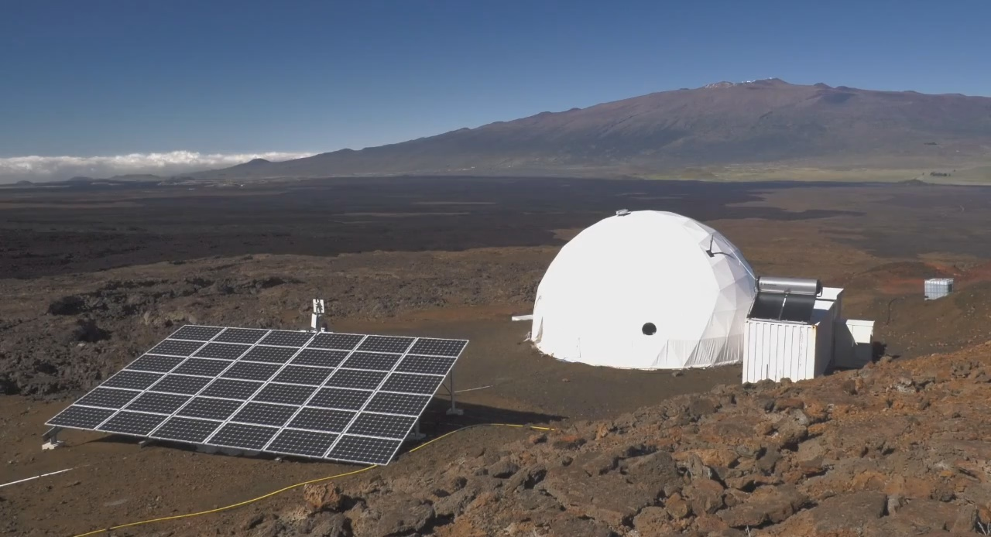
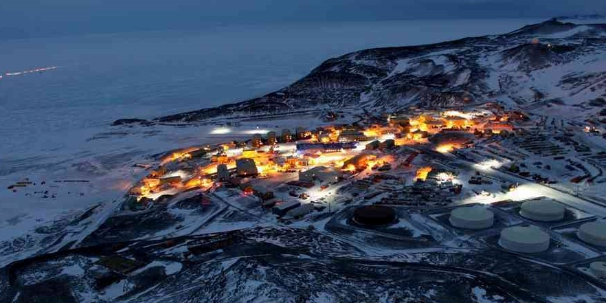
Experience
Analog counterpart on Earth
Learning from long-term habitation within Isolated, Confined, and Extreme (ICE) Habitat
Hi-SEAS, Hawaii, USA
Analog habitat for Mars
Study focus on crew dynamics
McMurdo Station, Antarctica
Research station in extreme environment
Notes:
Focuses on long-term crew dynamics
!!!!Transition from prev slide
A site of vast expanse and extreme conditions can also be found here on Earth. I looked into research stations in the South Pole as reference on human living in isolation due to extreme environmental conditions
Hi-SEAS: food, crew dynamics, behaviors, roles and performance, and other aspects of space flight and a mission on Mars itself is the primary focus / morale, stress management, group problem solving
Wine bar-coffee house, 1 of 3 main bars
https://www.reddit.com/r/CozyPlaces/comments/3wgzvr/mcmurdo_bunks_antarctica_certainly_not_everyones/
https://www.fathomantarctica.com/journal/day-2-hello-mcmurdo-station

Slide 18
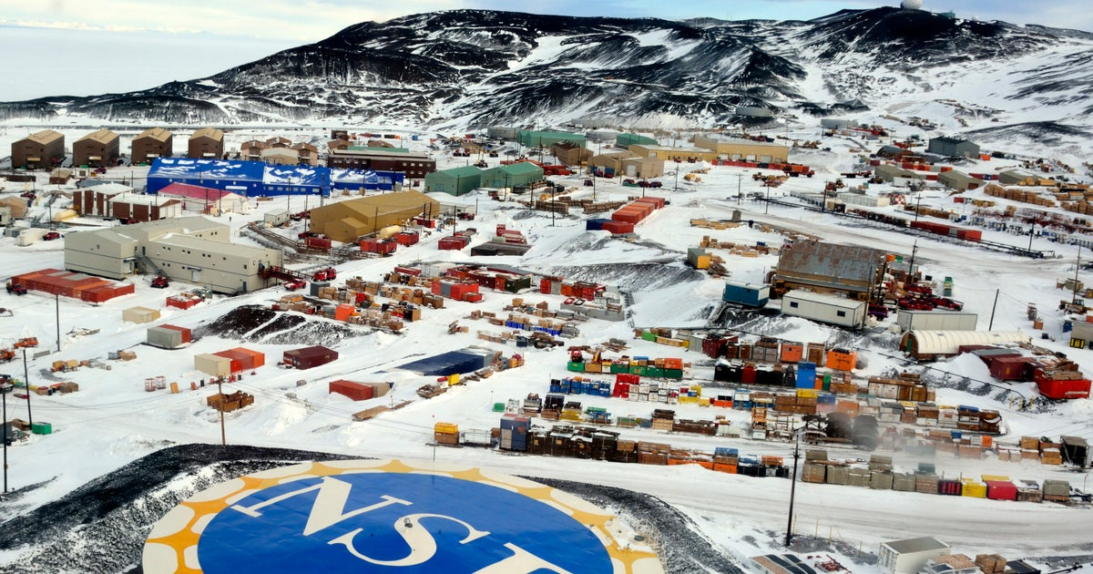
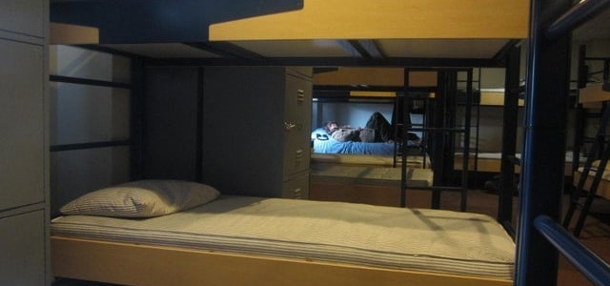
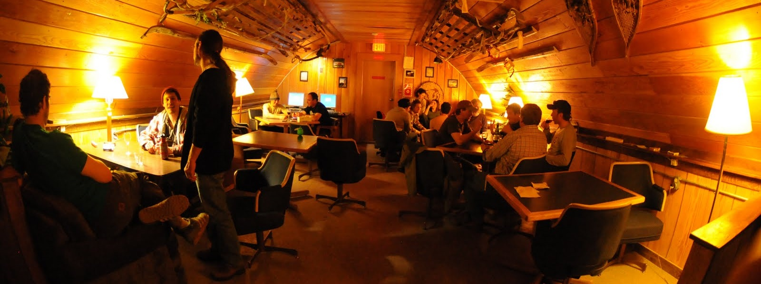
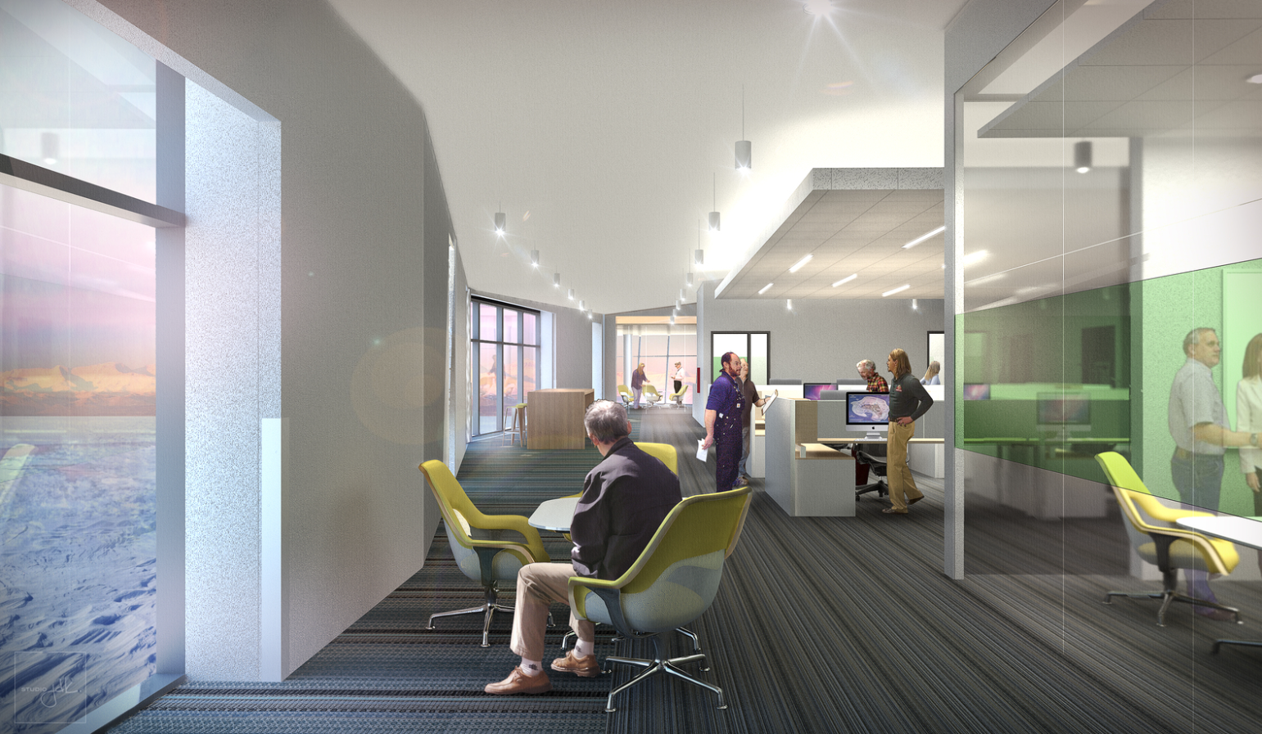
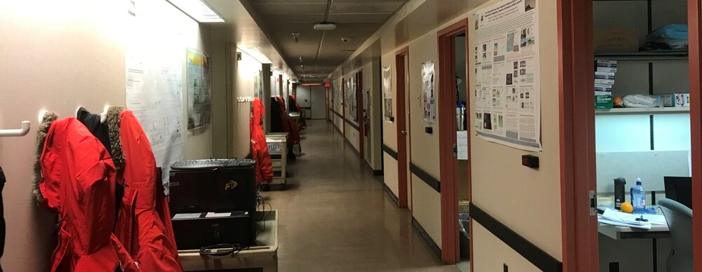
Experience
Learning from analog
Importance of designated privacy levels
Social space separated from work areas → allow more varied social interactions than purely work habitat
PERSONAL
Bunkbeds in shared room, McMurdo Station
Social space as “third place”
SOCIAL
Wine Bar-Coffee House, McMurdo Station
WORK
Hallway of a scientist group, McMurdo Station
Show more ppl + add work setting
Notes:
!!!!Transition from prev slide
A site of vast expanse and extreme conditions can also be found here on Earth. I looked into research stations in the South Pole as reference on human living in isolation due to extreme environmental conditions
Wine bar-coffee house, 1 of 3 main bars
https://www.reddit.com/r/CozyPlaces/comments/3wgzvr/mcmurdo_bunks_antarctica_certainly_not_everyones/
https://www.fathomantarctica.com/journal/day-2-hello-mcmurdo-station

Slide 19
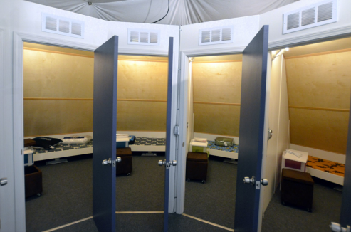
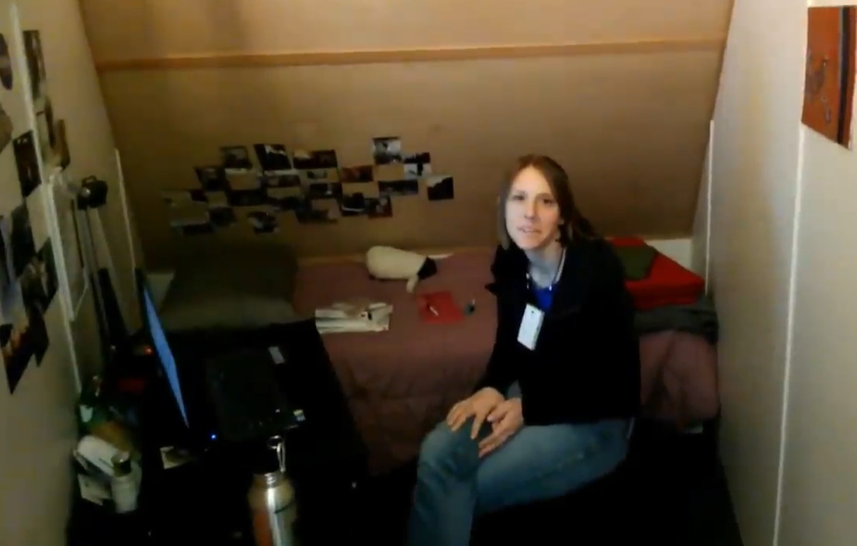
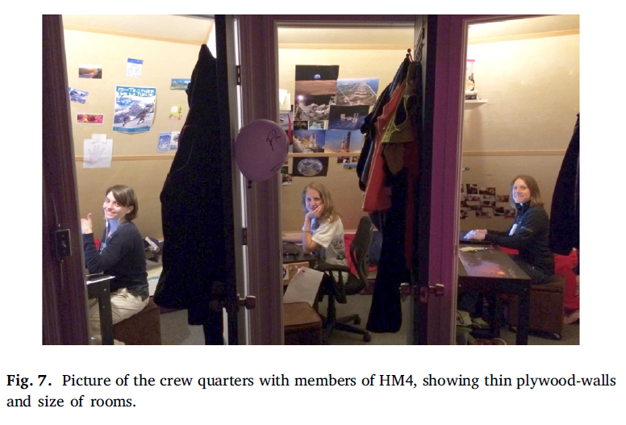
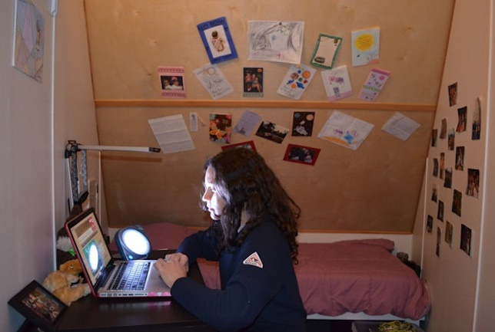
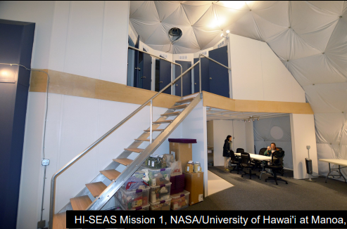
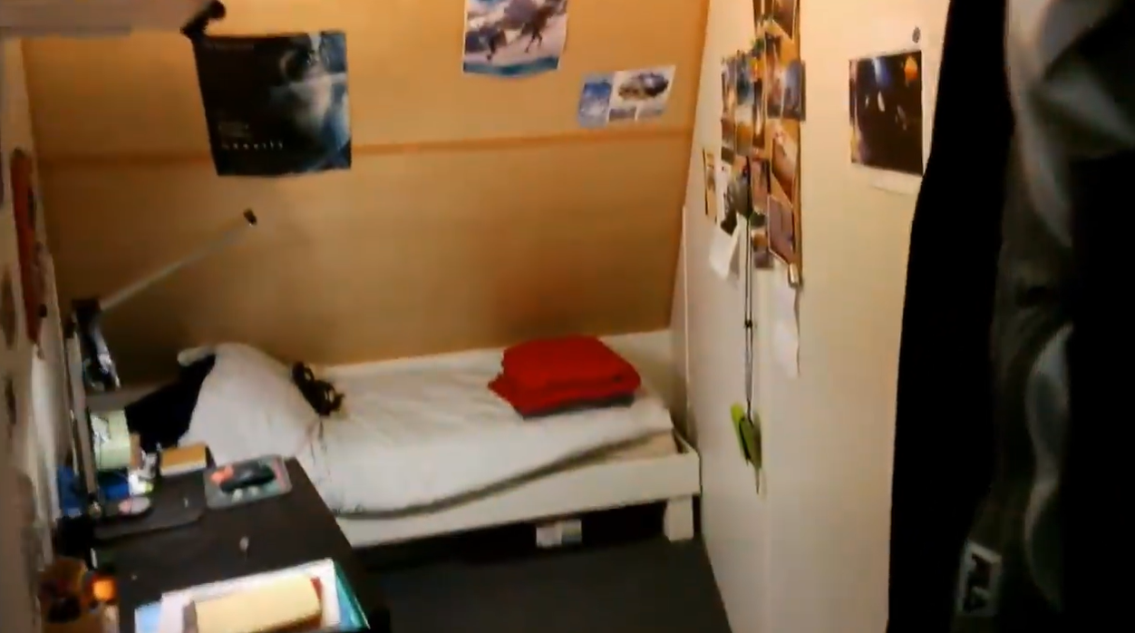
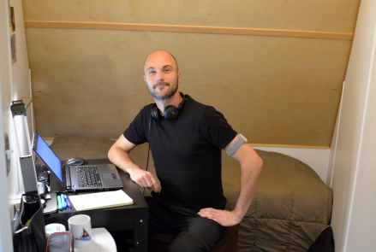
Experience
Personalization of private quarters
Private quarters
Learning from analog
Importance of designated private space
“The existence of the private quarters is more important than the size.”
“Stairs as physical separation of rest and work space,with the action of going up as mental cue to rest”
“Allow personalization as an important creative outlet!”
Angelo Vermuelen on Hi-SEAS Mission, lecture in TU Delft (2024).
Transition from public to private
Hi-SEAS Mission NASA, Angelo Vermuelen
Hi-SEAS Mission NASA, various sources
Notes:
To have some personalization within private areas
Less about the size, most important is the existence of a private quarter itself.
Stairs → physical activity of going up → conditioning separation of rest space in the mezzanine and workspace on the ground floor.
Simple design preferred → familiarity. Variation (personalization) done personally by each crew. → personalization as creative outlet!
- Not simple design, more like design that allows customization. If simple that can allow more changes or variable. If too designed, wont allow the crew to make their own changes (important creative outlet)
https://www.discovermagazine.com/the-sciences/why-astronauts-struggle-to-get-a-good-nights-sleep

Slide 20
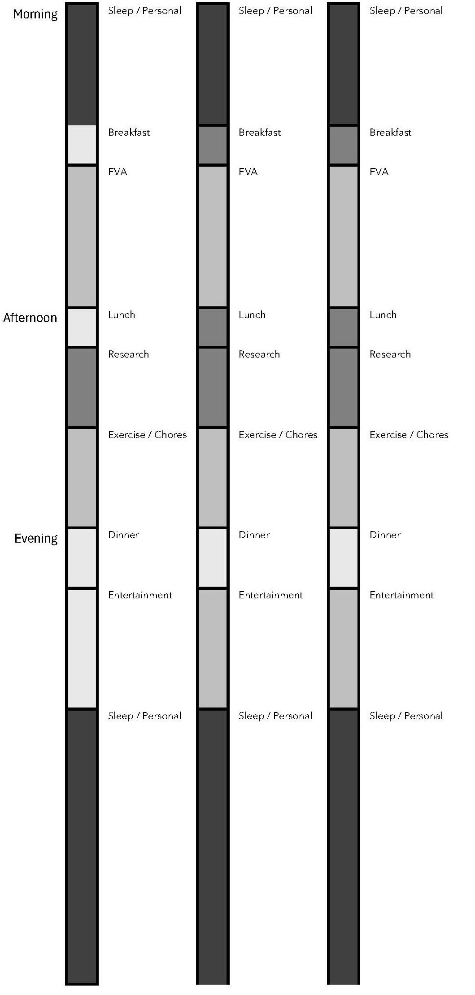
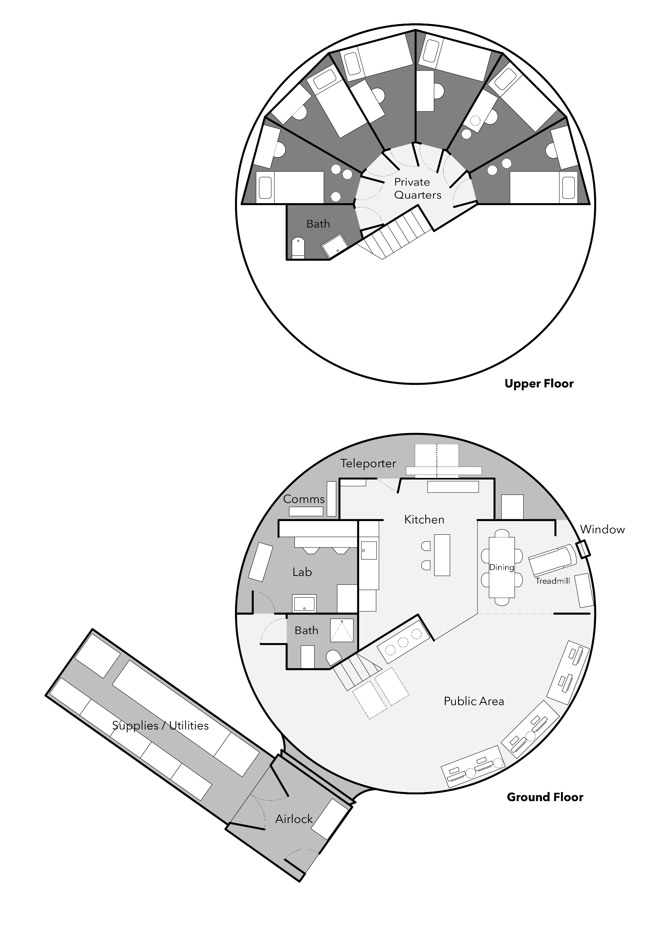
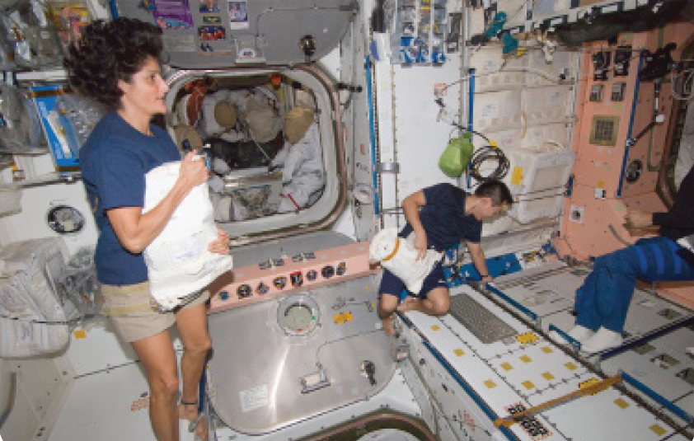
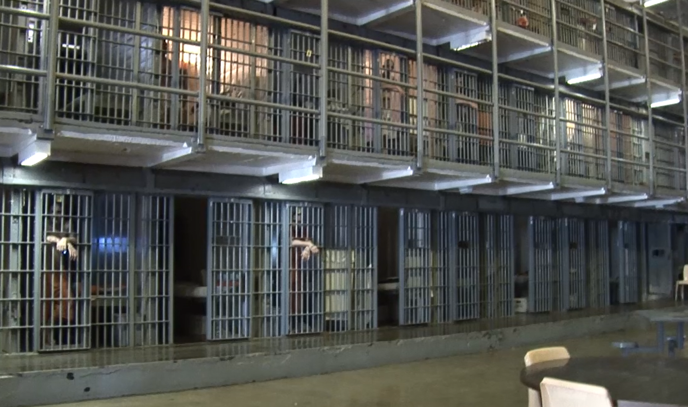
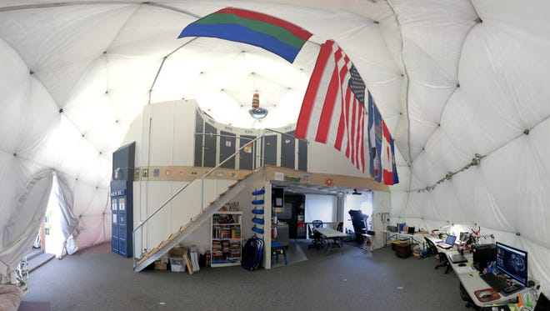
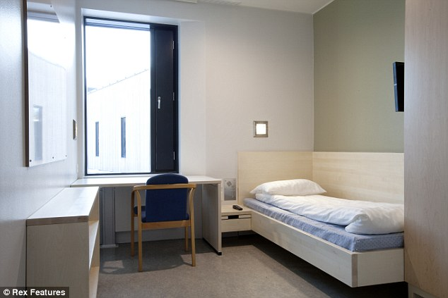
Experience
Entire group (4-6p)
Partial group (2-3p)
Individual
Learning from analog
Importance of privacy gradient
ISS
Hi-SEAS Missions
Declining participation in group activities over time
Formation of social cliques over time leads to frustration on the lack of semi-private space
“I abhorred the idea of crew members working in separated sections and made a case for a flexible open floor plan.” (Commander Angelo Vermuelen, Hi-SEAS I)
“One thing I would consider is having cubicles instead of the work bench. There is little privacy, and when you have someone trying to micromanage your own work it’s harder to escape. Most of my crew worked in their rooms most of the day….” (Simon Engler, Hi-SEAS I)
Arizona State Prison USA
Halden Prison, Norway
Hi-SEAS II
4 months
Hi-SEAS III
8 months
Hi-SEAS IV
12months
Complex social interaction in daily schedule
Dichotomic social interaction in habitat
Notes:
Schedule arranged autonomously by crew members → Similar schedule even with different crew
Balanced: nearly equal time for work – personal – social
Naturally mixing social interaction across the day
Formation of social cliques over time
On longer missions, there is declining participation in group activities over time
Frustration: lack of private space, especially auditory
Schedule of activities with varying amount of participants
Evening gathering time turned into private schedule on the last quarter of the mission

Slide 21
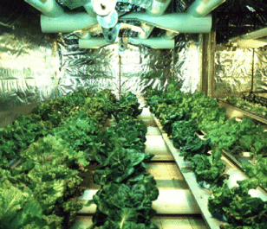
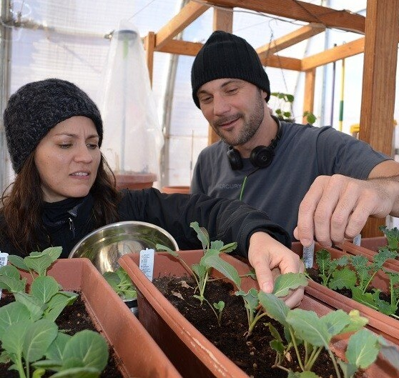
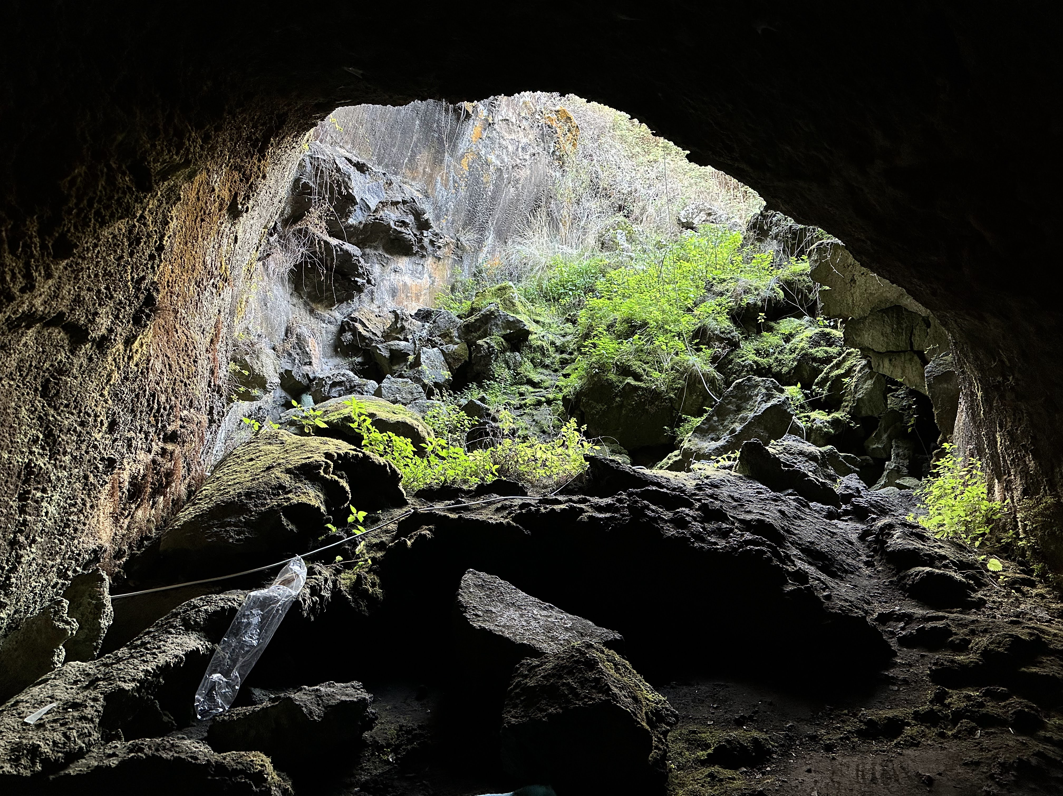
With people
Experience
Learning from analog
Organic social condenser
McMurdo greenhouse initiative in Antarctica, ca. 1990, Phil Sadler
Harvesting plants in Hi-SEAS GreenHab
View to outside cave. Lava Tube Mission (2024)
Greenhouse as popular therapy space in McMurdo → smell of living plants and feel of warm humid environment
Cave entrance as popular seating space in Lava Tube Mission → view of greenery
Notes:
Heart of habitat formed organically, with greenery evolving as social condenser over time
Life source as heart of habitat
Participatory projects as marker of important habitat features
Greenhouse as source of life → welcomed by everyone longing for fresh produce
There are also programs birthed by the participants, such as greenhouse. Analog mission can show us what programs are important for humans that they will create it when absent

Slide 22
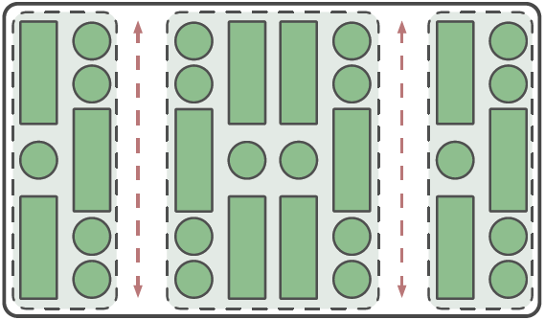
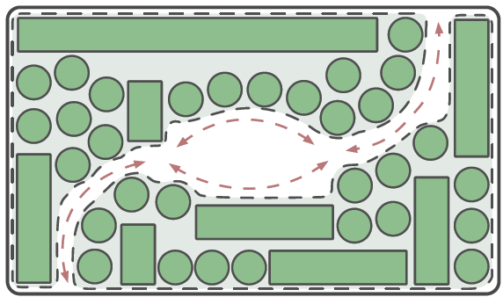
Greenhouse: rigid vs organic
Experience
Layout Strategy
Organic layout for long-term health benefits
Rigid greenhouse
Organic greenhouse
Efficient, prioritizes the plant research
Habitable qualities, consider the human experience
Diagrams from from The Design of Habitats for the Long-Term Health of Inhabitants in the Extreme Environments of Earth and Outer Space (Bassingthwaighte, 2017)
Notes:
Design direction
Incorporate informal greenhouse in different spaces

Slide 23








Personas
Personas: fictional crew members
Couple
Mission Goal and Task
Resource mining for ISRU
EVA scheduling, habitat inspection, emergency protocol
Effects of radiation exposure to human
Maintains crew mental and physical health
Regolith and radiation mitigation
Plans and leads EVA, habitat maintenance
Regolith studies and ISRU experiments
Leads scientific experiments
Plant biology in closed-loop systems
Maintains garden and food resourcing
Rover for ISRU
Operates, maintains, and troubleshoots robotic systems
Maintenance
Scanning and mapping for EVA, habitat cleaning
Personal : goal, hobbies, preferences
Learn 1 language
Piano, cooking
Light sleeper
Open workspace
Complete 1 song album
Sing, gardening
Light sleeper
Cubicles
Complete 1 song album
Guitar, chess
Heavy sleeper
Open workspace
Complete 5 painting
Guitar, painting
Light sleeper
Open workspace
Pass violin exam
Violin, cooking
Heavy sleeper
Cubicles
Beat the chess AI
Drum, chess
Light sleeper
Cubicles
Commander, 37
Medic, 33
EVA Specialist, 35
Geologist, 32
Ecologist, 29
Roboticist, 30
Habitat Robot
Notes:
Ganti ke scanollo

Slide 24







Personas
Personas’ activity
Sleep
Individual
Partial group
Entire group
Commander, 37
Medic, 33
EVA Specialist, 35
Geologist, 32
Ecologist, 29
Roboticist, 30
Habitat Robot
Notes:
Robot active 24/7
Create a schedule with colors based on shared or personal activities. Some individiuals like the commander have a more social schedule. While for the medic I create a persona that is prefers solitutde → more private activities
Semi-private = private activity in public space

Slide 25

Activity-based Design
Activity-based catalogue
How do you interact?
Based on Proxemics by Edward T. Hall
Notes:
Governs the possibility of interactions within a certain radius

Slide 26



Activity-based Design
Reference_Situated Interface
User adjusting to the space
to enable and disable certain activity and movement
A World Without Chairs
Art installation, van Dijk and Rietveld in Situated Anticipation (2018)
The End of Sitting
RAAAF & Barbara Visser (2014)
Notes:
User adjusting to the space
To slow down / speed up
Activate space/furniture/human interaction for more healthy lifestyle

Slide 27


Activity-based Design
Reconfigurable surfaces
Activity-based catalogue
How do you interact? How do you work? How do you relax?
Notes:
Degree of openness, size, access
By manipulating the angles, I discovered that
Personal space doesn’t have to be small, (like here you see the configuration doesn’t support interaction)
and gathering space can be intimate
So privacy can be a mix of gradient in openness, access, and size
Design with qualitative guideline
How to the space relate to each other

Slide 28










Concept
Spatial strategies to vary social interaction
Homogenous space
Early space civilization (short-term)
Human decentered design
Central core
Centralized views
Uniform configuration
Corridors
Repetitive structure
Heterogeneous space
Next generation
(long-term)
Human-centric design
= Unique experiences
Multiple cores
Varying views
Unique configuration
Intersection of spaces
Non-repetitive structure
Notes:
Monotonous to heterogenous
Connection and visibility (based on space station research etc) – Room adjacent to each other --??
Separation = distribution of rooms
Hypothesis= vary soc interaction will improve soc integration

Slide 29


Concept
Reference_Intersecting Atriums
“Everyone’s living room”. Deichman Bjørvika, Oslo.
▲ Asymmetrical atrium
Varying pocket spaces & vantage points ▶
Notes:
Pocket space & varying vantage points
Breaking down symmetry of large atrium → social cohesiveness

Slide 30


Concept
Sketch
Layered atriums
Upper atrium
5m
Lower atrium
Notes:
Intersecting atriums

