Slide 1
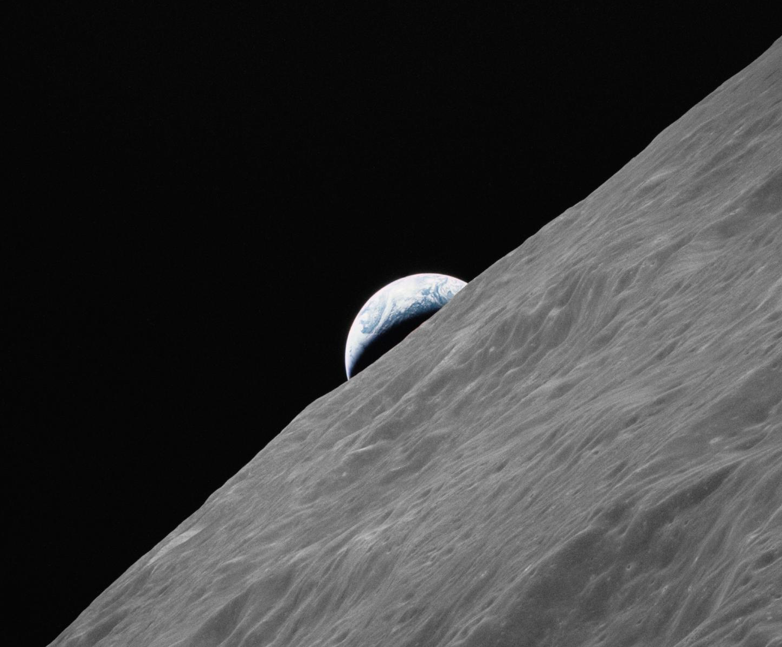
designing lunar habitat

Slide 2
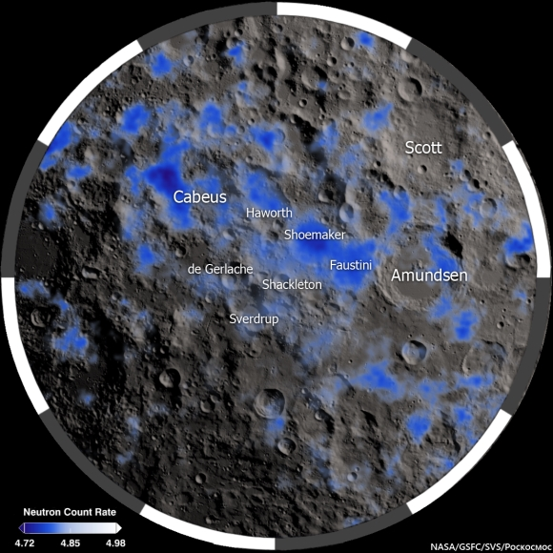
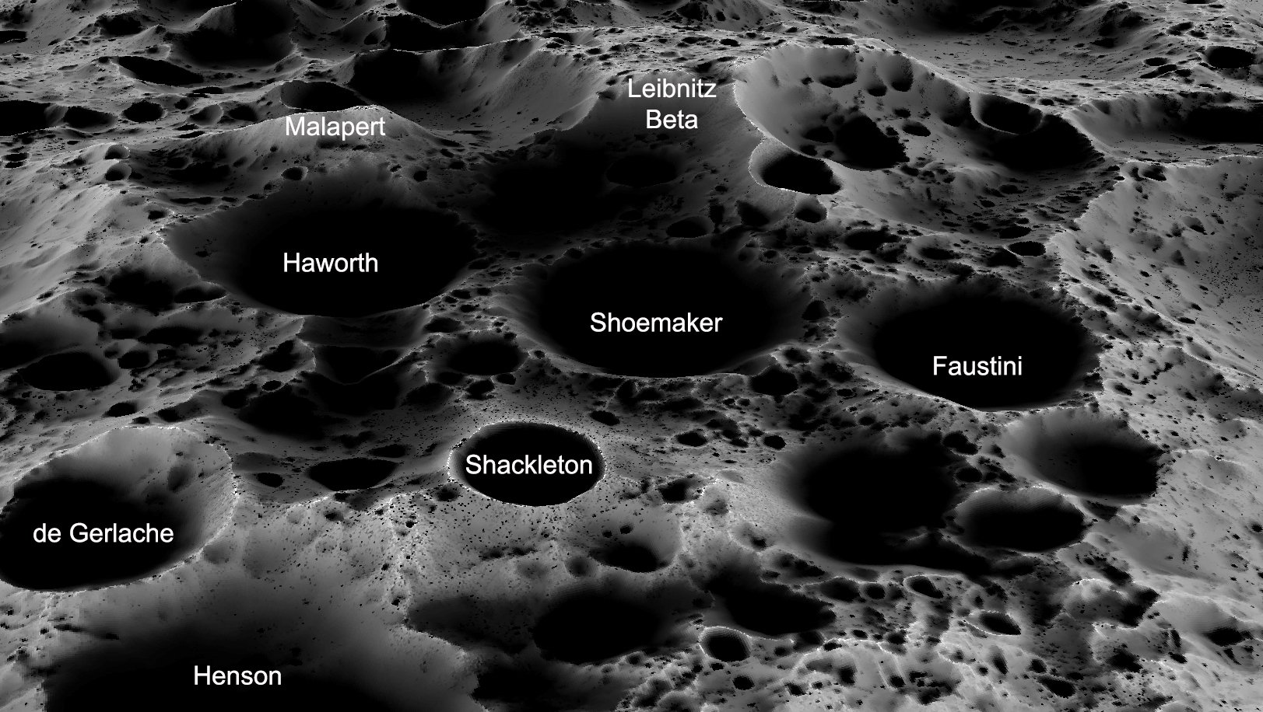
site
Design Context
Highlighted in Blue -> Ice Deposit
South pole of the moon is
filled with craters
SOURCE: lpi.usra.edu
South pole of moon
Resources
Water (Ice) -> Crater Base
Sun Power -> Crater Rim
SOURCE: Americaspace.com

Slide 3
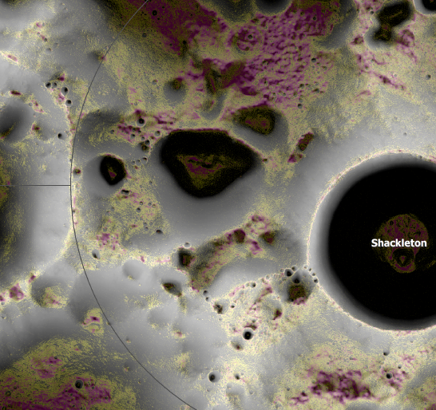
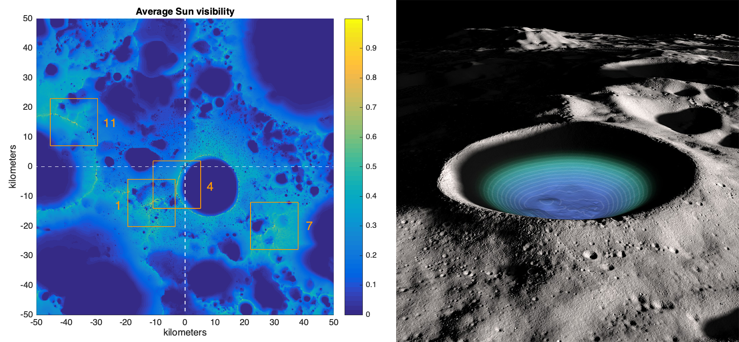
Design Context
site
Southwest Area of Shackleton Crater
50
0
De gerlache
0
Shackleton
50
50
kilometres
0
10
20
30
40
50
Approx. Site area
0
Sun visibility
1
SOURCE: Nccs.Nasa.Gov
10 km
SOURCE: lpi.usra.edu

Slide 4
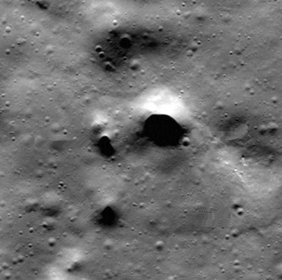
Design Context
site
(zoom in to 1:1000)
Lunar PIT (small scale Lava Tube)
Vertical pit with Diameter Varies from 5-25m
Protection from
Radiation (200x > earth surface)
Temperature fluctuations (-133 to 121 C)
Meteorite shower
O
25m
A Pit found close to north pole of the moon, suspected to be a lava tube
SOURCE: Seti Institute

Slide 5
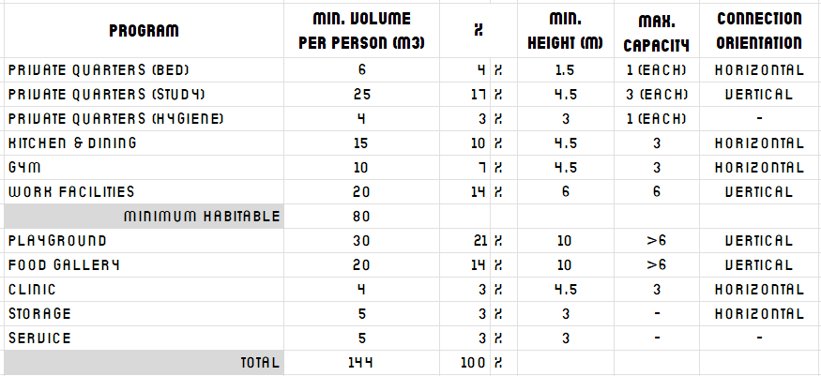
Design Programs
program requirements
(Min. 80m3 per person)
1. Public open spaces
2. Circulation
3. Specific
working spaces
Atrium/ playground
Vertical garden/ food gallery
Kitchen & dining
Semi-outdoor space
Climbing walls for encouraged main Circulation
Research lab
Desk stations
Control centre
Clinic
Gym
4. Personal
solitude spaces
Bedroom
Study
Hygiene
5. Service spaces
Life support storage
Airlock chambers
Donning & doffing area
Storage
Derived From: NASA & Space Architecture Education for Engineers and Architects (Book)

Slide 6
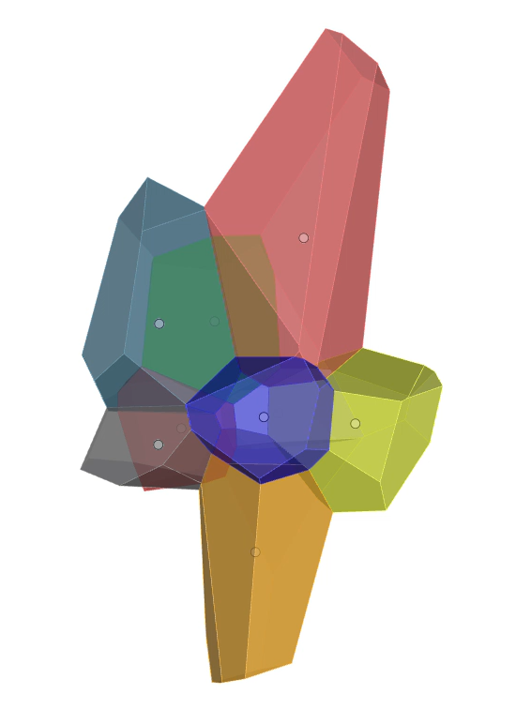
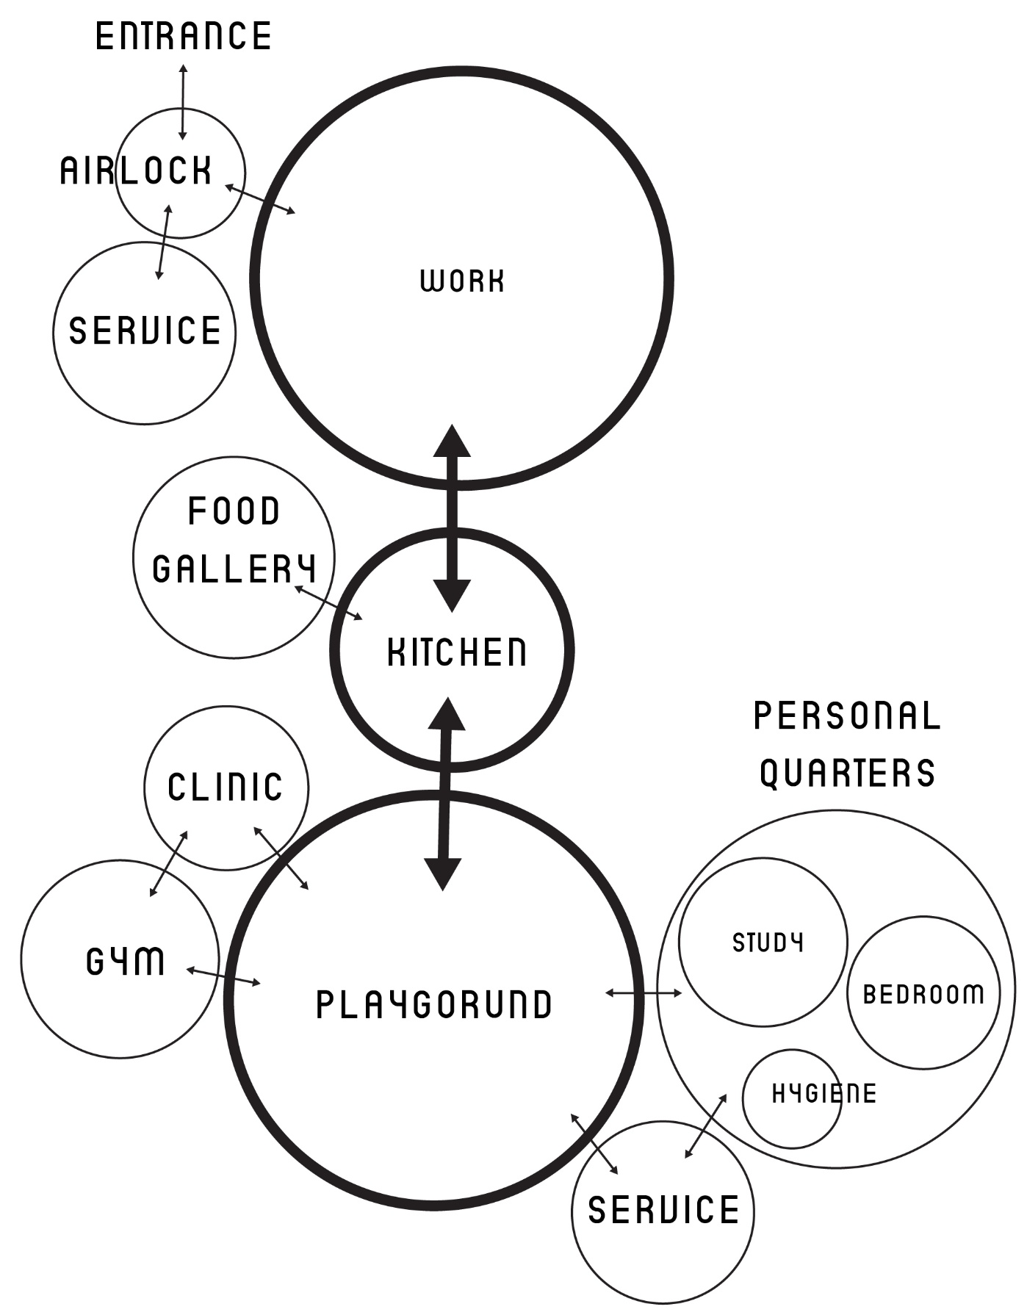
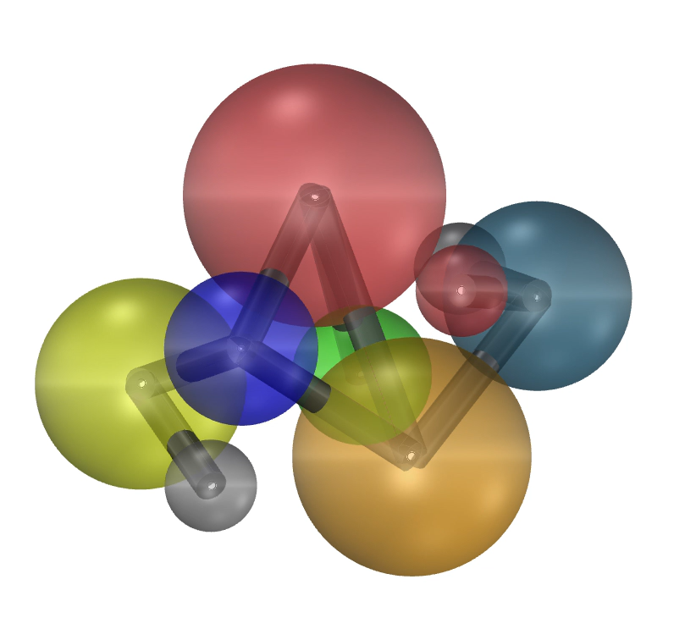
Design Programs
program spatial distribution
2D program adjacencies to 3D connectivity
USED Methodology
Playground
Personal Quarter
Clinic
Kitchen
Workstation
Service
Food Gallery
Gym
Airlock

Slide 7
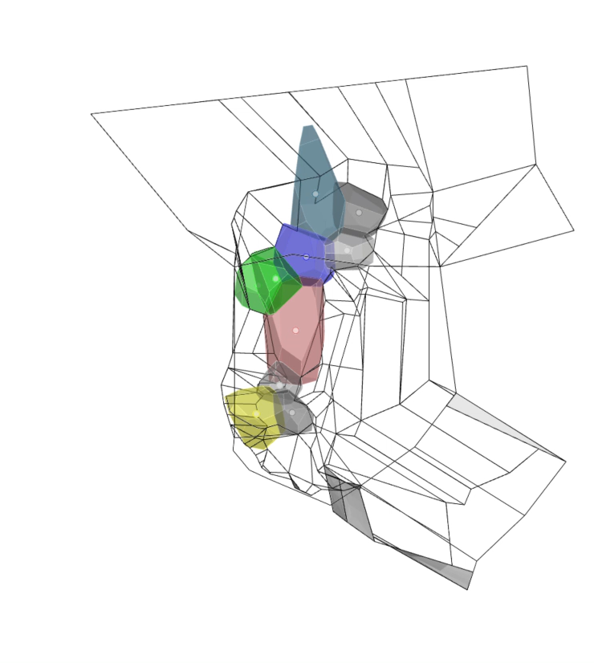
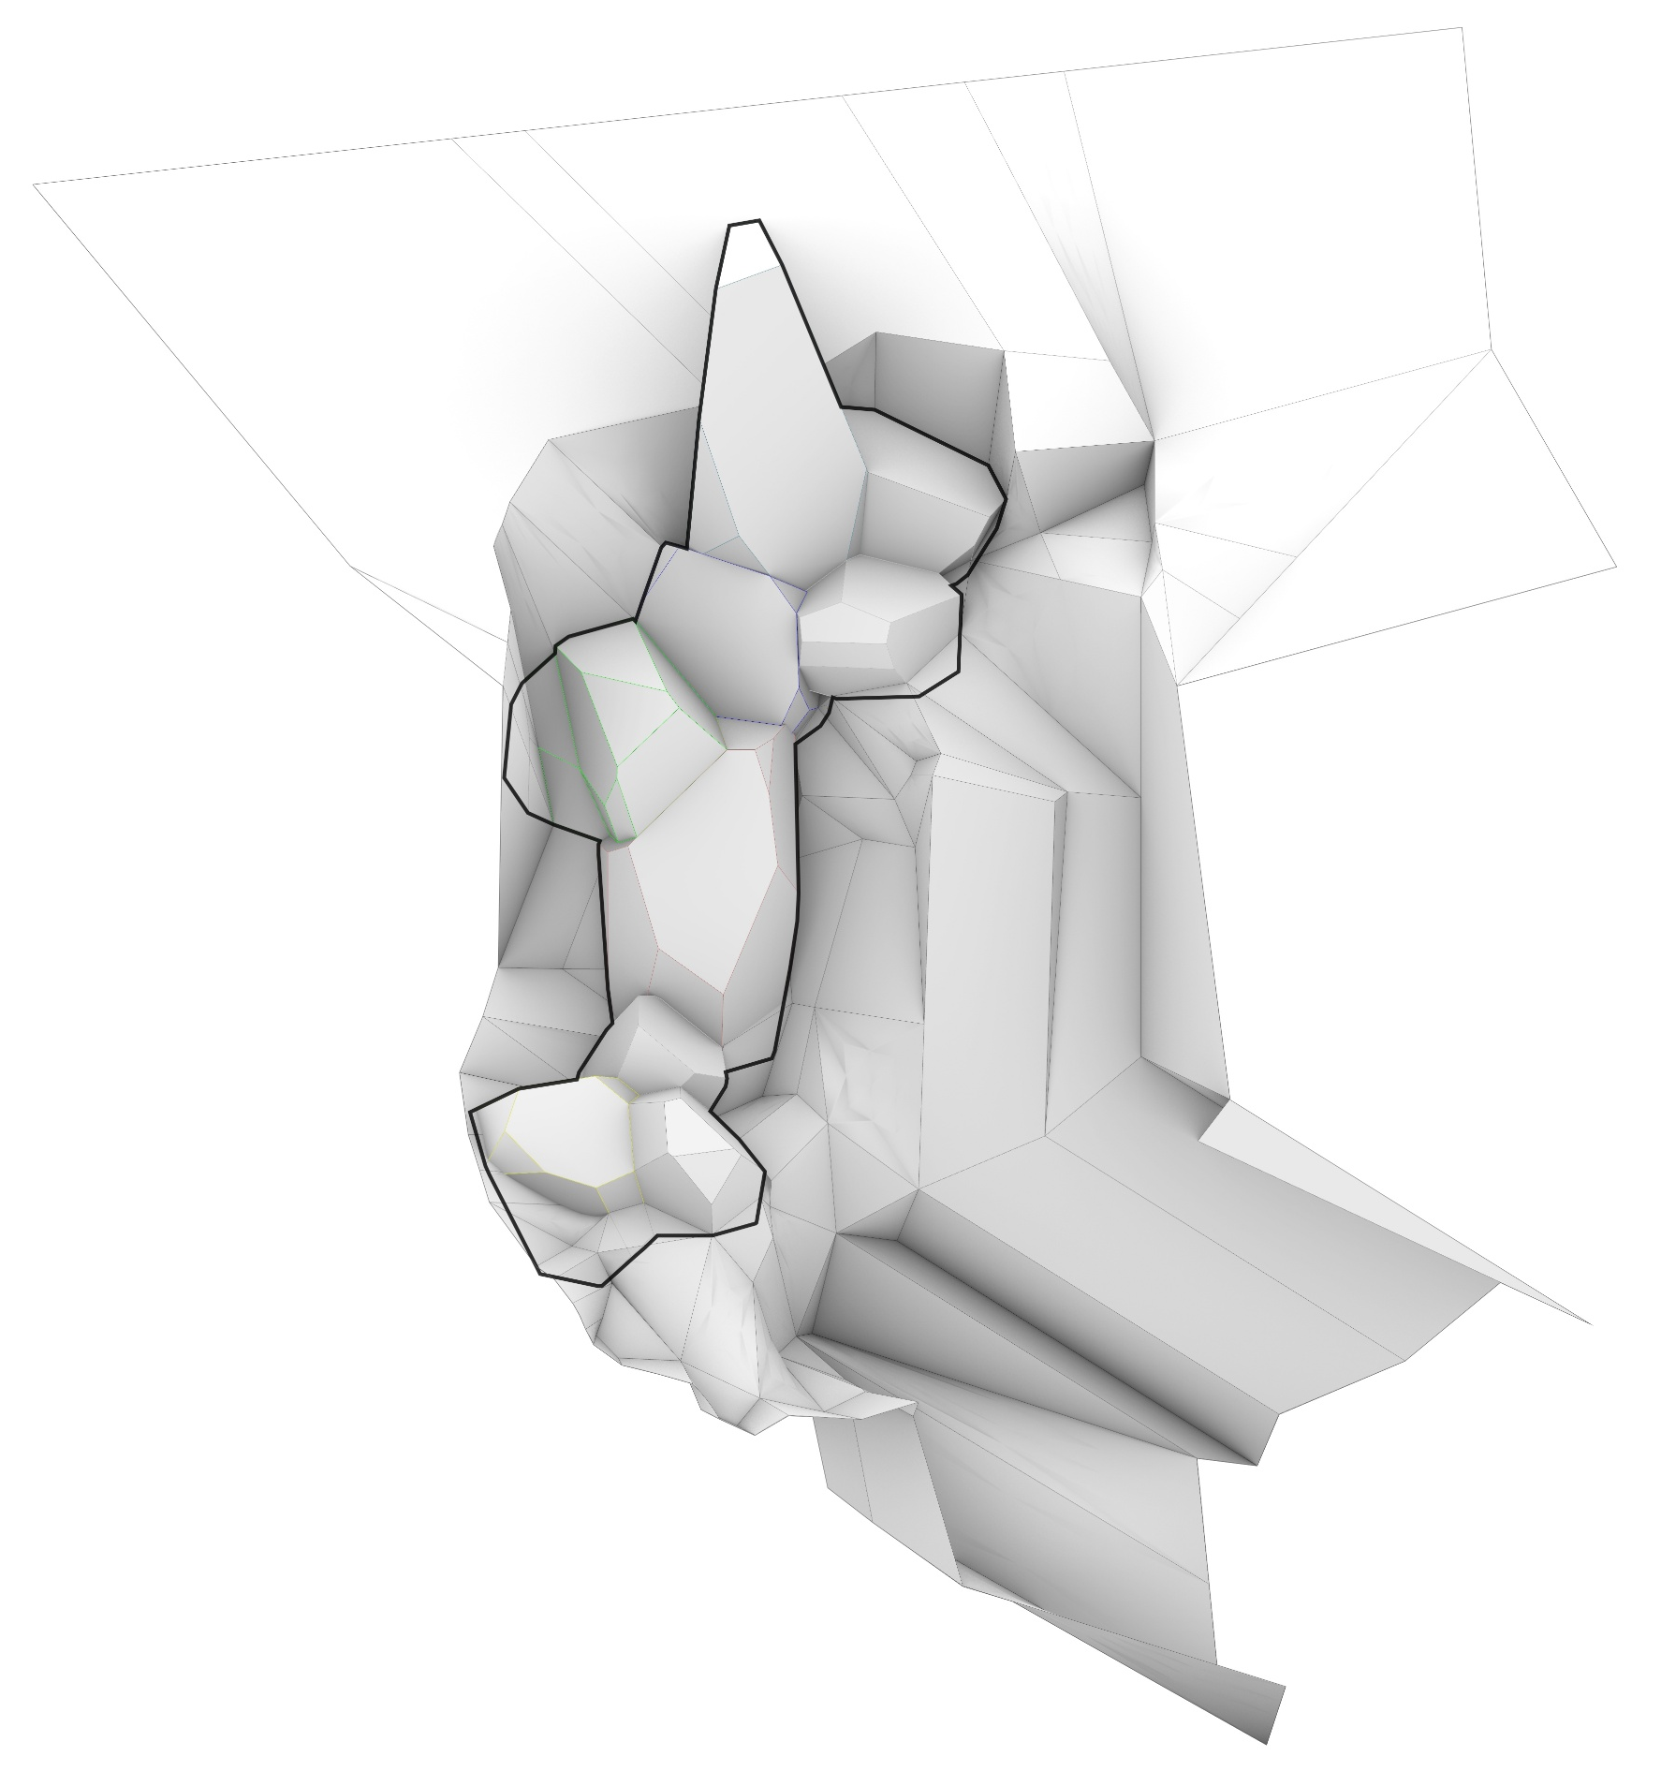
Design Programs
program massing
3D program adjacencies on site
Main Atrium Space
Labs
Top
Service
(On Surface =
Climate, Energy)
Dining & Kitchen
Airlock/
Main entrance
Food Gallery
Middle
Playground
Airlock
Bottom
Private Quarter
Service
Lab
(Expandable
according to
no. of members)
(Collection & Treatment)
Kitchen
Food Gallery
Playground
Personal Quarter
Service
Airlock
Program Massing on site ( Lunar Pit )

Slide 8
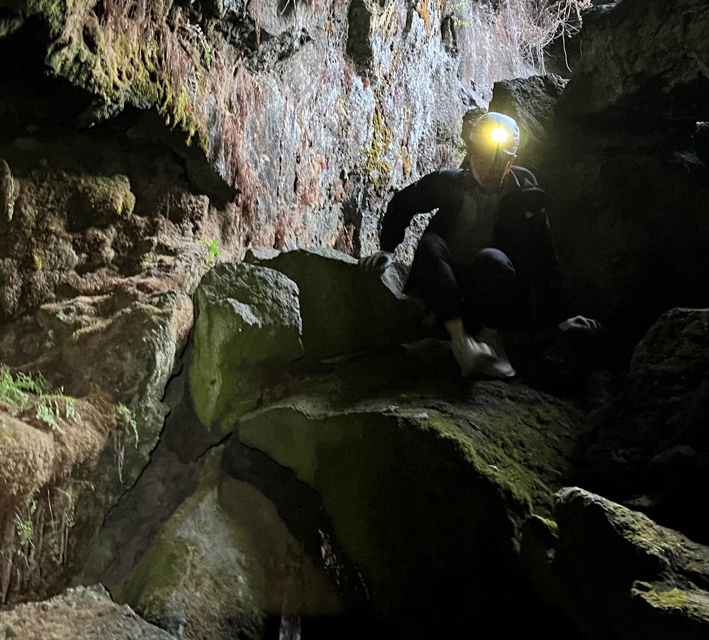
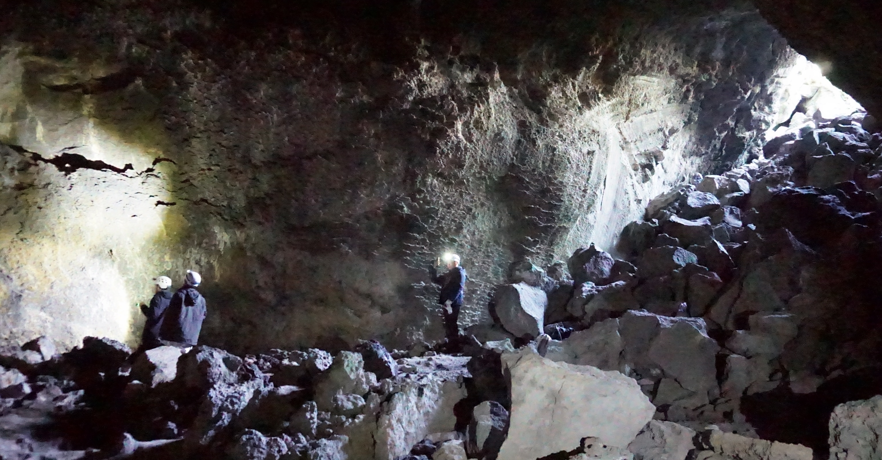
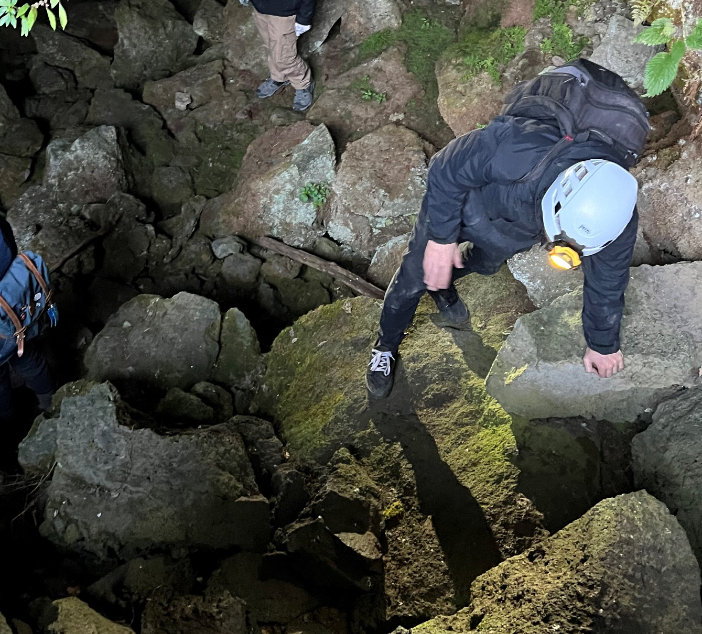
Design Context
| Empirical Observation
lava tube mission
Lava Tube Entrance
Lava Tube Immediate Interior
Challenging
Lava Tube Terrain
Eyes & Brain
Body
Dimensions
Spatial Coordination
Different Ways to Climb Down

Slide 9
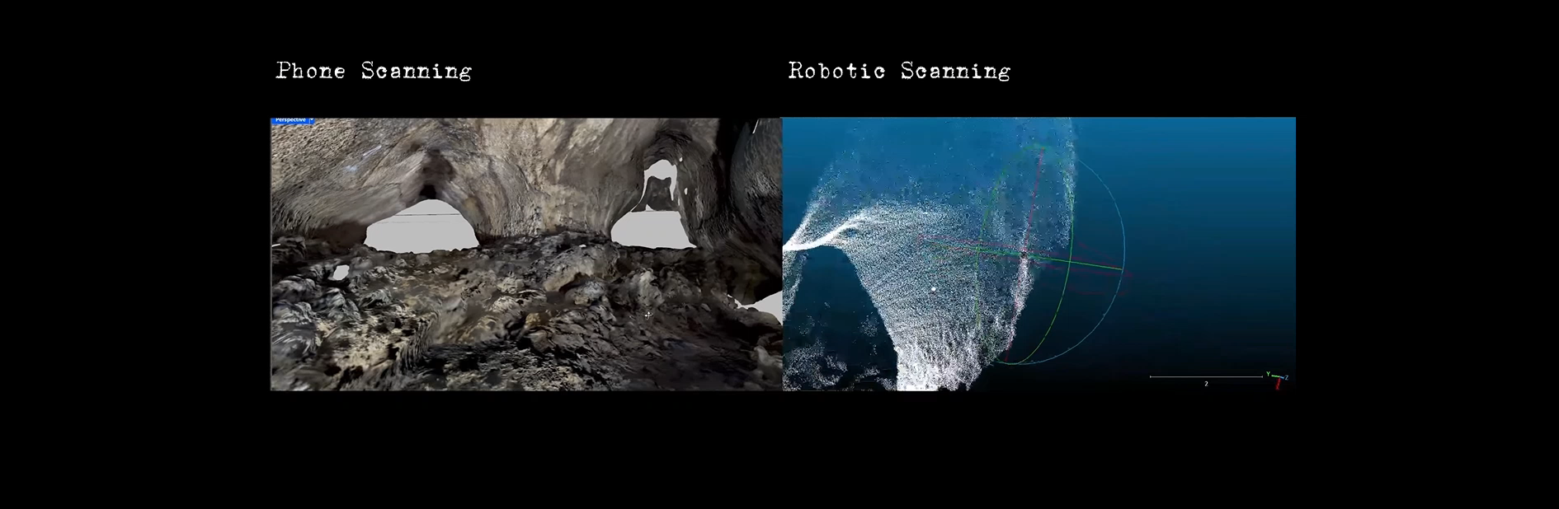
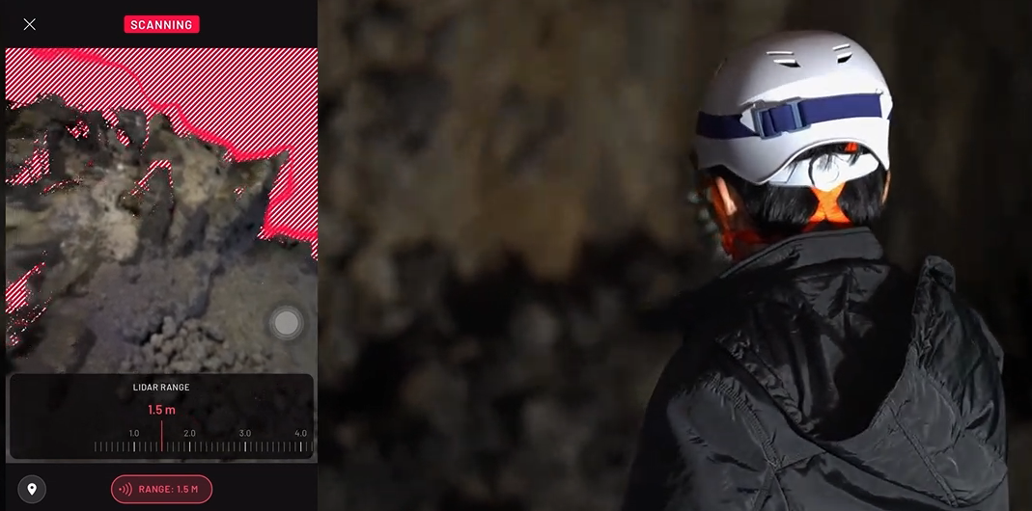
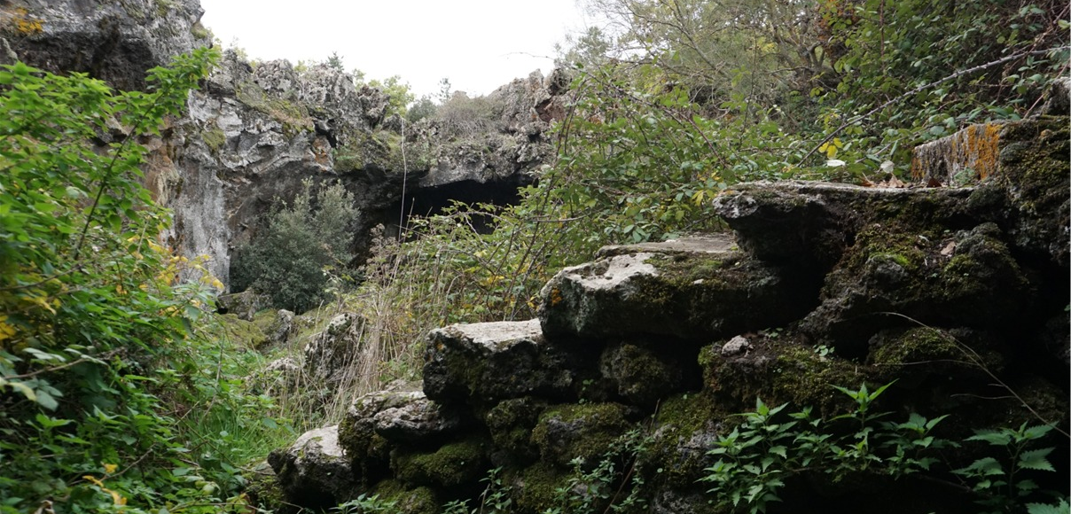
Design Context
| Empirical Observation
lava tube mission
Urban & architectural scales
Furniture & Material Scales

Slide 10
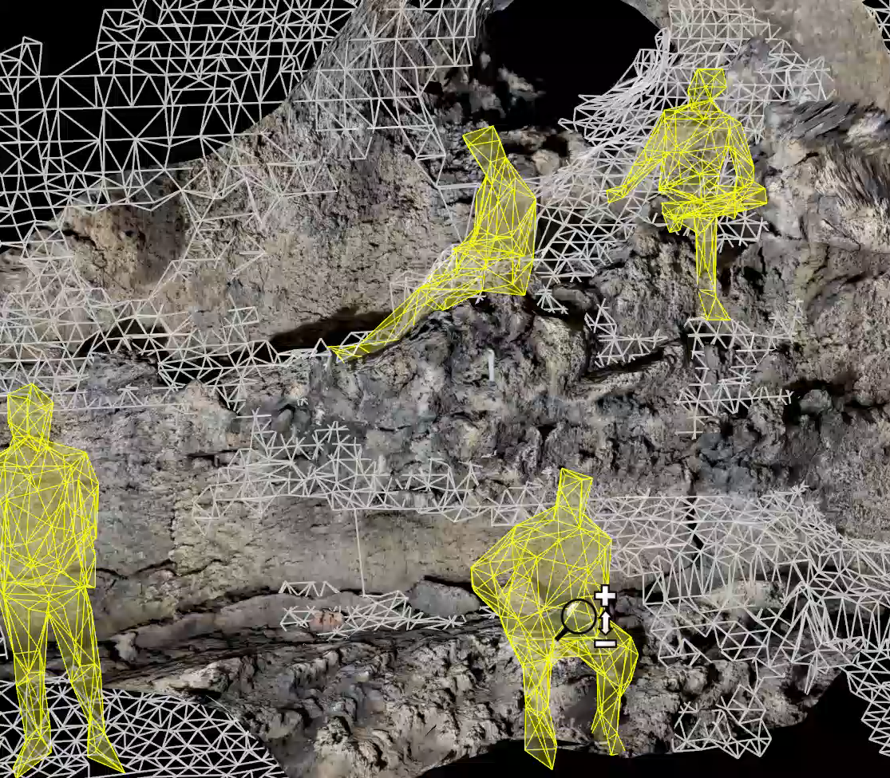
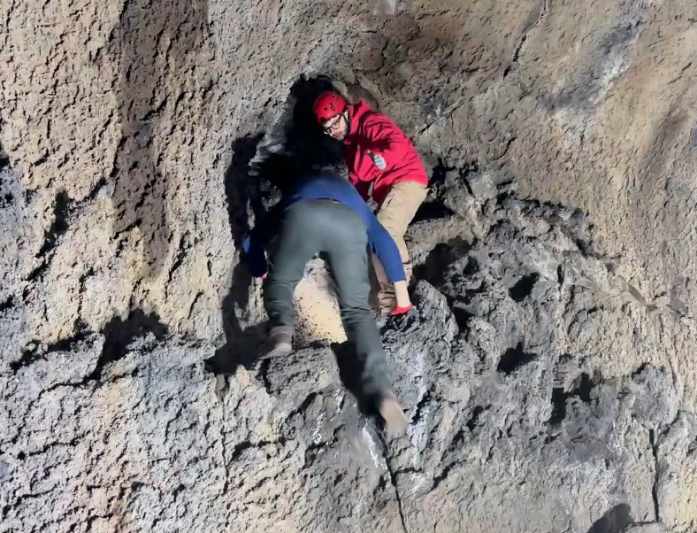
Design Context
| Empirical Observation
body dimensions to architectural scales
Wall Tectonics & textures (Vertical and Diagonal) Introduce extension of functional spaces

Slide 11
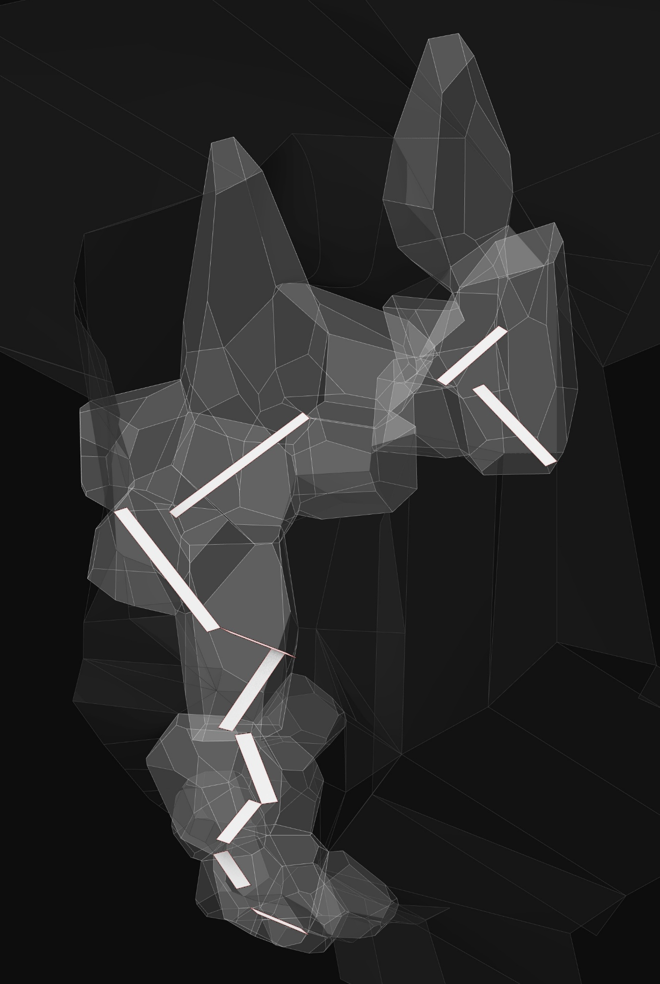
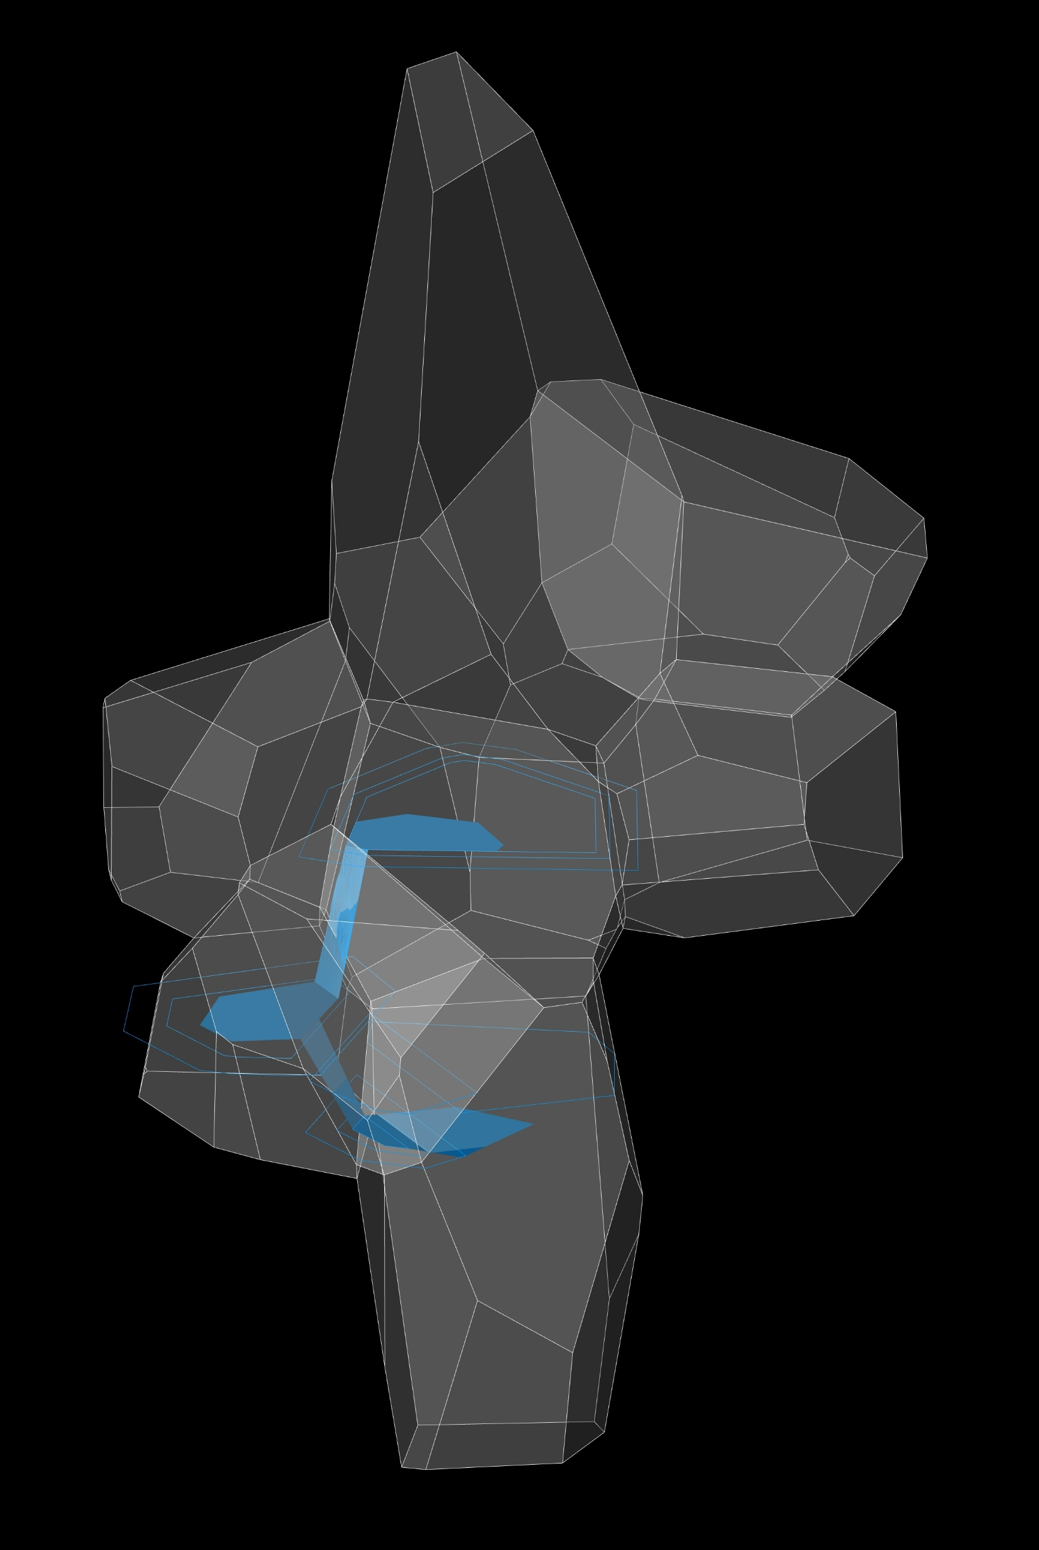
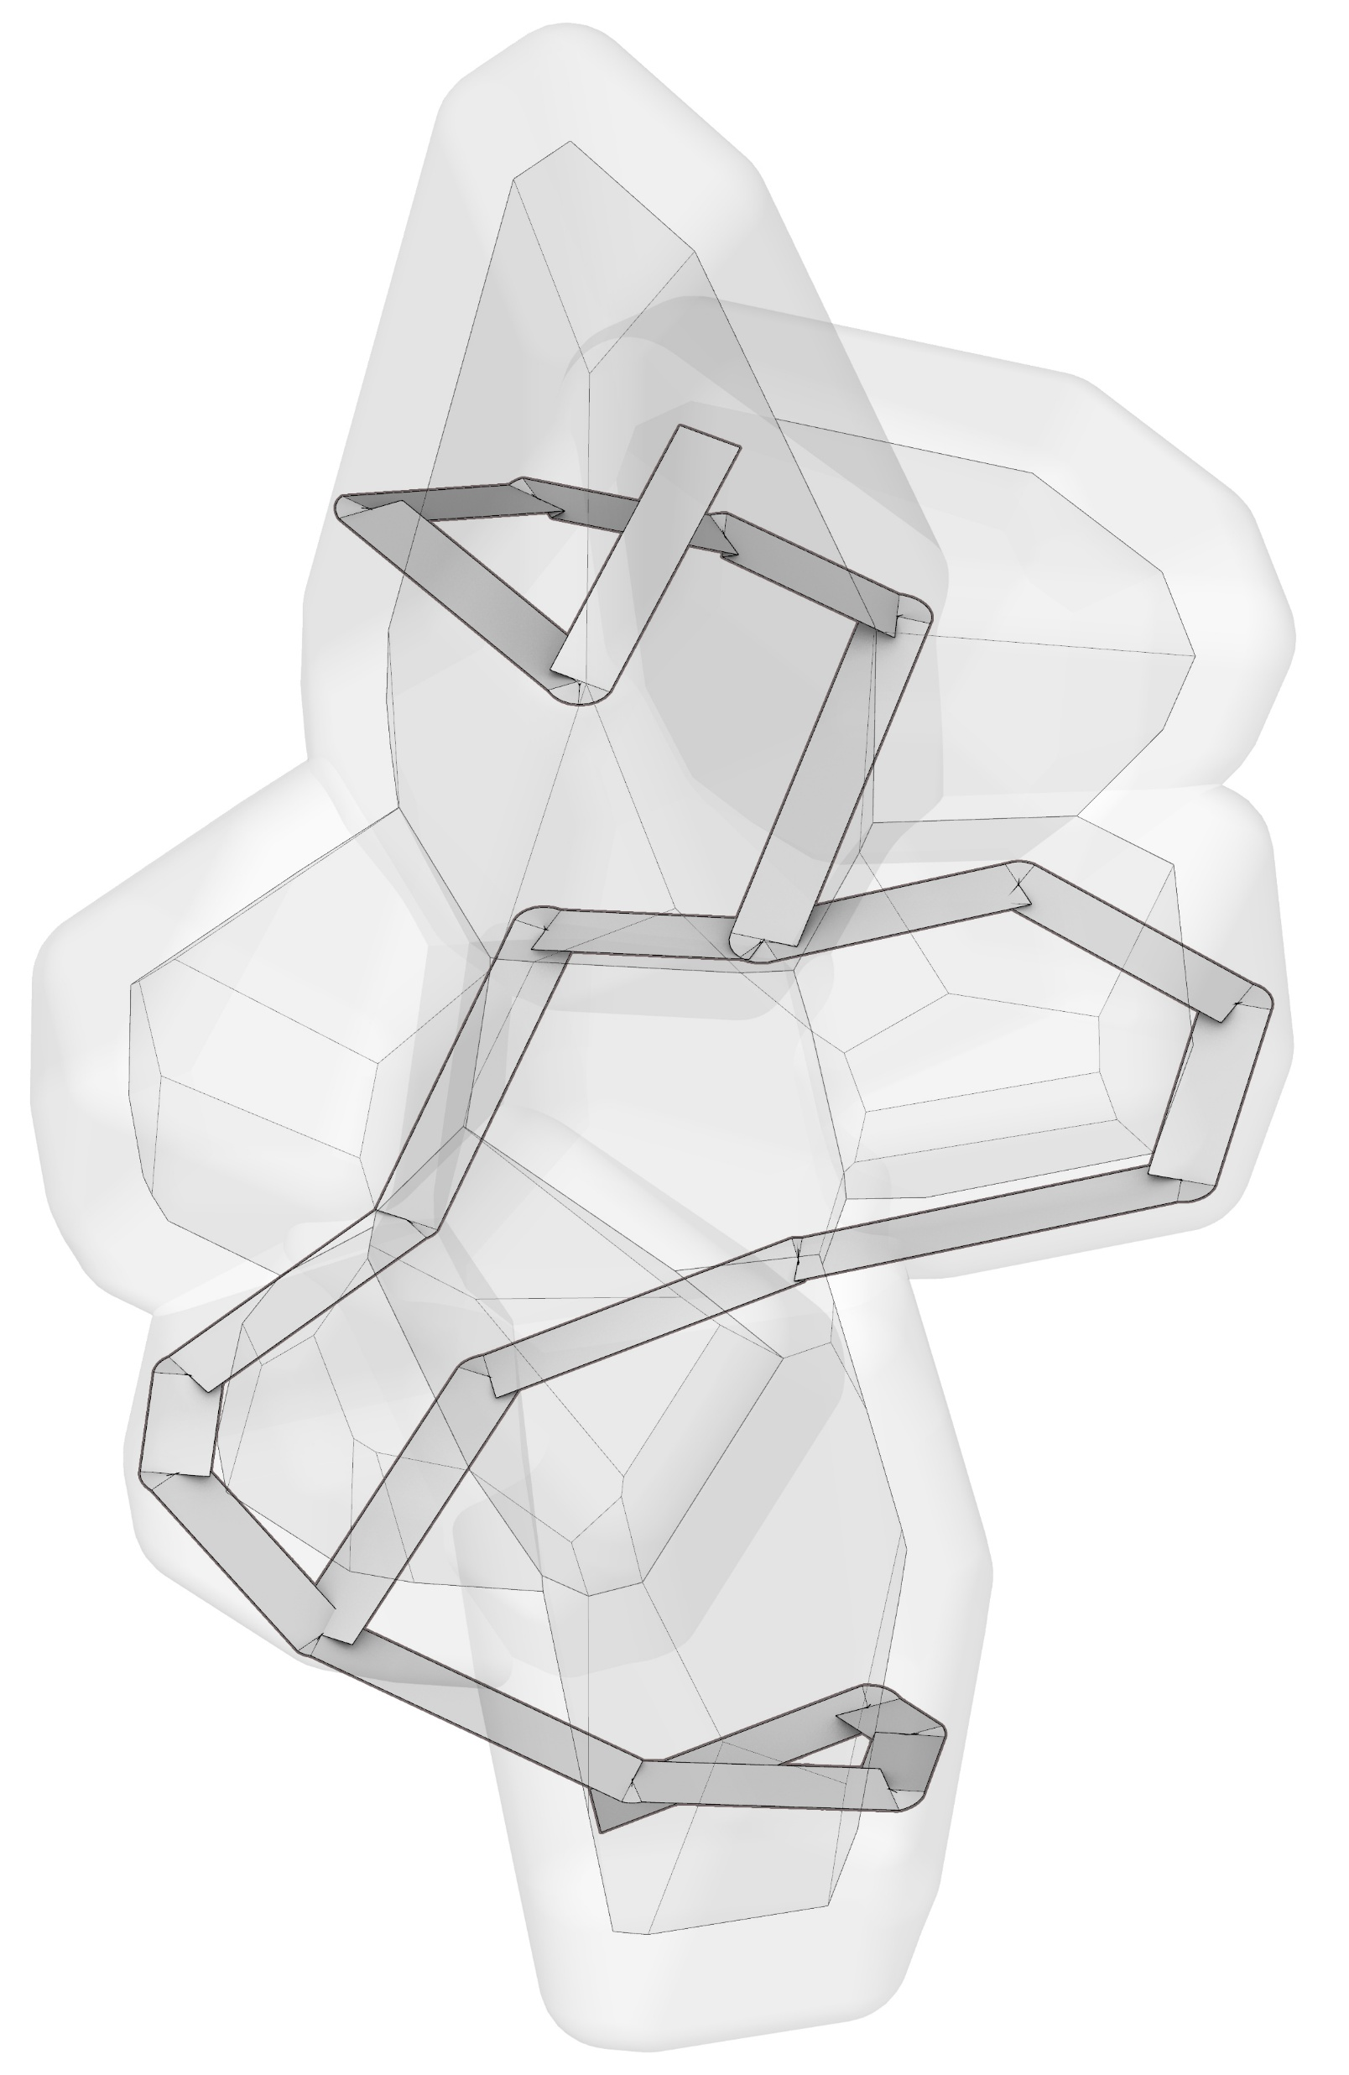
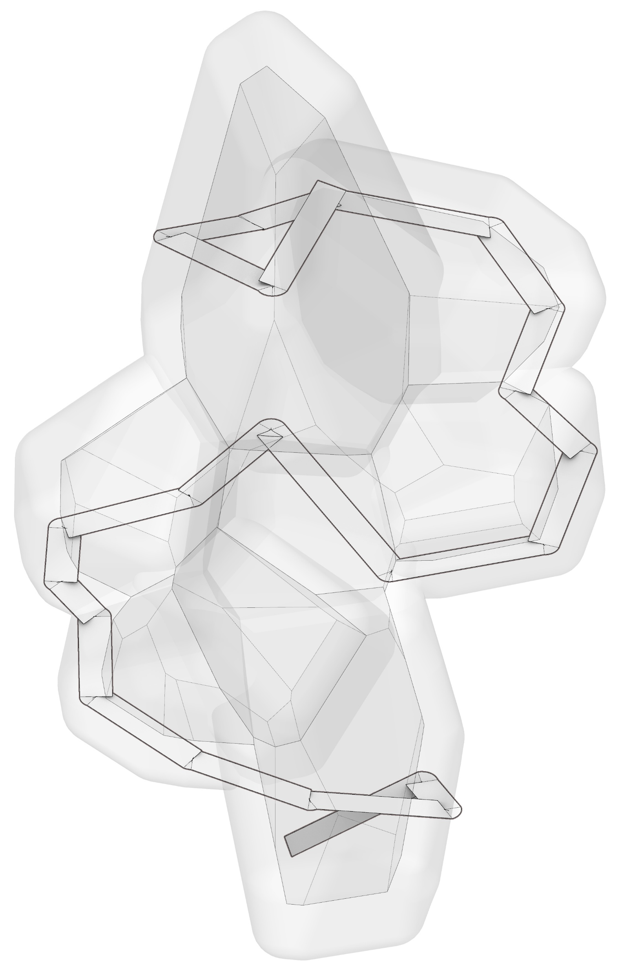
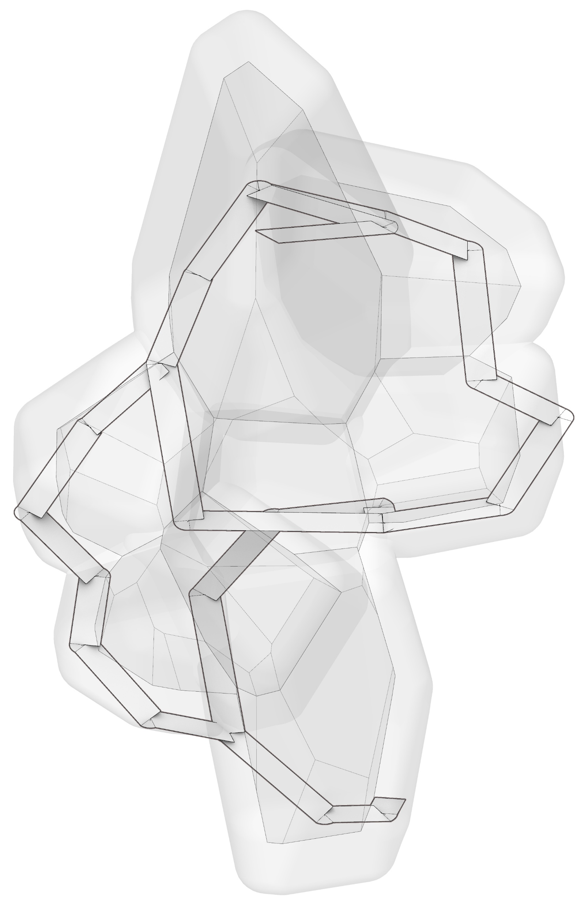

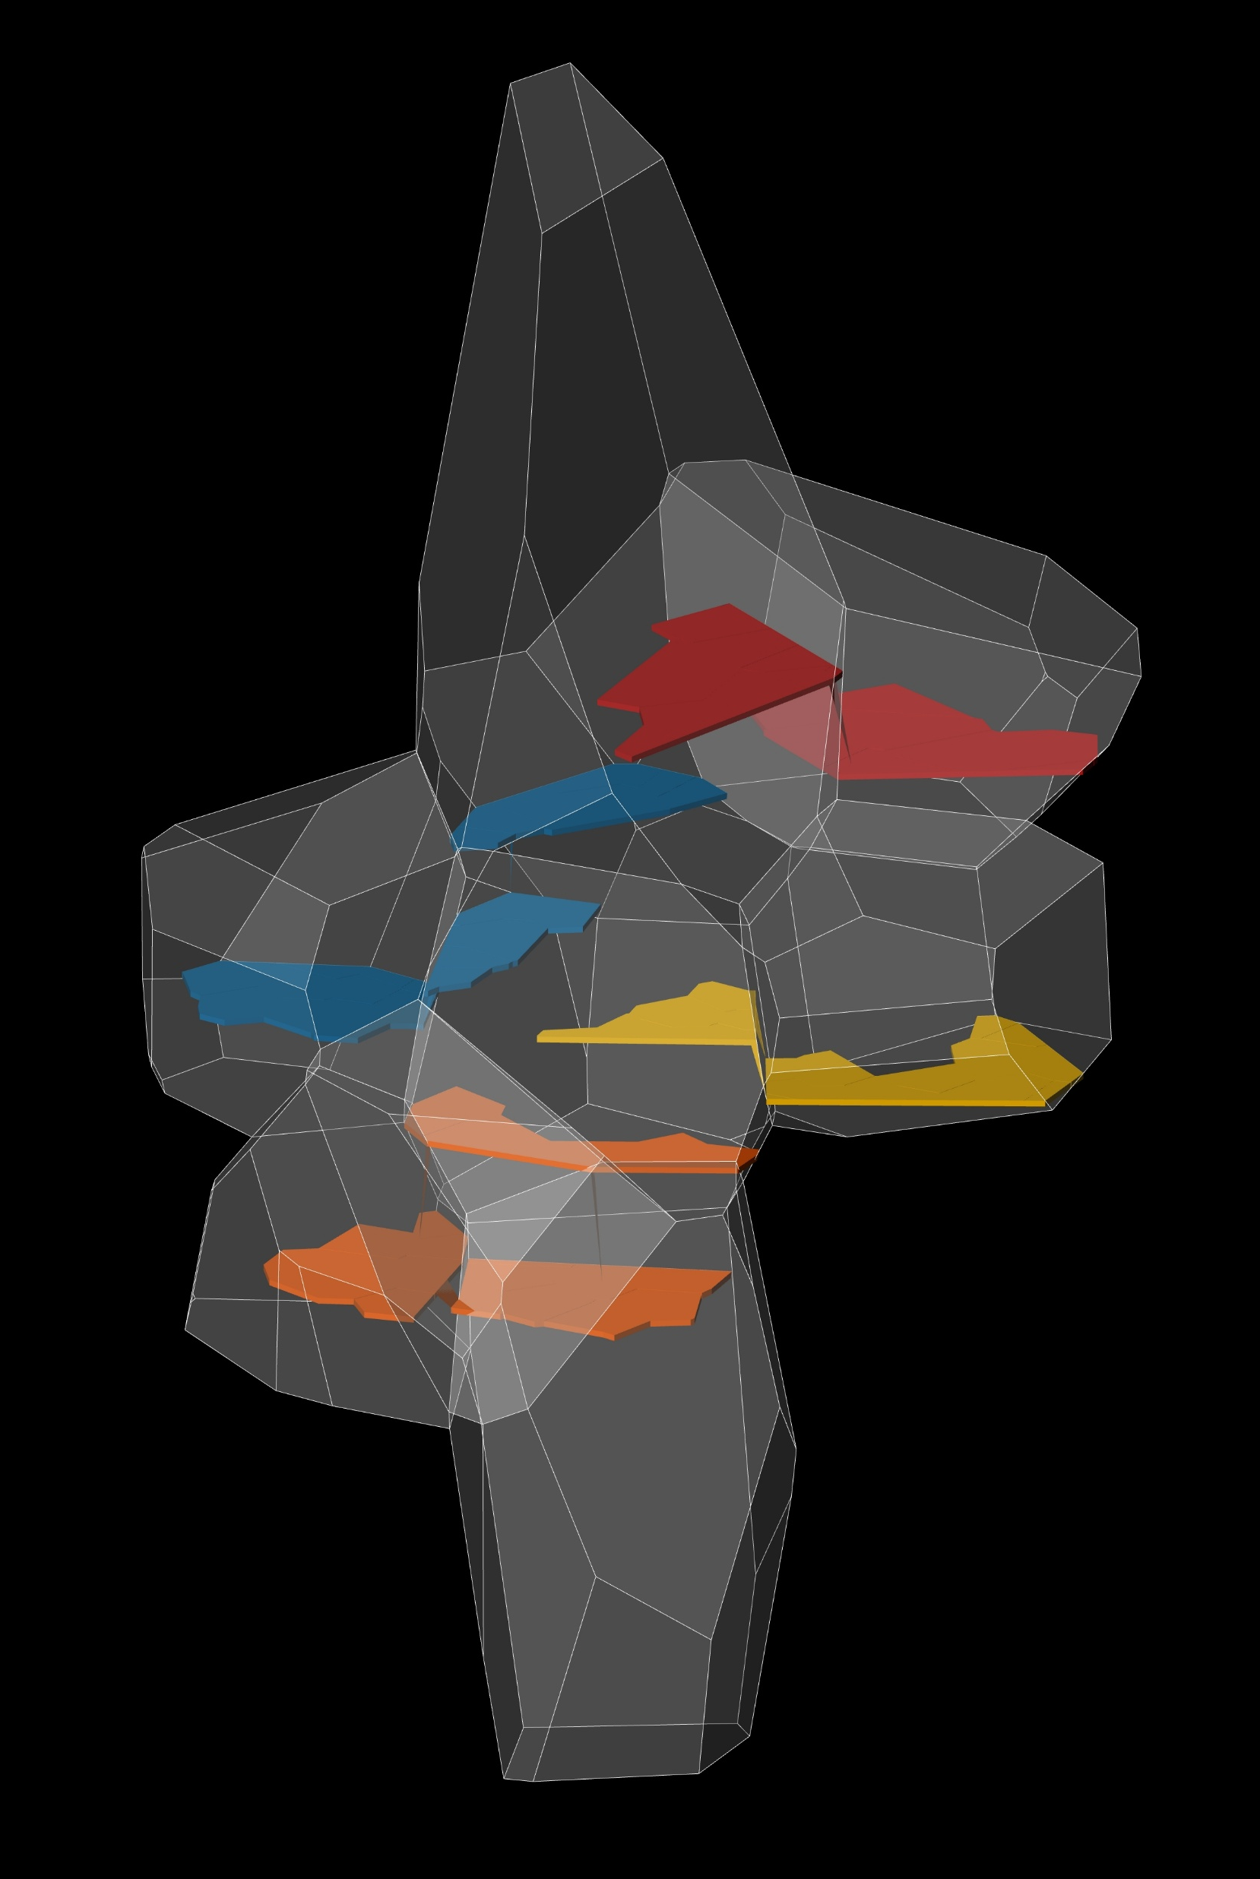
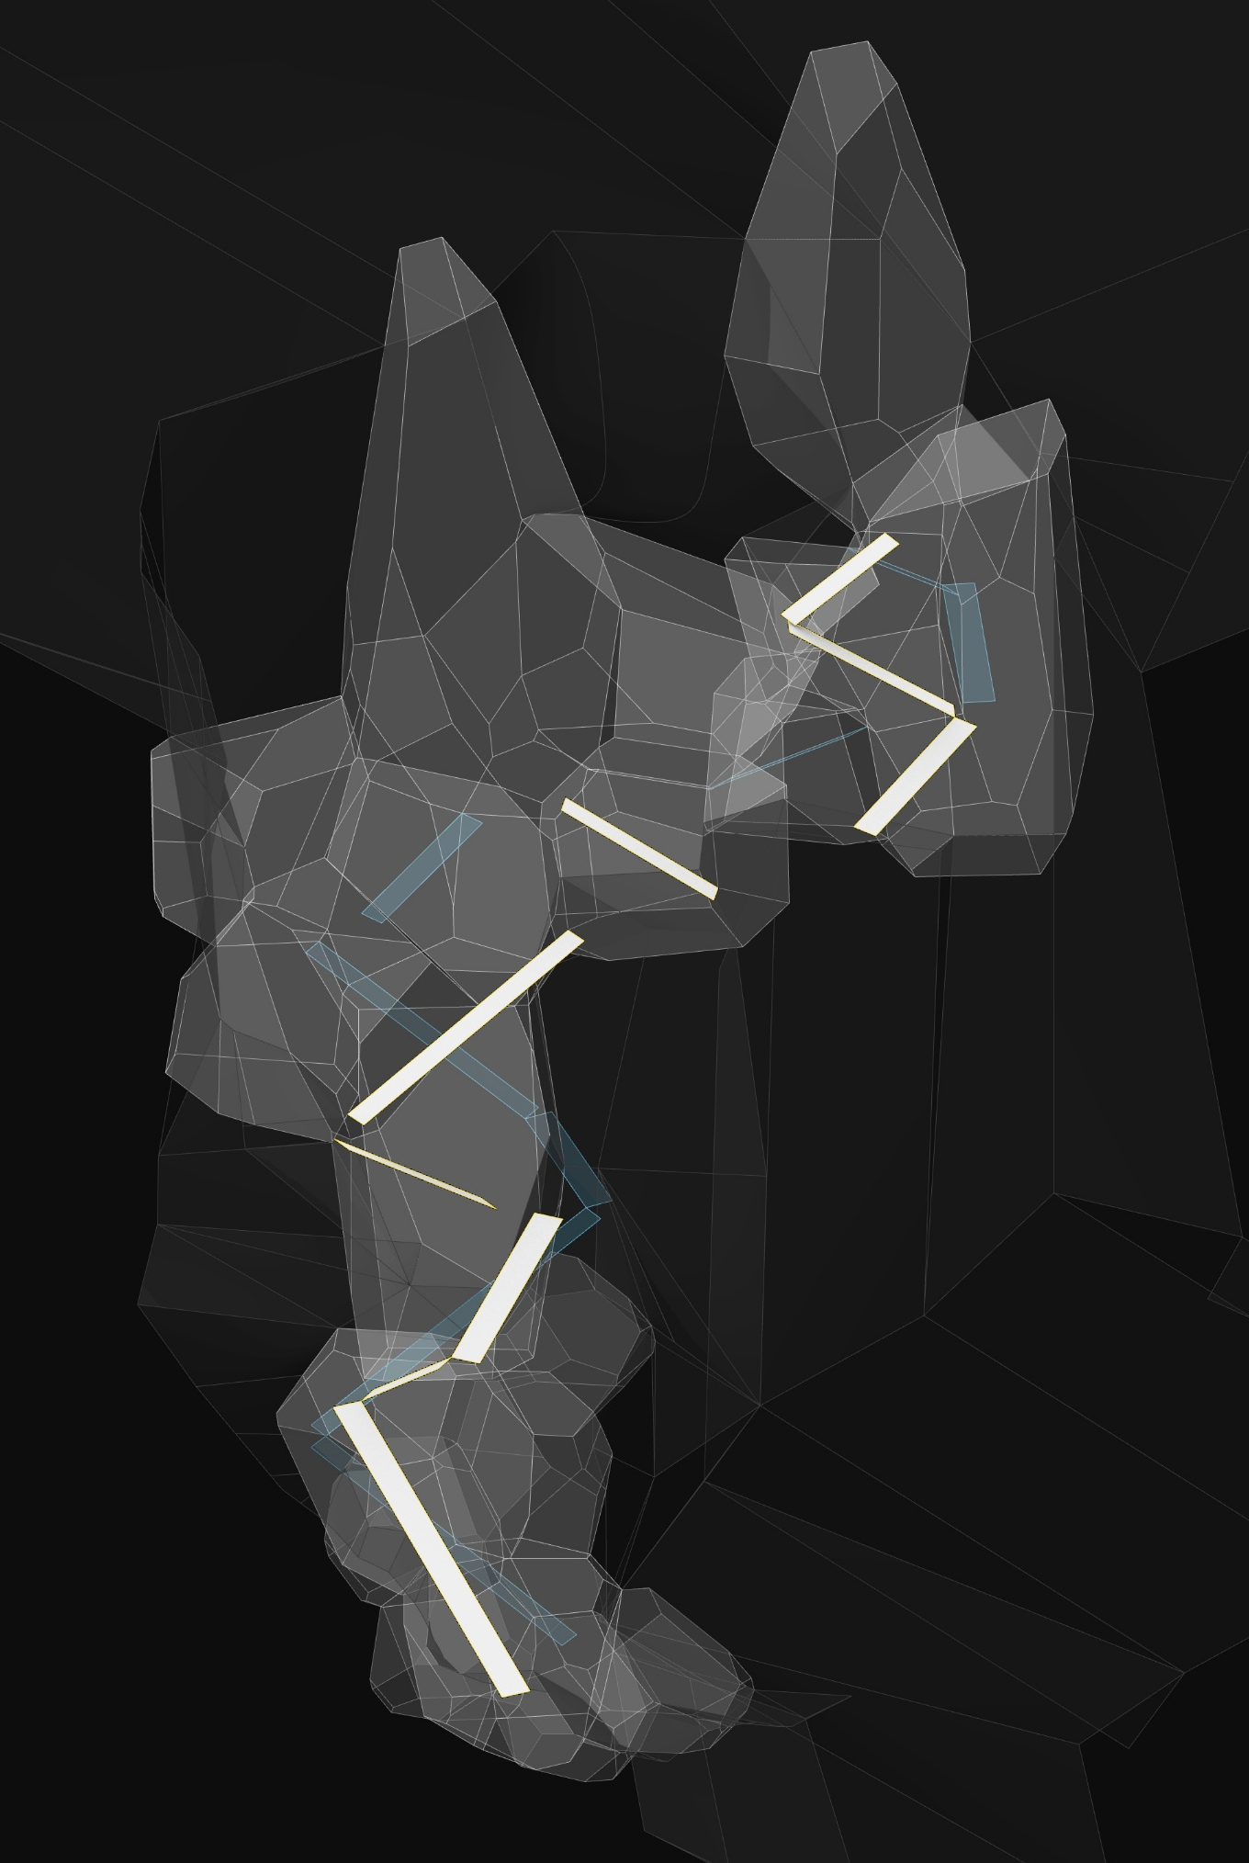
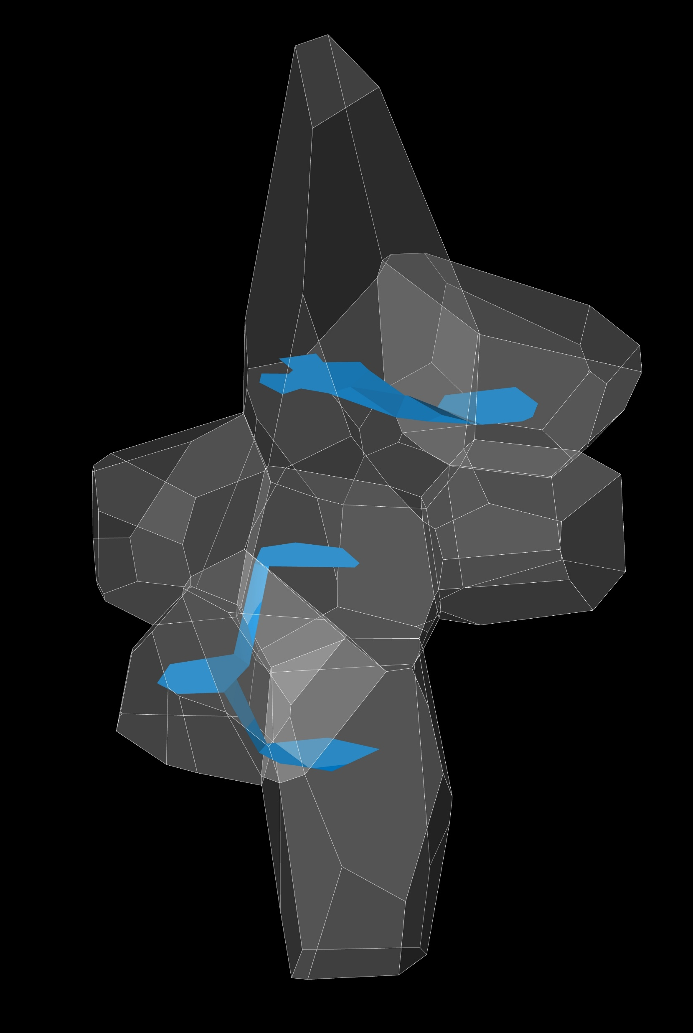
Design
form finding
thick walls and circulation
Gradual angled path goes through thick walls
Process study of ramps and platforms

Slide 12
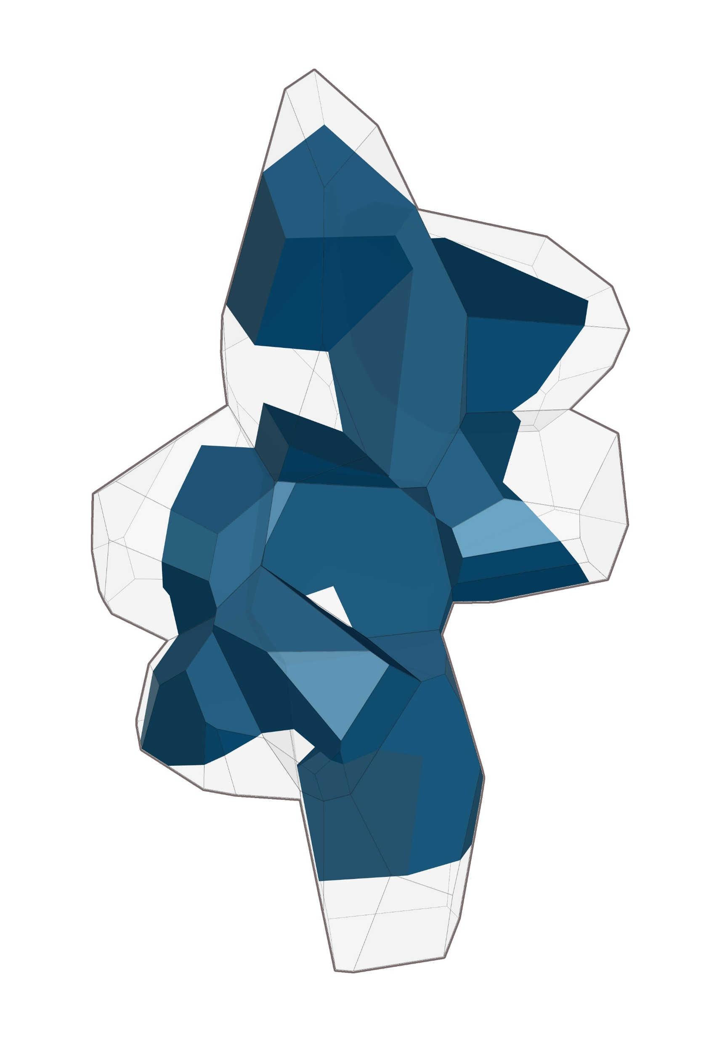
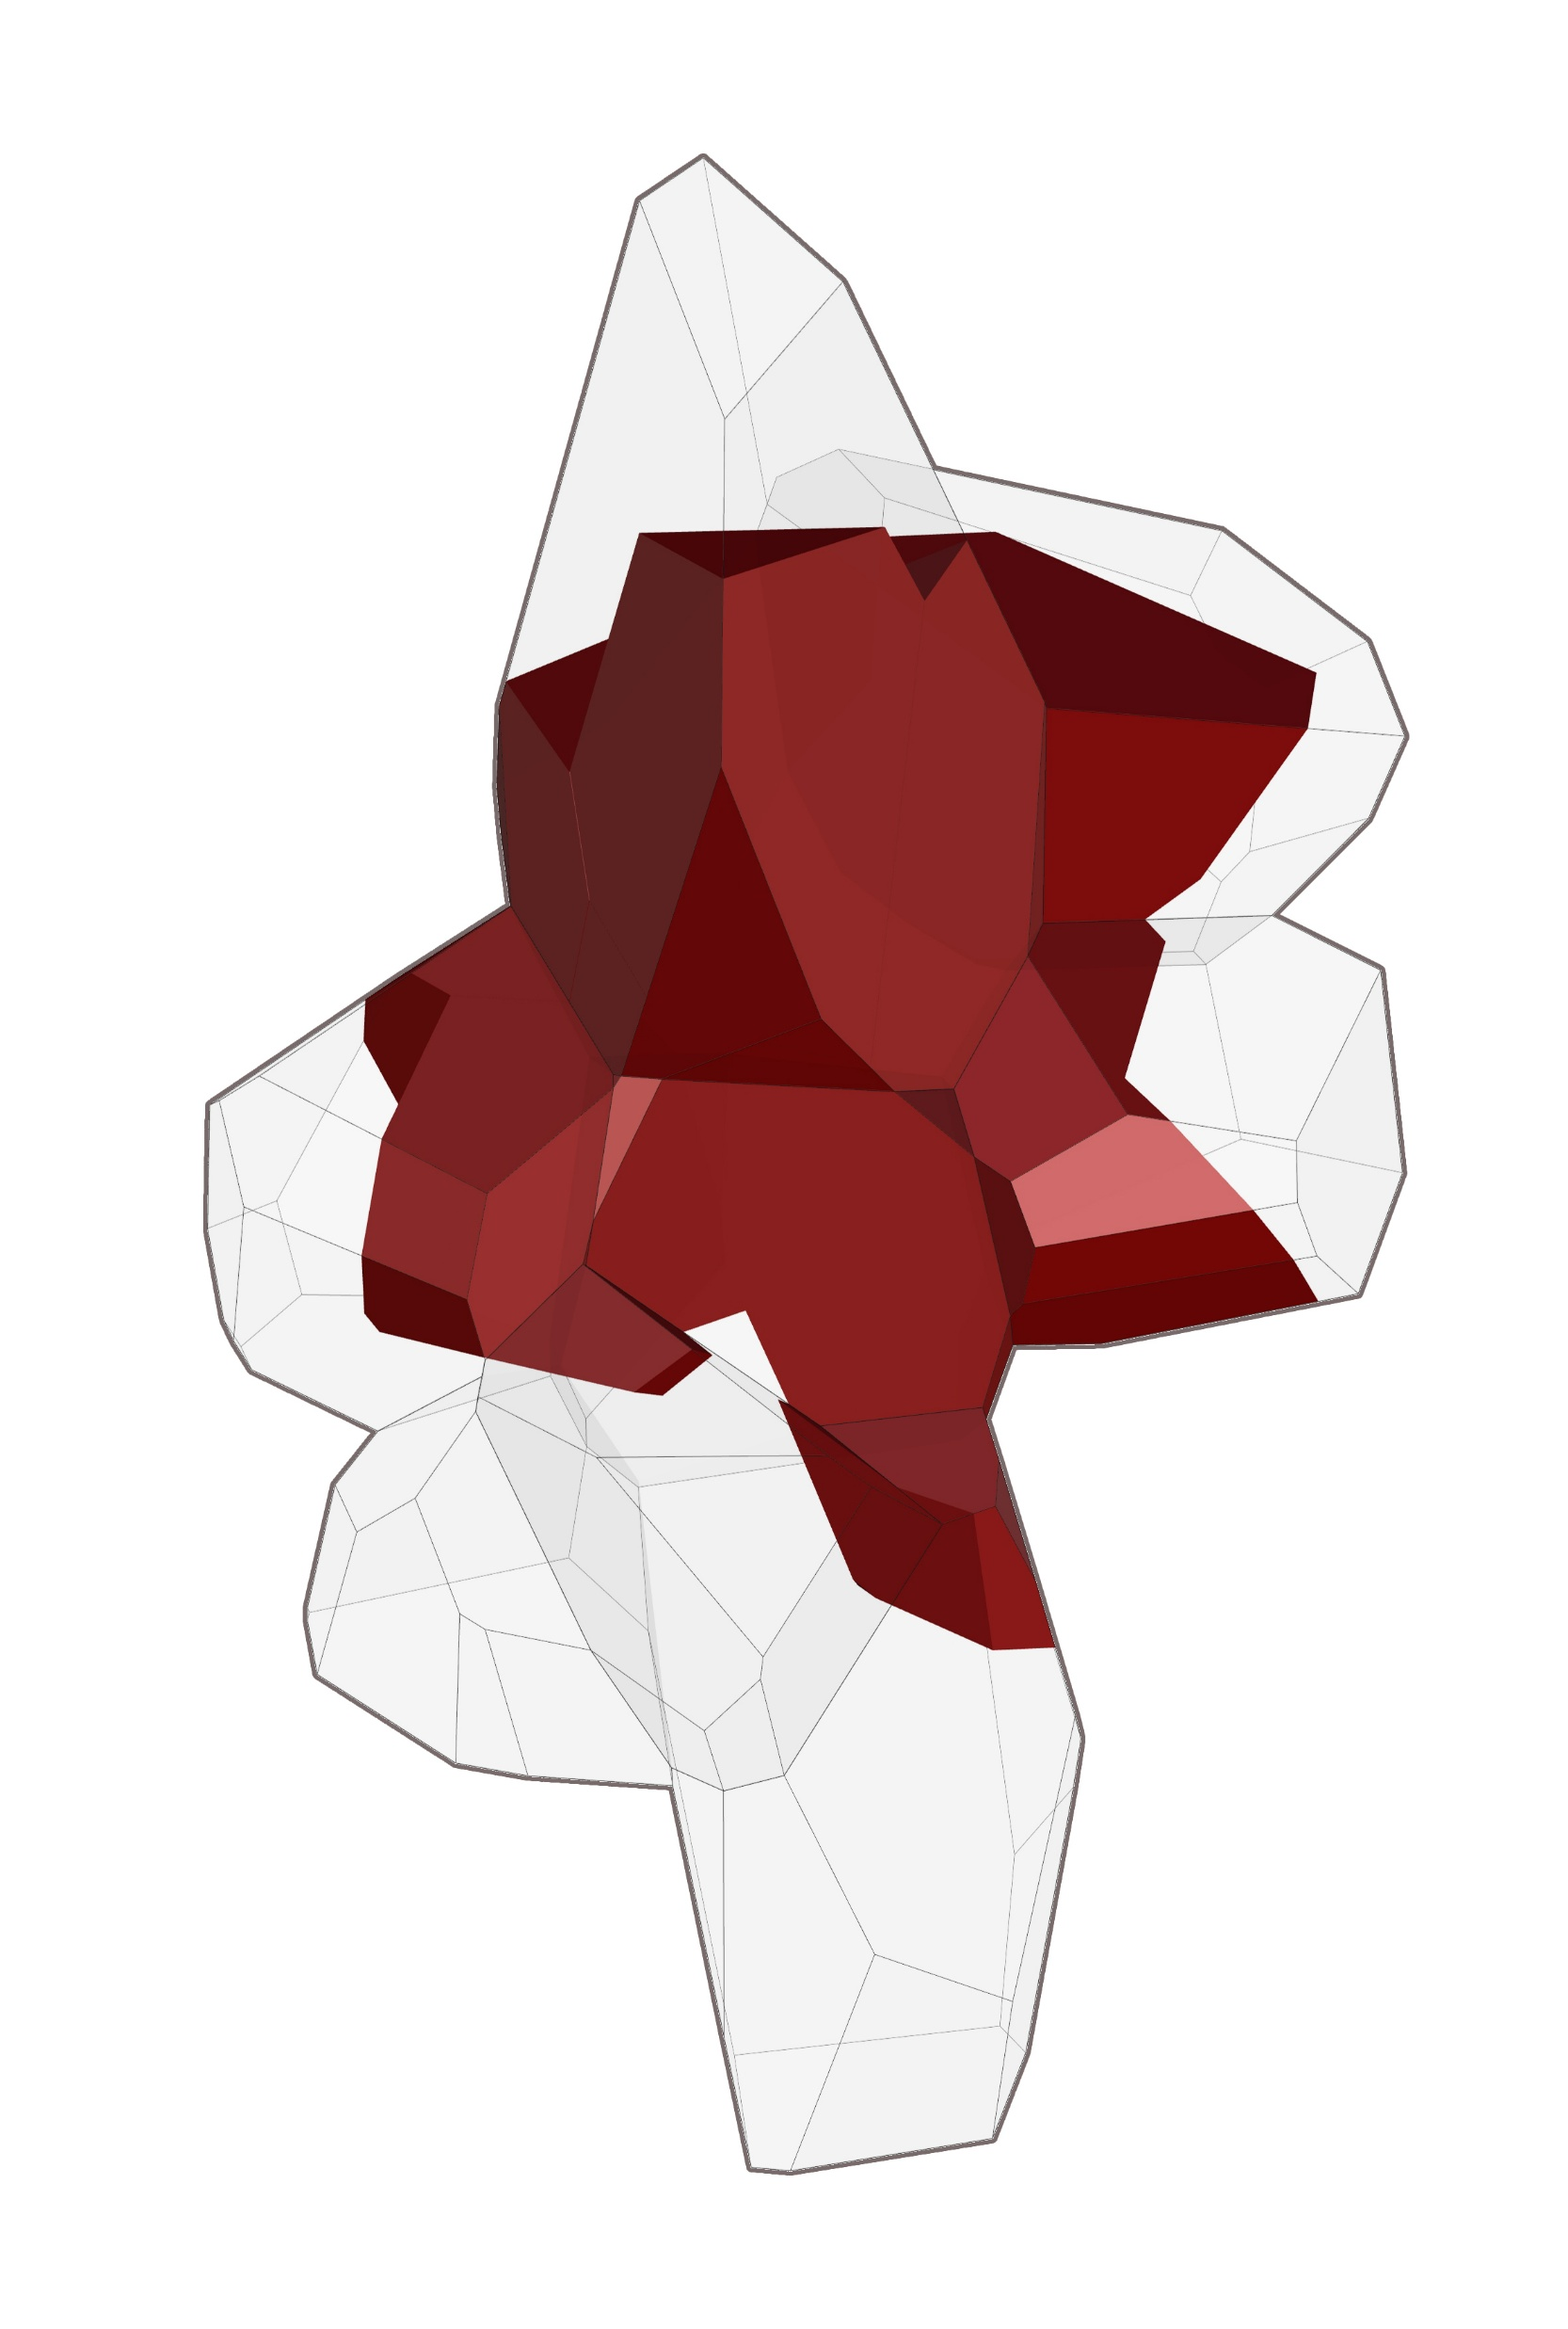
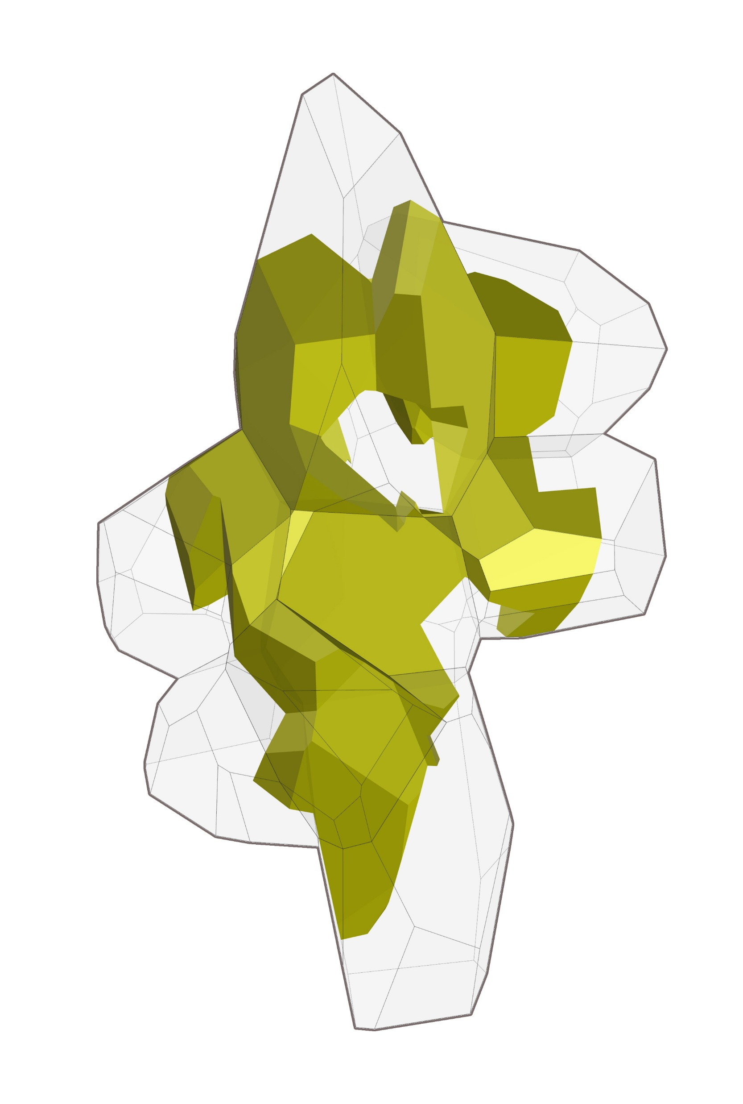
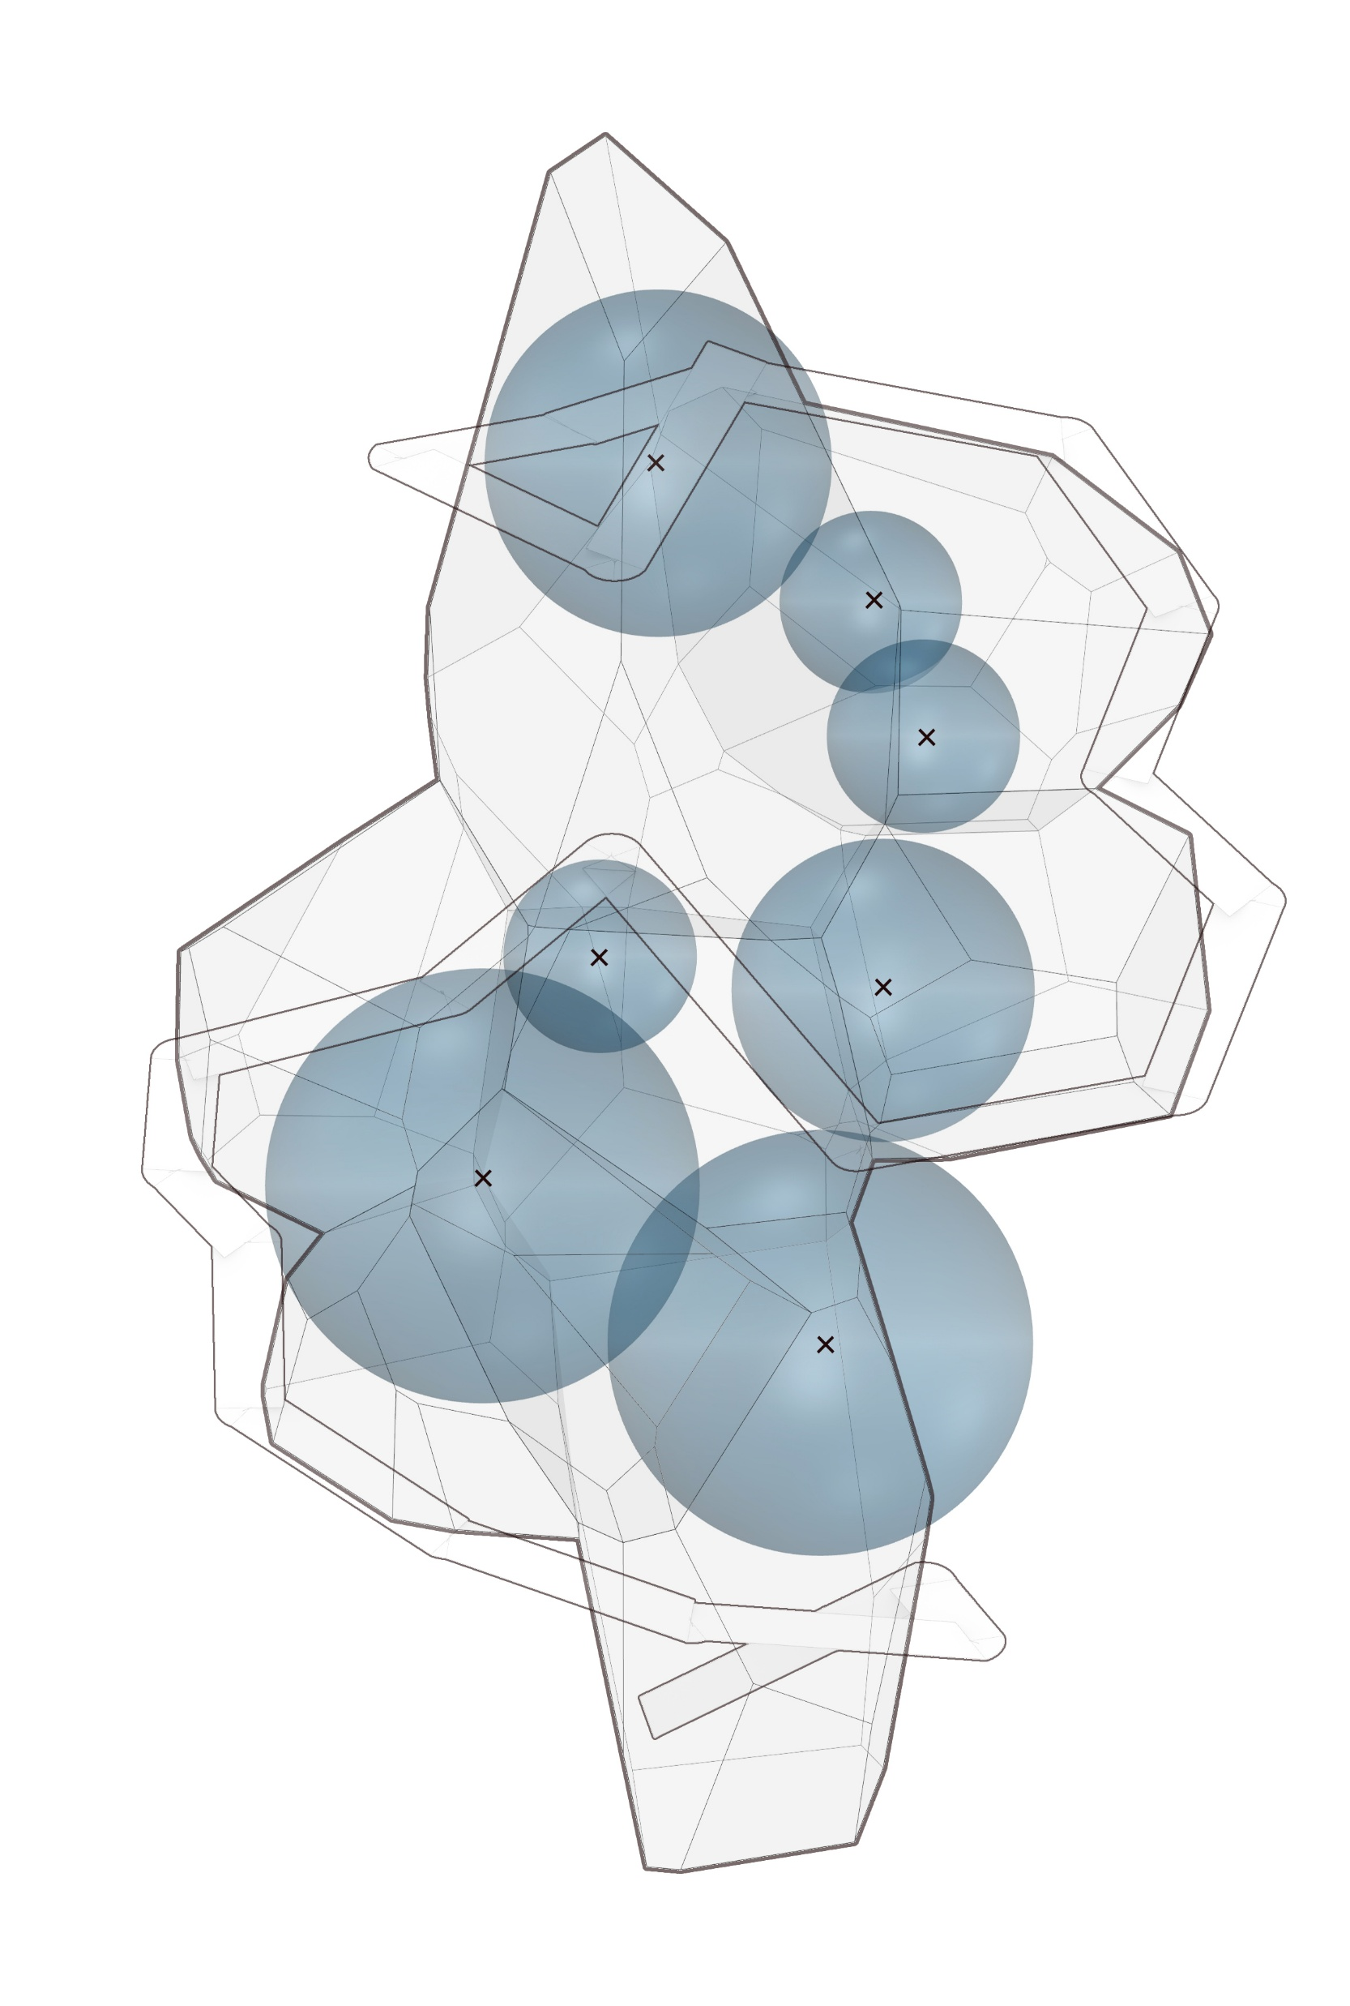
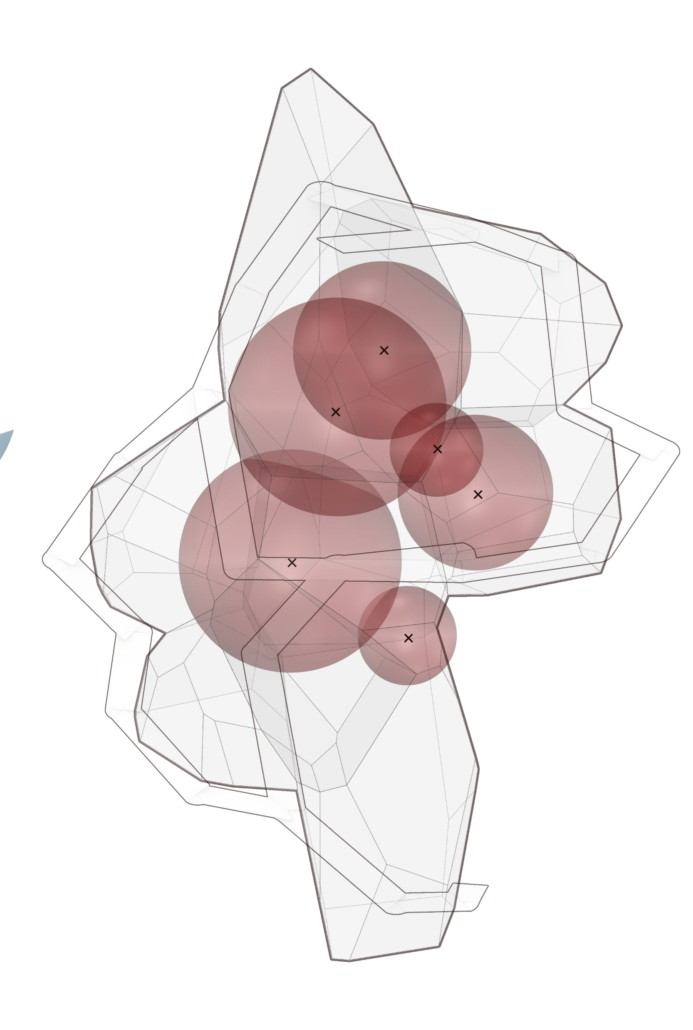
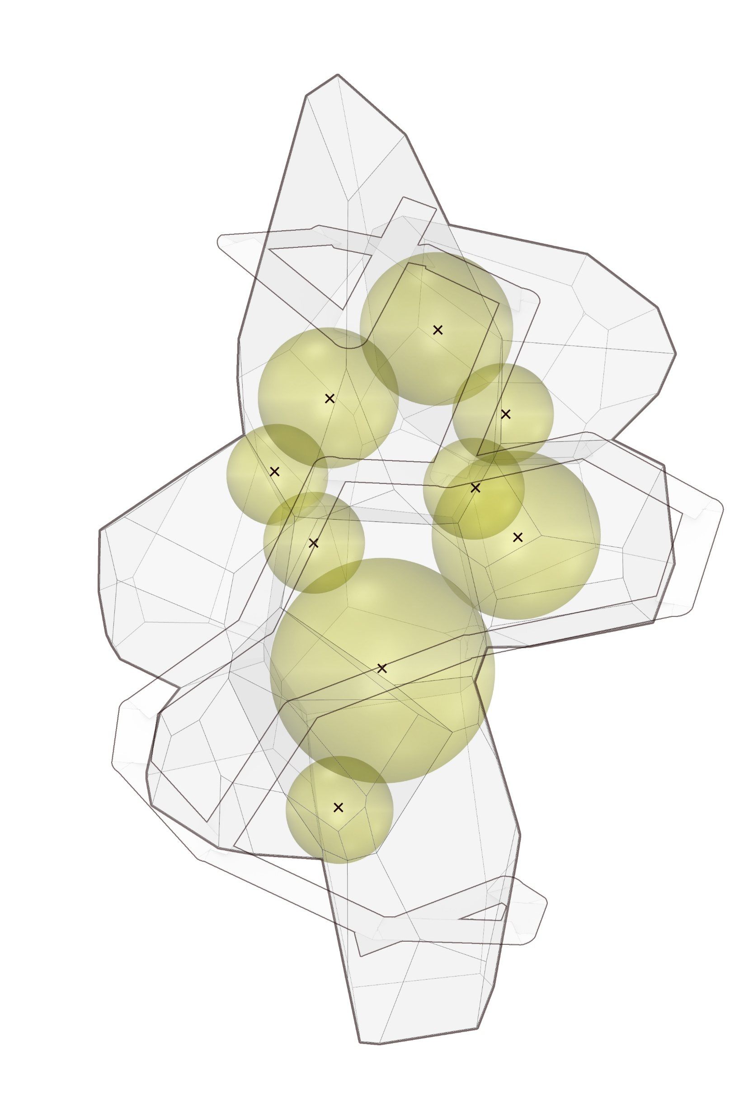
Design
form finding
programmatic function
Work
Entrance
Gym
Dining &
Kitchen
Food Gallery
Program Placement tested along circulation
Points generated from spheres -> converted into voronoi-based spaces

Slide 13
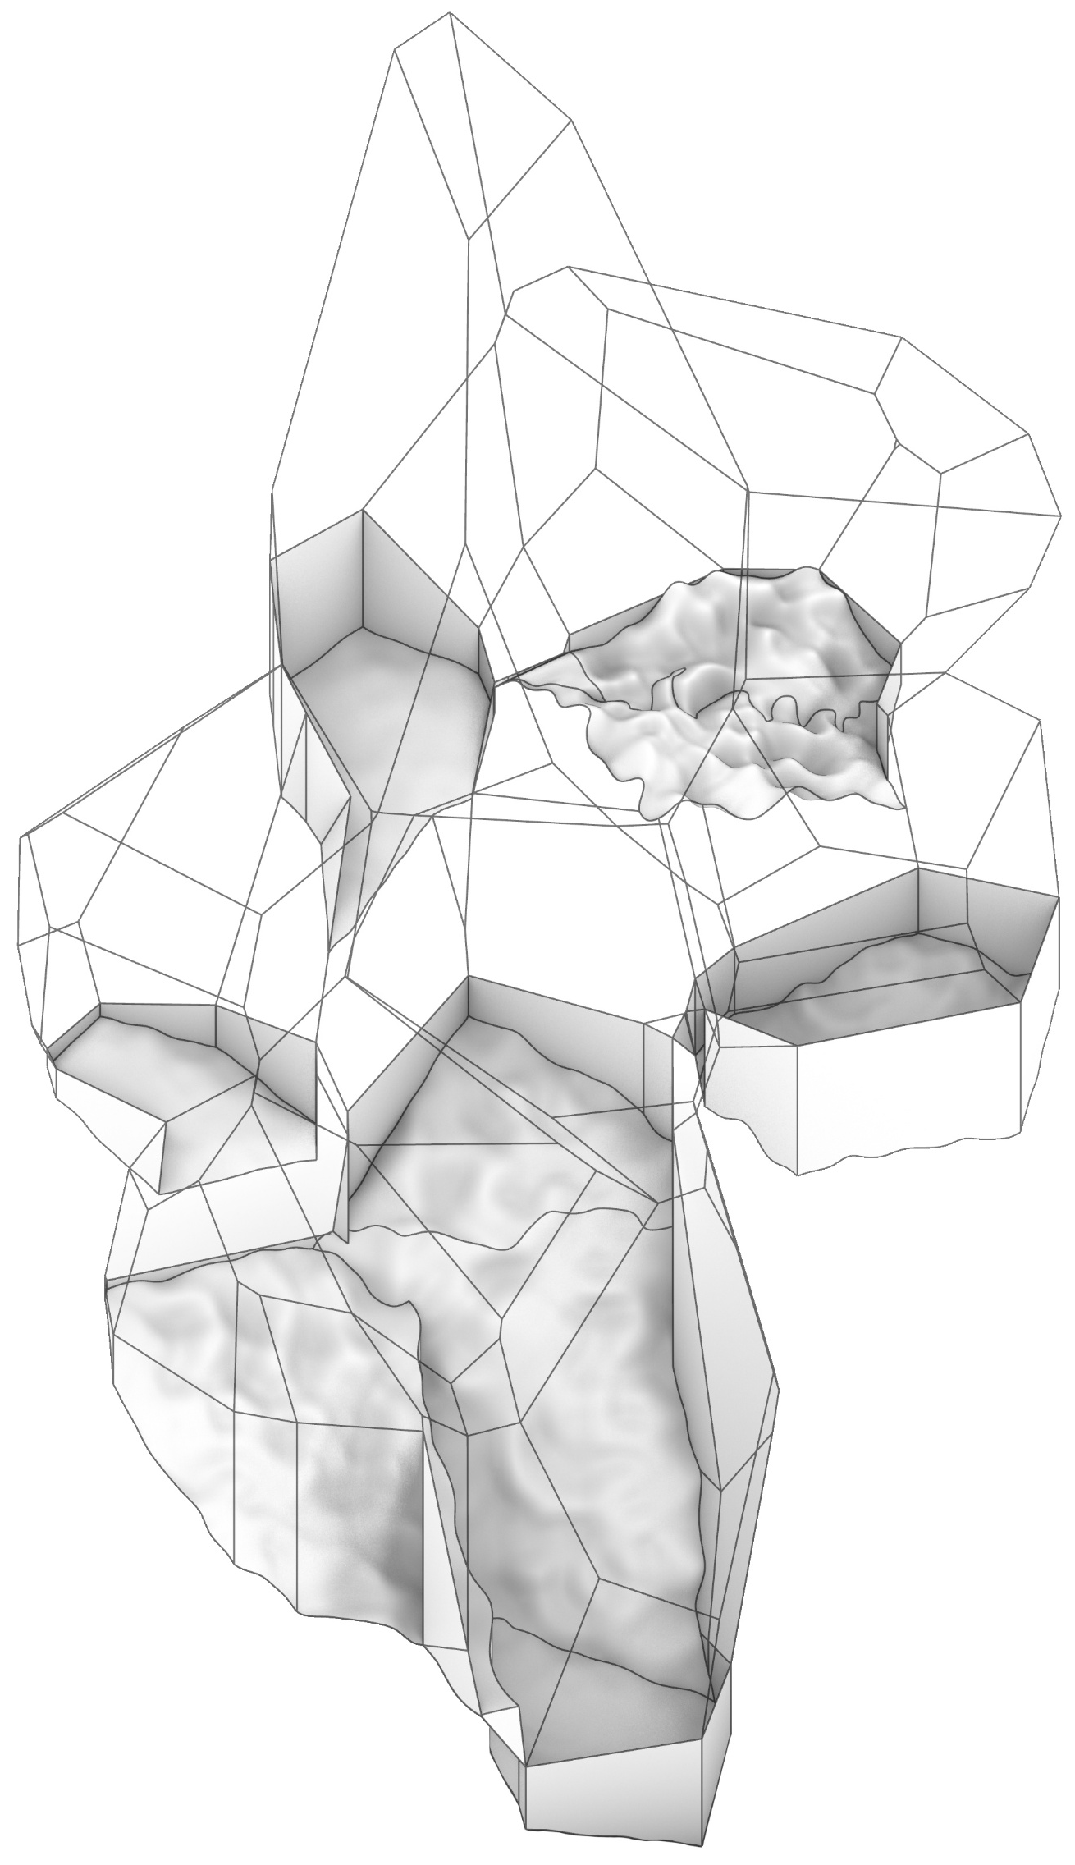
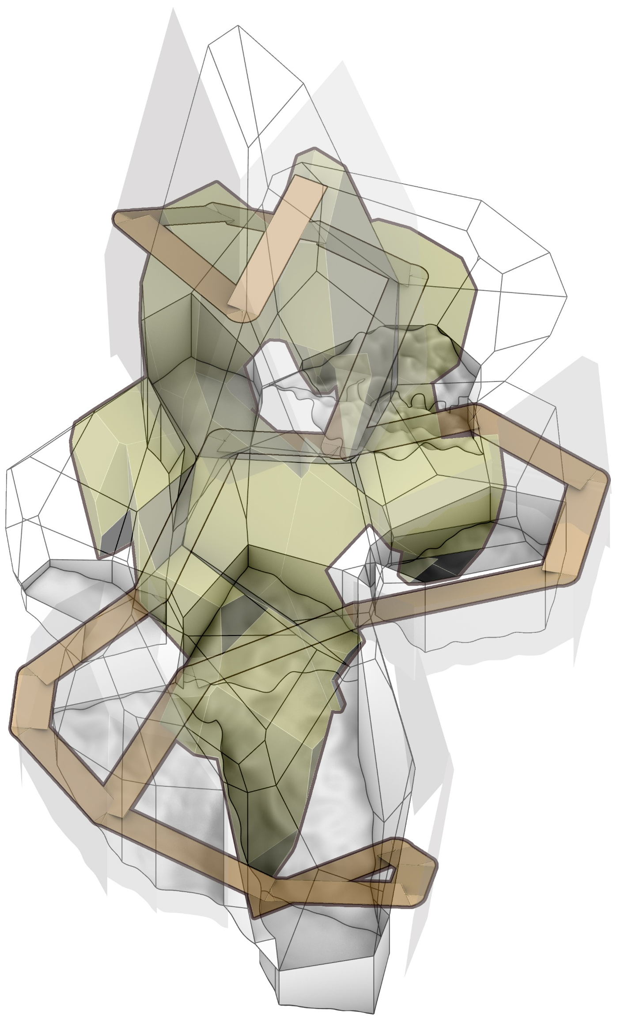
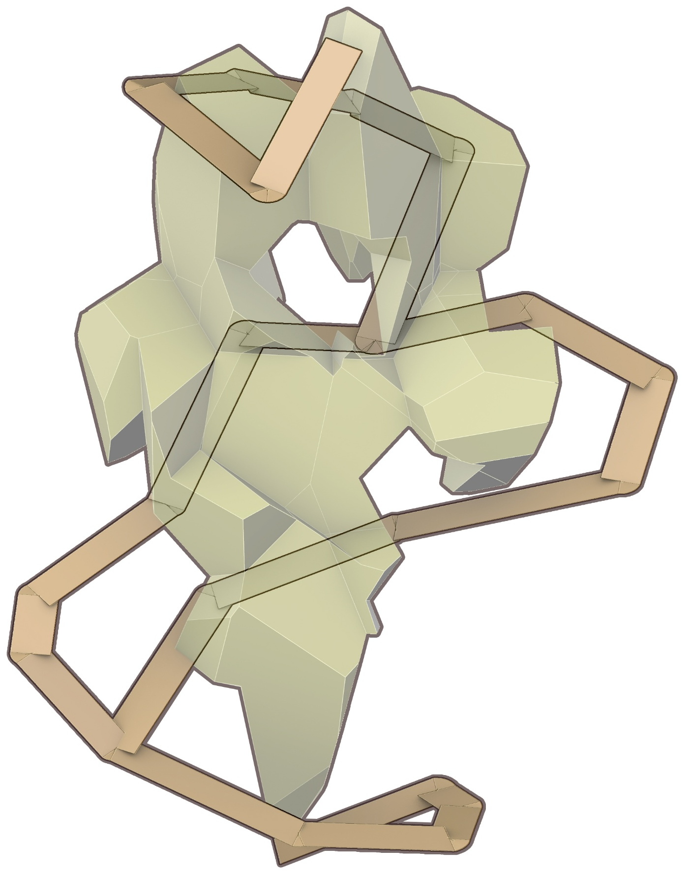
Design
form finding
man-made to nature
FIRST Stage
Current focused area
of development
Natural Terrain
Built Elements
Intertwined
Architectural Elements + Existing Terrain --> Surfaces angles and resolution

