Slide 1
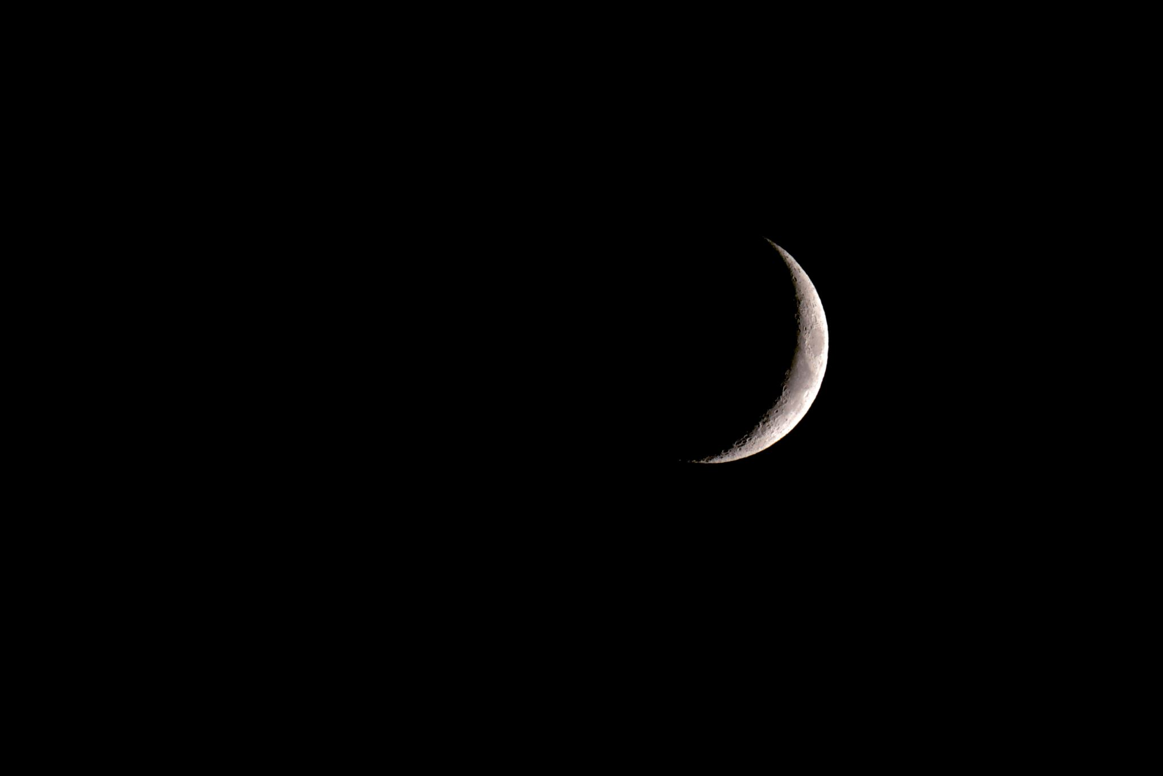
Continued research

Slide 2
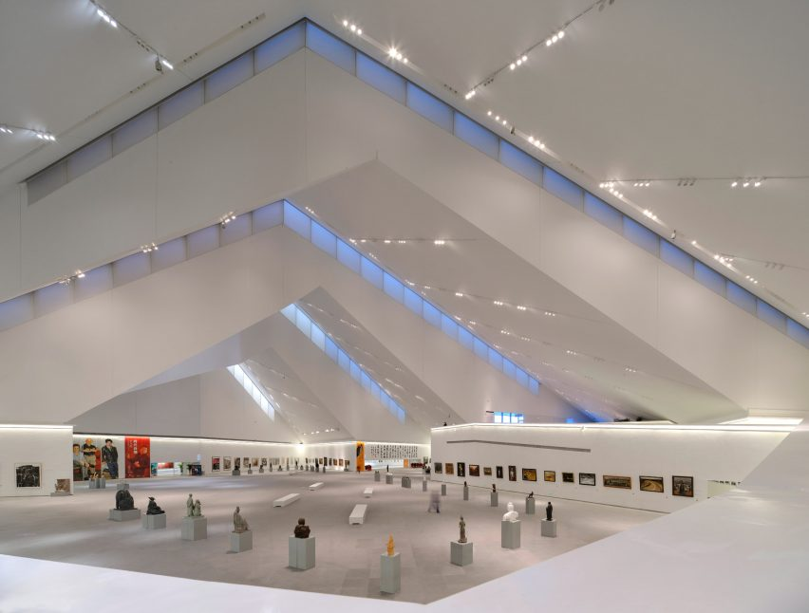
Utopian
Organic – building seems like a living entity
Mystical ambiance
Spaciousness
Escapism
Reminds us of the unknown, like looking at a far-away holiday brochure
https://neocha.com/magazine/reshaping-reality/
https://www.dezeen.com/2022/01/06/foster-partners-datong-art-museum-china/

Slide 3
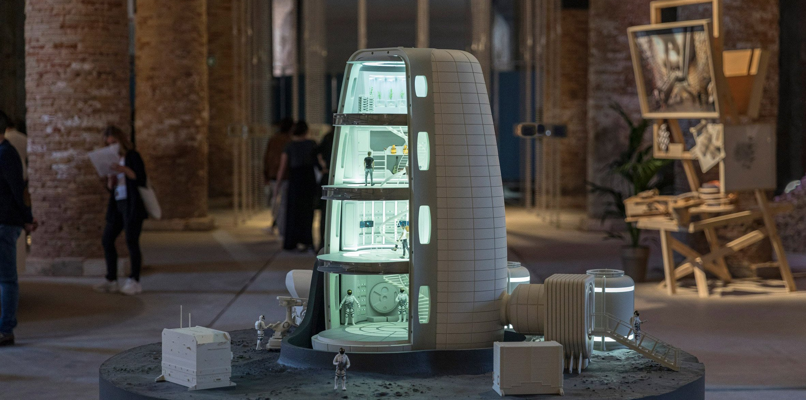
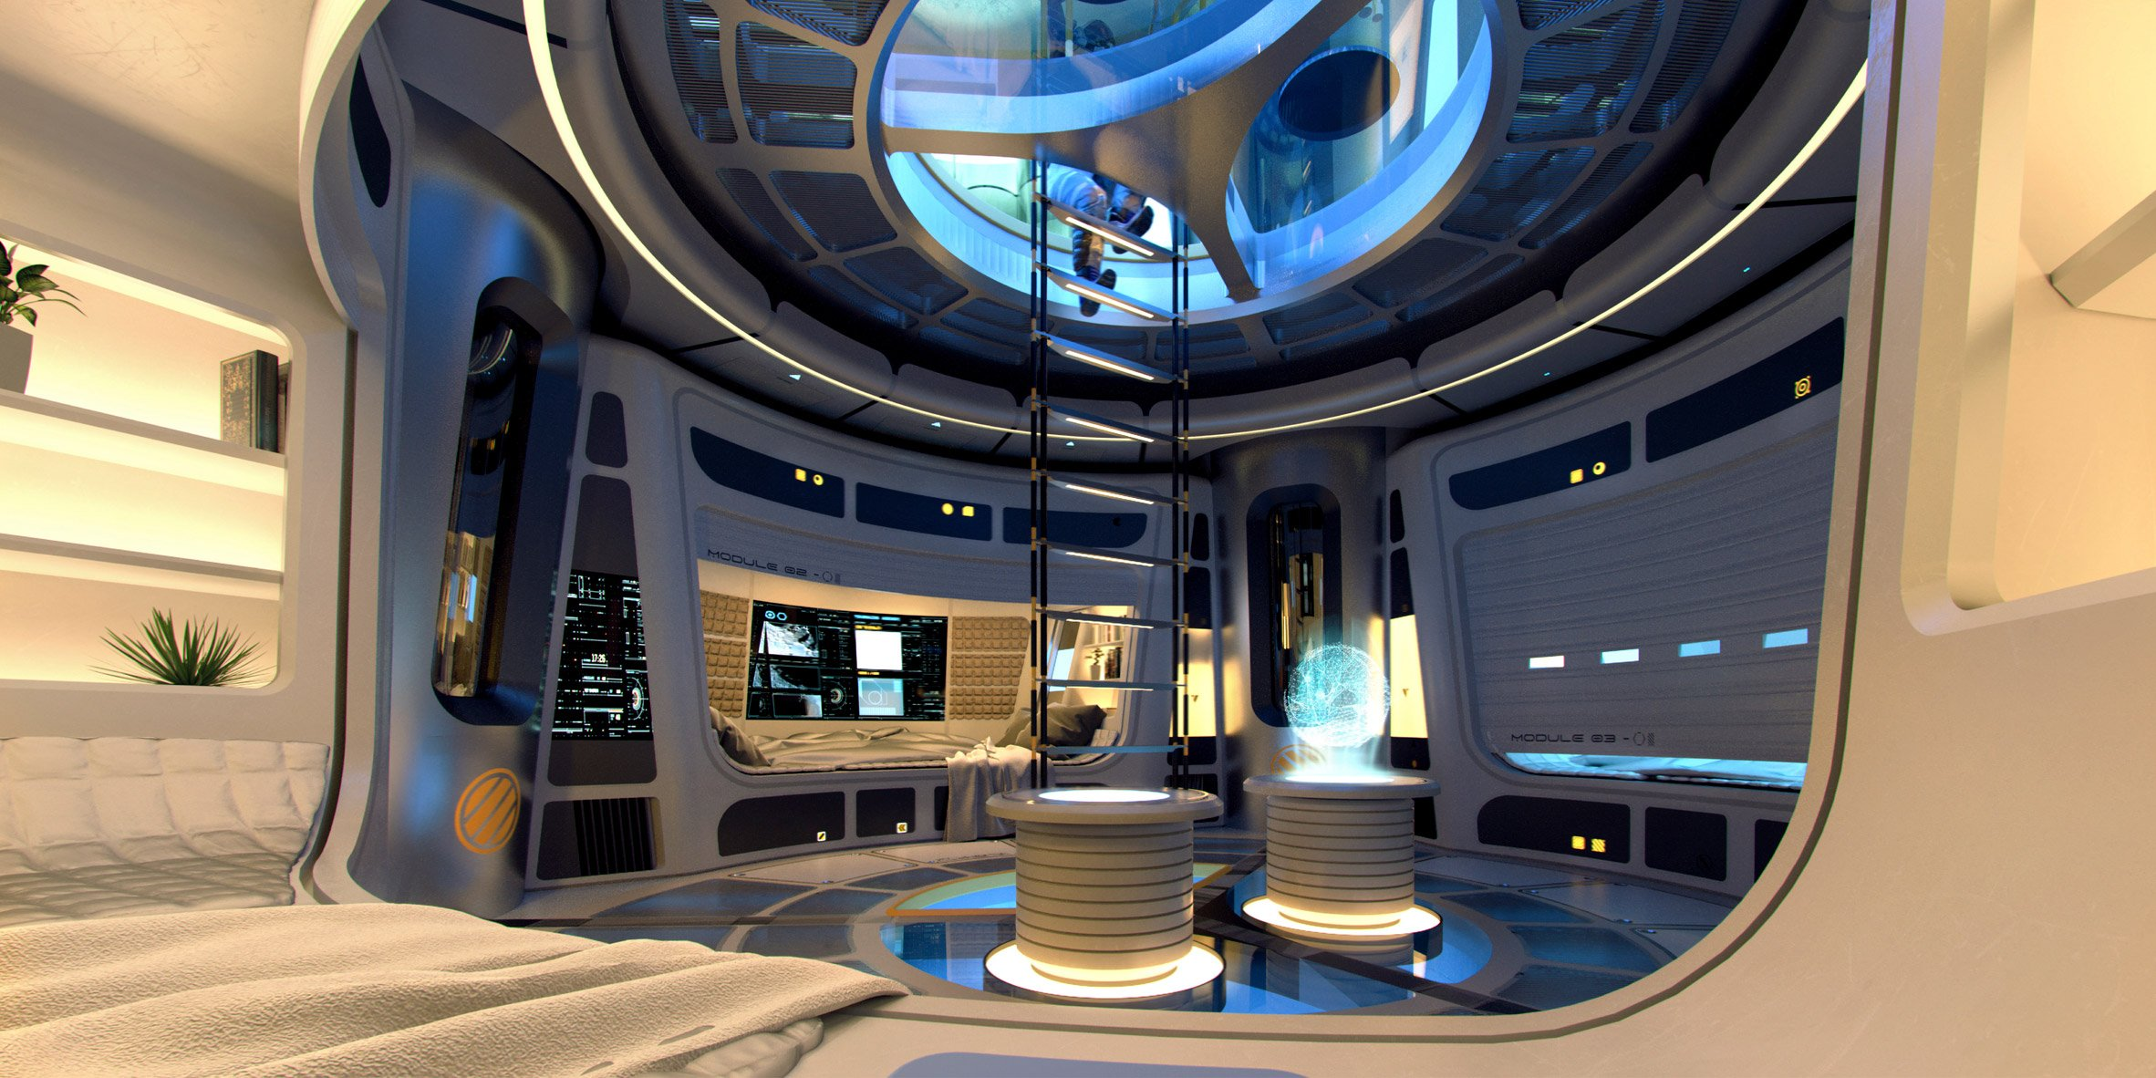
Moon Village -SOM
Characteristics:
Verticality – interlinked by stairs
Fitting within microgravity – moving vertically costs less energy
Inflatable structure

Slide 4
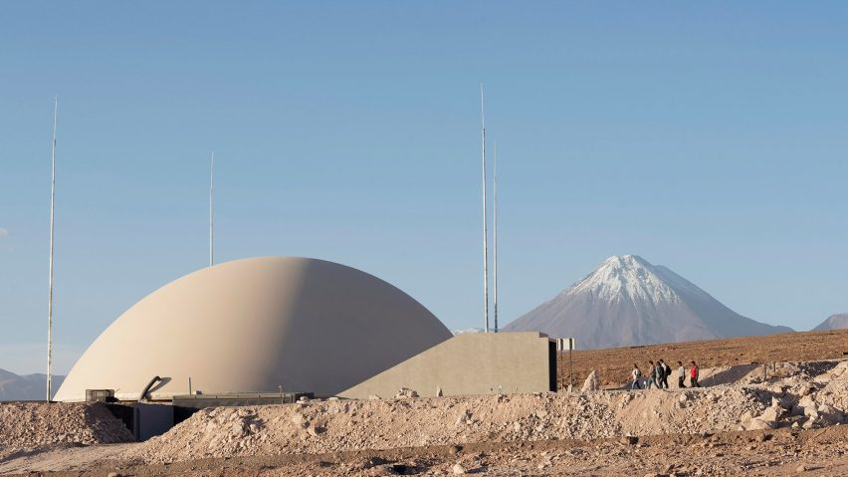
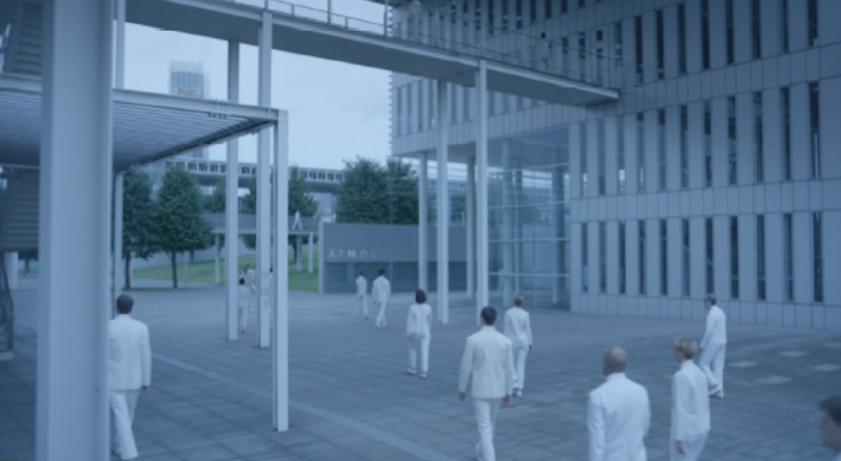
Dystopian
Extreme future environments:
Nuclear disaster
WW3
Climate disaster
“Shelters for the apocalypse”
Desert architecture
Bunker architecture
Dystopian atmosphere:
‘impersonal’ (1); clinical; minimalist
No room for individuality/ for the greater good
(1) https://www.archdaily.com.br/br/889083/cinema-e-arquitetura-equals-a-arquitetura-da-impessoalidade

Slide 5
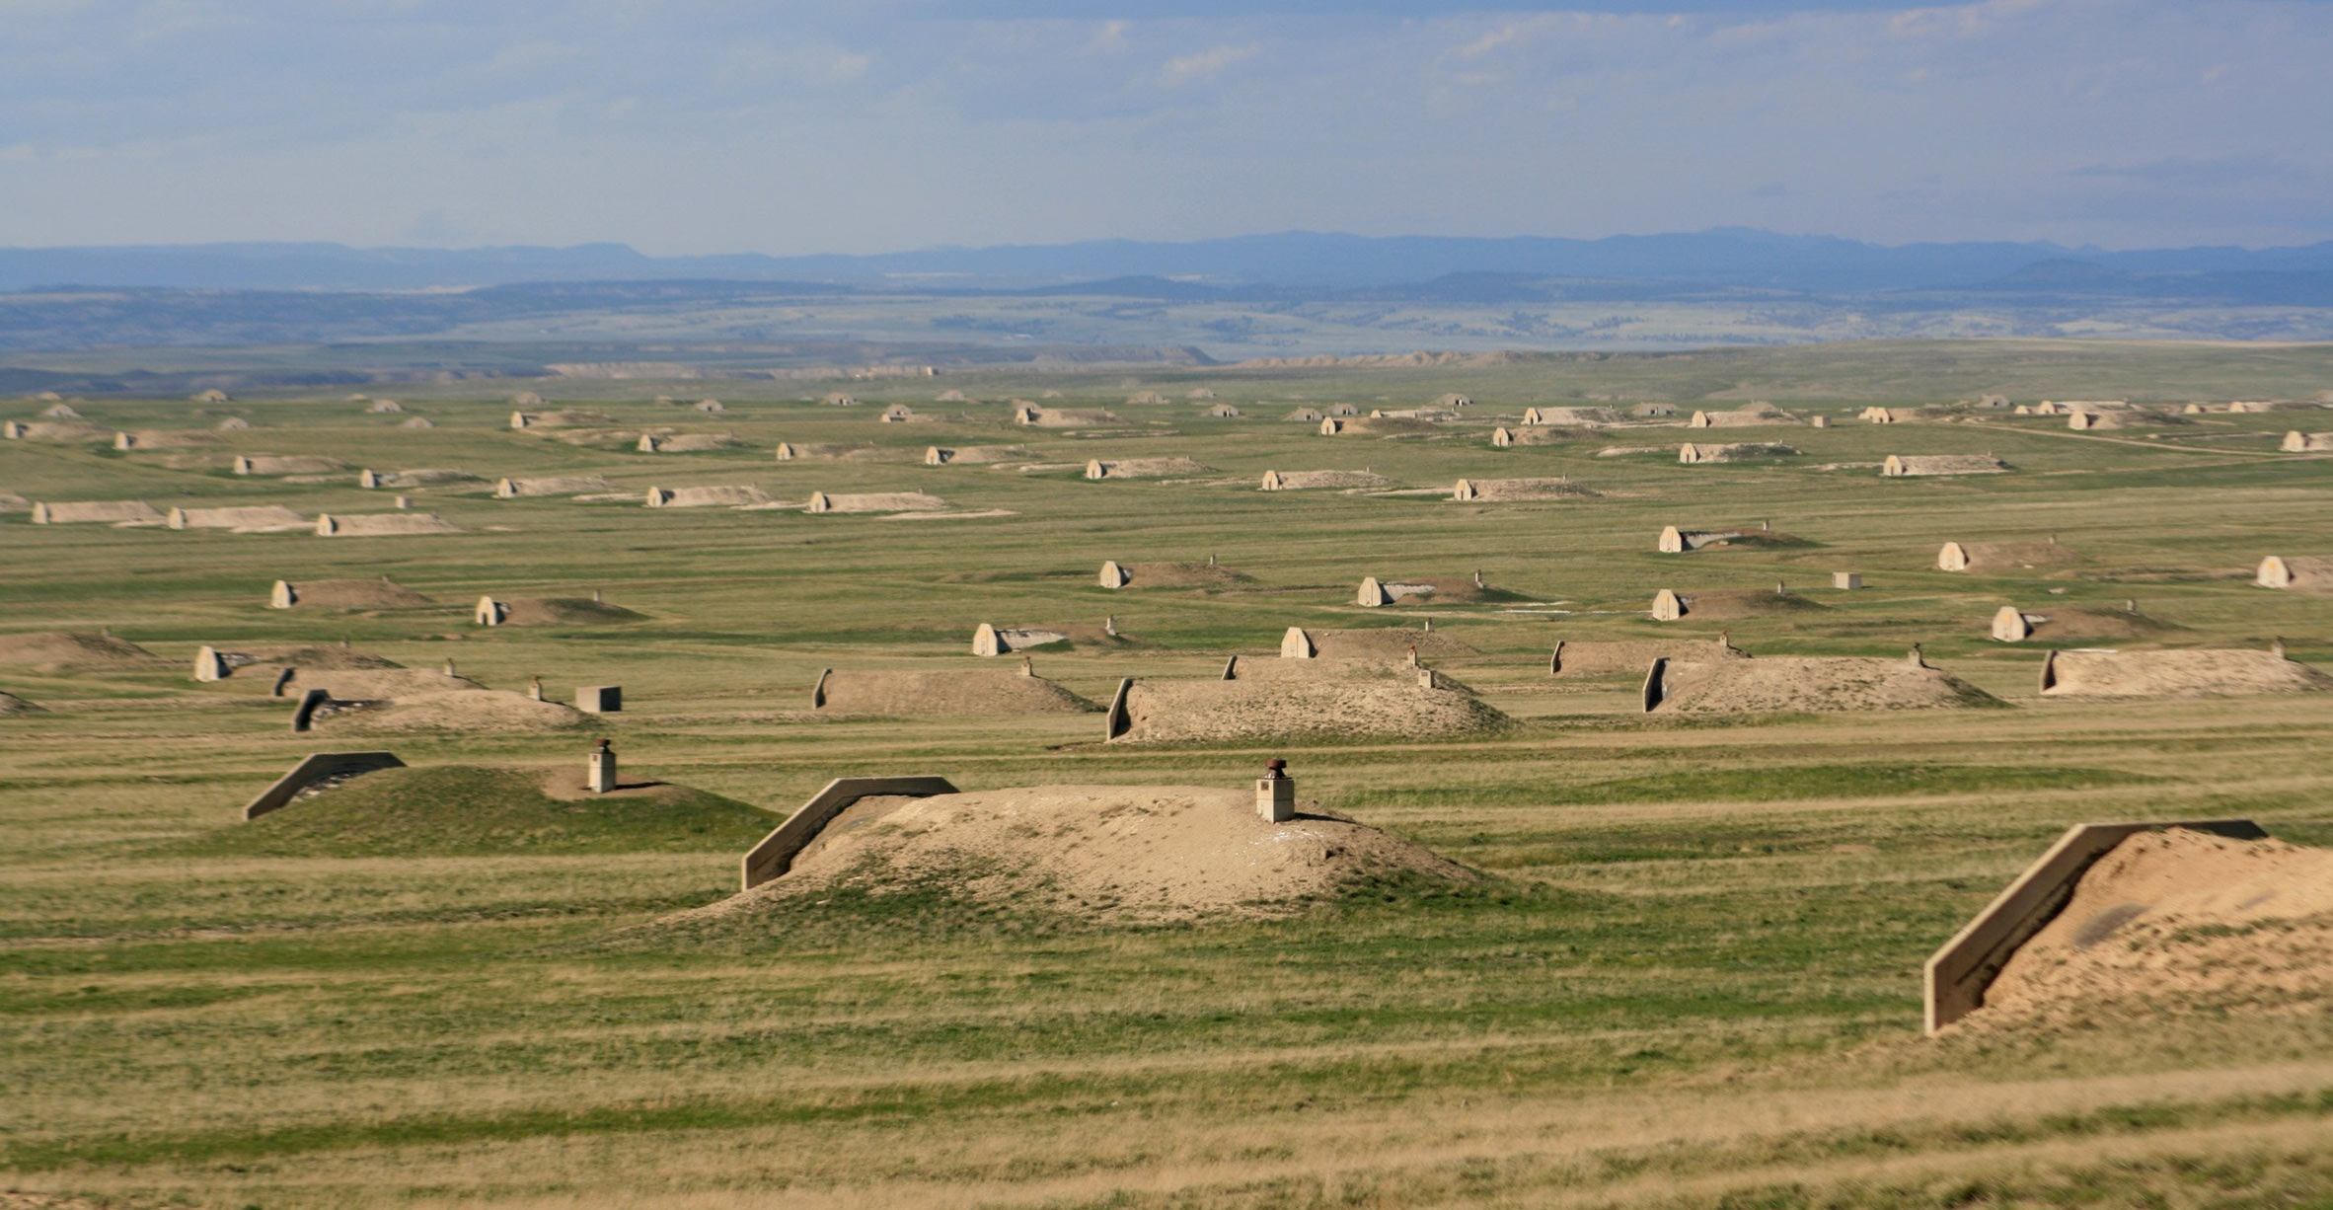
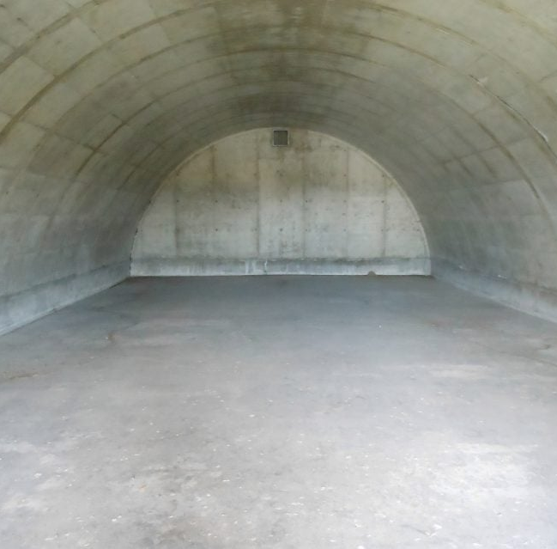
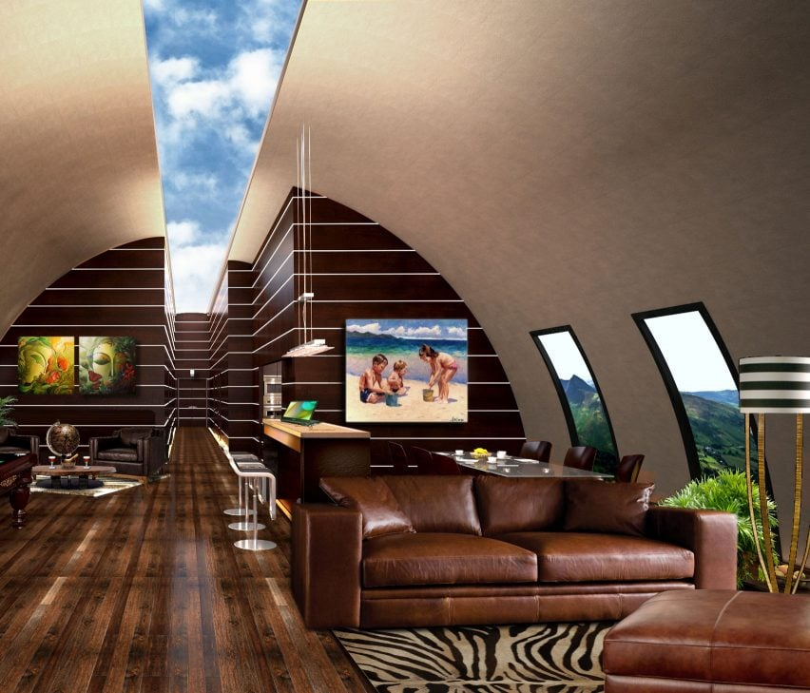
Dystopian
Bunker architecture
Bunker for hire in South Dakota
LED screens to mimic sky
https://www.dezeen.com/2017/01/11/vivos-xpoint-south-dakota-bunker-field-worlds-largest-survival-shelter-community/

Slide 6
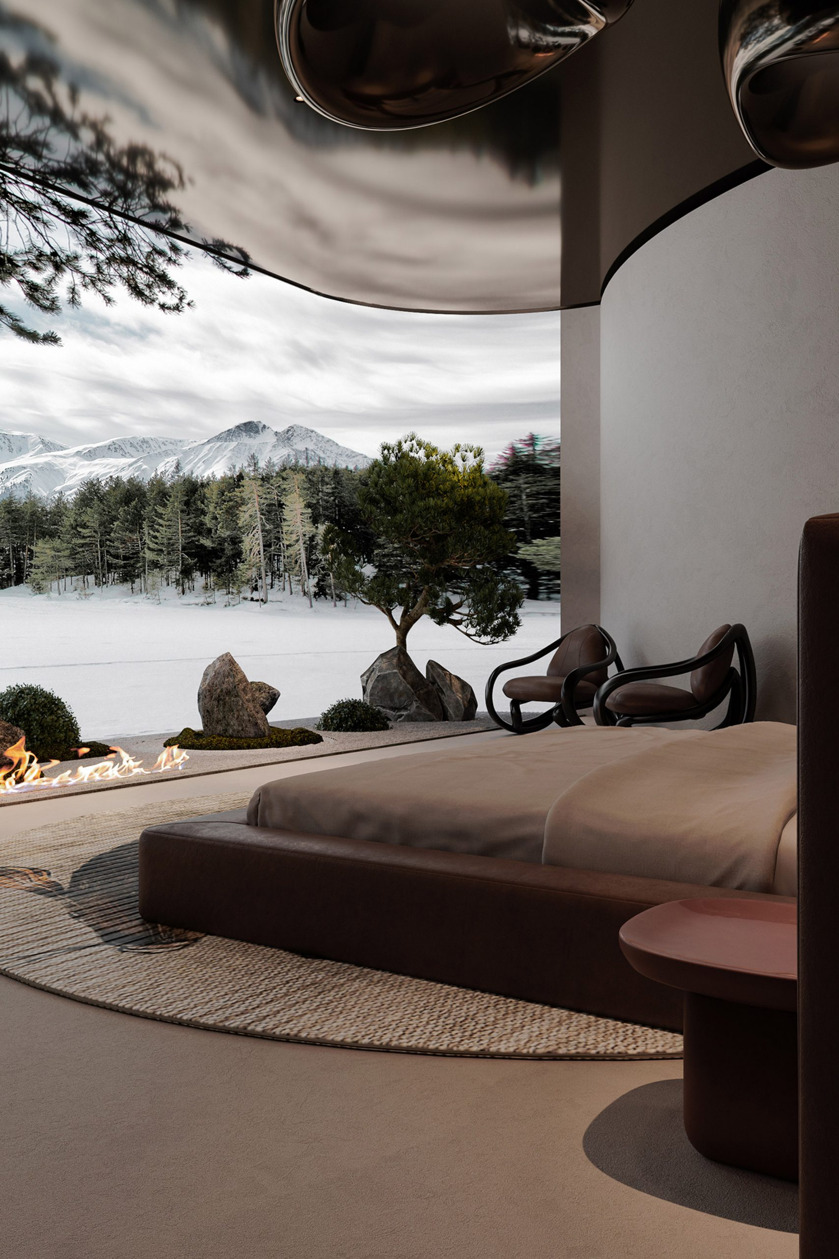
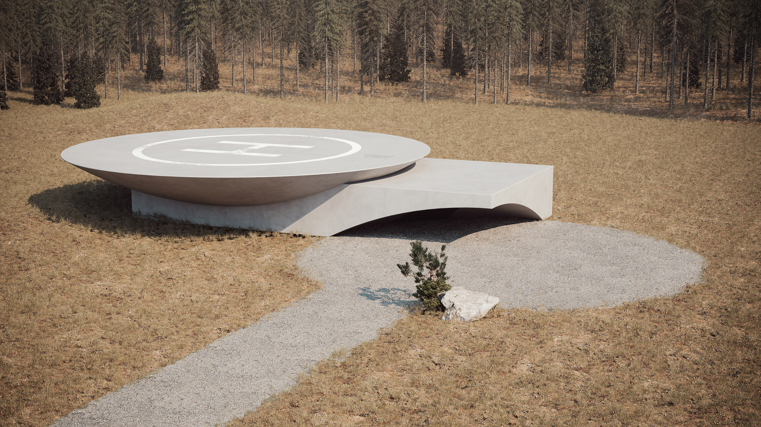
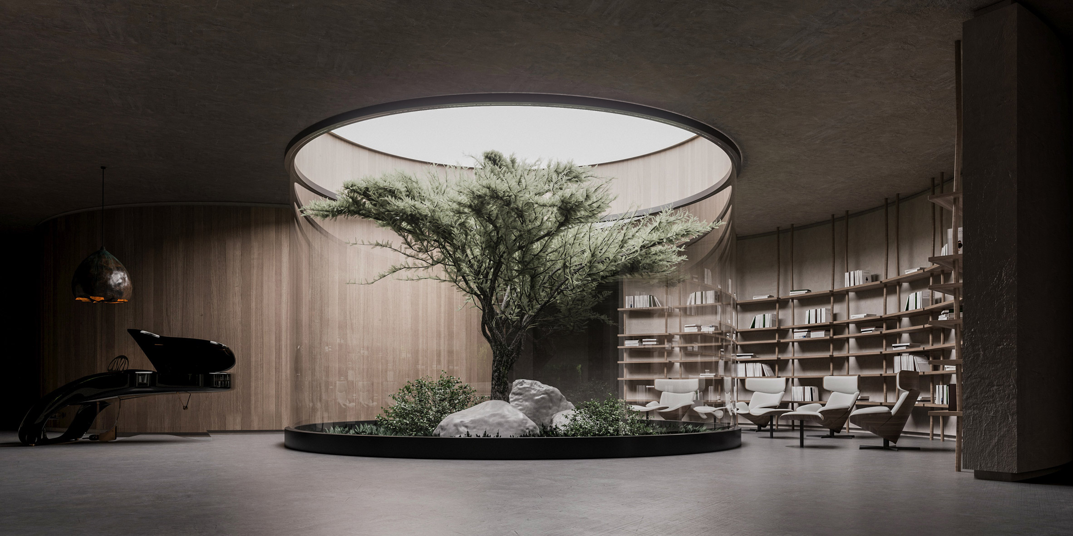
Underground House Plan B - Sergey Makhno Architects
Characteristics:
Ukraine war shelter
Playing with light, screens and (fake) greenery to create illusion of outside coming in
Round shapes, curved walls
Gray, concrete-like materials
Neutral colours, calm/pensive environment
https://www.dezeen.com/2020/07/02/underground-house-plan-b-bunker-architecture-ukraine/

Slide 7
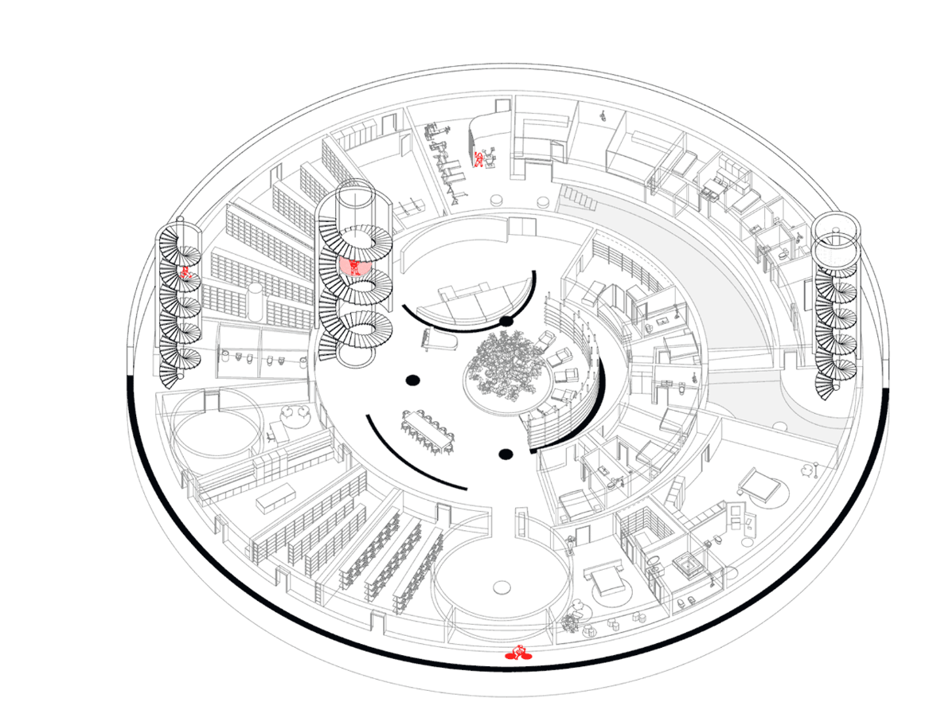
https://www.dezeen.com/2020/07/02/underground-house-plan-b-bunker-architecture-ukraine/

Slide 8
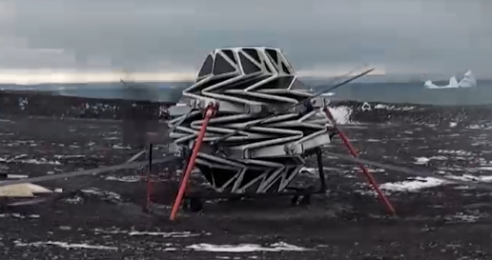
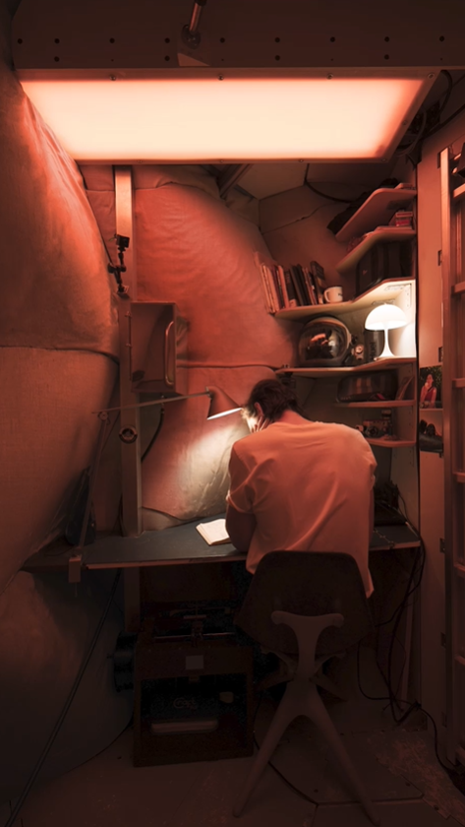
Realistic
Constraints:
Limits of materials
Development of technologies
Adapting to the environment
LUNARK
Artificial circadian light system
Solar panel façade
Expandable, lightweight module
Easy to transport
Can function to -45 degrees, tested in Greenland
Should be -175

Slide 9
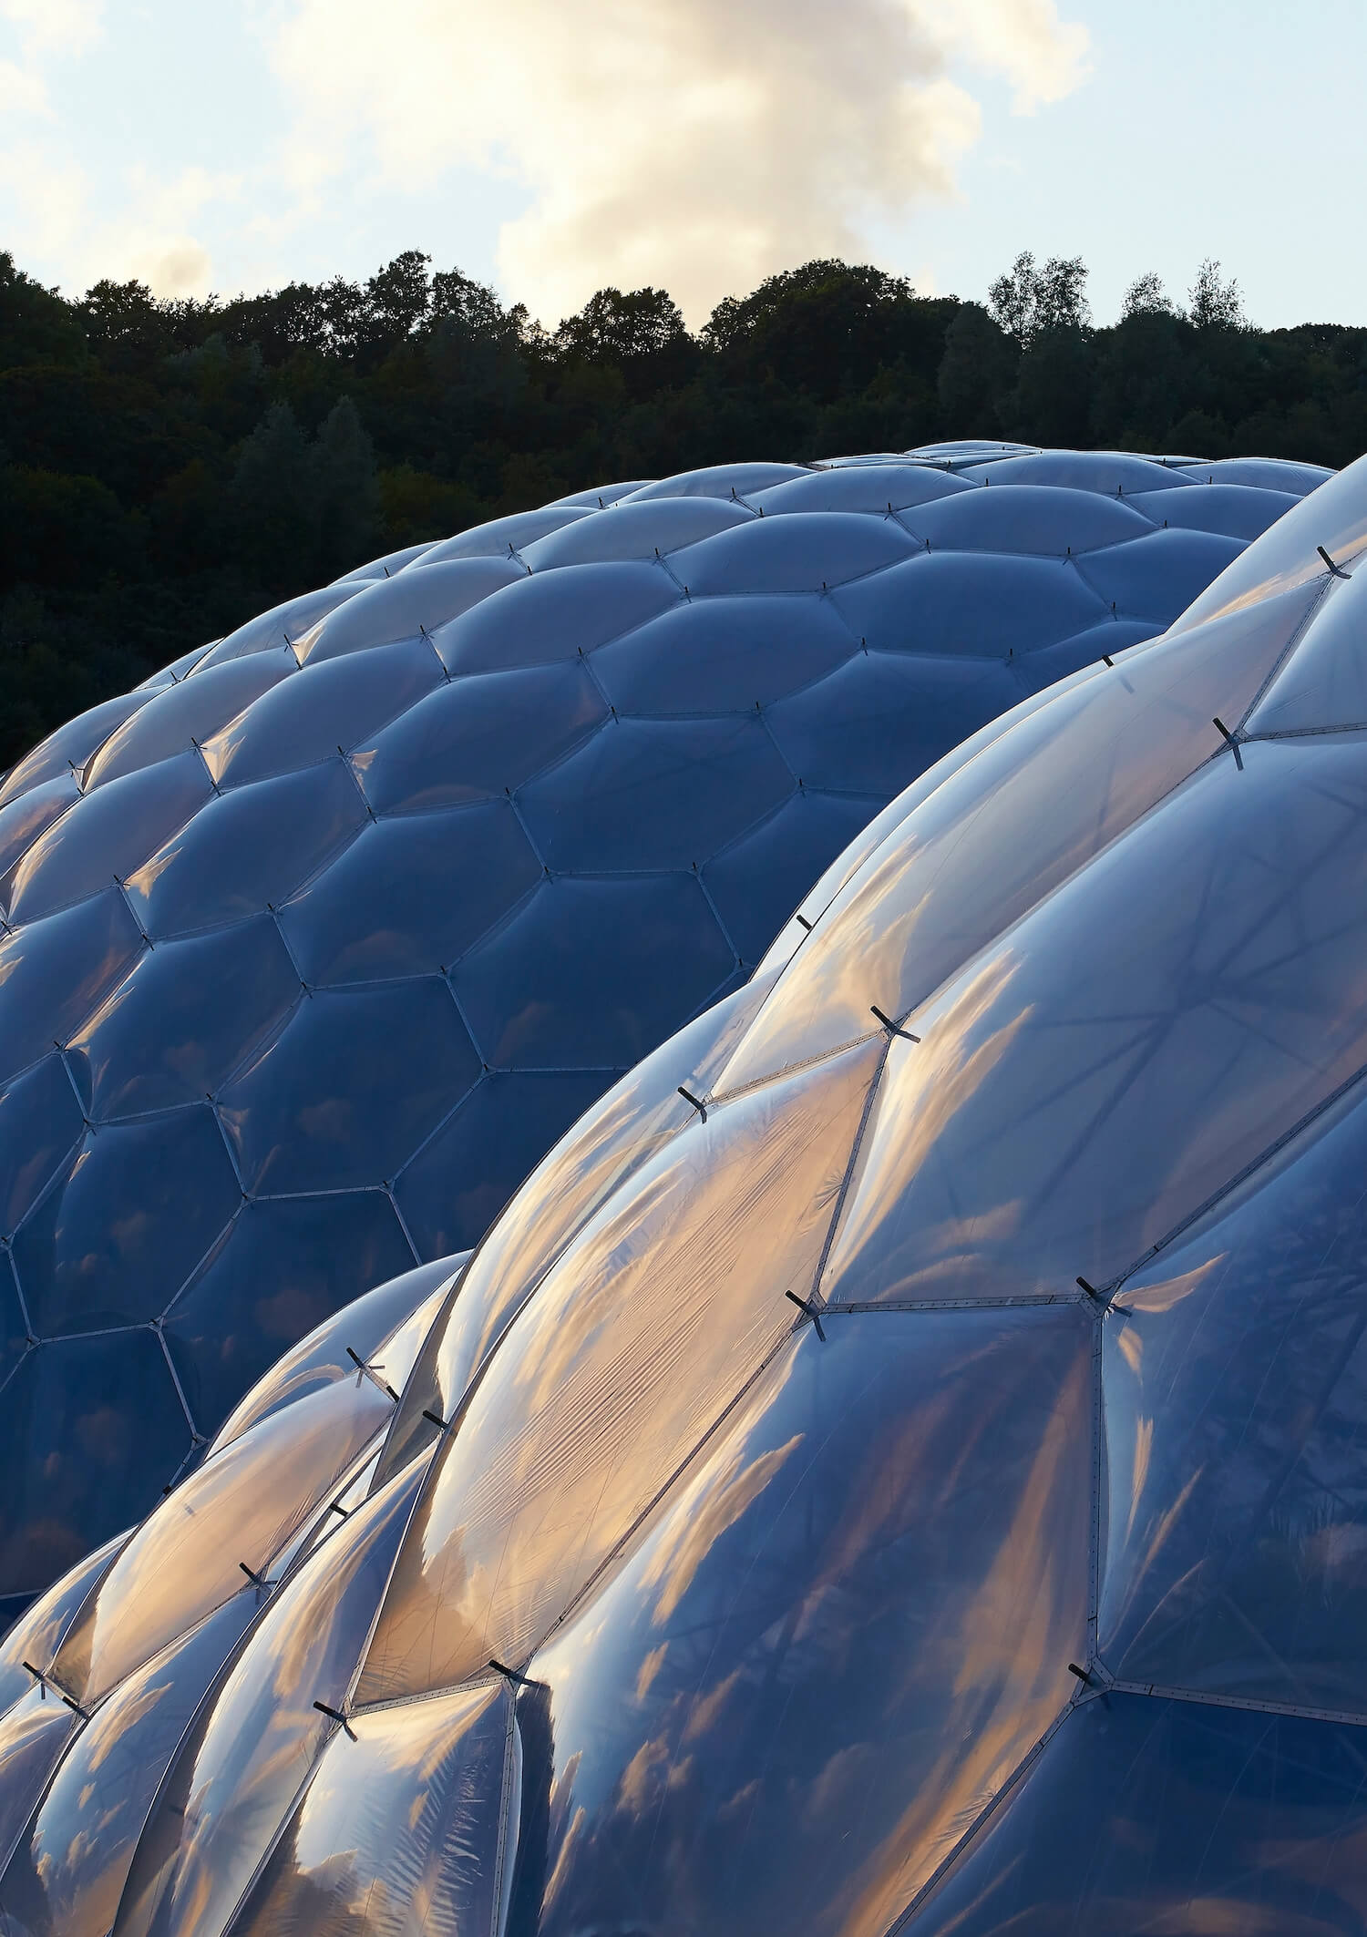
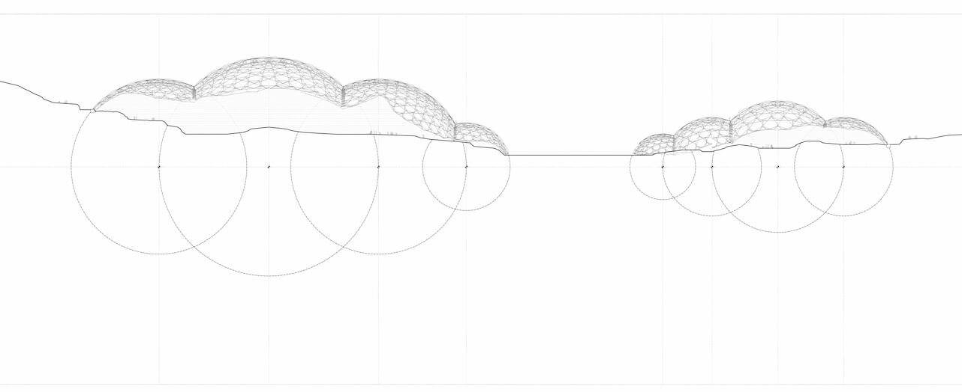
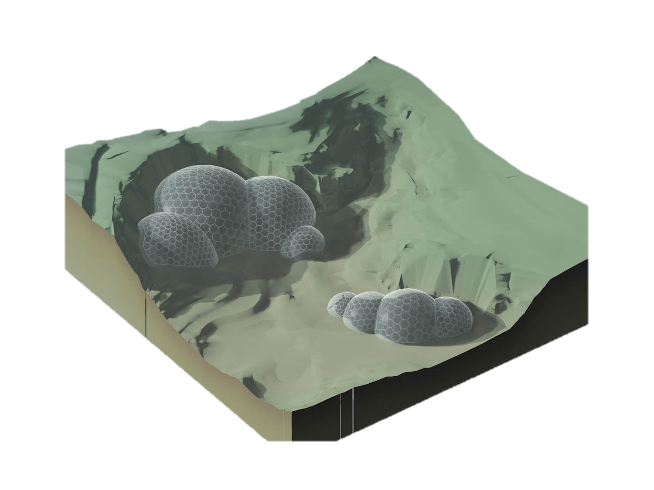
The Eden project -Nicholas Grimshaw & Partners
Points of interest:
Materials; ethylene tetra­fluoroethylene copolymer)ETFE bubble domes
Very lightweight, provide protection layer for radiation/secondaries?
Used for flexible solar panels
Resistance to chemicals, gamma radiation, UV radiation and radioactive radiation -> used in nuclear power plants
Ina Cheibas et al. – extracting metals from the regolith
Placement on uneven ground – old quarry
Bubbles adapt to rough terrain, like voronoi
https://www.edenproject.com/mission/architecture
https://amazingarchitecture.com/exhibitions/the-eden-project-in-cornwall-united-kingdom-by-grimshaw

Slide 10
Microgravity
Physiological effects of microgravity include calcium loss, fluid shifts, skeletal changes, muscle mass loss and vestibular alterations (NASA [MSIS], 1995 p. 178)
Most comfortable pose ->
Ergonomic design necessary, though no chair restraints necessary (like 0-grav)
Based on MALE body
Difficulty orientating – using markers/ colours
Häuplik-Meusburger, Sandra (2011). Architecture for Astronauts: An Activity-based Approach. SpringerWienNewYork.

Slide 11
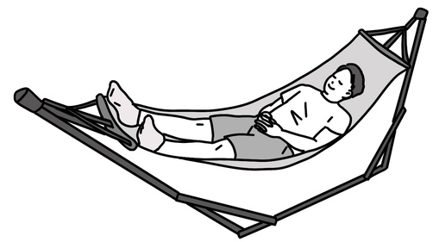
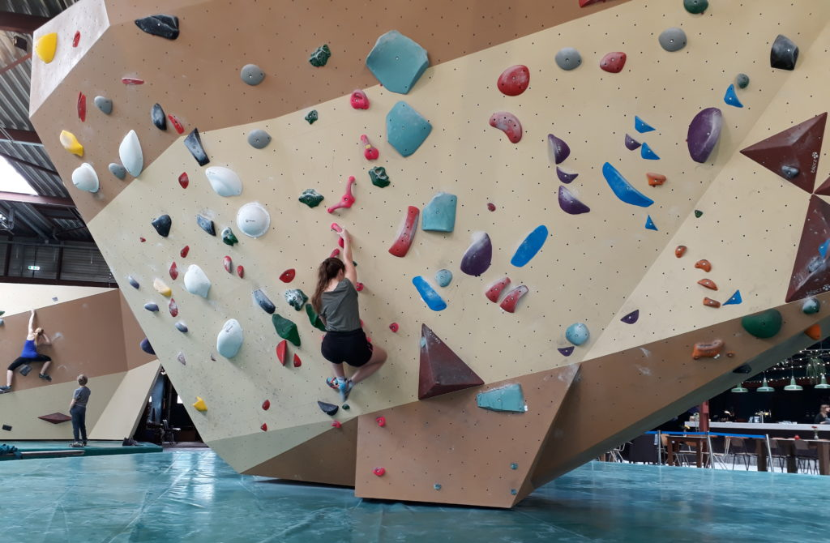
Microgravity: ideas
Sleeping in a hammocks
From experience: added in Apollo 12
Provides more comfort in microgravity
Exercise
Boulder wall?
Less heavy in microgravity (less dangerous)
Also mentally stimulating
Make them demountable and changeable, different routes

