Slide 1
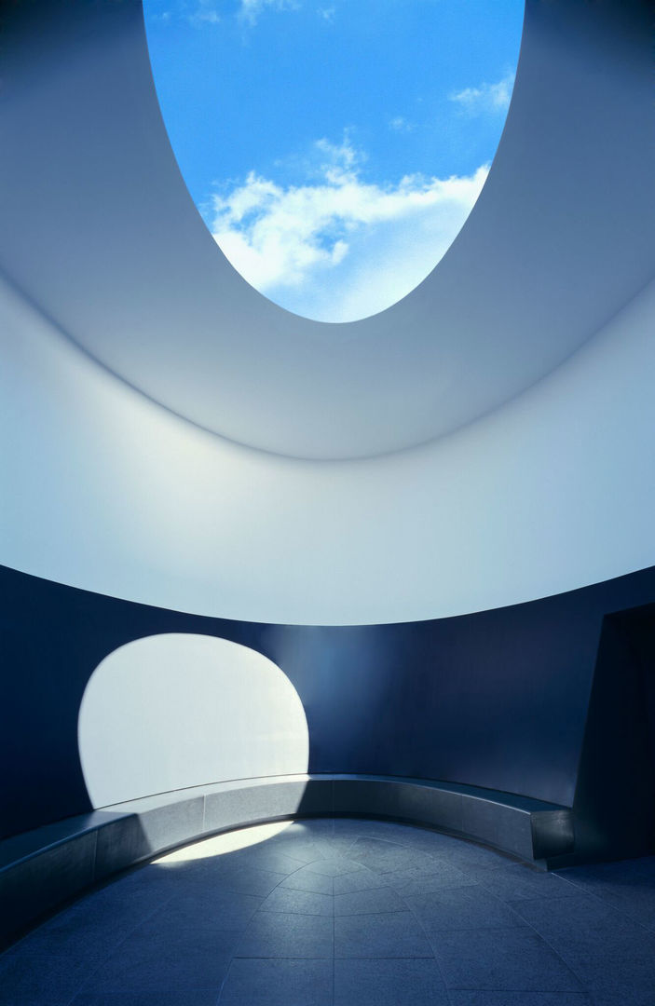
MoonSane
Designing Lunar Habitats for Improving Mental Wellness
Sophia Benfield | MoonSane | Lunar Architecture | Tutors: H. Bier & A. Hidding & F. Adema | 2024/25 | TU Delft
Notes:
Welcome everyone, my name is Sophia and today I will tell you about my project, called MoonSane. The objective is to design Lunar Habitats that are beneficial to the mental health of its inhabitants.

Slide 2
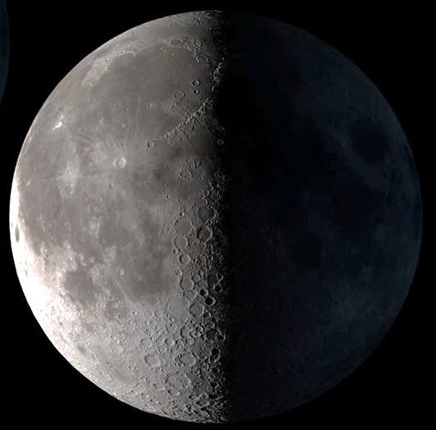
Approaching Lunar Architecture
Blank Canvas
Extreme Environment
Notes:
When approaching L A there are two sides to consider. On the one hand we have a blank canvas, providing new possibilities. On the other hand we are limited by the extremely hazardous environment.

Slide 3
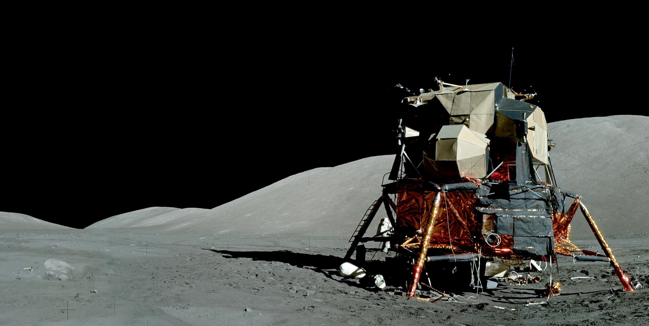
Habitat conditions
Far away from home and family
Limited social circle
Habitat is main stimulus
141:01:23 20871, 20890, and 20891 Source: NASA
Notes:
Due to the dangerous surface conditions, astronauts will be mainly confined to the moonbase. This confinement can also cause psychological distress. Looking at logbooks of astronauts, the main concerns are of a social nature: being away from family and the small crew rotation.
They also mention the importance of the habitat interior. Any negative stimuli have a great impact, increasing the feeling of isolation.

Slide 4
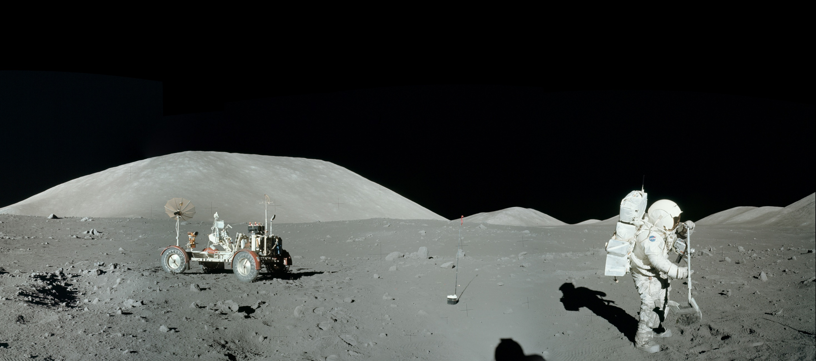
Views
4
AS17-136-20411-20425 Source: NASA
Notes:
No comfort can be found in the surface view, it’s like a black and white photograph. An alien landscape. The apollo 11 crew also remarked that the horizon is closer, because the moon is smaller that Earth, adding to the claustrophobic feeling.

Slide 5
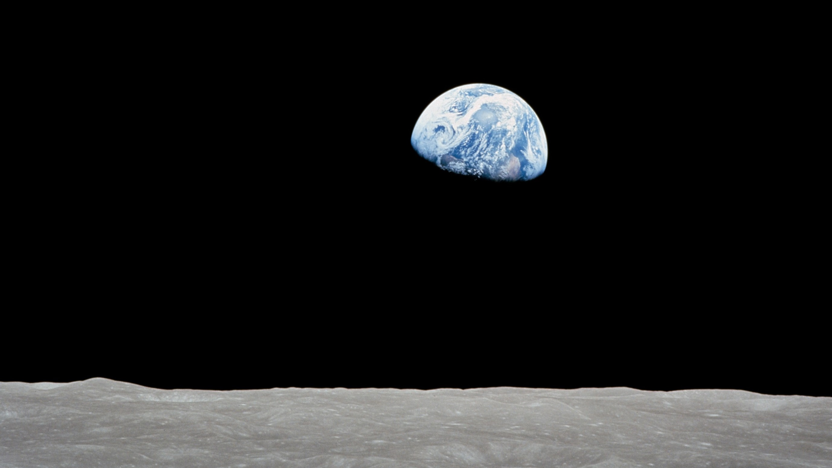
5
AS17-138-21063 (OF300) Source: NASA
Notes:
The only solace comes from the view of Earth in the sky, creating a connection to home and adding colour in beautiful shades of blue.

Slide 6
Research question
How can human spatial perception be used in the design of Lunar habitats, to mitigate the negative mental health effects of living long-term on the moon?
6
Sophia Benfield | MoonSane | Lunar Architecture | Tutors: H. Bier & A. Hidding & F. Adema | 2024/25 | TU Delft
Notes:
So my aim is to design a Lunar habitat that improves the mental health of astronauts, with my research question being:

Slide 7
Scope of habitat solutions
Lighting:
Allowing the passage of sunlight*
Habitat day/night cycles
Improved environmental lighting
Stimulating senses:
Improved colours of environment
Reduced noise levels
Variations in habitat environmental factors
Comfortable air temp/ humidity
Nature/plants included on station
Crew interaction:
Private quarters
Views:
Views of the habitat from the windows
More observation windows
Direct views of earth
Logan M. Smith, “The psychology and mental health of the spaceflight environment: A scoping review.” Acta Astronautica 201, 2022, 496-512, ISSN 0094-5765, https://doi.org/10.1016/j.actaastro.2022.09.054.
7
Sophia Benfield | MoonSane | Lunar Architecture | Tutors: H. Bier & A. Hidding & F. Adema | 2024/25 | TU Delft
Notes:
In a scoping review of suggested space habitat improvements, the solutions given in literature can be divided in four categories. Notable ones are ….

Slide 8
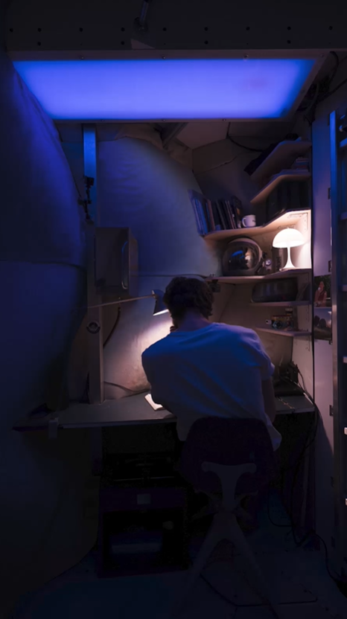
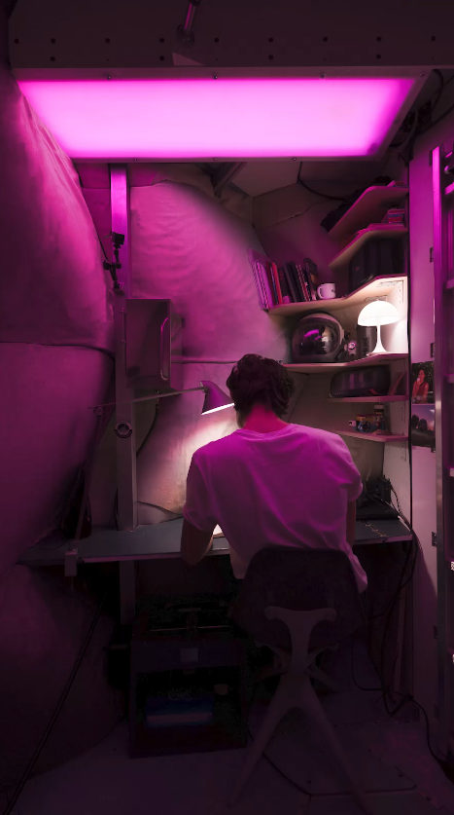
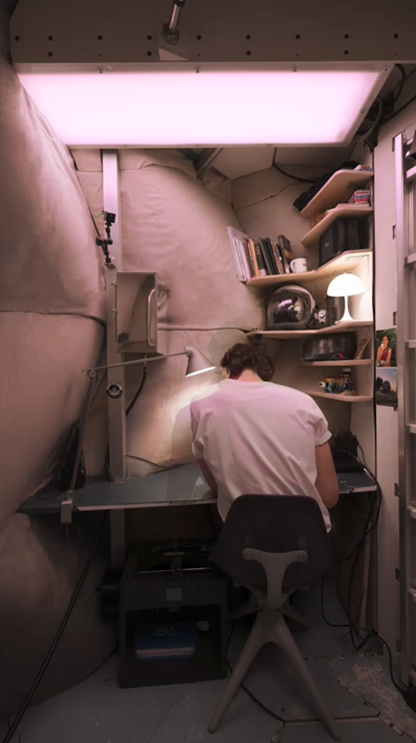
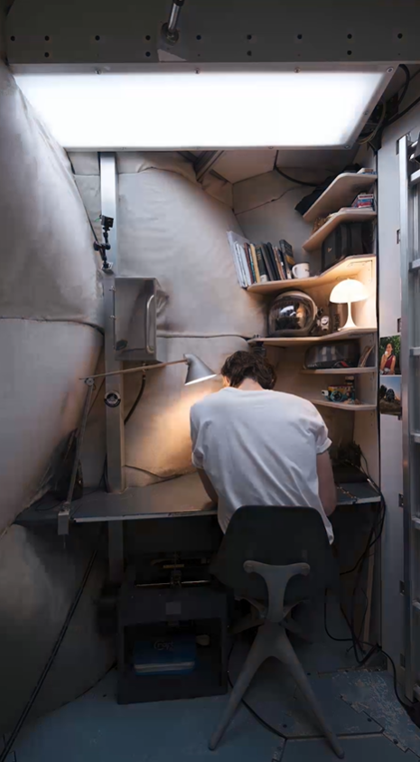
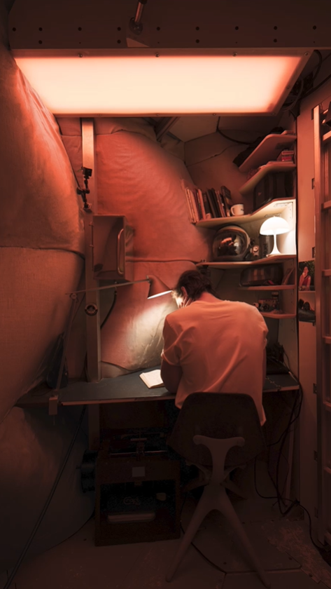
Light
Experiment: circadian rhythm lamps in the LUNARK module
  “Waking up to a sunrise inside our sleeping pods was an incredible natural feeling”
  Stationary
https://www.saga.dk/projects/lunark/circadian
8
Sophia Benfield | MoonSane | Lunar Architecture | Tutors: H. Bier & A. Hidding & F. Adema | 2024/25 | TU Delft
Notes:
As a solution for the lighting this LUNARK project is a good example how to create a more varied lighting system. The participants found it very successful but this project is still stationary. It would be interesting to make it a dynamic system, with light direction changing like the sun moving across the sky for time-of-day orientation.

Slide 9


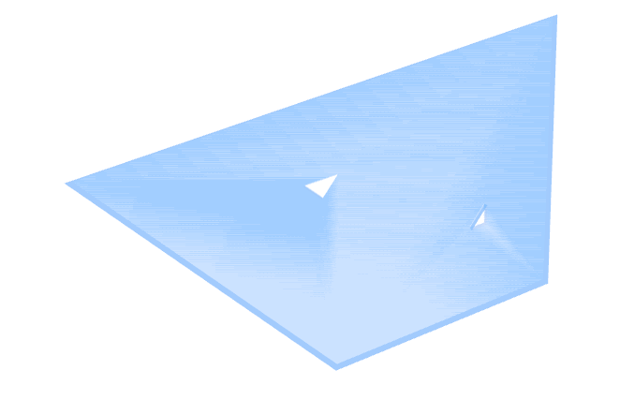
Spatial enclosure
Enclosed spaces
  increase stress
  trigger avoidance
  Locomotive vs visual permeability
Enclosure is judged by visual permeability
Vartanian, O., Navarrete, G., Chatterjee, A., Fich, L. B., Gonzalez-Mora, J. L., Leder, H., ... & Skov, M. (2015). Architectural design and the brain: Effects of ceiling height and perceived enclosure on beauty judgments and approach-avoidance decisions. Journal of environmental psychology, 41, 10-18.
9
Sophia Benfield | MoonSane | Lunar Architecture | Tutors: H. Bier & A. Hidding & F. Adema | 2024/25 | TU Delft
Notes:
With respect to variations in visual stimuli I looked into characteristics of architectural spaces that affect the human psychological state. First is spatial enclosure. Research shows that more enclosed spaces increase stress and makes people want to leave. How enclosed a space is is judged by how much and how far a person can see through a space; this is called visual permeability.

Slide 10
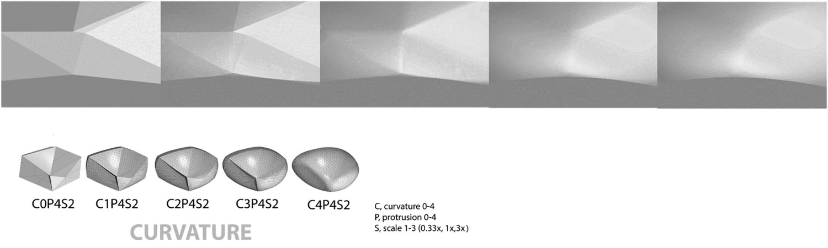
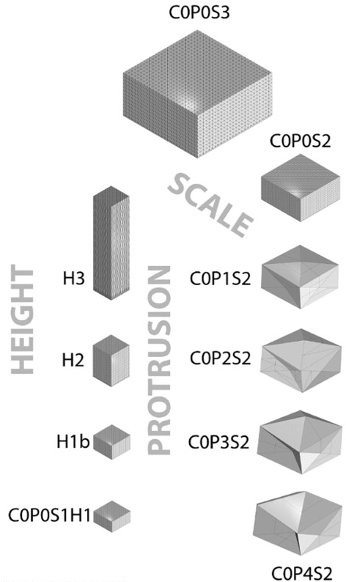
Spatial geometry
Study using VR
EEG, eye-tracking
Various rooms, different shapes
  Symmetric vs asymmetric
  Proportion
Asymmetric, angular spaces
  High pupil dilation- positive interest
  The more protrusion, the better
Shemesh, A., Leisman, G., Bar, M., & Grobman, Y. J. (2021). A neurocognitive study of the emotional impact of geometrical criteria of architectural space. Architectural Science Review, 64(4), 394–407. https://doi-org.tudelft.idm.oclc.org/10.1080/00038628.2021.1940827
10
Sophia Benfield | MoonSane | Lunar Architecture | Tutors: H. Bier & A. Hidding & F. Adema | 2024/25 | TU Delft
Notes:
I also investigated spatial geometry and how it impacts the viewer emotionally. This experiment using VR had subjects walk into differently shaped spaces and measured their reaction.
The results showed asymmetric spaces piqued the viewers interest, also the more protruding the shapes were, the more mentally engaged they were.

Slide 11
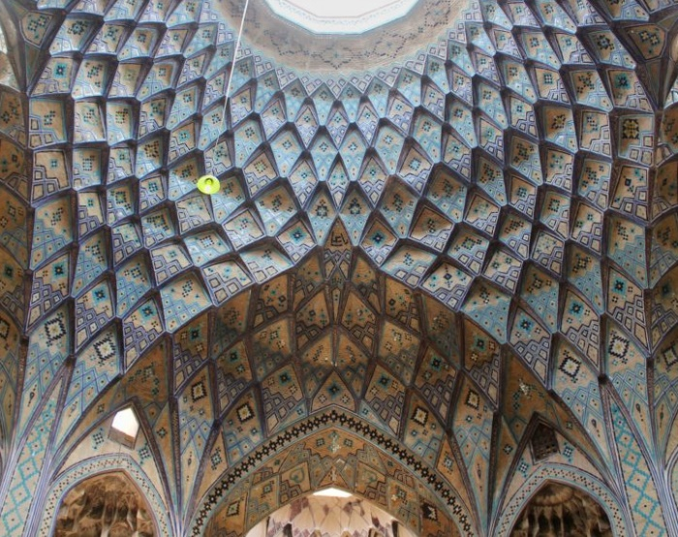
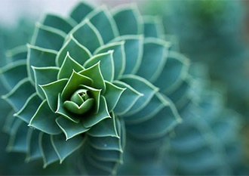
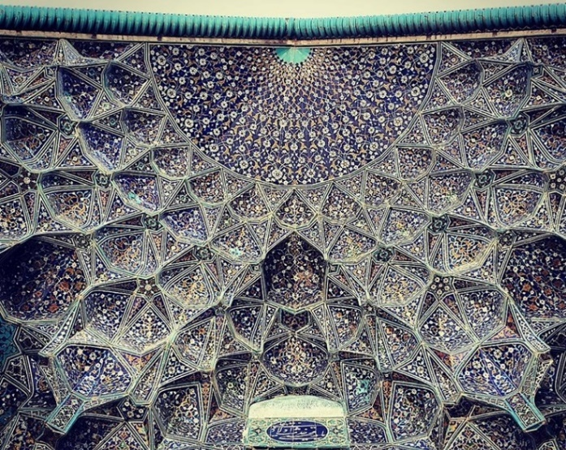
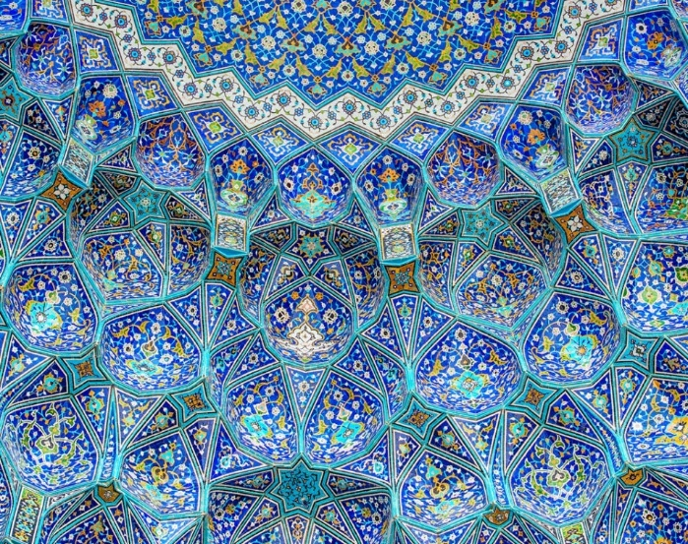

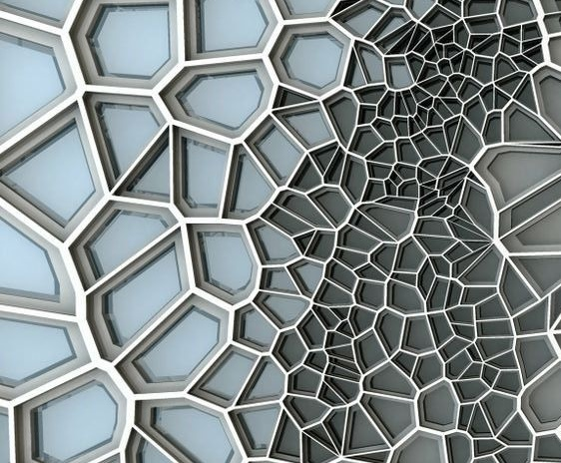
Natural geometry: fractal patterns
Repeating shapes
  Calming effect
  Hidden in nature: biophilia
  Dynamic: light shimmer
Voronoi
Abboushi, B., Elzeyadi, I., Taylor, R., & Sereno, M. (2019). Fractals in architecture: The visual interest, preference, and mood response to projected fractal light patterns in interior spaces. Journal of Environmental Psychology, 61, 57-70.
11
Sophia Benfield | MoonSane | Lunar Architecture | Tutors: H. Bier & A. Hidding & F. Adema | 2024/25 | TU Delft
Notes:
Looking into geometry and psychology, I came across fractal patterns, as found in nature. They are made up of the same shape repeating in decreasing scales. They provide a path for the brain to follow, inducing a form of hypnosis that calms down the mind and body. A particular pattern that is notable is called Voronoi, a point based pattern that creates asymmetric facetted cells that fit together seamlessly. This can perhaps be used to create the asymmetric spatial geometry that is required.

Slide 12
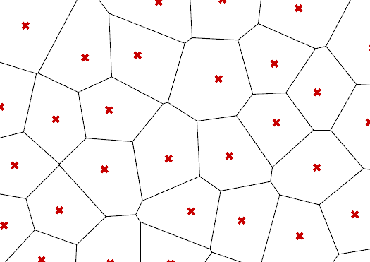
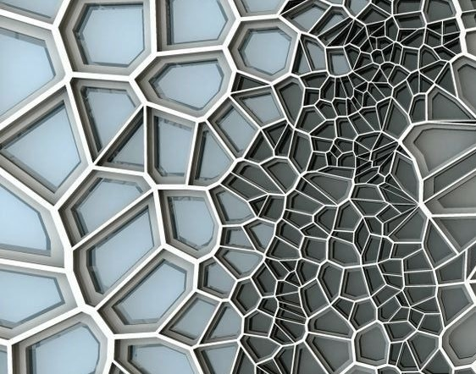
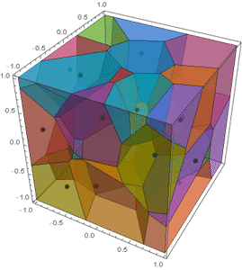
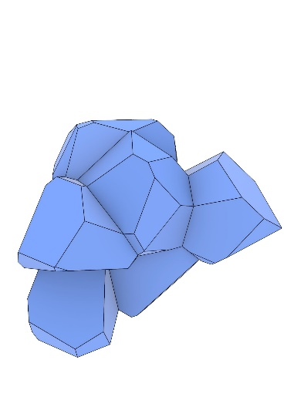
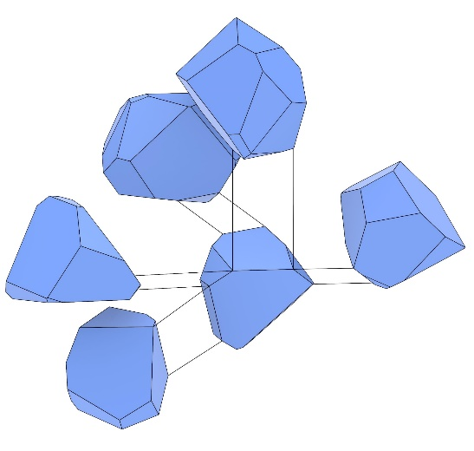
Natural geometry: Voronoi
Voronoi
  Point based pattern found in nature
  Scalable cells 2D or 3D
  Facetted geometry
Seamless fit
Adjustable density and scale
Extra-terrestrial form language
12
Sophia Benfield | MoonSane | Lunar Architecture | Tutors: H. Bier & A. Hidding & F. Adema | 2024/25 | TU Delft
Notes:
Looking into geometry and psychology, I came across fractal patterns, as found in nature. They are made up of the same shape repeating in decreasing scales. They provide a path for the brain to follow, inducing a form of hypnosis that calms down the mind and body. A particular pattern that is notable is called Voronoi, a point based pattern that creates asymmetric facetted cells that fit together seamlessly. This can perhaps be used to create the asymmetric spatial geometry that is required.

Slide 13
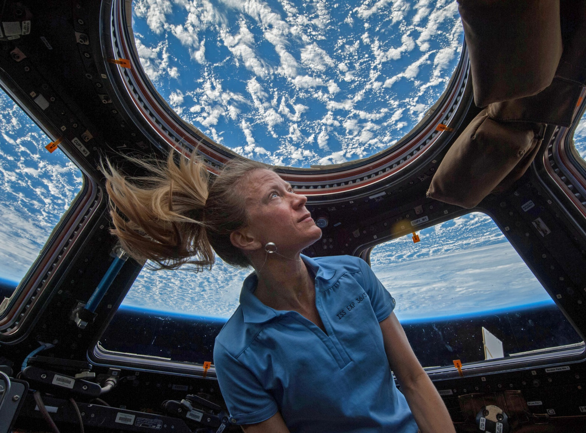
The Overview Effect
Phenomenon of astronauts who view Earth from space
Awe-inducing
  Increased empathy and sense of purpose
  Decrease in stress hormones
Nezami, A., Persaud, L. M., & White, F. (2021). The overview effect and well-being. In Expanding worldviews: astrobiology, Big history and cosmic perspectives (pp. 163-197). Cham: Springer International Publishing.
NASA
13
Sophia Benfield | MoonSane | Lunar Architecture | Tutors: H. Bier & A. Hidding & F. Adema | 2024/25 | TU Delft
Notes:
Adding more viewports to a habitat is preferred by astronauts because it reduces feelings of confinement. Permeability, remember? The earth view is most important because it facilitates a phenomenon called the Overview effect. When astronauts view earth from space it causes an intense emotional reaction that inhibits the fight-or-flight system.

Slide 14
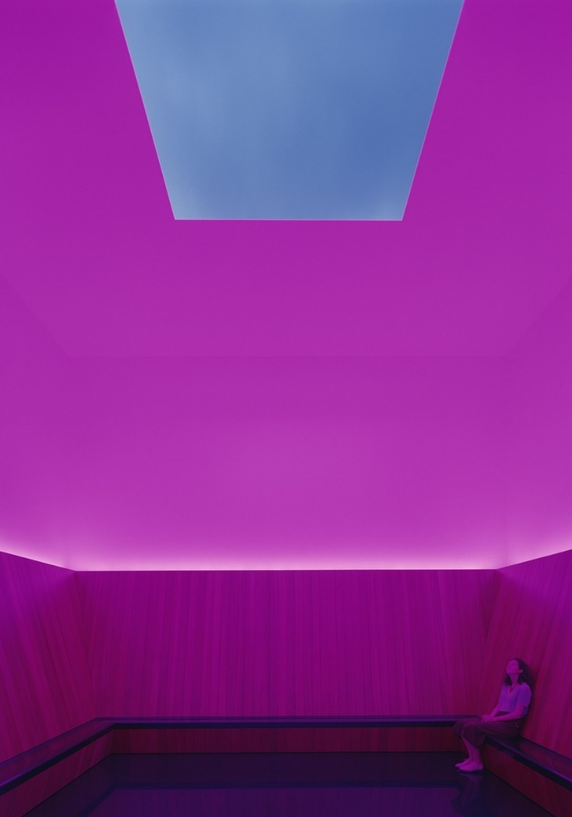
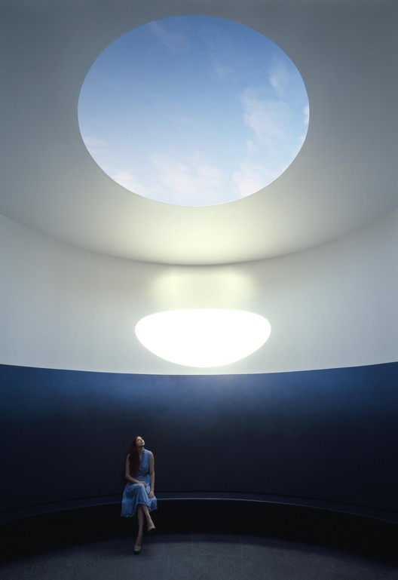
Earth gazing & “Skyspace”
James Turrell – “Skyspace”
looking upwards – positive effect
Earth view incorporated?
Mood lighting added to increase experience (based on mood of astronaut?)
14
Sophia Benfield | MoonSane | Lunar Architecture | Tutors: H. Bier & A. Hidding & F. Adema | 2024/25 | TU Delft
Notes:
It reminded me of an art installation I visited last year, called skyspace. It is a room with a skylight where you sit in silence looking at the sky, while the mood light changes around you. I would like to introduce such a reflection space to a habitat and combine it with the view of Earth, instead of the sky.

Slide 15
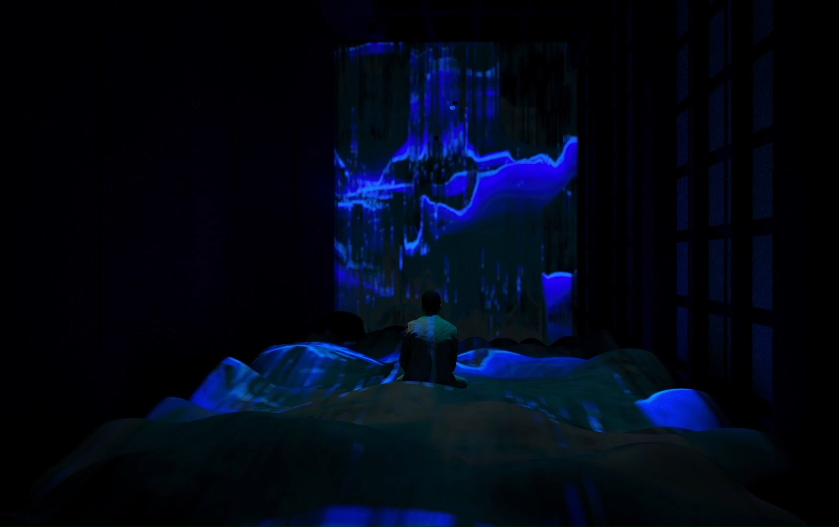
Colour projection
“EMO”- Xiying Bao
AI technology: facial recognition
Changes colours and shapes based on perceived emotion
Adaptive system monitors wellbeing of crew members
  influence/transform emotions as well?
https://designawards.core77.com/Interaction/104584/Emo.html
https://studentawards.mediaarchitecture.org/mab/project/11
15
Sophia Benfield | MoonSane | Lunar Architecture | Tutors: H. Bier & A. Hidding & F. Adema | 2024/25 | TU Delft
Notes:
Such a space would be even more powerful if the colours change according to the mood of the astronaut, just like this project meant to visualise emotions after the mental strain of the pandemic. Using facial recognition software, the visitor’s emotion is identified and visualised. I would like to take it a step further, with the visuals being used to transform the feeling of the astronaut for the better.

Slide 16
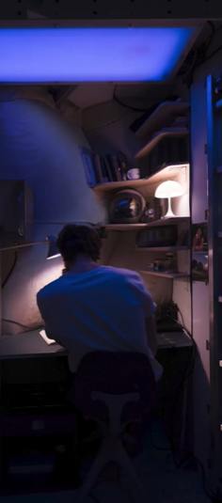
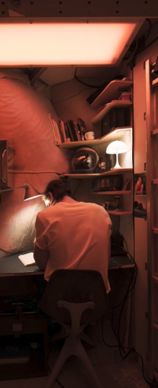
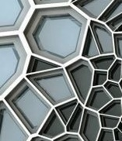
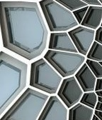
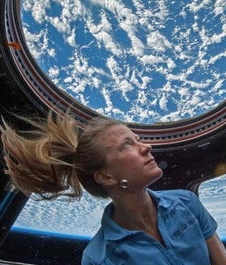
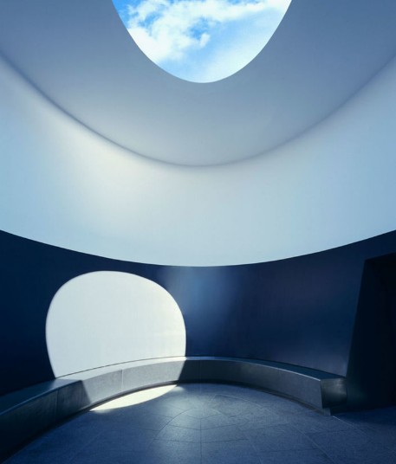
Concept
Concept
Designing a Lunar habitat that promotes mental wellness of the crew
16
Sophia Benfield | MoonSane | Lunar Architecture | Tutors: H. Bier & A. Hidding & F. Adema | 2024/25 | TU Delft
Notes:
To summarise, I propose to design a Lunar habitat that improves mental wellness by combining a dynamic lighting system with spatial geometry and both inside as outside views. I also propose to add a meditation space combining the overview effect with mood lighting, where crew members can find peace of mind.

