Slide 1
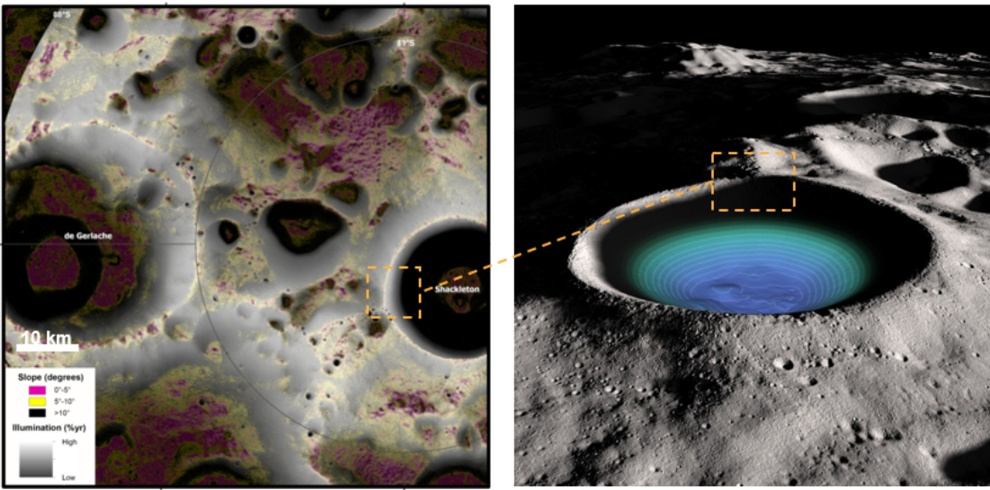

Slide 2
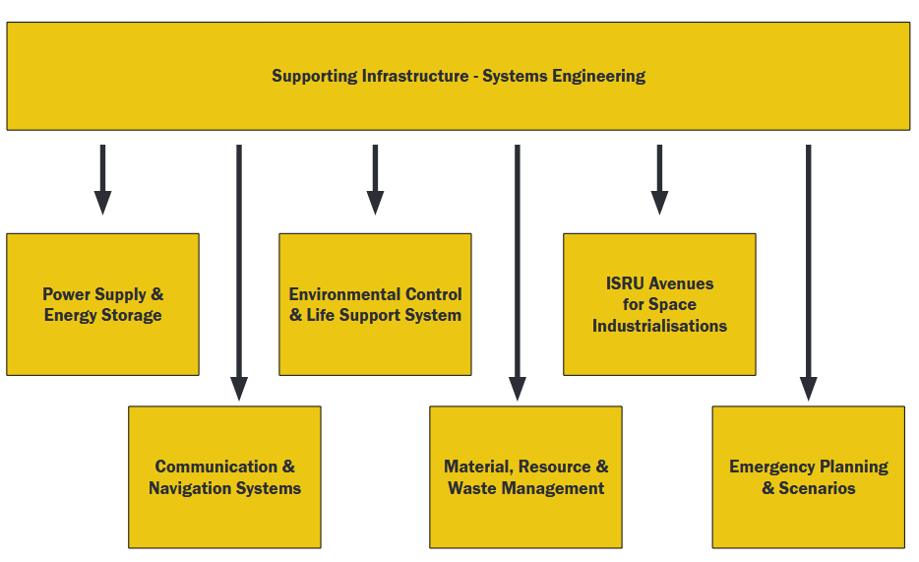
DESIGN OF A SCALABLE FRAMEWORK OF LUNAR HABITATS

Slide 3
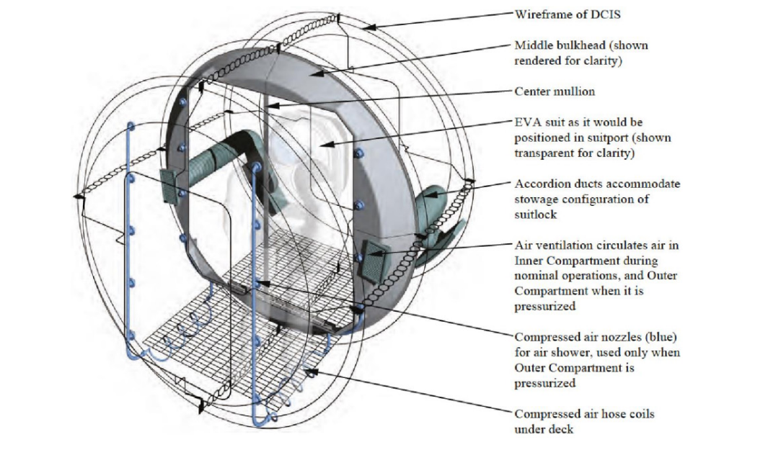

Slide 4
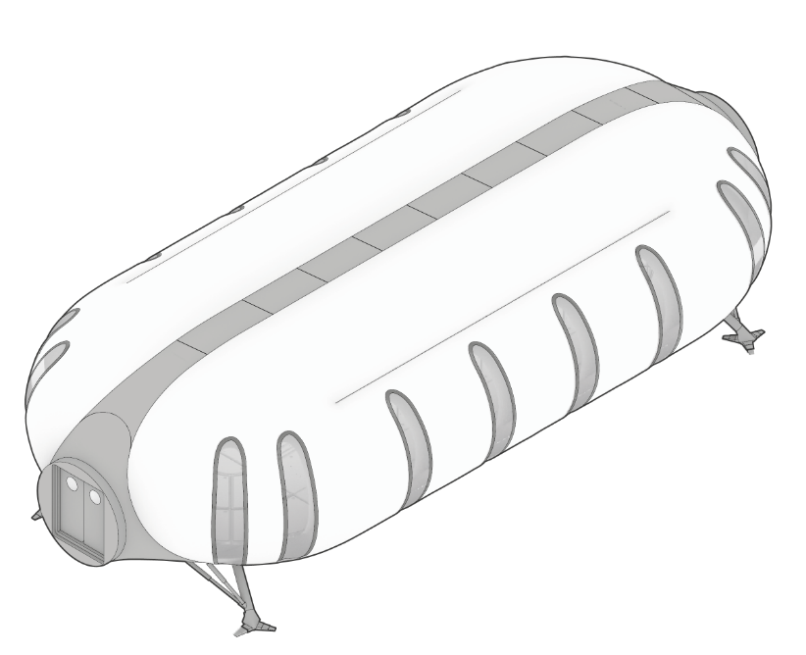

Slide 5
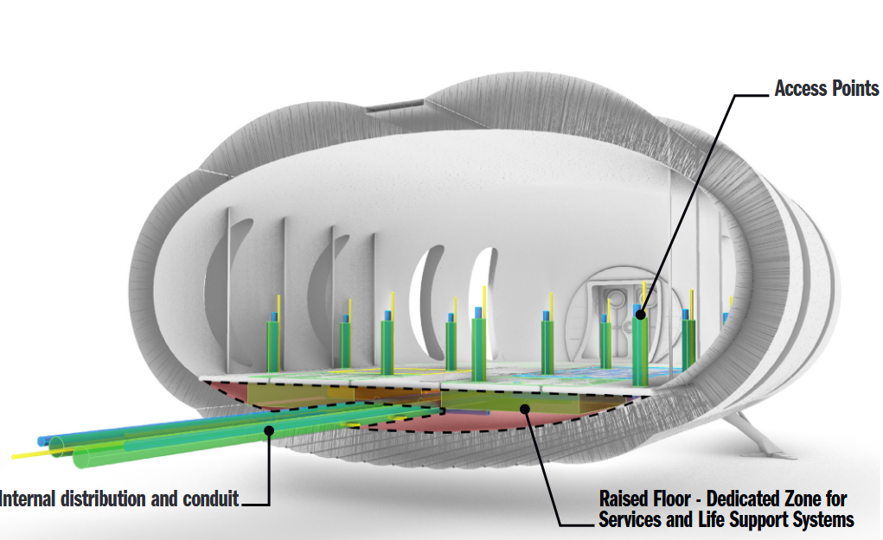

Slide 6
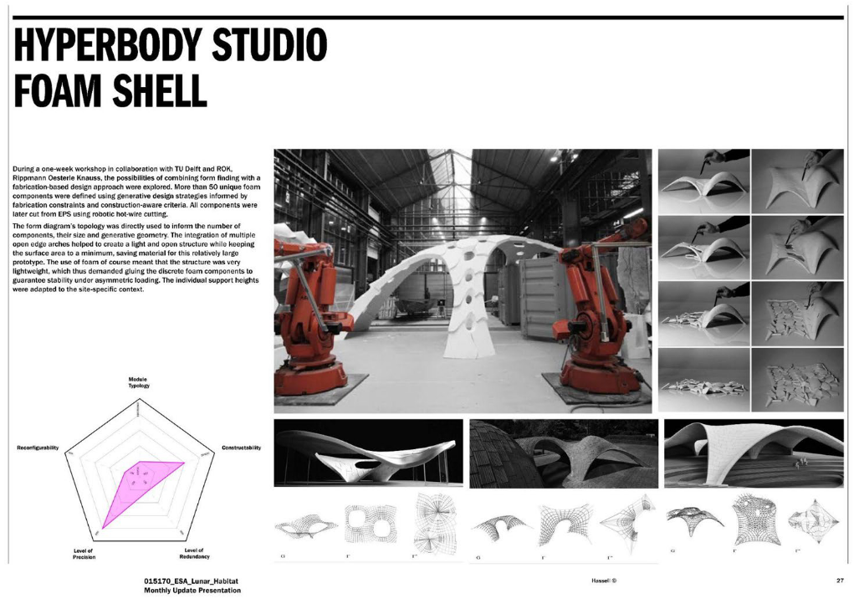

Slide 7
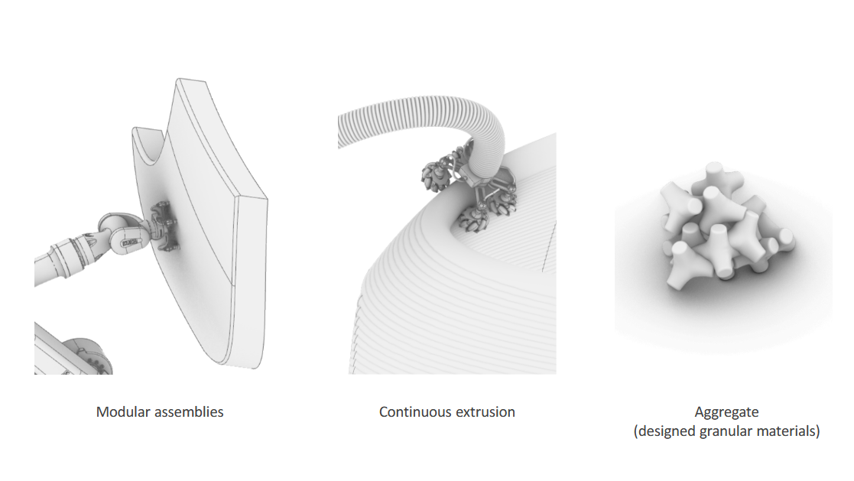

Slide 8
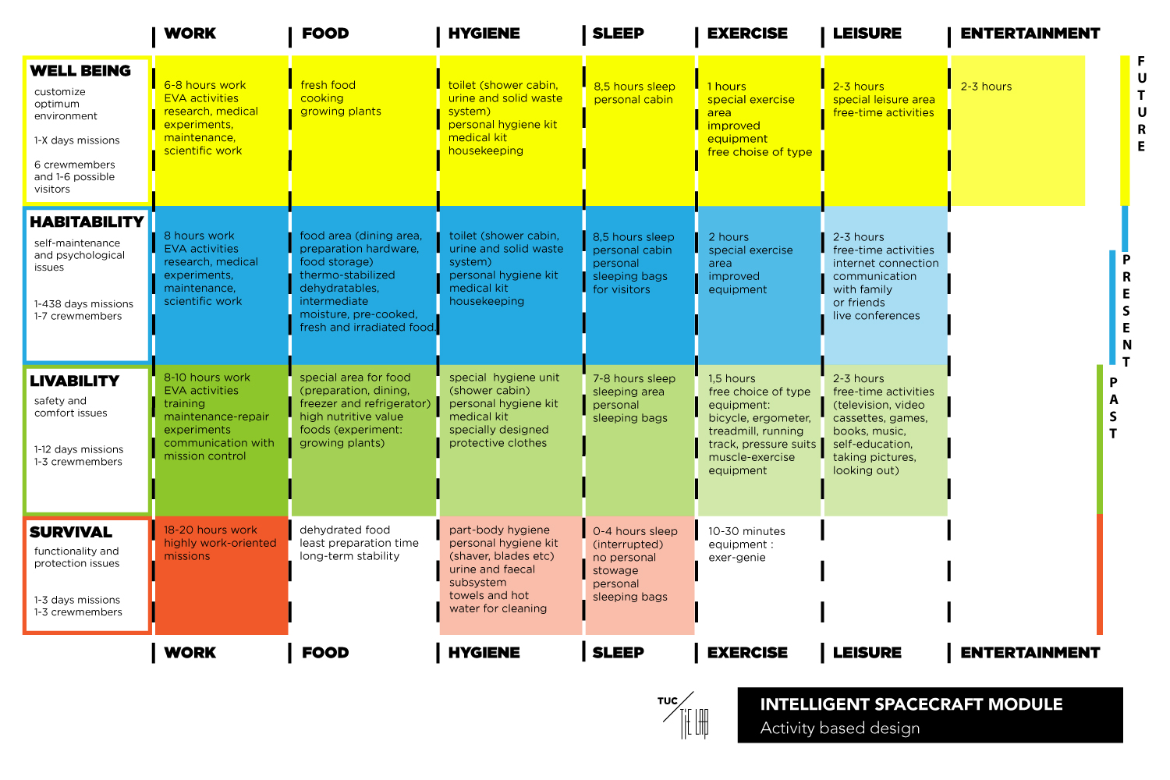
How can we play on the moon?

Slide 9
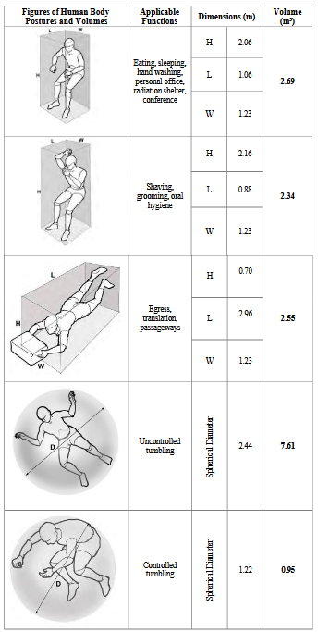
How can we play on the moon?

Slide 10
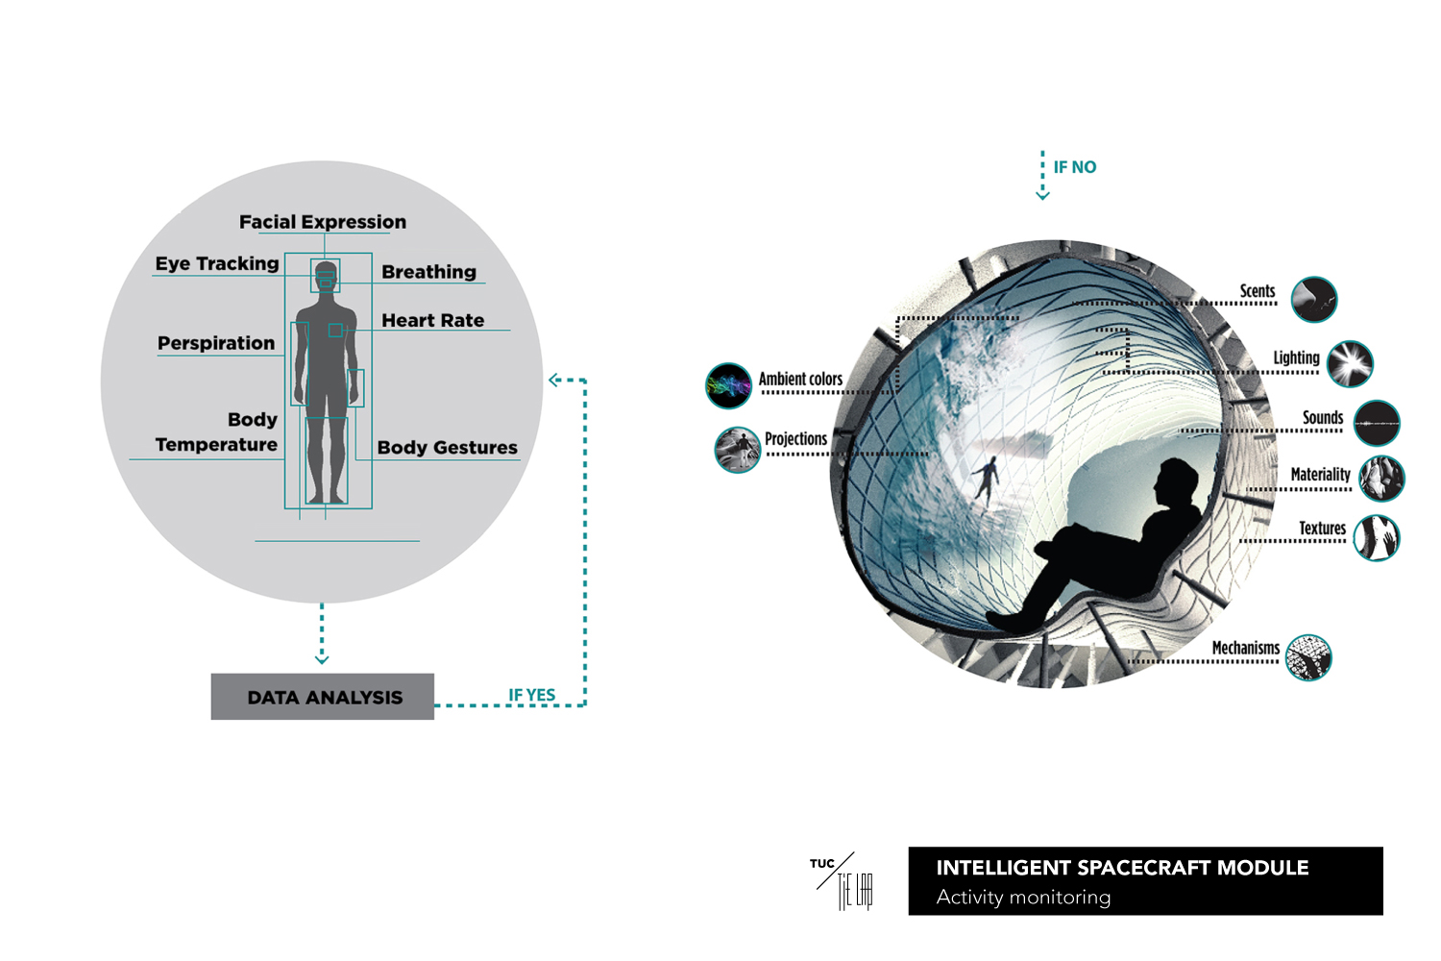
Sensponsive architecture

Slide 11
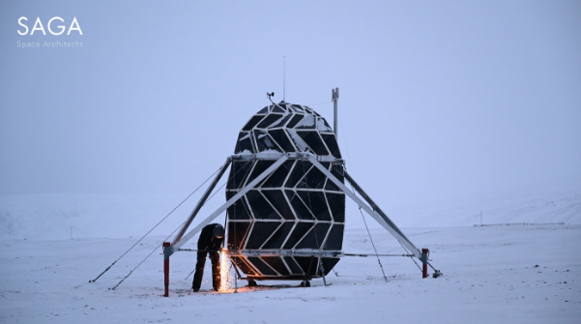
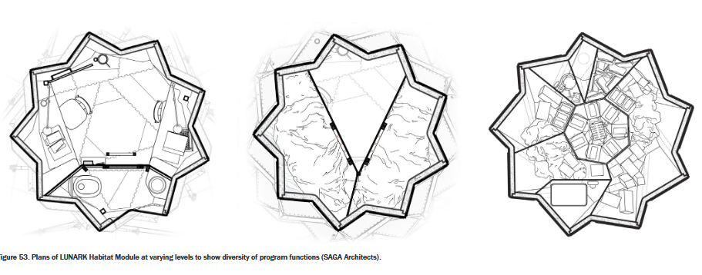
Sensponsive architecture

Slide 12
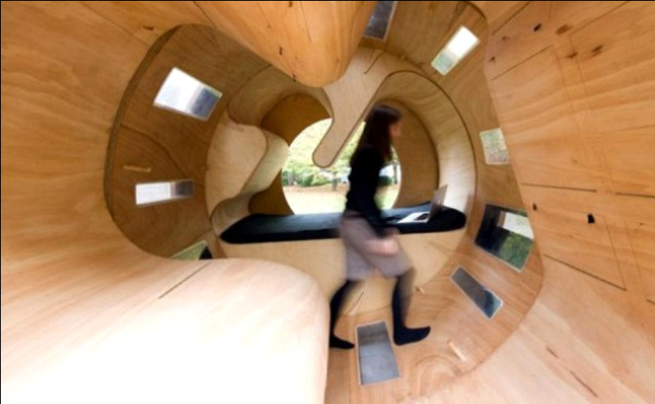
Sensponsive architecture

Slide 13
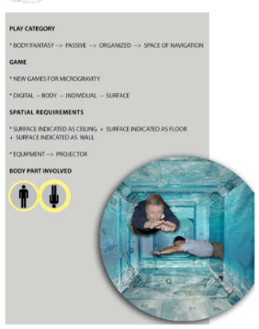
Light trigger the game

Slide 14
I want to design a lunar habitat that is itself a robot—capable of automatically changing its shape and adjusting its spaces according to human needs, especially leisure activity

Slide 15
1. Large-area diffuse panel lighting
Larger luminous surfaces = softer and safer illumination
Point light sources (bare LEDs) must be avoided or shielded
Harsh point sources increase glare, visual discomfort, and spatial disorientation
Interior lighting should rely on wide-area diffuse panels, not exposed point LEDs.
2. Indirect lighting via reflective surfaces
Light should not be aimed directly into the eyes
Reflected light from ceilings and walls provides more natural distribution
Indirect lighting reduces glare and improves uniformity
The primary illumination should be indirect, using reflective surfaces to bounce light into the space.
3. Use of diffusers and holographic diffusers
Diffusers are essential to create uniform, glare-free illumination
Holographic diffusers allow precise beam shaping
Diffusion layers help hide the LED and eliminate hotspots
Interior luminaires should integrate diffusion layers, especially holographic diffusers, to produce soft, even light.
4. Glare avoidance is a critical requirement
Glare is one of the most dangerous visual problems in space
Bare LEDs or direct beams must be avoided
Light sources must be shielded, recessed, or diffused
All fixtures must be designed to eliminate direct-glare conditions and hide bright points of light.
5. Minimization of shadows
NASA points out:
Strong shadows interfere with task performance and safety
Large-area lighting and indirect lighting reduce shadow contrast
Uniform illumination is essential in microgravity environments
👉 Conclusion: Lighting should be designed to produce soft, minimal shadows, supporting safe daily operations.
6. Thermal management through lighting design
In the space environment:
No air convection → heat must be radiated or conducted
Large luminous surfaces dissipate heat more efficiently
Point sources with high power density are less safe
👉 Conclusion: Large-area fixtures are preferred for better thermal stability and reliability.
7. Optimized placement of luminaires
NASA notes that:
Lighting should be positioned according to task zones
Beam direction must support crew activities and visual tasks
Light distribution should be tested through environmental simulation
👉 Conclusion: Interior lighting must follow a strategic layout, not simple ceiling placement.
⭐ One-sentence summary (perfect for your presentation):
NASA recommends using large-area diffuse lighting, indirect illumination, diffuser-based fixtures, glare-free optics, and minimal-shadow layouts to ensure safe, comfortable, and psychologically supportive interior environments for long-duration space habitats.

Slide 16
5. Minimization of shadows
Strong shadows interfere with task performance and safety
Large-area lighting and indirect lighting reduce shadow contrast
Uniform illumination is essential in microgravity environments
Lighting should be designed to produce soft, minimal shadows, supporting safe daily operations.
6. Thermal management through lighting design
No air convection → heat must be radiated or conducted
Large luminous surfaces dissipate heat more efficiently
Point sources with high power density are less safe
Large-area fixtures are preferred for better thermal stability and reliability.
7. Optimized placement of luminaires
Lighting should be positioned according to task zones
Beam direction must support crew activities and visual tasks
Light distribution should be tested through environmental simulation
Interior lighting must follow a strategic layout, not simple ceiling placement.

Slide 17
1. Visual Monotony is a Major Psychological Stressor
Long-duration missions expose crew to monotonous, unchanging environments.
Lack of colour and visual variation increases stress, anxiety, irritability, and emotional fatigue.
Antarctica, submarine, and space analogs all show similar negative effects.
2. Multicolour Lighting Reduces Stress and Anxiety
Participants under multicolour lighting reported lower anxiety, more positive mood, and less emotional decline.
Colour changes every few hours generated novelty, engagement, and pleasant surprise.
White-light (control) group showed continuous increase in stress, peaking on Day 4.
3. Colour Influences Emotions and Cognitive States Differently
Blue light → increases alertness, cognitive focus
Warm/yellow light → promotes relaxation and emotional comfort
Red light → helps visual recovery but can feel uncomfortable
Colour variety combats sensory deprivation and supports psychological resilience.

Slide 18
4. Multicolour Lighting Supports Mental Health in Confinement
Changes in colour helped reduce loneliness, visual fatigue, and boredom.
Participants perceived coloured lighting as a “care package”—similar to receiving emotional support from Earth.
Colour transitions improved emotional stability across 7-day confinement.
5. Practical Design Implications for Space Habitats
Interior lighting should not stay white and static.
Use slow colour cycles (every 2–4 hours) to maintain novelty without overstimulation.
Different room types should use different colour palettes depending on activity.
Combine with circadian lighting systems for full psychological support.

Slide 19
Morning (06:00–09:00)
Illuminance: 100–300 lux (soft light)
Color Temperature: 3000–4000K
Low blue-light content to allow gentle wake-up
Daytime Work Period (09:00–17:00)
Illuminance: 500–1000 lux
Color Temperature: 5000–6500K
Melanopic EDI: ≥ 250 lux (supports circadian alignment)
High blue-light ratio to promote alertness and cognitive performance
Evening (17:00–20:00)
Illuminance: 50–200 lux
Color Temperature: 2700–3500K
Reduced blue-light to help melatonin recovery
Night (20:00–06:00)
Illuminance: < 30 lux
Color Temperature: < 2000K (amber/red light)
Blue-light should be minimized or eliminated

Slide 20
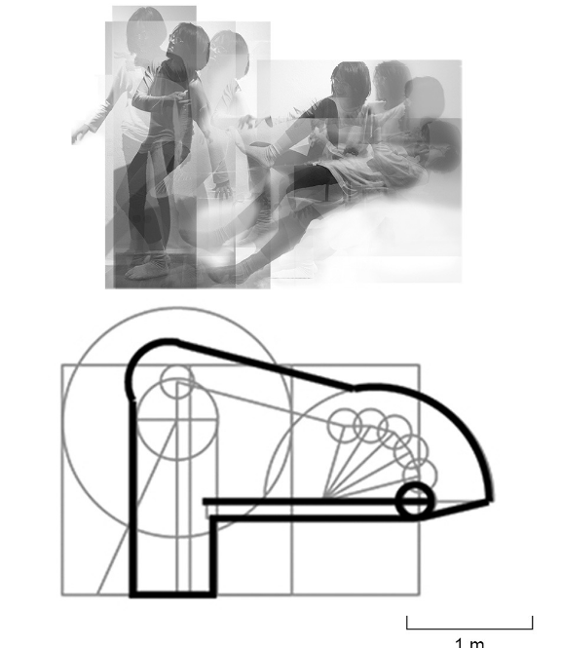
What if the whole architecture scale base on jumping?

Slide 21
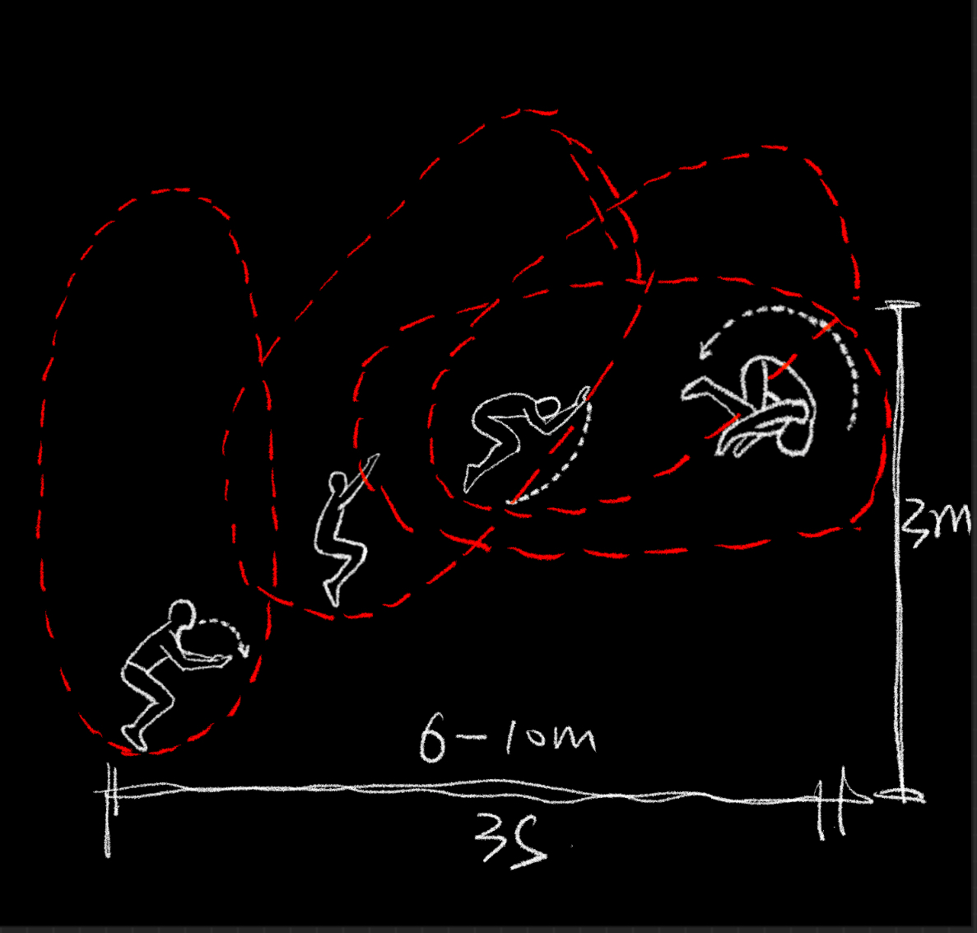
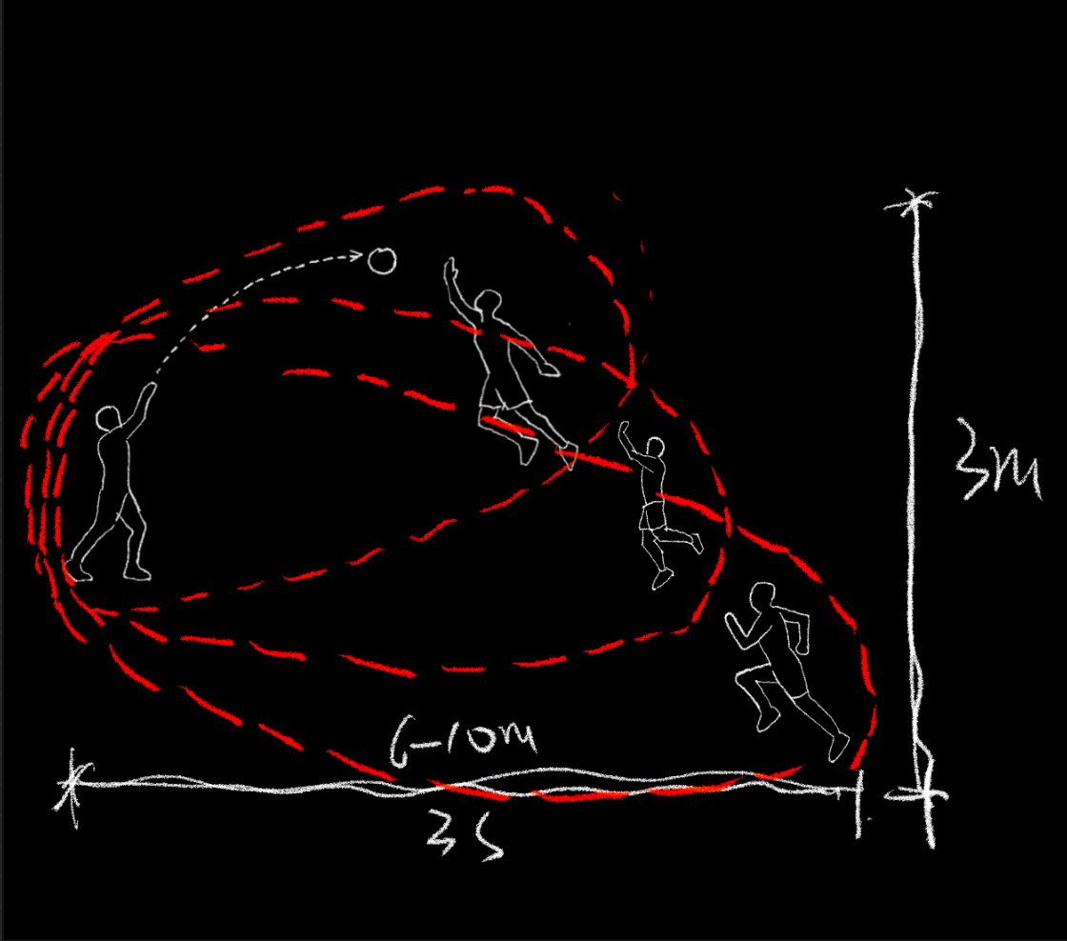
Mapping the whole jumping

Slide 22
Using inflatable structure to make stretchable building

Slide 23
As lunar missions progress into mid- and late-stage operational cycles, interpersonal tension and the psychological strain induced by limited privacy are expected to intensify among crew members. Historical evidence from orbital missions shows that even highly trained astronauts can become increasingly sensitive to spatial intrusion when confined for extended periods. This tendency is likely to be magnified in a lunar habitat, where daily routines, work duties, and recreational activities must all unfold within a fixed and highly controlled interior volume.
The challenge, therefore, extends beyond accommodating essential life-support infrastructure: it requires the creation of spatial environments that actively mediate social fatigue and support healthy personal boundaries.
In response, this research shifts its focus toward a movement-driven spatial strategy. Specifically, it investigates the act of jumping—a behavior fundamentally transformed by the Moon’s one-sixth gravity—and examines how its altered kinematics and extended trajectories can be mapped to generate new architectural logics. By analyzing the curves, arcs, and temporal sequences embedded in lunar jump movement, the project proposes a mobile architectural system whose form and spatial distribution derive directly from these motion paths.
Rather than relying on static, rigid modules, the proposed system employs reconfigurable and mobile units capable of expanding or contracting according to different activity phases. The amplified spatial envelope required for jumping—its long takeoff path, high apex, and extended landing arc—becomes a template for large, shared spatial configurations suited for collective exercise, recreation, and energy release. Conversely, when movement subsides, the same system can fold, compress, or rotate into compact arrangements that restore individual privacy.
By treating human movement—specifically, the lunar jump—as a generative design parameter, the architecture becomes responsive to both the physical conditions of reduced gravity and the psychological rhythms of long-duration habitation. Ultimately, this approach aims to mitigate interpersonal conflict, enrich daily embodied experience, and establish a resilient, adaptive spatial framework for future lunar living.

Slide 24
In response, this research shifts its focus toward a movement-driven spatial strategy. Specifically, it investigates the act of jumping—a behavior fundamentally transformed by the Moon’s one-sixth gravity—and examines how its altered kinematics and extended trajectories can be mapped to generate new architectural logics. By analyzing the curves, arcs, and temporal sequences embedded in lunar jump movement, the project proposes a mobile architectural system whose form and spatial distribution derive directly from these motion paths.
Rather than relying on static, rigid modules, the proposed system employs reconfigurable and mobile units capable of expanding or contracting according to different activity phases. The amplified spatial envelope required for jumping—its long takeoff path, high apex, and extended landing arc—becomes a template for large, shared spatial configurations suited for collective exercise, recreation, and energy release. Conversely, when movement subsides, the same system can fold, compress, or rotate into compact arrangements that restore individual privacy.
By treating human movement—specifically, the lunar jump—as a generative design parameter, the architecture becomes responsive to the physical conditions of reduced gravity. Ultimately, this approach aims to mitigate interpersonal conflict, enrich daily embodied experience, and establish a resilient, adaptive spatial framework for future lunar living.

Slide 25
Reference
NASA. (2016). Extravehicular Activity (EVA) Overview. NASA Human Spaceflight Documentation. https://www.nasa.gov
NASA. (2020). Neutral Buoyancy Laboratory (NBL) operations overview. NASA Johnson Space Center.
Chiang, Y.-C., Bier, H., & Mostafavi, S. (2018). Design to robotic assembly: An exploration in stacking. Frontiers in Digital Humanities, 5, 23. https://doi.org/10.3389/fdigh.2018.00023
SADA Architects. (2020). Lunark

Slide 26
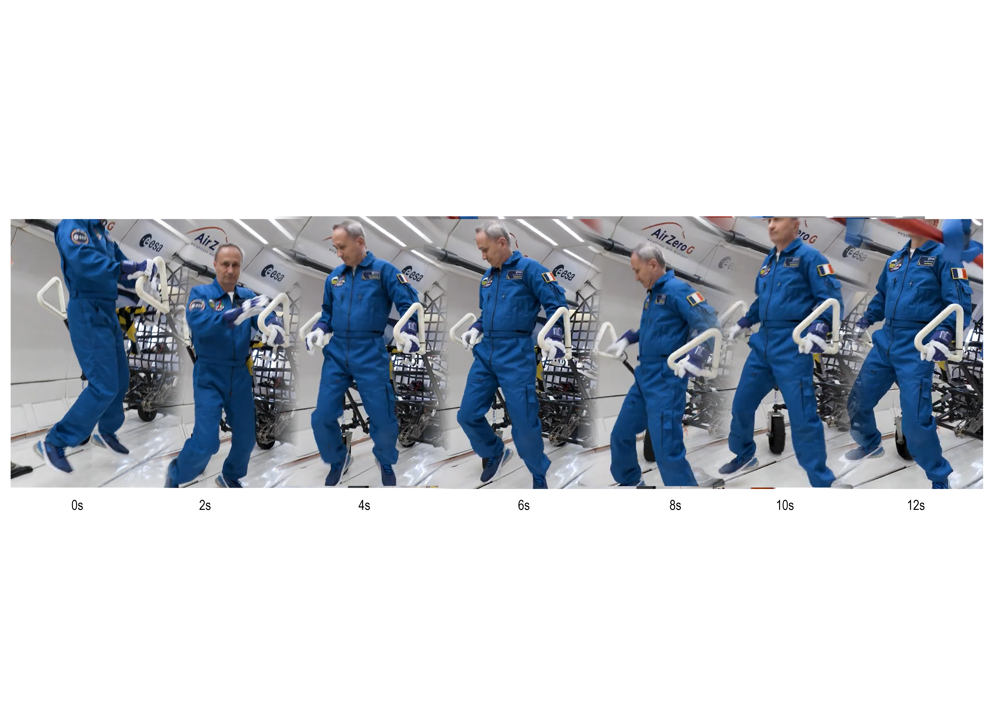

Slide 27
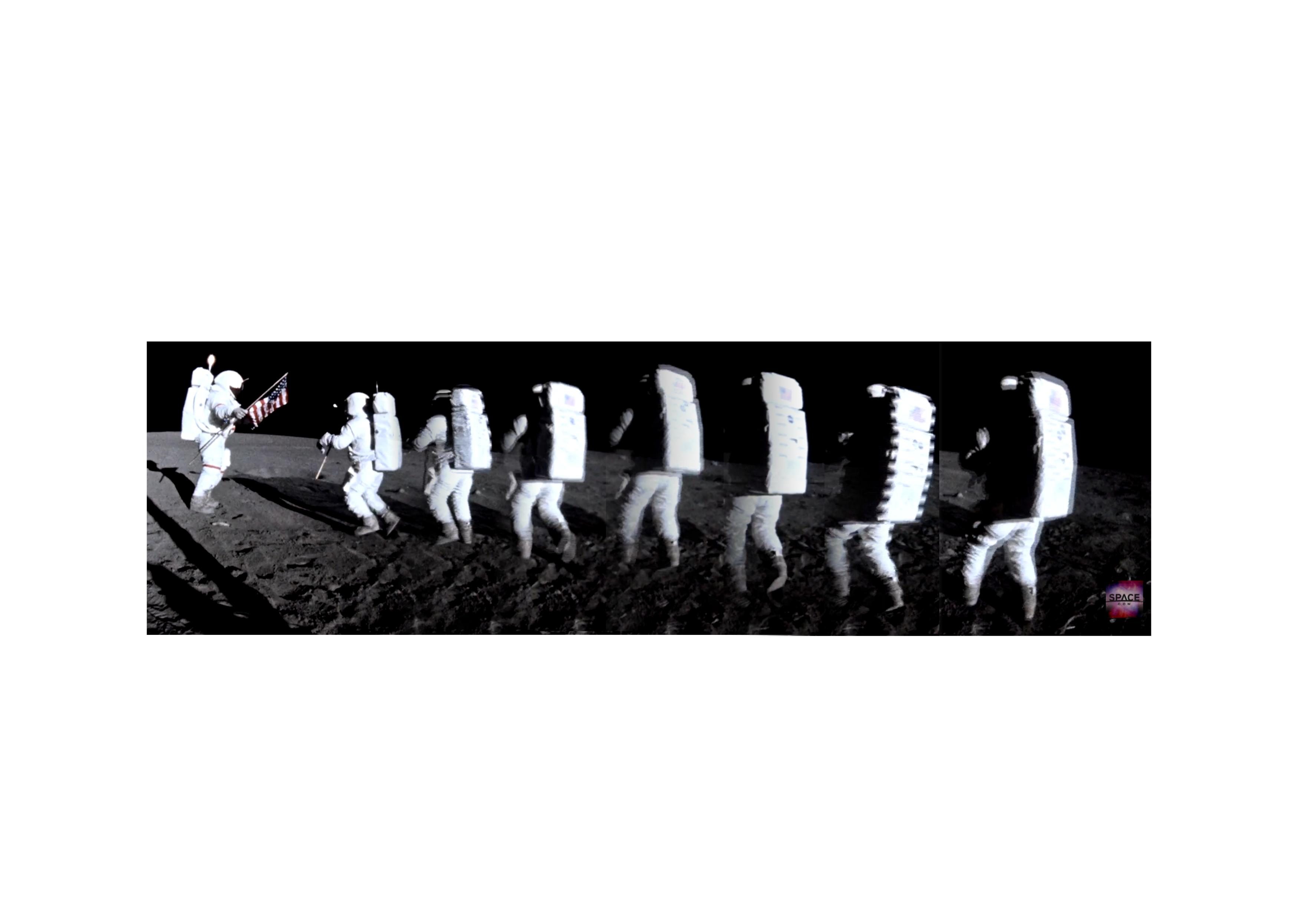

Slide 28
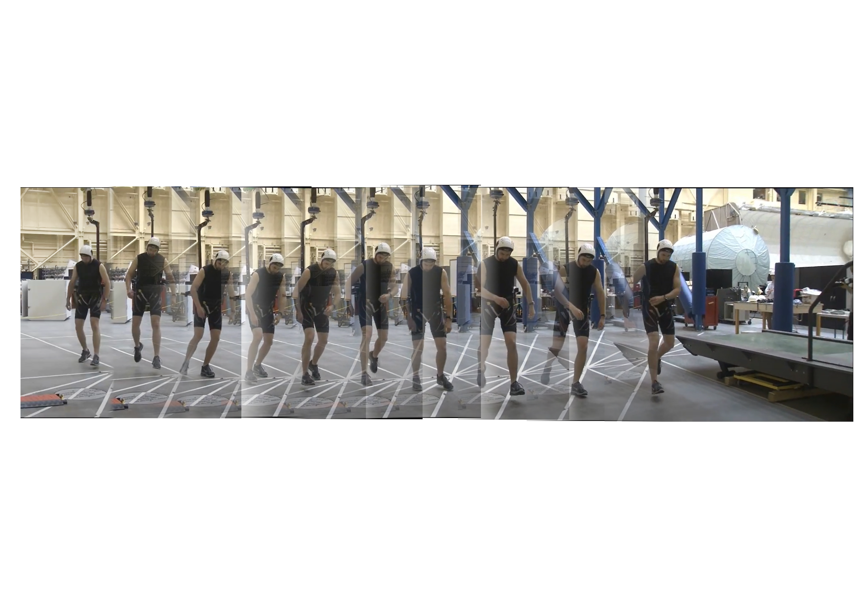

Slide 29
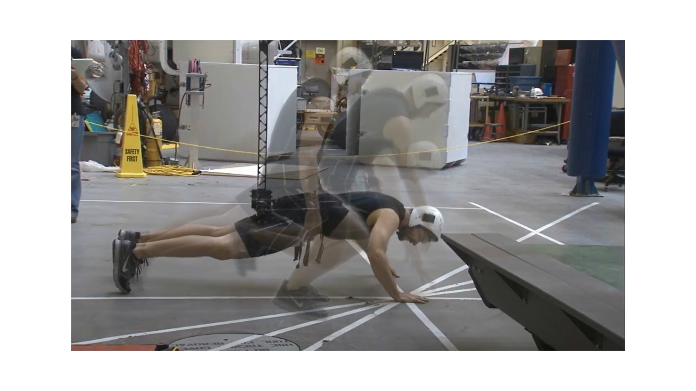

Slide 30
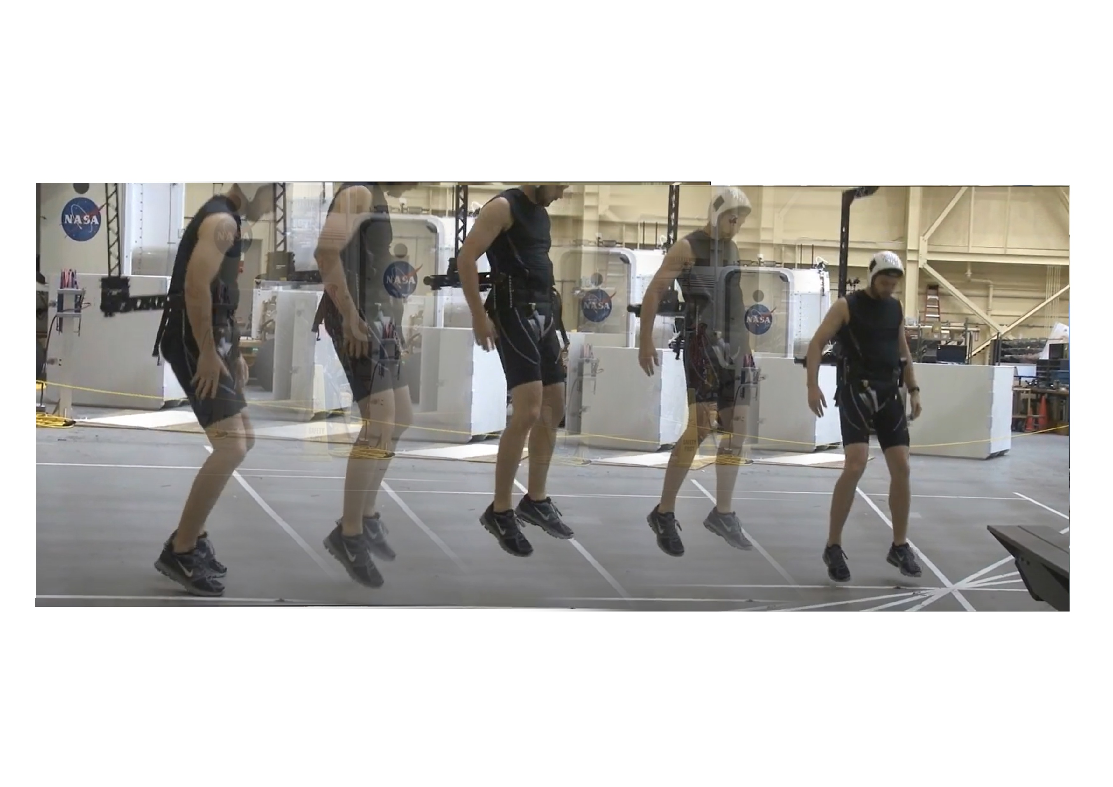

Slide 31
Reference
ESA – Moon gravity parabolic flight
NASA ARGOS（Active Response Gravity Offload System）
Apollo Lunar Surface Journal

Slide 32
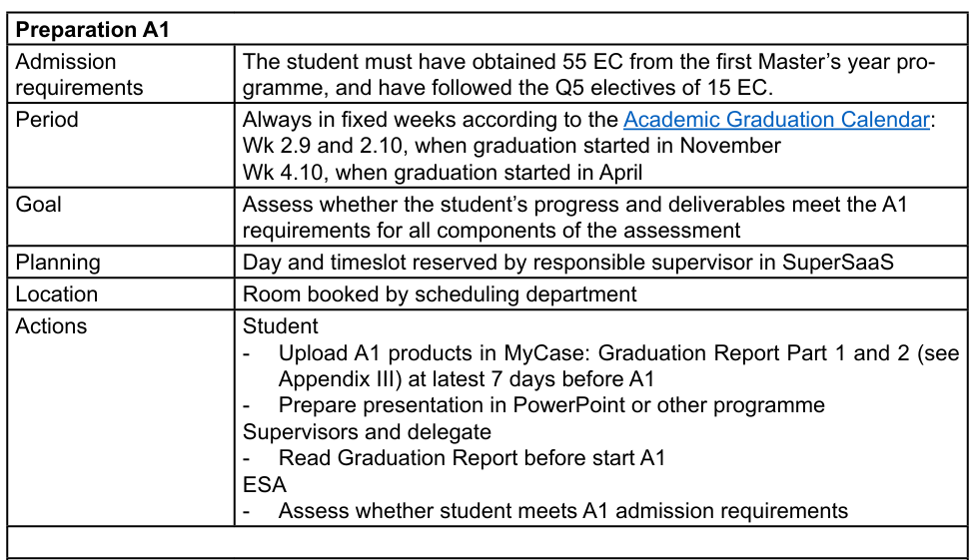

Slide 33
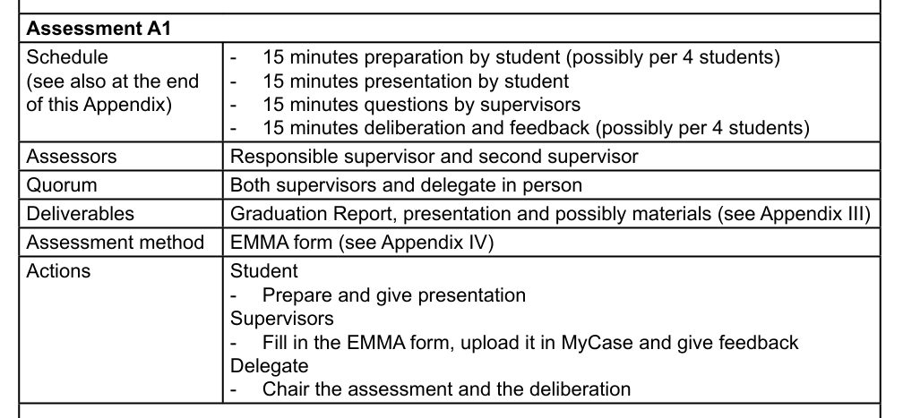

Slide 34
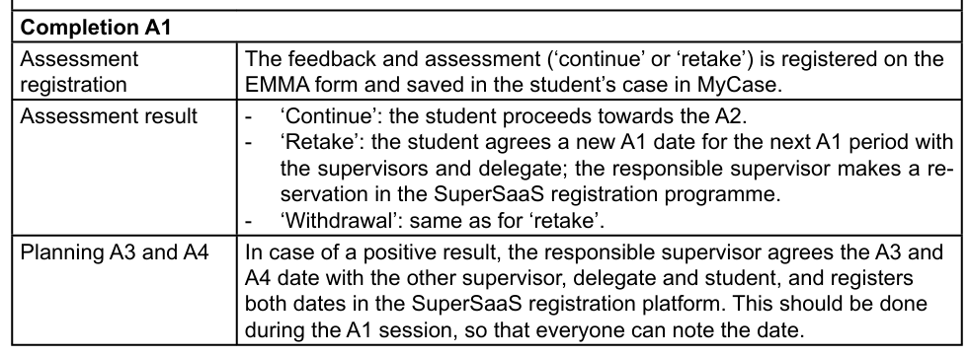

Slide 35
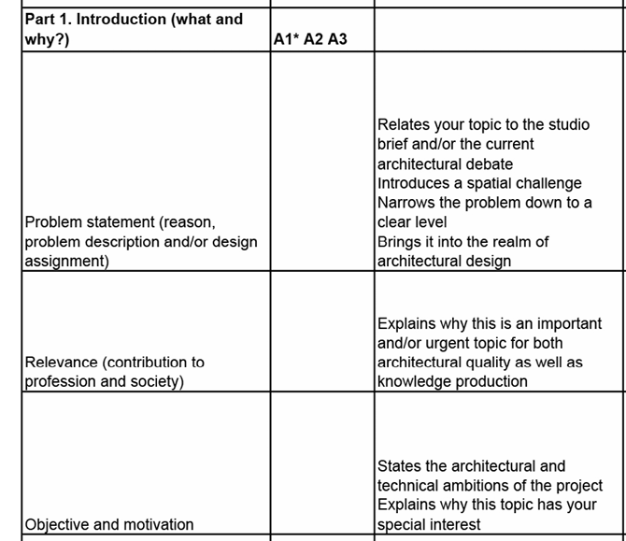
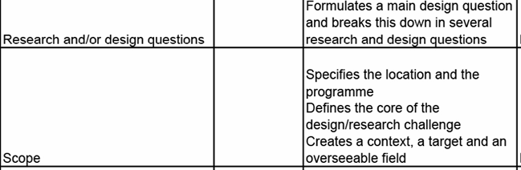

Slide 36
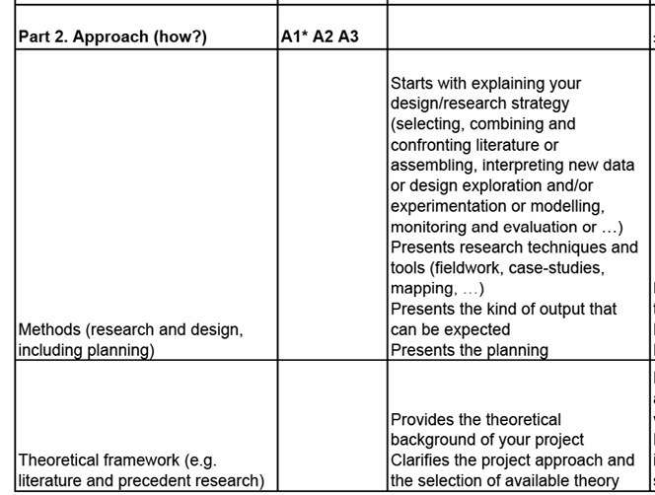

Slide 37
Planning
12.10 finishing the movement study diagram
12.24 space prototype
12.31 ME system draft

Slide 38
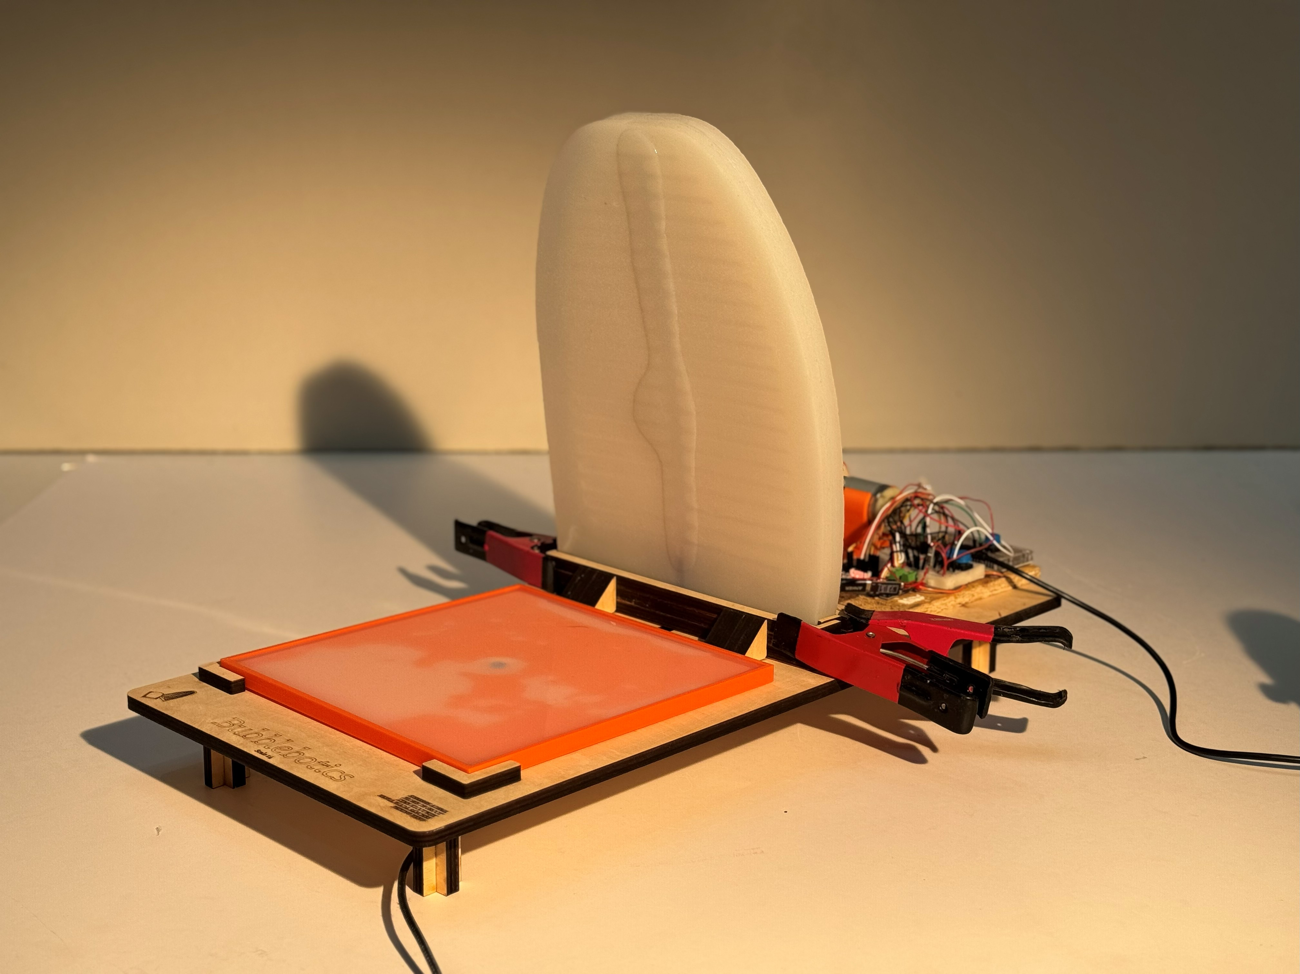
Bubblebotics
Notes:
This is our final prototype that we created with this course
Bubblebotics
We will take you quickly through our process of how we came to this design.

