Slide 1
[Lava Tubes Dwellings]
Preliminary ideas on graduation project
Walter Chung

Slide 2
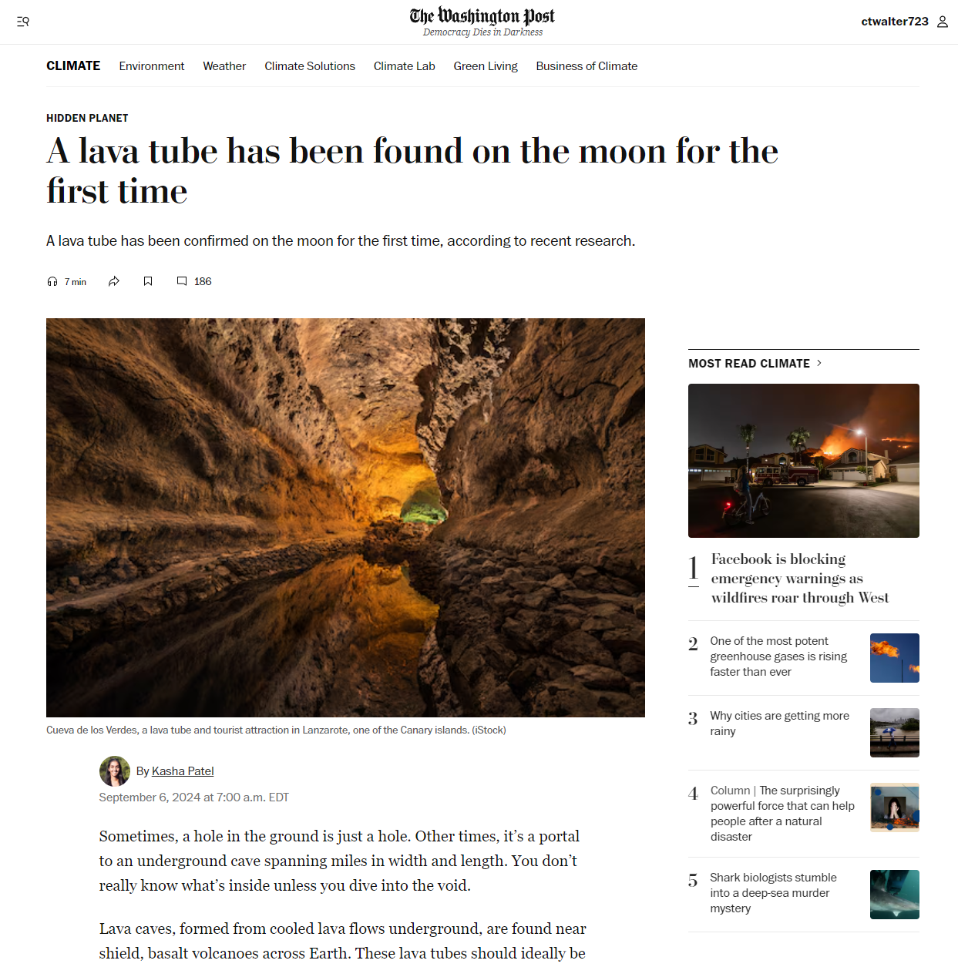
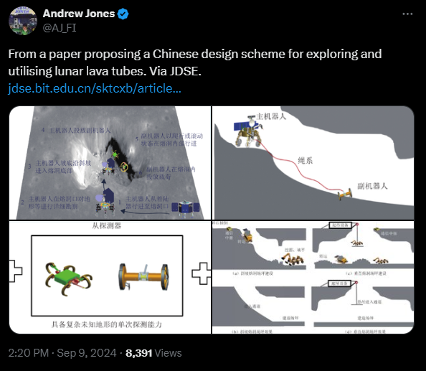
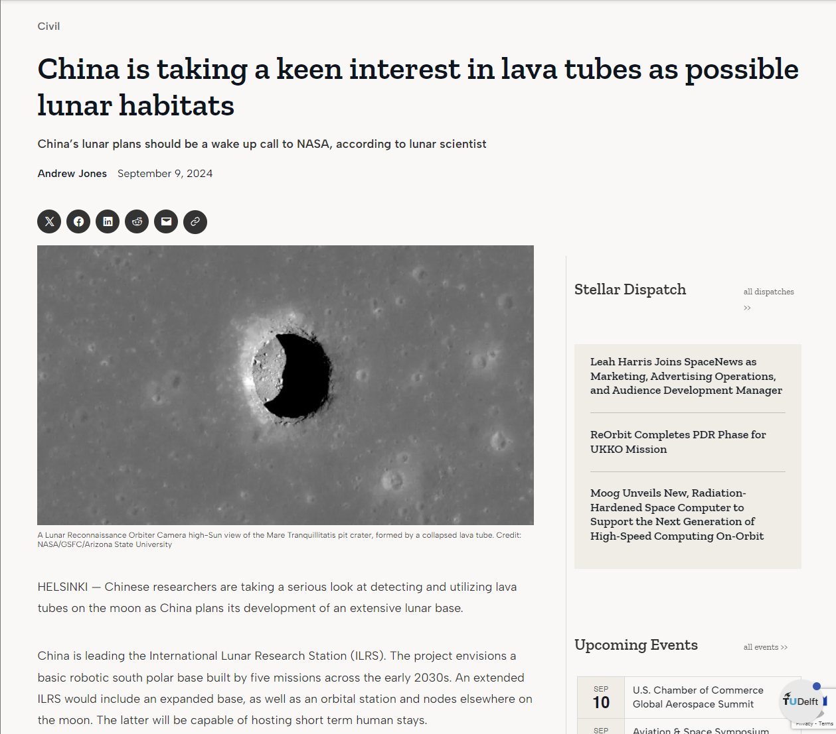

Slide 3
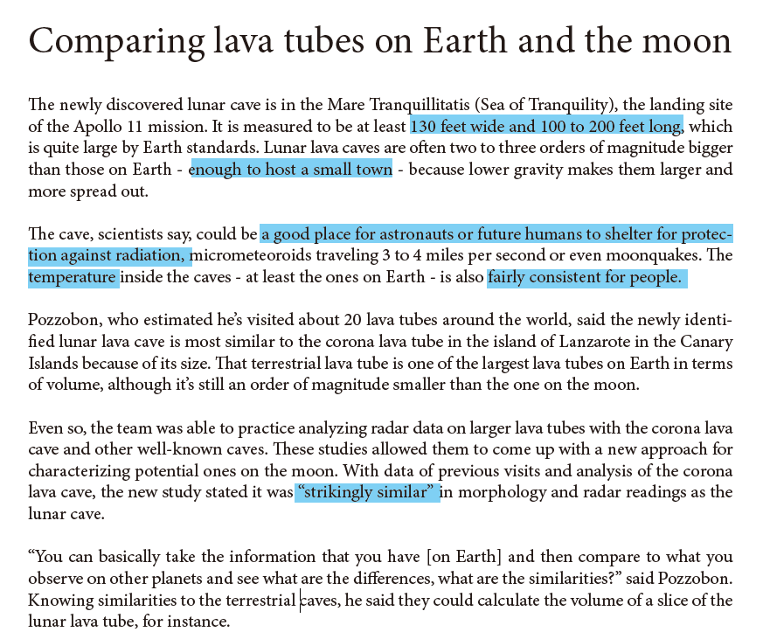

Slide 6
Sloped terrain

Slide 7
Cut-and-fill

Slide 8
Stilt houses

Slide 9
Terraced houses

Slide 10
Ceiling susceptible to collapse due to seismic activity

Slide 11
Structural reinforcement

Slide 12
Advantages of the 1/6 gravity on construction

Slide 13
Joinery for easy assembly

Slide 14
Lighting condition

Slide 15
Acoustic control

Slide 16
How to adapt to/optimise the uncertainties to live within the lava tubes?

