Slide 1
Moonshot
Lava Tube Mapping
Alexander James Becoy • 12.09.2024

Slide 2
Objective
Establish a methodology to robotically map a lava tube on Mars

Slide 3
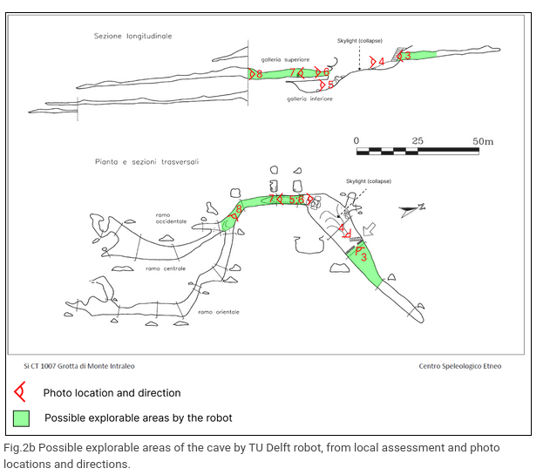
Lava Tube in Italy

Slide 4
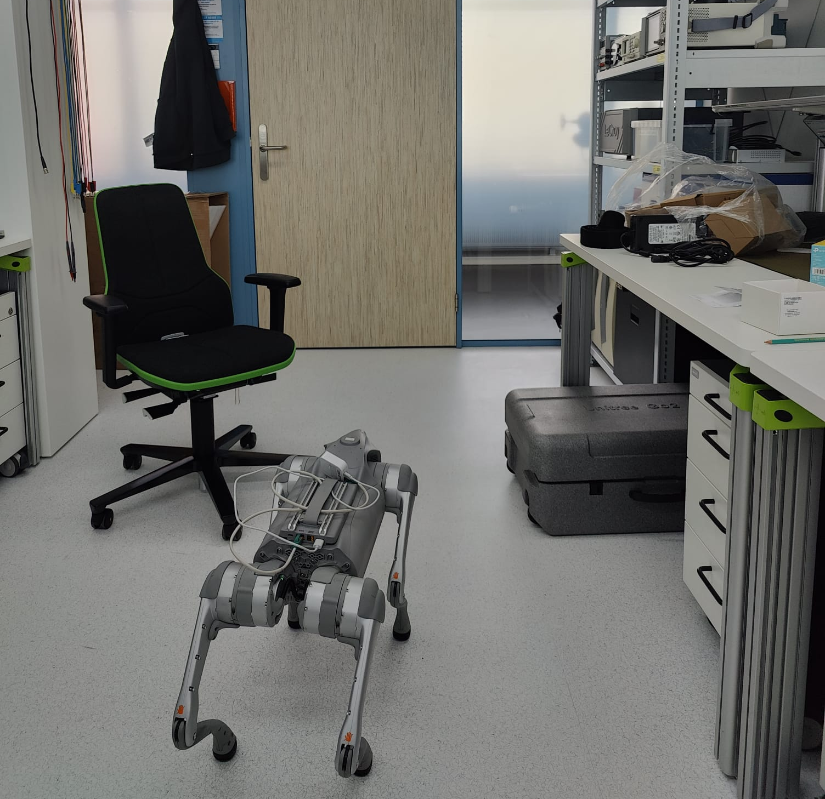
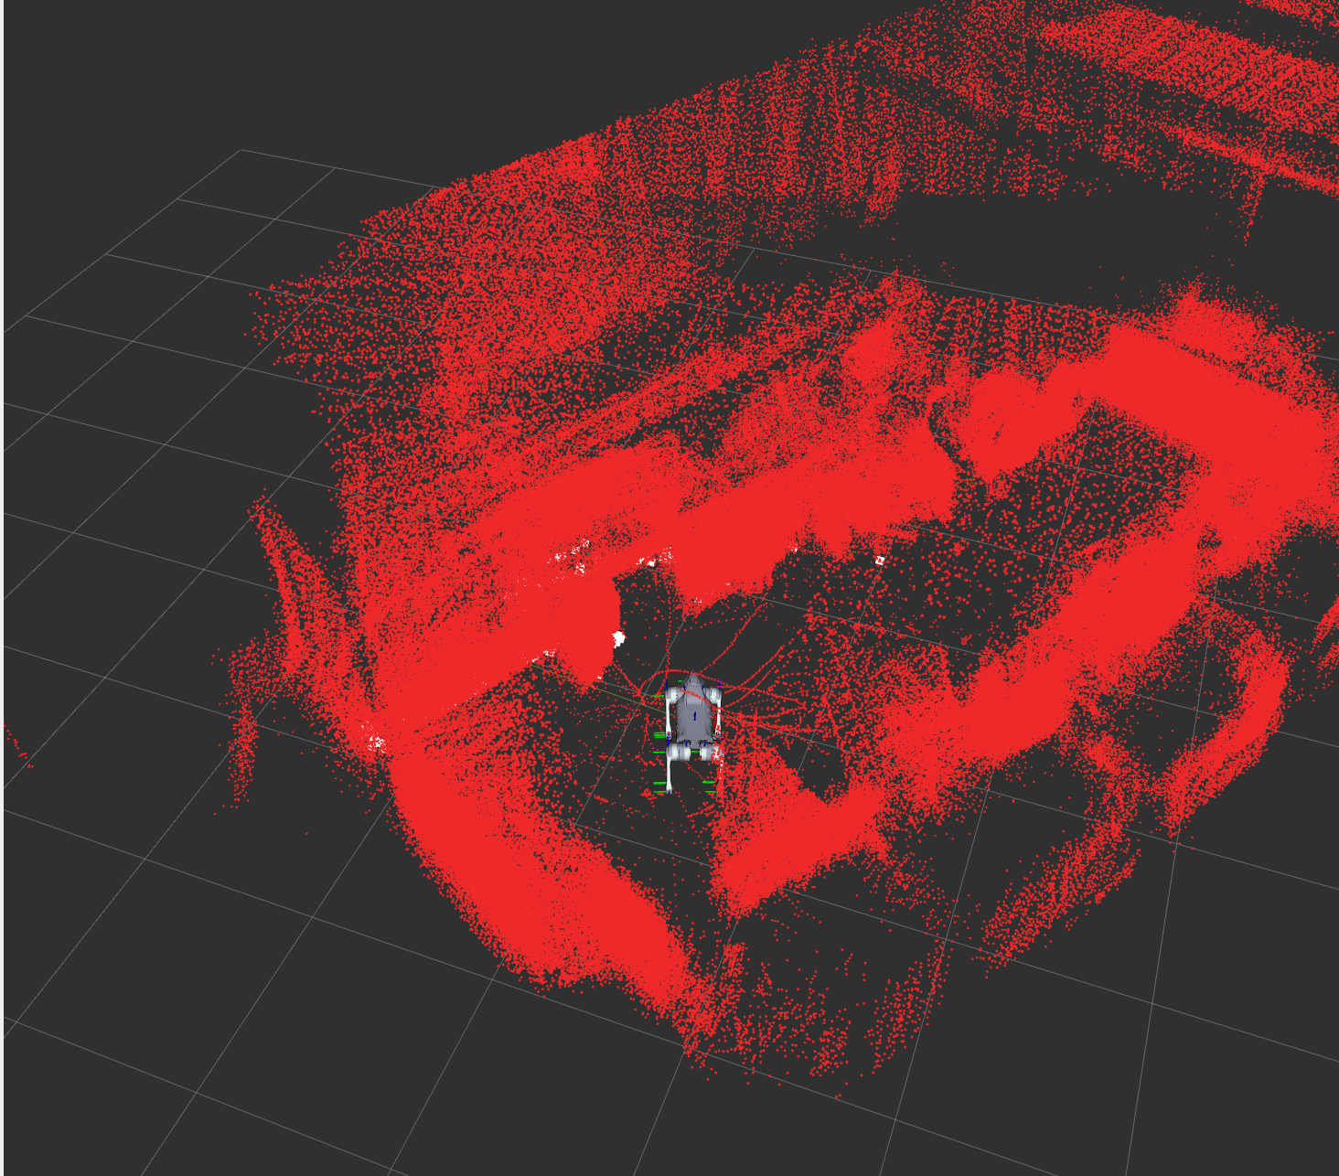
Implementation
Train a ML model to transform 2D RGB images to 3D model of the lava tube
Data acquisition:
Unitree Go2 Edu
3D pointclouds
2D images
Autonomous navigation (bonus)

Slide 5
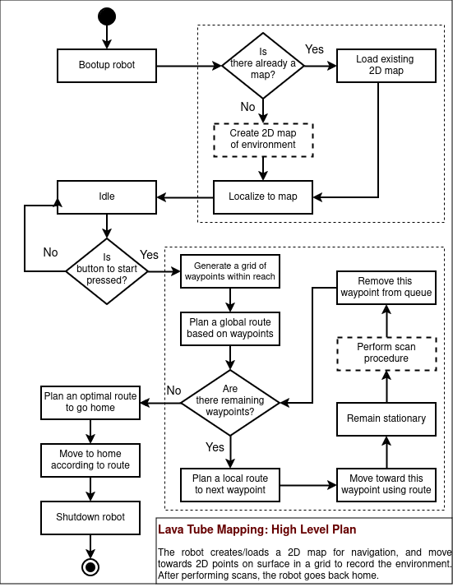
Implementation
Train a ML model to transform 2D RGB images to 3D model of the lava tube
Data acquisition:
Unitree Go2 Edu
3D pointclouds
2D images
Autonomous navigation (bonus)

Slide 6
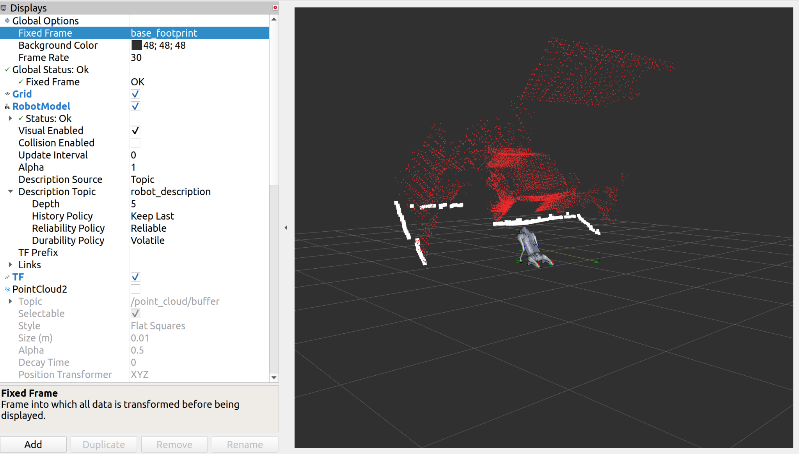

Slide 7
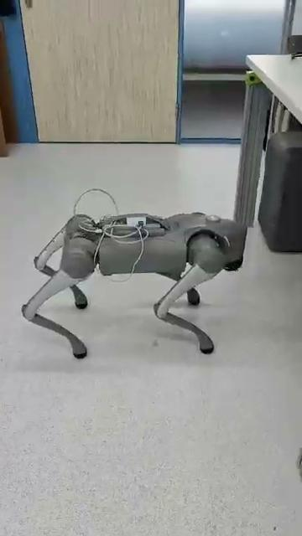
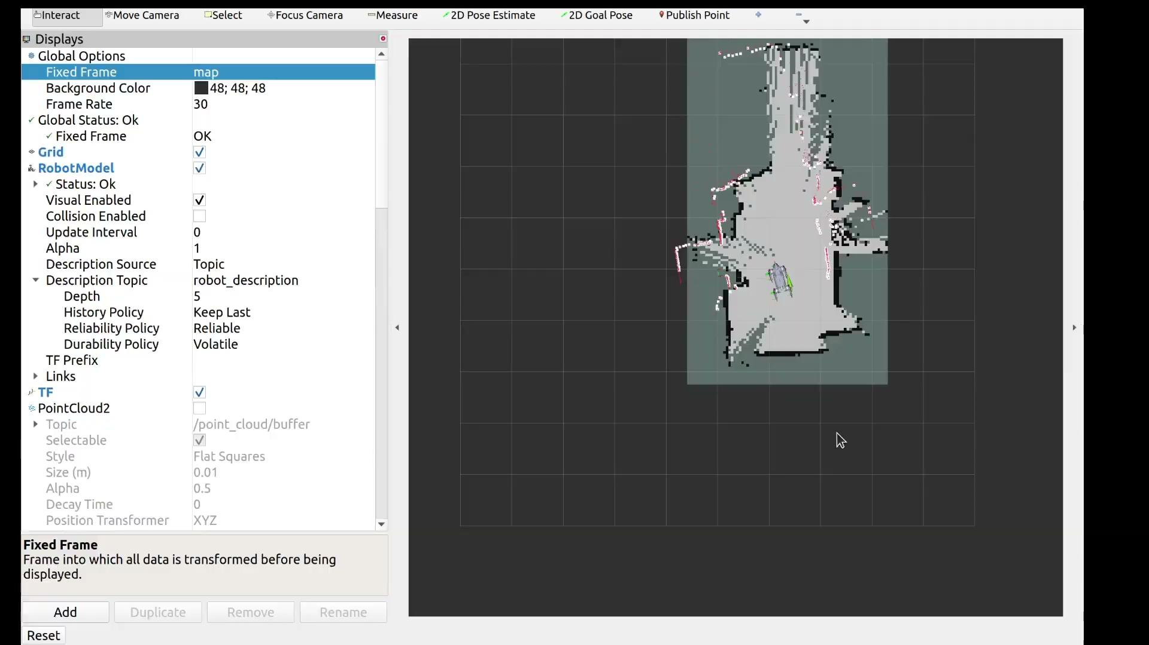

Slide 8
Thesis idea
Busy implementing…
General idea:
Optimization for robotic manipulators

