Slide 1
Human-Robot Interaction (HRI)
Workshop 2 Documentation
Lunar Architecture Graduation Studio (Coor. Henriette Bier)
TU Delft March 2025
Demonstration by: Arwin Hidding, Francesco Romio
Documentation by: Jonathan, Regina Tania Tan, Sophia Benfield, Walter Chung

Slide 2
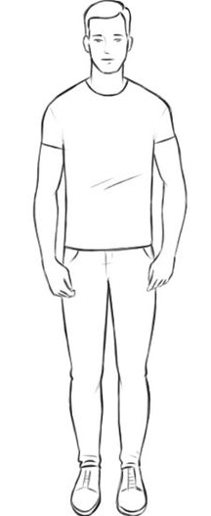
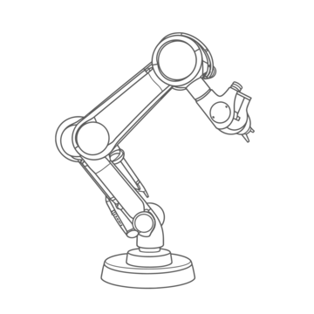
Workshop Relevance
Combining strengths of both robots and humans
Robot​
Human
strength:
heavy lifting
weakness:
delicate motor skills
strength:
delicate motor skills
weakness:
heavy lifting
End goal: Robot learns from the human
becomes autonomous

Slide 3
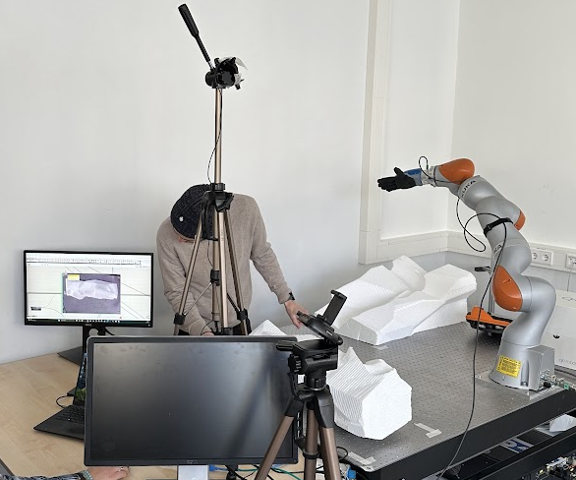
Workshop Setup
Camera
Robotic Arm
Computer Vision (CV)
via Grasshopper
Final Point
Starting Point

Slide 4
Robotic Process Supported by Computer Vision (CV)
Computer Vision (CV)
via Grasshopper
Robotic Arm
+
Human assistance
Component
Camera
1. Approaching component
2. Picking component
3. Transporting component
4. Adjusting component
5. Placing component

Slide 5
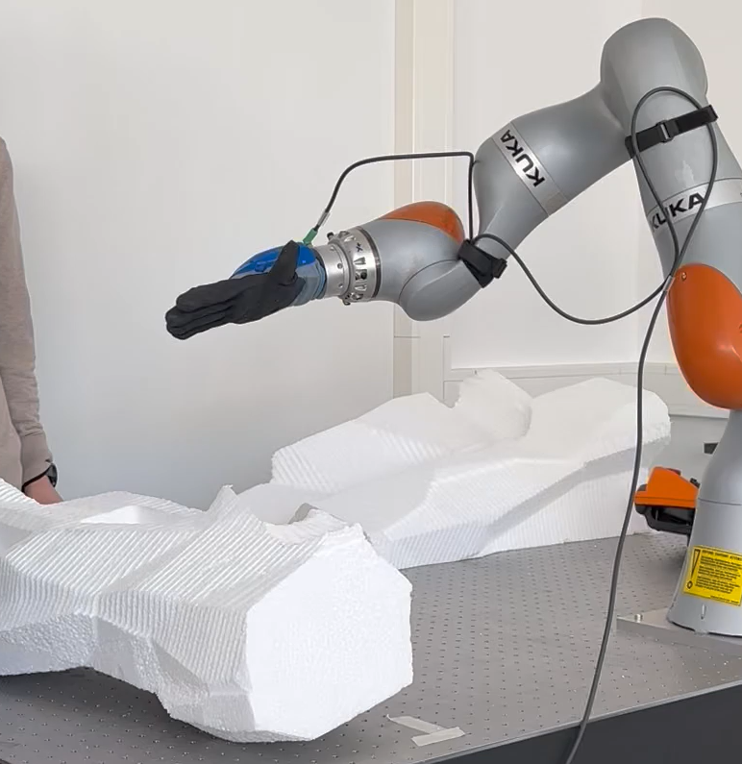
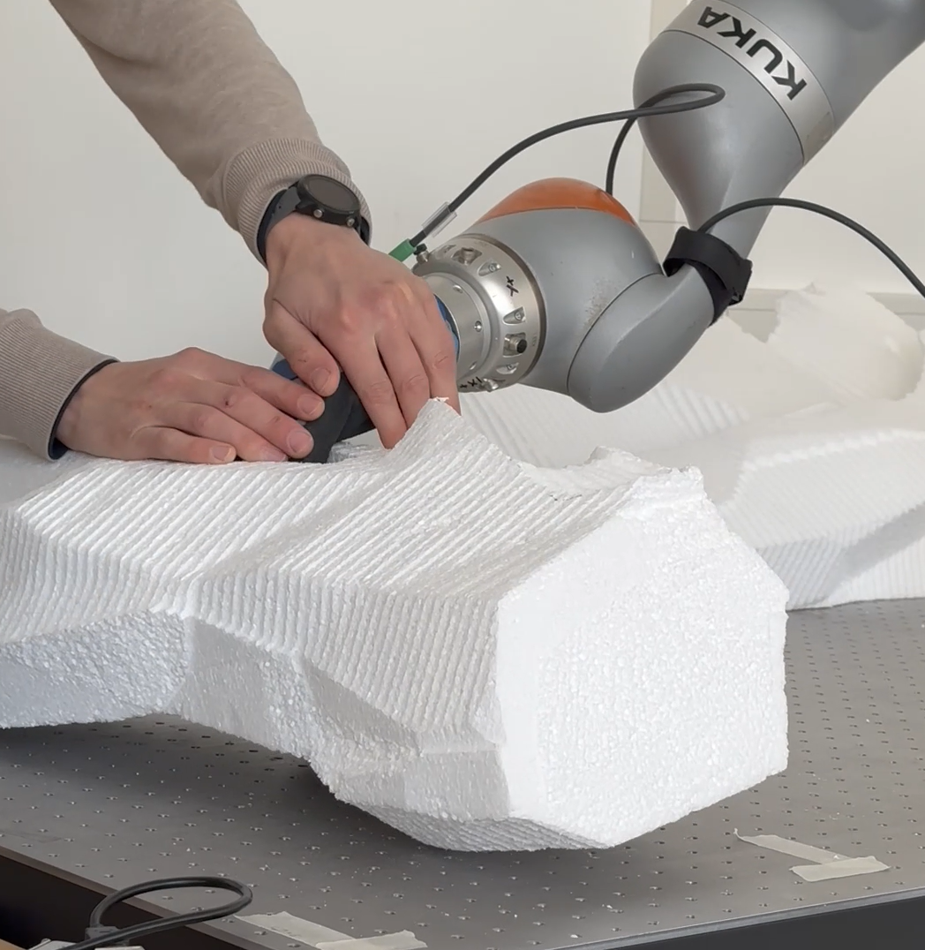
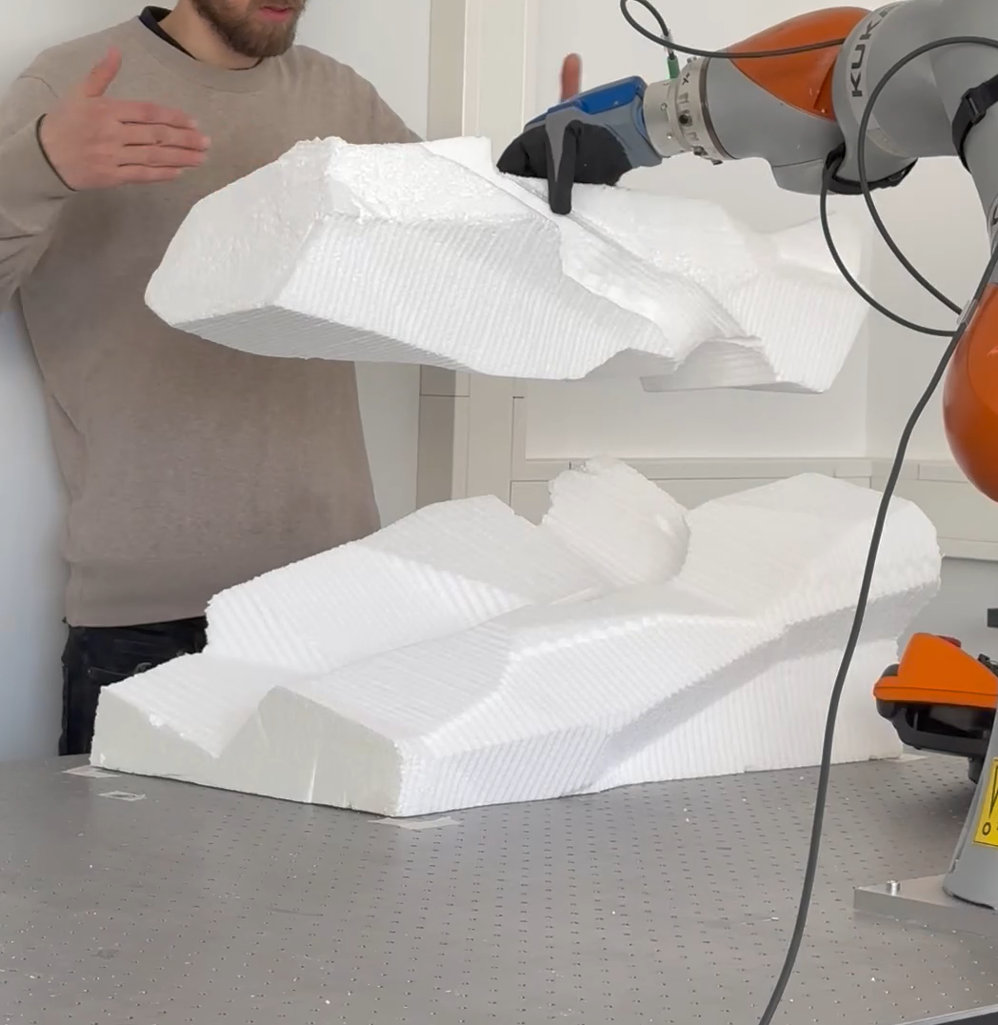
End Result
1. Approaching component
2. Picking component (assisted)
3. Transporting component to designated point
4. Adjusting Component
5. Placing component (Assisted)

