Slide 1
Lunar Playscape: the Climbing City
Initial Graduation Thesis Proposal
Jonathan

Slide 2
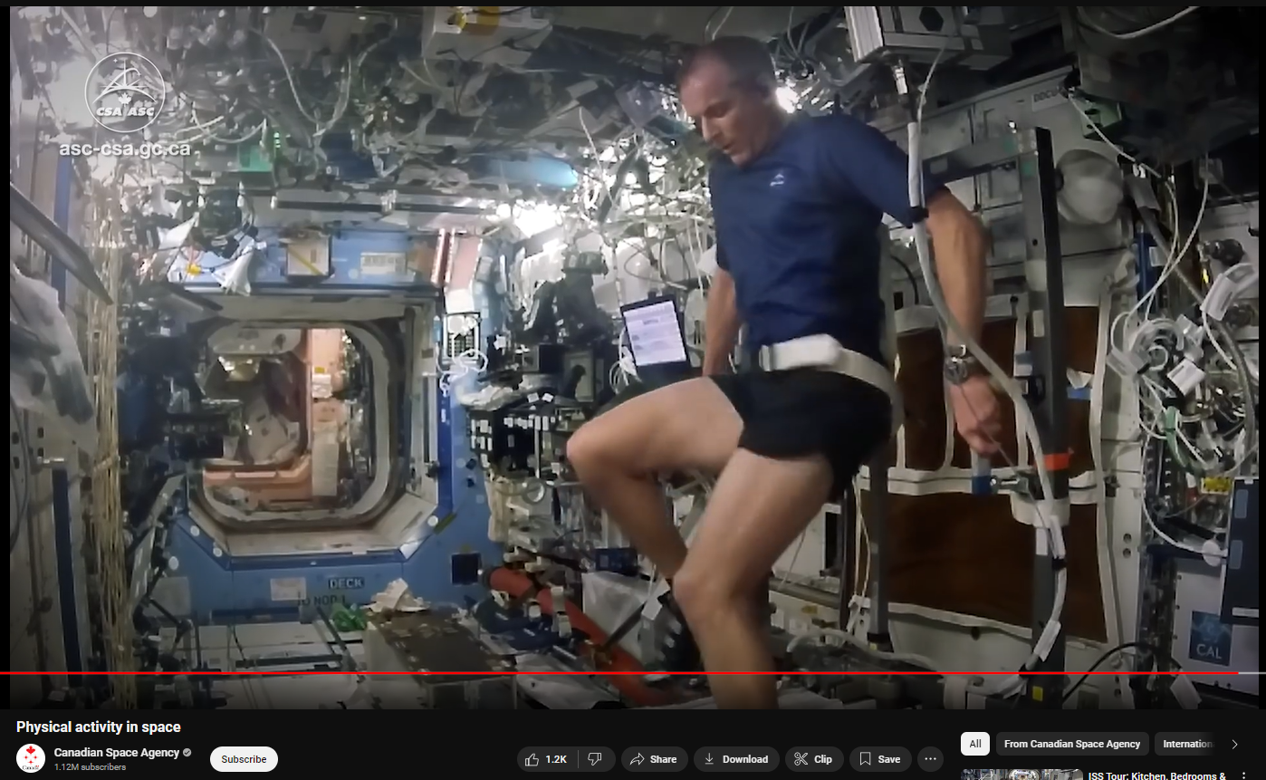
Cardio + Resistive Exercises
Astronauts to work-out 2 hours per day within their busy schedule

Slide 3
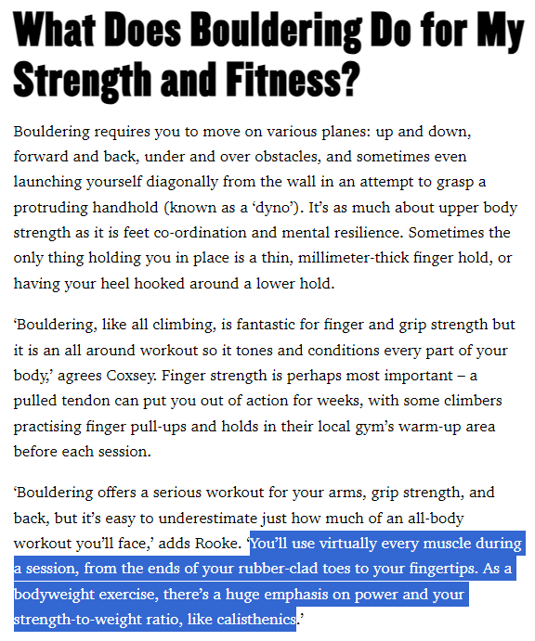
Source: menshealth.com/uk

Slide 4
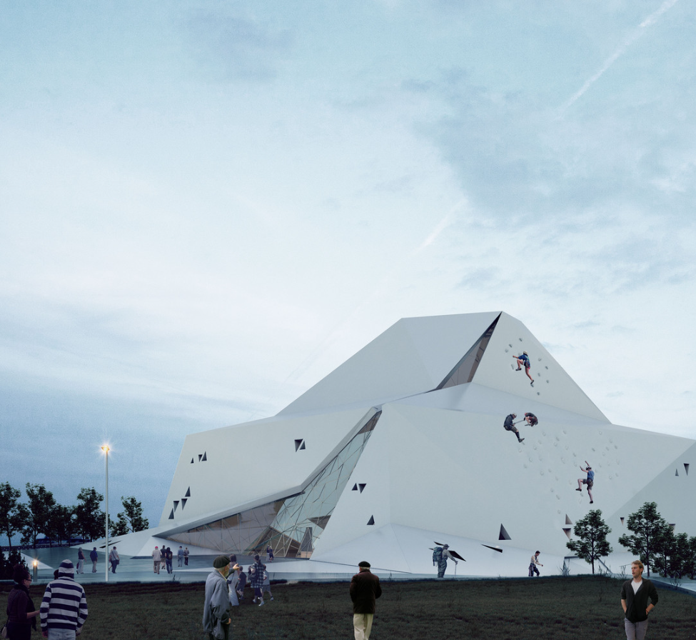
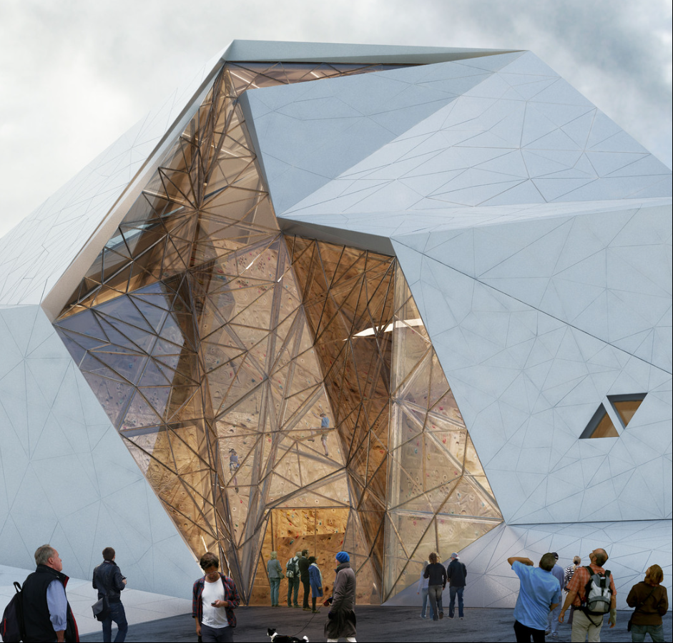
Source: weburbanist.com
Rock Gym in Polur, Iran by New Wave Architecture

Slide 5
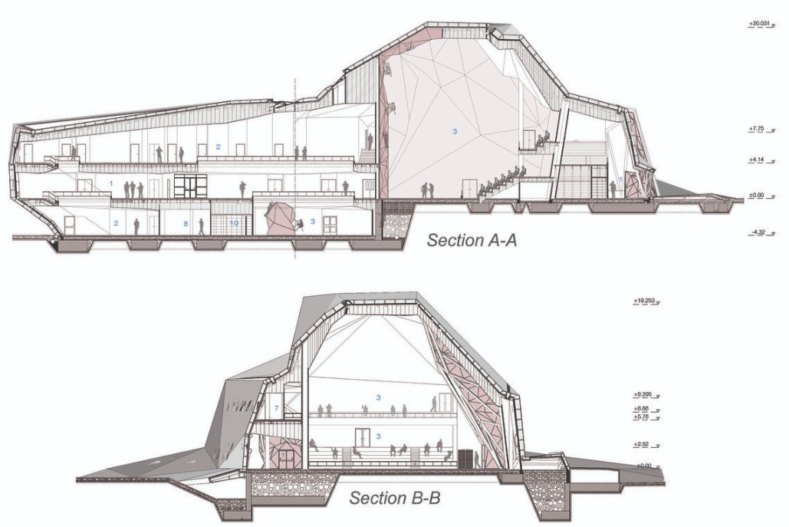
Source: weburbanist.com

Slide 6
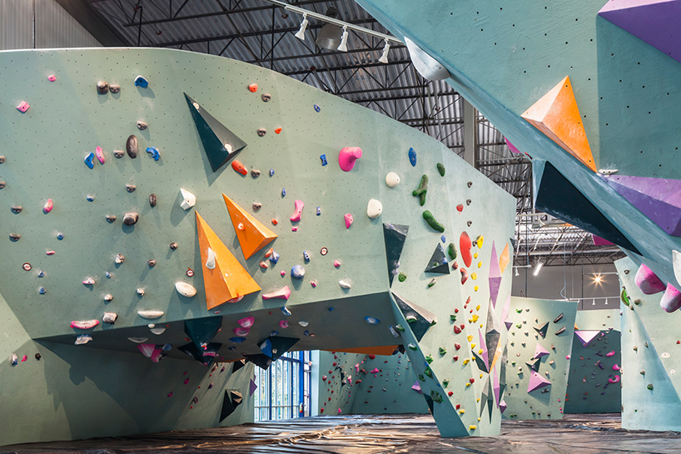
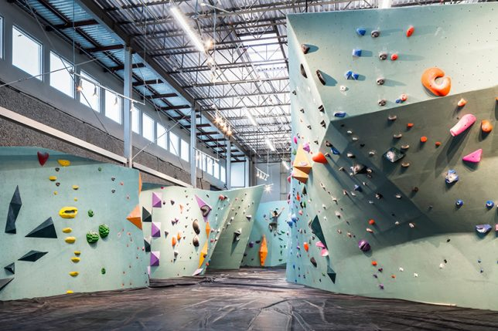
Source: weburbanist.com
World’s Largest Bouldering Gym, Austin Texas by DJA Architects + Lilianne Steckel

Slide 7
Rigidity + Flexibility
Long-term & short-term

Slide 8
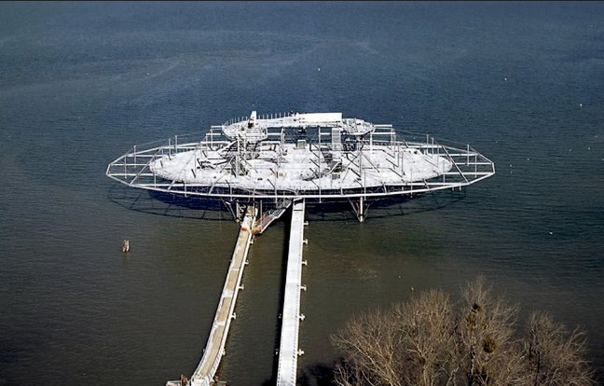
Source: arquitecturaviva
The Blur Building, Yverdon-les-Bains, Switzerland by Diller Scofidio + Renfro

Slide 9
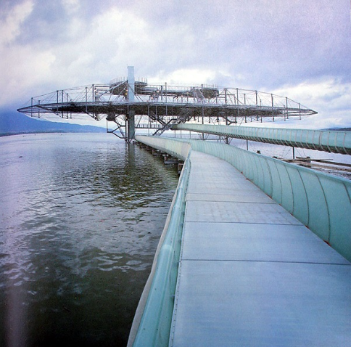
Source: arquitecturaviva

Slide 10
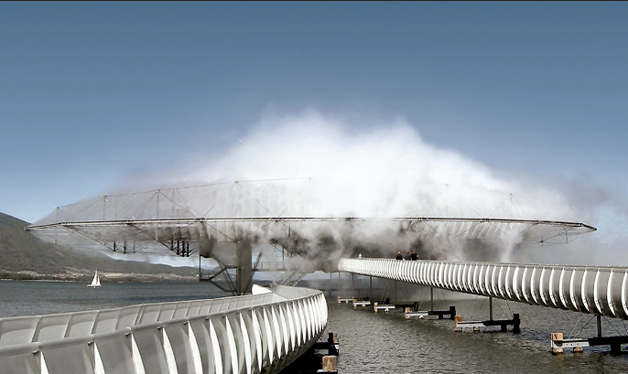
Source: arquitecturaviva

Slide 11
Source: arquitecturaviva

Slide 12
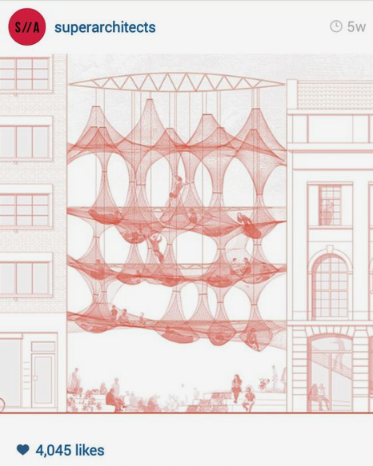

Slide 13
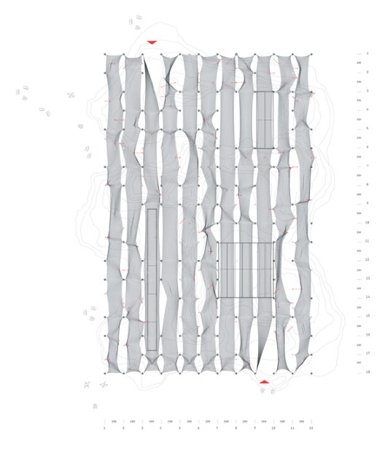
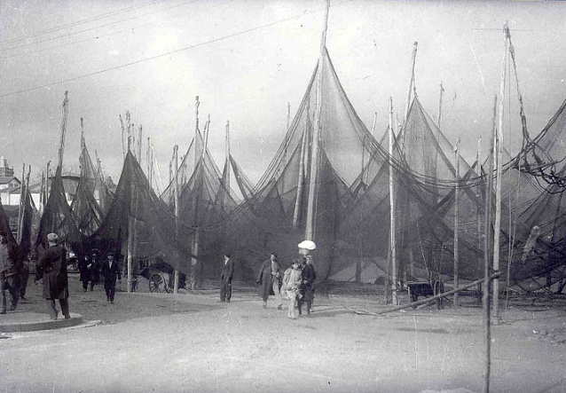
“0.5 kg of nylon to cover an area of more than 45m in length”
“How much does your building weigh, Mr. Foster? –Buckminster Fuller”
Source: Archdaily
5.5 Kg PAVILION, Finalist of YAP_Constructo 2016 by Contrucci + Sfeir

Slide 14
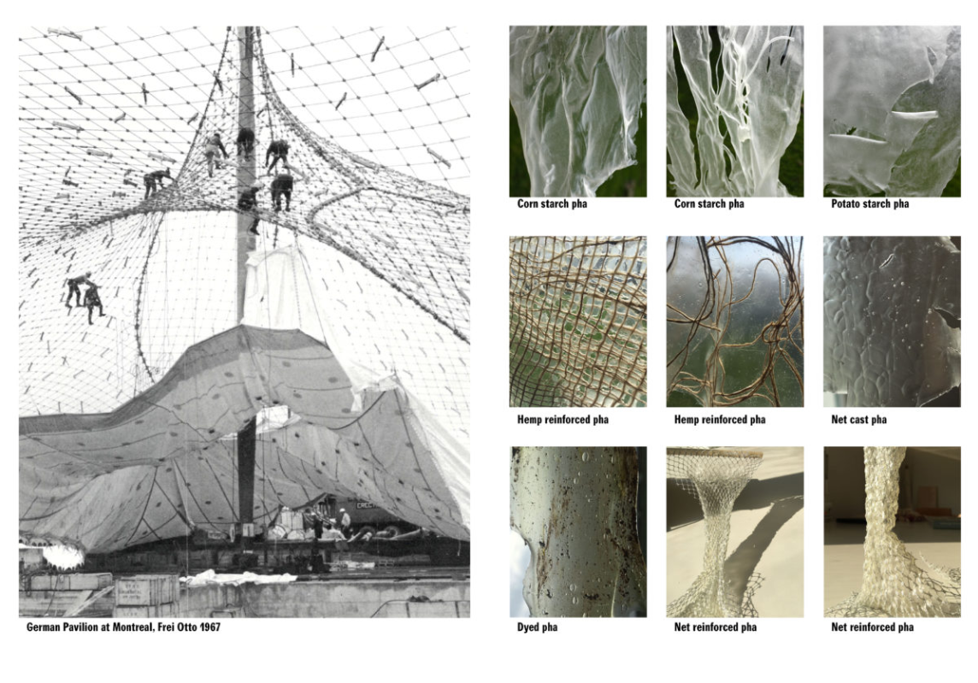
Source: works.arch.ethz.ch/thesis/shrinking-conservatory-thema-c

Slide 15
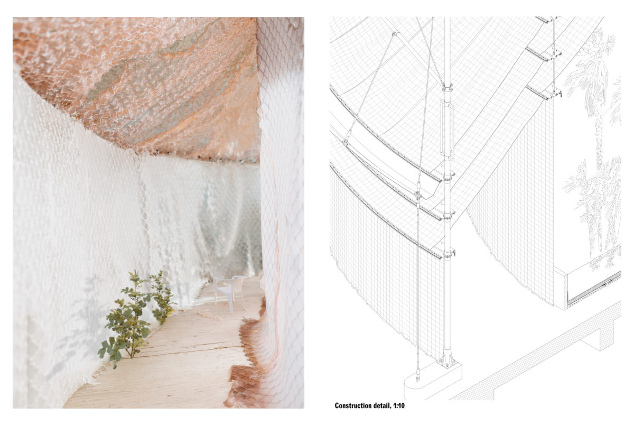

Slide 16
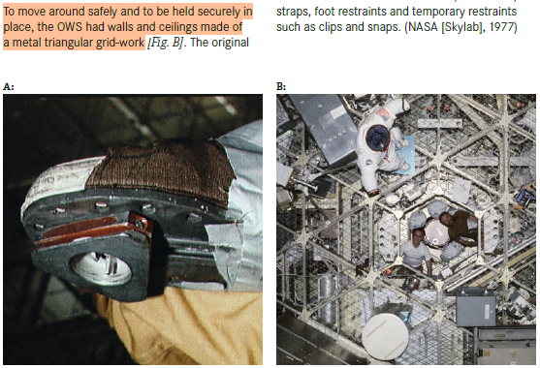
Source: Architecture for Astronauts (Book), pg. 56
Orbital Workshop, SkylabSpace Station

Slide 17
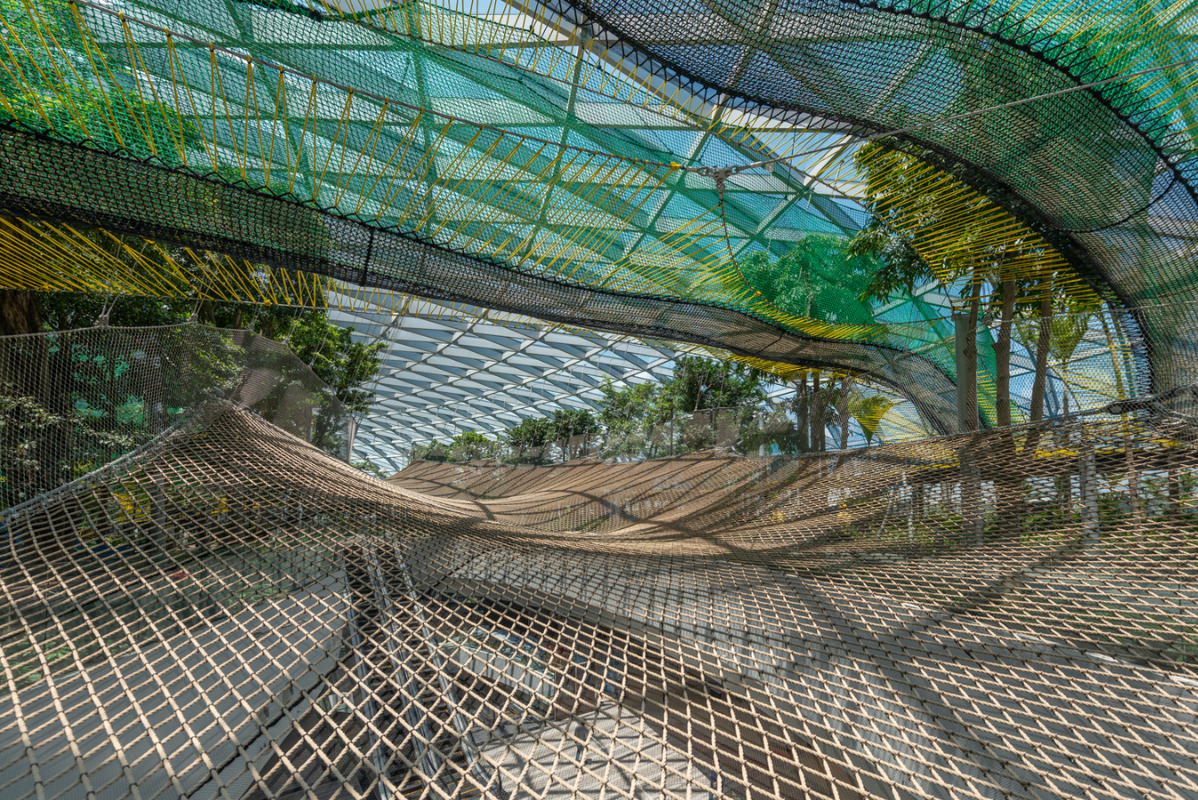
Source: Archdaily
Bouncing Net, Jewel at Changi Airport, Singapore by Safdie

Slide 18
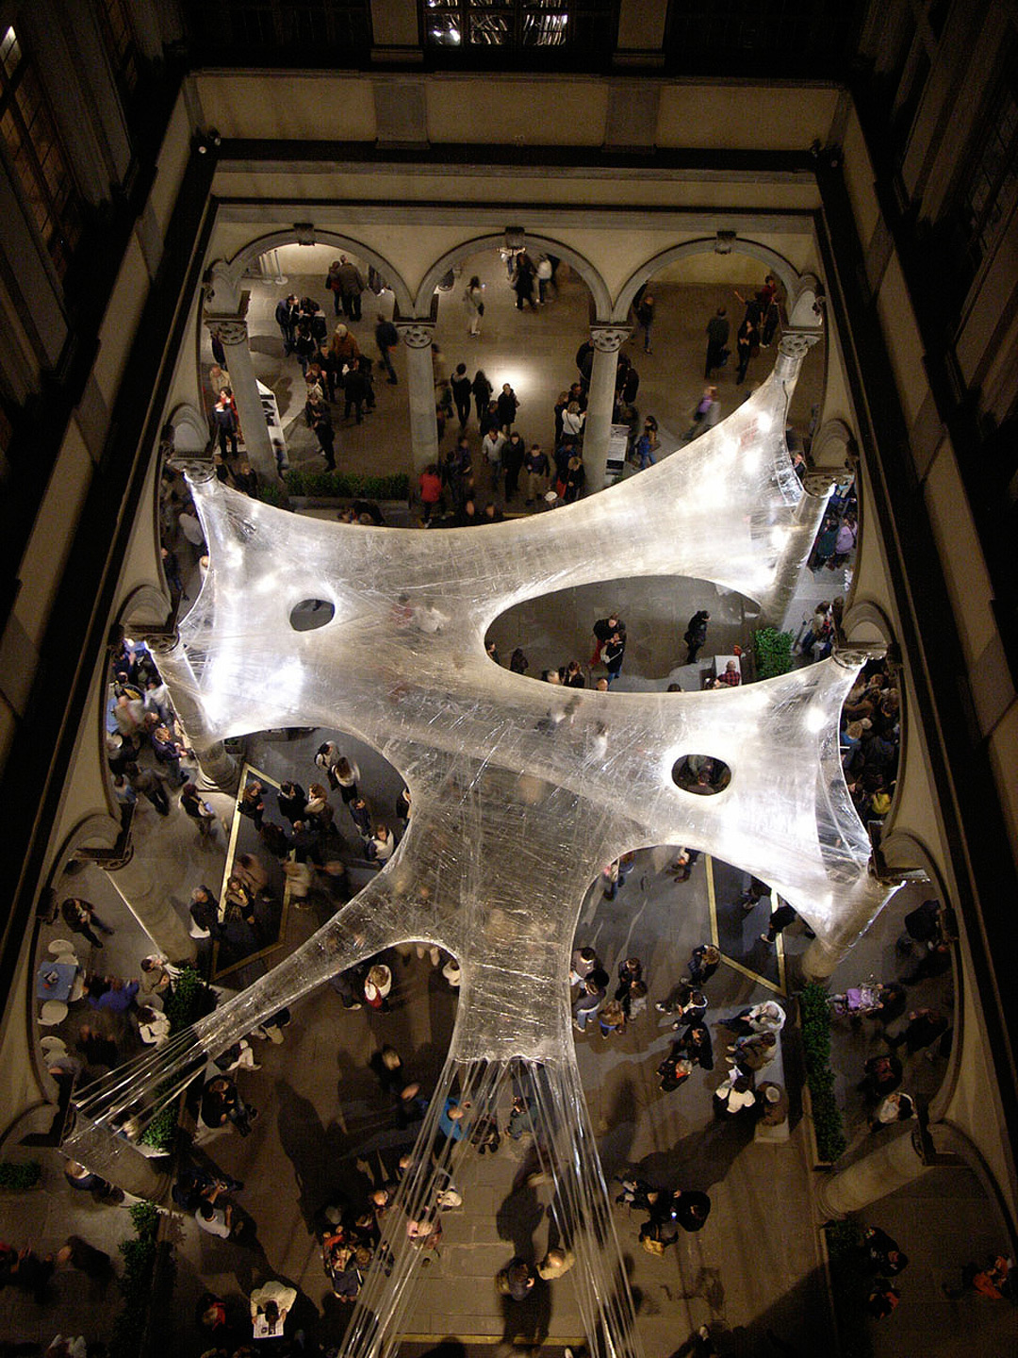
Tape Florence, by Palazzo Strozzi + Numen
Source: numen.eu/installations/tape/florence/

Slide 20
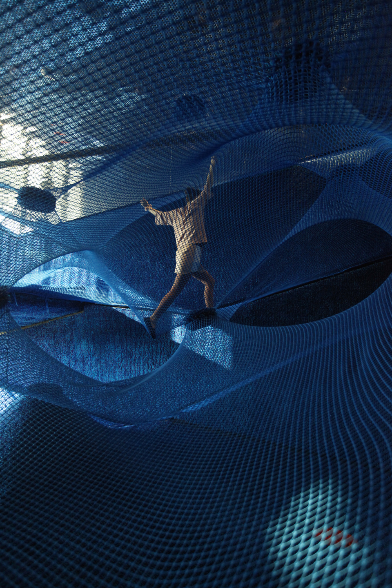
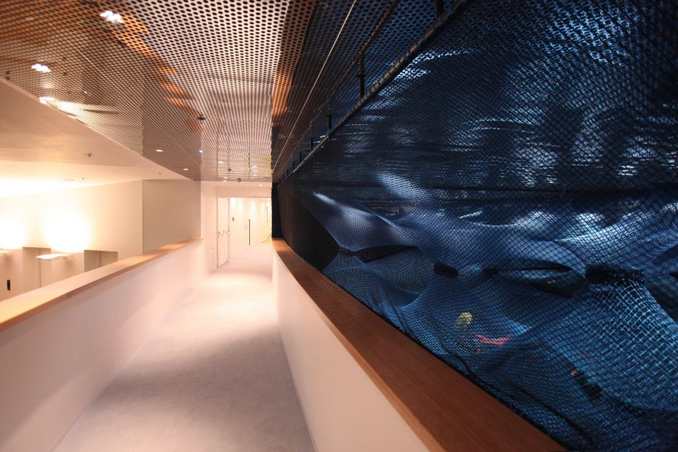
Net Rovinj, Hotel Amarin 2016, Croatia by Tvrtko Bojić + Numen
Source: numen.eu/installations/net/rovinj/

Slide 21
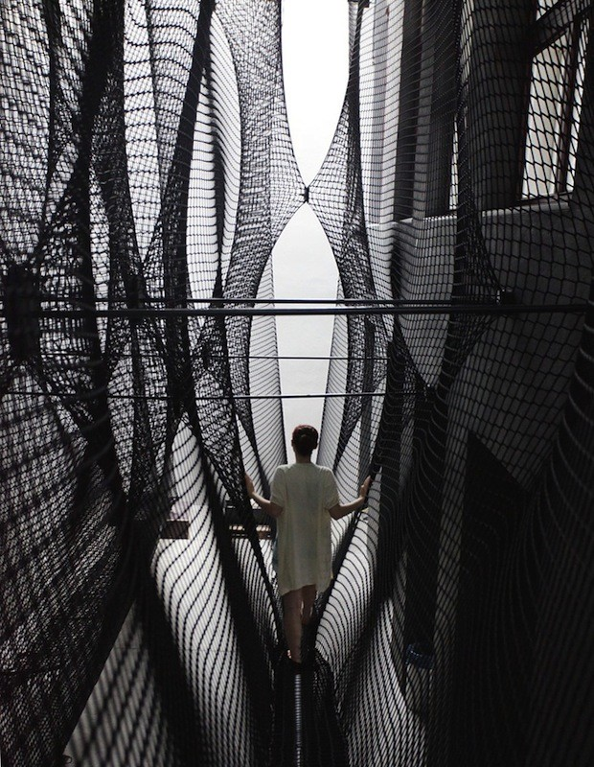
Austria’s OK Center for Contemporary Art by Numen
Source: architectureanddesign.com.au

Slide 22
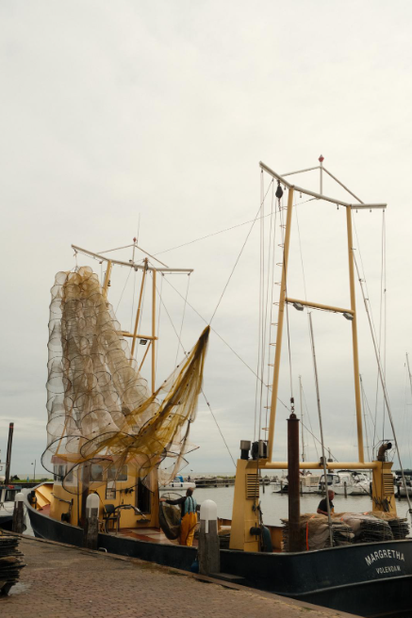
Kinetic + Net
Transportation, Logistics,
Fisherman Ship, Volendam
Source: Author

Slide 23
(more) Permanent Structure : Voronoi-based regolith
voids for activities & climbing walls
(less) Permanent Structure : Nets
Low impact & reconfigure-able (for next users)
Light (to transport from Earth)
Strong, Flexible, Easy-grip

